Slide 1



Slide 2
    I. The Importance of Doctrinal Purity and Clarity
    A. Doctrinal importance of the content of faith
    B. Doctrinal importance of pure faith

Slide 3
II. The Issue before the Council (15:1–35)
A. The problem of the Judaizers (15:1–5)
B. The discussion of the council (15:6–21)
1. Peter’s address (15:6–11)
2. Barnabas and Paul’s testimony (15:12)
3. James’s recommendation (15:13–21)
C. The decision of the council (15:22–35)

Slide 4
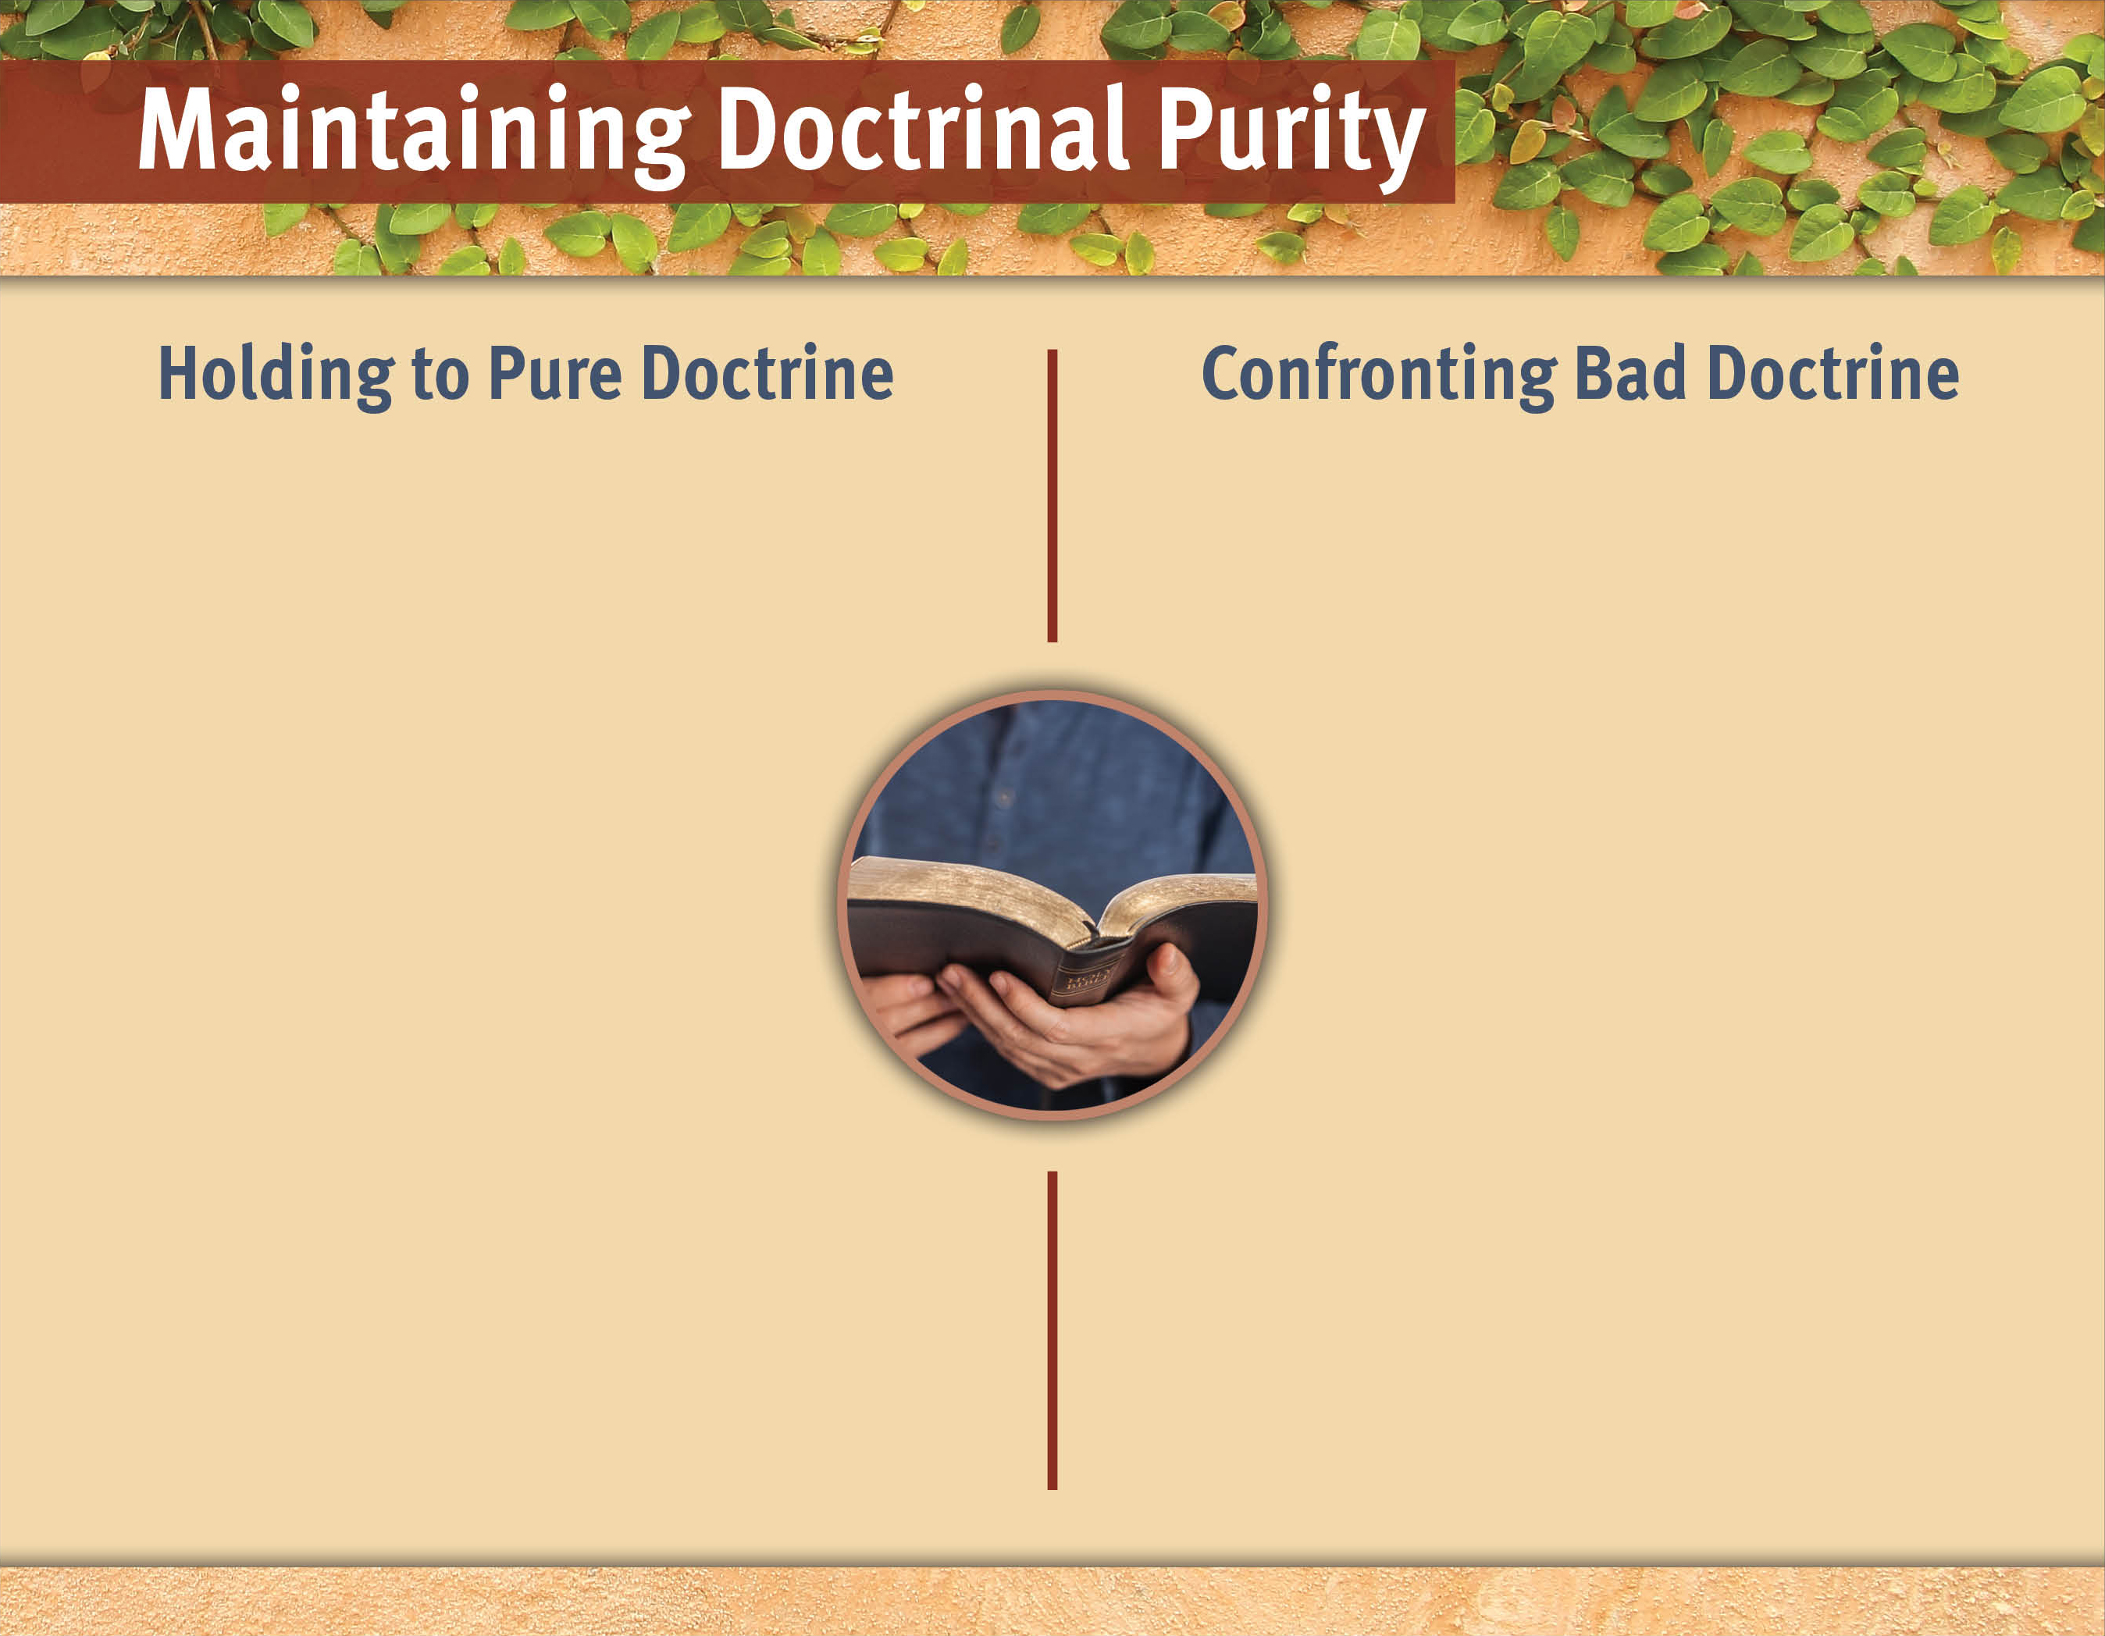
Pray for the church leadership.
Show grace and patience.
Do not allow for compromise.
Commit to teaching/ learning doctrine.
Use meekness and humility.
Have restoration as
your goal.
Use doctrinally sound Sunday School curriculum.
Type text here.
Type text here.
Type text here.
Type text here.

Slide 5
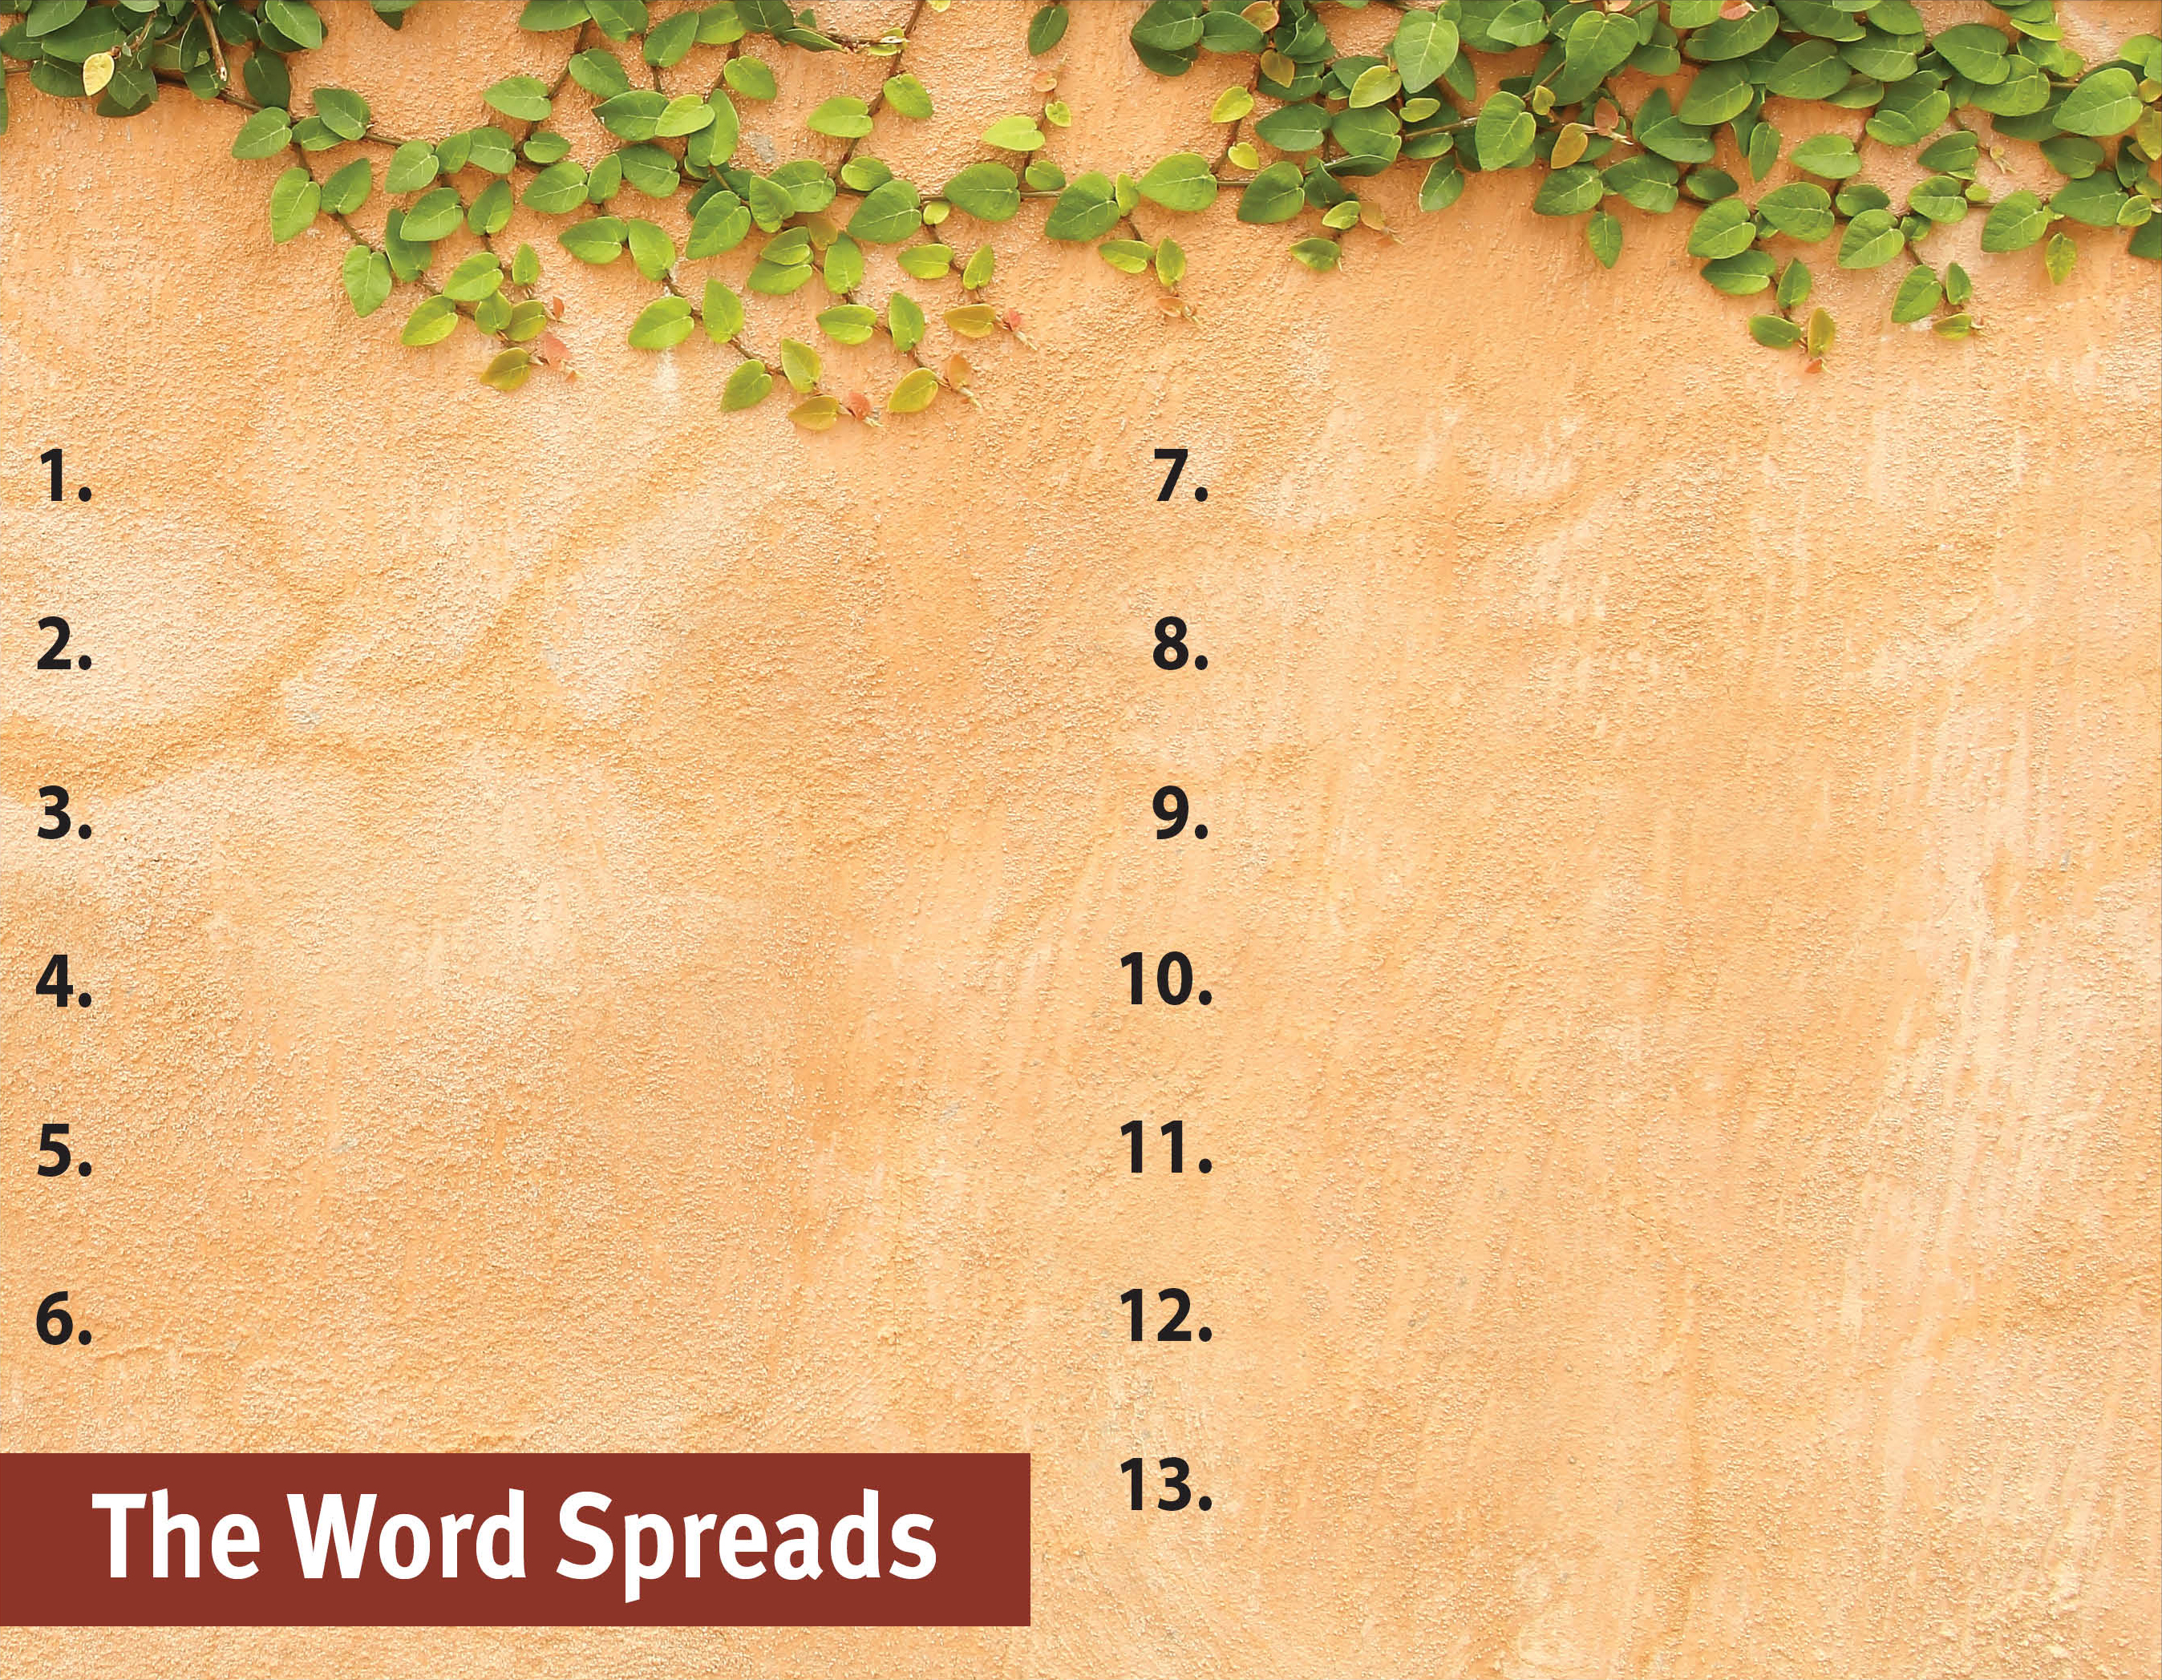
Commit to spread the Word.
Witness to all people.
Serve God by the Spirit.
Be active in and support missions.
Pray for God’s great grace.
Hold to pure doctrine.
Serve with a genuine,
sacrificial heart.
Recognize the Spirit’s power
is superior.
Set no limits on the gospel.

