Slide 1



Slide 2
    I. The Divine Commission of Paul and Barnabas (12:25—13:3)
    A. The church at Antioch (13:1–3)
    1. Thrived spiritually
    2. Understood the Holy Spirit
    3. Valued quality leadership
    B. The call to ministry

Slide 3
II. The First Missionary Journey (13:4—14:28)

Slide 4
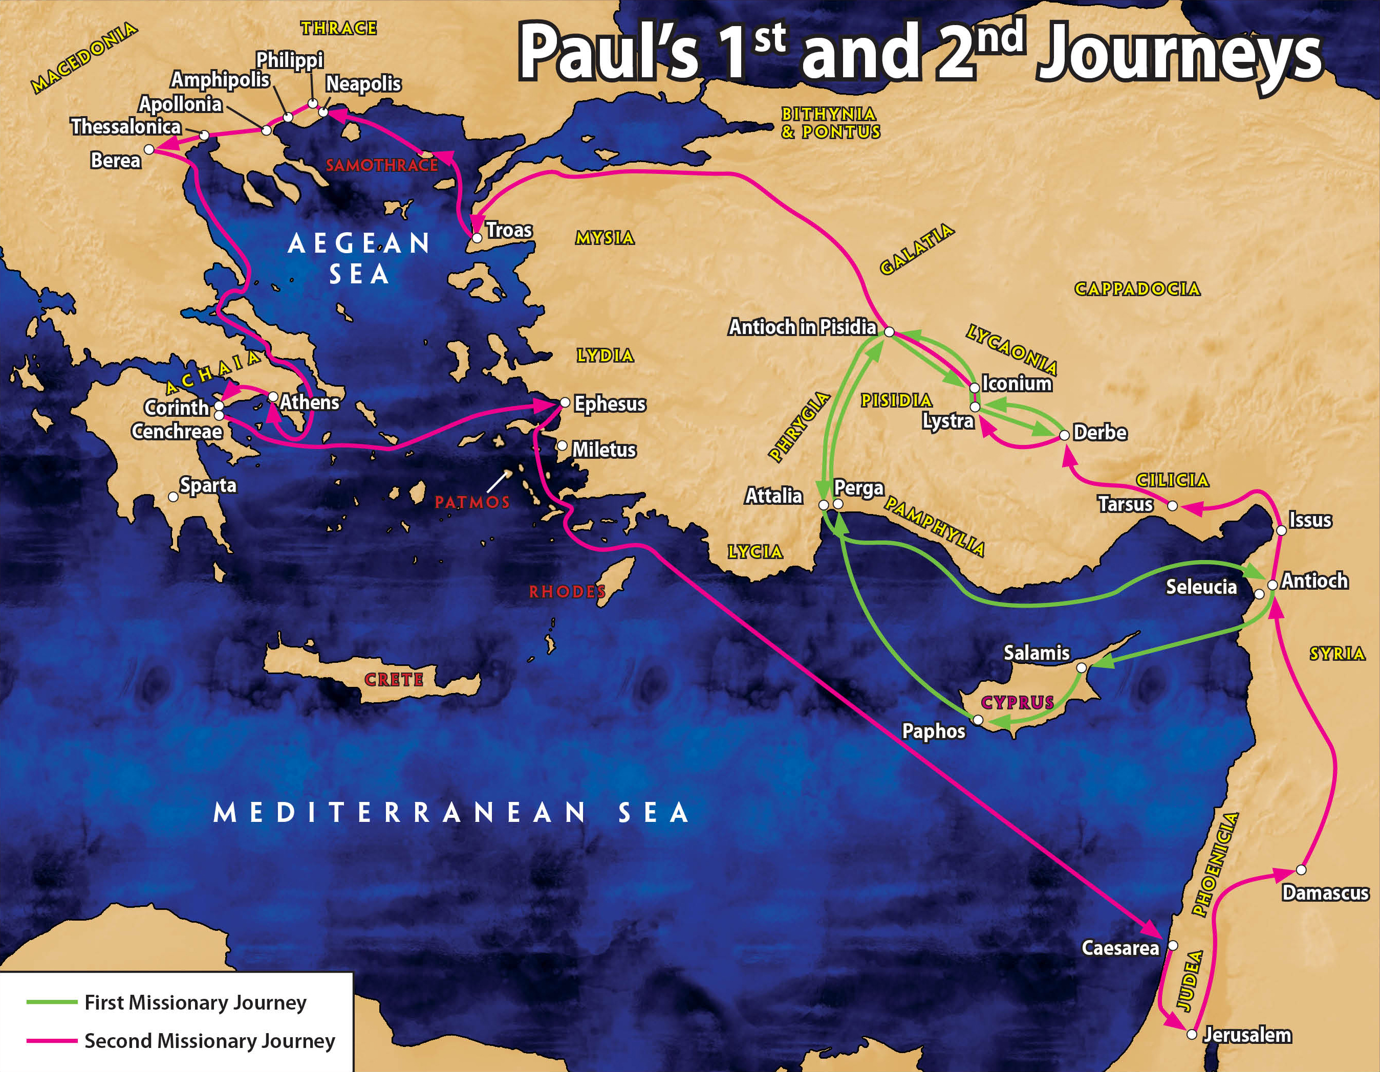

Slide 5
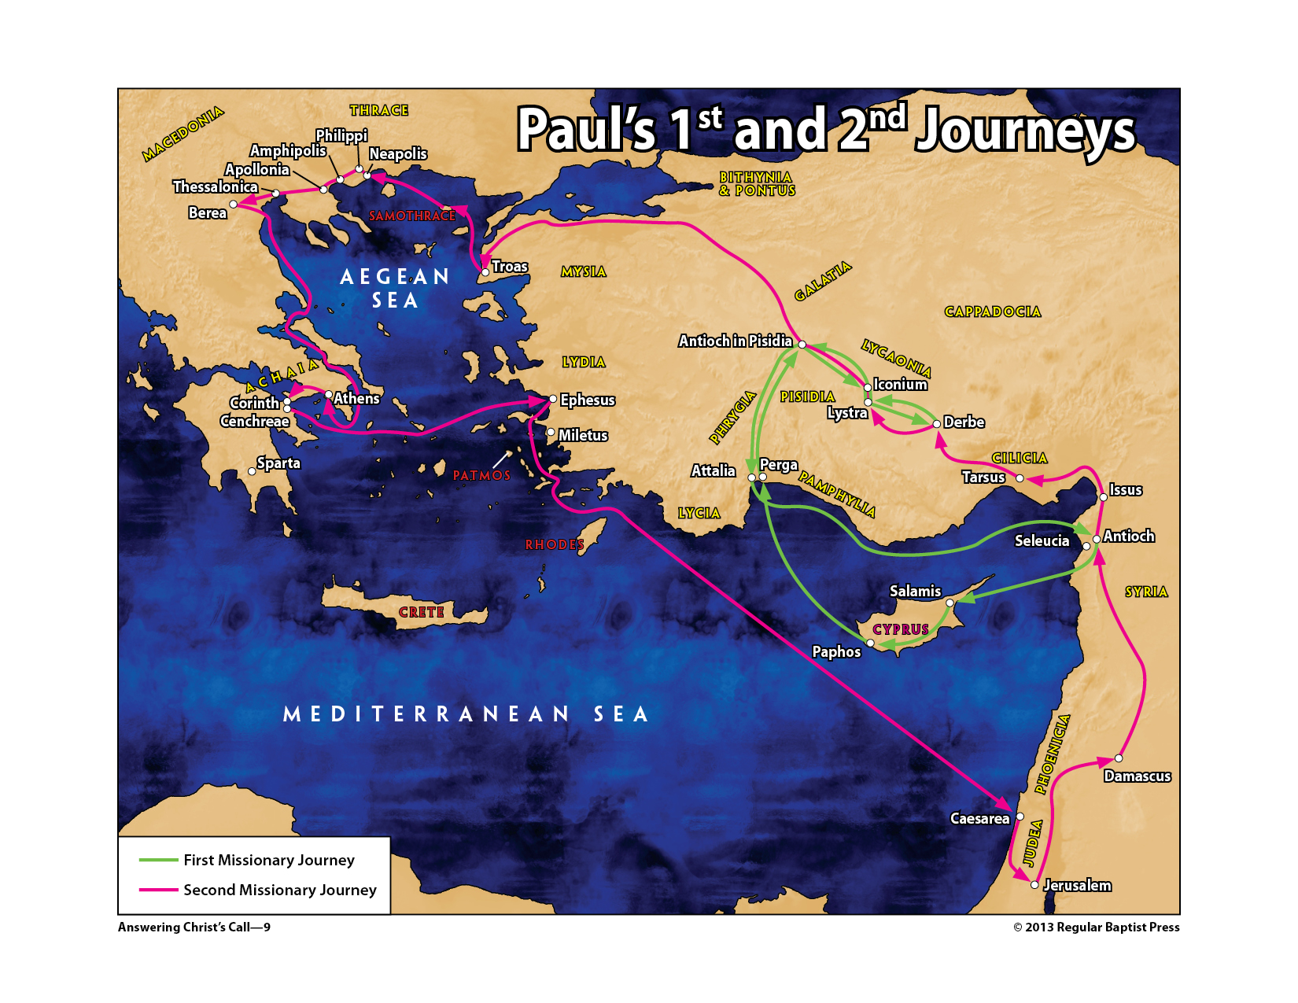

Slide 6
II. The First Missionary Journey (13:4—14:28)
A. Ministry in Cyprus (13:4–12)
B. Ministry in Pamphylia and Pisidian Antioch (13:13–52)
1. Departure of John Mark (13:13)
2. Paul’s sermon in the synagogue (13:14–41)
C. Ministry in Iconium (14:1–5)
D. Ministry in Lystra and Derbe (14:6–20)
E. The return to Antioch of Syria (14:21–28)

Slide 7
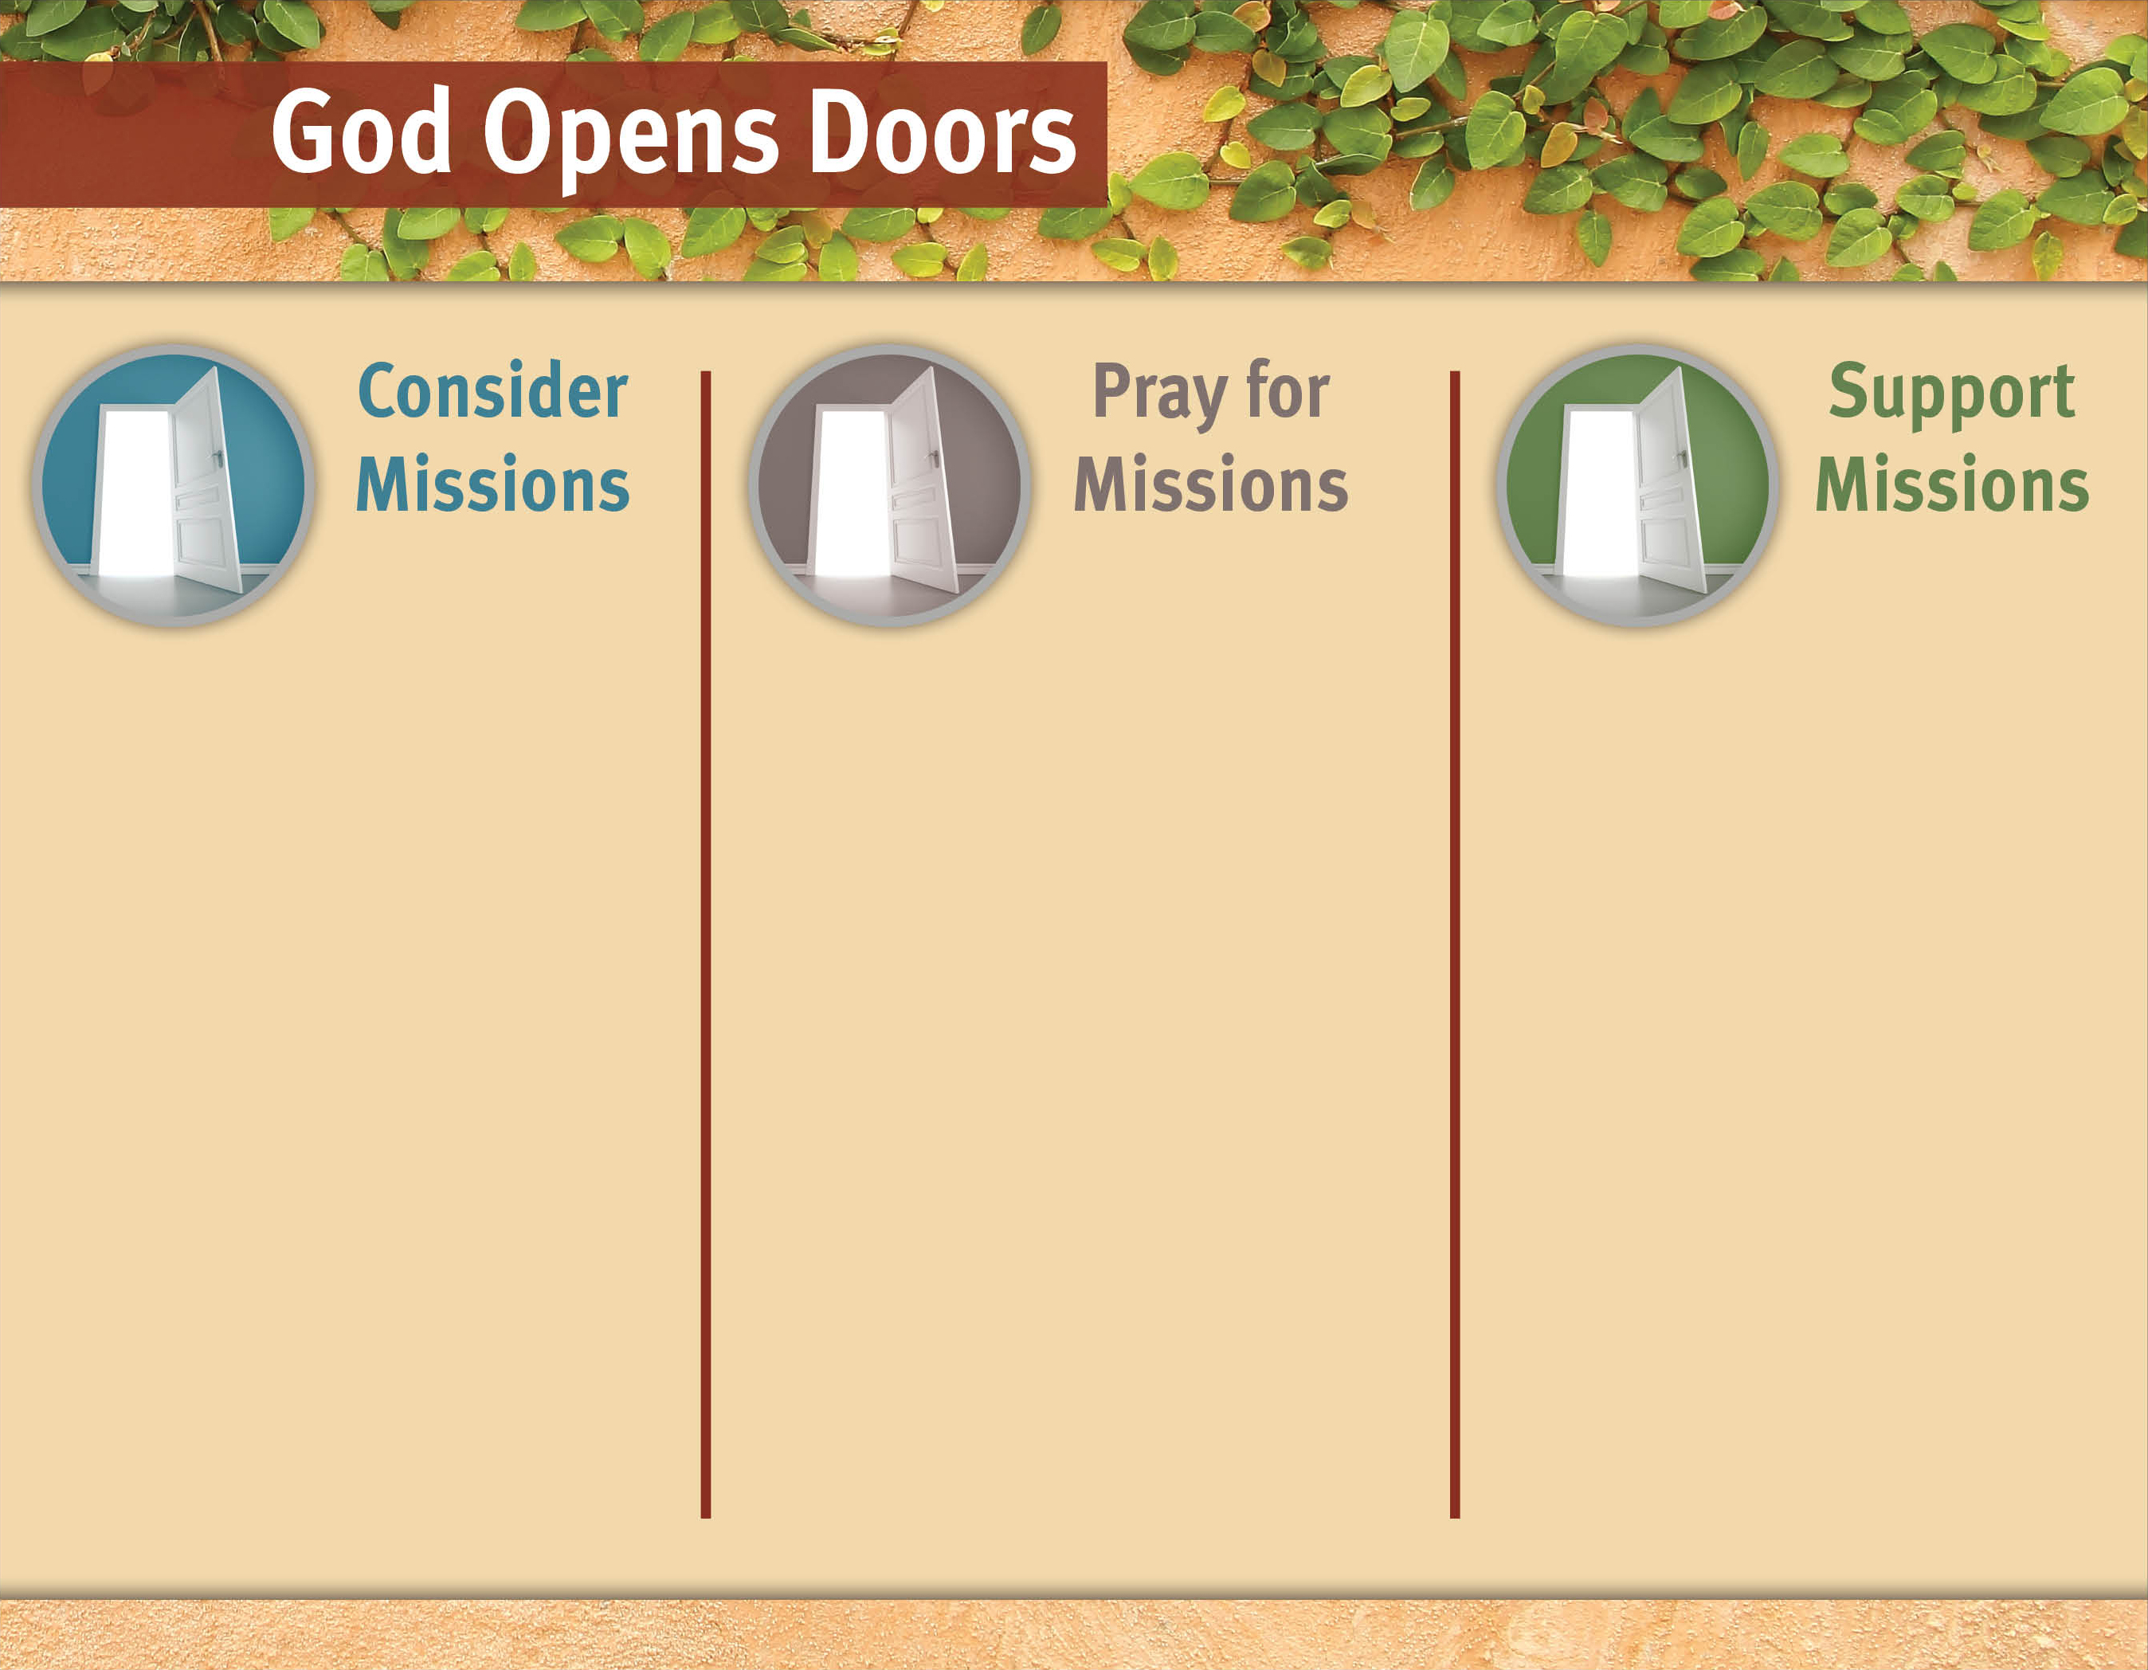
What’s God’s part
for me in reaching
the lost?
For God to send workers.
Pray God would give missionaries wisdom.
For salvation decisions.
Who has yet to be reached?
Give resources.
For boldness to share the gospel.
Consider vocational missions.
Where is God working?

Slide 8
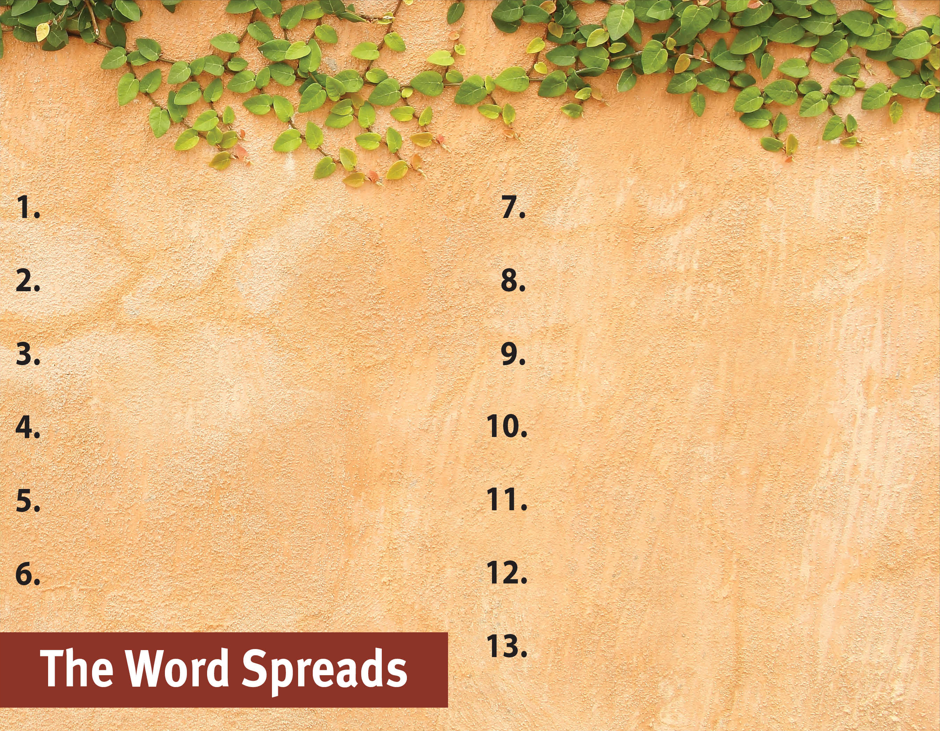
Commit to spread the Word.
Witness to all people.
Serve God by the Spirit.
Be active in and support missions.
Pray for God’s great grace.
Serve with a genuine,
sacrificial heart.
Recognize the Spirit’s power
is superior.
Set no limits on the gospel.

