Slide 1



Slide 2
I. Peter Ministers in Samaria (9:32—10:48)
A. Peter’s ministry in Lydda (9:32–35)

Slide 3
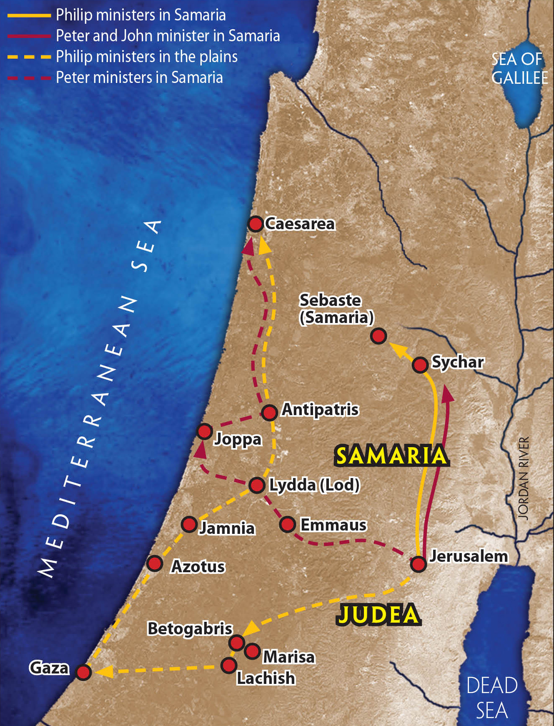

Slide 4
I. Peter Ministers in Samaria (9:32—10:48)
A. Peter’s ministry in Lydda (9:32–35)
B. Peter’s ministry in Joppa (9:36–43)

Slide 6
II. God Calls Peter to Minister to Gentiles (10:1–48)
A. Cornelius’ person and position (10:1, 2)
B. Cornelius’ vision (10:3–8)
C. Peter’s vision (10:9–16)
D. Peter’s visit to Cornelius (10:17–33)

Slide 8
II. God Calls Peter to Minister to Gentiles (10:1–48)
A. Cornelius’ person and position (10:1, 2)
B. Cornelius’ vision (10:3–8)
C. Peter’s vision (10:9–16)
D. Peter’s visit to Cornelius (10:17–33)
E. Peter’s message to Cornelius (10:34–43)
F. Giving of the Holy Spirit to the Gentiles (10:44–48)

Slide 9
III. Peter Reports to the Church in Jerusalem (11:1–18)
A. Jewish believers confront Peter (11:1–3)
B. Peter conveys God’s plan for the gospel (11:4–18)

Slide 10
IV. The Antioch Church Grows (11:19–30)
A. In their outreach to Gentiles (11:19–26)
B. In their care for Jerusalem Jews (11:27–30)

Slide 11
V. The Persecution of the Church at Jerusalem (12:1–24)

Slide 12
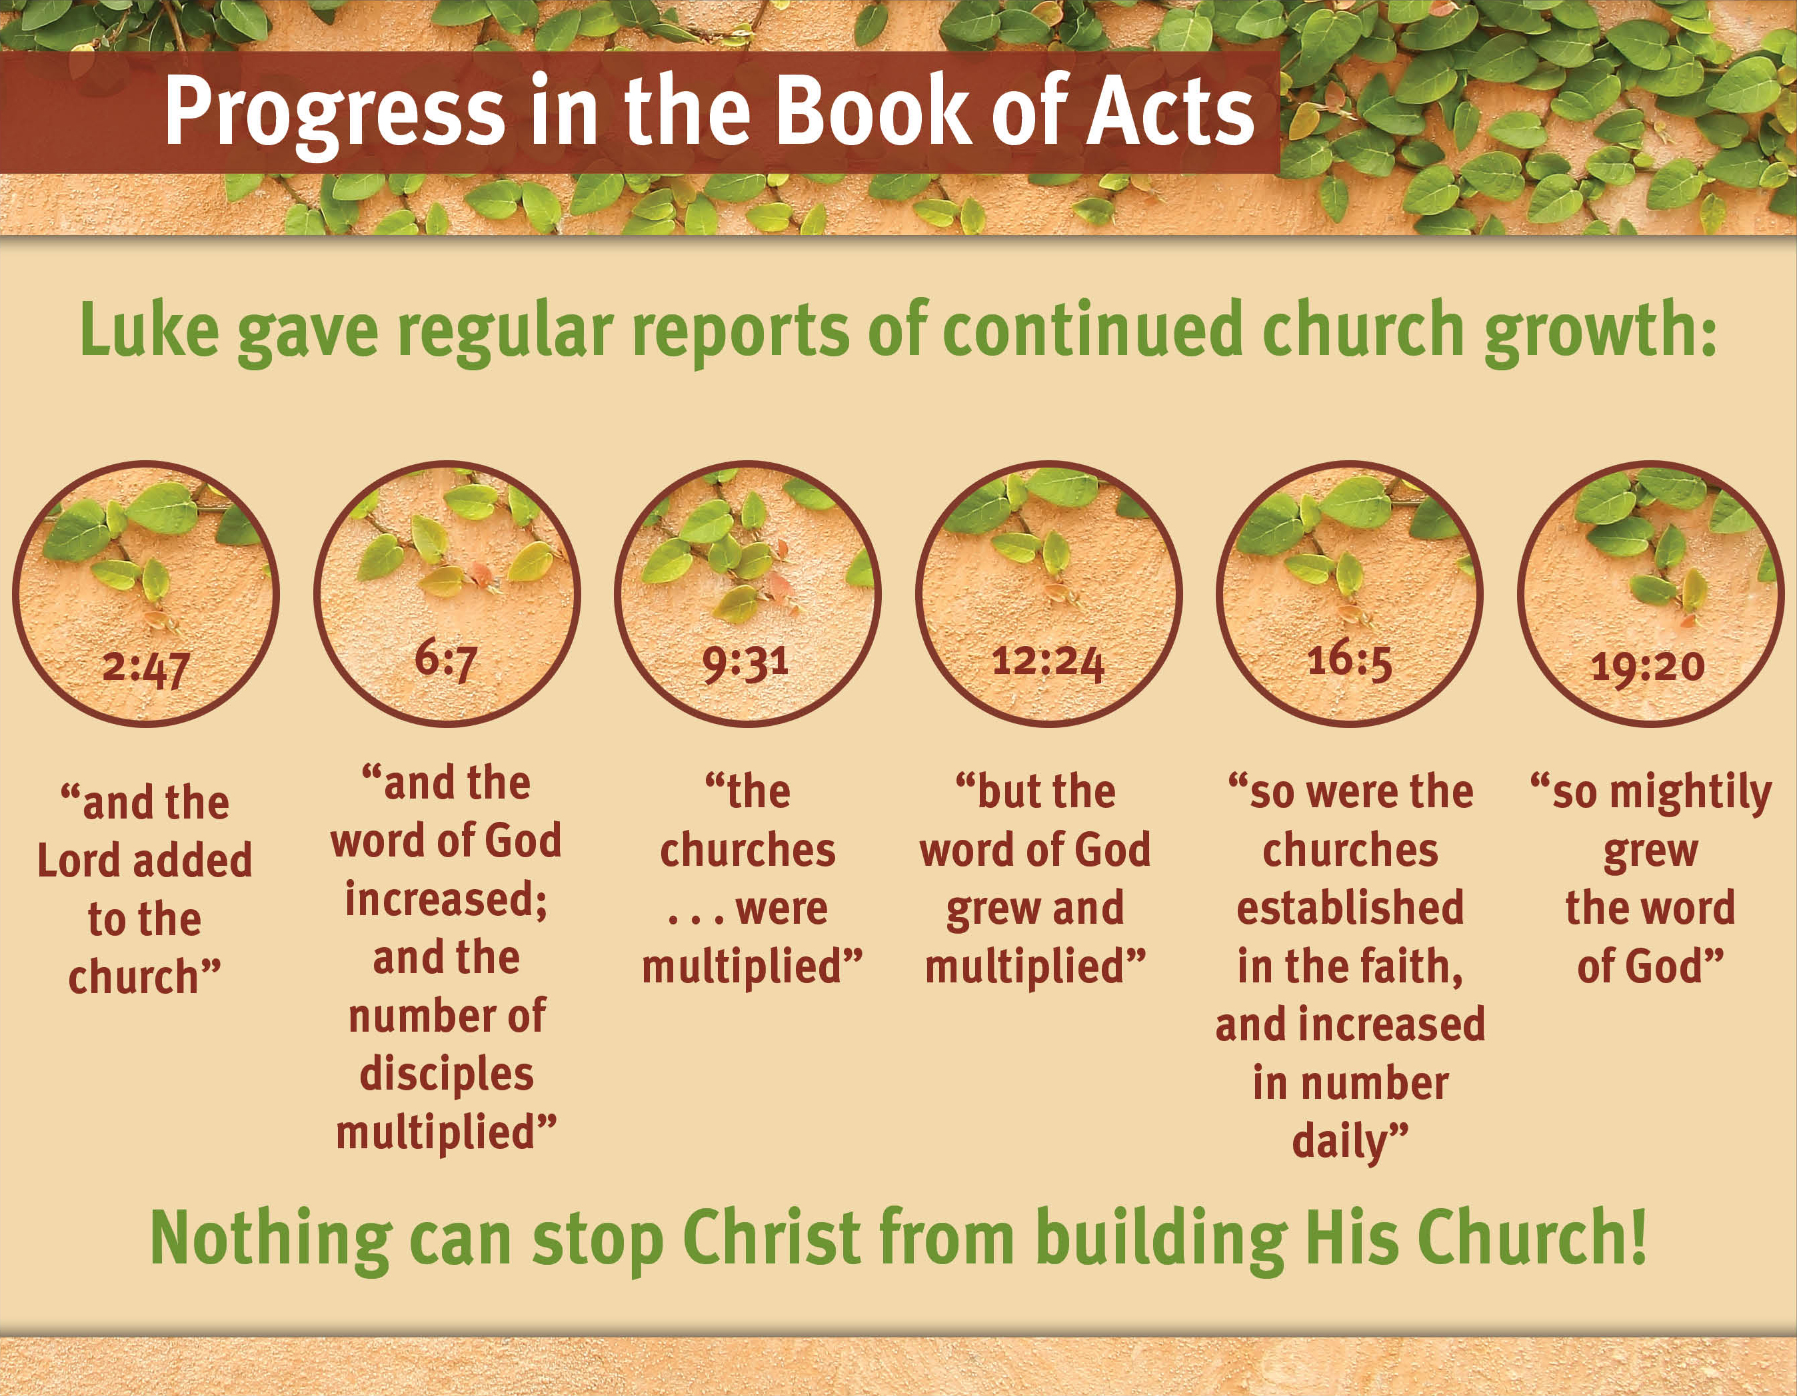

Slide 13
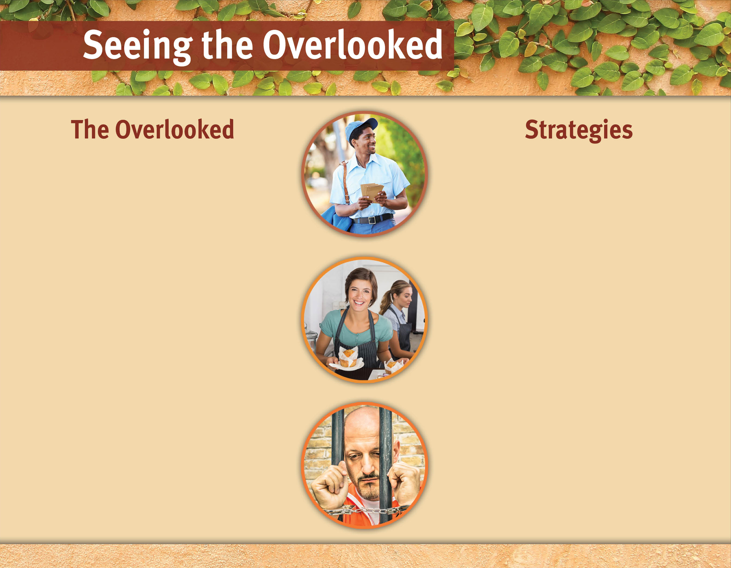
Grocery store clerk.
Create a prayer list of people we contact.
Restaurant server.
Neighbors we don’t know.
Pray for open doors to share the gospel.
Doctors and nurses.
Relatives we rarely see.
Develop a plan for guiding conversations to the gospel.
Prisoners.
Homeless.
Establish an accountability partner.

Slide 14
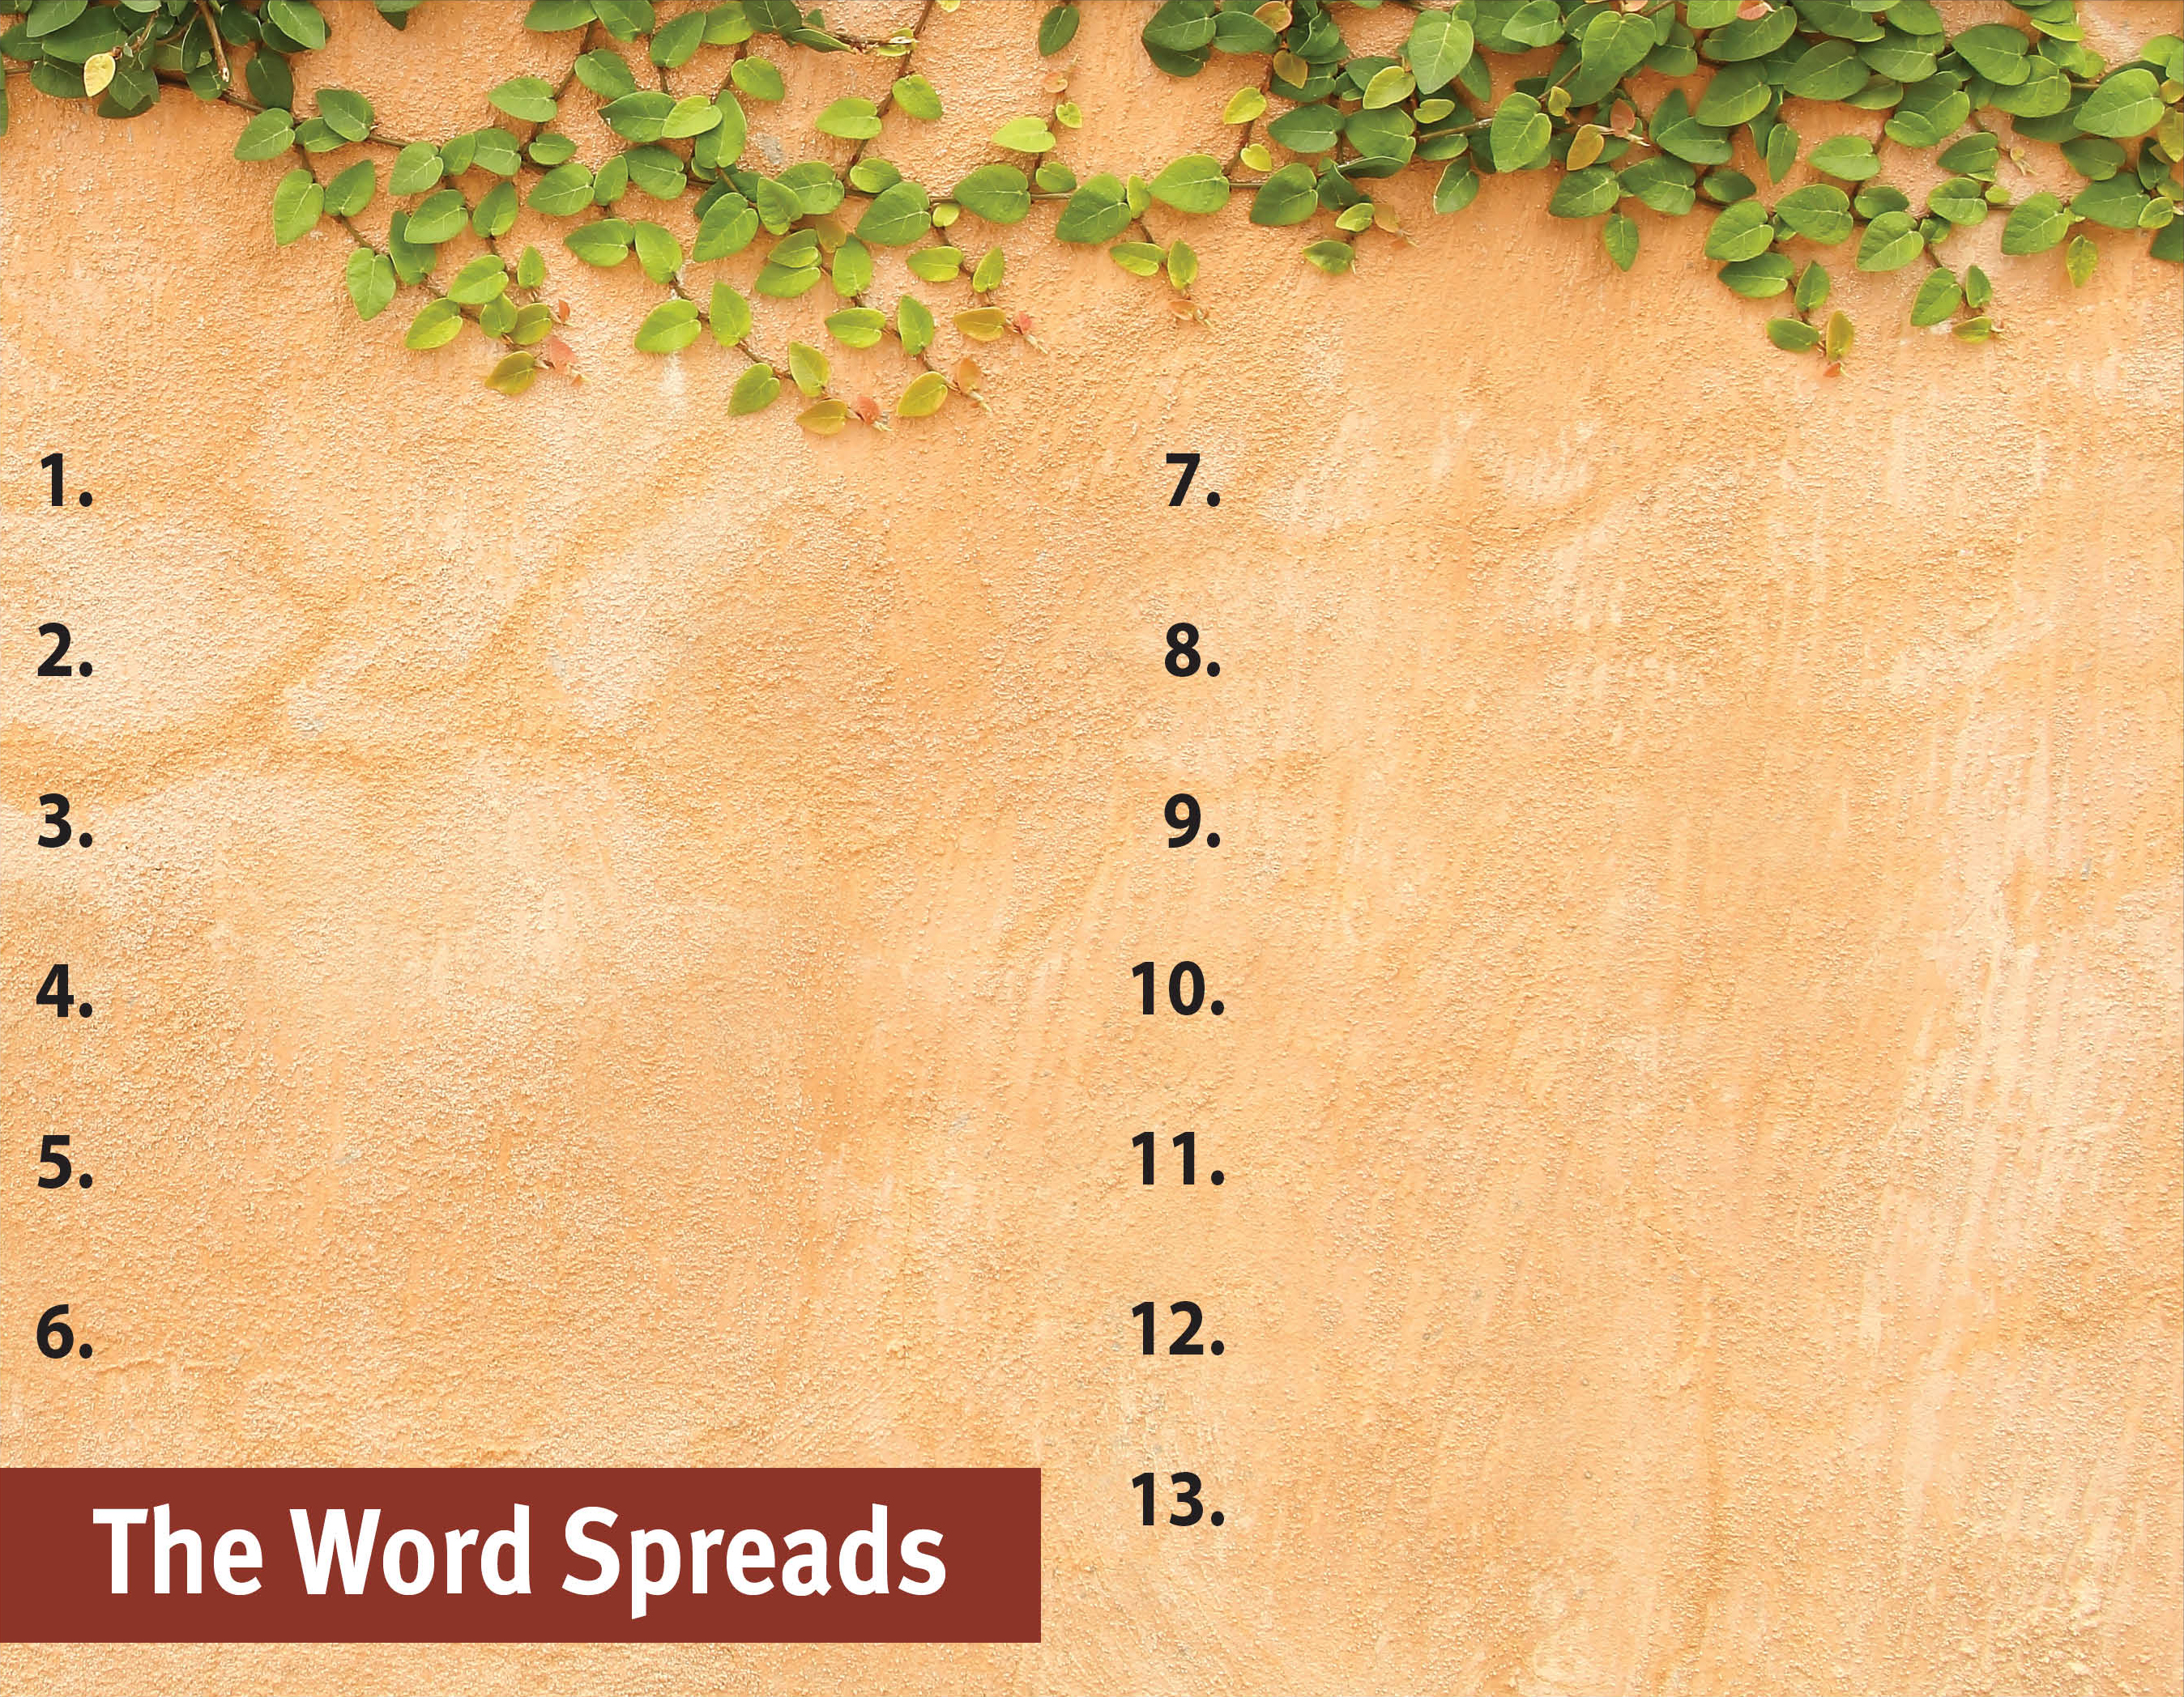
Commit to spread the Word.
Witness to all people.
Serve God by the Spirit.
Pray for God’s great grace.
Serve with a genuine, sacrificial heart.
Recognize the Spirit’s power is superior.
Set no limits on the gospel.

