Slide 1



Slide 2
I. Philip’s Ministry (8:4–40)
A. Philip ministry to the hated (8:4–25)

Slide 3
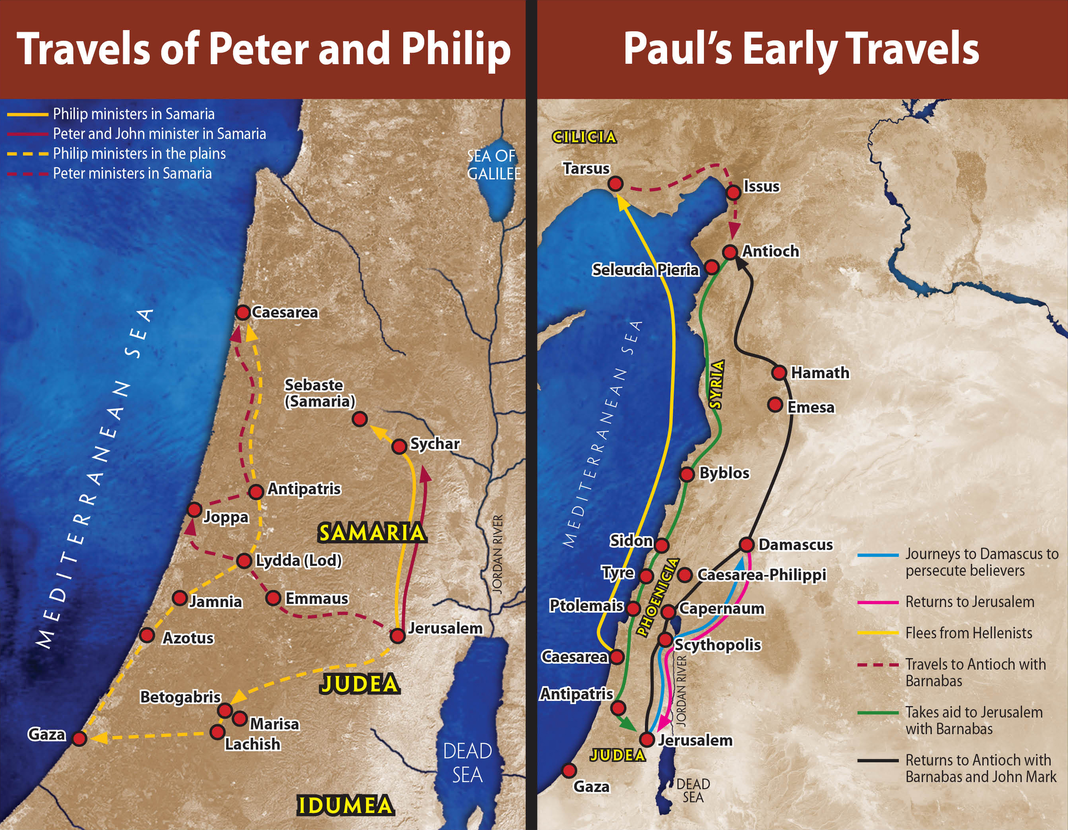

Slide 4
I. Philip’s Ministry (8:4–40)
A. Philip ministry to the hated (8:4–25)
B. Philip’s ministry to the heathen (8:26–40)

Slide 5
II. Saul’s Conversion (9:1–31)
A. Damascus Road conversion experience (9:1–9)

Slide 7
II. Saul’s Conversion (9:1–31)
A. Damascus Road conversion experience (9:1–9)
B. Saul’s first contact with believers (9:10–19a)
C. Saul’s early ministry (9:19b–22)
D. Saul’s escape from Damascus (9:23–25)
E. Saul’s reception in Jerusalem (9:26–31)

Slide 8
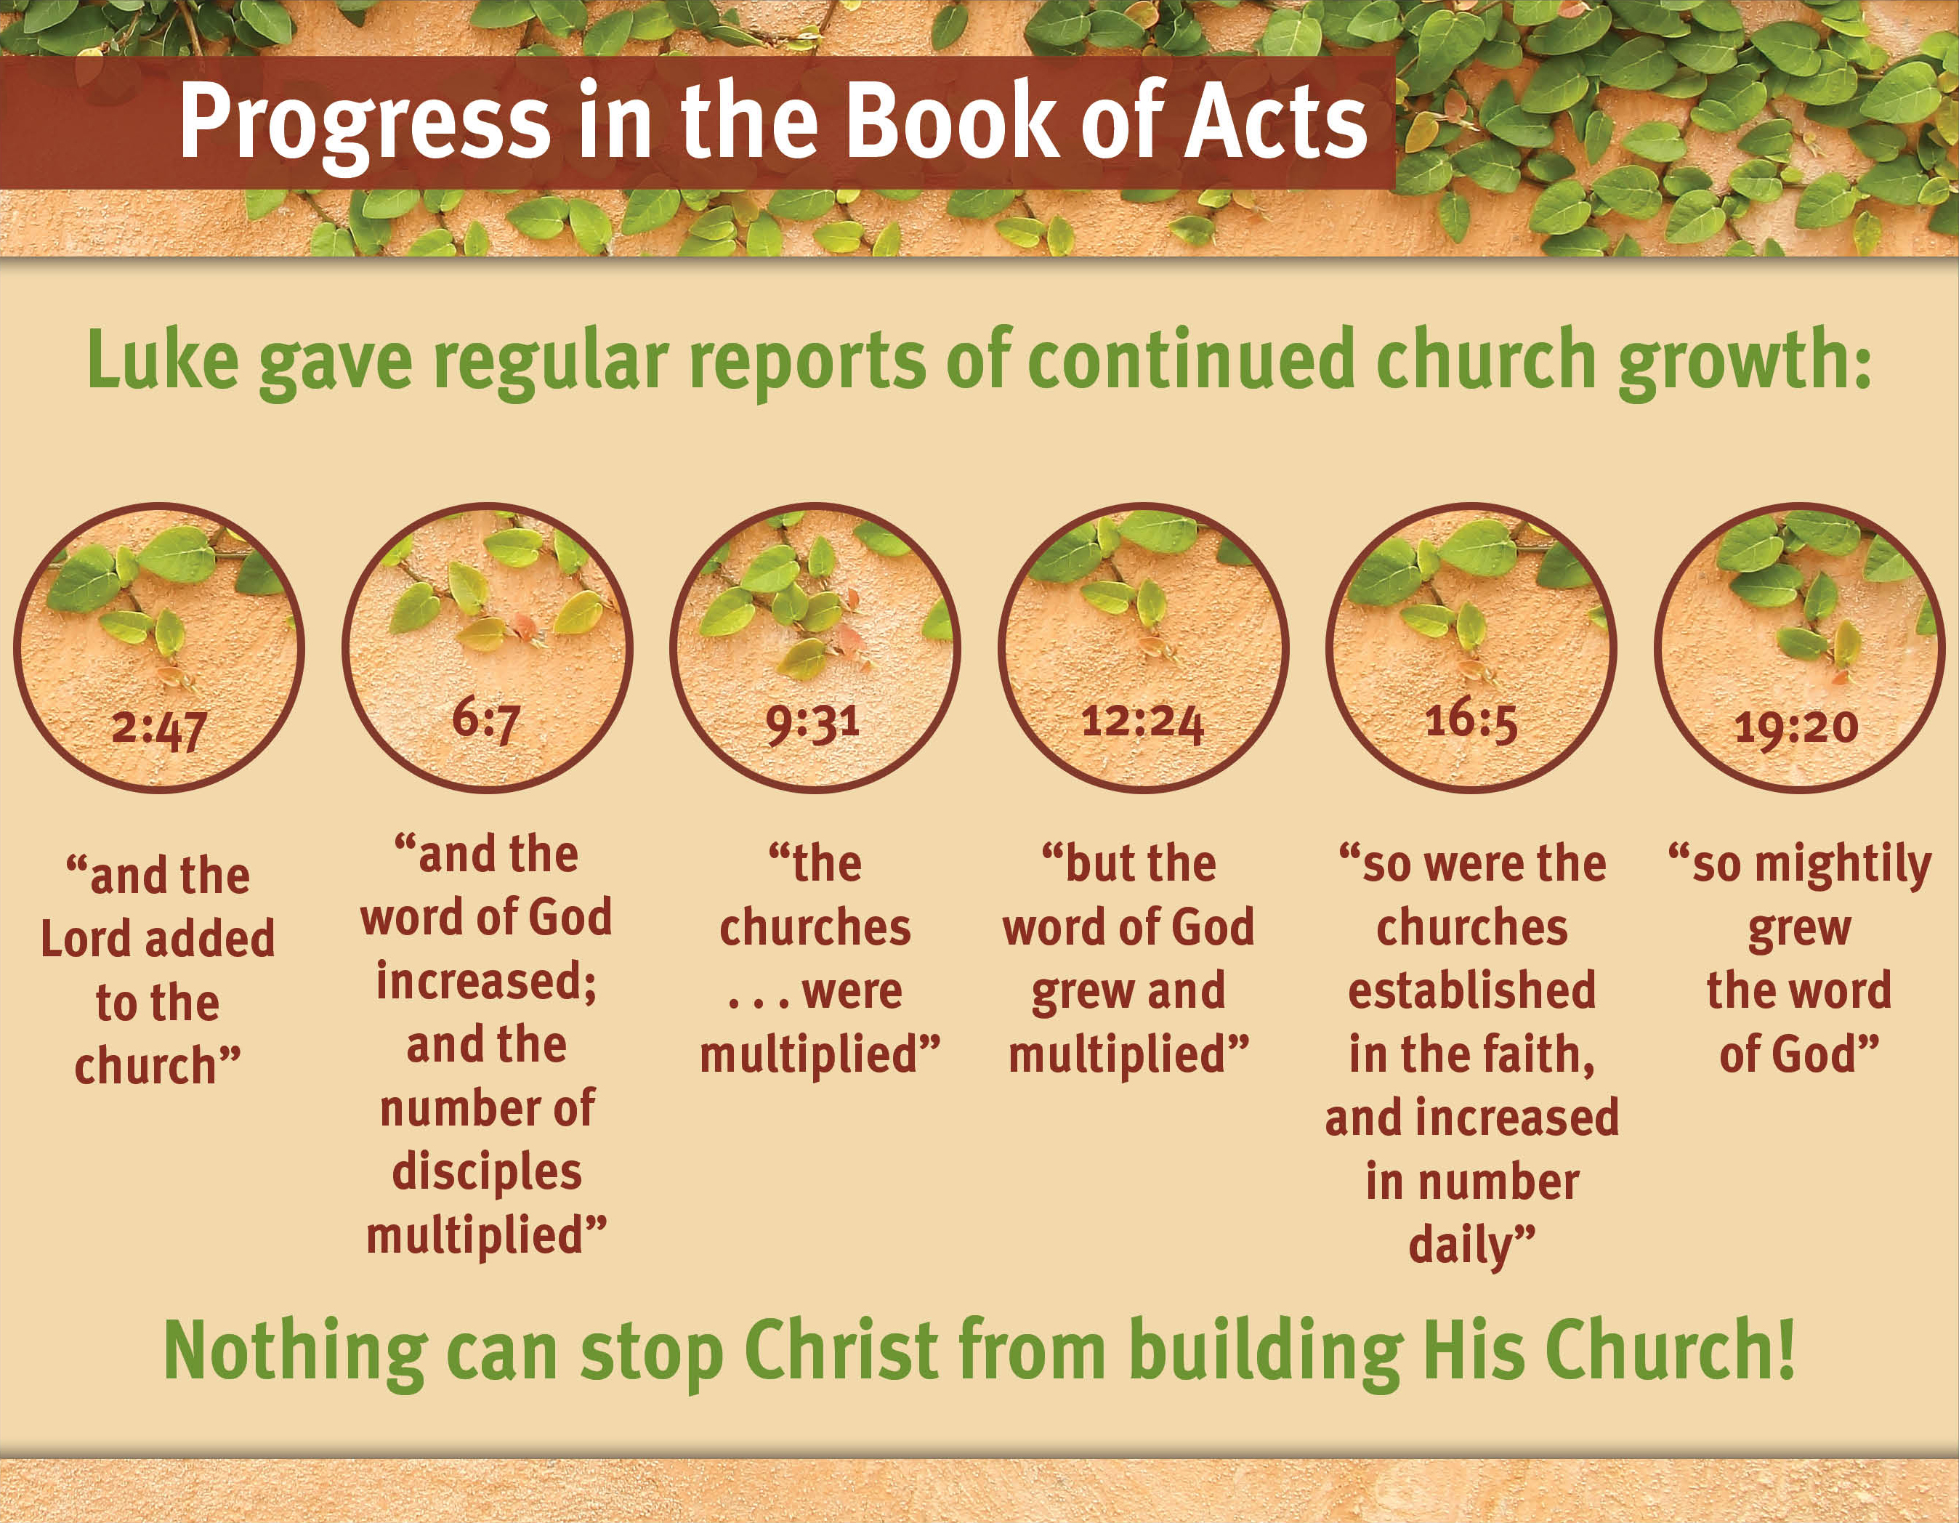

Slide 9
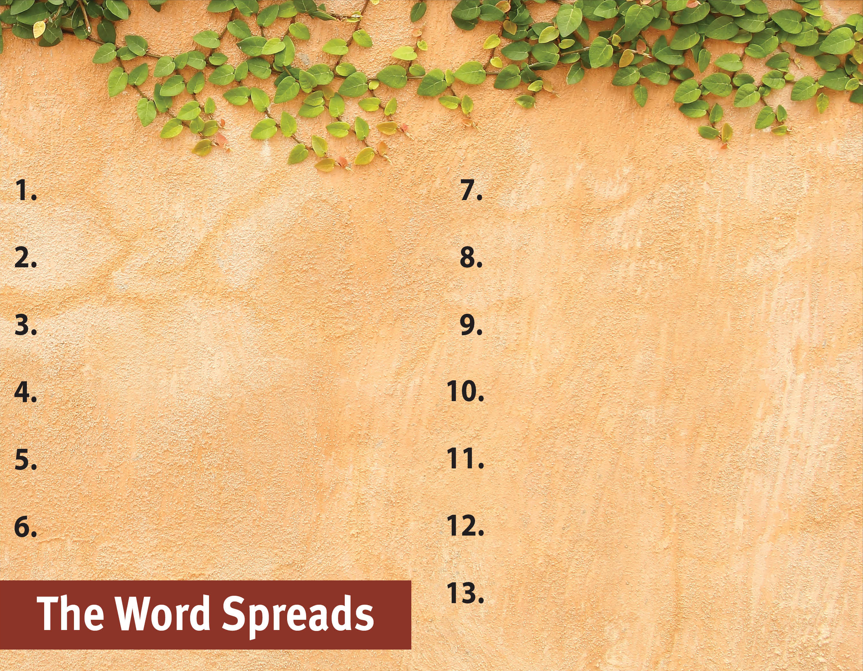
Commit to spread the Word.
Serve God by the Spirit.
Pray for God’s great grace.
Serve with a genuine, sacrificial heart.
Recognize the Spirit’s power is superior.
Set no limits on the gospel.

