Slide 1



Slide 2
    I. Stephen’s Irresistible Power (6:8—7:53)
    A. Powerful signs (6:8)
    B. Powerful wisdom (6:9–14)
    C. Powerful appearance (6:15)
    D. Powerful message (7:1–50)
    1. Progress
    2. Expansion
    3. Rebellion
    E. Powerful accusation (7:51–53)

Slide 3
II. Sanhedrin’s Incapable Power (7:54—8:3)
A. Incapable of silencing Stephen (7:54–60)
B. Incapable of stopping the gospel (8:1–3)

Slide 4
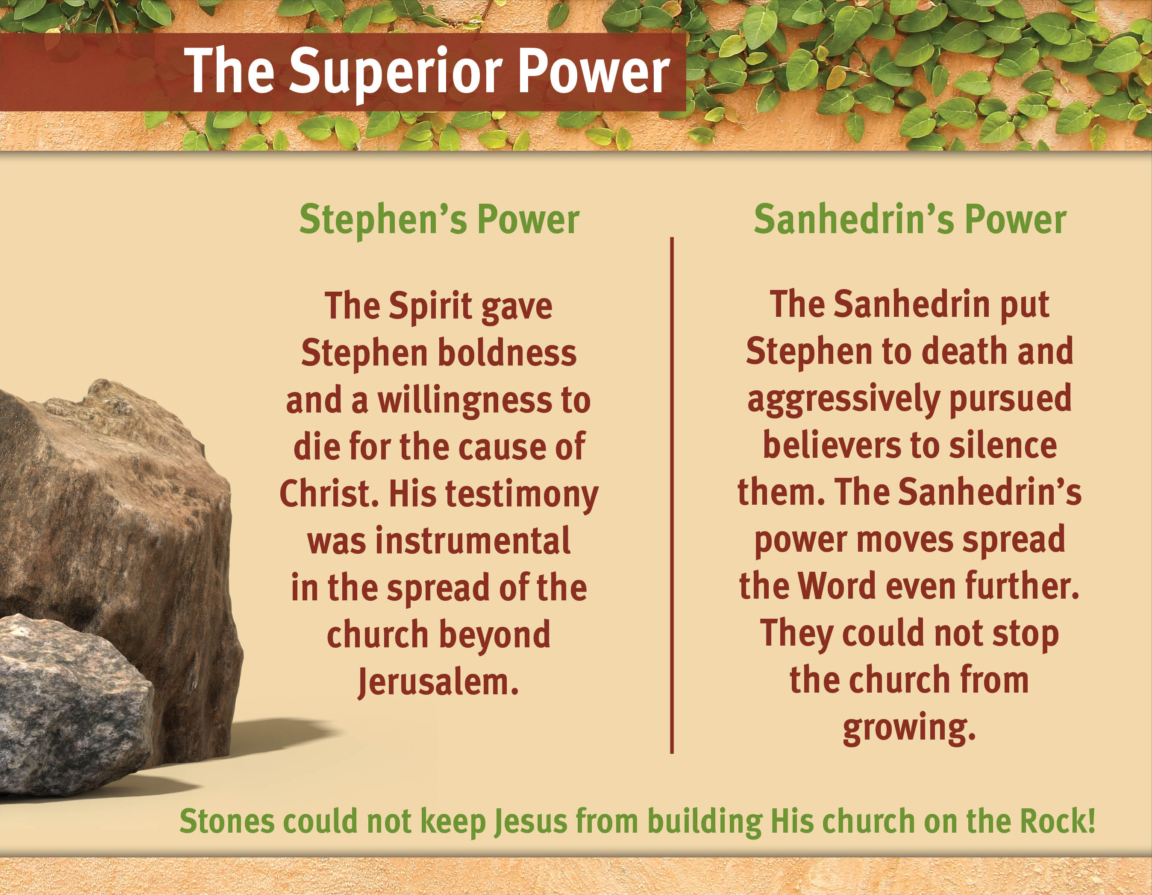

Slide 5
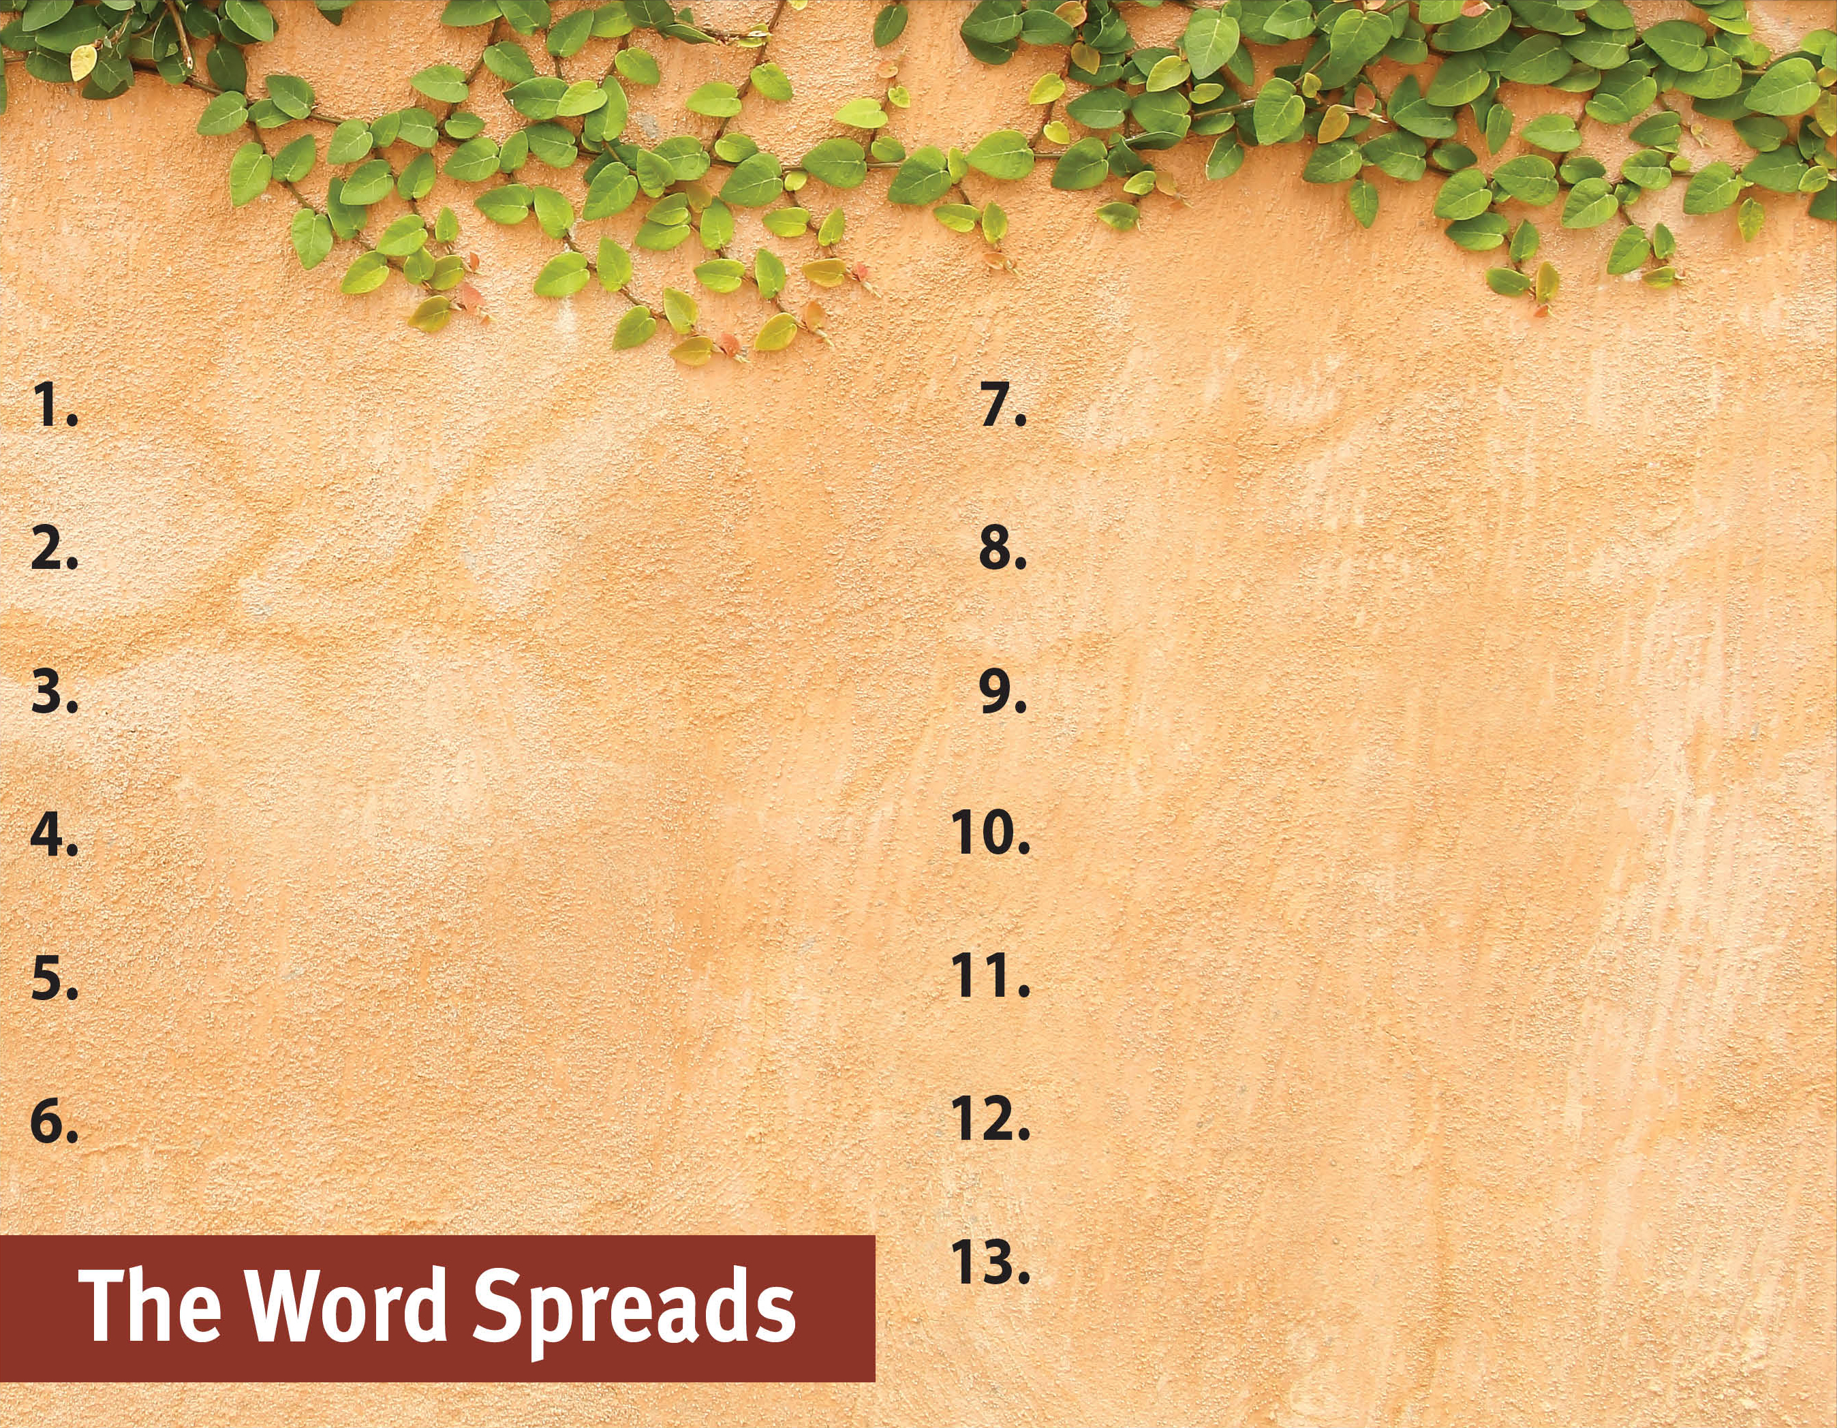
Commit to spread the Word.
Serve God by the Spirit.
Pray for God’s great grace.
Serve with a genuine,
sacrificial heart.
Recognize the Spirit’s power
is superior.

