Slide 1


Slide 2
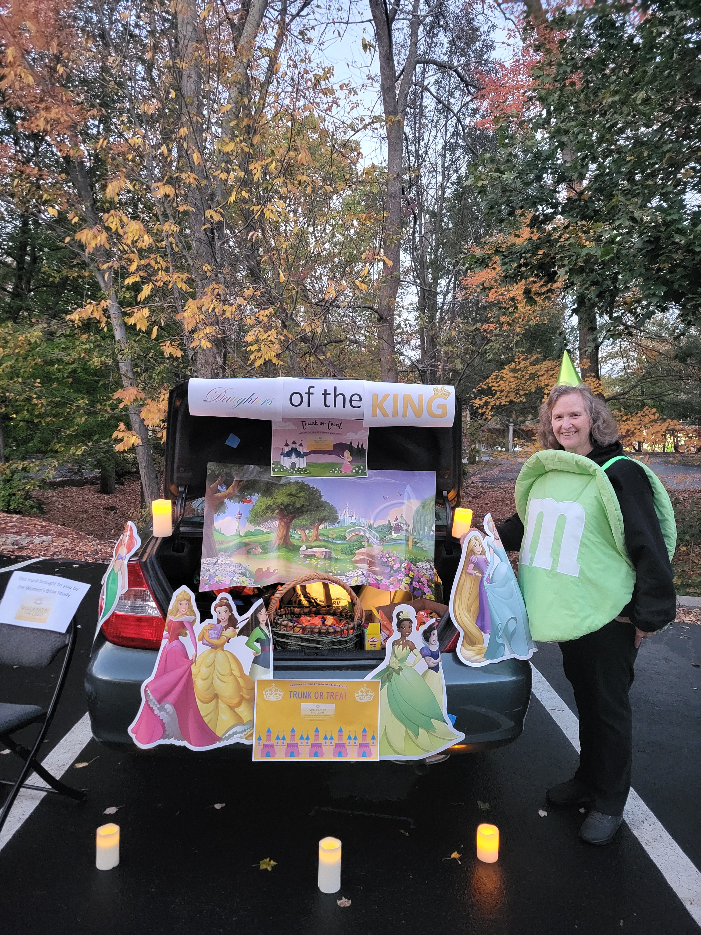
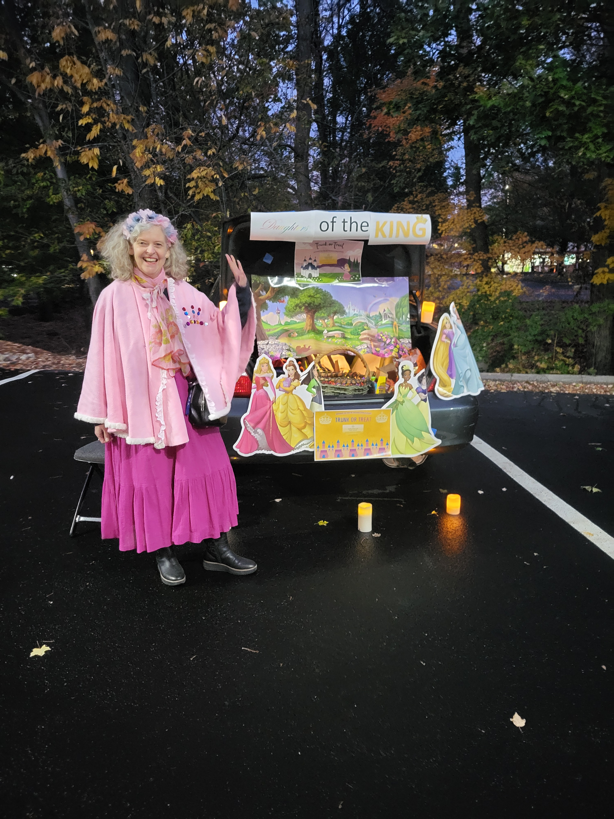

Slide 3
Light as Metaphor
for God’s
Life & Salvation

Slide 4
Walking in the Light
Psalm 89:15: Blessed are those who have learned to acclaim you, who walk in the light of your presence, LORD.
Isaiah 2:5: Come, descendants of Jacob, let us walk in the light of the LORD.
1 John 1:7: But if we walk in the light, as he is in the light, we have fellowship with one another, and the blood of Jesus, his Son, purifies us from all sin.

Slide 5
Walking in the Light
Isaiah 2:5: Come, descendants of Jacob, let us walk in the light of the LORD.
Psalm 27:1a: The LORD is my light and my salvation—whom shall I fear?
What does it mean to say that God is “my light and my salvation”? What is salvation, anyway?
How does the concept of light help us understand the concept of salvation?

Slide 6
What does “Salvation” Mean?

Slide 7
Exodus 15:1-3
Then Moses and the Israelites sang this song to the LORD:
“I will sing to the LORD,
for he is highly exalted.
Both horse and driver
he has hurled into the sea.

Slide 8
Exodus 15:1-3
² “The LORD is my strength and my defense;
he has become my salvation.
He is my God, and I will praise him,
my father’s God, and I will exalt him.
³ The LORD is a warrior;
the LORD is his name.”

Slide 9
“Salvation”
יְשׁוּעָה yᵉšûʽâ
salvation, deliverance, help, rescue from a dangerous circumstance; rescue from earthly enemies; can refer to being saved from guilt, sin, and punishment; related concepts: victory, rescue, safety
Joshua = “the LORD saves”; in Greek = Jesus (see Mt. 1:21)

Slide 10
parallelism
synonymous parallelism: the second line repeats the first line in different words to convey the same meaning (e.g., Isaiah 53:5: “But he was pierced for our transgressions,//he was crushed for our iniquities;//the punishment that brought us peace was on him,//and by his wounds we are healed.”)
antithetical parallelism: the second line presents a contrasting or opposite idea to the first (e.g., Prov. 10:1-2: “A wise son brings joy to his father,//but a foolish son brings grief to his mother.//Ill-gotten treasures have no lasting value,// but righteousness delivers from death.”)

Slide 11
“Salvation” in Parallel
Exodus 15:2: “The LORD is my strength and my defense//he has become my salvation.”
2 Chronicles 6:41: “May your priests, LORD God, be clothed with salvation,//may your faithful people rejoice in your goodness.”
Psalm 13:5: “But I trust in your unfailing love;//my heart rejoices in your salvation.”

Slide 12
“Salvation” in Parallel, cont.
**Psalm 27:1: “The LORD is my light and my salvation— whom shall I fear?//The LORD is the stronghold of my life— of whom shall I be afraid?”
Psalm 62:1: “Truly my soul finds rest in God; my salvation comes from him.”
Psalm 119:123: “My eyes fail, looking for your salvation,// looking for your righteous promise.”

Slide 13
“Salvation” in Parallel, cont.
Isaiah 49:8: “This is what the LORD says: “In the time of my favor I will answer you, //and in the day of salvation I will help you”
Isaiah 51:5: “My righteousness draws near speedily, //my salvation is on the way”

Slide 14
“Salvation” in Parallel, cont.
Isaiah 62:1: “For Zion’s sake I will not keep silent,//for Jerusalem’s sake I will not remain quiet,//till her vindication shines out like the dawn,//her salvation like a blazing torch.”
Luke 2:30-32: “For my eyes have seen your salvation,//which you have prepared in the sight of all nations://a light for revelation to the Gentiles, //and the glory of your people Israel.”

Slide 15
“Salvation” in Parallel
our strength and defense
God’s goodness
God’s unfailing love
the stronghold of my life
rest for my soul
God’s righteous promise
God’s favor
God’s righteousness
vindication for God’s people
a light for revelation and glory

Slide 16
Looking ahead
Nov. 4/5: Global Awareness Week (also Food Bank collection week)
Nov. 11/12: Veterans Day—study content but no meeting
Nov. 18/19: Large-group teaching
Nov. 25/26: Thanksgiving Week—No Meeting
Dec. 2: Extended small groups

Slide 17
Global Awareness Week
LEX: Gather in large group to hear from a panel of partners, then smaller groups to pray with one partner individually
  AM: Please feel free to bring a brunch item
  PM: Please feel free to bring desserts, cider
WAT & WIL: Partners will come spend time with each group

Slide 18
Small Groups

