Slide 1
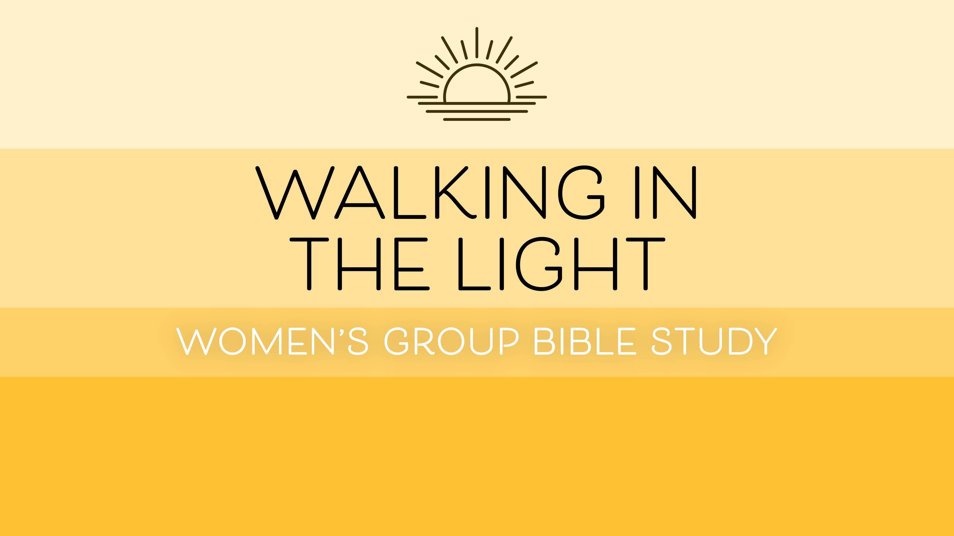

Slide 2
Walking in the Light
Psalm 89:15: Blessed are those who have learned to acclaim you, who walk in the light of your presence, Lord.
Isaiah 2:5: Come, descendants of Jacob, let us walk in the light of the Lord.
1 John 1:7: But if we walk in the light, as he is in the light, we have fellowship with one another, and the blood of Jesus, his Son, purifies us from all sin.

Slide 3
Walking in the Light: Developing the Spiritual Art of Discernment

Slide 4
Genesis 1
God’s creation of a perfectly ordered, perfectly harmonious world
two complementary descriptions of creation (1:1—2:3 and 2:4–25)
prologue/overture for the Bible as a whole
one God as Creator of all
addresses theological questions, not scientific or historical questions

Slide 5
Genesis 1:1
“In the beginning God created the heavens and the earth.”
the start of a sequence of events
elohim
created = something only God does
the heavens and the earth = everything

Slide 6
Genesis 1:2
“Now the earth was formless and empty, darkness was over the surface of the deep, and the Spirit of God was hovering over the waters.”
no context in which life could flourish
Days 1–3 create “form,” days 4–6 fill the emptiness
ḥōšek: darkness, blackness, gloom; despair, terror, ignorance; hard to understand
God’s Spirit present at this first act of creation

Slide 7
Genesis 1:3
“And God said, “Let there be light,” and there was light.”
God’s Word speaks creation into existence (see John 1:1)
creation completely obeys God’s command
’ôr: light, daylight, daybreak, brightness; positivity, happiness, relief from trouble
What is the source of light here? God himself!

Slide 8
Genesis 1:4
“God saw that the light was good, and he separated the light from the darkness.”
creation is good because its Creator is good
separation = work of first three days of creation
light has a function and darkness has a function

Slide 9
Genesis 1:5
“God called the light “day,” and the darkness he called “night.” And there was evening, and there was morning—the first day.”
to name = to claim authority over
daytime + nighttime = time

Slide 10
Genesis 1:5
“God called the light “day,” and the darkness he called “night.” And there was evening, and there was morning—the first day.”
to name = to claim authority over
daytime + nighttime = time

Slide 11
Genesis 1:14-19
“And God said, “Let there be lights in the vault of the sky to separate the day from the night, and let them serve as signs to mark sacred times, and days and years, and let them be lights in the vault of the sky to give light on the earth.” And it was so. God made two great lights—the greater light to govern the day and the lesser light to govern the night. He also made the stars. God set them in the vault of the sky to give light on the

Slide 12
Genesis 1:14-19, cont.
earth, to govern the day and the night, and to separate light from darkness. And God saw that it was good. And there was evening, and there was morning—the fourth day.”
words “sun” and “moon” not used here
why, not how
purpose: to mark sacred time

Slide 13
Responsive Reading & Prayer
“For the sake of Jacob my servant,
of Israel my chosen,
I summon you by name
and bestow on you a title of honor,
though you do not acknowledge me.
I am the LORD, and there is no other;
apart from me there is no God.
I will strengthen you,
though you have not acknowledged me,

Slide 14
Responsive Reading & Prayer
so that from the rising of the sun
to the place of its setting
people may know there is none besides me.
I am the LORD, and there is no other.
I form the light and create darkness,
I bring prosperity and create disaster;
I, the LORD, do all these things.
  (Isaiah 45:4-7)

Slide 15
Looking ahead to next week
Weekly prayer verse: Job 12:22: He reveals the deep things of darkness and brings utter darkness into the light.
Exodus 10:21–29, Psalm 104, Acts 26:1–18
Suggested spiritual practice: Journaling
Weekly reflection question: experiences of darkness

Slide 16
Announcements & Reminders
Books distributed for Part I—Zoom participants can pick up books Tuesday, Wednesday, Thursday, and Sunday of this week.
PDF of Week 2 also available.
Study format: prayer verse; three days of readings and questions; suggested spiritual practice; weekly reflection question—not always in that order!
Food Bank collection next week.

Slide 17
Small Groups

