Slide 1


Slide 2
Light as Metaphor
for God’s
Presence & Glory

Slide 3
Metaphor in Scripture
metaphor: “a figure of speech in which a word or phrase literally denoting one kind of object or idea is used in place of another to suggest a likeness or analogy between them (as in ‘drowning in money’)”
“taking one idea, usually something very tangible and easy to understand and mapping that idea onto a more abstract experience”
e.g., God as father, shepherd, king, warrior, etc.

Slide 4
Metaphor in Scripture
Concepts like glory, holiness, sin, salvation, etc.
e.g., God as rock:
  The Lord is my rock, my fortress and my deliverer; my God is my rock, in whom I take refuge… (Psalm 18:2)
  strong, solid, dependable, steady, etc.
God’s presence and glory; God’s life and salvation; God’s righteousness; God’s wisdom and teaching

Slide 5
Light as Metaphor for Glory
“the glory of God”
  who God is and what God does
  our experience of who God is and what God does
  when we experience God’s presence in a way that moves us to worship and serve and follow him
“Yahweh” → “The Lord” → “the glory of the Lord” → light as metaphor for the glory of the Lord
Not taking God’s otherness for granted

Slide 6
Exodus 34 Background
God chooses one family, the Israelites
Slavery in Egypt, deliverance
Invitation to covenant at Mount Sinai
Covenant ceremony: ten commandments
Golden calf, God and Moses furious, broken tablets
Moses asks God to show him his presence and his glory

Slide 7
Exodus 33:18-23
¹⁸ Then Moses said, “Now show me your glory.”
¹⁹ And the LORD said, “I will cause all my goodness to pass in front of you, and I will proclaim my name, the LORD, in your presence. ... ²⁰ But,” he said, “you cannot see my face, for no one may see me and live.”… ²² When my glory passes by, I will… cover you with my hand until I have passed by. ²³ Then I will remove my hand and you will see my back; but my face must not be seen.”

Slide 8
Exodus 34:1–8, 29–35
The LORD said to Moses, “Chisel out two stone tablets like the first ones, and I will write on them the words that were on the first tablets, which you broke. ² Be ready in the morning, and then come up on Mount Sinai. Present yourself to me there on top of the mountain. ³ No one is to come with you or be seen anywhere on the mountain; not even the flocks and herds may graze in front of the mountain.”

Slide 9
⁵ Then the LORD came down in the cloud and stood there with him and proclaimed his name, the LORD. ⁶ And he passed in front of Moses, proclaiming, “The LORD, the LORD, the compassionate and gracious God, slow to anger, abounding in love and faithfulness, ⁷ maintaining love to thousands, and forgiving wickedness, rebellion and sin. Yet he does not leave the guilty unpunished; he punishes the children and their children for the sin of the parents to the third and fourth generation.”

Slide 10
²⁹ When Moses came down from Mount Sinai with the two tablets of the covenant law in his hands, he was not aware that his face was radiant because he had spoken with the LORD. ³⁰ When Aaron and all the Israelites saw Moses, his face was radiant, and they were afraid to come near him. ³¹ But Moses called to them; so Aaron and all the leaders of the community came back to him, and he spoke to them. ³² Afterward all the Israelites came near him, and he gave them all the commands the LORD had given him on Mount Sinai.

Slide 11
³³ When Moses finished speaking to them, he put a veil over his face. ³⁴ But whenever he entered the Lord’s presence to speak with him, he removed the veil until he came out. And when he came out and told the Israelites what he had been commanded, ³⁵ they saw that his face was radiant. Then Moses would put the veil back over his face until he went in to speak with the Lord.

Slide 12
2 Corinthians 3:7-17
⁷ Now if the ministry that brought death, which was engraved in letters on stone, came with glory, so that the Israelites could not look steadily at the face of Moses because of its glory, transitory though it was, ⁸ will not the ministry of the Spirit be even more glorious? …¹² Therefore, since we have such a hope, we are very bold. ¹³ We are not like Moses, who would put a veil over his face to prevent the Israelites from seeing

Slide 13
2 Corinthians 3:7-17
the end of what was passing away…. ¹⁶ But whenever anyone turns to the Lord, the veil is taken away. ¹⁷ Now the Lord is the Spirit, and where the Spirit of the Lord is, there is freedom. ¹⁸ And we all, who with unveiled faces contemplate the Lord’s glory, are being transformed into his image with ever-increasing glory, which comes from the Lord, who is the Spirit.

Slide 14
2 Corinthians 3:18 (Message)
[Now there’s] nothing between us and God, our faces shining with the brightness of his face. And so we are transfigured, much like the Messiah, our lives gradually becoming brighter and more beautiful as God enters our lives and we become like him.

Slide 15
Looking ahead to next week
Prayer verse: Psalm 31:16: Let your face shine on your servant; save me in your unfailing love.
Isaiah 60; John 1:1–14; Rev. 21 & 22
Spiritual practice: Prayer of Examen
Reflection question: On what specific areas of your life would you like for God’s face to shine?

Slide 16
Announcements & Reminders
Trunk or Treat October 24th
Beth Moore Simulcast in WIL on October 25th
  Both at grace.org/events
Schedule adjustment for Veterans Day
  No meeting on Nov. 11/12 but we do have reading for that week
Please register if you haven’t already done so

Slide 17


Slide 18
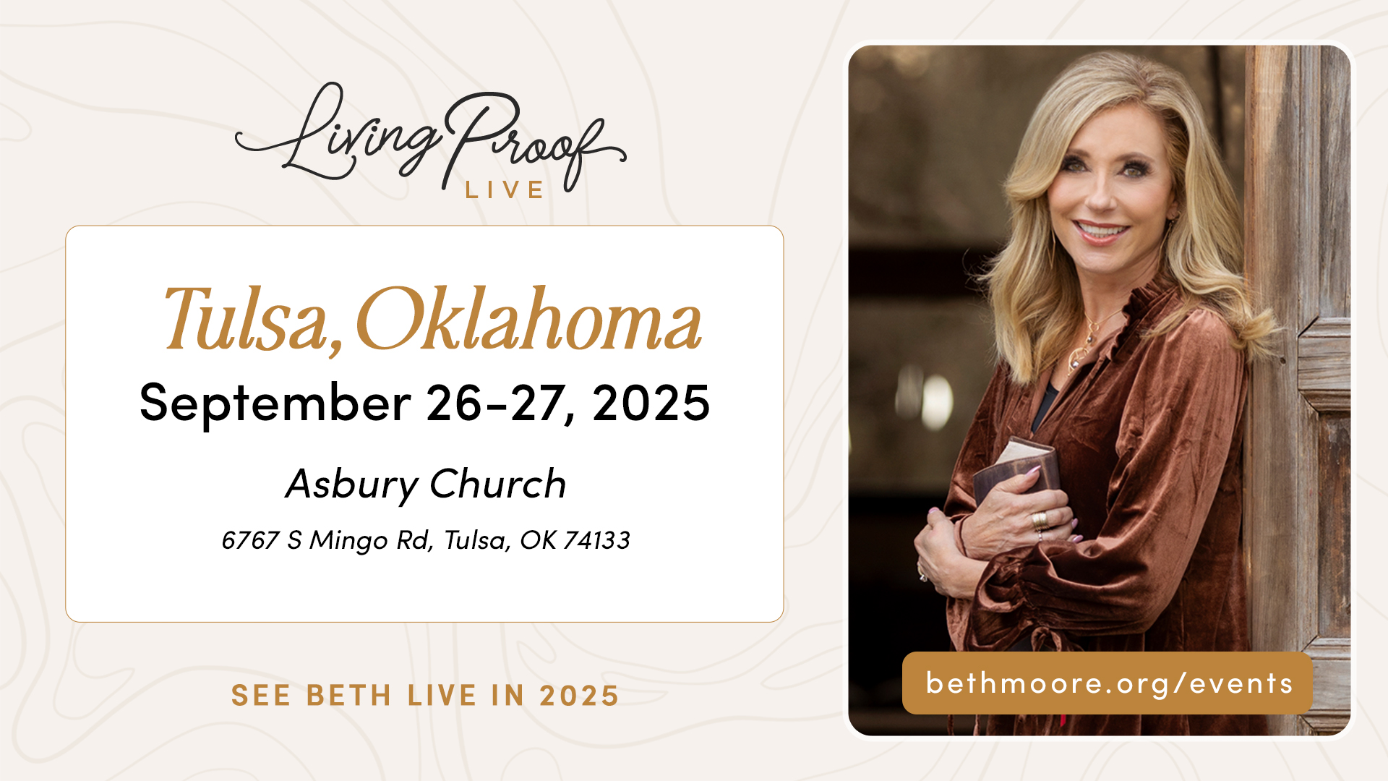
October 25th
9am-2pm
Grace Chapel Wilmington
grace.org/events

Slide 19
Announcements & Reminders
Trunk or Treat October 24th
Beth Moore Simulcast in WIL on October 25th
  Both at grace.org/events
Schedule adjustment for Veterans Day
  No meeting on Nov. 11/12 but we do have reading for that week
Please register if you haven’t already done so

Slide 20
Small Groups

