Slide 1

Group Leader Winter Training 2026
Welcome Group Leaders!

Slide 2
Talk to Each Other :)
Optional Ice-Breaker Question:
- Growing up, I thought my job would be … but I do/did this ….
- I am predicting that we get this many …. more snow storms
- For the Super Bowl …
… I am hoping we win.
… I am praying and fasting for it.
… I am wondering when it is and who is in it.

Slide 3
The What and Why of Group Life
Group Life Vision:
“Small groups of people practicing the way of Jesus together.”
Group Life Values:
Spiritual Formation
Strengthening Relationships
Missional Living

Slide 4
“The Son is the image of the invisible God, the firstborn over all creation. For in him all things were created: things in heaven and on earth, visible and invisible, whether thrones or powers or rulers or authorities; all things have been created through him and for him. He is before all things, and in him all things hold together.”
Colossians 1:15-18 (NIV)

Slide 5
“The modern church is facing a spiritual formation crisis and the spiritual formation movement is facing a crisis of church.”
- Brandon Shields

Slide 6

Lent 2026

Slide 7
Spiritually Forming our Leaders and our Congregation
Prayer – Fasting – Sabbath- Why it Matters
- Life keeps getting louder, more overwhelming and moving faster.
Prayer:
Paramount of the spiritual disciplines as all practices have a component of prayer/communing with God.
When we pray, we grow closer to Jesus and become more like Jesus.
Fasting:
The practice of saying no to yourself in order to make space spiritually for communing with Jesus.
Sabbath:
The practice of stopping from the rush, to rest the body/mind, enjoy life, & worship God.

Slide 8
Spiritual Formation for Leaders
- Some of our formational is unintentional .. Therefore we must be intentional.
- The need to ask ourselves, “Who am I becoming?” and therefore,
“Am I being more intentional in who I am becoming?
It’s often said we cannot lead from where we have not been. Therefore the need to keep growing so we can continue influencing, teaching, developing, encouraging, and serving others.
Spiritual Practices like Fasting and Praying and Sabbath and Praying not only rest and reset us, but they form and teach us. Even more, they create personal pockets of worship where we spend powerful and often soul-awakening moments with God.
Sabbath and Fasting are Faith-Building Practices.

Slide 9
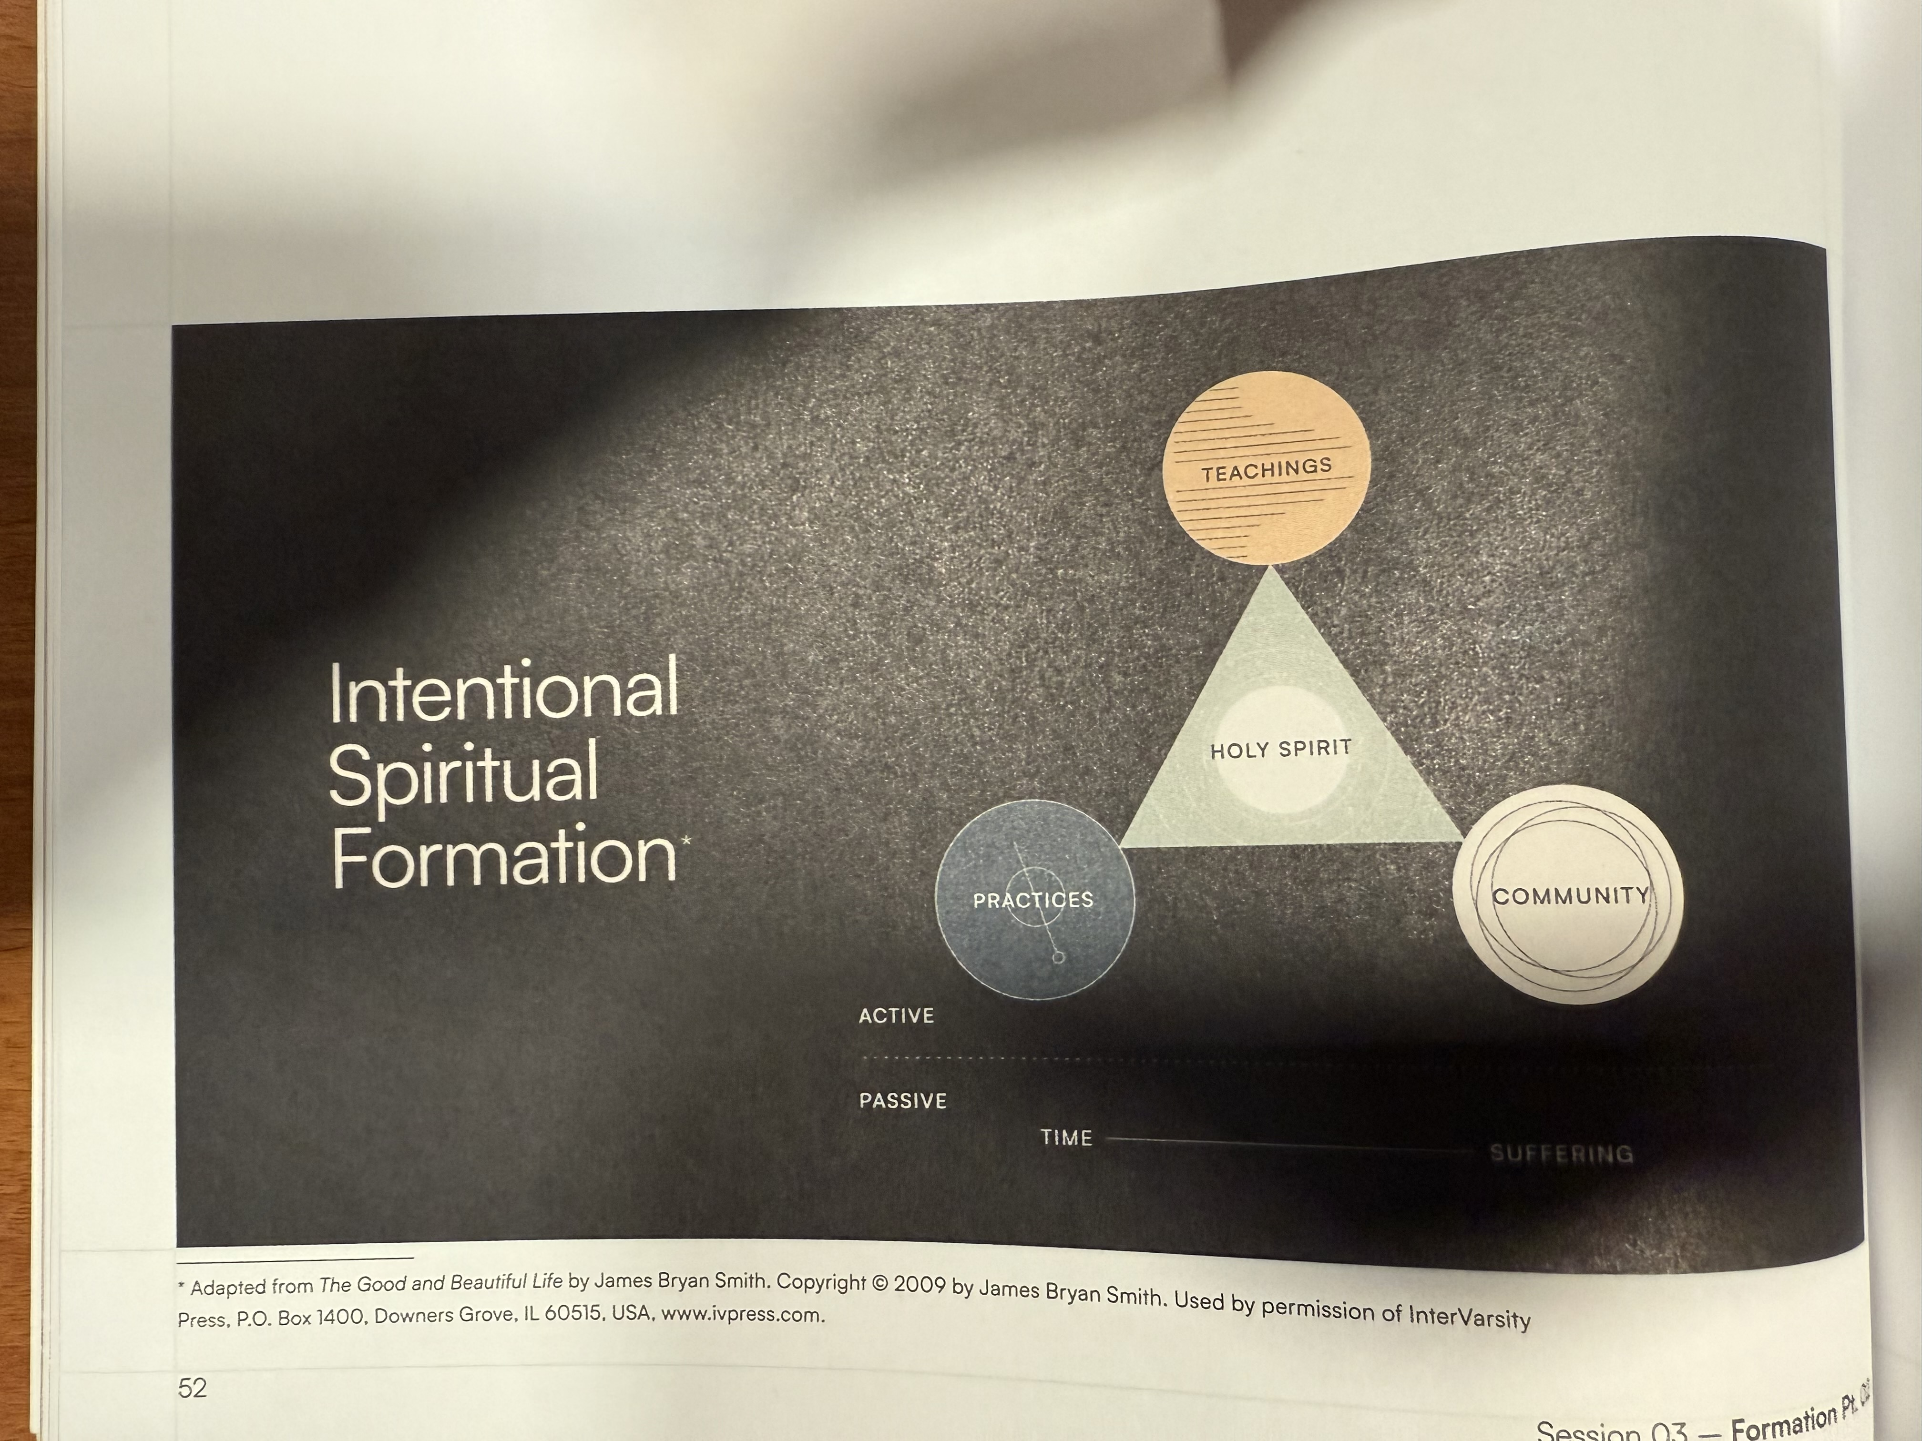

Slide 10
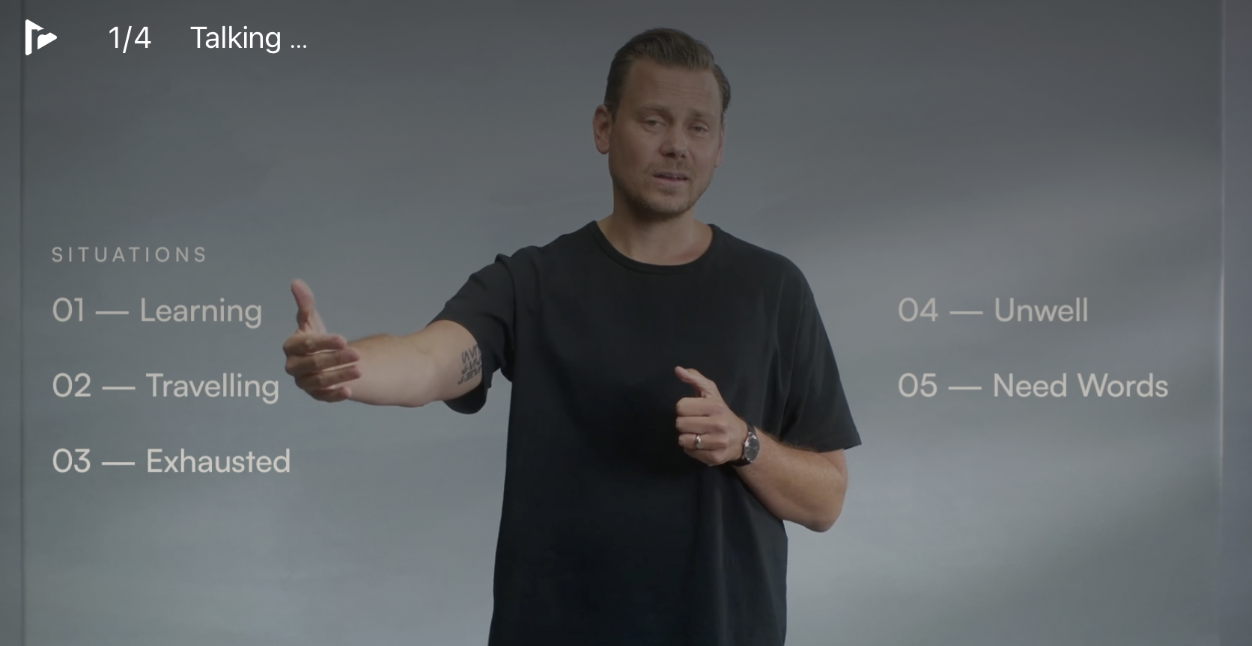
LENT 2026
Multiple Practice Course Options:
- Fasting Practice
Sabbath Practice
Prayer Practice
The Practice Course
- Taught my John Mark Comer
- 4 Week Video Courses with Discussion Guides
- Available for Free on Right Now Media and Practicing the Way

Slide 11
https://grace.org/groupleaders
- Training
- Content
- Leader Development
- More
Notes:
https://www.grace.org/groupleaders/

Slide 12


Slide 13
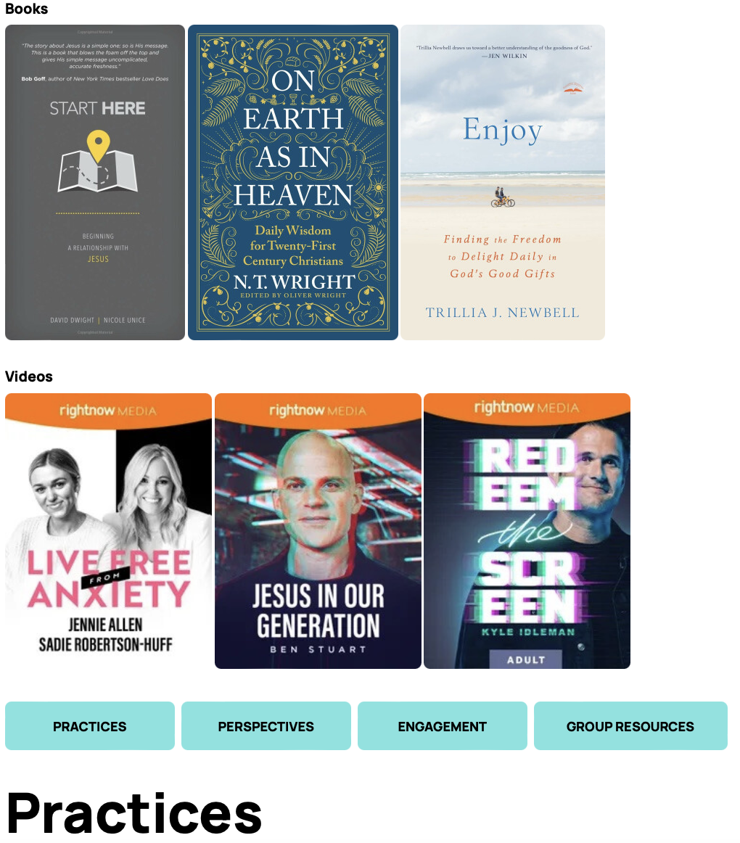
www.grace.org/jrl

Slide 14
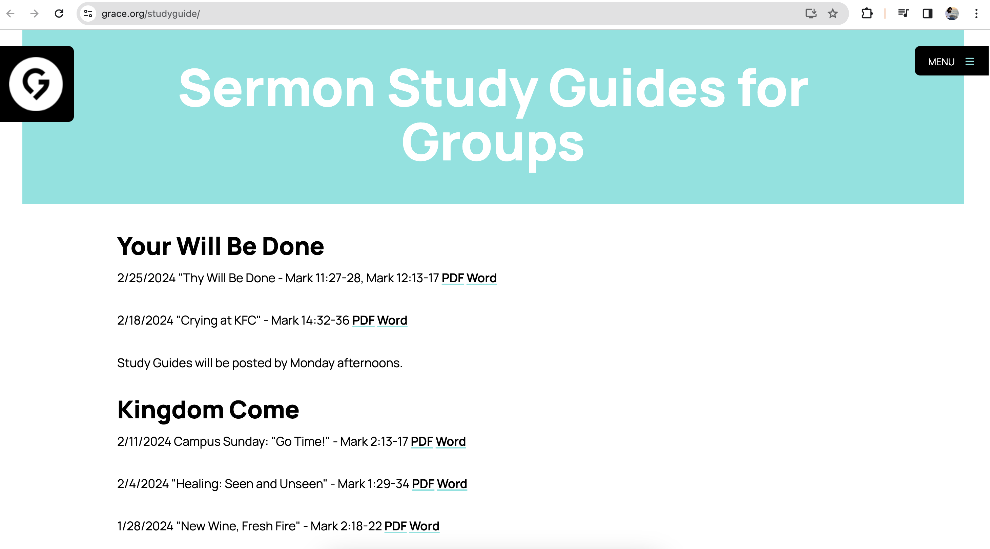
www.grace.org/studyguide

Slide 15
https://grace.org/groupleaders https://grace.org/jrl https://grace.org/studyguide
Notes:
https://www.grace.org/groupleaders/

Slide 16
Tracking Our Engagement …
The Why:
Faithfulness and Integrity
A Tool for Shepherding
Understanding our Trends and Creating Ministry for our Context

Slide 17
Next steps from here …
Campus Groups Sep 2025-Jan '26
Campus | # of Groups | # Logging Att. | # Missing Att. | Total Average # of People Attending Groups
Lex | 94 | 60 | 34 | 509
Cen | 4 | 1 | 3 | 13
Wil | 18 | 12 | 6 | 132
Wat | 14 | 8 | 6 | 70
Fox | 6 | 3 | 3 | 31
Onl | 6 | 5 | 1 | 30
Total | 142 | 89 | 53 | 785
Campus Groups Sep 2024-Jan '25
Campus | # of Groups | # Logging Att. | # Missing Att. | Total Average # of People Attending Groups
Lex | 88 | 50 | 38 | 426
Cen | 4 | 2 | 2 | 19
Wil | 17 | 14 | 3 | 164
Wat | 14 | 11 | 3 | 89
Fox | 9 | 6 | 3 | 51
Onl | 3 | 3 | 0 | 8
Total | 135 | 86 | 49 | 757

Slide 18
Let’s Keep Learning …
Post Lent Update
End of Ministry Year Update (June)

Slide 19

Q & A

Slide 21
Next steps from here …

Slide 22
Next steps from here …

Slide 23
Next steps from here …

