Slide 1
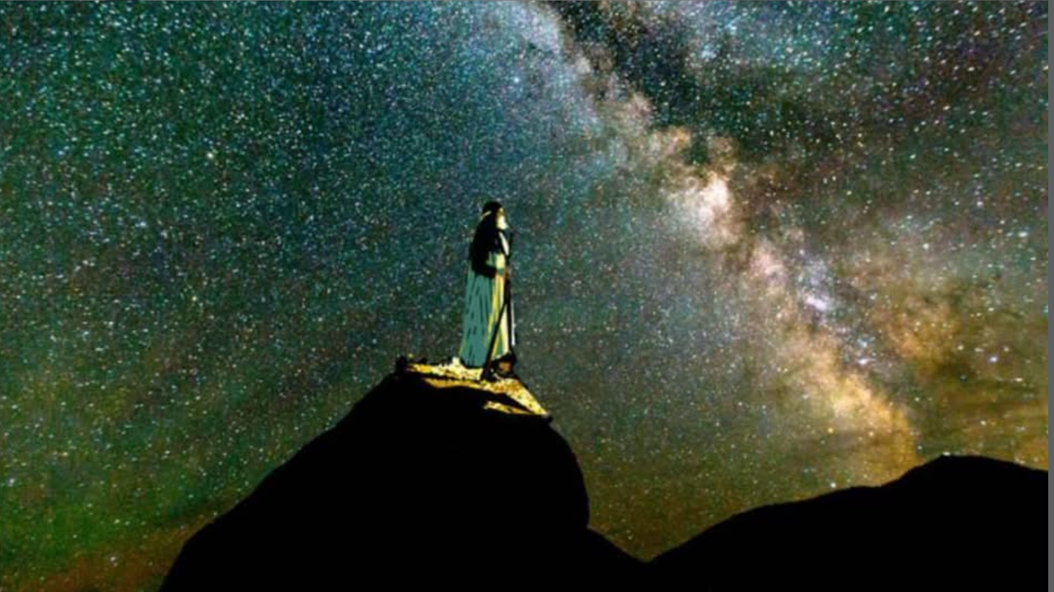
WELCOME to
WFW-AM!
Romans 4

Slide 2
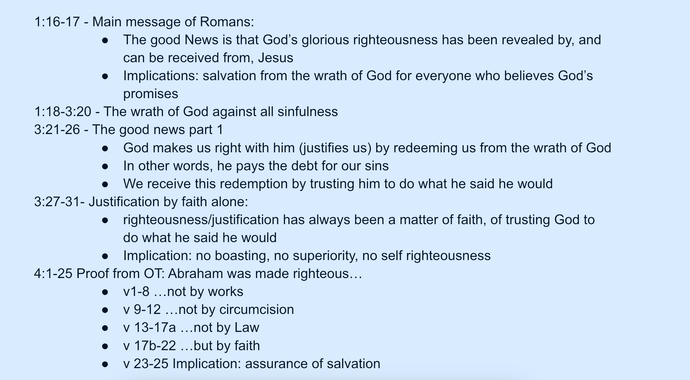

Slide 3
Christopher Ashe:
“It is important to notice that the central focus in this passage is not on Abraham and his heroic faith,but on God and His life giving promise. It is God, not Abraham, ‘who gives life to the dead”(v. 17); it is God who makes the promise (v. 18,20); it is God who ‘had the power to do what He had promised’ (v. 21). This passage is bracketed by the strength of God (vv. 17, 21) and at its center is the utter helplessness of Abraham and Sarah (v, 19).”

