Slide 1

Word Filled Women – AM
Romans 3:1-20

Slide 2
What do you notice about this painting?

Slide 3
FALLEN EXCLAMATION MARK OR QUESTION MARK OR ABSTRACTLY VICE versa (2019)
Dmitri Matkovsky

Slide 4
Question Marks – 3:1-8:
Jewish questions/objections
Exclamation Points – 3:9-20:
Emphatic Final Verdict

Slide 5
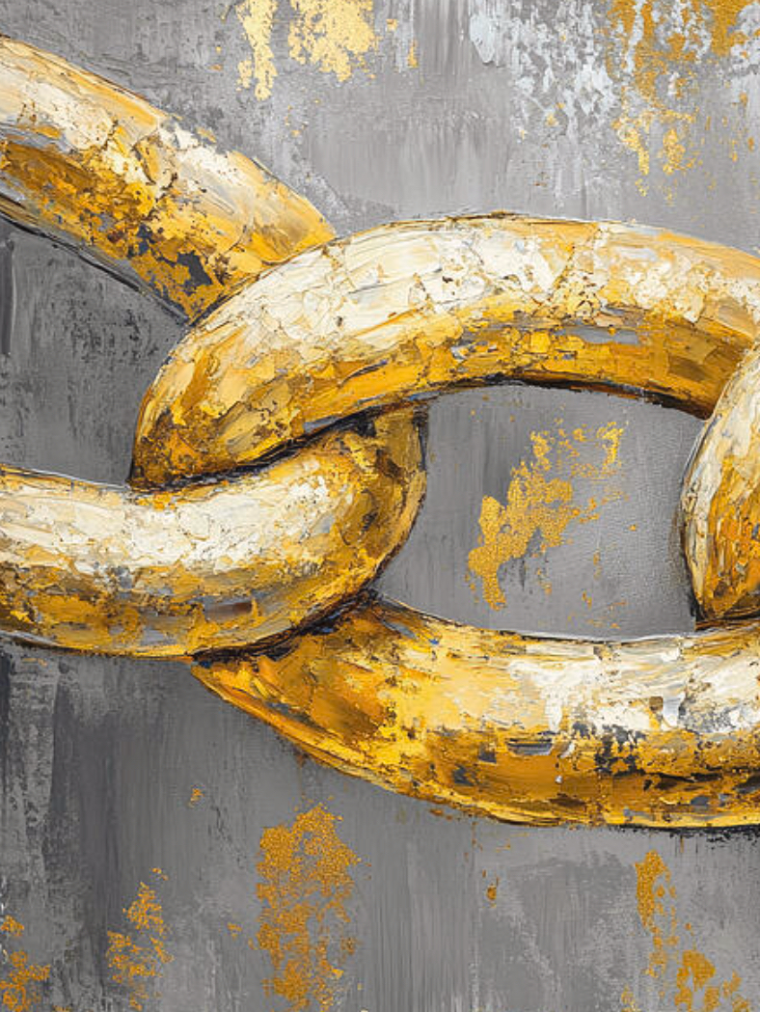
Simple outline of Romans
1:1-17: Introduction of the Letter
1:18-5:21: Paul’s Case for Justification by Faith Alone
6:1-11:36: Paul Answers Objections to Justification by Faith Alone
12:1-15:13: Exhortation and Application
15:14-16:27: Personal Matters and Final Greetings

Slide 6
Outline of Romans (thus far)
I. Romans 1:1-17
A.Introduction (1:1-7)
B.Gospel Summary (1:8-17)
1.Paul’s Thesis (1:16-17) The Good News (“the Gospel”) is That We Are Saved by Faith Alone
II. Romans 1:18-5:21: Paul’s Case for Justification by Faith Alone
A. All Are Sinful (1:18-3:20)
1. Romans 1:18-32- the Gentiles
2 .Romans 2 - The religious people
3. Romans 3:1-8 –Jewish Objections/quest.
4. Roman’s 3:9-20 – Emphatic Final Verdict
B.To be continued….

Slide 7
Our Time Today
Question Marks – 3:1-8:
Jewish questions/objections
Exclamation Points – 3:9-20:
Emphatic Final Verdict

Slide 8
What advantage, then, is there in being a Jew, or what value is there in circumcision? Much in every way! First of all, the Jews have been entrusted with the very words of God. What if some were unfaithful? Will their unfaithfulness nullify God’s faithfulness? Not at all! Let God be true, and every human being a liar. As it is written:“So that you may be proved right when you speak and prevail when you judge.” But if our unrighteousness brings out God’s righteousness more clearly, what shall we say? That God is unjust in bringing his wrath on us? (I am using a human argument.) Certainly not! If that were so, how could God judge the world? Someone might argue, “If my falsehood enhances God’s truthfulness and so increases his glory, why am I still condemned as a sinner?” Why not say—as some slanderously claim that we say—“Let us do evil that good may result”? Their condemnation is just!
Romans 3:1-8

Slide 9
Romans 3:9-18
As it is written:
“There is no one righteous, not even one; there is no one who understands; there is no one who seeks God. All have turned away, they have together become worthless; there is no one who does good, not even one.” “Their throats are open graves; their tongues practice deceit.” “The poison of vipers is on their lips.” “Their mouths are full of cursing and bitterness.” “Their feet are swift to shed blood; ruin and misery mark their ways, and the way of peace they do not know.” “There is no fear of God before their eyes.”

Slide 10
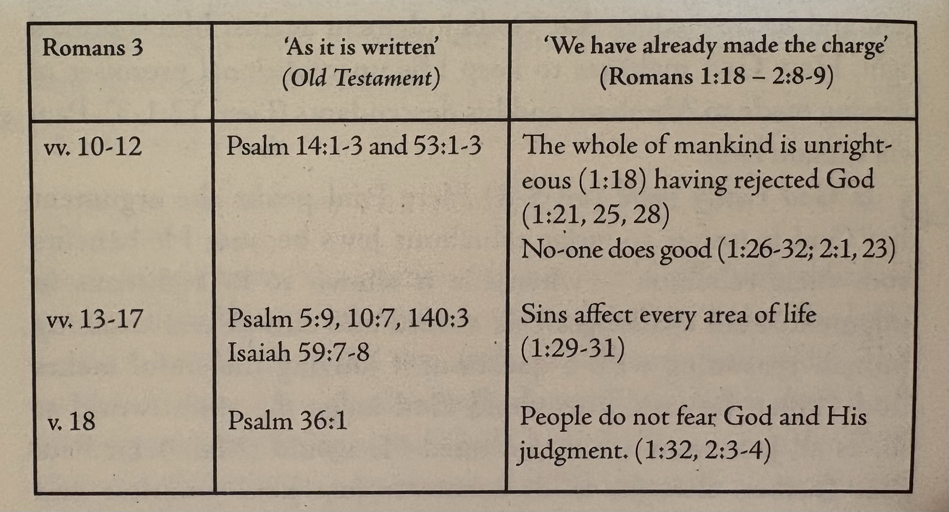
Romans 3:9-20
How does this collection of Old Testament passages describe the condition of fallen human beings?

Slide 11
Total Depravity/Totally Incapable
Man, by his fall into a state of sin, hath wholly lost all ability of will to any spiritual good accompanying salvation; so as, a natural man, being altogether averse from that good, and dead in sin, is not able, by his own strength, to convert himself, or to prepare himself thereunto. (WCF 9.3)
In the Reformed tradition, total depravity does not mean utter depravity. . . . the idea of total in total depravity doesn’t mean that all human beings are as wicked as they can possibly be. It means that the fall was so serious that it affects the whole person.
R.C. Sproul

Slide 12
Romans 3:19-20
Now we know that whatever the law says, it says to those who are under the law, so that every mouth may be silenced and the whole world held accountable to God.
Therefore no one will be declared righteous in God’s sight by the works of the law; rather, through the law we become conscious of our sin.

Slide 13
An EMPHATIC diatribe proving the sinfulness of humanity and our just condemnation to experience the wrath of God.
Romans 1:18-3:20
This is BAD NEWS indeed!

Slide 14
-an attribute -and an activity -and an acheivement
Righteousness of God
How can a righteous God righteously save unrighteous people?

Slide 15
BUT…
Romans 3:21

