Slide 1
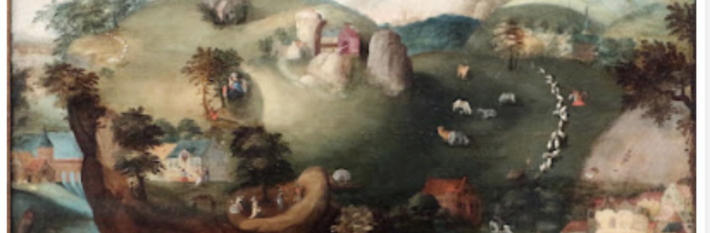
Word Filled Women
Wednesday August 17
Romans 1:1-17

Slide 2
“The Apostle Paul’s letter to the Romans is one of the most influential and theologically rich Epistles given from God to His Church.
Since that is the case, Romans 1:16 and 17- as they set up the theme of the entire Epistle - are two of the most important verses to understand if we want to rightly interpret one of the most important books of the Bible...”

Slide 3
“…Given the importance of these verses, their meaning should be pretty straight forward, right?
Well, whether they should be straight forward or not, ambiguity rears its indecisive head in verse 17….
The “righteousness of God” in verse 17 is ambiguous.”

Slide 4
Luther wrote, “…I hated the word ‘righteousness of God,’ because …I had been taught to understand it philosophically as meaning, ...the formal or active righteousness according to which God is righteous and punishes sinners and the unjust…”

Slide 5
“…As a monk I led an irreproachable life. Nevertheless I felt that I was a sinner before God. My conscience was restless, and I could not depend on God being propitiated by my satisfactions. Not only did I not love, but I actually hated the righteous God who punishes sinners…”

Slide 6
“…Dayand night I tried to meditate upon the significance of these words: ‘The righteousness of God is revealed in it, as it is written: The righteous shall live by faith.’”

Slide 7
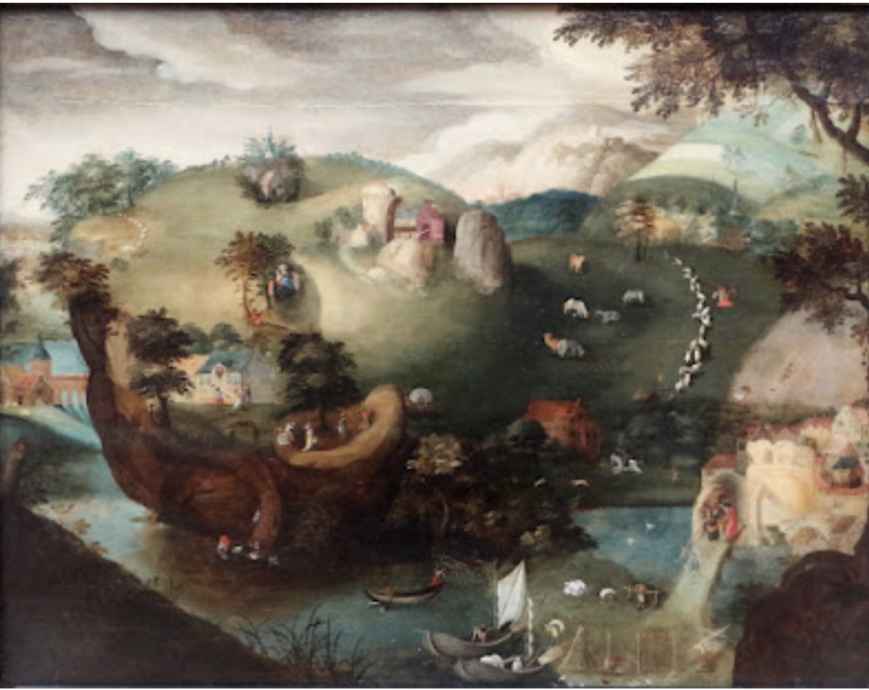

Slide 8
“Then finally God had mercy on me, and I began to understand that the righteousness of God is a gift of God by which a righteous man lives, namely faith, and that sentence: The righteousness of God is revealed in the Gospel, is passive, indicating that the merciful God justifies us by faith, as it is written: ‘The righteous shall live by faith.’ Now I felt as though I had been reborn altogether and had entered Paradise. In the same moment the face of the whole of Scripture became apparent to me.”

Slide 9
John Stott on Righteousness in Romans 1:17
John Stott says, “Thus ‘the righteousness of God’ can be thought of as a divine attribute (our God is a righteous God), or activity (he comes to our rescue), or achievement (he bestows on us a righteous status)”.
The Message of Romans

Slide 10
John Stott on Righteousness in Romans 1:17
“All three are true…I have never been able to see why we have to choose, and why all three should not be combined… In other words, [the righteousness of God] is at one and the same time a quality, an activity and a gift.”
The Message of Romans

