Slide 1


Slide 2
I. Comforting Words (23:1–11)
A. God’s past work (23:1–3)
B. God’s present work (23:4–11)

Slide 3
II. Clear Warnings (23:12–16)
A. About clinging to the Canaanites (23:12, 13)
B. About breaking the covenant (23:14–16)

Slide 4
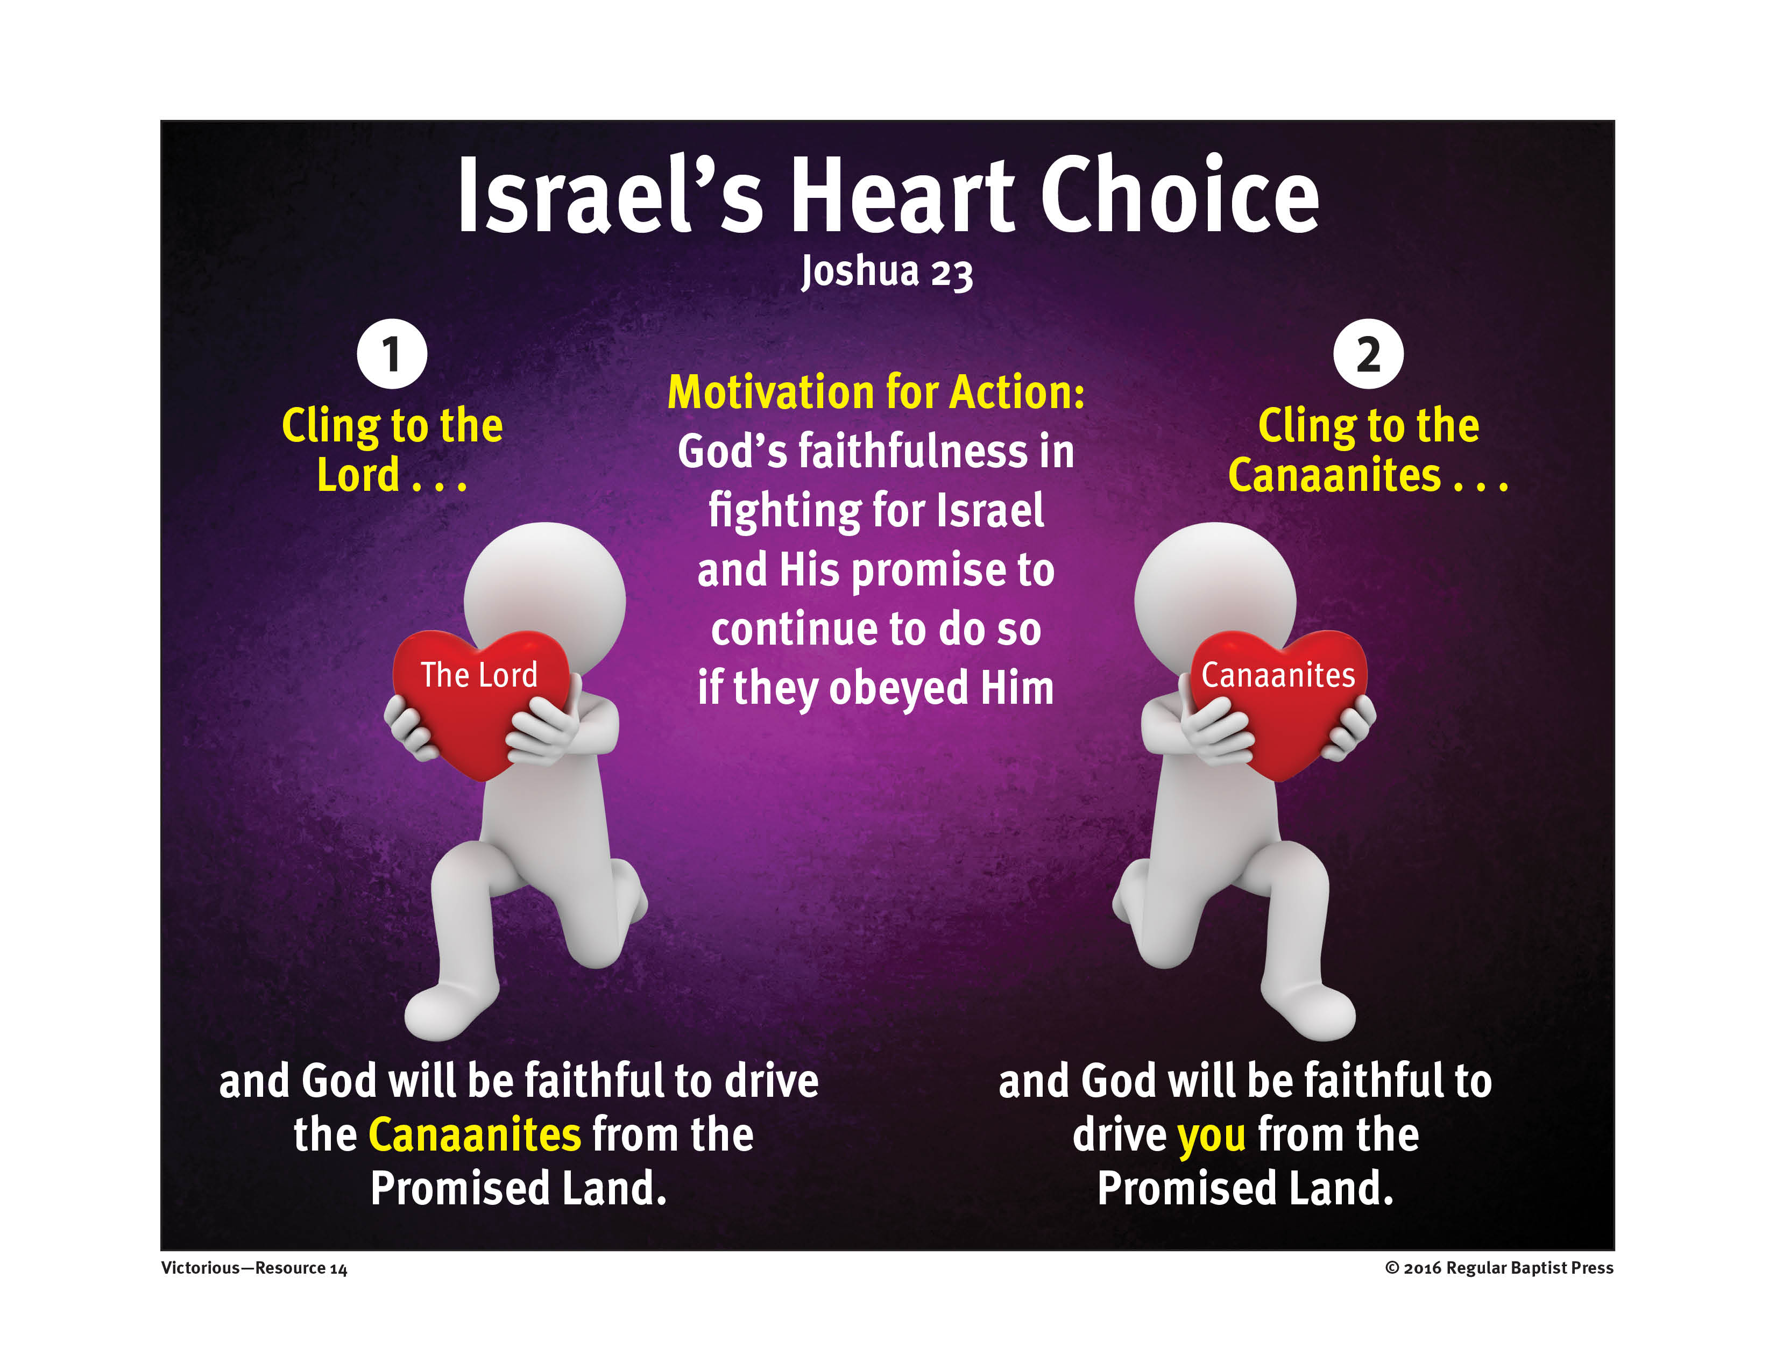

Slide 5
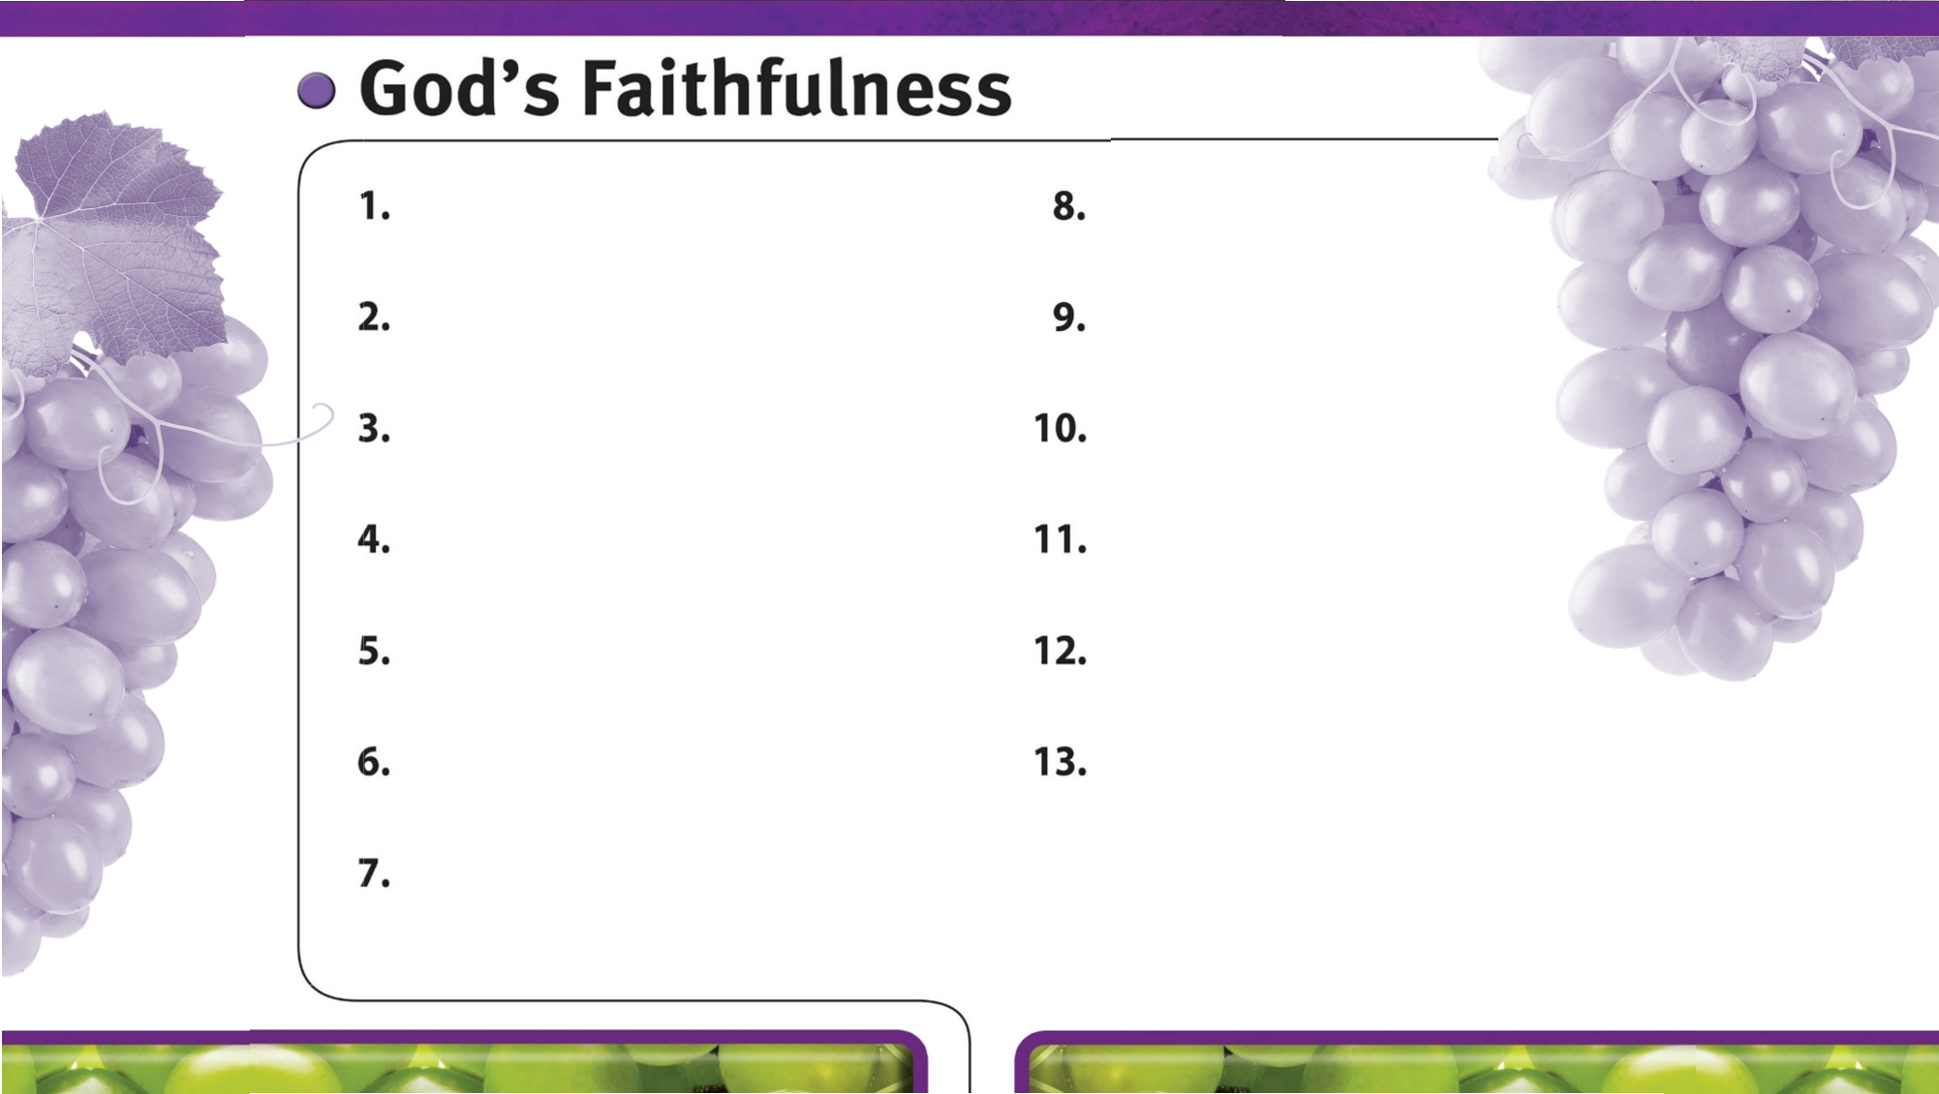
God is always faithful.
God faithfully gives wisdom to those who ask.
God faithfully provides strength and courage to do His will.
God faithfully works through His people.
God’s faithfulness is worthy of glory.
God’s faithfulness encourages perseverance.
God’s sovereign power encourages faith in Him.
God expects us to be loving, just, and giving.
God faithfully leads us by His grace.
God’s faithfulness encourages our faithfulness to Him.
God is faithful to His promises.
God is faithful to His warnings about sin.

