Slide 1


Slide 2
I. The Lord Expected Love and Justice in the Land (20)
A. The Lord required cities of refuge (20:1–6)
B. The people appointed cities of refuge (20:7–9)

Slide 3
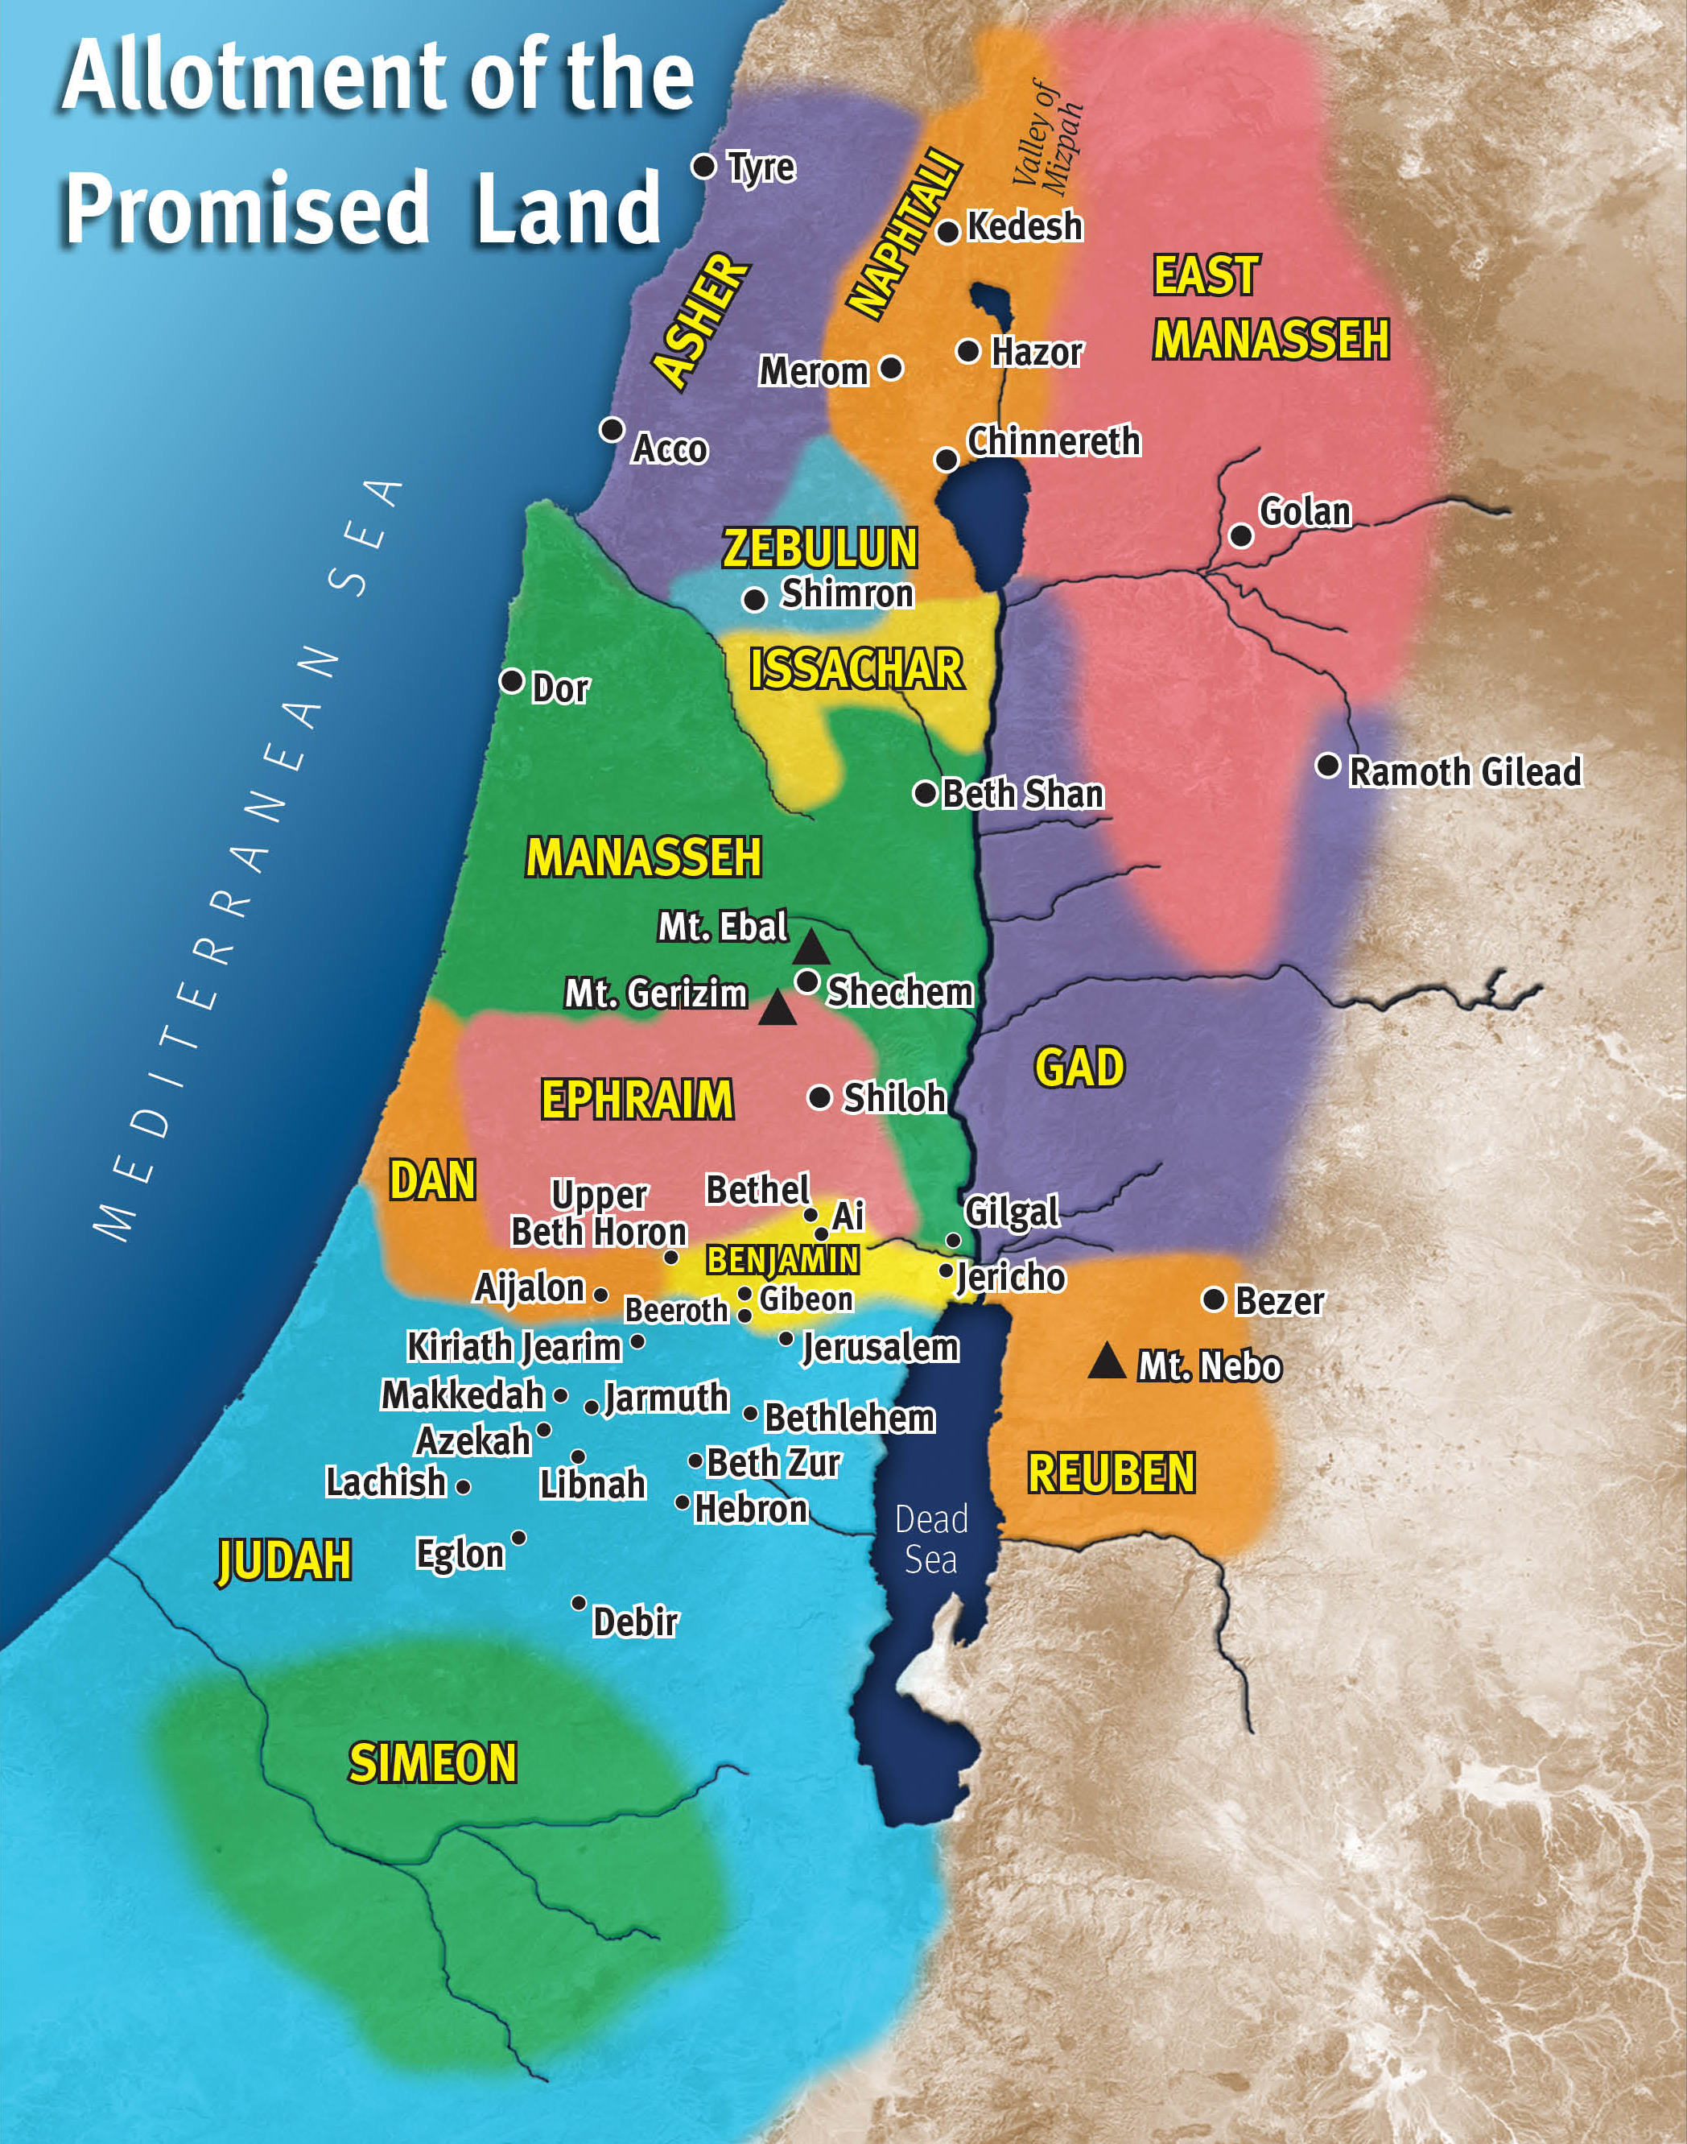
Hebron is another name for Kirjath Arba

Slide 4
II. The Lord Expected Giving and Worship in the Land (21)
A. The people gave cities to Levites (21:1–3)
B. The Lord assigned Levites to cities (21:4–45)

Slide 5
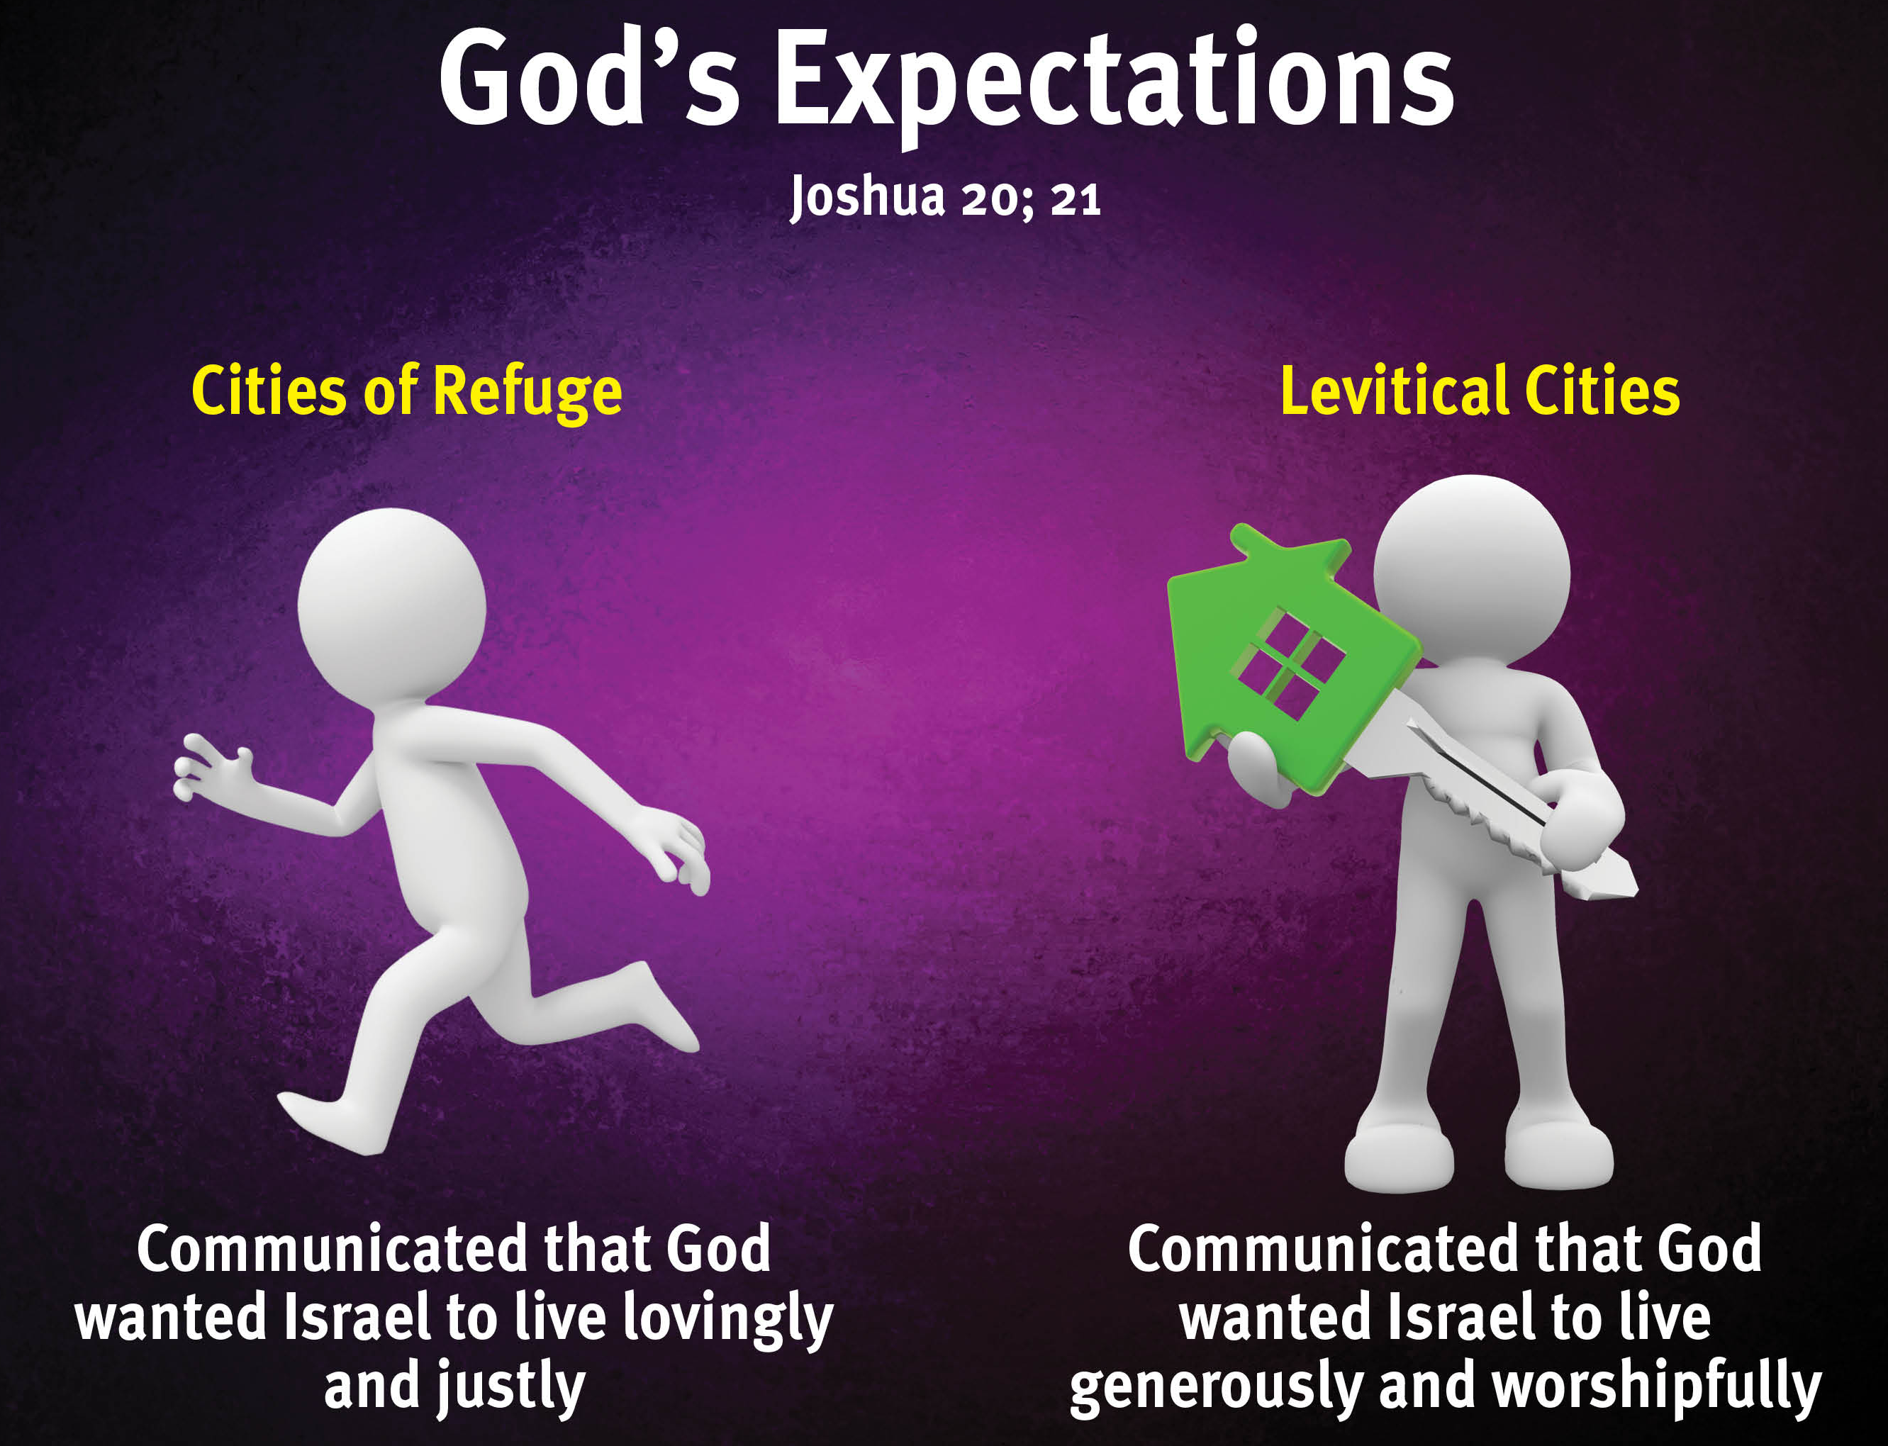

Slide 6
III. The People Met God’s Expectations (22)
A. Joshua encouraged the possessors (22:1–9)
B. The tribes established a proof (22:10)
C. Israel explored the altar’s purpose (22:11–20)
D. The tribes explained their point (22:21–29)
E. Israel expressed their pleasure (22:30–34)

Slide 7
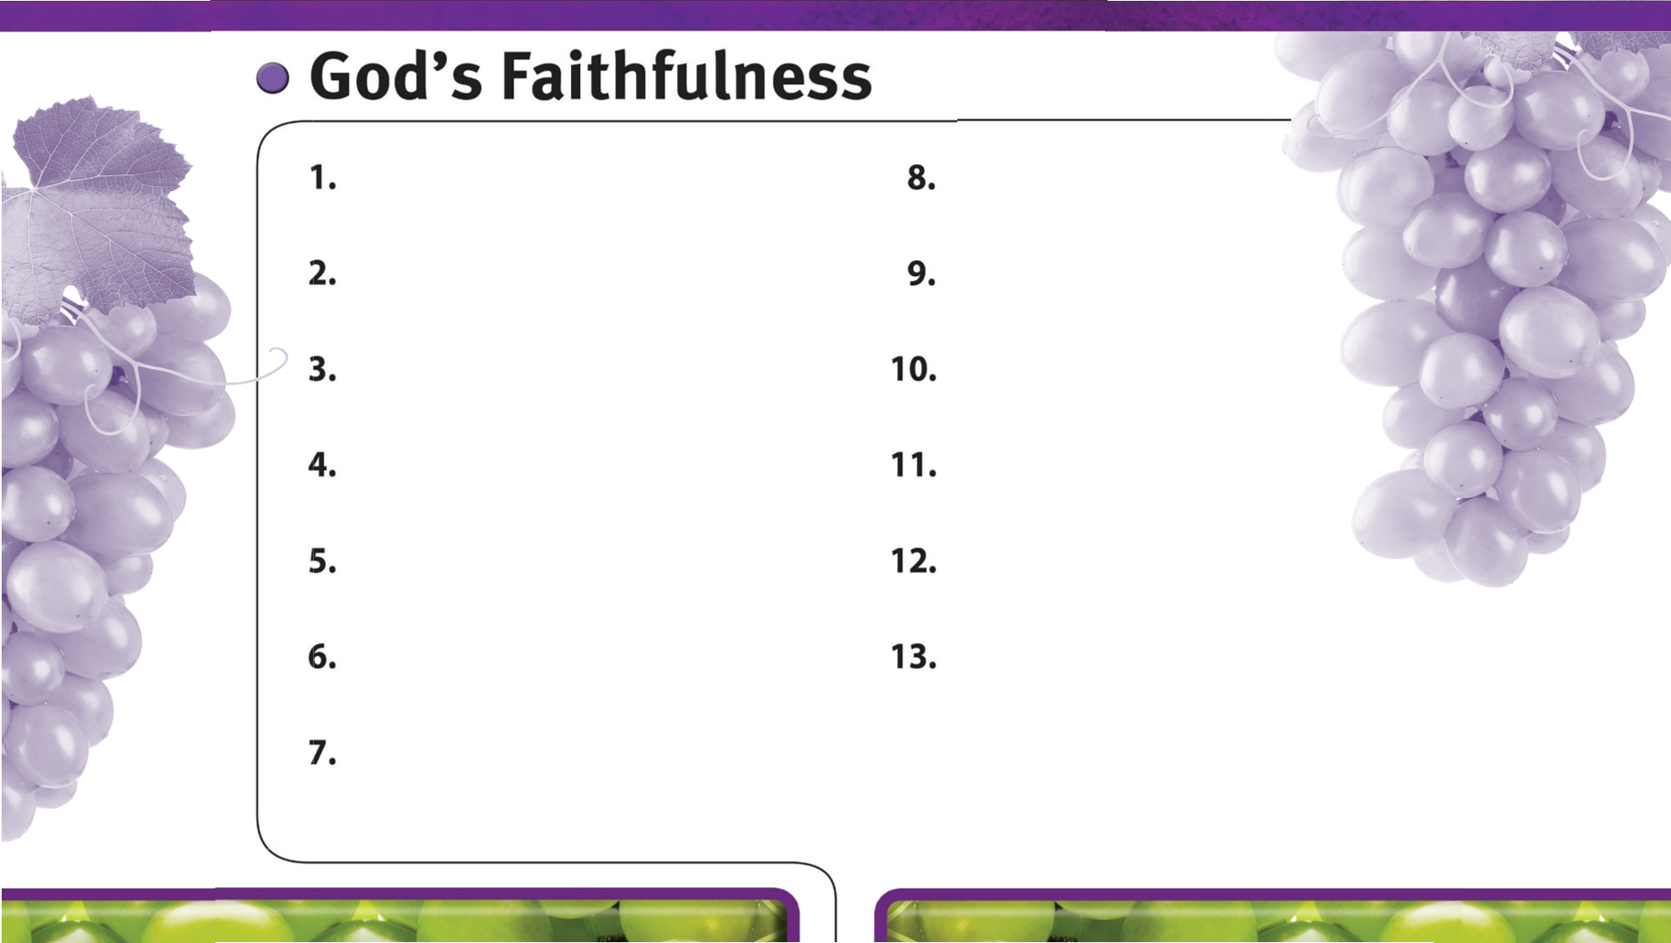
God is always faithful.
God faithfully gives wisdom to those who ask.
God faithfully provides strength and courage to do His will.
God faithfully works through His people.
God’s faithfulness is worthy of glory.
God’s faithfulness encourages perseverance.
God’s sovereign power encourages faith in Him.
God expects us to be loving, just, and giving.
God faithfully leads us by His grace.
God is faithful to His promises.
God is faithful to His warnings about sin.

