Slide 1


Slide 2
I. Evidence of God’s Faithfulness (12)
A. Kings defeated by Moses (12:1–6)
B. Kings defeated by Joshua (12:7–24)

Slide 3
II. Opportunities for Faith in God (13—19)
A. God promised to drive out the enemy (13:1–7)

Slide 4
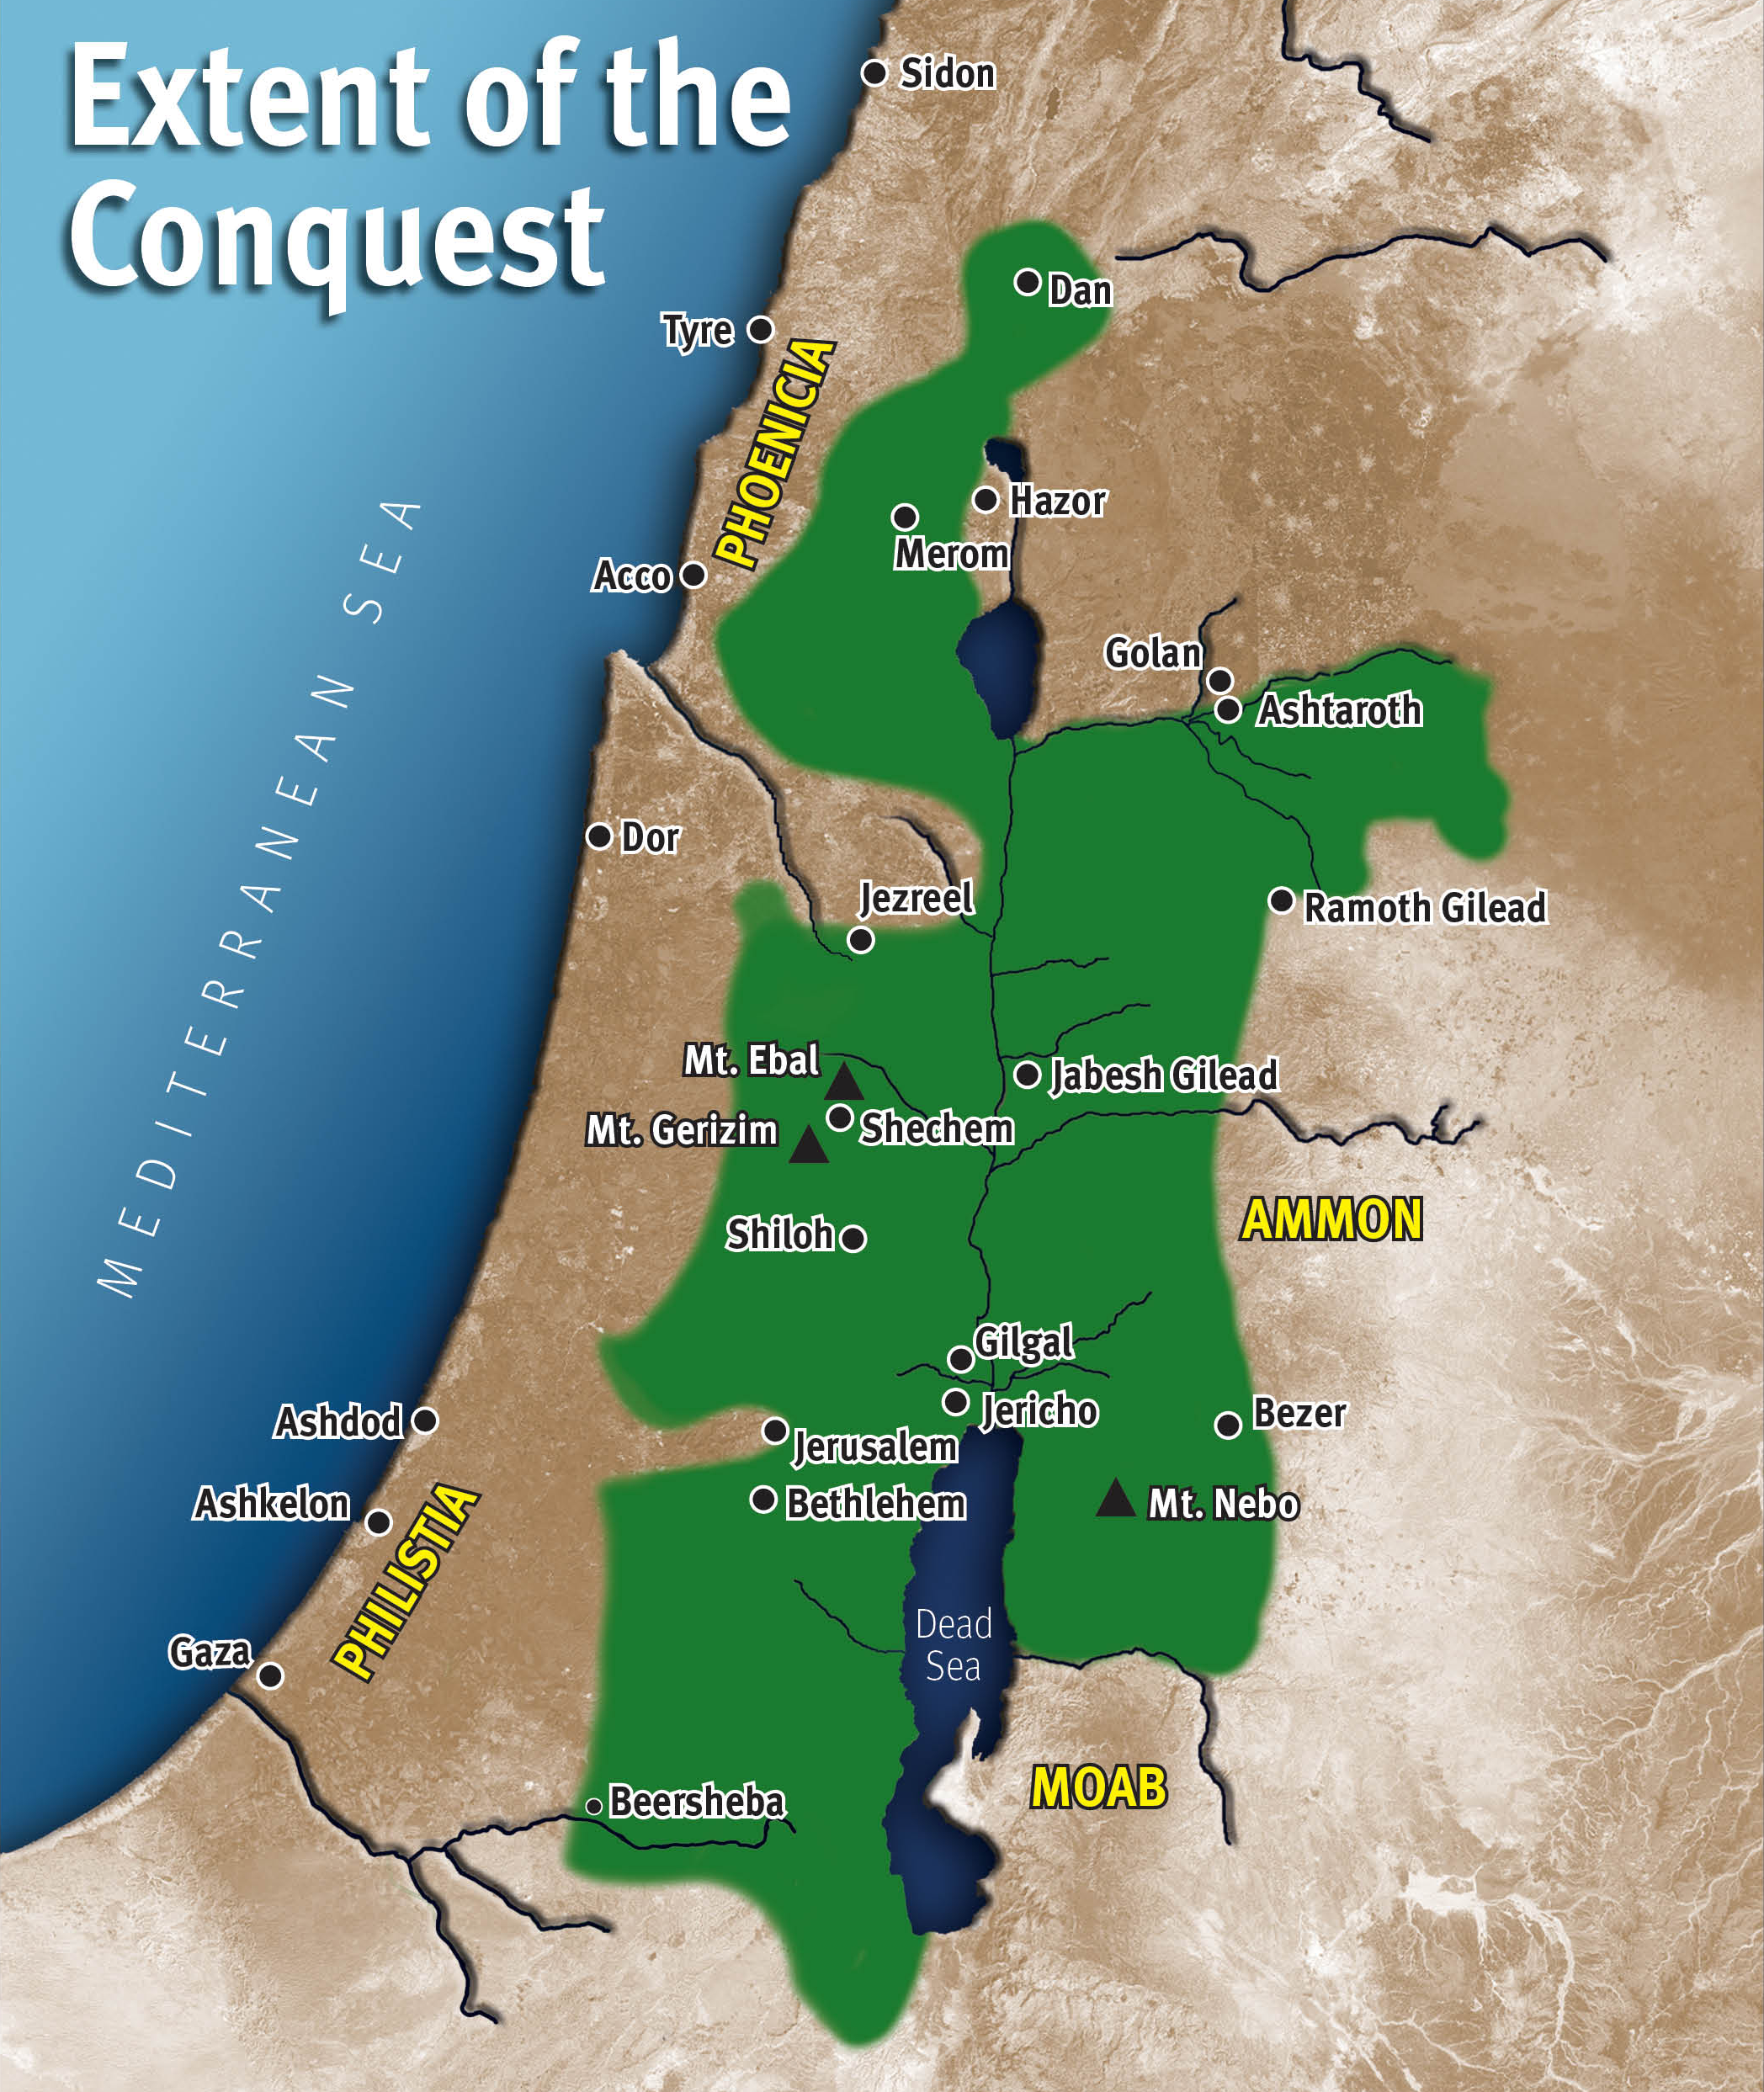

Slide 5
II. Opportunities for Faith in God (13—19)
A. God promised to drive out the enemy (13:1–7)
B. God divided the land east of Jordan (13:8–33)
C. God provided an example of faith (14:1—15:19)
D. God divided the land west of Jordan (15:20—19:48)
E. God provided another example of faith (19:49–51)

Slide 6
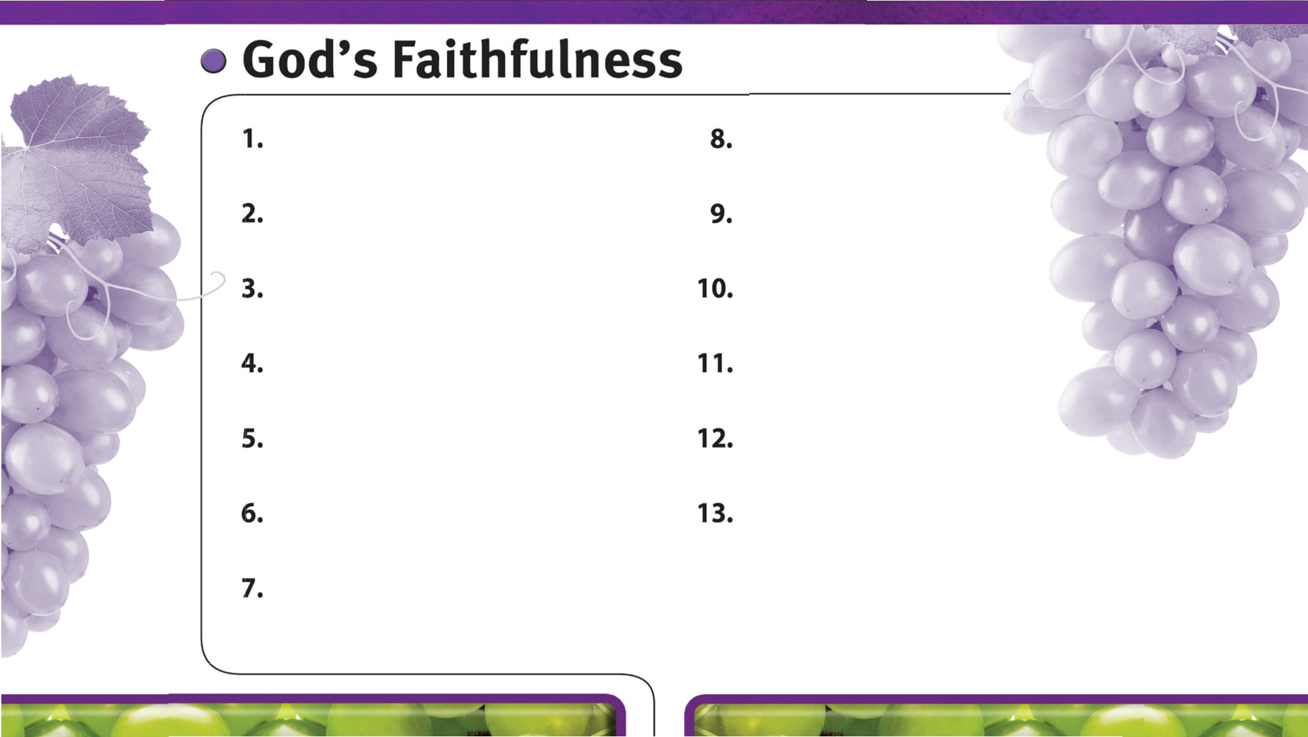
God is always faithful.
God faithfully gives wisdom to those who ask.
God faithfully provides strength and courage to do His will.
God faithfully works through His people.
God’s faithfulness is worthy of glory.
God’s faithfulness encourages perseverance.
God’s sovereign power encourages faith in Him.
God faithfully leads us by His grace.
God is faithful to His promises.
God is faithful to His warnings about sin.

