Slide 1


Slide 2
I. Victory in Southern Canaan (10)
A. Five kings feared (10:1–4)

Slide 3
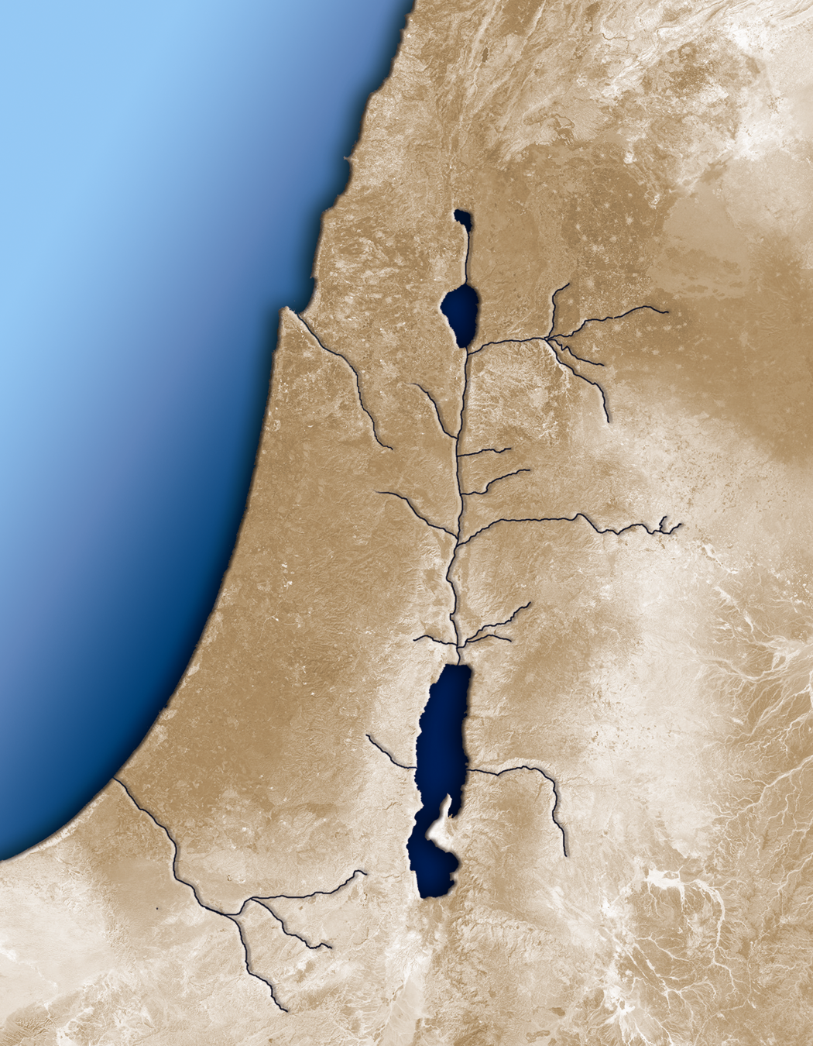
Amorites Mobilize to Attack Gibeon
Upper Beth
Horon
Gilgal
Chephirah
Aijalon
Gibeon
Beeroth
Kiriath Jearim
Jerusalem
Makkedah
Jarmuth
Azekah
Lachish
Libnah
Hebron
Eglon
Debir

Slide 4
I. Victory in Southern Canaan (10)
A. Five kings feared (10:1–4)
B. Five kings fought (10:5–10)

Slide 5
Israelites March All Night to Gibeon
Upper Beth
Horon
Gilgal
Chephirah
Aijalon
Gibeon
Beeroth
Kiriath Jearim
Jerusalem
Makkedah
Jarmuth
Azekah
Lachish
Libnah
Hebron
Eglon
Debir

Slide 6
I. Victory in Southern Canaan (10)
A. Five kings feared (10:1–4)
B. Five kings fought (10:5–10)
C. Five kings fled (10:11–15)

Slide 7
Israelites Route the Southern Coalition
Upper Beth
Horon
Gilgal
Chephirah
Aijalon
Gibeon
Beeroth
Kiriath Jearim
Jerusalem
Makkedah
Jarmuth
Azekah
Lachish
Libnah
Hebron
Eglon
Debir

Slide 8
I. Victory in Southern Canaan (10)
A. Five kings feared (10:1–4)
B. Five kings fought (10:5–10)
C. Five kings fled (10:11–15)
D. Five kings are found (10:16–21)
E. Five kings are finished (10:22–43)

Slide 9
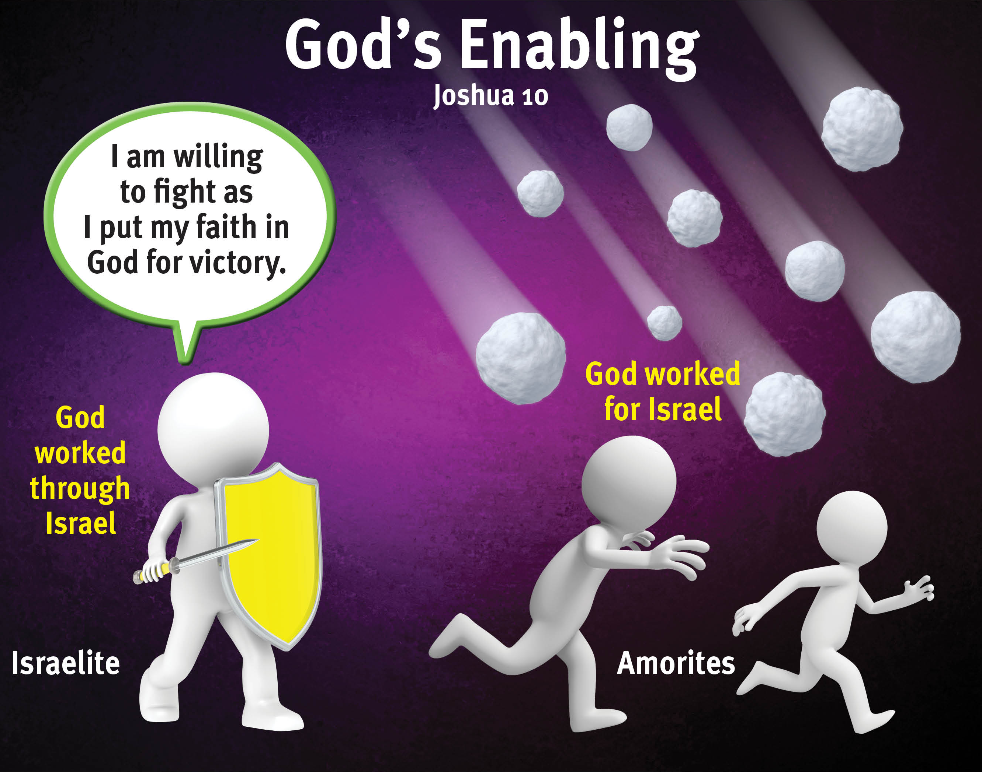

Slide 10
II. Victory in Northern Canaan (11:1–15)
A. Northern kings came together (11:1–5)

Slide 11
Northern Coalition Gathers at Merom
Tyre
Valley
of Mizpah
Kedesh
Hazor
Merom
Acco
Chinnereth
Achshaph
Shimron
Dor
Beth Shan

Slide 12
II. Victory in Northern Canaan (11:1–15)
A. Northern kings came together (11:1–5)
B. Northern kings are conquered (11:6–15)

Slide 13
Tyre
Valley
of Mizpah
Israelites Route the Northern Coalition
Kedesh
Hazor
Merom
Acco
Chinnereth
Achshaph
Shimron
Dor
Beth Shan

Slide 14
III. Victory in All of Canaan (11:16–23)

Slide 15
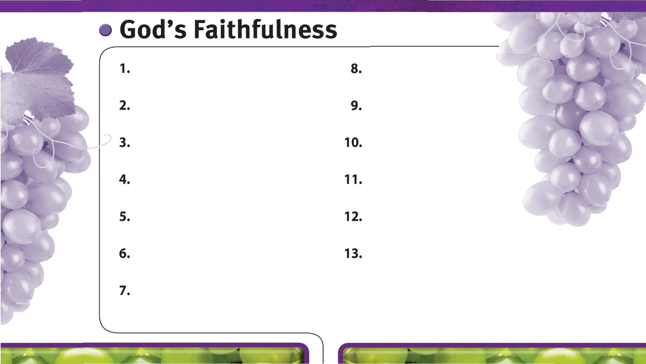
God is always faithful.
God faithfully gives wisdom to those who ask.
God faithfully provides strength and courage to do His will.
God faithfully works through His people.
God’s faithfulness is worthy of glory.
God’s sovereign power encourages faith in Him.
God faithfully leads us by His grace.
God is faithful to His promises.
God is faithful to His warnings about sin.

