Slide 1


Slide 2
I. Canaanites Strategized to Survive (9:1–6)
A. Coalition’s power strategy (9:1, 2)
B. Gibeon’s psychological strategy (9:3–6)

Slide 3
II. Israel’s Leaders Played Detective (9:7–15)
A. The leaders raised suspicion (9:7–13)
B. Joshua made the decision (9:14, 15)

Slide 4
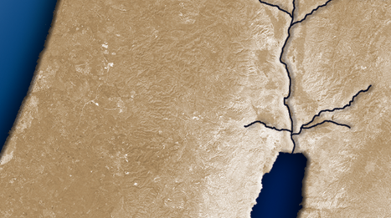
III. Israel’s Leaders Scrambled to Save Face (9:16–27)
A. Discovery of Gibeon’s wiliness (9:16–18)
B. Declaration of Gibeon as woodcutters and water
carriers (9:19–21)
C. Determination of Gibeon’s wisdom (9:22–27)
25 miles
Gilgal
Gibeon

Slide 5
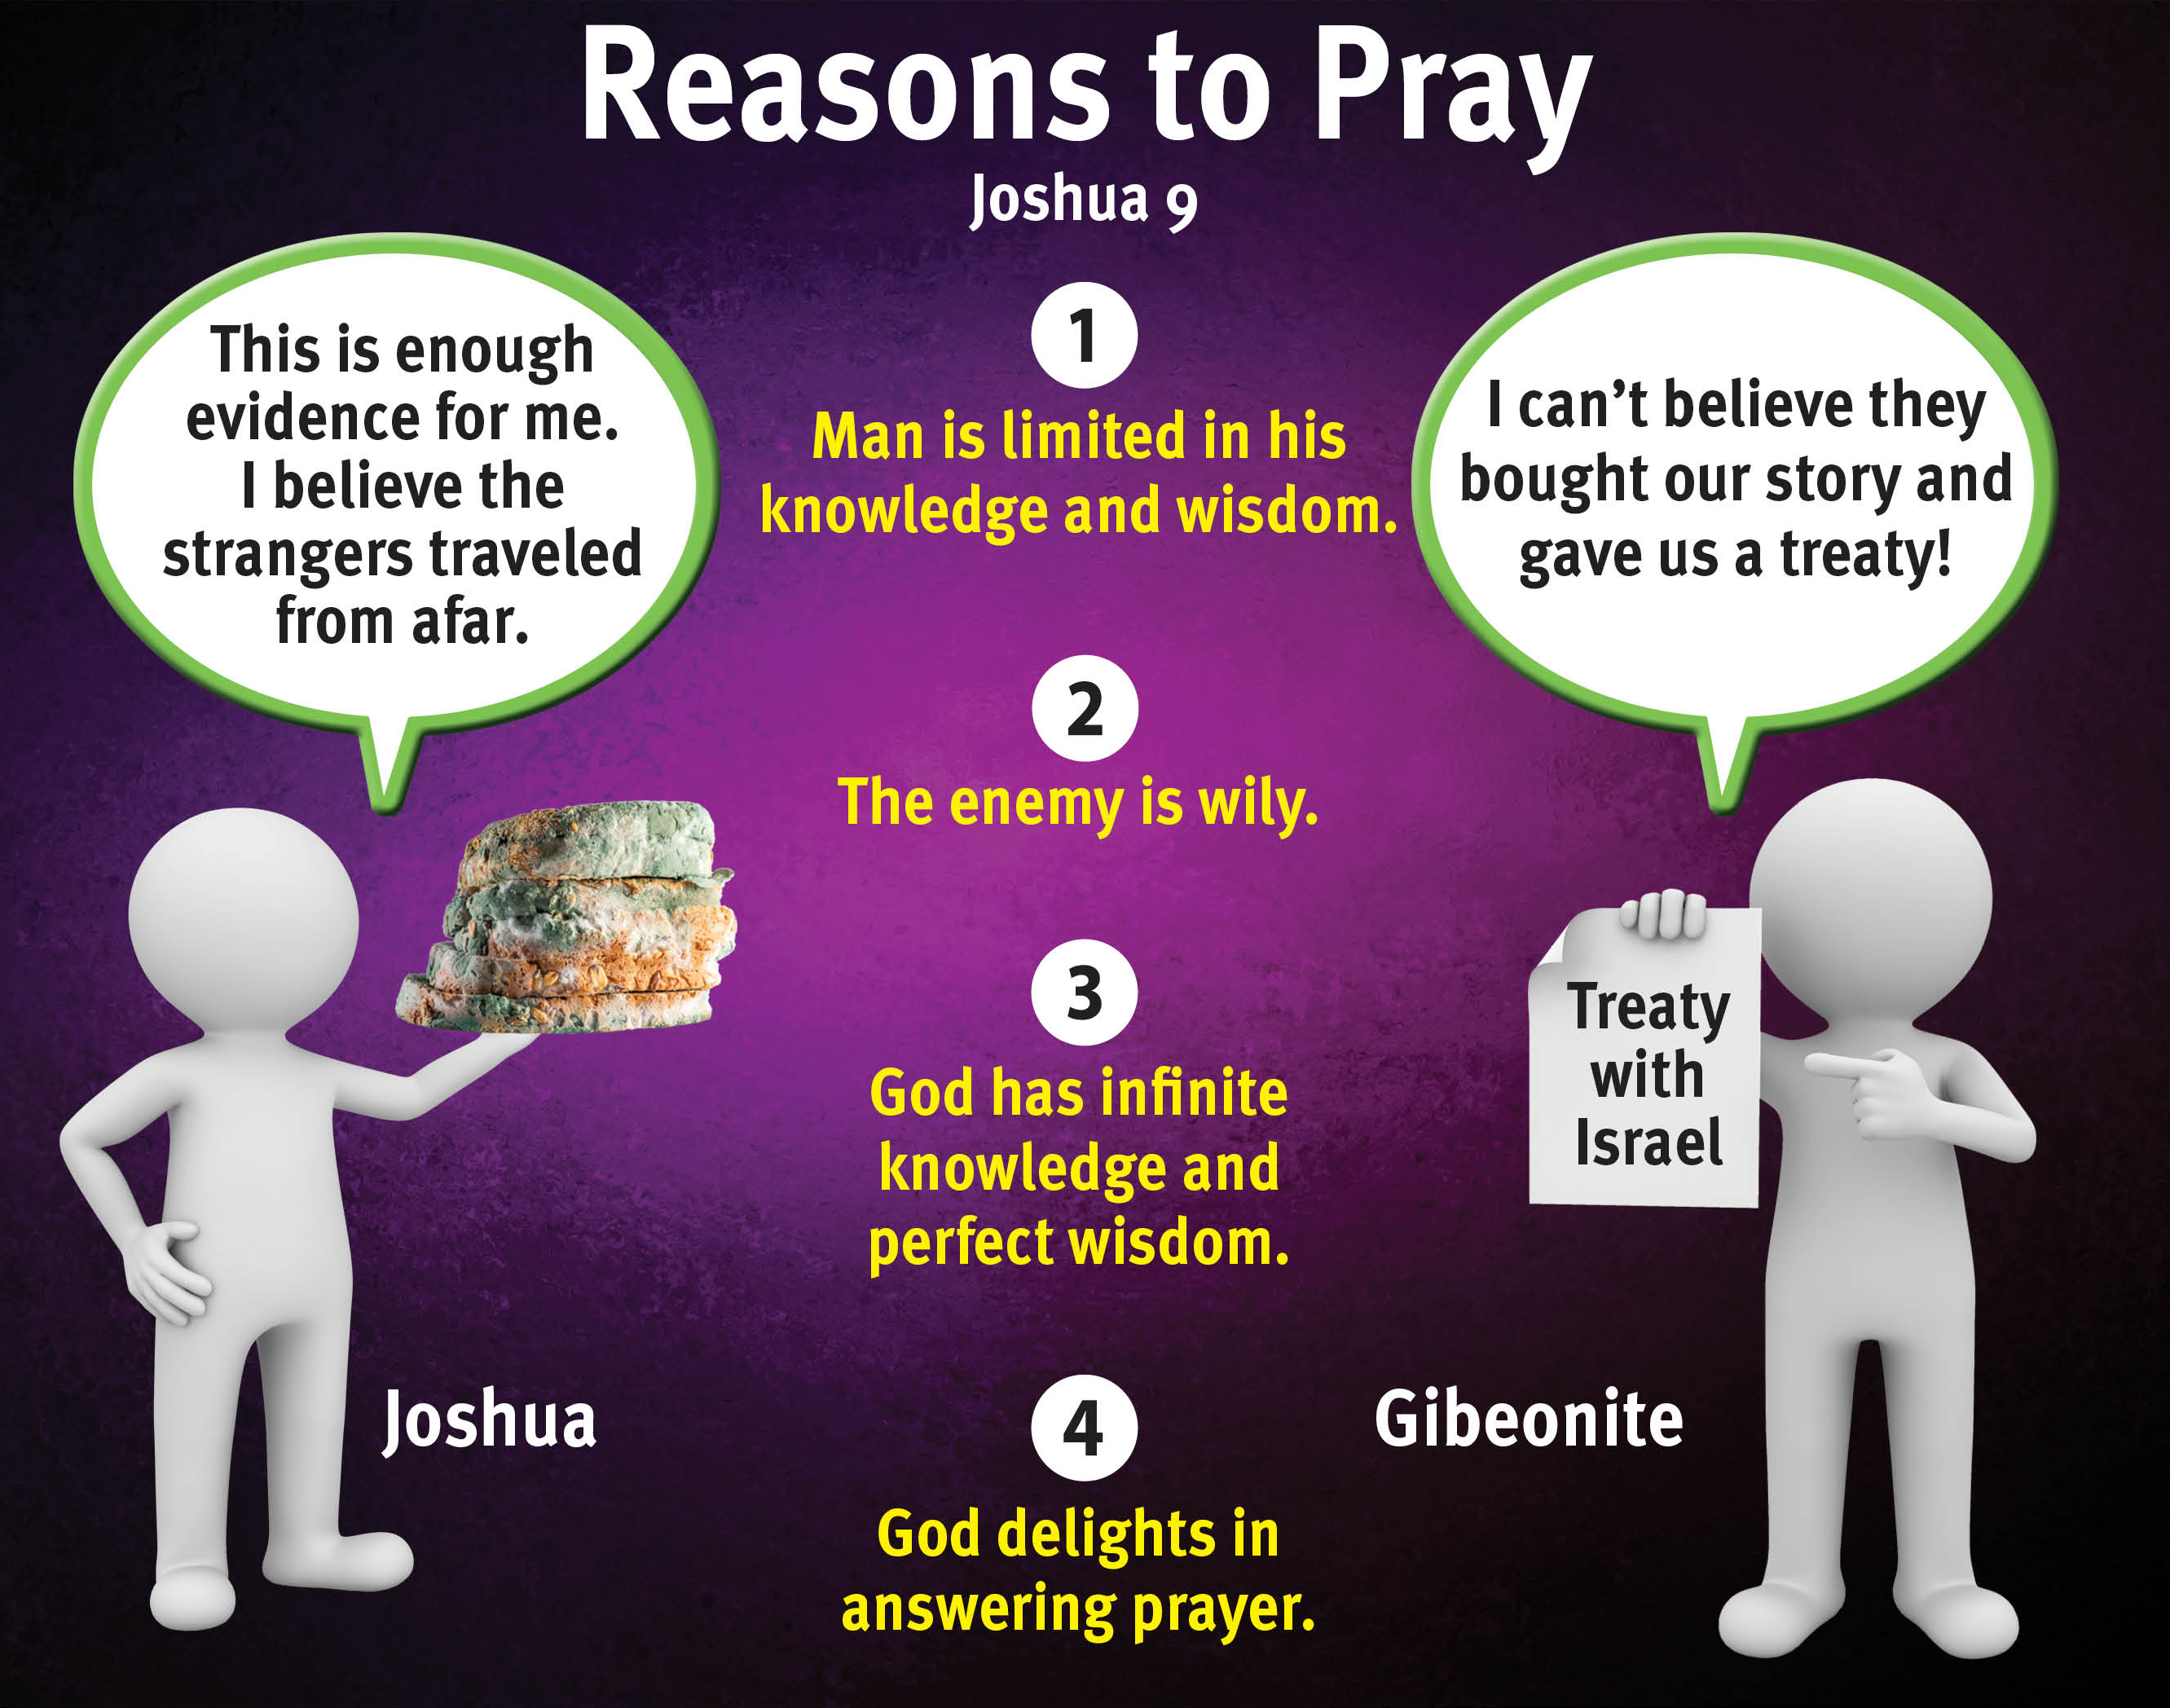

Slide 6
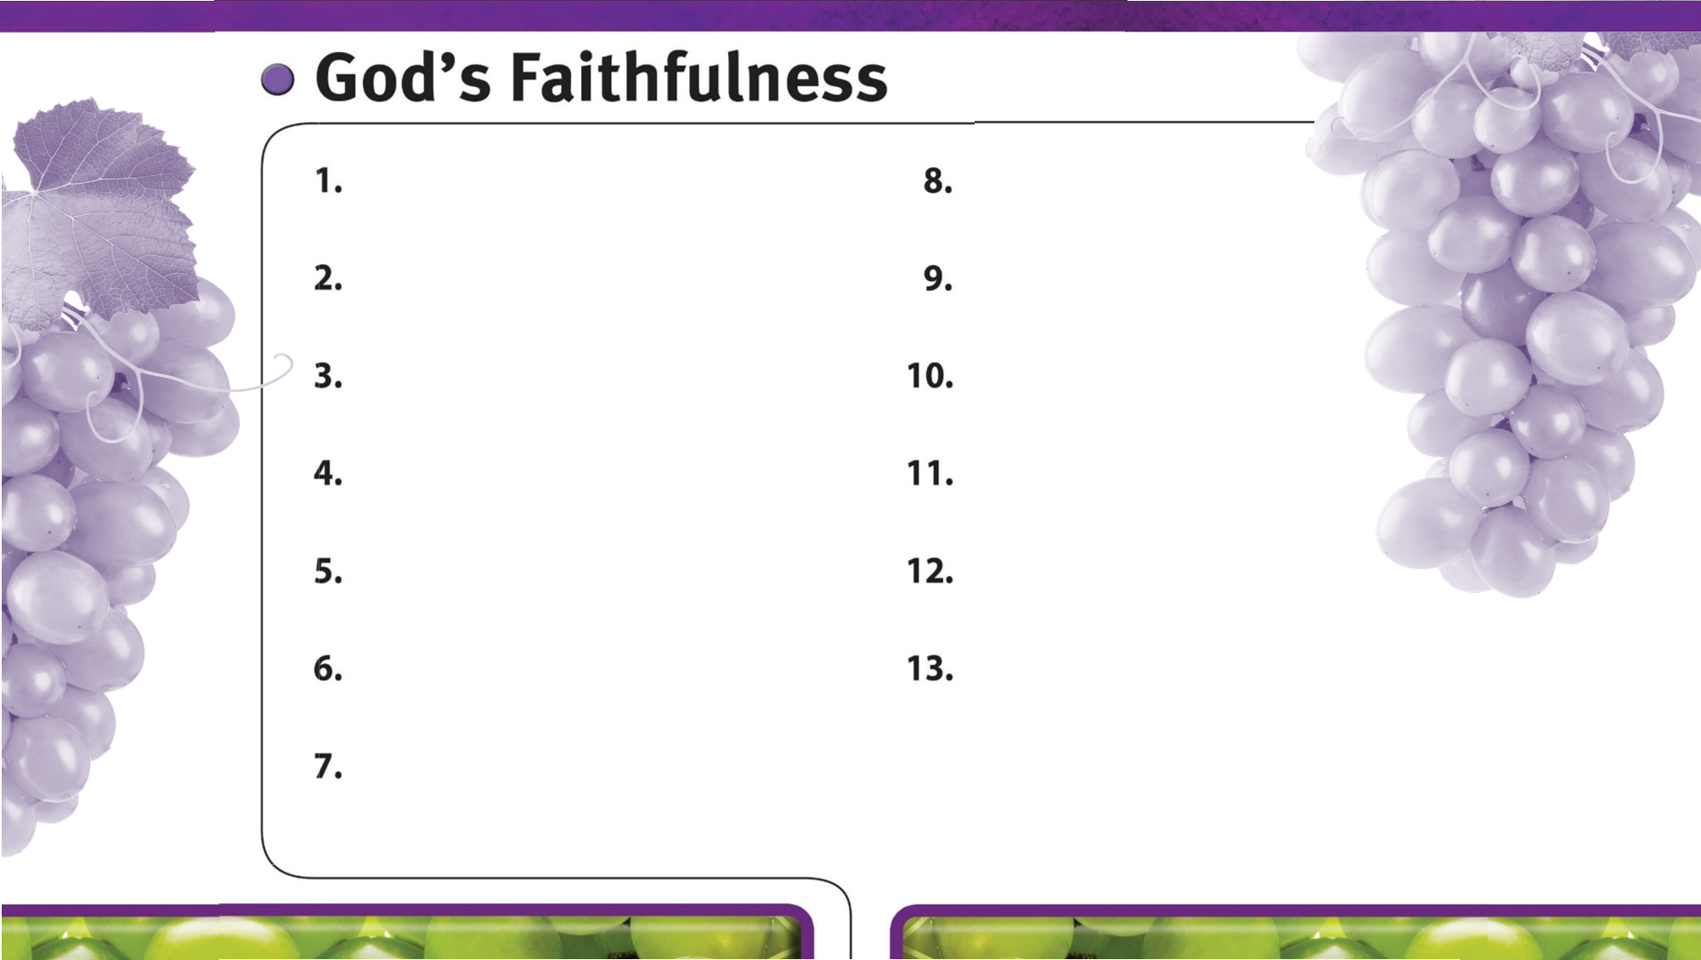
God is always faithful.
God faithfully gives wisdom to those who ask.
God faithfully provides strength and courage to do His will.
God’s faithfulness is worthy of glory.
God’s sovereign power encourages faith in Him.
God faithfully leads us by His grace.
God is faithful to His promises.
God is faithful to His warnings about sin.

