Slide 1


Slide 2
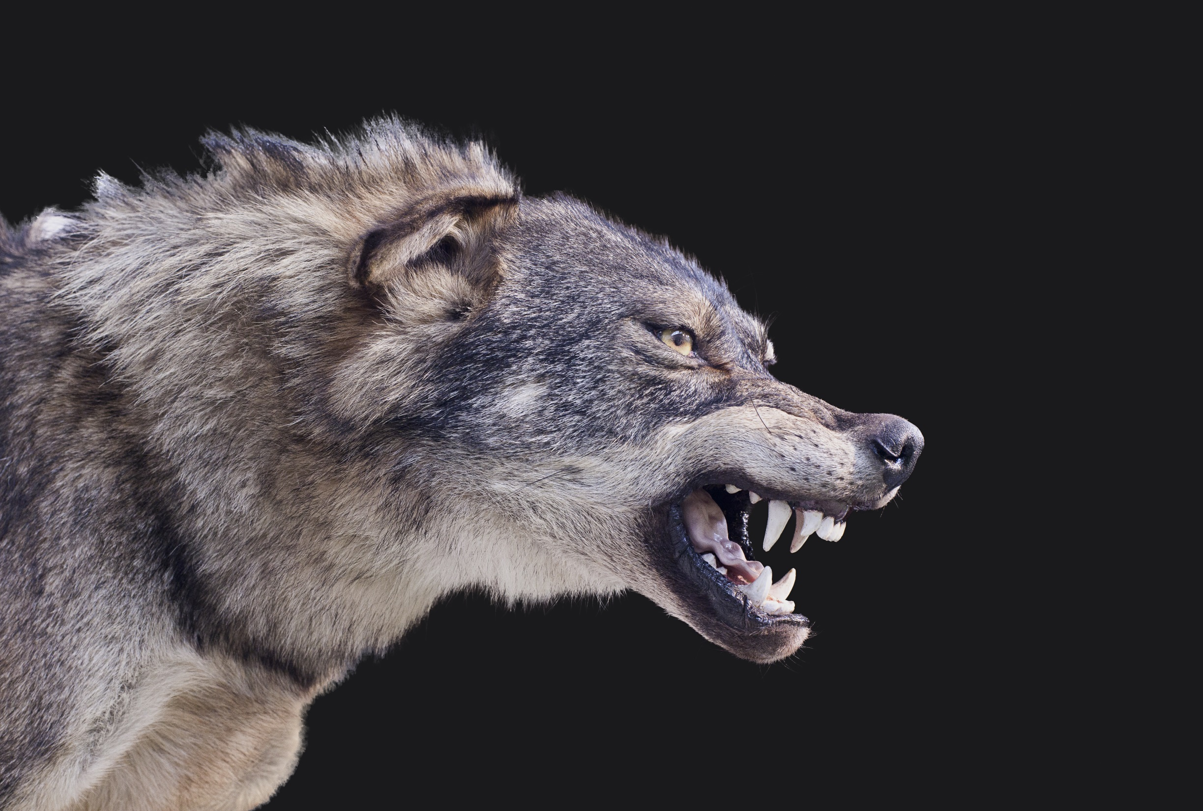

Slide 3
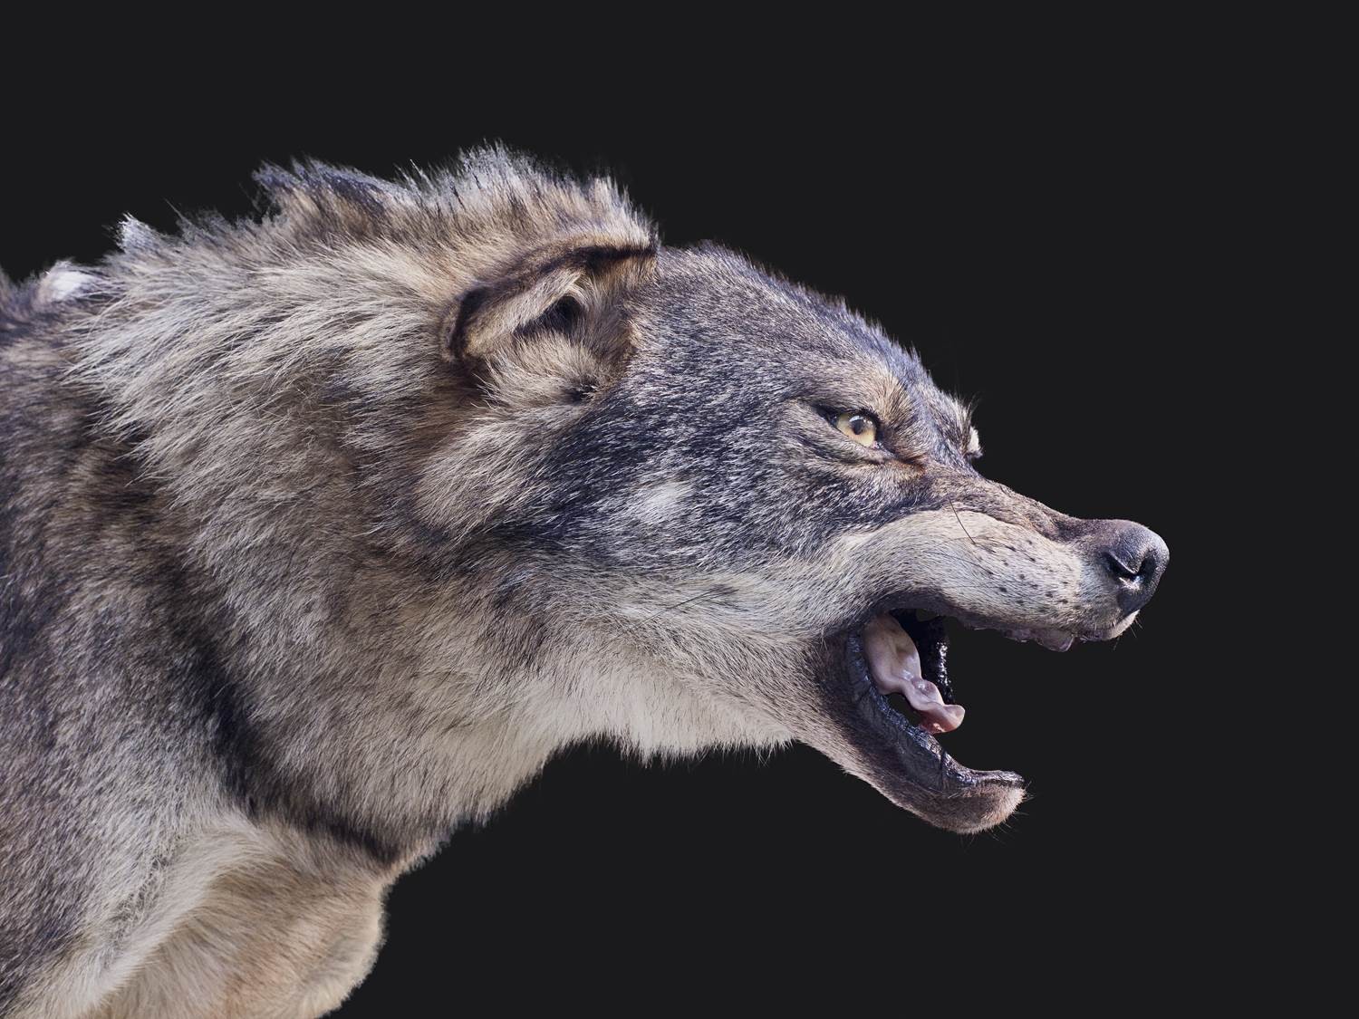

Slide 4
I. Achan Tested God’s Faithfulness (7:1)

Slide 5
II. Joshua Assumed Israel’s Faithfulness (7:2–4a)

Slide 6
III. God Demonstrated His Faithfulness (7:4b, 5)

Slide 7
IV. Joshua Questioned God’s Faithfulness (7:6–9)
A. Joshua’s first question (7:7a)
B. Joshua’s second question (7:7b)
C. Joshua’s third question (7:8)
D. Joshua’s fourth question (7:9)

Slide 8
V. God Exposed Achan’s Unfaithfulness (7:10–26)
A. God defended His actions (7:10–12)
B. God provided for Israel’s restoration (7:13–26)

Slide 9
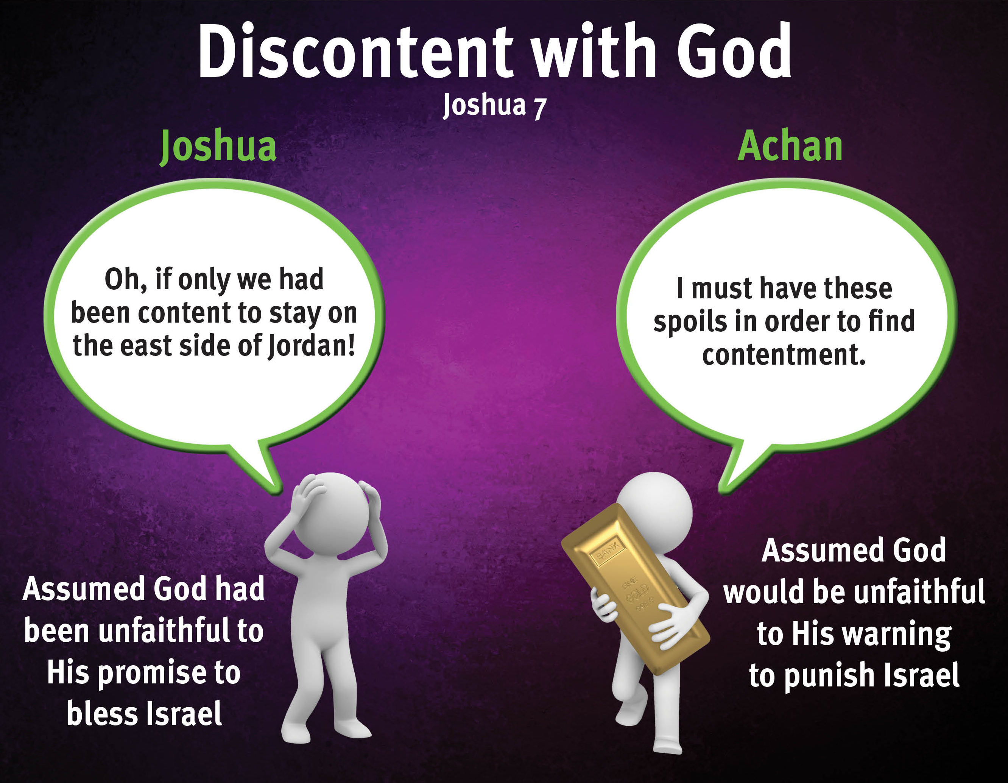

Slide 10

God is always faithful.
God faithfully provides strength and courage to do His will.
God’s faithfulness is worthy of glory.
God’s sovereign power encourages faith in Him.
God faithfully leads us by His grace.
God is faithful to His promises.
God is faithful to His warnings about sin.

