Slide 1


Slide 2
I. God Faithfully Encouraged Israel (5:13—6:5)
A. With His coming (5:13, 14)
B. With His command (5:15)
C. With His control (6:1, 2)
D. With His circling (6:3–5)

Slide 3
II. God Faithfully Delivered Israel (6:6–27)

Slide 4
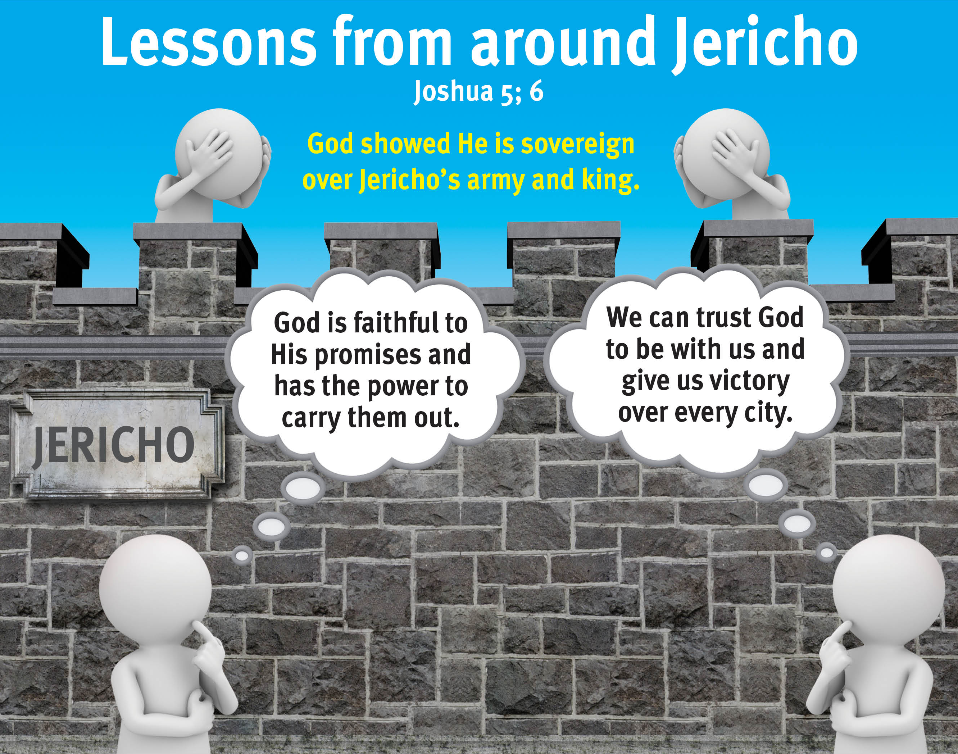
People of
Jericho
Israel

Slide 5
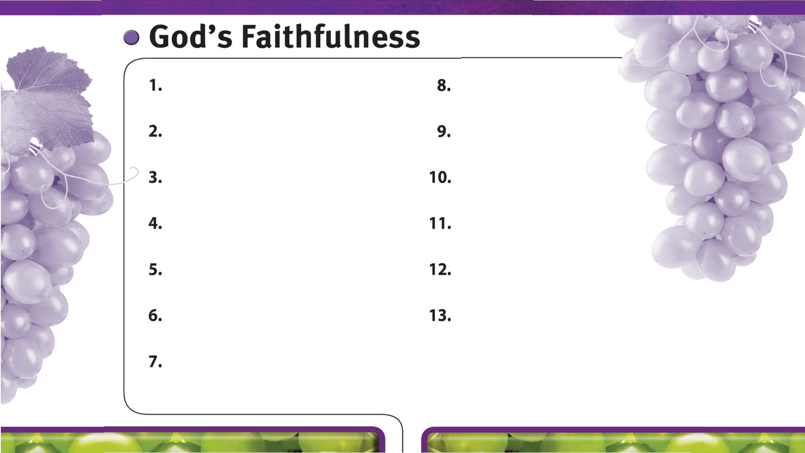
God is always faithful.
God faithfully provides strength and courage to do His will.
God’s faithfulness is worthy of glory.
God’s sovereign power encourages faith in Him.
God faithfully leads us by His grace.
God is faithful to His promises.

