Slide 1


Slide 2
I. Israel Set out after God (3)
A. Directions for the crossing (3:1–4)
B. Dedication before the crossing (3:5, 6)
C. Demonstrations at the crossing (3:7–17)

Slide 3
II. Israel Set up a Memorial to God (4:1—5:1)
A. Instructions for the memorial (4:1–5)
B. Importance of the memorial (4:6—5:1)

Slide 4
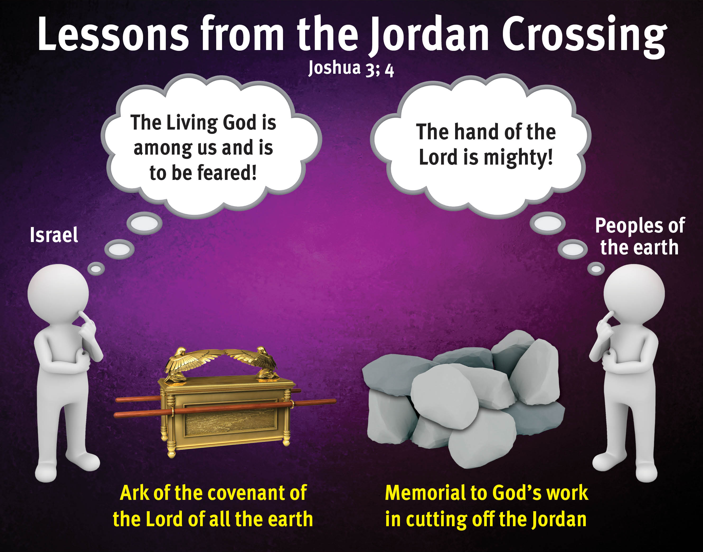

Slide 5
III. Israel Submitted to God (5:2–12)
A. Reinstitution of the sign of the covenant (5:2–9)
B. Renewal of the Passover celebration (5:10)
C. Realization of the blessings of Canaan (5:11, 12)

Slide 6
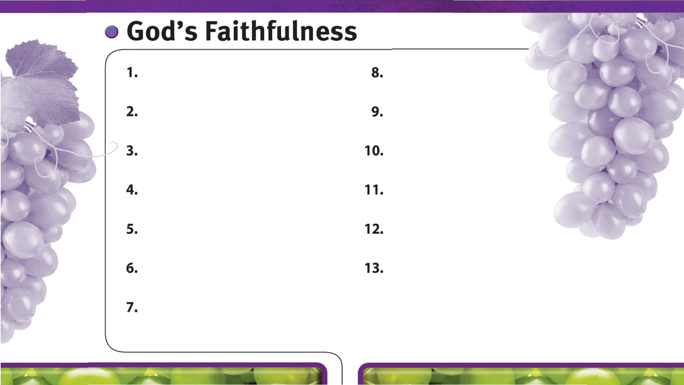
God is always faithful.
God faithfully provides strength and courage to do His will.
God’s faithfulness is worthy of glory.
God’s sovereign power encourages faith in Him.
God faithfully leads us by His grace.

