Slide 1


Slide 2
I. Jericho Responded to God with Fear (2:1–11)
A. Jericho’s weakness (2:1–7)
B. Jericho’s cowardice (2:8–11)

Slide 3
II. Rahab Responded to God with Faith (2:12–21)
A. Rahab’s request (2:12–14)
B. Rahab’s test (2:15–21)

Slide 4
III. The Spies Responded to God with Confidence (2:22–24)
A. The spies’ account (2:22, 23)
B. The spies’ certainty (2:24)

Slide 5
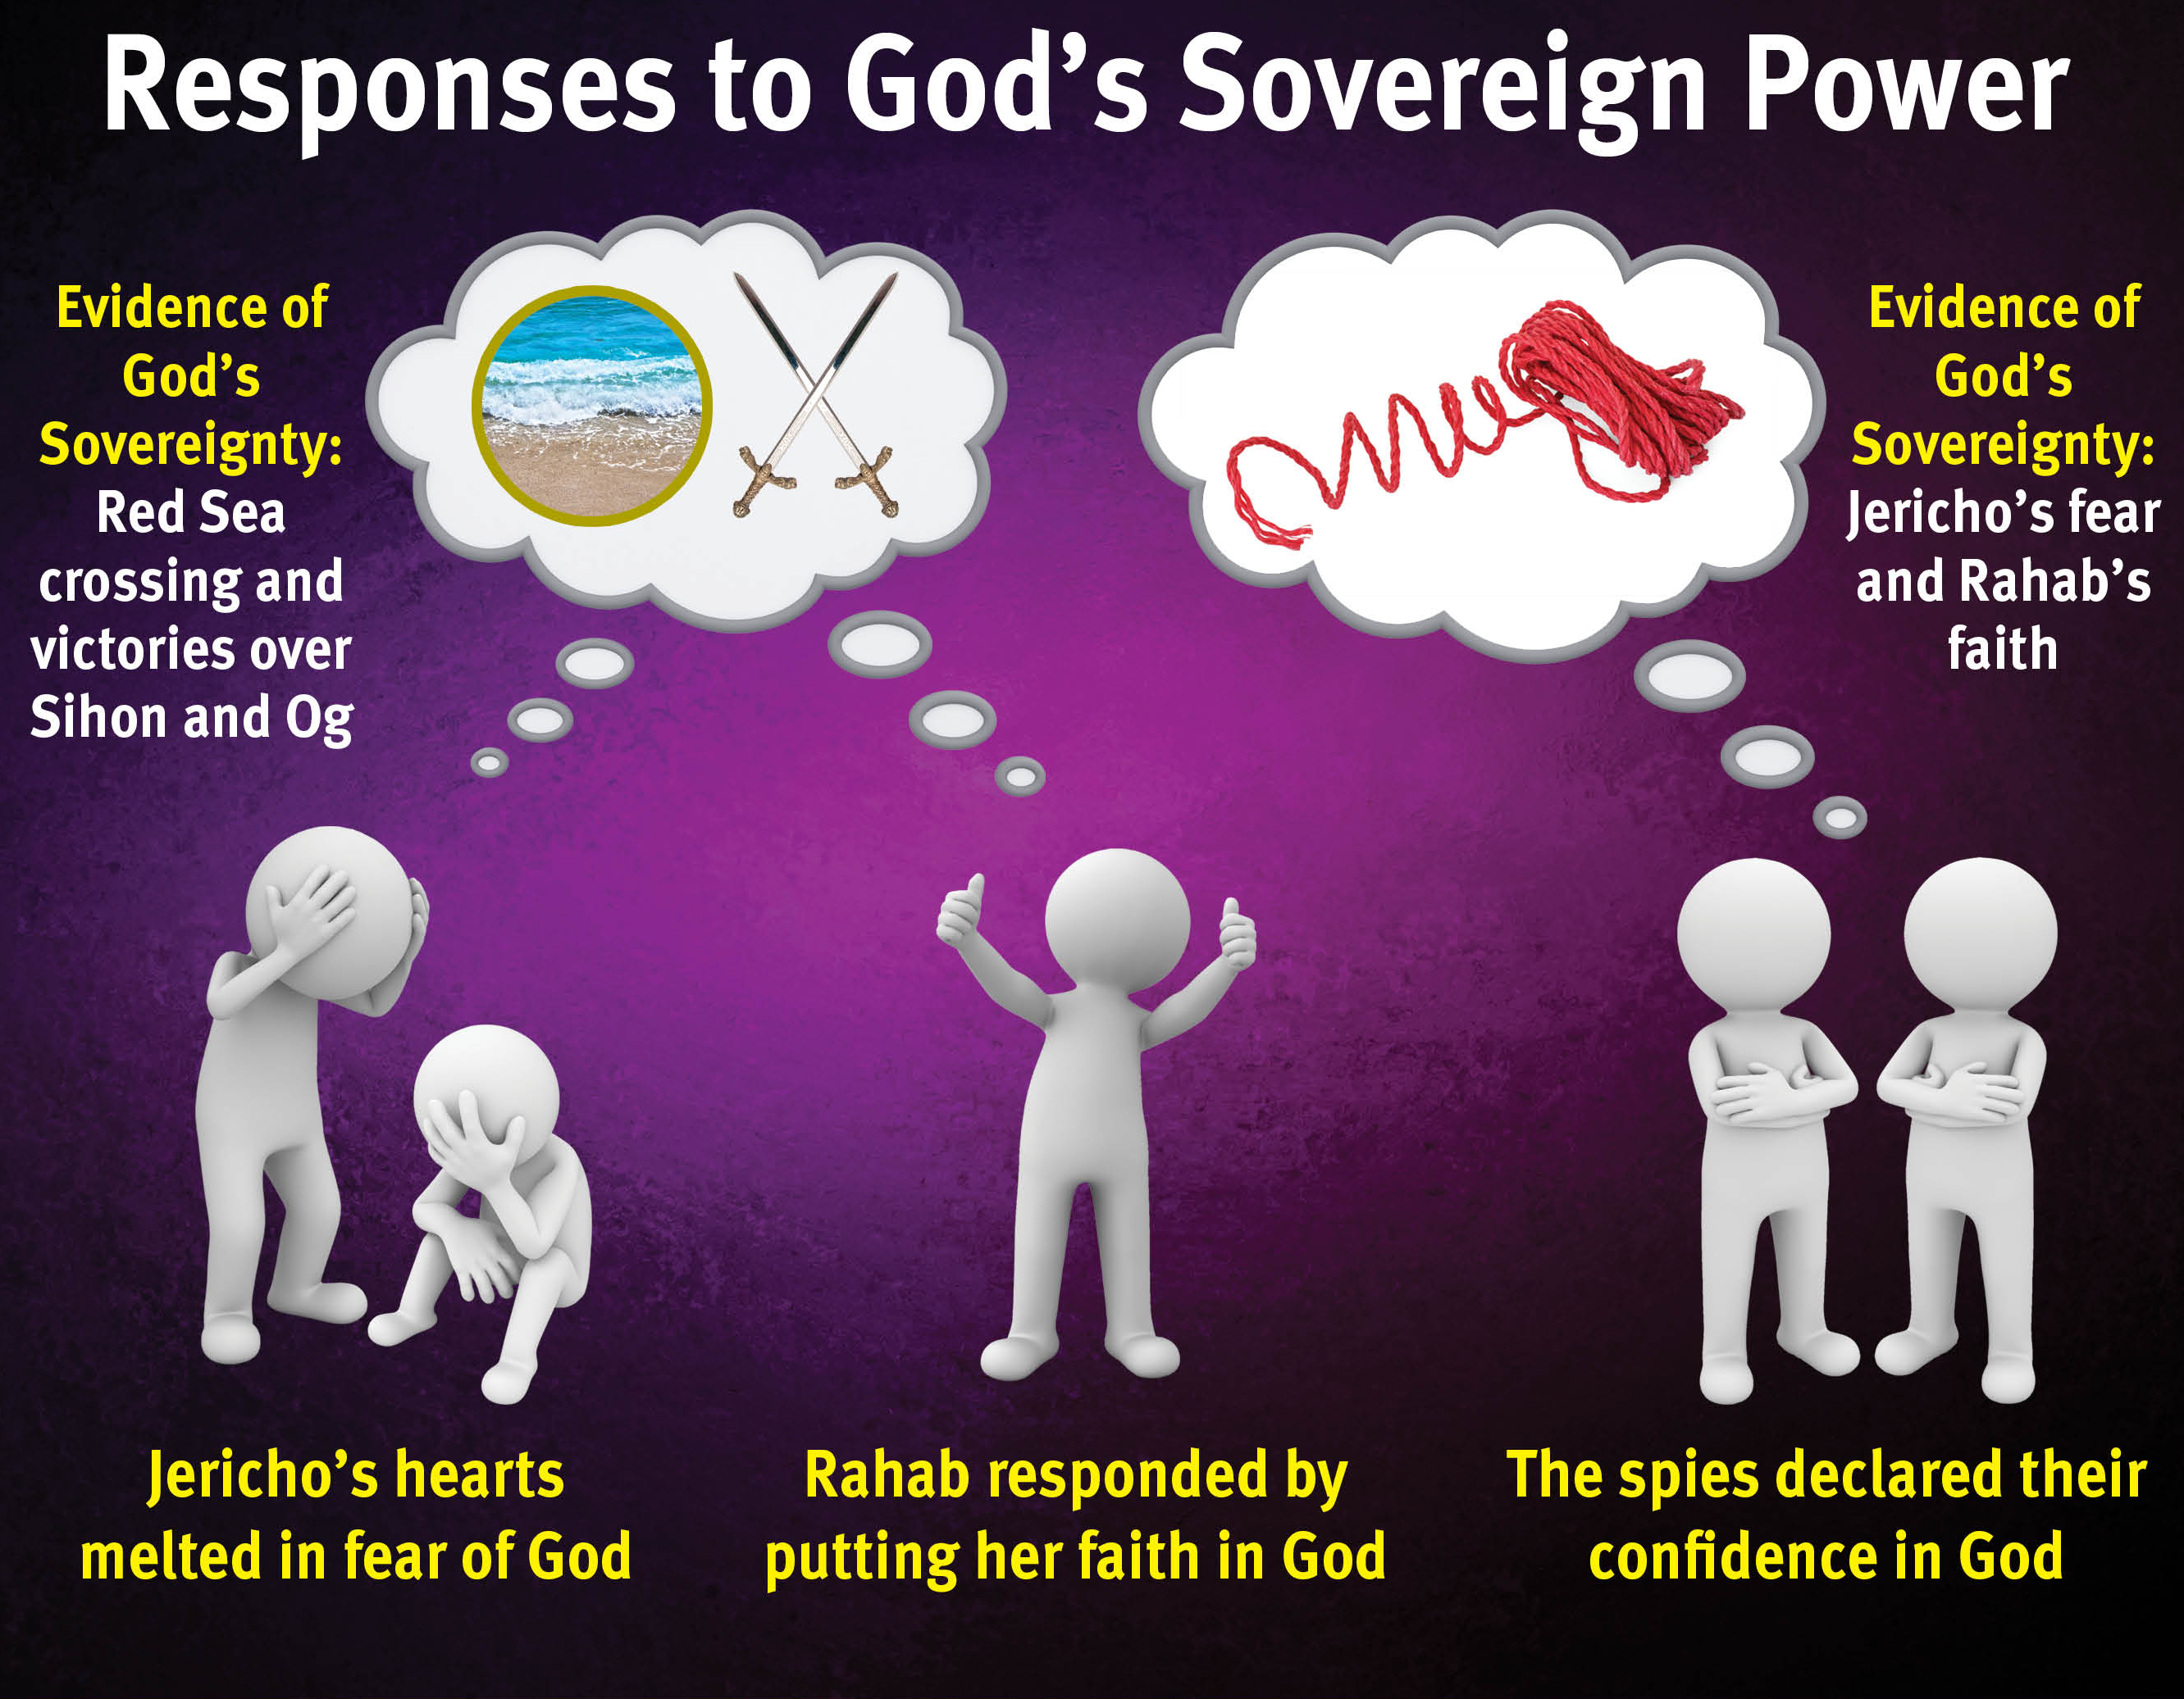

Slide 6
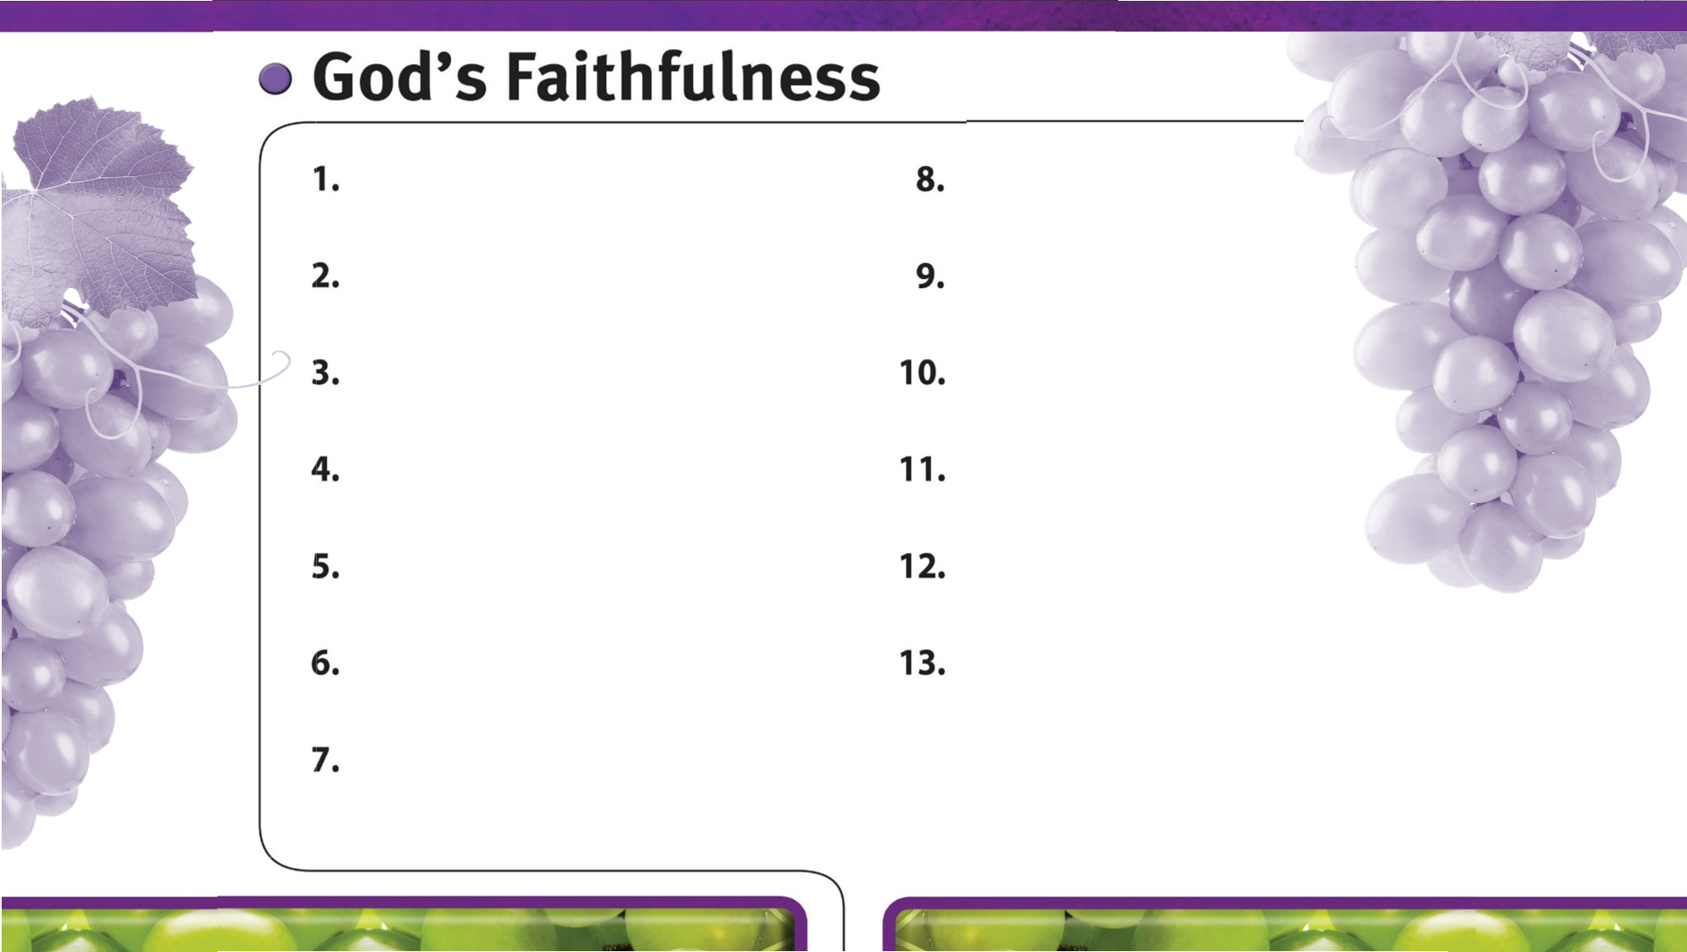
God is always faithful.
God faithfully provides strength and courage to do His will.
God’s faithfulness is worthy of glory.
God’s sovereign power encourages faith in Him.

