Slide 1


Slide 2
I. God’s Grace in Gifting the Land (1:1–4)
A. God’s new leader (1:1, 2a)
B. God’s gracious gift (1:2b–4)

Slide 3
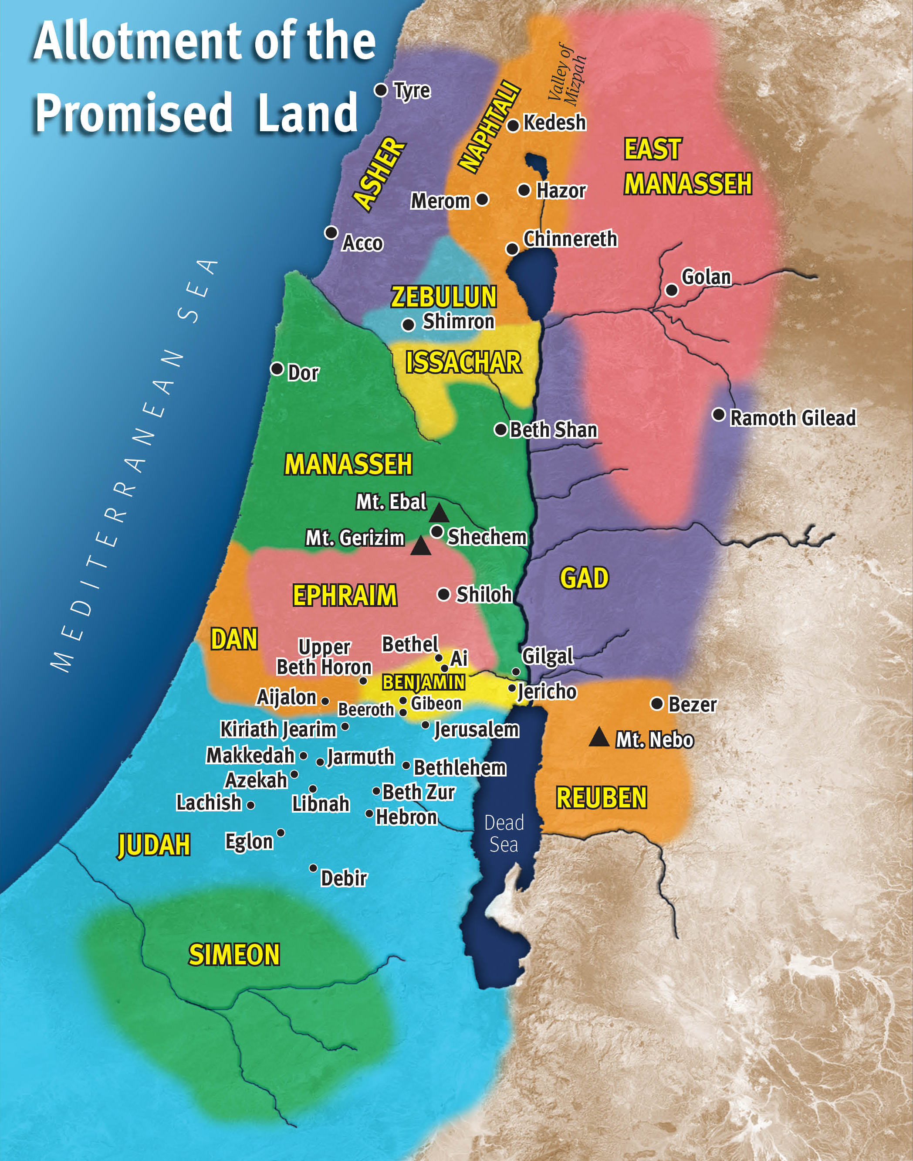
Jordan
River
The land east of the Jordan was not technically part of the Promised Land.

Slide 4
II. God’s Enablement for Taking the Land (1:5, 6)
A. God promised His presence (1:5)
B. God supplied strength and courage (1:6)

Slide 5
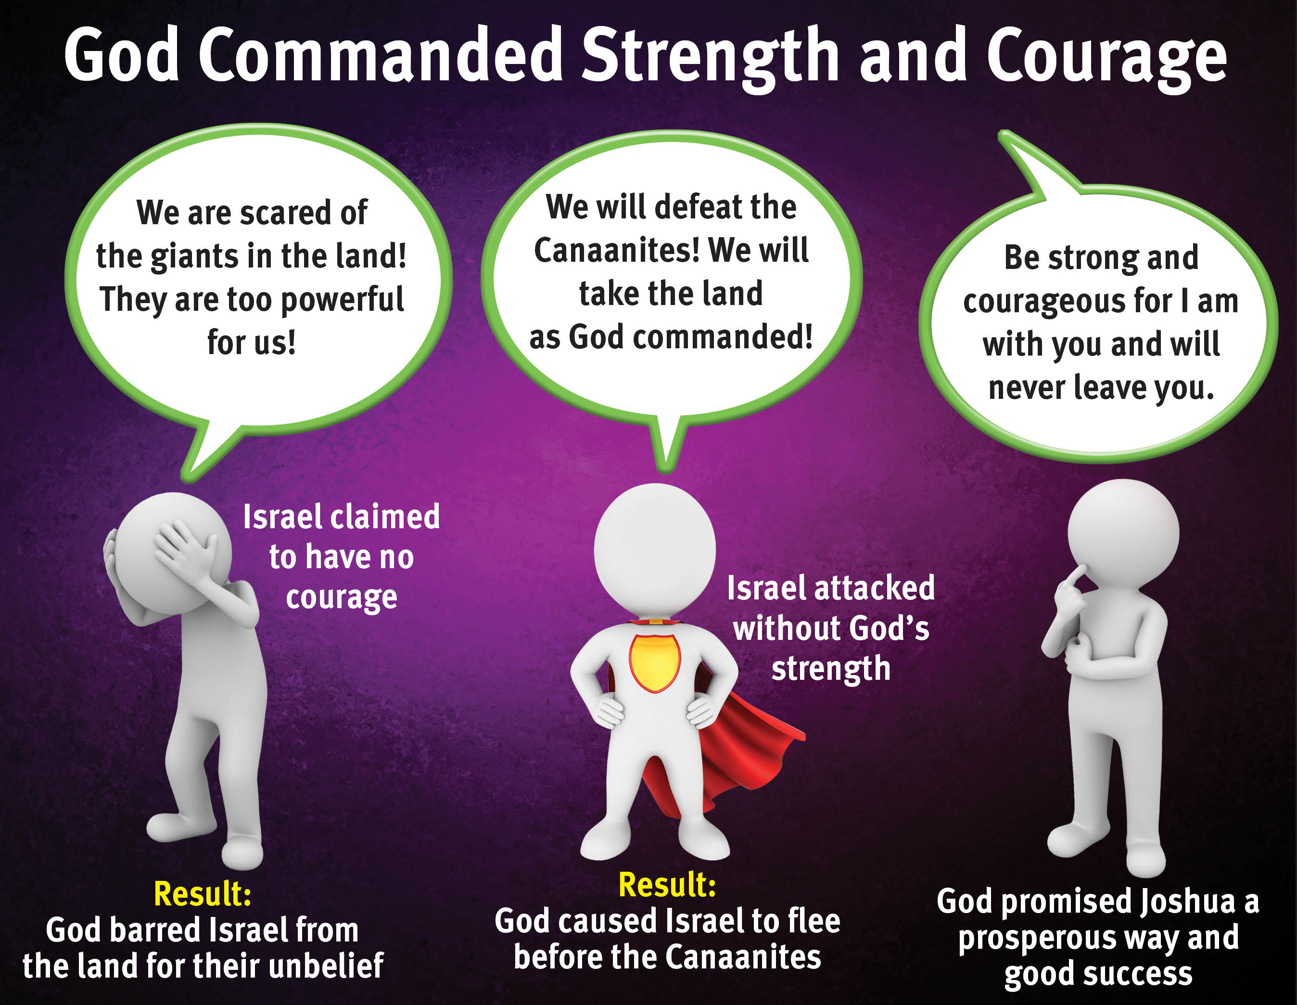

Slide 6
III. God’s Directives for Living in the Land (1:7–9)
A. God’s law gave direction (1:7)
B. God’s law required meditation (1:8, 9)

Slide 7
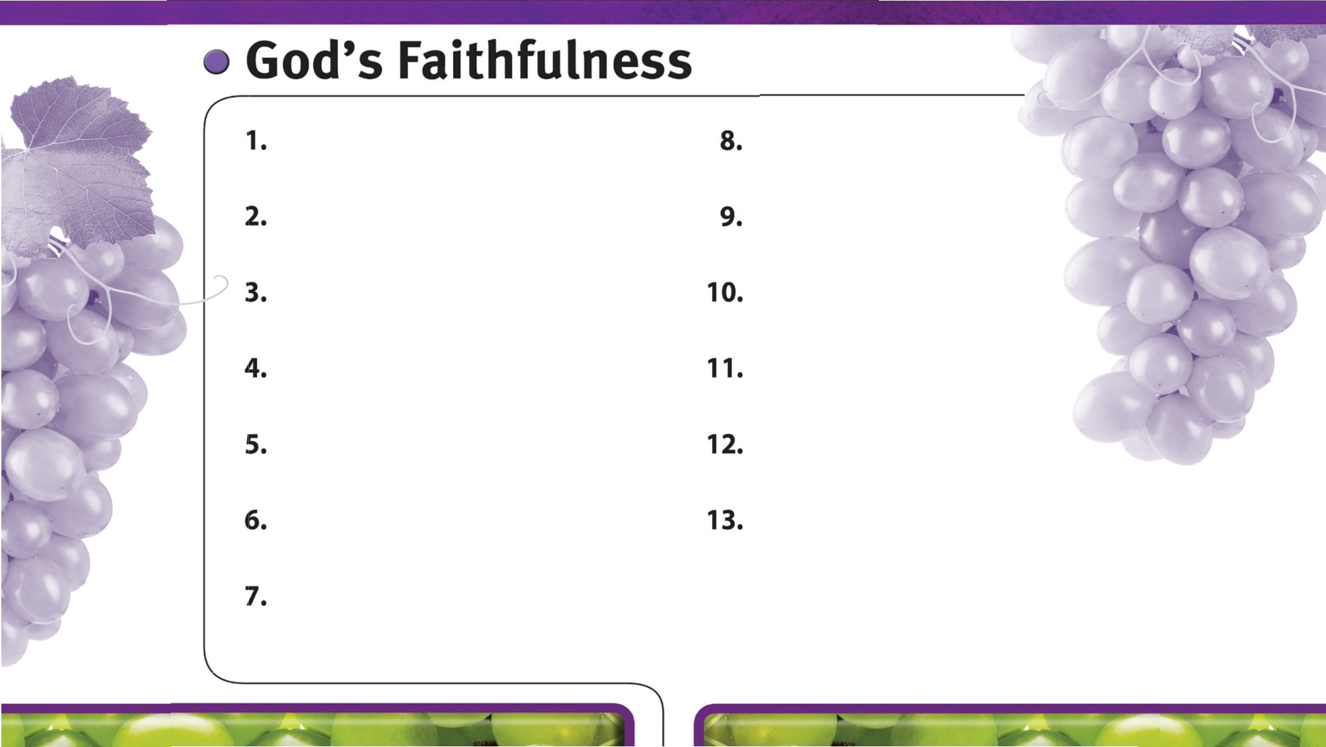
God is always faithful.
God faithfully provides strength and courage to do His will.

