Slide 1


Slide 2
I. God’s Plan for the Nation (1:10–15)
A. God gave individual responsibilities (1:10, 11)
B. God gave individual rest (1:12–14a)
C. God gave national responsibilities (1:14b)
D. God promised national rest (1:15)

Slide 3
II. Israel’s Pledge to God (1:16–18)
A. The tribes made a promise to obey (1:16, 17a)
B. The tribes said a prayer for Joshua (1:17b)
C. The tribes rehearsed the penalty for rebellion (1:18a)
D. The tribes made a plea to their leader (1:18b)

Slide 4
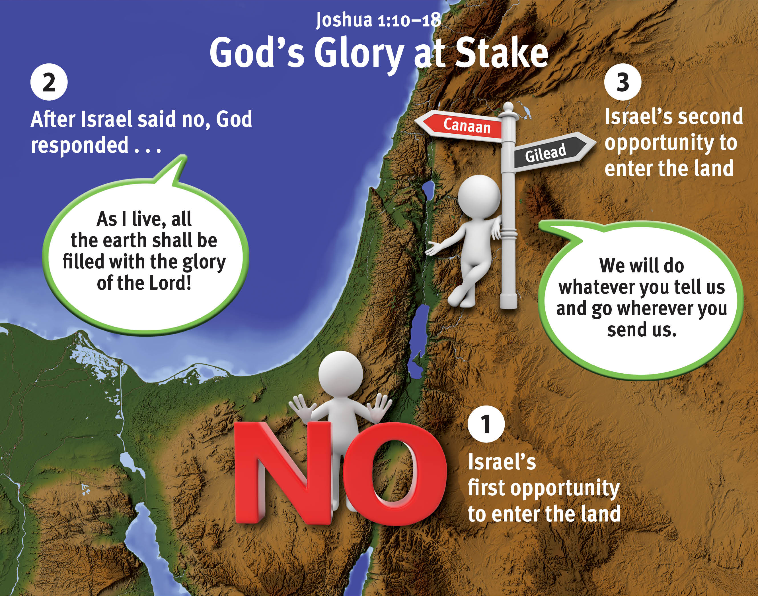

Slide 5
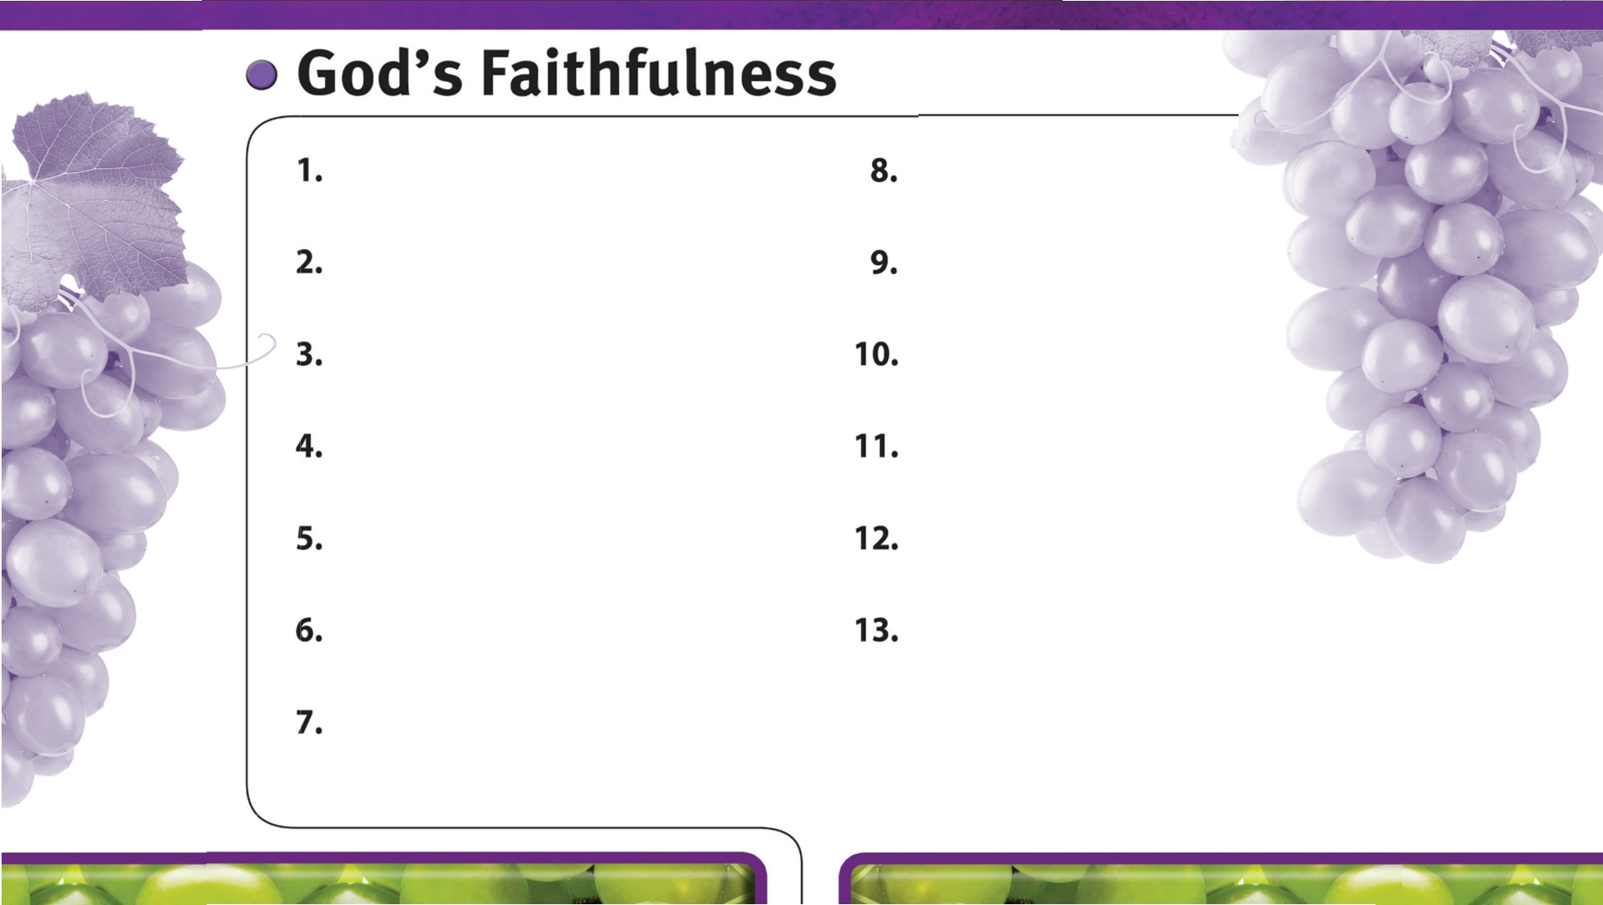
God is always faithful.
God faithfully provides strength and courage to do His will.
God’s faithfulness is worthy of glory.

