Slide 1


Slide 2
I. Purposes
A. Historical
B. Theological
1. Backdrop of God’s self-revelation
2. Story of God’s continued self-revelation

Slide 3
II. Practical Application

Slide 4
III. Perceived Problem
A. Defining the problem
B. Resolving the problem
1. Promise to Israel
2. Punishment of the Canaanites
3. Prevention of idolatry

Slide 5
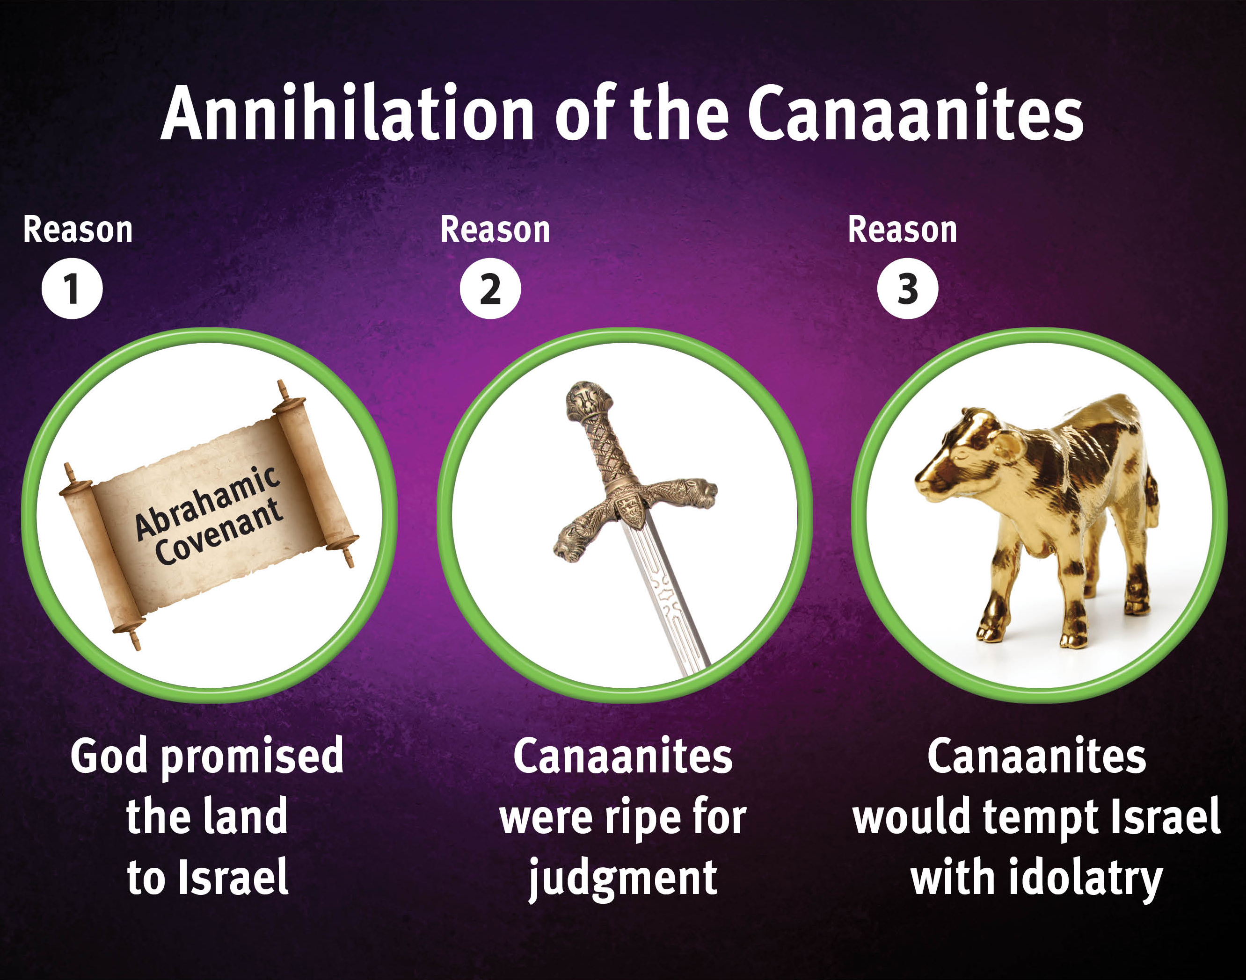

Slide 6
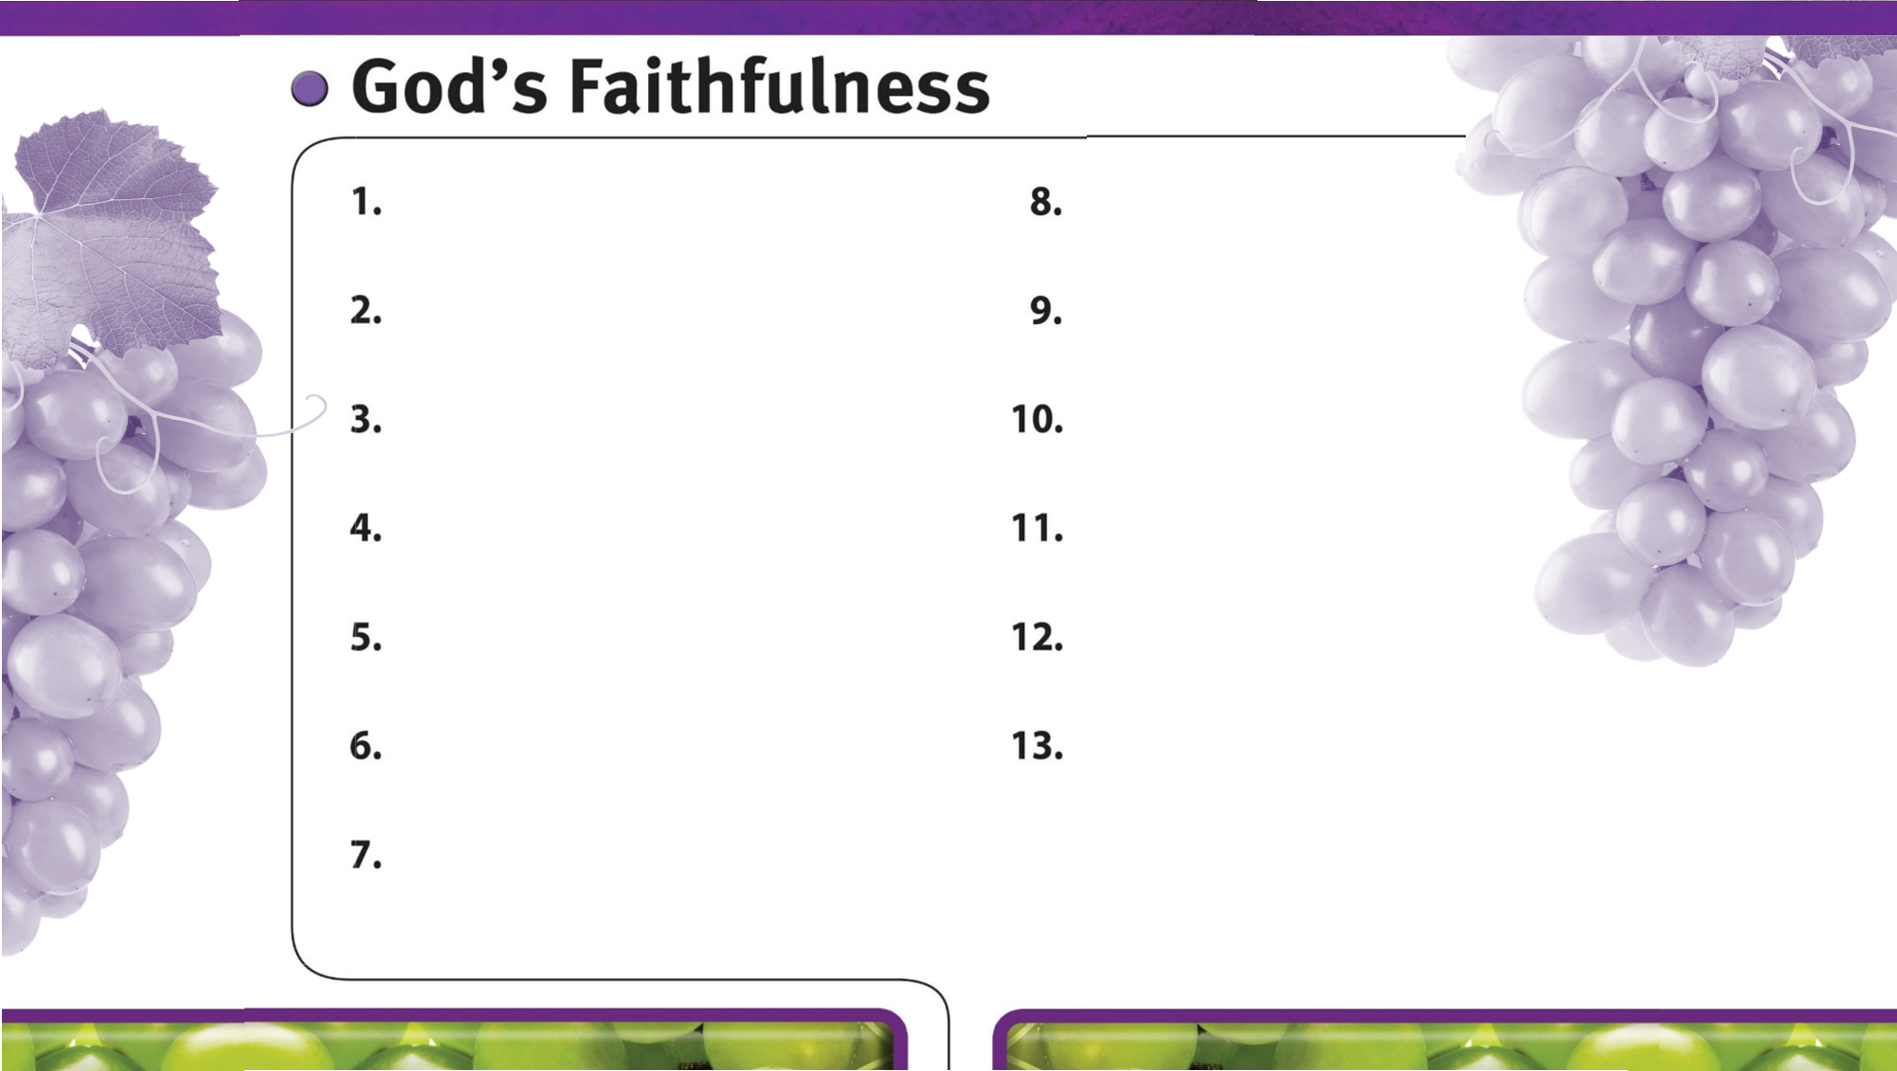
God is always faithful.

