Slide 1

Love boldly and risk greatly:
Faithful responses to the current
immigration realities in the U.S
Baltimore-Washington Annual Conference 2026
Rev. Cassy Núñez
Rev. Carlos Reyes Rodríguez

Slide 2
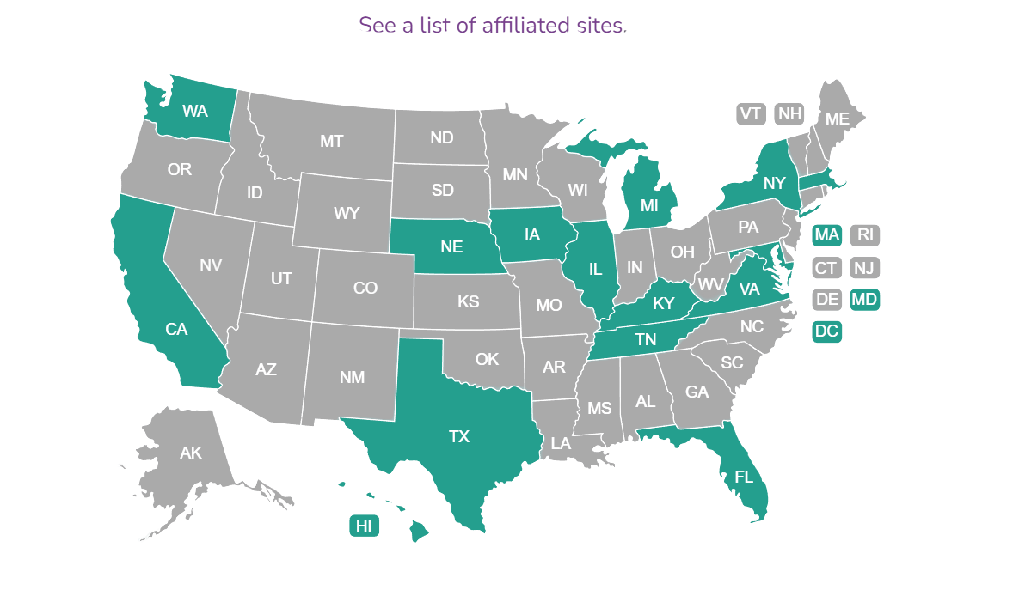


Slide 3
In 2025 We Served
Immigrants, Refugees, and Asylum Seekers from 129 Countries
TOP 20 COUNTRIES OF ORIGIN
  Mexico
  Honduras
  Guatemala
  El Salvador
  Afghanistan
  Venezuela
  Ukraine
  Colombia
  Cuba
  Nicaragua
  11. Congo (DRC)
  12. Haiti
  13. Peru
  14. Ecuador
  15. Dominican Republic
  16. Philippines
  17. Myanmar
  18. Jamaica
  19. Thailand
  20. Ethiopia

Slide 4
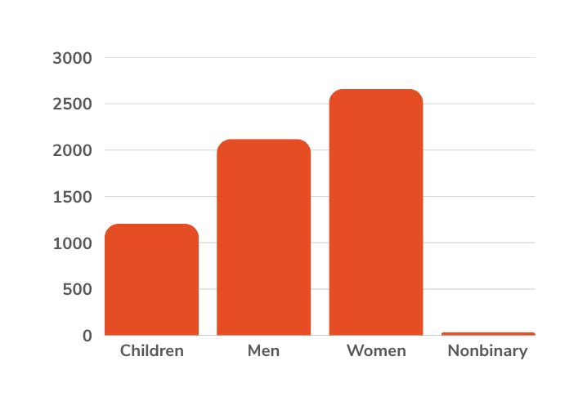
WHO WE SERVE
CLIENT NUMBERS
18,914 Total Cases
4,056
6,292
Work Authorization
Escaping Violence
3,479
4,454
Family Reunification
Advice & Counsel
633
Citizenship

Slide 5
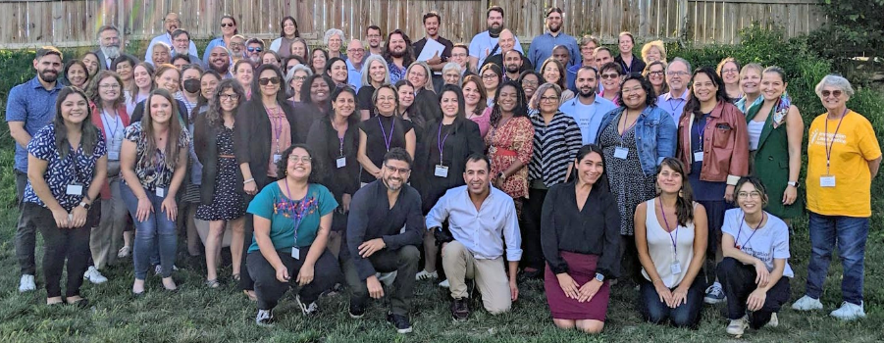
Our Mission:
We welcome immigrants by providing low-cost or free, high-quality immigration legal services, engaging in advocacy for immigrants' rights, and offering education to communities of faith and the public.

Slide 6
Before we
start
  We are not a lawyers and will not give any legal advice
  Be aware of your emotional state
  If sensitivities get hurt, pause and think why
  Give this space a chance to challenge you
  no time for debates
  We are here to learn and organize
  with the immigrant community

Slide 7
Pop-up questions:
    How do you think that the immigrant community perceives you/your church?
    What are the main concerns of your community? What are you witnessing?

Slide 8
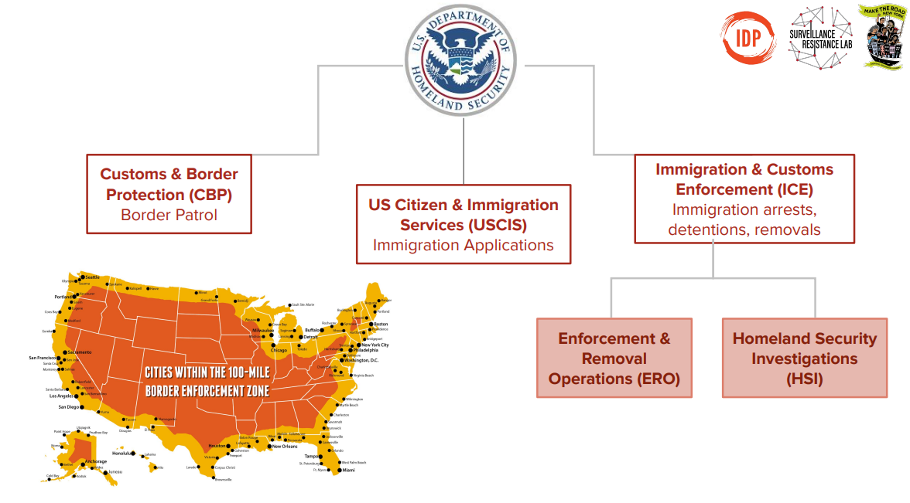

Slide 9
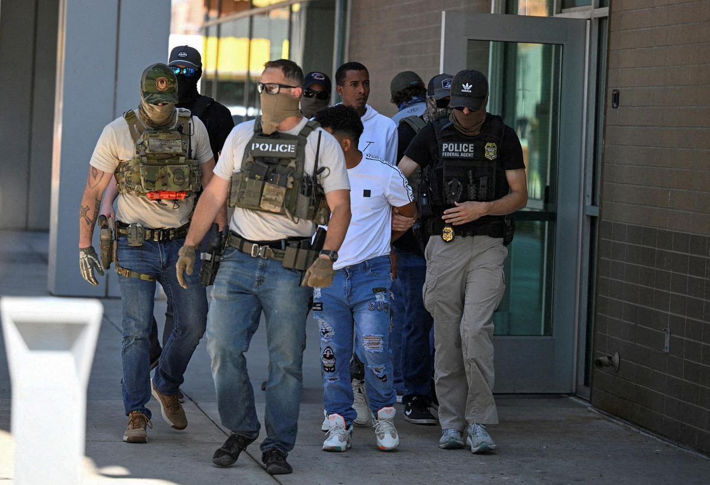
mechanisms they are using to deliver Trump’s promises
  Abuse of Law Enforcement
    Cross-agency collaboration
    Proliferation of 287(g) Agreements (ICE+PD)
  Violating due process and constitutional rights
    Dismissing court cases
    Expedited Removal: ICE deporting without court process
    Sensitive Locations
  Revoking/eliminating humanitarian programs
    2 million people from Biden’s administration
      CBP One
      TPS
      Unaccompanied Children
      Dismantling Asylum: 115K>5K Asylum seekers and refugees

Slide 10
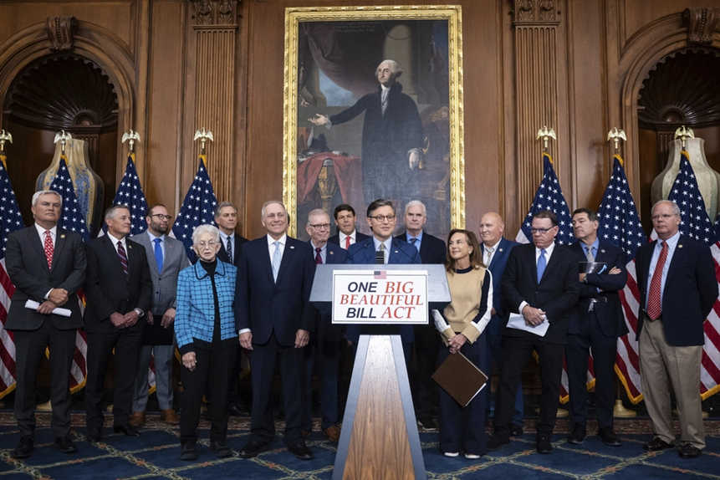
mechanisms they are using to deliver Trump’s promises
  Budget cuts for the federal aid and budget surplus for the criminalization of immigrants.
    Firing of immigration judges
    Dismantling the Rep. DOJ credential program
    OBB - A total of $165 billion ($17.1B in 2024)
      Recruitment of ICE and CBP Agents
      The wall
      Family detention/separation
      Transportation and deportation.
  Challenging birthright citizenship for kids coming from mixed-status immigrant families.
  Reevaluating and revoking naturalization and green card residency processes.
  Fees for immigration applications at USCIS:
    Asylum: $100 + $100 per year pending
    Humanitarian Program Parole: between $0 and $550 to $1,070
    TPS: from $50 to $530
    Status Adjustment: $1,400 to $2,940

Slide 11
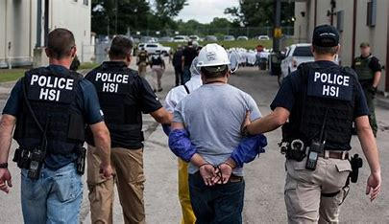
Mass raids, expanded detention & Deportations
  Raids: ICE arrests multiple people at their homes, on the streets, in a public place, or at a workplace. Collateral arrests.
  13 million undocumented immigrants.
    70% living in the US for more than a decade.
    50% living for two decades in the US
  Initial quota of 1,200 arrests a day. Now, 3,000.
    OBB/HR1;
      2024: 40,000
      2025: 60,000
      Up to date: 68,000
      Their goal: 105,000 beds
      70% of detainees don’t have criminal records
      32 people died under ICE custody in 2025
  780 incidents of ICE agents using physical force
  17 people have died so far in 2026
  GOAL: ONE MILLION DEPORTEES A YEAR

Slide 12
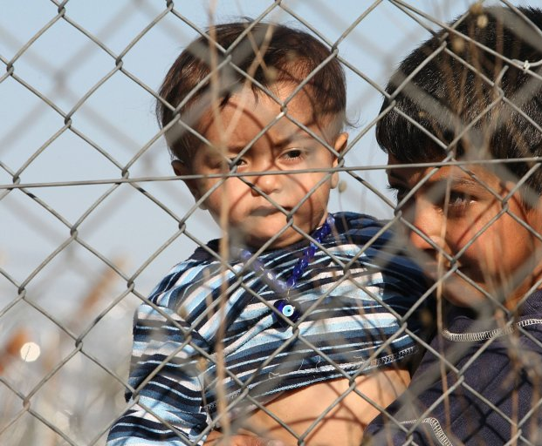


Slide 13
Biblical Characteristics of an Ally
    Shiphrah & Puah - Exodus 1:15-22
    King of Egypt
      “If the baby is a boy, kill him”
  “The midwives, however, feared God and did not do what the king of Egypt had told them to do; they let the boys live”
  “Hebrew women are not like Egyptian women; they are vigorous and give birth before the midwives arrive”

Slide 14
who is an Ally?
    Aware of sociopolitical environment
    “Fear” of God’s Spirit
    Love
    Knowledge and experience
    Strategic
    “Hebrew women are not like Egyptian women; they are vigorous and give birth before the midwives arrive”
  Courage
    Sacrificial/Risky
      Status quo
      Close circles

Slide 15
UMC Approach
    Christian Tradition: Christian witness of civil disobedience to provide a safe place for sojourners and the persecuted.
      0-300 CE
      1800s Underground Railroad
      1980s Safe Sanctuary movement

Slide 16
How is the church responding?
  Rethinking church spaces and reassigning them as restricted areas
    Sanctuary v. Pastor’s Office
    Locked doors v. Unlocked
  Safety protocols
    Assessment of citizenship privileges and designate specific people to engage with ICE officers.
    Training on 1st, 4th, and 5th Amendments of the US Constitution.
    Safety team before, during, and after worship service or church events.
  Plugging in to already established Rapid Response orgs. in your area.

Slide 17
How is the church responding?
  Primary Response/Care Bear
  Supportive Response
  Advocacy Response
  Rescuing the babies thrown in the river
  and/or tackling the cause that throws babies to the river

Slide 18
How is the church responding?
  Primary Response/Care Bear
    Groceries
    Transportation
    Car repairs
    Safety & Rapid Response Teams
    Create Healing Spaces providing mental health services
    Crowd Sourcing for Legal representation

Slide 19
How is the church responding?
  Supportive response
    Safety planning
    Power of attorney
    Provide messages of welcome and support. Make them visible!
    Attending court appointments if they choose to go
    Crowd Sourcing for Legal representation

Slide 20
How is the church responding?
  Advocacy Response
    Campaigns
    Show up at organizing spaces. It’s time to participate!
    Attend rallies, marches, and protests!
    Draft letters to the editor and position statements
    Donate to immigration non-profits and grassroots organizers
    Crowd Sourcing for legal representation

Slide 21
How is the church responding?
  Changing the narrative
    Consistent teachings on Christian Theology and Praxis
    Curriculum that supports advocacy and civil disobedience as an expression of our faith in Christ.
      Bible studies and sermons
      Mobilizing the church to support community organizers and organizations that are already doing the advocacy work.
      How are you using your power and leadership to co-build justice, bring joy, and provide hope?

Slide 22
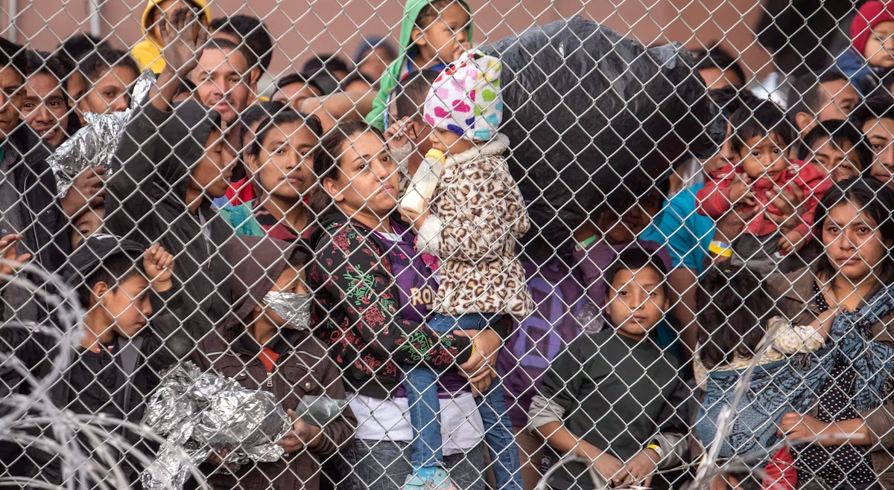
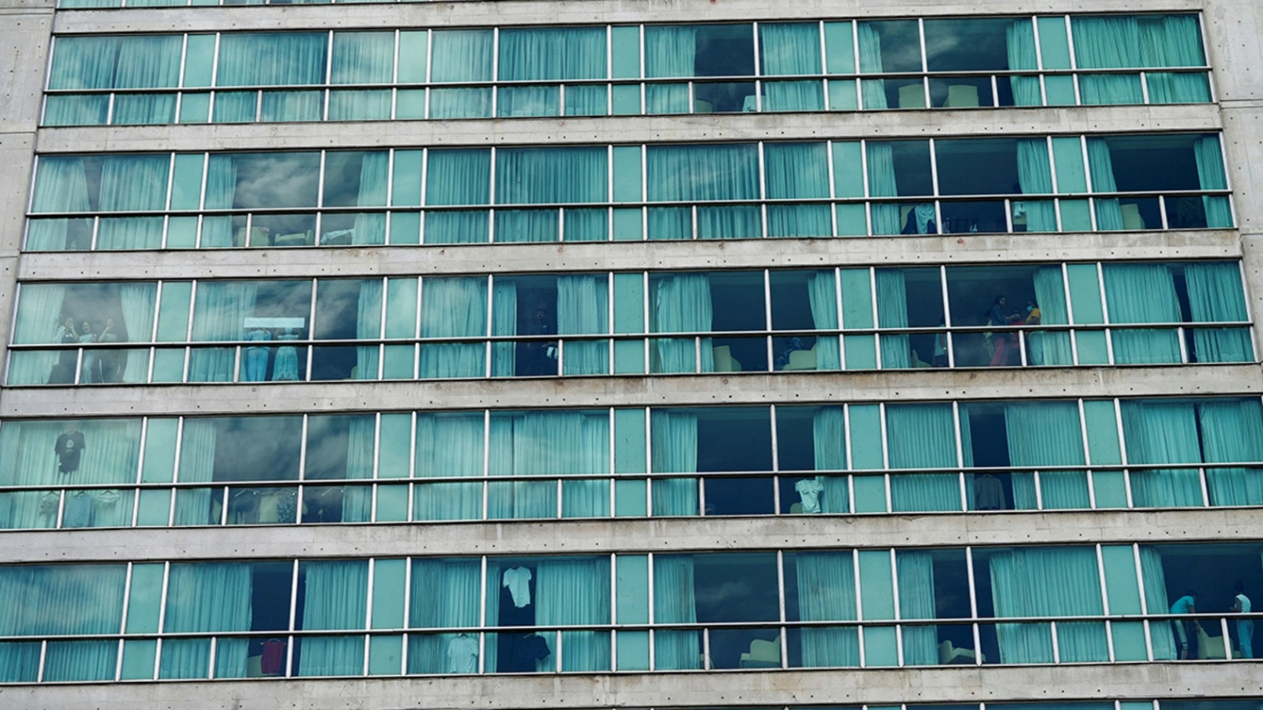
Advocate to get ICE & CBP out of our communities
    Call Representatives
      The Melt ICE Act was introduced by Congresswomen Delia Ramirez and Yvette Clarke.
      Dignity for Detained Immigrants Act, by Sen. Cory Booker.
        The Ban Warehouse Detention Act, by Congresswoman Rashida Tlaib.
Notes:
- The Melt ICE Act would
● Close ALL immigration detention facilities
● Release our neighbors from detention so they can reunite wit their family and communities.
● End electronic monitoring of our immigrant communities
● Invest in communities by re-directing ICE funding to community -based services that support working families.
Senator Cory Booker, alongside Senator Andy Kim, introduced the End Warehouse Detention Act in early 2026 to prohibit the Department of Homeland Security (DHS) from using taxpayer funds—specifically from the 2025 "One Big Beautiful Bill"—to purchase or convert warehouses into ICE detention centers. The bill aims to halt expansion of industrial-scale detention facilities.
We demand that Members of Congress endorse Congresswoman Tlaib's upcoming bill, the Ban Warehouse Detention Act, which would prohibit the Department of Homeland Security, including ICE, from establishing, operating, expanding, converting, or renovating any warehouse, industrial facility, tent, soft-sided structure, modular unit, or similar building or structure for the purposes of housing, processing, or detaining individuals under civil immigration authority and from establishing another such new immigration detention model.

Slide 23
Next Steps: How are you going to respond?
Christian Call to Put Faith in Action
Baptism
“Do you accept the freedom and power God gives you to resist evil, injustice, and oppression in whatever forms they present themselves?”
Holy Communion
“Grant that we may go into the world in the strength of your Spirit, to give ourselves for others, in the name of Jesus Christ. Amen.”

Slide 24
workshop
    What are the strengths of your congregation/community that would back up the implementation of an action plan?
    Make an assessment in five minutes
Notes:
- The Melt ICE Act would
● Close ALL immigration detention facilities
● Release our neighbors from detention so they can reunite wit their family and communities.
● End electronic monitoring of our immigrant communities
● Invest in communities by re-directing ICE funding to community -based services that support working families.
Senator Cory Booker, alongside Senator Andy Kim, introduced the End Warehouse Detention Act in early 2026 to prohibit the Department of Homeland Security (DHS) from using taxpayer funds—specifically from the 2025 "One Big Beautiful Bill"—to purchase or convert warehouses into ICE detention centers. The bill aims to halt expansion of industrial-scale detention facilities.
We demand that Members of Congress endorse Congresswoman Tlaib's upcoming bill, the Ban Warehouse Detention Act, which would prohibit the Department of Homeland Security, including ICE, from establishing, operating, expanding, converting, or renovating any warehouse, industrial facility, tent, soft-sided structure, modular unit, or similar building or structure for the purposes of housing, processing, or detaining individuals under civil immigration authority and from establishing another such new immigration detention model.

Slide 25
workshop
    What questions/challenges do you foresee in implementing an action/response?
Notes:
- The Melt ICE Act would
● Close ALL immigration detention facilities
● Release our neighbors from detention so they can reunite wit their family and communities.
● End electronic monitoring of our immigrant communities
● Invest in communities by re-directing ICE funding to community -based services that support working families.
Senator Cory Booker, alongside Senator Andy Kim, introduced the End Warehouse Detention Act in early 2026 to prohibit the Department of Homeland Security (DHS) from using taxpayer funds—specifically from the 2025 "One Big Beautiful Bill"—to purchase or convert warehouses into ICE detention centers. The bill aims to halt expansion of industrial-scale detention facilities.
We demand that Members of Congress endorse Congresswoman Tlaib's upcoming bill, the Ban Warehouse Detention Act, which would prohibit the Department of Homeland Security, including ICE, from establishing, operating, expanding, converting, or renovating any warehouse, industrial facility, tent, soft-sided structure, modular unit, or similar building or structure for the purposes of housing, processing, or detaining individuals under civil immigration authority and from establishing another such new immigration detention model.

Slide 26
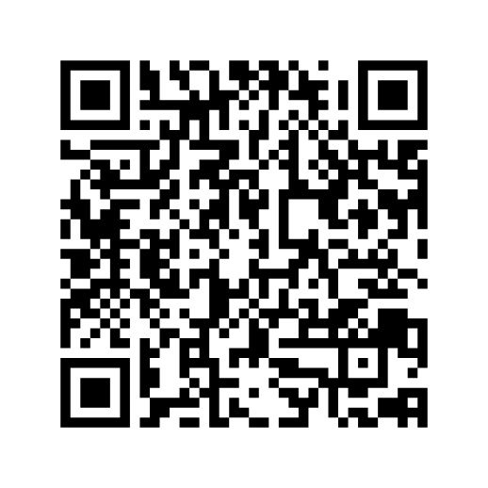
How is the church responding?
  Primary Response/Care Bear
  Supportive Response
  Advocacy Response
  Rescuing the babies thrown in the river
  and/or tackling the cause that throws babies to the river

Slide 27
questions?

Slide 28
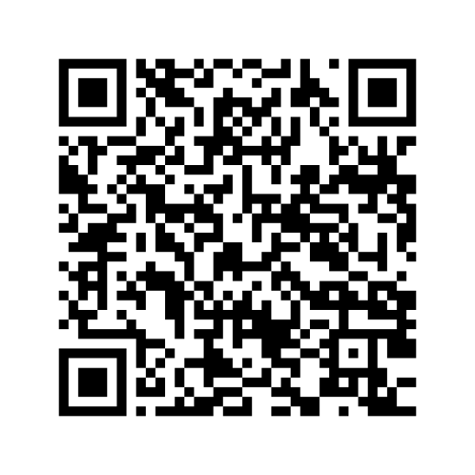
Toolkit for next steps
    ResourceUMC

Slide 29
Questions to nurture next steps
    1. Who are your House Representatives and Senators?
    2. What are their stand on immigration?
    3. Do you see links between immigration policy and other social justice issues? Gender, reproductive rights, race, class? If so, where?
    4. Find out how they voted on the Big Beautiful Bill (ICE and CBP)
    5. Are there 287(a) agreements in place in your context?
    6. Locate the closest detention centers near your community/church.
    Do you know of Hotline or Rapid Response Teams in your area to counter ICE operations in your county, city, or state?
    Make a plan

