Slide 1
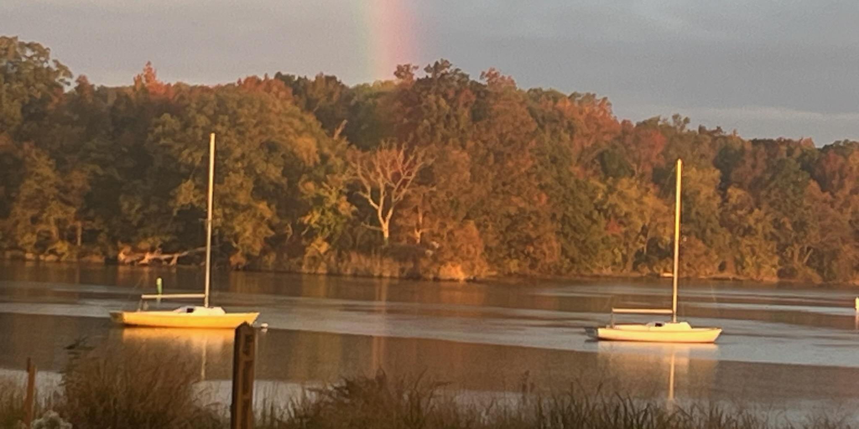

Camping Sunday

Slide 2



Slide 3
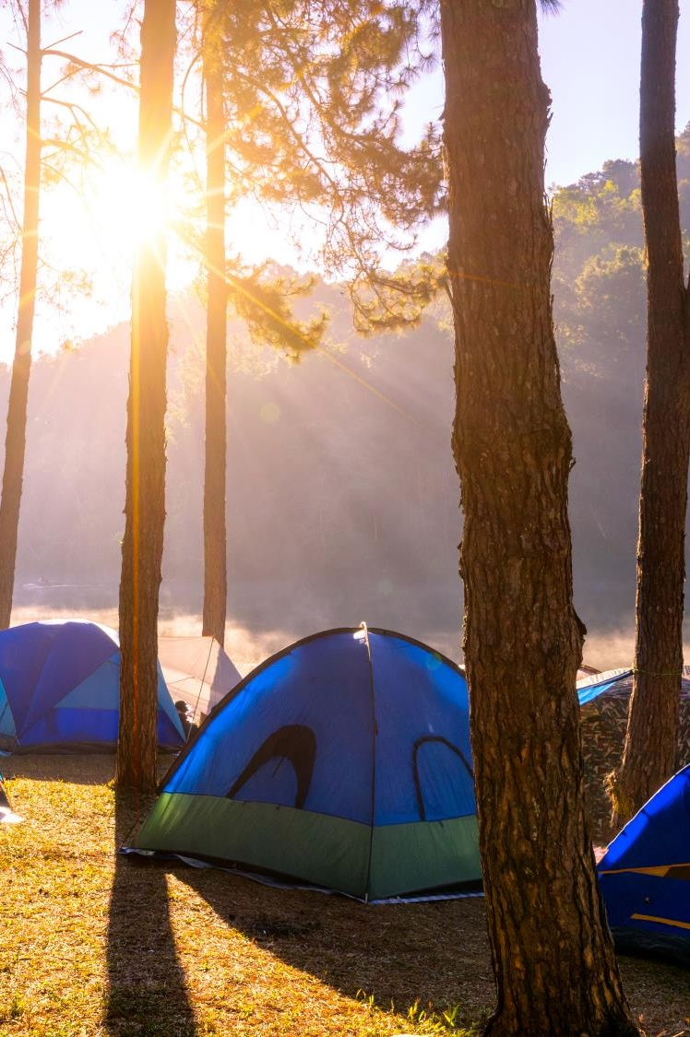
Call to Worship
One: You are the salt of the earth
Many: We give flavor to the world, preserving the love of Christ at work
One: You are the light of the world
Many: Even amidst the night of pain and sorrow, we shine the light of Christ’s love
One: You are the fresh breeze of a new life
Many: We remind the world to return to the peace and beauty of creation

Slide 4
Call to Worship
One: You are God’s hands and feet
Many: We are working for healing in a broken world
One: You are to live out God’s call of love and justice
All: We will guide the world to reconnect with God through community and creation

Slide 5
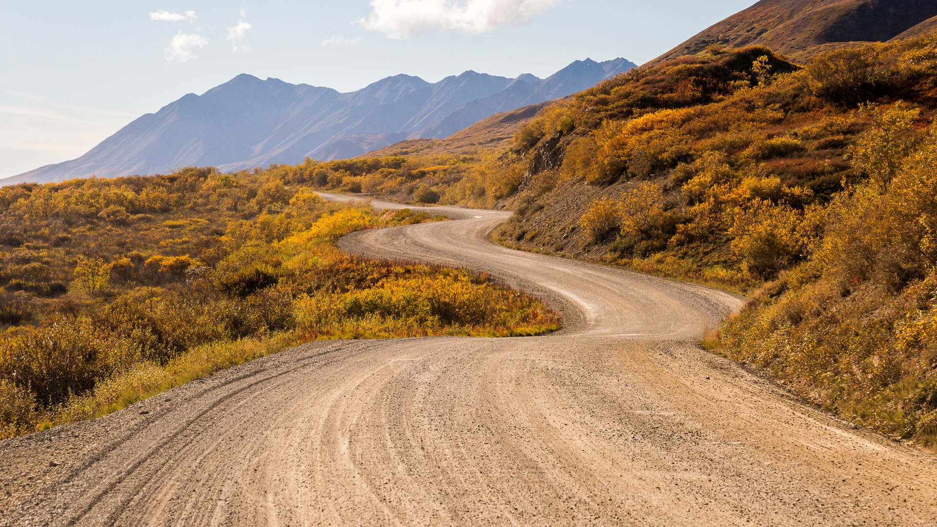
Opening Prayer

Slide 6
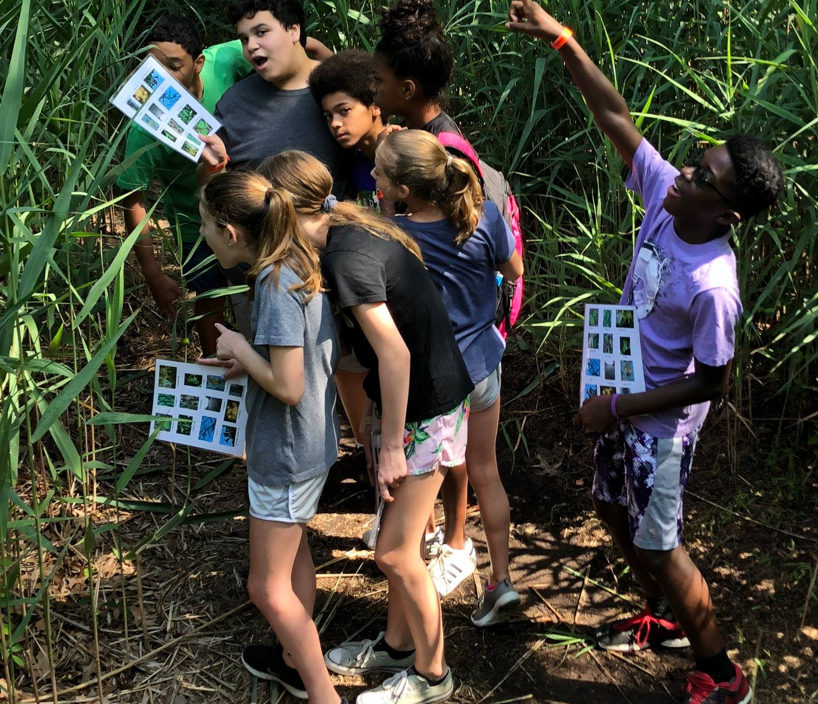
Psalm 112:1-9

Slide 7
Pastoral Prayer

Slide 8
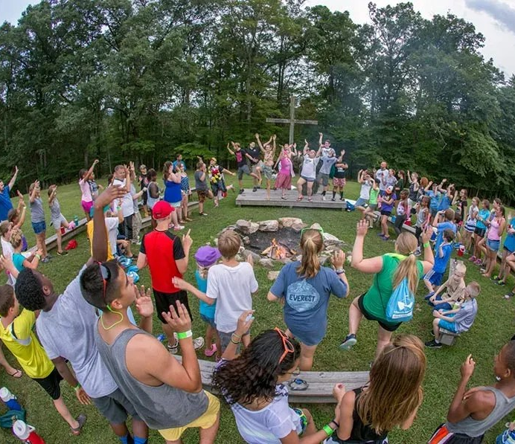
Matthew 5:13-20

Slide 9
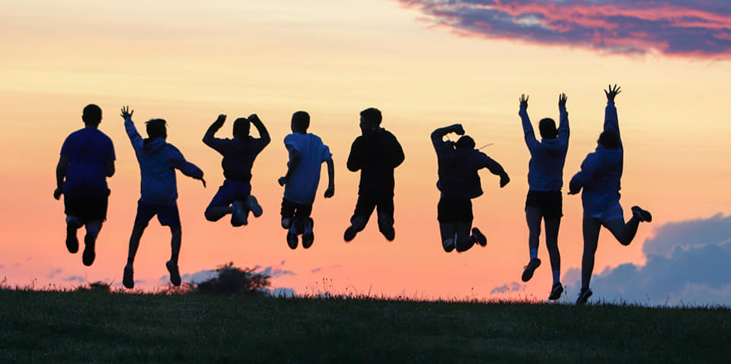
Sermon

Slide 10
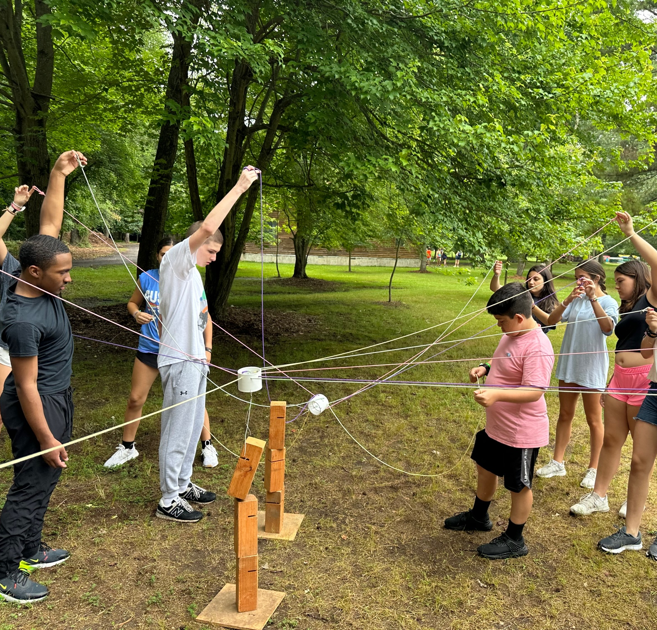

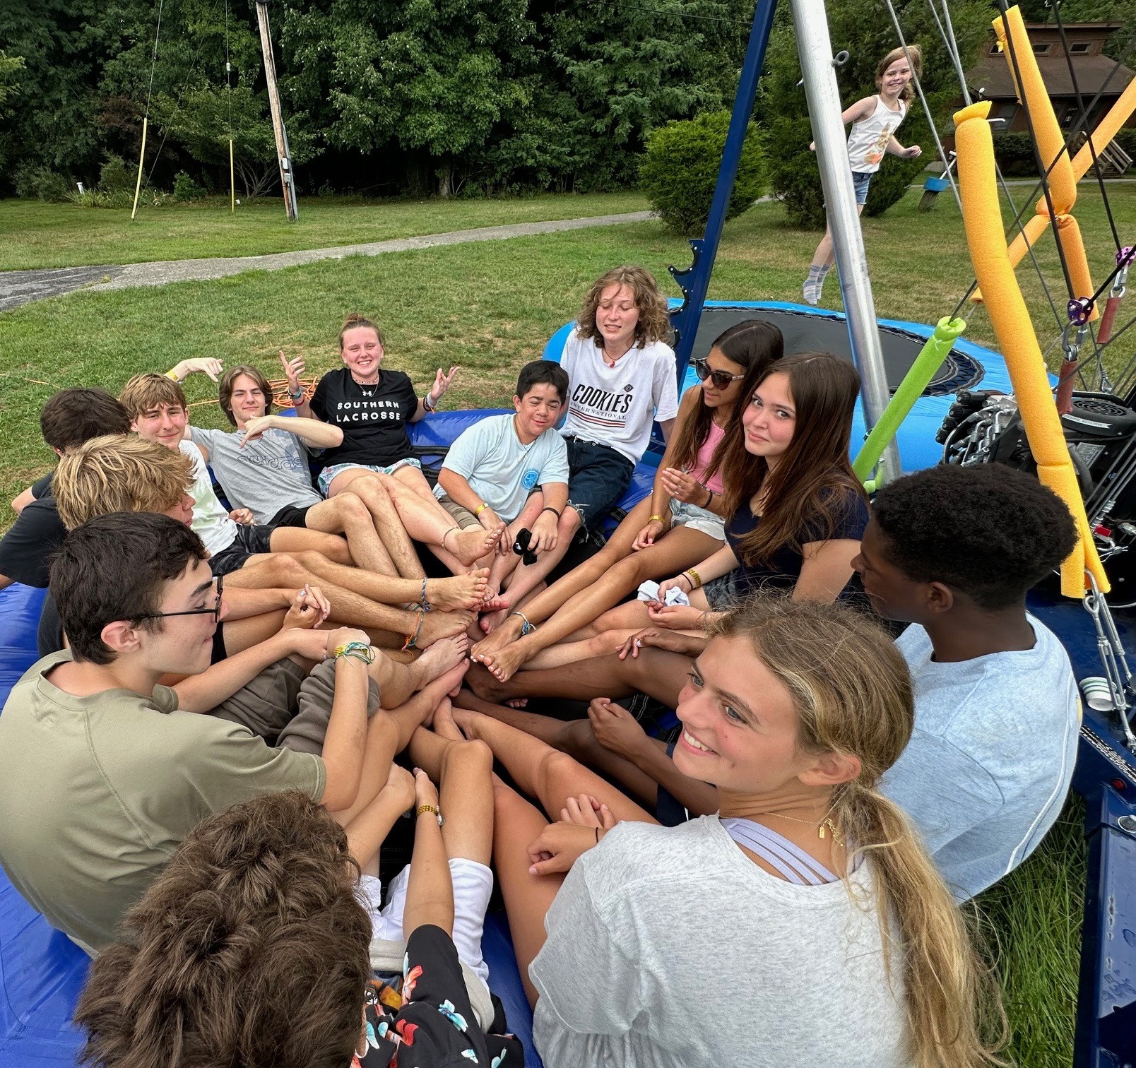
Offertory

