Slide 1
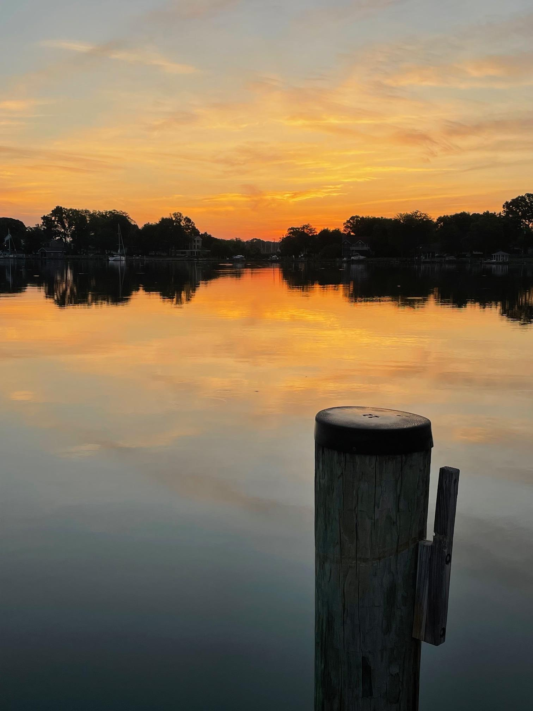
Camping Sunday 2025

Slide 2
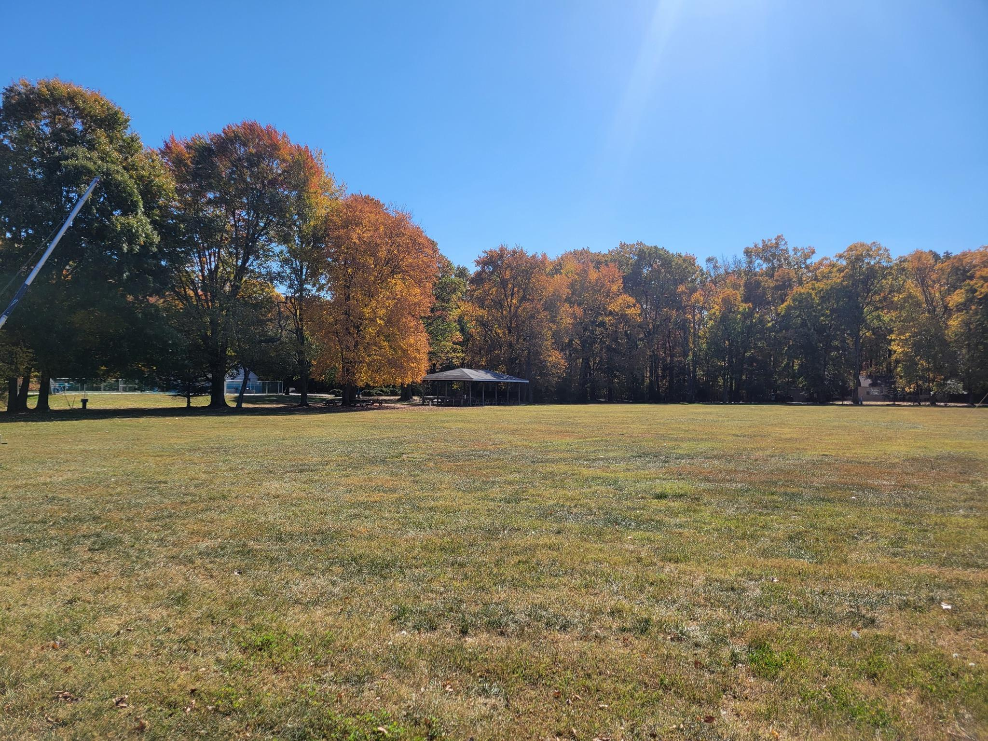
Call to Worship
Leader: I give you thanks, O LORD, with my whole heart;
People: I bow down and give thanks to your name for your steadfast love and your faithfulness
Leader: On the day I called, you answered me; you increased my strength of soul.
People: All the leaders of the earth shall praise you, O LORD, for they have heard the words. They shall sing of the ways of the LORD

Slide 3
Call to Worship
Leader: For though the LORD is high, God regards the lowly, but the haughty God perceives from far away.
People: Though I walk in the midst of trouble, you preserve me against the wrath of my enemies; you stretch out your hand, and your right hand delivers me. The LORD will fulfill the purpose for us. Your steadfast love, O LORD, endures forever.

Slide 4
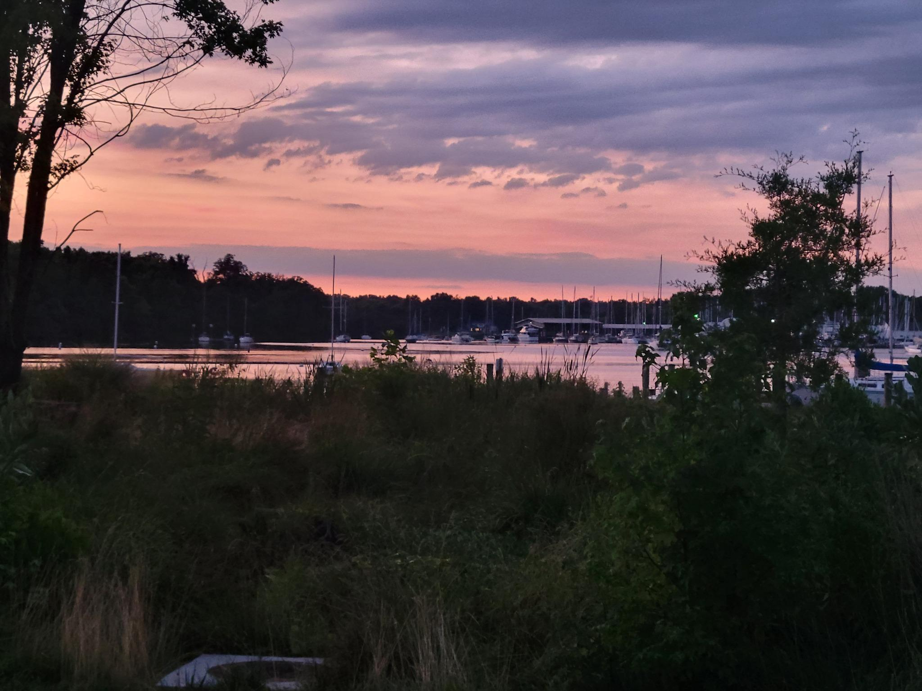
Opening Prayer
Loving God, we come into your presence with thanksgiving, deeply grateful for the unfailing love and faithfulness. When we call out to you, you answer. When we are exhausted, you give us the strength to go on. When we find ourselves in trouble, you are there, standing beside us. Open our eyes to see and know you in our midst; help us to recognize your voice. And then send us out from here, to live and work in the world as your disciples. In the name of Jesus Christ, our Savior and Lord. Amen.

Slide 5
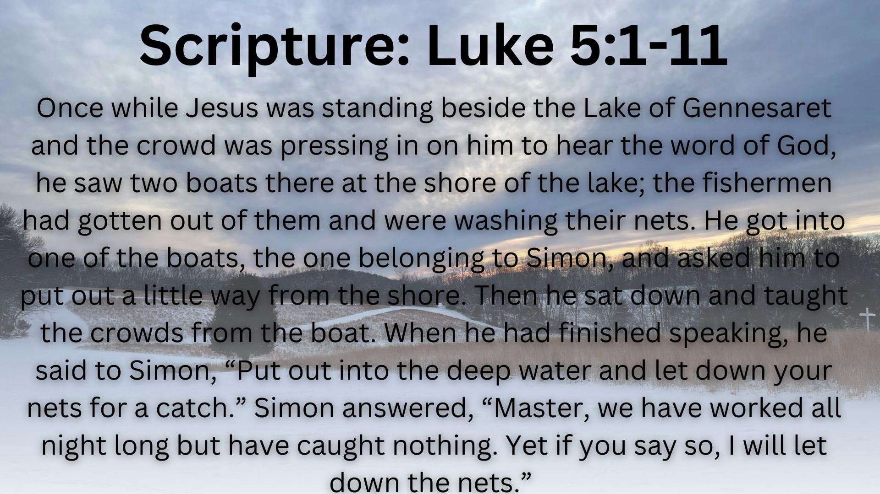

Slide 6
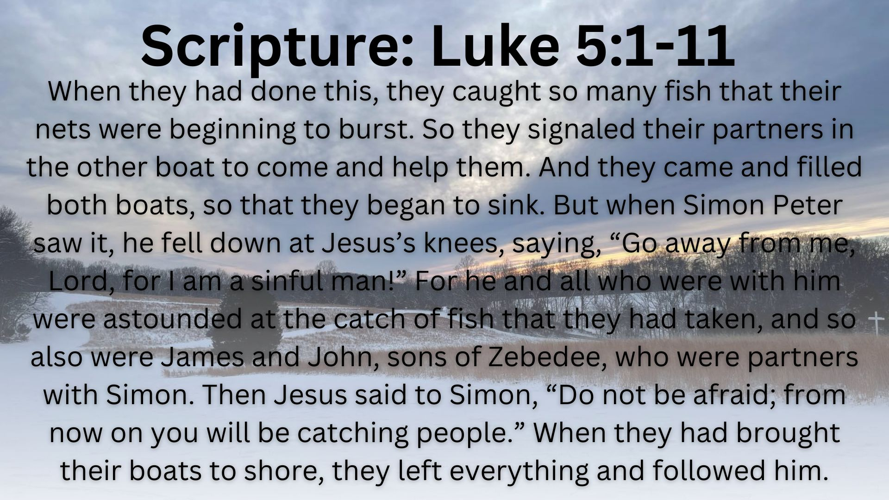

Slide 7
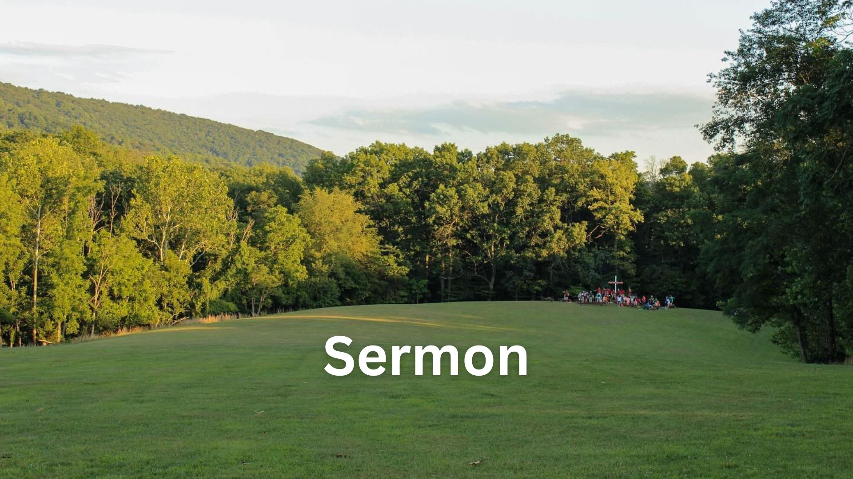

Slide 8


