Slide 1
AI
Benefits and Risks
of Artificial Intelligence
Rev. David Jacobson • Rev. Mark Gorman
Baltimore Washington Conference • AI Task Force
May 27, 2026
Notes:
Intros: CUMC. Masters in Computer Science
Opening prayer: Holy Spirit of wisdom and revelation, meet us in this time. Help us to learn, to discern, and to grow as faithful witnesses of Jesus Christ our Lord, in whose name we pray. Amen.

Slide 2
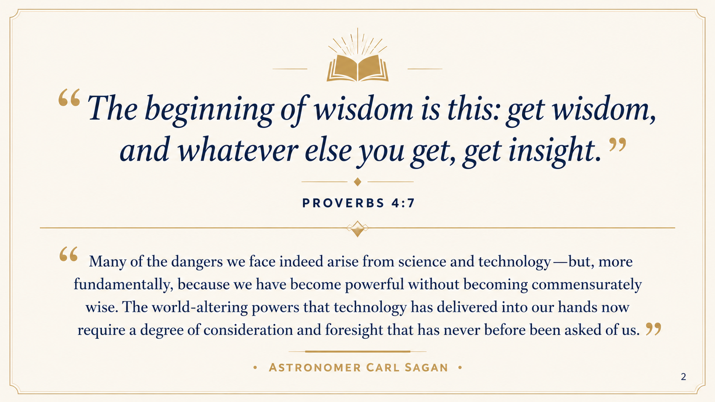

“The beginning of wisdom is this: get wisdom,
and whatever else you get, get insight.”
Proverbs 4:7
Many of the dangers we face indeed arise from science and technology — but, more fundamentally, because we have become powerful without becoming commensurately wise. The world-altering powers that technology has delivered into our hands now require a degree of consideration and foresight that has never before been asked of us.
Astronomer Carl Sagan
OPENING
2
Notes:
What we’re trying to do today is to seek wisdom about living in this era of AI.
Pope Leo, writing about AI, recently said “We must ask God for the wisdom to interpret the great trends of our time, particularly technological advances.”
Proverbs makes it clear that wisdom is of paramount importance
Some of you might remember the late science communicator Carl Sagan. He said…

Slide 3
WHY WE'RE HERE
The BWC AI Task Force
OVERVIEW
THIS WORKSHOP
●
Established at the direction of the bishop during AC2025
A forum to begin conversations and to resource the church to think theologically about AI.
Response to the resolution, “Encouraging Awareness and Faithful Living in the Era of Artificial Intelligence”
●
Meetings were open to anyone in the BWC
~20 people, lay and clergy, participated in 4 sessions in late 2025
●
A humble scope
To help resource better conversations within the BWC
Part 1 · What is AI?
Capabilities, trends, and risks (David)
●
Format: Presentations and Open Conversation
Topics: “Theology and AI,” “What Is AI?” and “AI Risks and Benefits”
Part 2 · Theology & Discernment
Faith, ethics, and our response (Mark)
OPENING
3
Notes:
We’re here this morning not only because AI is an important topic, but because last year there was a resolution calling on conference members and congregations to “begin to discern through prayer and thoughtful conversation how to live faithfully in the era of Artificial Intelligence.” The bishop asked me and Rev. Gorman to facilitate a task force to resource the church in fulfilling the resolution.
And so in the fall, we put out the call in the e-connection to anyone that wanted to participate. We ended up with about 20 people who participated in at least one of four sessions that we had.
Our scope was humble— not to answer every question we might have about AI, but simply to do our best to resource the people of God in conversation with one another.
This morning, I’ll be speaking at a high level about the current state of AI as well as benefits and risks we see both now and in the not-too-distant future.
Rev. Gorman will then guide us to think wisely and theologically from a Methodist perspective about this new era.

Slide 4
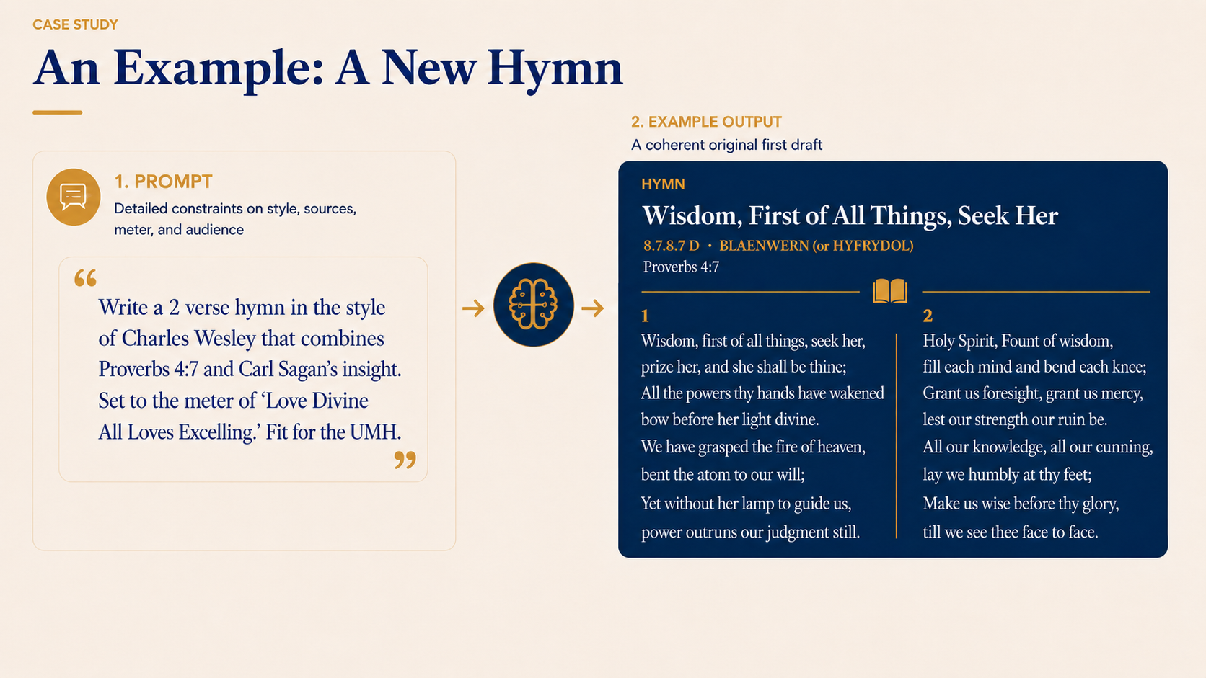
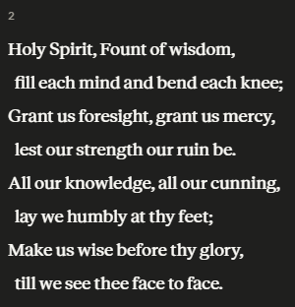
3
Notes:
If you’ve used ChatGPT before — or a similar tool like Gemini or Claude or Grok— will you please raise your hand.
Well, here’s an example of the type of thing that we’ve been able to do for about 3 ½ years now.

Slide 5
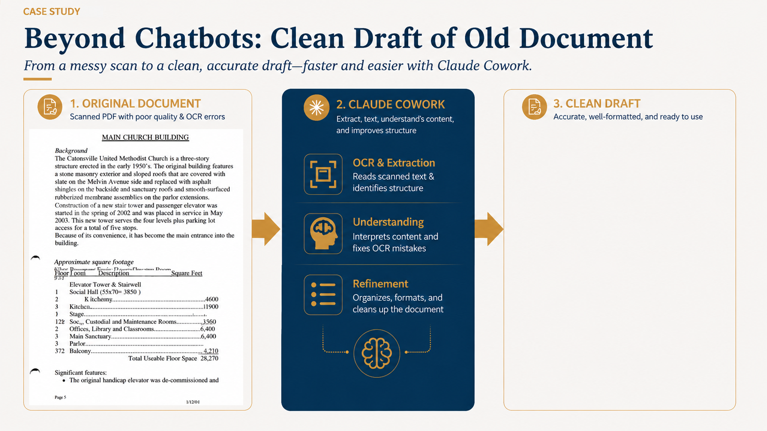
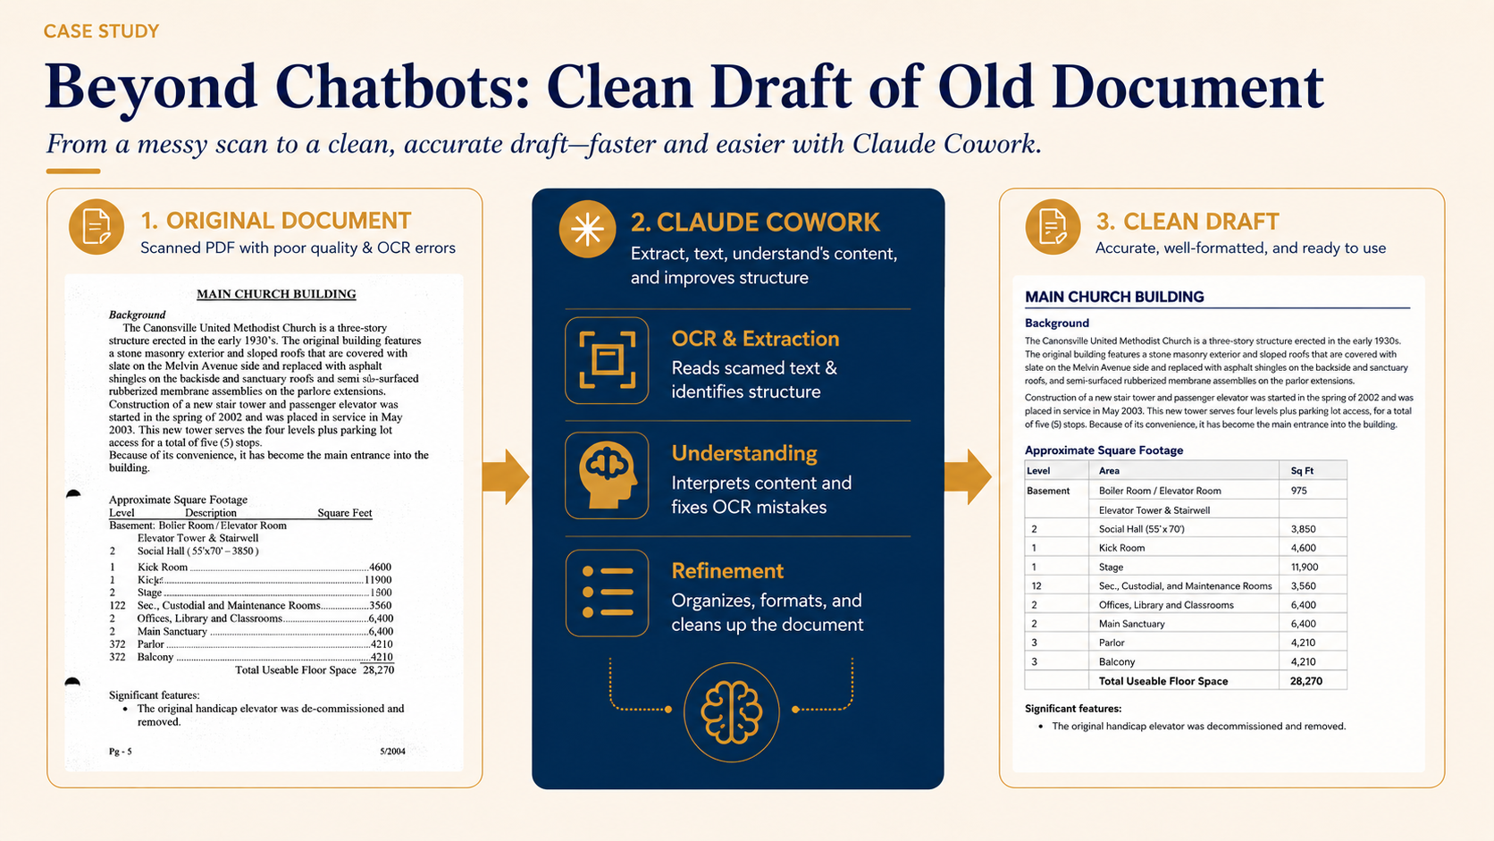
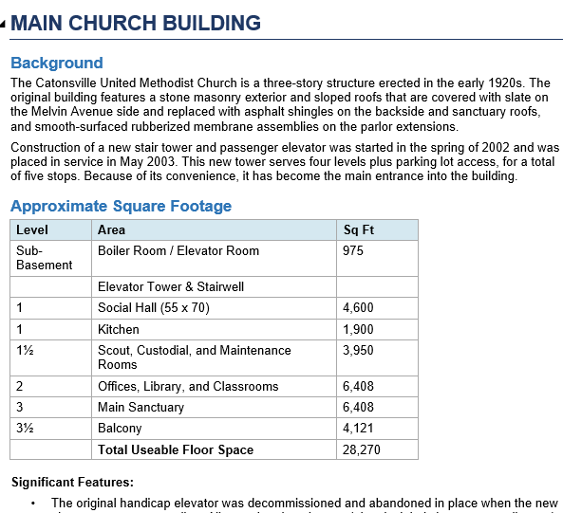
Notes:
That was just a fun example. But here’s something that I actually did that saved me hours of work. We had an old facility manual that we wanted to update. A member of the trustees scanned it in. But the program that he used left a document that had lots of errors in it. The information was there, but the formatting was way off. So I told Claude Cowork, which is like a ChatGPT that can access files on your computer, to make me a clean draft. It churned and maybe 10 minutes later, I had a brand new beautiful document that could be a clean starting point for updates.

Slide 6
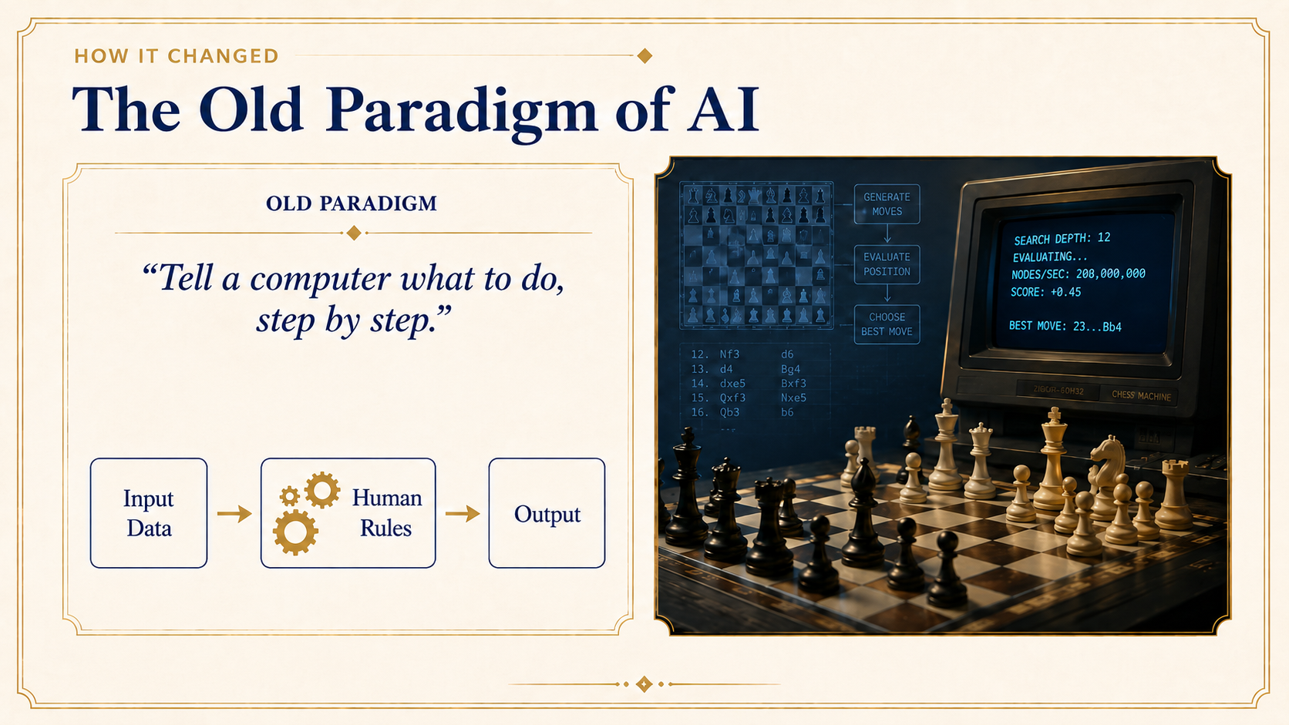
Notes:
So AI is a broad term with no agreed-upon definition. But today, when I say “AI,” I mostly mean today’s general-purpose systems like ChatGPT, Claude, Gemini, and Copilot. Older AI was usually narrow: one system for one task. What changed is that these systems are becoming broad, flexible, and increasingly able to learn patterns and act across many domains.
I should say that you’ll hear me refer to these systems as “LLMs” which stands for Large Language Models— or as “models” for short.
Now some of you may remember back in 1997, when world chess champion Garry Kasparov was defeated by IBM’s Deep Blue. Deep Blue was an AI of sorts, but it worked very differently from today’s systems. It was a purpose-built chess machine that relied heavily on hand-coded evaluation designed by human experts. “If this then do that” and so on. Basically, people had told the computer what to do, step by step.

Slide 7
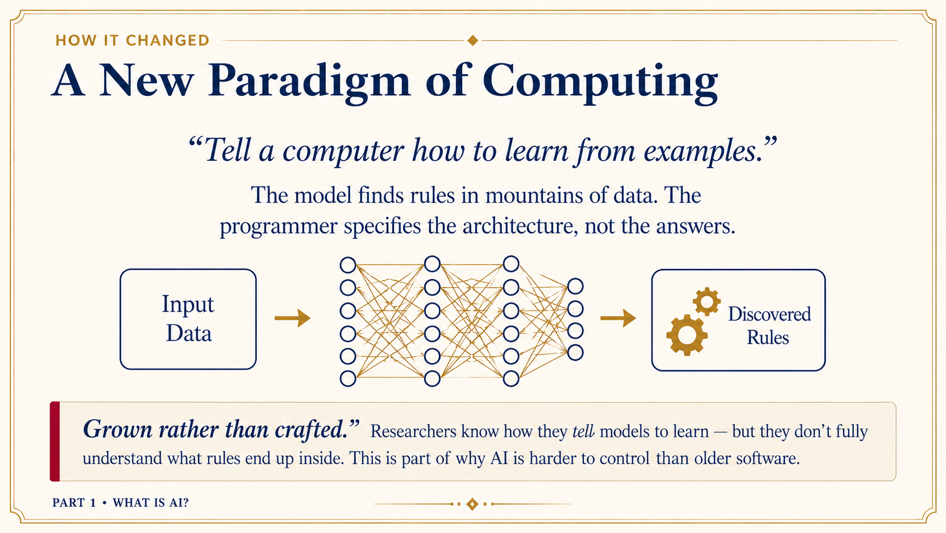
Notes:
But modern AI represents a major shift. Instead of programming all the rules directly, we train models on enormous amounts of data and teach them how to learn patterns from examples. The programmer designs the architecture and the training process, but the model develops internal rules on its own.
That is why I describe modern AI as “grown rather than crafted.” Even the people building these systems don’t fully understand all the patterns and representations that emerge inside them. The result is that today’s AIs are both remarkably powerful AND much harder to fully explain or control than older software.

Slide 8
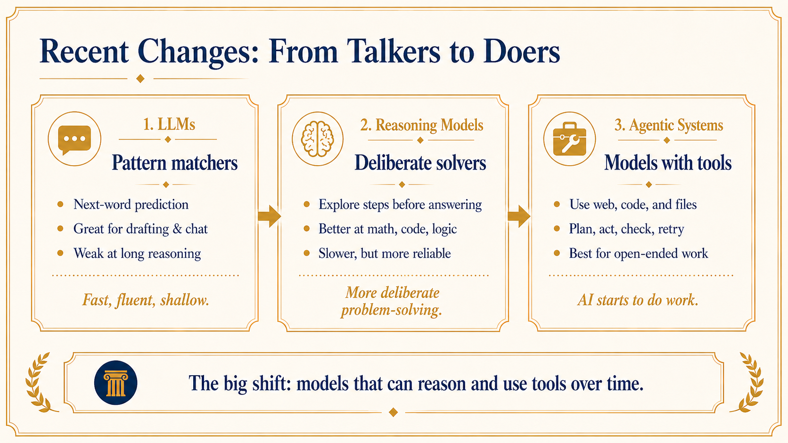
Notes:
AI is moving incredibly fast, and there have been several major paradigm shifts since the release of chatgpt in November 2022.
Early versions of ChatGPT were exciting, but relatively shallow. They were basically autocomplete on steroids. They were pattern matchers, trained, more or less, to predict the next word of internet text.
About 18 months ago there was a paradigm shift toward “reasoning models”, which allowed the AI to take time to think things through before answering.
But now, just in the last 6 months, there’s been another huge paradigm shift toward Agentic systems— systems that will do longer term planning and use tools on your computer to get work done

Slide 9
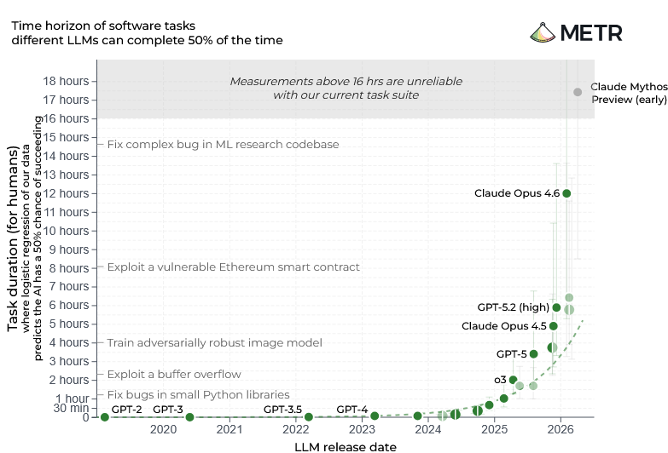
HOW FAST IS IT IMPROVING?
AI Task Horizons Are Doubling Every Few Months
GPT-2 (2019)
~9 seconds
GPT-4 (2023)
~5 minutes
CLAUDE MYTHOS PREVIEW (2026)
“Likely at least 16 hrs”
AND STILL ACCELERATING
From a few seconds in 2019 to multiple workdays in Q2 2026. If the trend holds, week-long autonomous tasks become routine within a year or two.
Source: METR (Model Evaluation & Threat Research). 50% success rate on autonomous software tasks.
PART 1 · WHAT IS AI?
Notes:
As it turns out, it’s actually hard to quantity and understand how quickly systems are getting better.
But there’s an organization called METR that gives us one of the clearest public windows into how quickly AI capabilities are advancing. They take real software engineering, machine learning, and cybersecurity tasks, measure how long those tasks take skilled human experts, and then test whether AI systems can complete them successfully.
What they’ve found is that AI systems tend to have a “task horizon”: a limit to the length and complexity of task they can reliably complete.
Back in 2023, GPT-4 could successfully complete tasks that took humans about 5 minutes roughly half the time. Today, frontier systems are able to accomplish multi-hour tasks. And importantly, this capability curve has literally been growing exponentially— actually even faster than exponentially. METR’s earlier estimate was that these horizons were doubling about every 7 months, but the more recent trend since 2023 looks closer to every 4 months. So these systems aren’t just getting a little better at answering chat prompts, but they’re actually becoming extremely capable of sustained work over long periods of time.

Slide 10
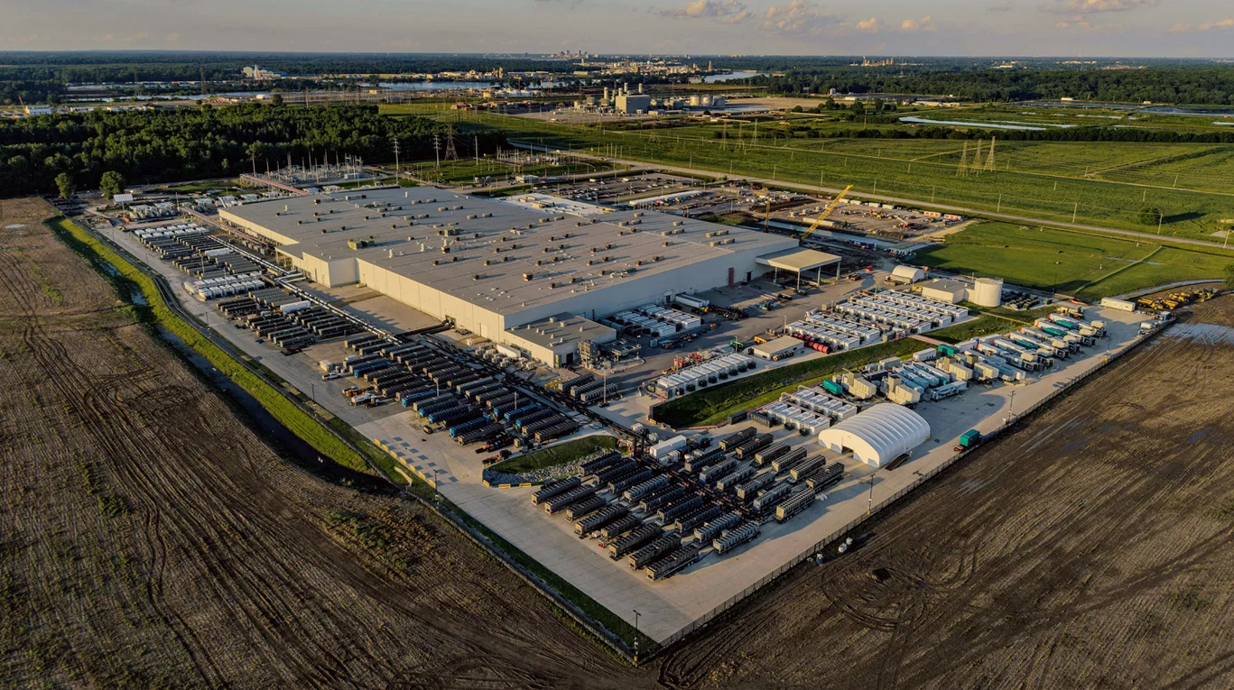
BEHIND THE SCENES
Huge Investments
$3-5T
projected global AI data-center build-out by 2030
100,000
homes' worth of power for one Memphis facility
1 GW
expected for next-generation models—Hoover Dam scale power
“Colossus” datacenter, Memphis
PART 1 · WHAT IS AI?
Notes:
As these systems grow more capable, demand for computing power is exploding. Training modern AI models requires enormous amounts of computation, but serving them to millions of users also consumes massive amounts of electricity and hardware. That is leading to something like a modern data-center gold rush. Companies are racing to build facilities at unprecedented scale, spending trillions globally on AI infrastructure. And when people talk about “the cloud,” this is what they mean: not something floating in the sky, but giant warehouses full of computers, networking equipment, and cooling systems consuming extraordinary amounts of power. Some next-generation AI facilities are expected to require around a gigawatt of electricity—roughly the scale of a major power plant.
Now, ask yourself: why would companies spend trillions of dollars on data centers? It’s probably not because of your $20/month ChatGPT subscription. It’s probably because they anticipate that businesses will see a lot of value in paying more like $1000/month instead of paying a human employee $5000 - $10000 a month.

Slide 11
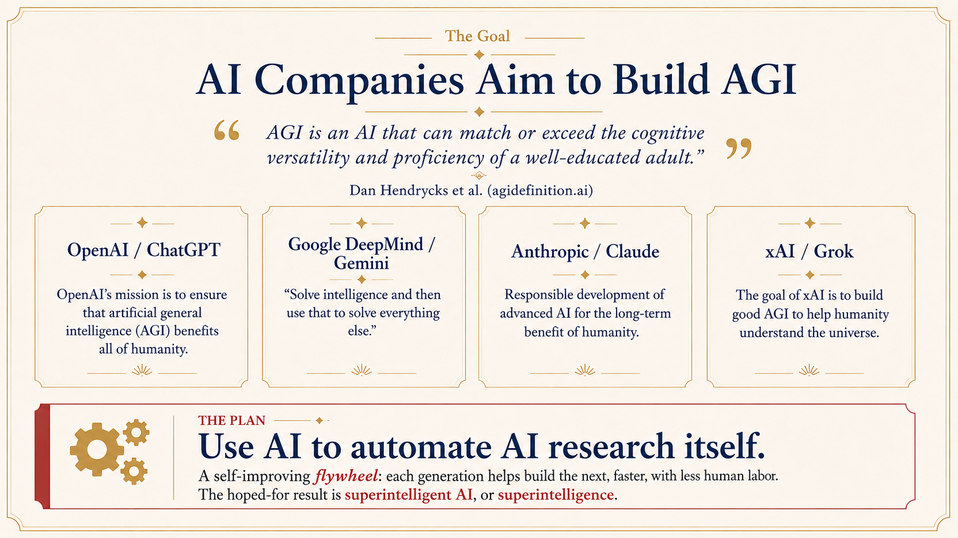
Notes:
The bet that these companies are making is that they can make AI systems that will be able to do anything that a human can do on a computer. The lingo for this is “AGI”-- artificial general intelligence.
That in and of itself would be disruptive and unsettling. But to me the most concerning thing is that these companies are seeking to use AI to automate AI research itself. Their hope is that they can use AI to make better AI, and that that will set off a sort of self-improving flywheel that will result in an AI that is vastly more intelligence than humanity. That’s called “superintelligent AI” or superintelligence. Thankfully we’re not there yet, but all of the AI companies are already using their AI tools to improve their AIs, which is much of what accounts for the acceleration that we see.

Slide 12
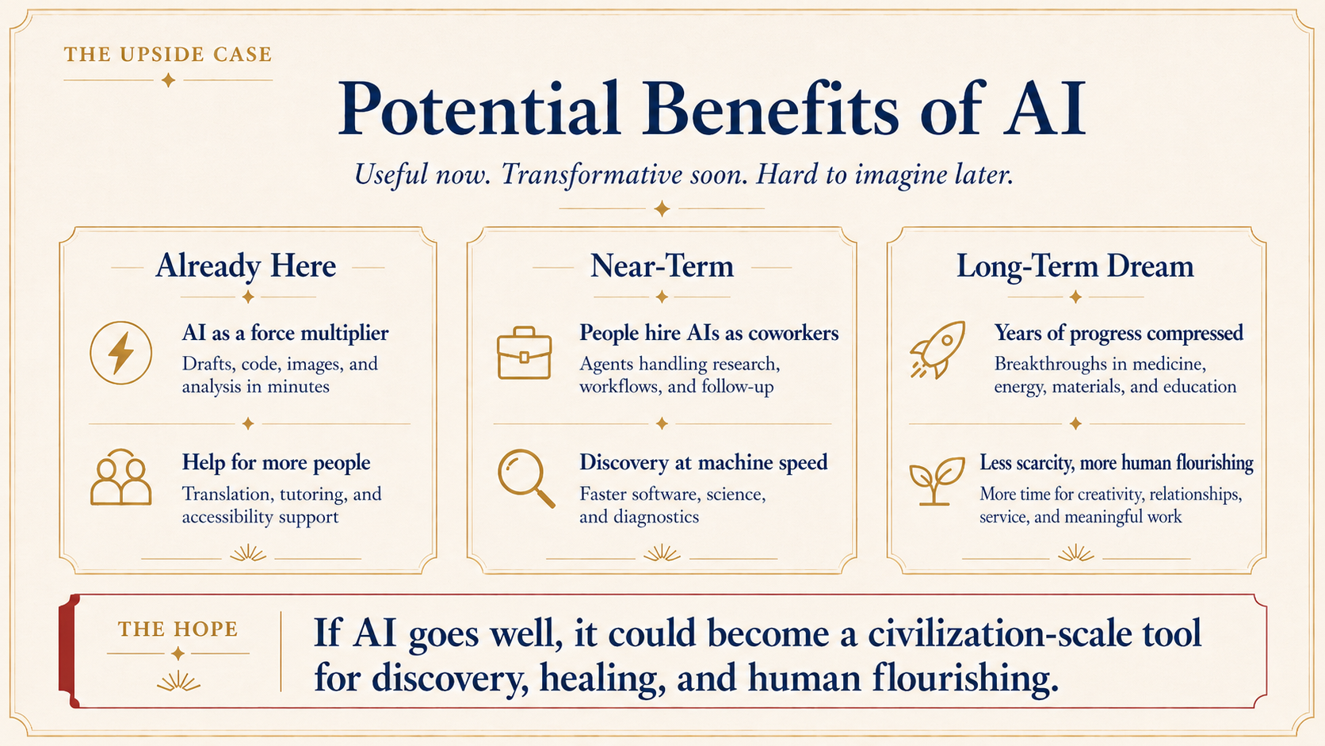
Notes:
Now, AI is clearly very useful for a lot of things. You didn’t think I could make pretty slides like this on my own, did you? It’s worth naming some of the good things that AI can be used for as well as some of the dreams of those who are building it.
Already, AI is incredibly useful as a force multiplier. A couple months ago, we had to cancel a big event at church on very short notice. Within minutes with AIs help, I had an image and text that was ready for social media. Many of you have found ways that current AI is extremely helpful.
But in the near term, businesses will actually be able to basically hire an AI agent as a coworker. It’s going to create a sort of productivity boom. It’s also accelerating science, freeing scientists up to do the parts of their jobs that actually advance their fields.
In the long term— and if you listen to the AI companies, the long term is like 5 years— AI could itself lead to great discoveries in science and medicine. It could help us to solve some of the most challenging problems of our time.

Slide 13
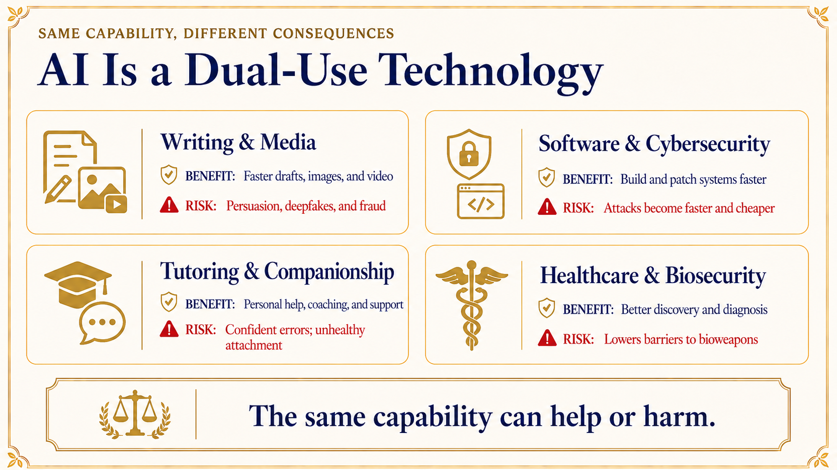
Notes:
But even if AI stays in the “tool” category, it poses some serious challenges. Because it’s a dual-use technology— meaning that the same capabilities can either help or harm. The clearest and scariest example of this is human biology. Having a great deal of knowledge about biology means that you can make medicine or maybe bioweapons. Similarly, being able to write code for anything means that you can find and illegally exploit vulnerabilities in software. Being an effective writer means that you can write effective propaganda. And sounding personable means that people might begin to emotionally attach themselves to you.

Slide 14
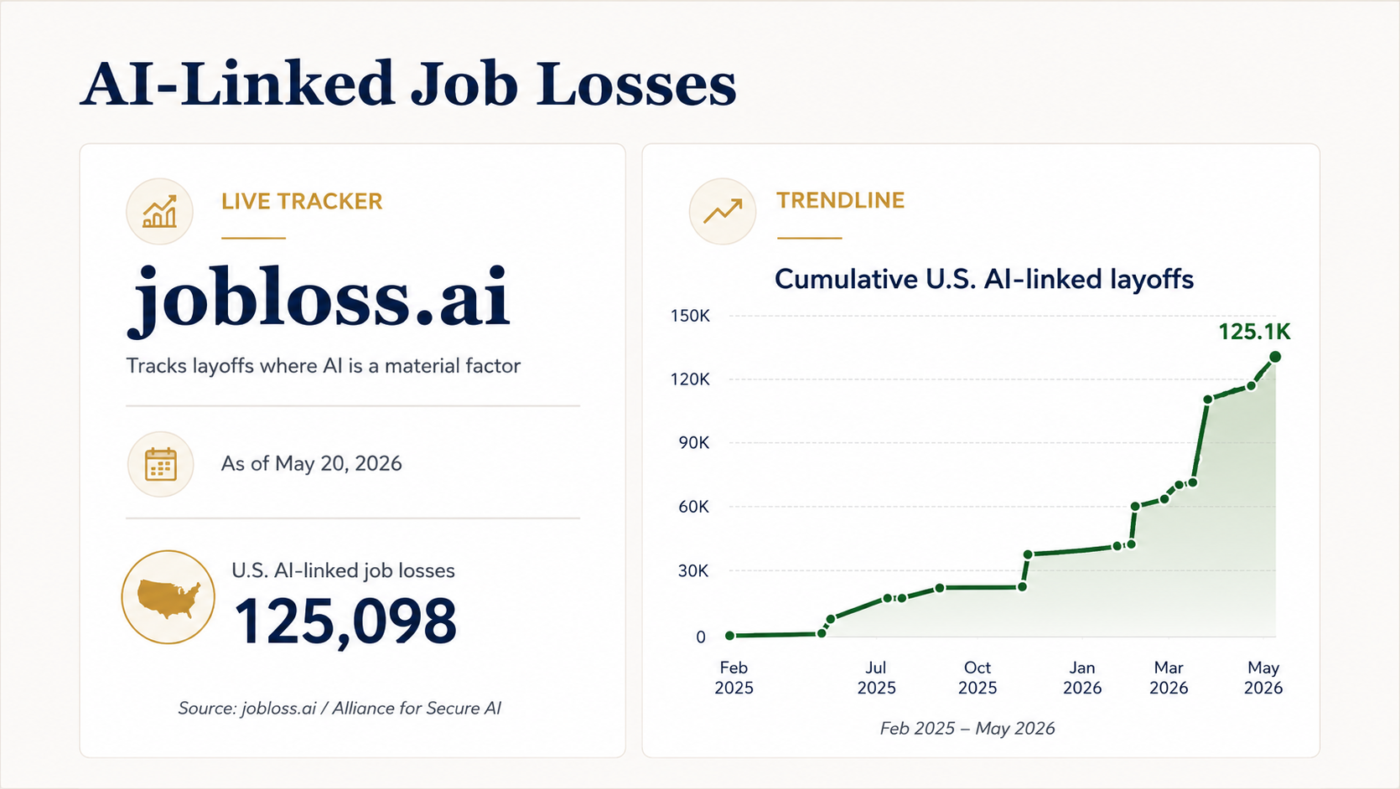
Notes:
Another risk of AI that gets a lot of press is job loss due to AI.
Public reports collected by jobloss.ai attribute nearly 100,000 U.S. layoffs in 2026 so far to AI-related restructuring, automation, or strategic shifts. Many of these cases certainly stem from multiple motives rather than direct one-for-one AI replacement.
New grads are having a harder time than usual getting good first jobs, especially in white-collar roles. AI is part of that story.

Slide 15
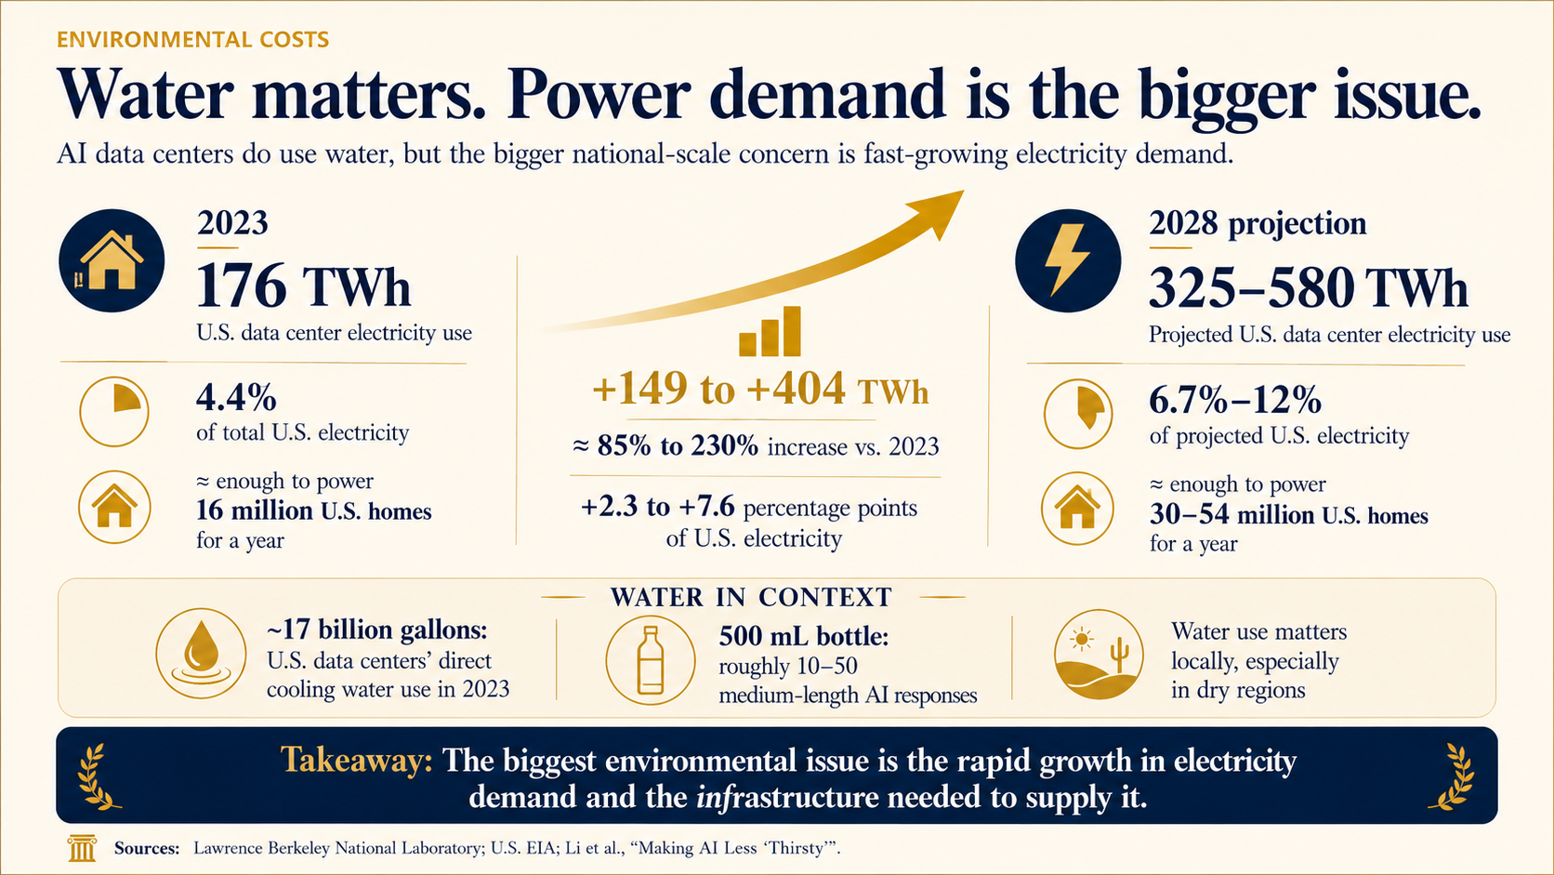
Notes:
One concern that many of us have around AI is environmental impact. All of those data centers use water and large amounts of power.
In several communities, AI data centers have become flashpoints for water access. Residents in Georgia reported low pressure or muddy well water near data-center projects. Communities in Oregon and Arizona have challenged projects due to concerns about drought and groundwater depletion. Public water systems and aquifers are being asked to support a new industrial-scale demand.
Nevertheless, it’s worth keeping AI water usage in perspective. One pair of jeans uses something like 1000 gallons of water over its life cycle. Golf-course irrigation in the U.S. is estimated to be 2 billion gallons per day. It puts the 17 billion gallons of data center water usage in perspective.
What is a bigger national issue is electricity demand due to AI datacenters. Estimates are that by 2028, power usage will be as much as 230% greater than just 5 years earlier. We’re right to be concerned about the environmental impact of new power generation at that scale.

Slide 16
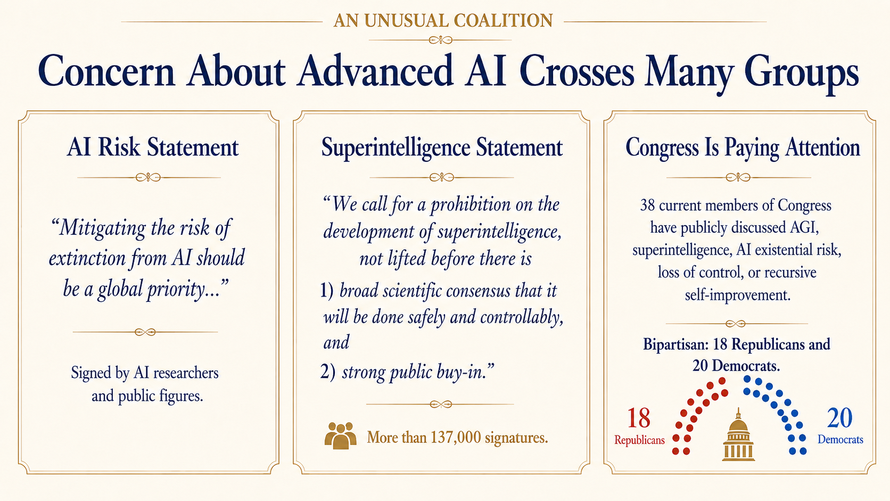
Notes:
Now, when we presented concerns about AI at annual conference last year, it felt like nobody was talking about risks at that time. From my perspective, the national conversation has shifted dramatically over the past year— and even since the task force concluded in December. There’s an increasingly loud chorus of voices that are rising up to warn us about the dangers of smarter-than-human AI, in particular. And unlike most issues these days, it’s broadly bi-partisan.
Pope Leo wrote this week that "What is needed is a more active political involvement that is capable of slowing things down when everything is accelerating…."

Slide 17
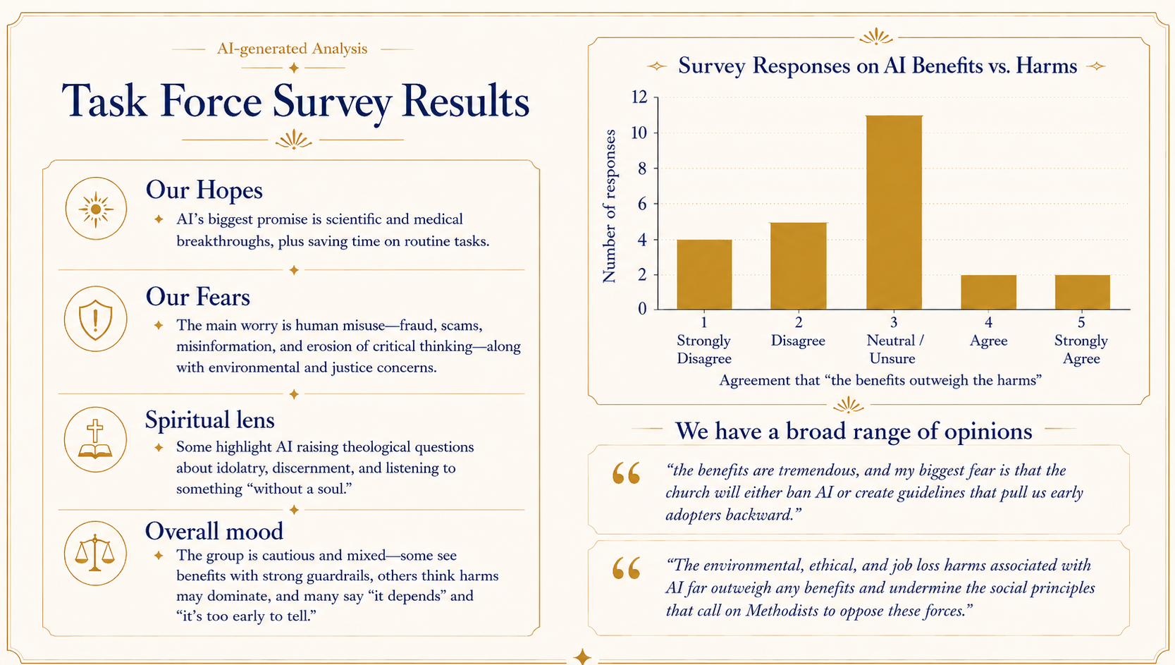
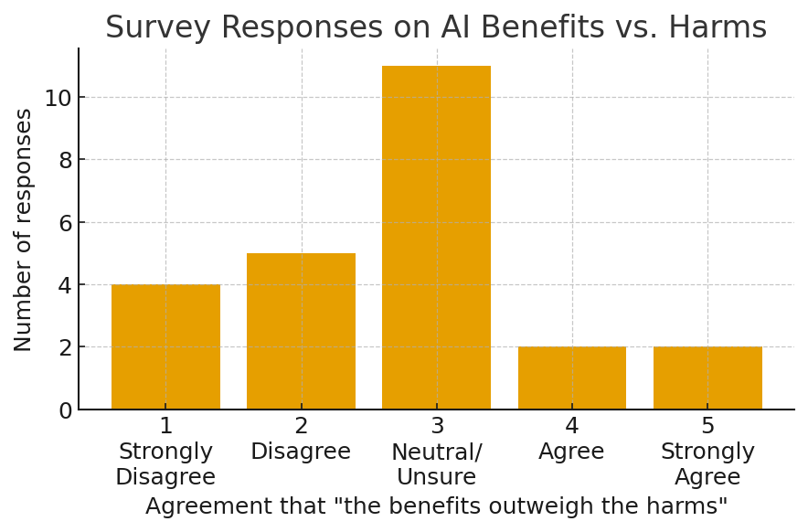
Task Force Survey Results
AI-generated Analysis
Our Hopes
  AI’s biggest promise is scientific and medical breakthroughs, plus saving time on routine tasks.
Our Fears
  The main worry is human misuse—fraud, scams, misinformation, and erosion of critical thinking—along with environmental and justice concerns.
Spiritual lens
  Some highlight AI raising theological questions about idolatry, discernment, and listening to something “without a soul.”
Overall mood
  The group is cautious and divided—some see benefits with strong guardrails, others think harms may dominate, and many say “it depends” and “it’s too early to tell.”
We’re quite divided
“the benefits are tremendous, and my biggest fear is that the church will either ban AI or create guidelines that pull us early adopters backward.”
“The environmental, ethical, and job loss harms associated with AI far outweigh any benefits and undermine the social principles that call on Methodists to oppose these forces.”
Notes:
Following task forces meetings in the fall, we surveyed participants about their hopes and concerns surrounding AI. Broadly speaking, we’re excited about the promise of scientific and medical breakthroughs, but concerned about the environmental impact of AI and environmental and justice issues surrounding AI. The group was cautious and the expressed a broad range of opinions. (See the two quotes)

Slide 18
Wrestling with AI as United Methodists
BWC AI Taskforce Presentation, Part II

Slide 19
Being steeped in Scripture and in prayer
Recalling our doctrines and foundational beliefs
Learning from our past and from our contemporaries
Asking questions and having conversations guided by who we are in Jesus Christ

Slide 20
Scripture and Prayer

Slide 21
Scriptural Themes to Ground Us and For Study
From creation to new creation
  Genesis 1; Revelation 21; Psalms; Romans 8:18-27
  Not “doomsday” or “the singularity” but resurrection
Created in God’s image
  Genesis 1; Colossians 1; John 1; Galatians 5
  Not “transhuman” but restored humanity
Guided by the Spirit
  Mark 1; Luke 4; Acts
  Not “reactive decisions” but communal discernment

Slide 22
Prayer as Grace and Means of Grace
Prayer is a Sabbath, not a retreat, from the world
  In prayer we can rest from anxiety and worry
  In prayer we are released from needing to know enough, be smart enough, together or individually, to figure things out
Prayer is God’s means of guiding us
  Prayer opens us to the work of the Holy Spirit
  Prayer involves us with the interceding work of Jesus Christ
Prayer is how we love our neighbor
  In prayer we entrust the world to God
  In prayer we seek God’s way, rather than our own

Slide 23
Doctrines and Beliefs

Slide 24
The Wesleyan Way
Grace and human agency
  Surrender/submission to God part of our salvation
  Grace empowers us to want and follow God’s will
  Grace does not displace or destroy our own human will
  How does AI relate to human agency vs. how God relates to it?

Slide 25
The United Methodist Way
Revised Social Principles: especially pertinent
  Community of All Creation
    Water and power usage of AI Data Centers
  Economic Community
    Job losses due to AI innovation
Worldwide Connection
  Beyond local church, who are we discerning about AI with?

Slide 26
Learning from Our Past and Present

Slide 27
Technological Advances Contributed to Who We Are
Printing press/Gutenberg Bible (1455)
  Instrumental to Protestant Reformation (1517)
  Centering of Scripture in lives of everyday Christians outside of liturgy
  Wesley the publisher
Publishing Problems (even pre-internet, pre-social media)
  Access expands to previously excluded groups over time
  Also: means official denominational publications are on a more competitive field

Slide 28
Technological Advances Contributed to Who We Are
(cont.)
Industrial Revolution (1760s-1840s)
  Methodism had a mixed reaction
  Social Creed a (late) result (1908)
  Methodism and social concerns (deaconesses, home missioners)
Industrial Irony
  As (United) Methodism became more socially conscious, also became more disconnected from social classes most directly affected by the industrial revolution

Slide 29
We Are Not Alone in Wrestling with AI
Pope Leo XIV: took this name because of Artificial Intelligence
  Just published Magnifica Humanitas
Teachers and administrators in education
Technology writers in journalism are doing good work

Slide 30
Questions and Conversations

Slide 31
In Genesis 1:26, God says, “Let us make humans in our image, according to our likeness.” How might AI help us celebrate our creation in God’s image? How could it obscure our vision of God’s image in ourselves or in others?
As part of our Social Creed, we United Methodists believe “in the elimination of economic and social distress.” How do we see AI as a companion and/or as an obstacle to this goal?
What does the advent of AI have in common with other recent technological advances (e.g., nuclear power; computers; genome sequencing; cloning)? How is it different from these?

