Slide 1
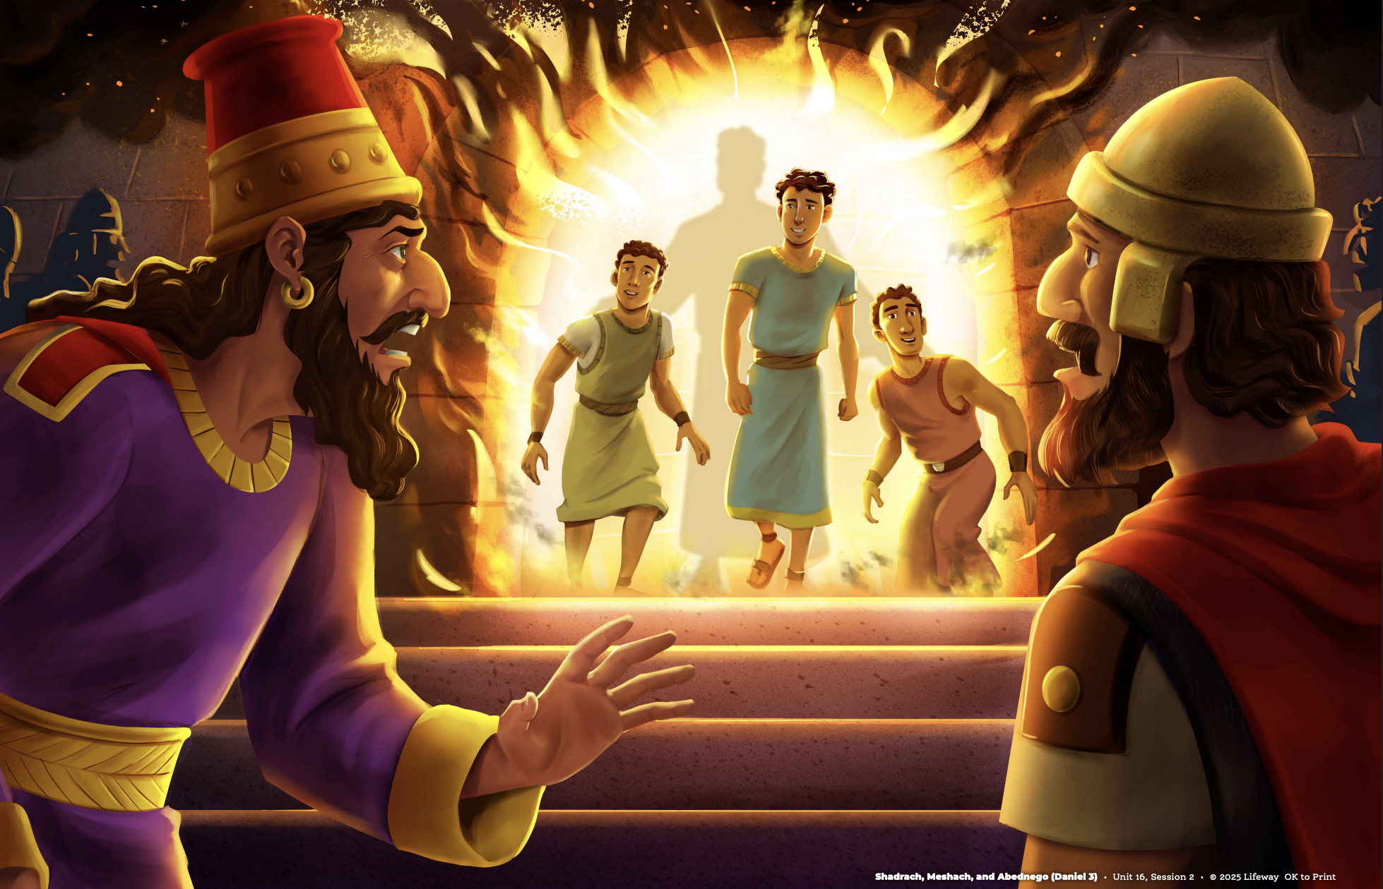

Slide 2
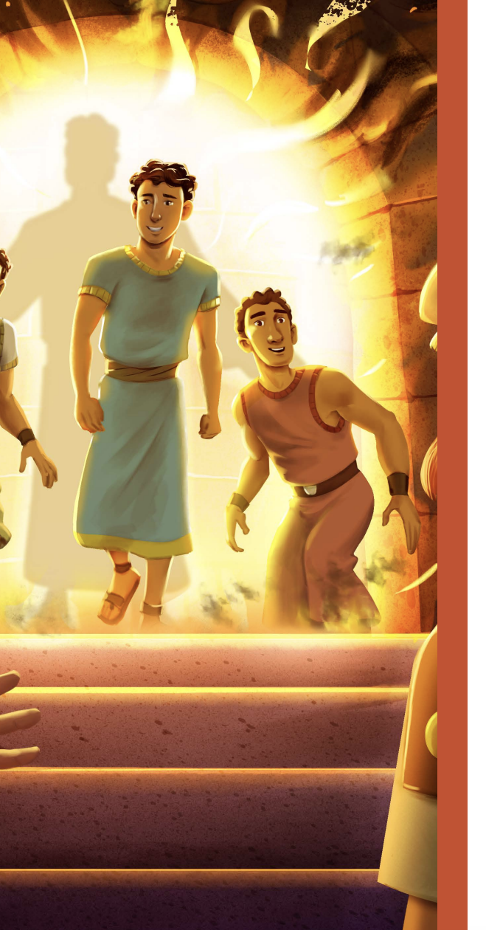
Shadrach, Meshach, and Abednego obeyed God by refusing to worship the gold statue.

Slide 3
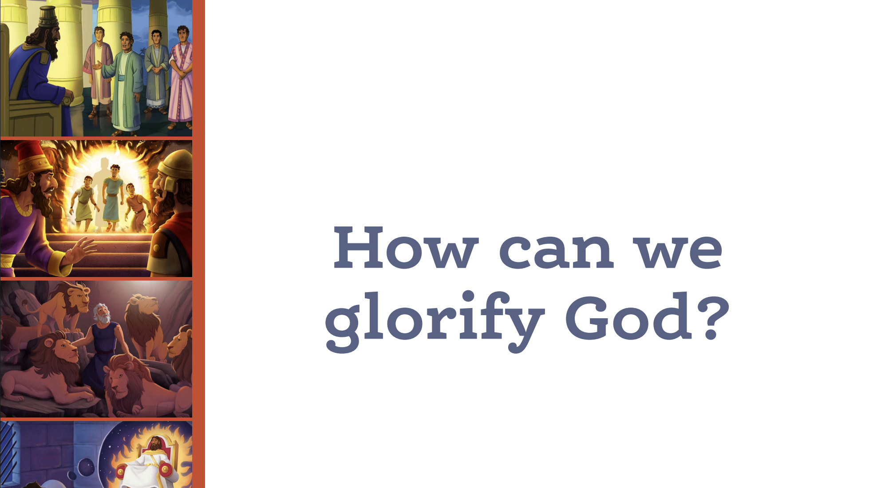

Slide 4
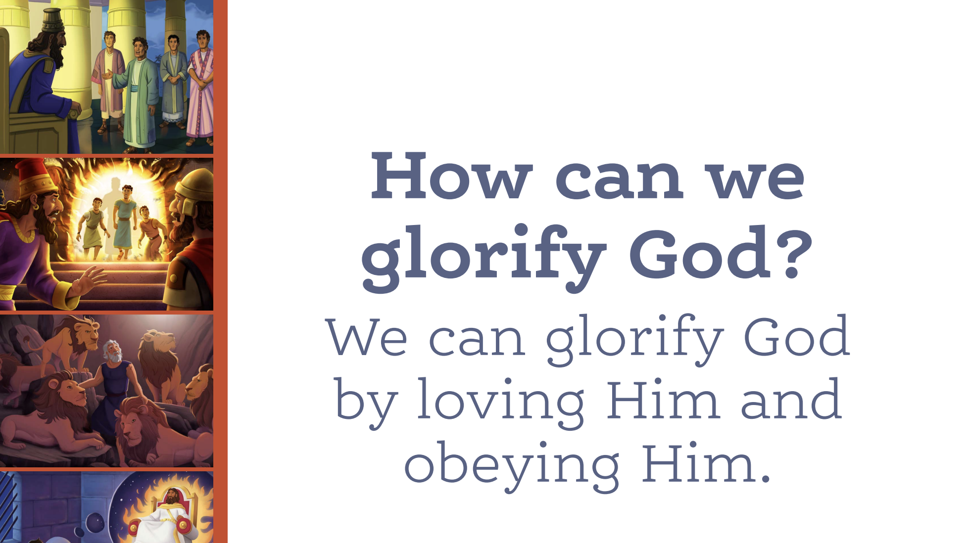

Slide 5
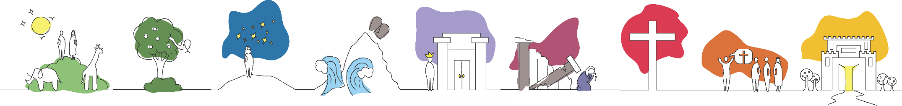



Creation
The
Fall
The
Promised
Kingdom
Exodus
and the
Promised
Land
Kings
and the
Temple
Divided
Kingdom
Jesus’
Birth,
Death,
and Resurrection
The
Church
Spreads
The
New
Creation

Slide 6

Creation
The
Fall
The
Promised
Kingdom
Exodus
and the
Promised
Land
Kings
and the
Temple
Divided
Kingdom
Jesus’
Birth,
Death,
and Resurrection
The
Church
Spreads
The
New
Creation

Slide 7
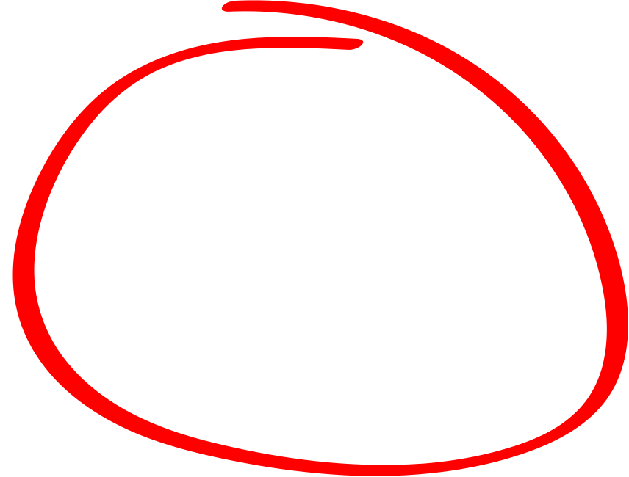
We
are Here!
Creation
The
Fall
The
Promised
Kingdom
Exodus
and the
Promised
Land
Kings
and the
Temple
Divided
Kingdom
Jesus’
Birth,
Death,
and Resurrection
The
Church
Spreads
The
New
Creation

Slide 8
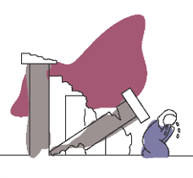

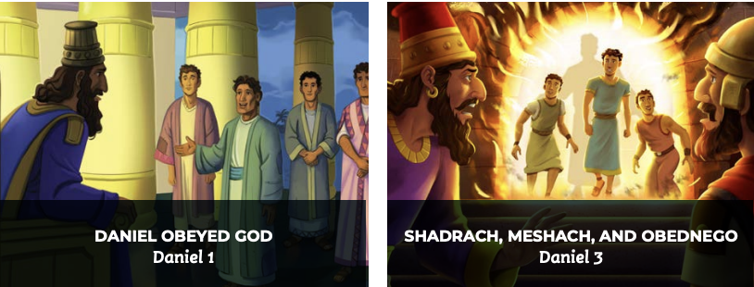
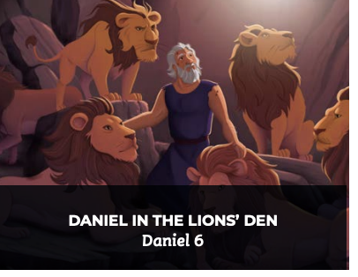

Slide 10
