Slide 2
Blessed is the one . . .

Slide 3
We don’t live for happiness, we live for holiness.
All human beings seek to lead lives not just of pleasure, but of purpose, righteousness, and virtue.
. . . people have a responsibility to become more moral over time.
The best life is oriented around the increasing excellence of the soul and is nourished by moral joy,
the quiet sense of gratitude and tranquility
that comes as a byproduct of successful moral struggle.
- David Brooks

Slide 4
1 Blessed is the one
who does not walk in step with the wicked
or stand in the way that sinners take
or sit in the company of mockers . . .

Slide 5
1 Blessed is the one
who does not walk in step with the wicked
or stand in the way that sinners take
or sit in the company of mockers . . .

Slide 6
Blessed is the one . . .
whose delight is in the law of the Lord,
and who meditates on his law day and night.
That person is like a tree planted by streams of water,
which yields its fruit in season
and whose leaf does not wither—
whatever they do prospers.

Slide 7
Psalm 1 starts ‘Blessed . . .’
Psalm 2 ends
Serve the Lord with fear
and celebrate his rule with trembling.
Kiss his son, or he will be angry
and your way will lead to your destruction,
for his wrath can flare up in a moment.
Blessed are all who take refuge in him.

Slide 8
Blessed is the one . . .
whose delight is in the law of the Lord,
and who meditates on his law day and night.
That person is like a tree planted by streams of water,
which yields its fruit in season
and whose leaf does not wither—
whatever they do prospers.

Slide 9
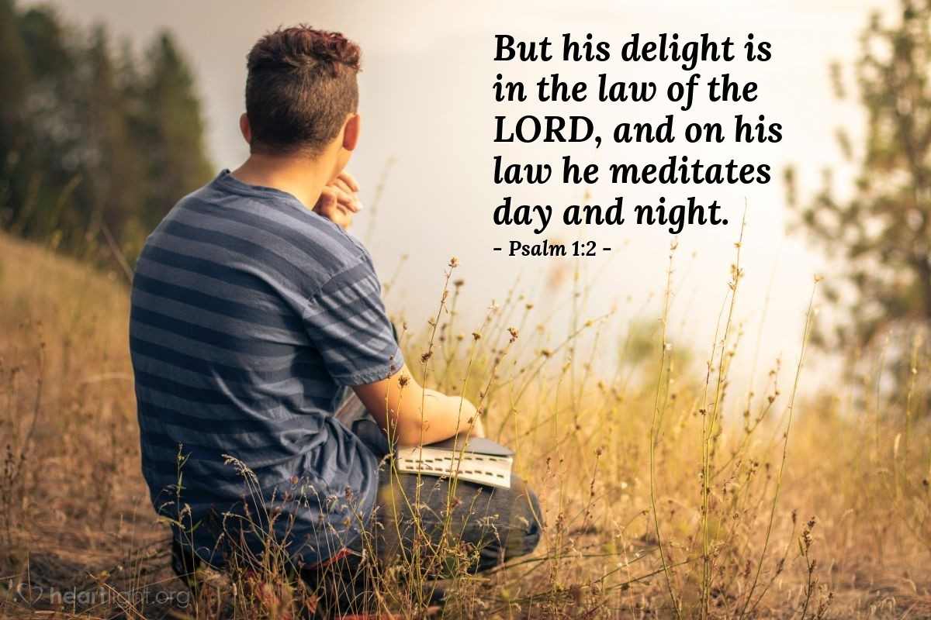

Slide 10


Slide 11
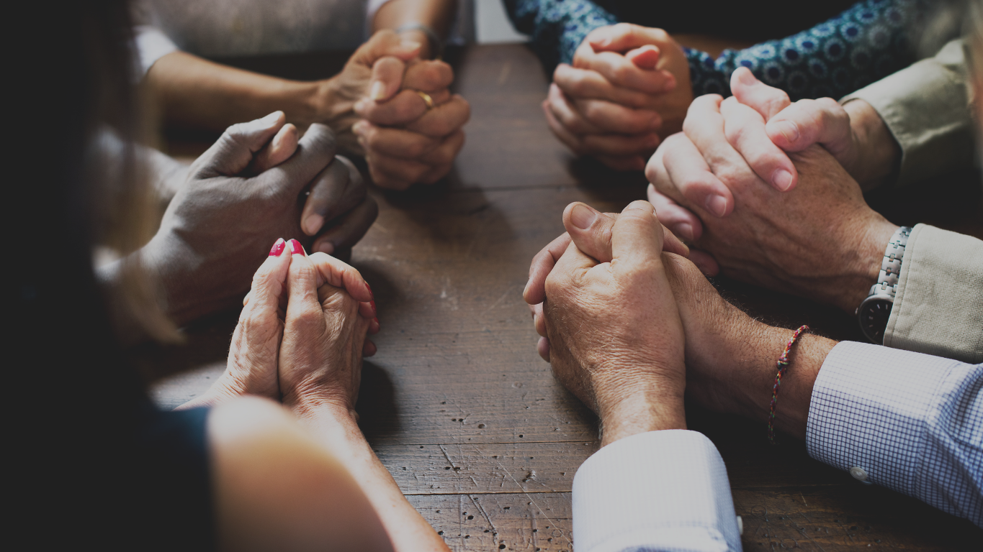

Slide 12
As you work on your resume virtues
don’t neglect your eulogy virtues.

Slide 13
“. . . the Lord watches over
the way of the righteous.”

