Slide 1
Simply stated, grace is undeserved favor and blessing. Share about a time someone gave you grace.

Slide 2

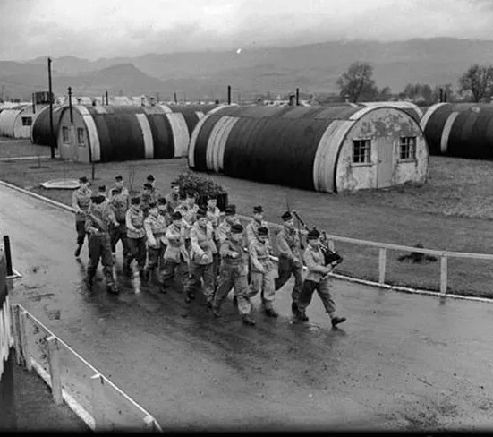
The Grace We Need
1st Corinthians 1:3-9

Slide 3

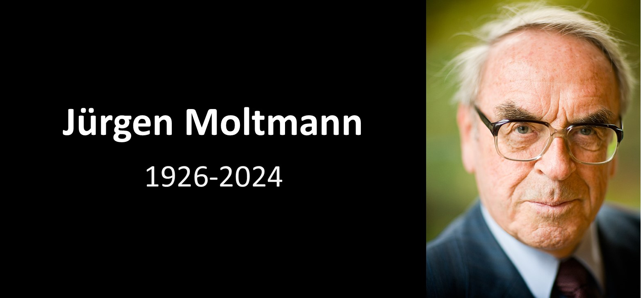




Slide 4
1 Corinthians 1:3-9
³ Grace and peace to you from God our Father and the Lord Jesus Christ.
⁴ I always thank my God for you because of his grace given you in Christ Jesus. ⁵ For in him you have been enriched in every way—with all kinds of speech and with all knowledge— ⁶ God thus confirming our testimony about Christ among you. ⁷ Therefore you do not lack any spiritual gift as you eagerly wait for our Lord Jesus Christ to be revealed. ⁸ He will also keep you firm to the end, so that you will be blameless on the day of our Lord Jesus Christ. ⁹ God is faithful, who has called you into fellowship with his Son, Jesus Christ our Lord.

Slide 5
#1. Biblical grace is, from start to finish, about our God.
1 Cor. 1:3--Grace and peace to you from God our Father and the Lord Jesus Christ.

Slide 6
#2. Biblical grace has two sides to the same coin:
a.) undeserved favor from God &
b.) powerful, practical helpfulness from God.

Slide 7
Ephesians 2:4-9—“But because of his great love for us, God, who is rich in mercy, ⁵ made us alive with Christ even when we were dead in transgressions—it is by grace you have been saved. ⁶ And God raised us up with Christ and seated us with him in the heavenly realms in Christ Jesus, ⁷ in order that in the coming ages he might show the incomparable riches of his grace, expressed in his kindness to us in Christ Jesus. ⁸ For it is by grace you have been saved,
through faith—and this is not from yourselves, it is the gift of God— ⁹ not by works, so that no one can boast.”

Slide 8
Acts 15:10-11
“Now then, why do you try to test God by putting on the necks of Gentiles a yoke that neither we nor our ancestors have been able to bear? ¹¹ No! We believe it is through the grace of our Lord Jesus that we are saved, just as they are.”

Slide 9
Romans 3:23-24
“For all have sinned and fall short of the glory of God, ²⁴ and all are justified freely by his grace through the redemption that came by Christ Jesus.”

Slide 10
God’s grace cannot coexist with…
Human merit

Slide 11
God’s grace cannot coexist with…
Human merit
Human obligation

Slide 12
God’s grace cannot coexist with…
Human merit
Human obligation
Human guilt

Slide 13
Grace we need in the PRESENT
1 Corinthians 1:5-7
“For in him you have been enriched in every way—with all kinds of speech and with all knowledge— ⁶ God thus confirming our testimony about Christ among you. ⁷ Therefore you do not lack any spiritual gift...⁹God is faithful, who has called you into fellowship with his Son, Jesus Christ our Lord.”

Slide 14
Grace we need in the PRESENT
1 Corinthians 1:5-7
“For in him you have been enriched in every way—with all kinds of speech and with all knowledge— ⁶ God thus confirming our testimony about Christ among you. ⁷ Therefore you do not lack any spiritual gift...⁹God is faithful, who has called you into fellowship with his Son, Jesus Christ our Lord.”

Slide 15
Grace we need in the PRESENT
1 Corinthians 1:5-7
“For in him you have been enriched in every way—with all kinds of speech and with all knowledge— ⁶ God thus confirming our testimony about Christ among you. ⁷ Therefore you do not lack any spiritual gift...⁹God is faithful, who has called you into fellowship with his Son, Jesus Christ our Lord.”

Slide 16
2 Greek words that are connected:
Grace = (Gk) charis
Gifts = (Gk) charisma

Slide 17
1 Corinthians 1:9
God is faithful, who has called you into fellowship with his Son, Jesus Christ our Lord.

Slide 18
1 Corinthians 1:9
God is faithful, who has called you into fellowship with his Son, Jesus Christ our Lord
1 John 1:3
We proclaim to you what we have seen and heard, so that you also may have fellowship with us. And our fellowship is with the Father and with his Son, Jesus Christ.

Slide 19
Grace we need in the FUTURE
1 Corinthians 1:7-8
⁷ Therefore you do not lack any spiritual gift as you eagerly wait for our Lord Jesus Christ to be revealed. ⁸ He will also keep you firm to the end, so that you will be blameless on the day of our Lord Jesus Christ.

Slide 20
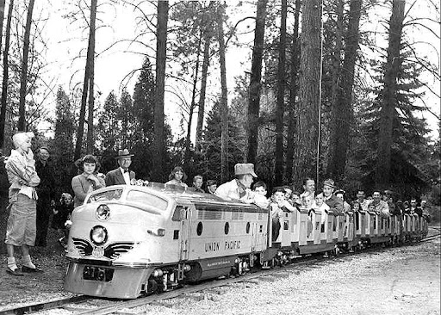
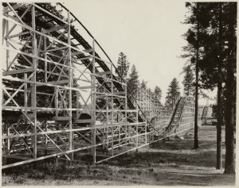
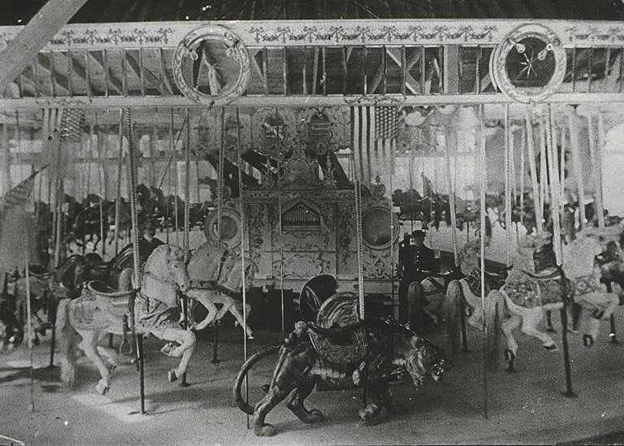

Slide 21
Grace we need in the FUTURE
1 Corinthians 15:10
But by the grace of God I am what I am, and his grace to me was not without effect. No, I worked harder than all of them—yet not I, but the grace of God that was with me.

Slide 22
1 Corinthians 1:8-9
He will also keep you firm to the end, so that you will be blameless on the day of our Lord Jesus Christ. ⁹ God is faithful,
who has called you into fellowship with his Son, Jesus Christ our Lord.

