Slide 1


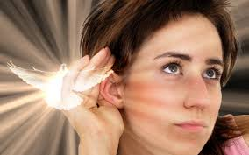



Tell someone about an experience you have had where you sensed God was speaking to or guiding you.

Slide 2
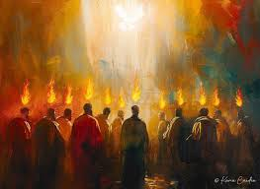
The Holy Spirit in the book of Acts
Knowing the Voice of the Spirit

Slide 3
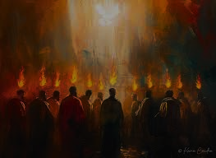
What does the Holy Spirit love to speak to us about?
1. Jesus and his words to us.

Slide 4
Hebrews 1:1-2
In the past God spoke to our ancestors through the prophets at many times and in various ways, ² but in these last days he has spoken to us by his Son….

Slide 5
John 14:26
But the Advocate, the Holy Spirit, whom the Father will send in my name, will teach you all things and will remind you of everything I have said to you.
John 15:26, 27
“When the Advocate comes, whom I will send to you from the Father—the Spirit of truth who goes out from the Father—he will testify about me. ²⁷ And you also must testify, for you have been with me from the beginning.”

Slide 6
What does the Holy Spirit love to speak to us about?
Jesus and his words to us.
What, when, where, how and to whom he wants us to talk about Jesus Christ and the Gospel.

Slide 7
Acts 1:8
But you will receive power when the Holy Spirit comes on you; and you will be my witnesses in Jerusalem, and in all Judea and Samaria, and to the ends of the earth.”
Acts 2—Peter’s sermon at Pentecost

Slide 8
Acts 4
The priests and the captain of the temple guard and the Sadducees came up to Peter and John while they were speaking to the people. ² They were greatly disturbed because the apostles were teaching the people, proclaiming in Jesus the resurrection of the dead. ³ They seized Peter and John and, because it was evening, they put them in jail until the next day. ⁴ But many who heard the message believed; so the number of men who believed grew to about five thousand.”

Slide 9
Acts 4
“¹¹ Jesus is ‘the stone you builders rejected, which has become the cornerstone.’ ¹² Salvation is found in no one else, for there is no other name under heaven given to mankind by which we must be saved.”
¹⁸ Then they called them in again and commanded them not to speak or teach at all in the name of Jesus. ¹⁹ But Peter and John replied, “Which is right in God’s eyes: to listen to you, or to him [Jesus]? You be the judges! ²⁰ As for us, we cannot help speaking about what we have seen and heard.”

Slide 10
Acts 4
“¹¹ Jesus is ‘the stone you builders rejected, which has become the cornerstone.’ ¹² Salvation is found in no one else, for there is no other name under heaven given to mankind by which we must be saved.”

Slide 11
Acts 4
¹⁸ Then they called them in again and commanded them not to speak or teach at all in the name of Jesus. ¹⁹ But Peter and John replied, “Which is right in God’s eyes: to listen to you, or to him [Jesus]? You be the judges! ²⁰ As for us, we cannot help speaking about what we have seen and heard.”

Slide 12
  Acts 5
  ²⁷ The apostles were brought in and made to appear before the Sanhedrin to be questioned by the high priest. ²⁸ “We gave you strict orders not to teach in this name,” he said. “Yet you have filled Jerusalem with your teaching and are determined to make us guilty of this man’s blood.”
  ²⁹ Peter and the other apostles replied: “We must obey God rather than human beings! ³⁰ The God of our ancestors raised Jesus from the dead—whom you killed by hanging him on a cross. ³¹ God exalted him to his own right hand as Prince and Savior that he might bring Israel to repentance and forgive their sins. ³² We are witnesses of these things, and so is the Holy Spirit, whom God has given to those who obey him.”

Slide 13
What does the Holy Spirit love to speak to us about?
Jesus and his words to us.
What, when, where, how and to whom he wants us to talk about Jesus Christ and the Gospel.
The things God wants us to do and the places he wants us to go.

Slide 14
  Acts 8:29—Philip and the Ethiopian Official
  The Spirit told Philip, “Go to that chariot and stay near it.”

Slide 15
  Acts 10-11—Peter and Cornelius
  10:¹⁹ While Peter was still thinking about the vision, the Spirit said to him, “Simon, three men are looking for you. ²⁰ So get up and go downstairs. Do not hesitate to go with them, for I have sent them.”

Slide 16
  Acts 20:22-23—Paul at Ephesus
  “And now, compelled by the Spirit, I am going to Jerusalem, not knowing what will happen to me there. ²³ I only know that in every city the Holy Spirit warns me that prison and hardships are facing me.

Slide 17
Acts 21—¹⁰ After we had been there a number of days, a prophet named Agabus came down from Judea. ¹¹ Coming over to us, he took Paul’s belt, tied his own hands and feet with it and said, “The Holy Spirit says, ‘In this way the Jewish leaders in Jerusalem will bind the owner of this belt and will hand him over to the Gentiles.’”
¹² When we heard this, we and the people there pleaded with Paul not to go up to Jerusalem.
¹³ Then Paul answered, “Why are you weeping and breaking my heart? I am ready not only to be bound, but also to die in Jerusalem for the name of the Lord Jesus.” ¹⁴ When he would not be dissuaded, we gave up and said, “The Lord’s will be done.”

Slide 18
Romans 8:16-18
¹⁶ The Spirit himself testifies with our spirit that we are God’s children. ¹⁷ Now if we are children, then we are heirs—heirs of God and co-heirs with Christ, if indeed we share in his sufferings in order that we may also share in his glory. ¹⁸ I consider that our present sufferings are not worth comparing with the glory that will be revealed in us.

Slide 19
QUESTIONS?

Slide 20
James 1:4-6
⁴ Let perseverance finish its work so that you may be mature and complete, not lacking anything. ⁵ If any of you lacks wisdom, you should ask God, who gives generously to all without finding fault, and it will be given to you. ⁶ But when you ask, you must believe and not doubt, because the one who doubts is like a wave of the sea, blown and tossed by the wind.

Slide 21
Acts 16:6-10
⁶ Paul and his companions traveled throughout the region of Phrygia and Galatia, having been kept by the Holy Spirit from preaching the word in the province of Asia. ⁷ When they came to the border of Mysia, they tried to enter Bithynia, but the Spirit of Jesus would not allow them to. ⁸ So they passed by Mysia and went down to Troas. ⁹ During the night Paul had a vision of a man of Macedonia standing and begging him, “Come over to Macedonia and help us.” ¹⁰ After Paul had seen the vision, we got ready at once to leave for Macedonia, concluding that God had called us to preach the gospel to them.

Slide 22
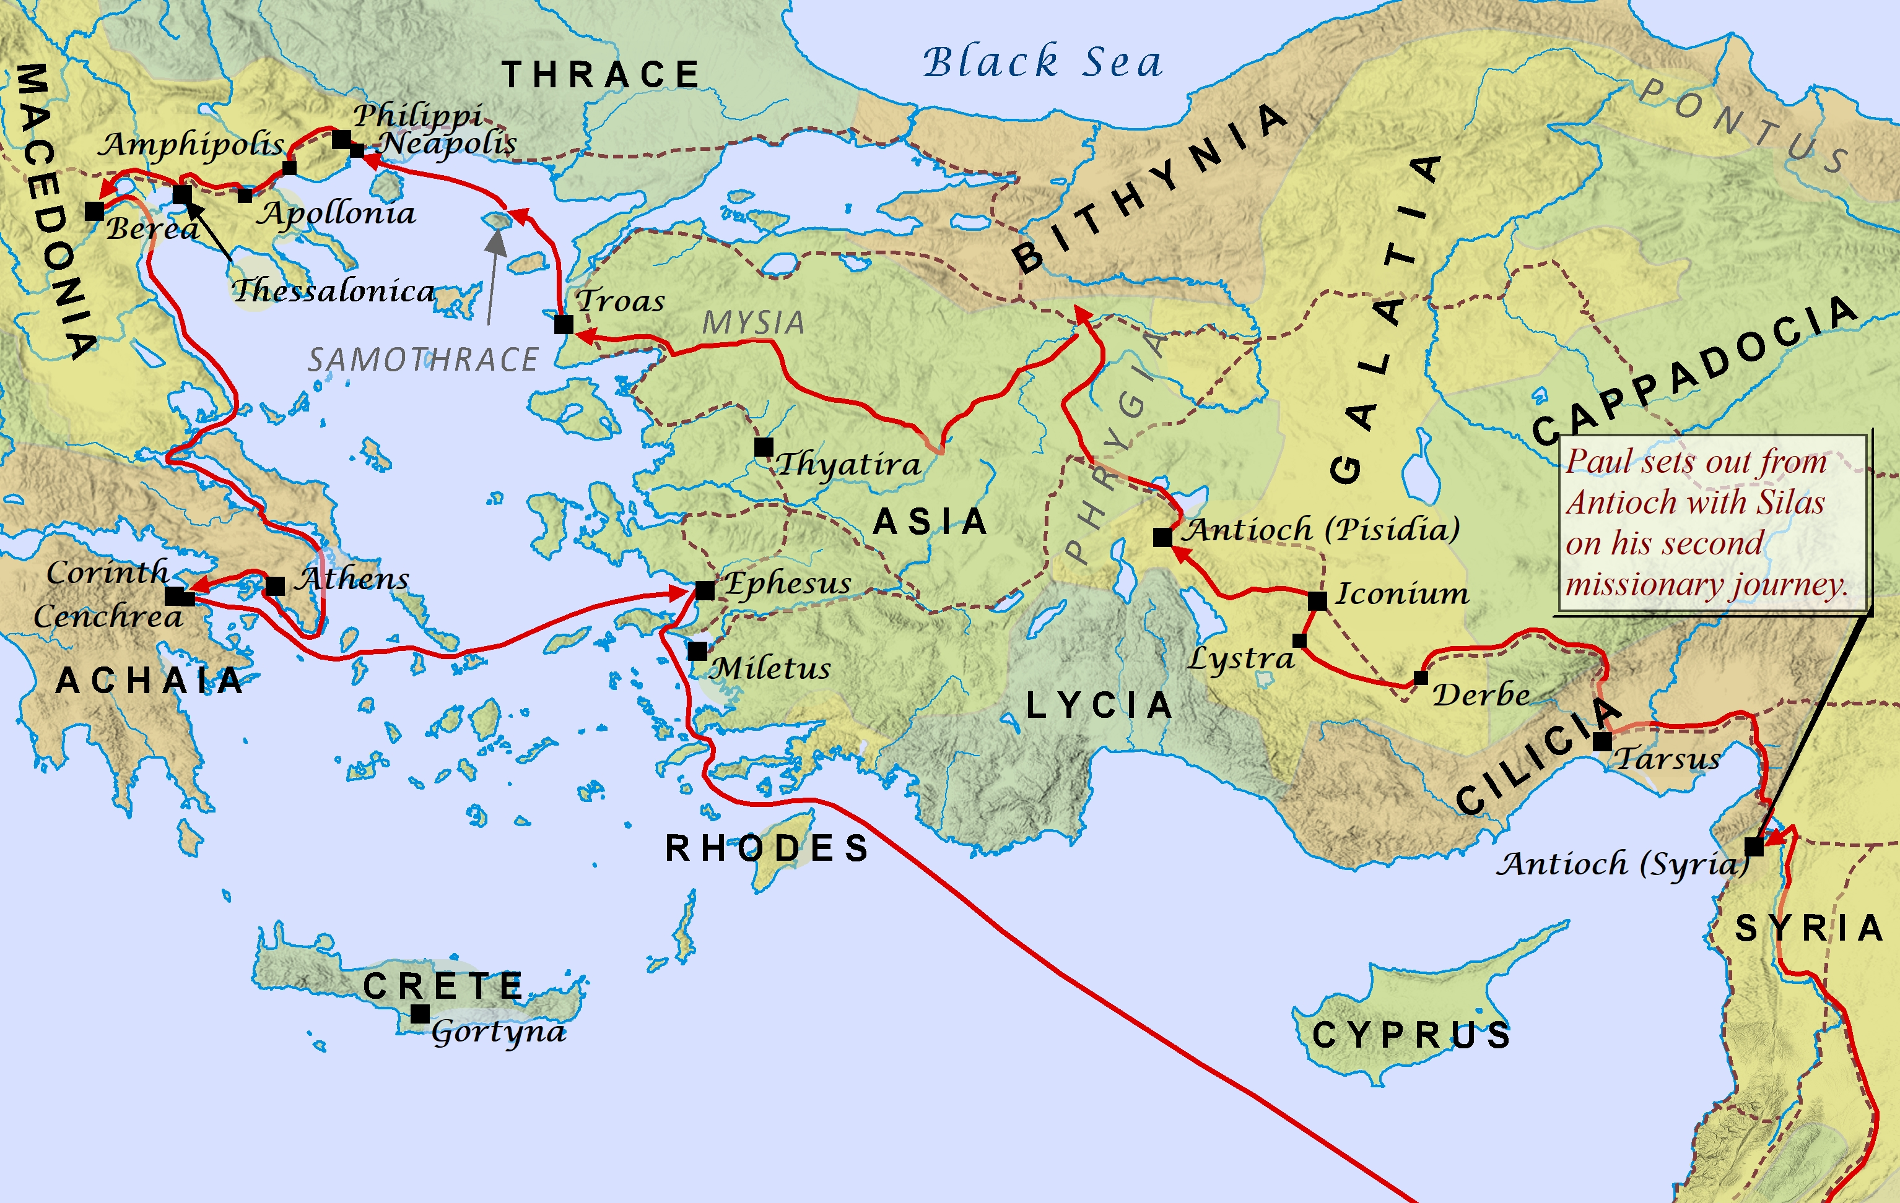

Slide 23
What does the Holy Spirit love to speak to us about?
Jesus and his words to us.
What, when, where, how and to whom he wants us to talk about Jesus Christ and the Gospel.
The things God wants us to do and the places he wants us to go.

