Slide 1






If you were to identify one shortcoming of the church today, what might it be?

Slide 2
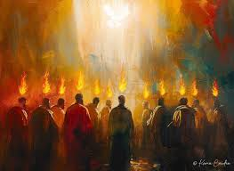
Acts 2:41—3,000 new believers added.
Acts 4:4—the church grows to 5,000 men (20,000 believers?).
Acts 5:14—“More and more men and women believed in the Lord and were added to their number.”

Slide 3
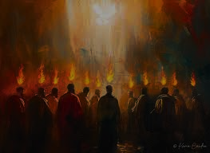
Acts 4:32-35 ³² All the believers were one in heart and mind. No one claimed that any of their possessions was their own, but they shared everything they had. ³³ With great power the apostles continued to testify to the resurrection of the Lord Jesus. And God’s grace was so powerfully at work in them all ³⁴ that there were no needy persons among them. For from time to time those who owned land or houses sold them, brought the money from the sales ³⁵ and put it at the apostles’ feet, and it was distributed to anyone who had need.

Slide 4
Acts 6:1 In those days when the number of disciples was increasing, the Hellenistic Jews among them complained against the Hebraic Jews because their widows were being overlooked in the daily distribution of food.

Slide 5
Acts 6:2-4 ² So the Twelve gathered all the disciples together and said, “It would not be right for us to neglect the ministry of the word of God in order to wait on tables. ³ Brothers and sisters, choose seven men from among you who are known to be full of the Spirit and wisdom. We will turn this responsibility over to them ⁴ and will give our attention to prayer and the ministry of the word.”

Slide 6
Essential Qualities of Servant Leaders in the Church
1.) Full of the Holy Spirit
2.) Full of wisdom

Slide 7
Galatians 5:22 But the fruit of the Spirit is love, joy, peace, forbearance, kindness, goodness, faithfulness, gentleness and self-control. Against such things there is no law.

Slide 8
James 3:13-17 Who is wise and understanding among you? Let them show it by their good life, by deeds done in the humility that comes from wisdom. ¹⁴ But if you harbor bitter envy and selfish ambition in your hearts, do not boast about it or deny the truth. ¹⁵ Such “wisdom” does not come down from heaven but is earthly, unspiritual, demonic. ¹⁶ For where you have envy and selfish ambition, there you find disorder and every evil practice. ¹⁷ But the wisdom that comes from heaven is first of all pure; then peace-loving, considerate, submissive, full of mercy and good fruit, impartial and sincere. ¹⁸ Peacemakers who sow in peace reap a harvest of righteousness.

Slide 9
Acts 6:5-7— “This proposal pleased the whole group. They chose Stephen, a man full of faith and of the Holy Spirit; also Philip, Procorus, Nicanor, Timon, Parmenas, and Nicolas from Antioch, a convert to Judaism. ⁶ They presented these men to the apostles, who prayed and laid their hands on them. ⁷ So the word of God spread. The number of disciples in Jerusalem increased rapidly, and a large number of priests became obedient to the faith.”

Slide 10
Essential Qualities of Servant Leaders in the Church
1.) Full of the Holy Spirit
2.) Full of wisdom
3.) Full of FAITH

Slide 11
Acts 6:8 Now Stephen, a man full of God’s grace and power, performed great wonders and signs among the people.

Slide 12
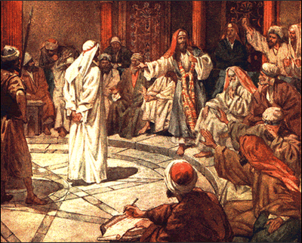
Jewish leaders accuse Stephen

Slide 13
Acts 7:51-53 “You stiff-necked people! Your hearts and ears are still uncircumcised. You are just like your ancestors: You always resist the Holy Spirit! ⁵² Was there ever a prophet your ancestors did not persecute? They even killed those who predicted the coming of the Righteous One. And now you have betrayed and murdered him— ⁵³ you who have received the law that was given through angels but have not obeyed it.”

Slide 14
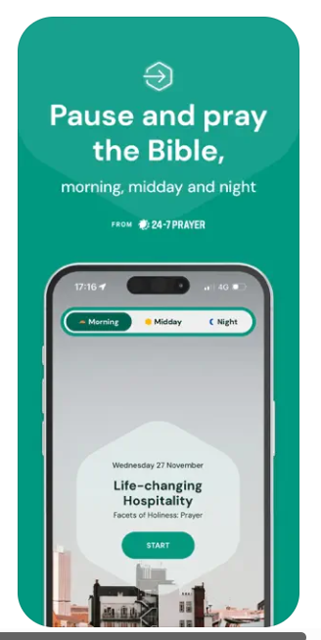
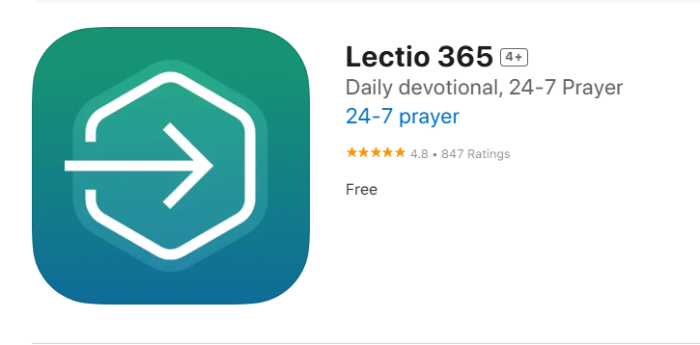

Slide 15
Essential Qualities of Servant Leaders in the Church
1.) Full of the Holy Spirit
2.) Full of wisdom
3.) Full of FAITH
4.) They speak to us about sin

Slide 16
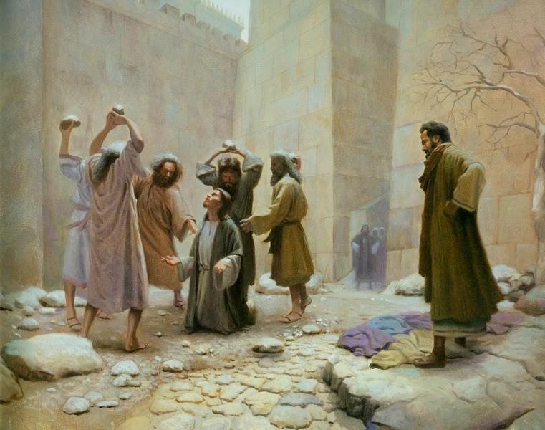

Slide 17
Acts 7:54-56 When the members of the Sanhedrin heard this, they were furious and gnashed their teeth at him. ⁵⁵ But Stephen, full of the Holy Spirit, looked up to heaven and saw the glory of God, and Jesus standing at the right hand of God. ⁵⁶ “Look,” he said, “I see heaven open and the Son of Man standing at the right hand of God.”

Slide 18
Acts 7:54-56 ⁵⁷ At this they covered their ears and, yelling at the top of their voices, they all rushed at him, ⁵⁸ dragged him out of the city and began to stone him. Meanwhile, the witnesses laid their coats at the feet of a young man named Saul.

Slide 19
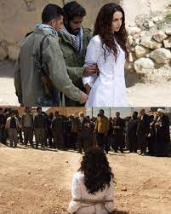


Slide 20
Essential Qualities of Servant Leaders in the Church
5.) Spirit-filled Christians, particularly church leaders, forgive like Jesus did.
Acts 7:59, 60—While they were stoning him, Stephen prayed, “Lord Jesus, receive my spirit.” ⁶⁰ Then he fell on his knees and cried out, “Lord, do not hold this sin against them.” When he had said this, he fell asleep.

