Slide 1






Tell someone about how God has spoken to you in the past or recently using His Word.

Slide 2

Human communication is complex.

Slide 3
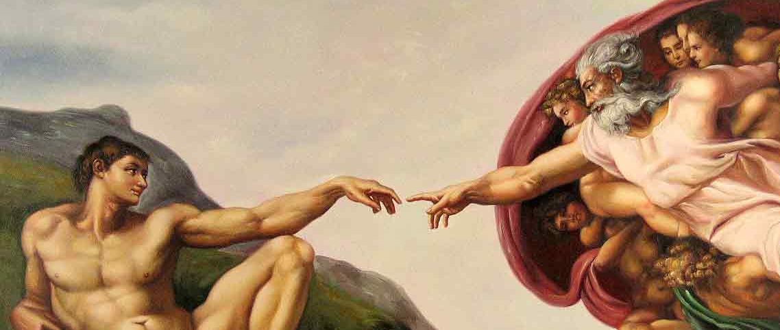
Divine-human communication is….

Slide 4
Acts 1:1,2 (NET)
I wrote the former account, Theophilus, about all that Jesus began to do and teach ² until the day he was taken up to heaven, after he had given orders by the Holy Spirit to the apostles he had chosen.

Slide 5
Acts 1:8 (NET)
But you will receive power when the Holy Spirit has come upon you, and you will be my witnesses in Jerusalem, and in all Judea and Samaria, and to the farthest parts of the earth.”

Slide 6
Acts 1:16-17, 20 (NET)
“Brothers, the scripture had to be fulfilled that the Holy Spirit foretold through David concerning Judas—who became the guide for those who arrested Jesus— ¹⁷ for he was counted as one of us and received a share in this ministry. ²⁰ “For it is written in the book of Psalms, ‘Let his house become deserted, and let there be no one to live in it,’ and ‘Let another take his position of responsibility.’

Slide 7

If we want to hear God speak, our lives must be soaked in the speech of God— the Scriptures.

Slide 8
A. New Testament authors themselves understood both the Old Testament and much (if not all) of the New Testament to be God-inspired, God-given, God-breathed Scripture.
Paul believed it: 2 Timothy 3:14-17

Slide 9
2 Timothy 3:14-17
¹⁴ But as for you, continue in what you have learned and have become convinced of, because you know those from whom you learned it, ¹⁵ and how from infancy you have known the Holy Scriptures, which are able to make you wise for salvation through faith in Christ Jesus. ¹⁶ All Scripture is God-breathed and is useful for teaching, rebuking, correcting and training in righteousness, ¹⁷ so that the servant of God may be thoroughly equipped for every good work.

Slide 10
Peter believed it: 2 Peter 1:20-21
Above all, you must understand that no prophecy of Scripture came about by the prophet’s own interpretation of things. ²¹ For prophecy never had its origin in the human will, but prophets, though human, spoke from God as they were carried along by the Holy Spirit.

Slide 11
Peter believed it about Paul’s letters:
2 Peter 3:16
“He [Paul] writes the same way in all his letters, speaking in them of these matters. His letters contain some things that are hard to understand, which ignorant and unstable people distort, as they do the other
Scriptures, to their own destruction.”

Slide 12
Jesus believed it: Matthew 5:17-19
“Do not think that I have come to abolish the Law or the Prophets; I have not come to abolish them but to fulfill them. ¹⁸ For truly I tell you, until heaven and earth disappear, not the smallest letter, not the least stroke of a pen, will by any means disappear from the Law until everything is accomplished. ¹⁹ Therefore anyone who sets aside one of the least of these commands and teaches others accordingly will be called least in the kingdom of heaven, but whoever practices and teaches these commands will be called great in the kingdom of heaven.

Slide 13
A. New Testament authors themselves understood both the Old Testament and much (if not all) of the New Testament to be God-inspired, God-given, God-breathed Scripture.
Jesus quoted extensively from the Pentateuch (all 5 books), Psalms and 8 of the 16 prophetic books.

Slide 14
B. Old Testament authors believed in the divine inspiration of their writings.
Isaiah 59:21
“As for me, this is my covenant with them,” says the Lord. “My Spirit, who is on you, will not depart from you, and my words that I have put in your mouth will always be on your lips, on the lips of your children and on the lips of their descendants—from this time on and forever,” says the Lord.
(See also 2 Sam. 23:2-3 & Jer. 1:9)

Slide 15
B. Old Testament authors believed in the divine inspiration of their writings.
Explicit statements of inspiration
Attributing their words directly to God: “Thus says the Lord….”
Direct quotes of God: “The word of the Lord” or “Thy Word….”
Fulfillment of Prophecies

Slide 16

The Bible is the only book whose author is always present when you read it.

Slide 17
John 6:63
The Spirit gives life; the flesh counts for nothing. The words I have spoken to you—they are full of the Spirit and life.

Slide 18

ILLUMINATION: the work of the Holy Spirit in helping us properly interpret & apply the Word of God.

Slide 19
John 14:26
“But the Counselor, the Holy Spirit, whom the Father will send in my name, will teach you all things and will remind you of everything I have said to you.”

Slide 20
1 Corinthians 2:12, 13
¹² What we have received is not the spirit of the world, but the Spirit who is from God, so that we may understand what God has freely given us. ¹³ This is what we speak, not in words taught us by human wisdom but in words taught by the Spirit, explaining spiritual realities with Spirit-taught words.

Slide 21
How do we experience regular, transformational encounters with God the Holy Spirit in His Word?
#1. Without the presence of the Holy Spirit in you, there is no possibility that the “circuit” of divine illumination will happen to you. Therefore, trust in Jesus who gives the Holy Spirit.

Slide 22
How do we experience regular, transformational encounters with God the Holy Spirit in His Word?
#2. Approach your time in God’s Word with…
  Pray
  Persistence: read until “the light goes on.”
  Personal Journaling: jot down what the Holy Spirit has illuminated.

