Slide 1
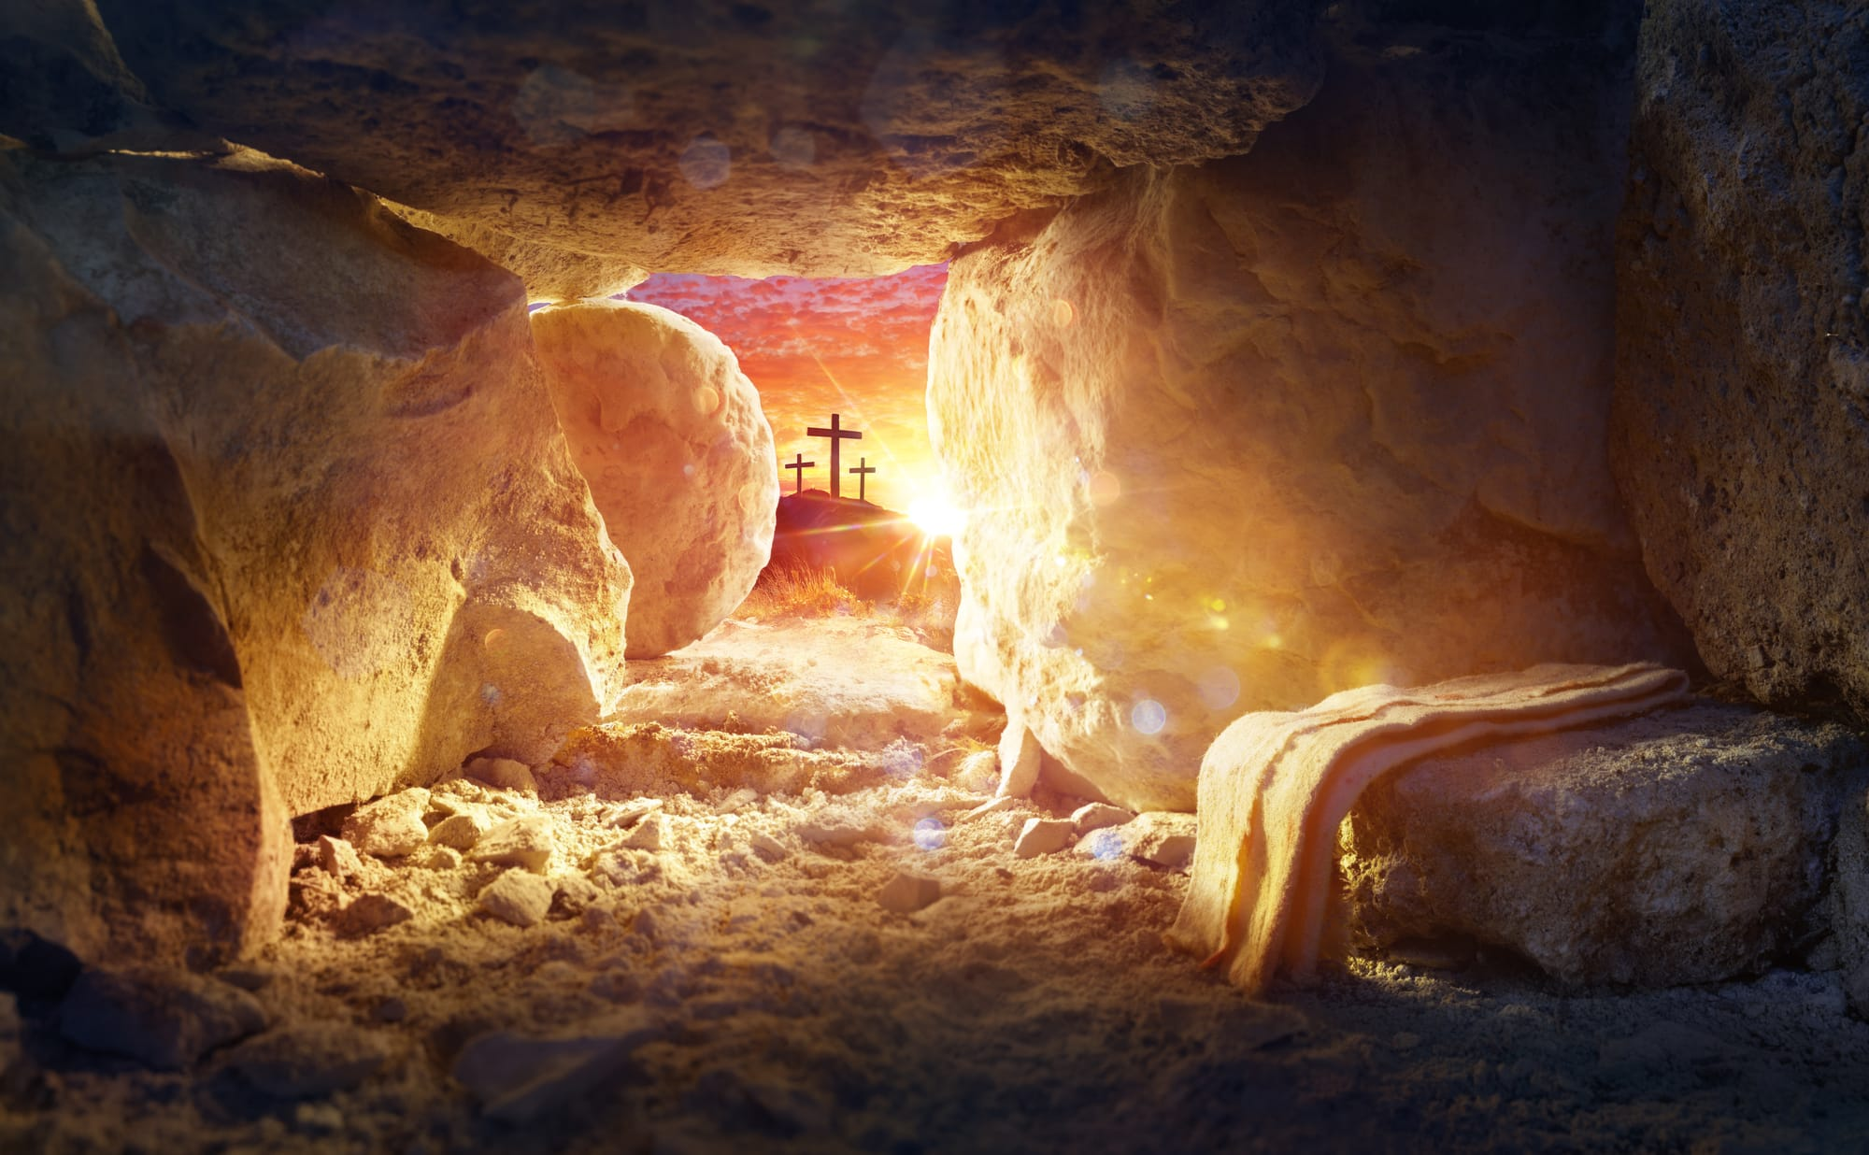
What are you grateful that Jesus’ resurrection changed?

Slide 3


Slide 5
Guarantees for EVERYONE from the Resurrection of Jesus
Every human being will be resurrected.

Slide 6

1 Corinthians 15:20-23
²⁰ But Christ has indeed been raised from the dead, the firstfruits of those who have fallen asleep. ²¹ For since death came through a man, the resurrection of the dead comes also through a man. ²² For as in Adam all die, so in Christ all will be made alive. ²³ But each in turn: Christ, the firstfruits; then, when he comes, those who belong to him. ²⁴ Then the end will come, when he hands over the kingdom to God the Father after he has destroyed all dominion, authority and power.

Slide 7
John 5:25-29
²⁵ Very truly I tell you, a time is coming and has now come when the dead will hear the voice of the Son of God and those who hear will live….
²⁸ “Do not be amazed at this, for a time is coming when all who are in their graves will hear his voice ²⁹ and come out—those who have done what is good will rise to live, and those who have done what is evil will rise to be condemned.

Slide 8
Revelation 20:4-5
Saints martyred in the Great Tribulation “…came to life and reigned with Christ a thousand years. ⁵ (The rest of the dead did not come to life until the thousand years were ended.) This is the first resurrection.”

Slide 9
1st Thessalonians 4:16
¹⁶ For the Lord himself will come down from heaven, with a loud command, with the voice of the archangel and with the trumpet call of God, and the dead in Christ will rise first.

Slide 10
Guarantees for EVERYONE from the Resurrection of Jesus
There will be a judgment for everyone.
Acts 17:31—For he [God] has set a day when he will judge the world with justice by the man [Jesus] he has appointed. He has given proof of this to everyone by raising him from the dead.”

Slide 11
Judgment of Unbelievers
Revelation 20:11-15
¹¹ Then I saw a great white throne and him who was seated on it. The earth and the heavens fled from his presence, and there was no place for them. ¹² And I saw the dead, great and small, standing before the throne, and books were opened. Another book was opened, which is the book of life. The dead were judged according to what they had done as recorded in the books.

Slide 12
Judgment of Unbelievers
Revelation 20:11-15
¹³ The sea gave up the dead that were in it, and death and Hades gave up the dead that were in them, and each person was judged according to what they had done. ¹⁴ Then death and Hades
were thrown into the lake of fire. The lake of fire is the second death. ¹⁵ Anyone whose name was not found written in the book of life was thrown into the lake of fire.

Slide 13
“Judgment” of Believers—Bema Seat
2 Corinthians 5:10
For we must all appear before the judgment seat of Christ, so that each of us may receive what is due us for the things done while in the body, whether good or bad.
See also Romans 14:10 &
1 Corinthians 3:10-15

Slide 14
Guarantees for EVERYONE from the Resurrection of Jesus
There will be a judgment for everyone… different & at different times for believers and unbelievers.

Slide 15
Guarantees for CHRIST FOLLOWERS from the Resurrection of Jesus
We have a living, productive faith that saves us from our sins.
1 Corinthians 15:14, 17
¹⁴ And if Christ has not been raised, our preaching is useless and so is your faith. ¹⁷ And if Christ has not been raised, your faith is futile; you are still in your sins.
²⁰ But Christ has indeed been raised from the dead….

Slide 16
Guarantees for CHRIST FOLLOWERS from the Resurrection of Jesus
We have the resurrection power of the God who brings life out of death at work in us.

Slide 17
Romans 6:3-4
³ Or don’t you know that all of us who were baptized into Christ Jesus were baptized into his death? ⁴ We were therefore buried with him through baptism into death in order that, just as Christ was raised from the dead through the glory of the Father, we too may live a new life.

Slide 18
Ephesians 1:19-21
⁸ I pray that the eyes of your heart may be enlightened in order that you may know the hope to which he has called you, the riches of his glorious inheritance in his holy people, ¹⁹ and his incomparably great power for us who believe. That power is the same as the mighty strength ²⁰ he exerted when he raised Christ from the dead and seated him at his right hand in the heavenly realms, ²¹ far above all rule and authority, power and dominion, and every name that is invoked, not only in the present age but also in the one to come.

Slide 19
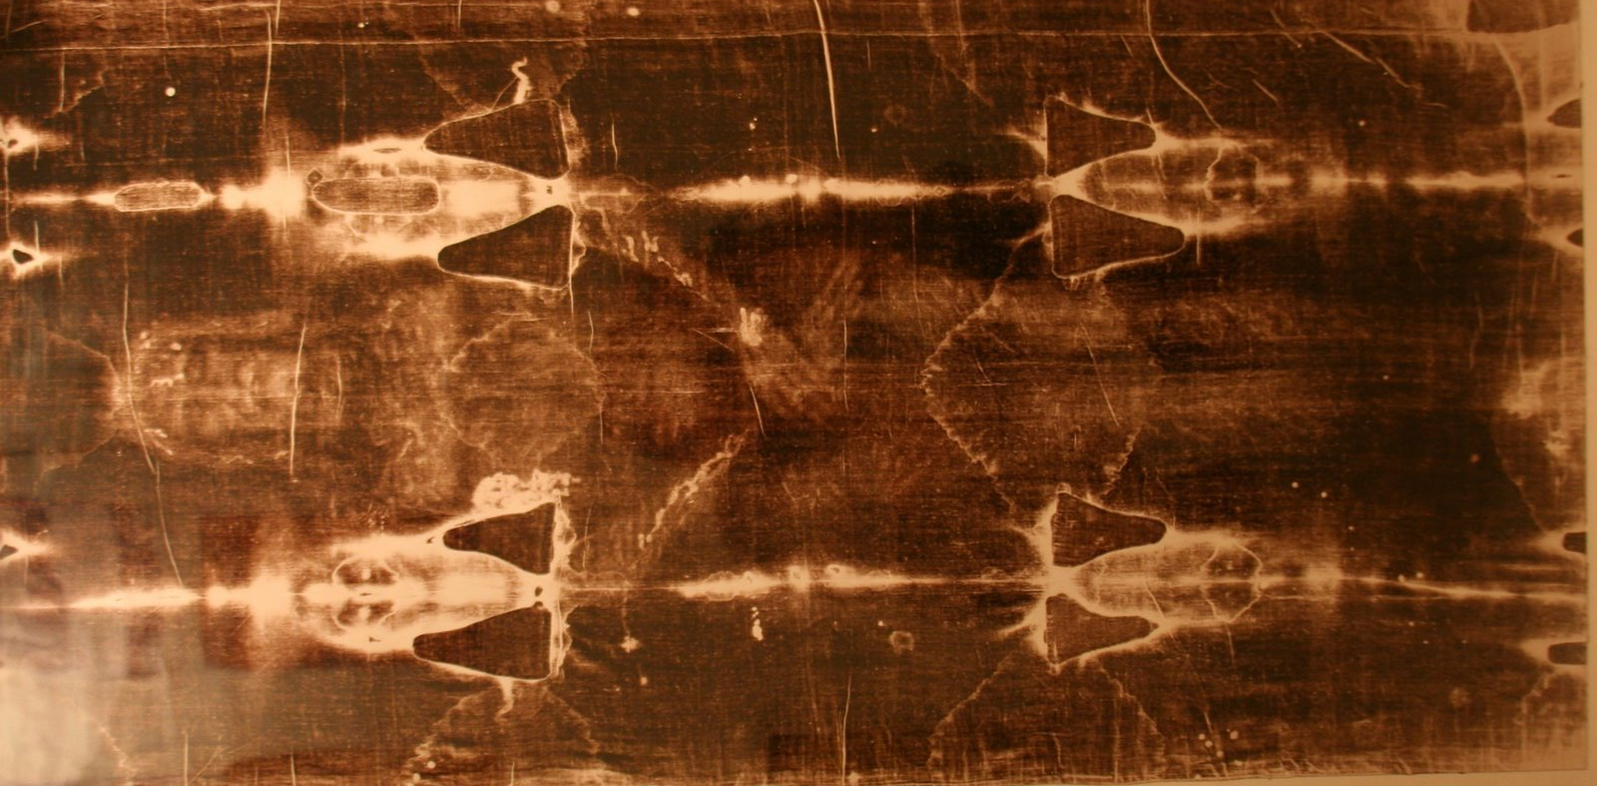
Physical Power

Slide 20
Ephesians 1:19-21—Spiritual Power
⁸ I pray that the eyes of your heart may be enlightened in order that you may know the hope to which he has called you, the riches of his glorious inheritance in his holy people, ¹⁹ and his incomparably great power for us who believe. That power is the same as the mighty strength ²⁰ he exerted when he raised Christ from the dead and seated him at his right hand in the heavenly realms, ²¹ far above all rule and authority, power and dominion, and every name that is invoked, not only in the present age but also in the one to come.

Slide 21
Guarantees for CHRIST FOLLOWERS from the Resurrection of Jesus
We have the resurrection power of the God who brings life out of death at work in us.
Physical
Spiritual
Mental & Emotional

Slide 22
Do you know the resurrected Jesus as your Savior and Lord?
Where do you want to see His resurrection power bring life to you?

