Slide 1
Share with someone about something or someone that helped you discover who God has uniquely made you to be.

Slide 2
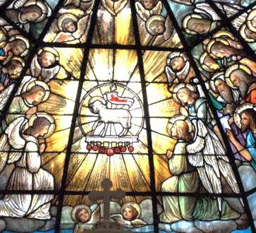
THE SAINTS WE ARE…& AREN’T
1st Corinthians 1

Slide 3

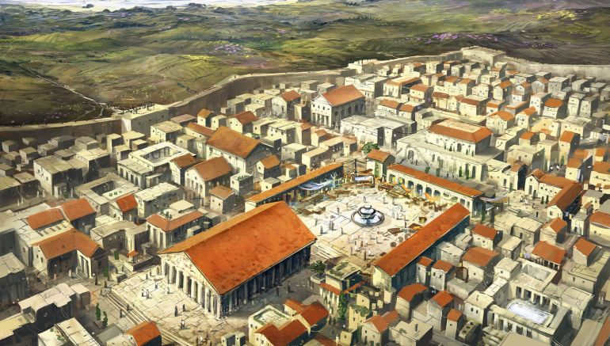




1st Corinthians

Slide 4
Paul visited Corinth on his first missionary journey.

Slide 5
Paul visited Corinth on his first missionary journey.
Paul spent almost 3 years living in Corinth establishing the church.

Slide 6
Paul visited Corinth on his first missionary journey.
Paul spent almost 3 years living in Corinth establishing the church.
The city of Corinth in Paul’s day was only about 100 years old.

Slide 7
Paul visited Corinth on his first missionary journey.
Paul spent almost 3 years living in Corinth establishing the church.
The city of Corinth in Paul’s day was less than 100 years old.
Corinth had a reputation as an immoral city.

Slide 8
Corinth was famous for which athletic games: a.) the Olympic games, or b.) the Isthmian games?

Slide 9
Corinth was famous for which athletic games: a.) the Olympic games, or b.) the Isthmian games?
Corinth was a port city.

Slide 10
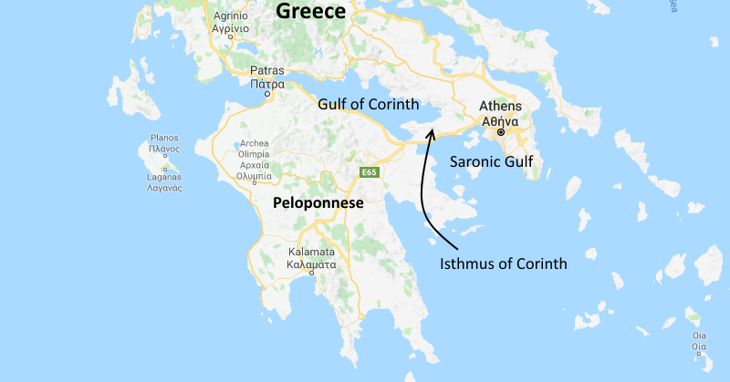

Slide 11
Corinth was famous for which athletic games: a.) the Olympic games, or b.) the Isthmian games?
Corinth was a port city.
There is currently a canal connecting those two ports.

Slide 12
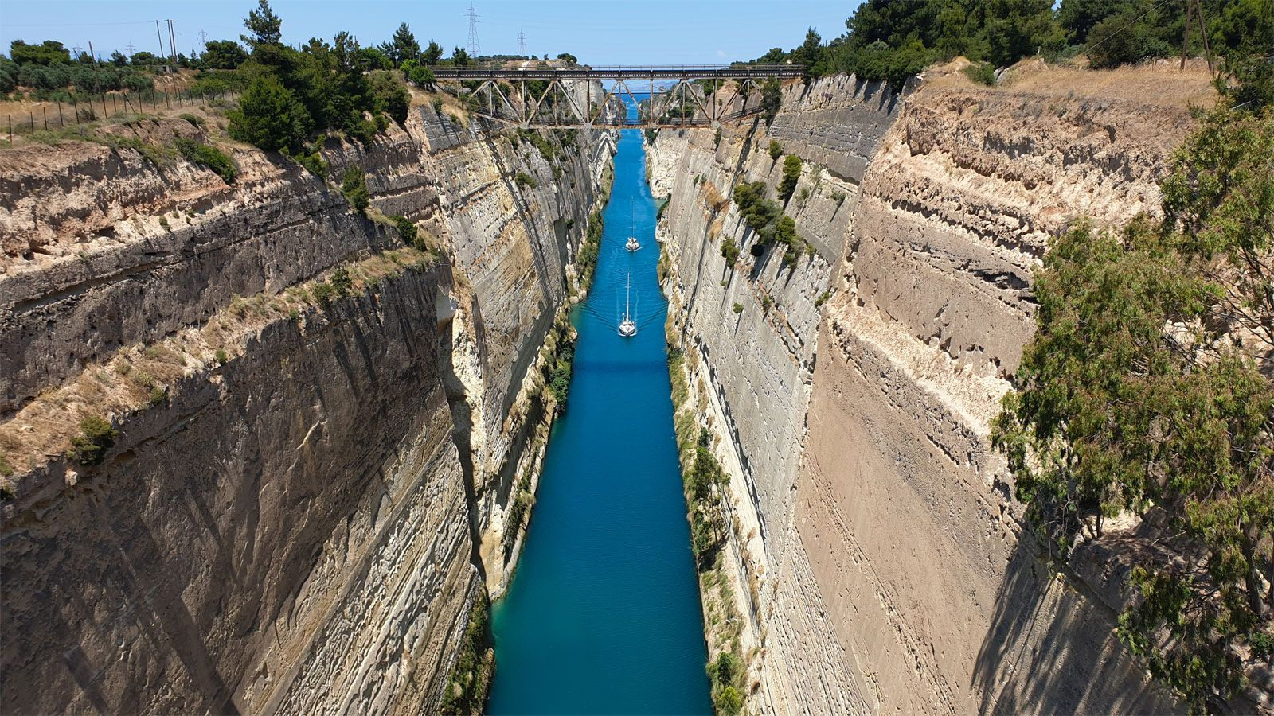

Slide 13
Corinth was famous for which athletic games: a.) the Olympic games, or b.) the Isthmian games?
Corinth was a port city.
There is currently a canal connecting those two ports.
1st Corinthians was Paul’s first letter to the Corinthian church.

Slide 14
1st Corinthians focuses more on church challenges than Christian theology.

Slide 15
1st Corinthians focuses more on church challenges than Christian theology.
1st Corinthians was written while Paul was living in Rome.

Slide 16
1st Corinthians addresses more church challenges than church theology.
1st Corinthians was written while Paul was living in Rome.
The Corinthian church was known for its abundance of spiritual gifts.

Slide 17
1st Corinthians

Slide 18
1 Corinthians 1:1
Paul, called to be an apostle of Christ Jesus by the will of God, and our brother Sosthenes….

Slide 19
1 Corinthians 1:2
To the church of God in Corinth, to those sanctified in Christ Jesus and called to be his holy people, together with all those everywhere who call on the name of our Lord Jesus Christ—their Lord and ours.

Slide 20
1. The church (ekklesia) is a “called-out people.”

Slide 21
The church (ekklesia) is a “called-out people.”
The church is also a “set-apart” people, holy saints.

Slide 22
The church (ekklesia) is a “called-out people.”
The church is also a “set-apart” people, holy saints.
What is it that makes someone a “saint” according to the New Testament?

Slide 23
Hebrews 2:11
Both the one [Jesus] who makes people holy and those who are made holy are of the same family. So Jesus is not ashamed to call them brothers and sisters.”

Slide 24
1 Corinthians 1:2
“…to those…called to be his holy people.”
God is the one who calls us.
(See Gal. 1:6; Eph 4:1,4; Col 3:15; 1 Tim. 6:12; I Peter 2:9, 21; 3:9; 2 Peter 1:3; Jude 1.)

Slide 25
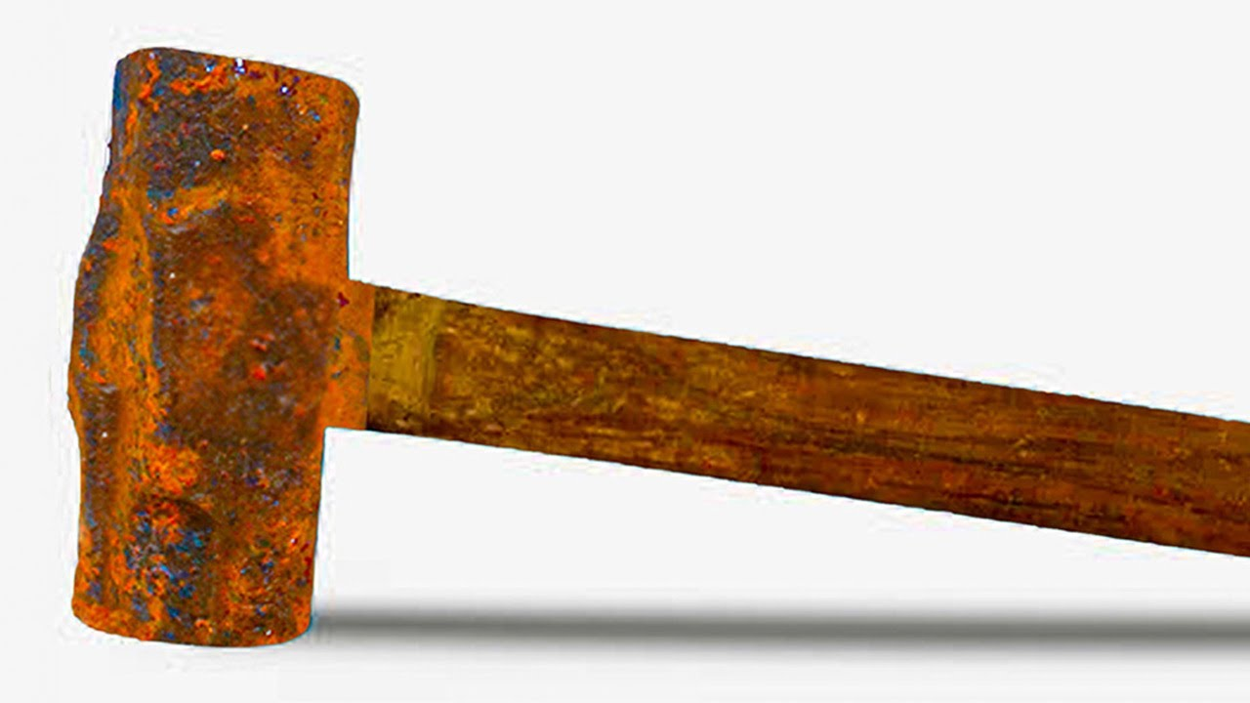

Slide 26
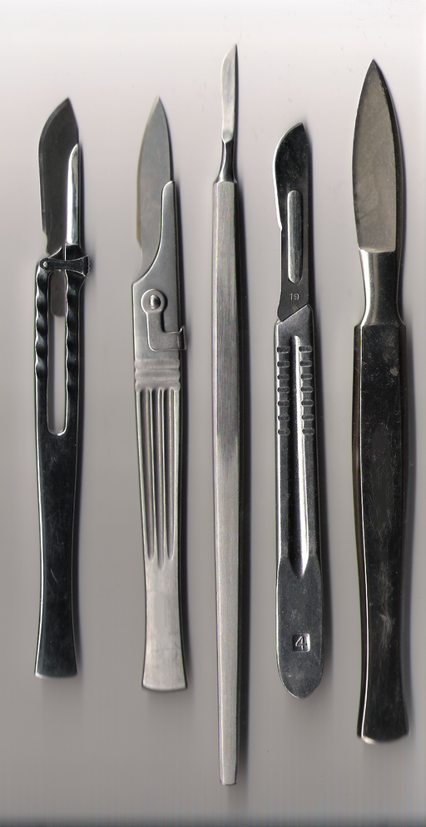

Slide 27
