Slide 1
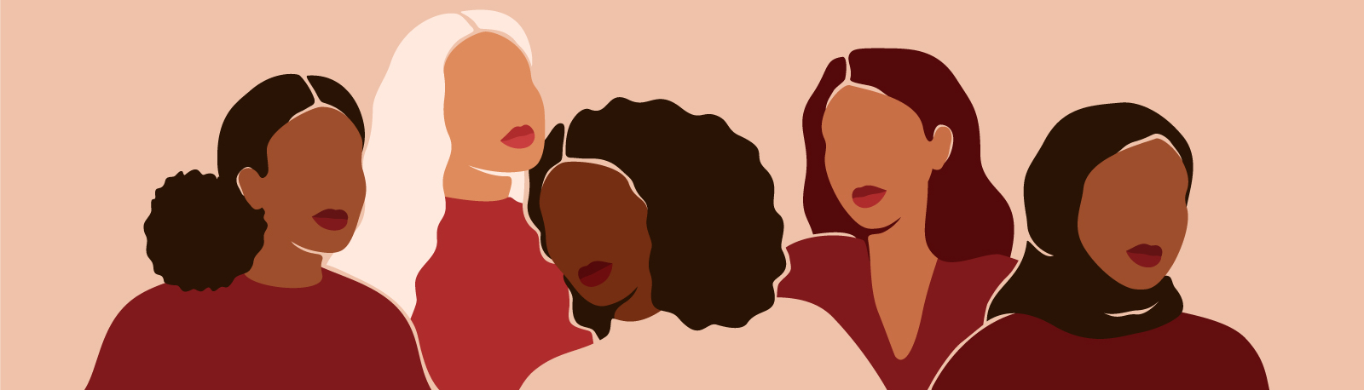
Tell someone about an important or influential woman in your life
(other than your mother)
and how she helped you.

Slide 3
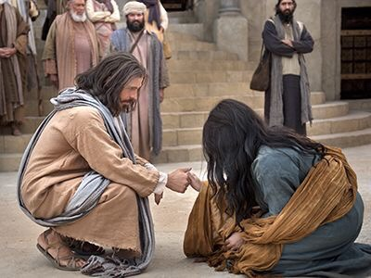
Christ, Christianity & Women

Slide 4
Women mentioned at Jesus’ Resurrection
Matt. 28 Mark 16 Luke 24 John 20
1.) Mary Magdalene
2.) Mary the mother of James
1.) Mary Magdalene
2.) Mary the mother of James
3.) Salome
1.) Mary Magdalene
2.) Joanna
3.) Mary the mother of James
4. & 5.) the “other women with them”
1.) Mary Magdalene

Slide 5
Mark 16
When the Sabbath was over, Mary Magdalene, Mary the mother of James, and Salome bought spices so that they might go to anoint Jesus’ body. ² Very early on the first day of the week, just after sunrise, they were on their way to the tomb ³ and they asked each other, “Who will roll the stone away from the entrance of the tomb?”
⁴ But when they looked up, they saw that the stone, which was very large, had been rolled away. ⁵ As they entered the tomb, they saw a young man dressed in a white robe sitting on the right side, and they were alarmed.

Slide 6
Mark 16
⁶ “Don’t be alarmed,” he said. “You are looking for Jesus the Nazarene, who was crucified. He has risen! He is not here. See the place where they laid him. ⁷ But go, tell his disciples and Peter, ‘He is going ahead of you into Galilee. There you will see him, just as he told you.’”
⁸ Trembling and bewildered, the women went out and fled from the tomb. They said nothing to anyone, because they were afraid.

Slide 7
Mark 1
⁹ When Jesus rose early on the first day of the week, he appeared first to Mary Magdalene, out of whom he had driven seven demons. ¹⁰ She went and told those who had been with him and who were mourning and weeping.
¹¹ When they heard that Jesus was alive and that she had seen him, they did not believe it.¹² Afterward Jesus appeared in a different form to two of them while they were walking in the country. ¹³ These returned and reported it to the rest; but they did not believe them either. ¹⁴ Later Jesus appeared to the Eleven as they were eating; he rebuked them for their lack of faith and their stubborn refusal to believe those who had seen him after he had risen.

Slide 8
Who is Mary Magdalene?
Mary from Magdala
Migdal = tower

Slide 9
What do we know about Mary Magdalene?
She had been possessed by 7 demons (Lk. 8:2).

Slide 10
What do we know about Mary Magdalene?
She had been possessed by 7 demons (Lk. 8:2).
She was not the “sinful woman” of Lk. 7:37.

Slide 11
What do we know about Mary Magdalene?
She had been possessed by 7 demons (Lk. 8:2).
She was not the “sinful woman” of Lk. 7:37.
She was rescued from the control of evil and transformed into a godly leader of disciples and follower of Jesus.

Slide 12
The ‘Sweet Sorrow’ of Death and Resurrection
Grief and sorrow at death of a beloved.

Slide 13
The ‘Sweet Sorrow’ of Death and Resurrection
Grief and sorrow at death of a beloved.
Joy and confidence at the reality of the resurrection.

Slide 14
Lessons from the Heart of A Godly Woman

Slide 15
Lessons from the Heart of A Godly Woman
The resurrection of Jesus completely changes the equation of grief.

Slide 16
Lessons from the Heart of A Godly Woman
The resurrection of Jesus completely changes the equation of grief.
The resurrection of Jesus actually causes death to lose its destructive power.

Slide 17
Have you really embraced the promise of the resurrection?

Slide 18
Have you really embraced the promise of the resurrection?
Men, have we adopted Jesus’ heart of sacrificial love and respect for women?

Slide 19
Have you really embraced the promise of the resurrection?
Men, have we adopted Jesus’ heart of sacrificial love and respect for women?
Women, have you embraced your divinely-given value and role as a woman in Christ?

