Slide 1

What is your favorite tax…
and why?

Slide 2
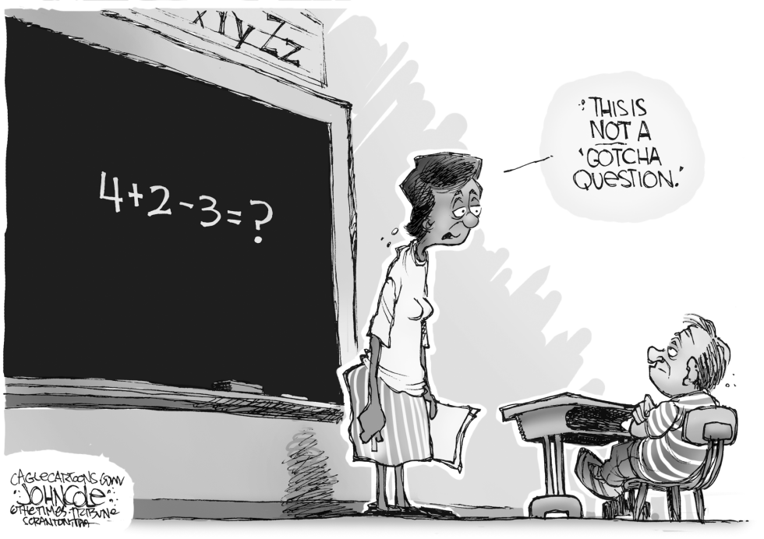

Slide 3

Mark 12:13-17
¹³ Later they sent some of the Pharisees and Herodians to Jesus to catch him in his words.
¹⁴ They came to him and said, “Teacher, we know that you are a man of integrity. You aren’t swayed by others, because you pay no attention to who they are; but you teach the way of God in accordance with the truth. Is it right to pay the imperial tax to Caesar or not? ¹⁵ Should we pay or shouldn’t we?”

Slide 4
Mark 12:13-17
But Jesus knew their hypocrisy. “Why are you trying to trap me?” he asked. “Bring me a denarius and let me look at it.” ¹⁶ They brought the coin, and he asked them, “Whose image is this? And whose inscription?”
“Caesar’s,” they replied.
¹⁷ Then Jesus said to them, “Give back to Caesar what is Caesar’s and to God what is God’s.”
And they were amazed at him.

Slide 5


Slide 6
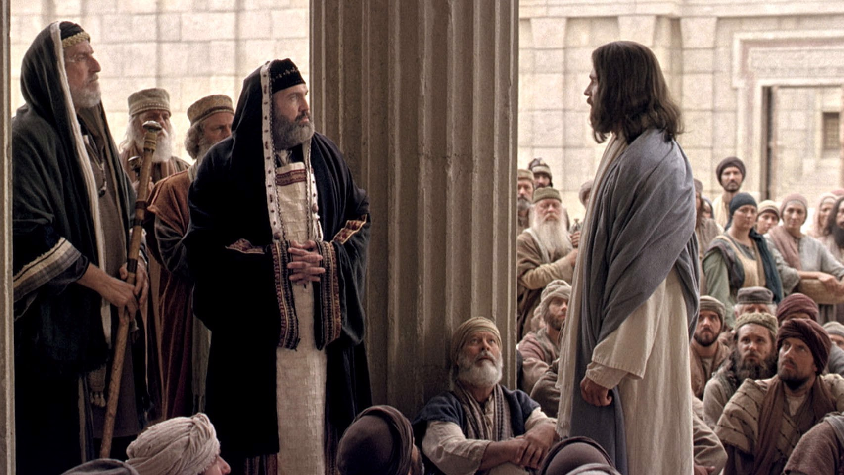

Slide 7
Mark 12:13-17
¹⁴ They came to him and said, “Teacher, we know that you are a man of integrity.

Slide 8
Mark 12:13-17
¹⁴ They came to him and said, “Teacher, we know that you are a man of integrity. You aren’t swayed by others, because you pay no attention to who they are….

Slide 9
Mark 12:13-17
You aren’t swayed by others, because you pay no attention to who they are; but you teach the way of God in accordance with the truth.

Slide 10
Mark 12:13-17
Is it right to pay the imperial tax to Caesar or not? ¹⁵ Should we pay or shouldn’t we?”

Slide 11
Mark 12:13-17
But Jesus knew their hypocrisy. “Why are you trying to trap me?”

Slide 12
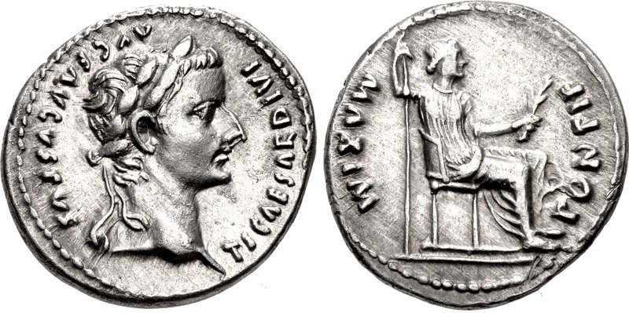
Mark 12:13-17
But Jesus knew their hypocrisy. “Why are you trying to trap me?” he asked. “Bring me a denarius and let me look at it.” ¹⁶ They brought the coin, and he asked them, “Whose image is this? And whose inscription?” “Caesar’s,” they replied.

Slide 13
Obverse side:
Latin letters TICAESARDVIVI AVGRAVGVSTVS
translated “Tiberius Caesar Augustus Son of the Divine Augustus”
Reverse side:
Latin PONTIF MAXIM translated “HIGH PRIEST”

Slide 14
Principle #1: Give to the government what rightfully belongs to the government.
Principle # 2: Give to God what rightfully belongs to God.

Slide 15
Church
Distinct Spheres of Authority
Family
Government

Slide 16
Church
Distinct Spheres of Authority
Family
Government
Procreation, health, provision, nurture, education and spiritual instruction (Genesis 1:26-28; Deuteronomy 6:4-9; Ephesians 5:22-6:4; 1 Timothy 5:8)

Slide 17
Church
Distinct Spheres of Authority
Family
Government
Procreation, health, provision, nurture, education and spiritual instruction (Genesis 1:26-28; Deuteronomy 6:4-9; Ephesians 5:22-6:4; 1 Timothy 5:8)
Protection, economic order, civic order, justice, and defense (Exodus 18, 2 Samuel 23:1-6, Psalm 72, Romans 13:1-7, 1 Peter 2:13-17)

Slide 18
Church
Distinct Spheres of Authority
Family
Government
Procreation, health, provision, nurture, education and spiritual instruction (Genesis 1:26-28; Deuteronomy 6:4-9; Ephesians 5:22-6:4; 1 Timothy 5:8)
Doctrine, practice, and governance (Matthew 16:18,
1 Timothy, Titus).
Protection, economic order, civic order, justice, and defense (Exodus 18, 2 Samuel 23:1-6, Psalm 72, Romans 13:1-7, 1 Peter 2:13-17)

Slide 19
Important Scriptures on the Role & Limits of the Authority of Government
Acts 5:29
1 Timothy 2:1-2
Daniel 1, 3, 6
Romans 13:1-7
1 Peter 2:13-17

Slide 20
Acts 5:29
Peter and the other apostles replied: “We must obey God rather than human beings!

Slide 21
Romans 13:1-7
Let everyone be subject to the governing authorities, for there is no authority except that which God has established. The authorities that exist have been established by God. ² Consequently, whoever rebels against the authority is rebelling against what God has instituted, and those who do so will bring judgment on themselves. ³ For rulers hold no terror for those who do right, but for those who do wrong. Do you want to be free from fear of the one in authority? Then do what is right and you will be commended. ⁴ For the one in authority is God’s servant for your good. But if you do wrong, be afraid, for rulers do not bear the sword for no reason. They are God’s servants, agents of wrath to bring punishment on the wrongdoer. ⁵ Therefore, it is necessary to submit to the authorities, not only because of possible punishment but also as a matter of conscience.
⁶ This is also why you pay taxes, for the authorities are God’s servants, who give their full time to governing. ⁷ Give to everyone what you owe them: If you owe taxes, pay taxes; if revenue, then revenue; if respect, then respect; if honor, then honor.

Slide 22
Biblical Principles about Government
Submission to government should be our general attitude, rule and first desire.

Slide 23
Biblical Principles about Government
Submission to government should be our general attitude, rule and first desire.
Government mandates/laws/requirements/authorities are legitimate as long as they…
  reward good, as defined by God, and
  punish evil, as defined by God.

Slide 24
Biblical Principles about Government
Submission to government should be our general attitude, rule and first desire.
Government mandates/laws/requirements/authorities are legitimate as long as they…
  reward good, as defined by God, and
  punish evil, as defined by God.
When government does not do this, Christians are obligated to obey God rather than government, i.e. engage in non-violent civil disobedience.

Slide 25
Biblical Principles about Government
Submission to government should be our general attitude, rule and first desire.
Government mandates/laws/requirements/authorities are legitimate as long as they…
  reward good, as defined by God, and
  punish evil, as defined by God.
When government does not do this, Christians are obligated to obey God rather than government, i.e. engage in non-violent civil disobedience.
When we engage in non-violent civil disobedience, we must be willing to accept the punishment.

Slide 26

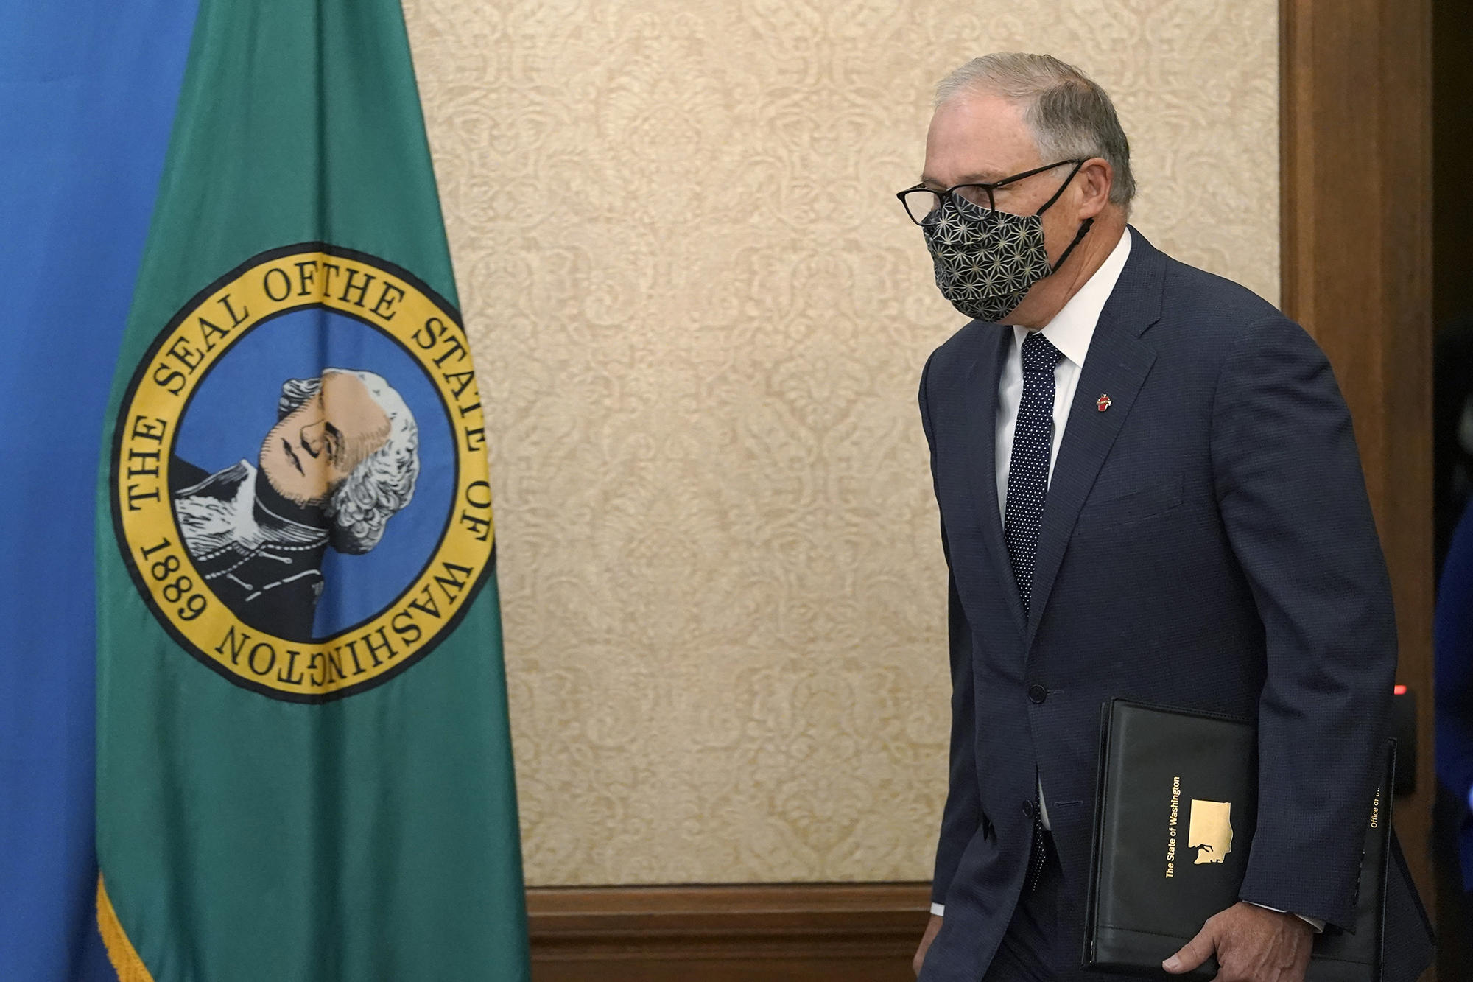



Slide 27
QUESTIONS?

Slide 28
1.) Where am I tempted to disobey government when God has called me to obey, i.e. “render to Caesar what is his”?
2.) Where am I disobeying the sphere of family authority where God wants me to obey?
3.) How am I rejecting church authority where God is calling me to obey, i.e. rejecting sound doctrine, sound teaching, wise elders?
4.) How may I be rejecting Jesus’ authority/lordship in my life?

