Slide 1
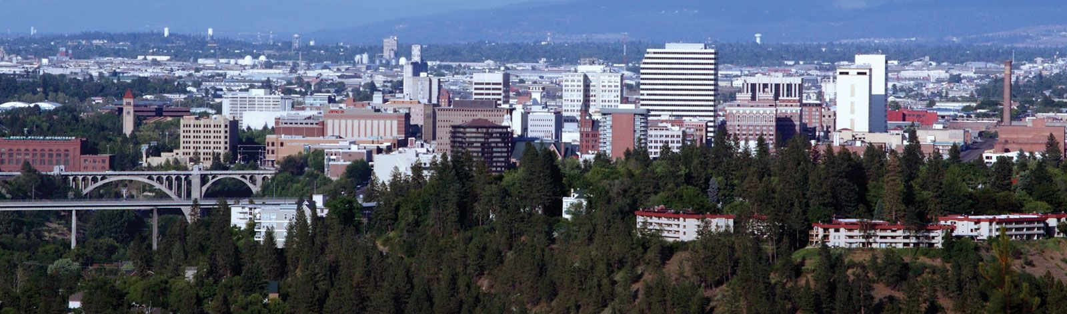
Who is one of the most famous people you have every seen or met in Spokane?

Slide 2
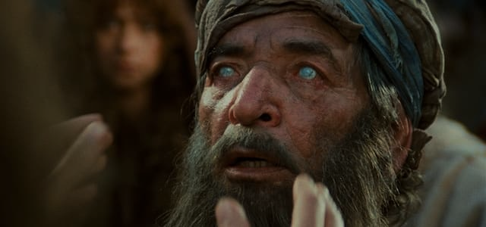

Slide 3
MARK 10 ⁴⁶ Then they came to Jericho. As Jesus and his disciples, together with a large crowd, were leaving the city, a blind man, Bartimaeus (which means “son of Timaeus”), was sitting by the roadside begging. ⁴⁷ When he heard that it was Jesus of Nazareth, he began to shout, “Jesus, Son of David, have mercy on me!” ⁴⁸ Many rebuked him and told him to be quiet, but he shouted all the more, “Son of David, have mercy on me!”

Slide 4
MARK 10 ⁴⁹ Jesus stopped and said, “Call him.” So they called to the blind man, “Cheer up! On your feet! He’s calling you.” ⁵⁰ Throwing his cloak aside, he jumped to his feet and came to Jesus. ⁵¹ “What do you want me to do for you?” Jesus asked him. The blind man said, “Rabbi, I want to see.” ⁵² “Go,” said Jesus, “your faith has healed you.” Immediately he received his sight and followed Jesus along the road.

Slide 5
>Matthew 20 >Mark 10 >Luke 18

Slide 6
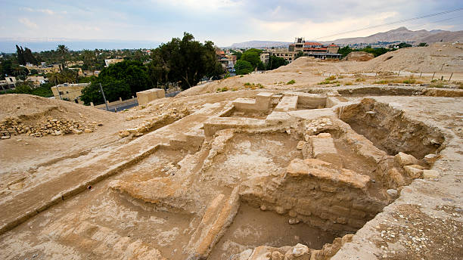
Jericho

Slide 7
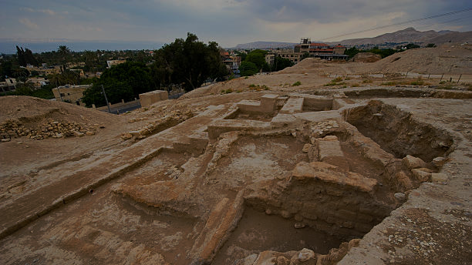
JOSHUA 6:26
At that time Joshua pronounced this solemn oath: “Cursed before the Lord is the one who undertakes to rebuild this city, Jericho:
“At the cost of his firstborn son he will lay its foundations; at the cost of his youngest he will set up its gates.” (See 2 Kings 6:34)

Slide 8
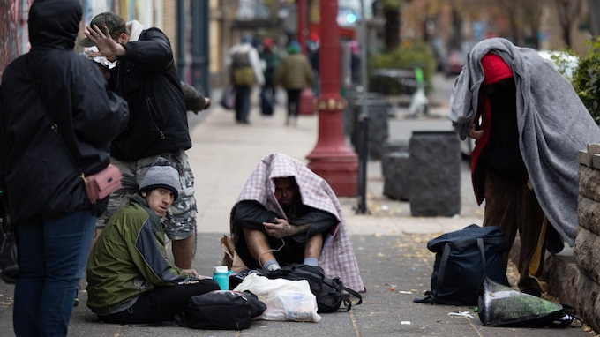

Slide 9

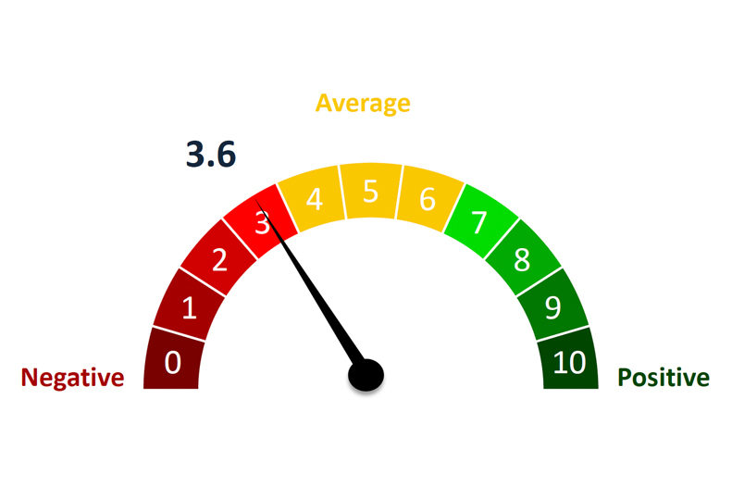
>58% of respondents think the overall quality of life in the region is getting worse. >58% of respondents have actively considered moving out of the area. >89% of respondents are worried about the future of downtown Spokane. >74% of respondents agree that recent policy decisions by the city are causing local small businesses to close and move away. >only 21% would feel safe visiting downtown Spokane at night. >94% of respondents agree that downtown Spokane cannot fully recover until the homelessness and public safety problems are addressed. >69% of respondents feel less safe in their own neighborhood than they did two years ago. >72% of respondents think providing funding to mental health and substance abuse facilities is important or extremely important. *78% of respondents agree that hiring more police officers should be an immediate priority for the city. *77% of respondents don't trust the local government to spend their tax dollars responsibly.
Recent Survey Results:
Spokane's quality of life viewed negatively, survey shows

Slide 10
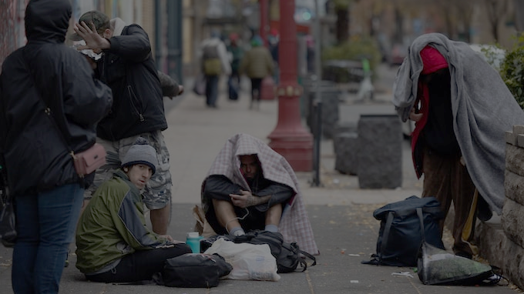
Spokane is 1 of the top 10 cities in America for human trafficking.
5,800% increase in overdose deaths in 6 years
While nation-wide drug deaths dropped 10% last year, in Spokane they increased 18%!
Washington State has more drug addicted babies than any other state … and Spokane has twice the Washington State average.

Slide 11
Poverty, disabilities and desperate needs are THE best candidates
for a work of God.

Slide 12
Qualities that made Bartimaeus a great miracle candidate:

Slide 13
Qualities that made Bartimaeus a great miracle candidate:
Blindness

Slide 14
Qualities that made Bartimaeus a great miracle candidate:
Blindness
Poverty

Slide 15
Qualities that made Bartimaeus a great miracle candidate:
Blindness
Poverty
Desperation

Slide 16
Qualities that made Bartimaeus a great miracle candidate:
Blindness
Poverty
Desperation
Willingness to let go of the past

Slide 17
What do we want Jesus to change about…
Us?
Spokane?
Mosaic?

Slide 18
Mark 10:47 When he heard that it was Jesus of Nazareth, he began to shout, “Jesus, Son of David, have mercy on me!”

Slide 19
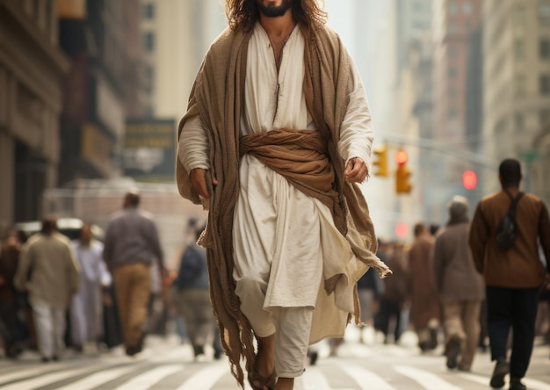
If we knew that Jesus was passing by our home or apartment, our church or our city, for what would we be seeking mercy?

Slide 20
Mark 10:48 Many rebuked him and told him to be quiet, but he shouted all the more, “Son of David, have mercy on me!”

Slide 21
There will always be opposition to any steps of faith we take.

Slide 22
There will always be opposition to any steps of faith we take but… let opposition fuel your determination.

Slide 23

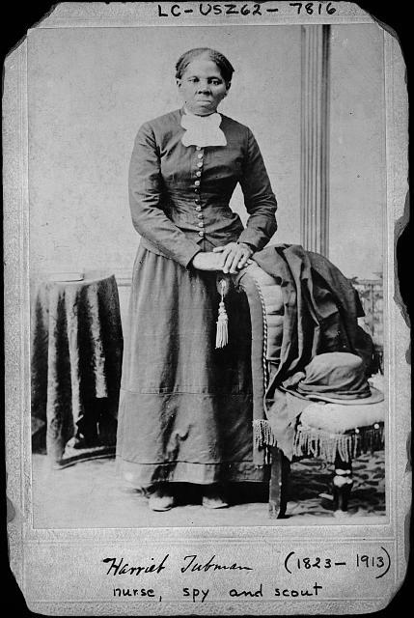
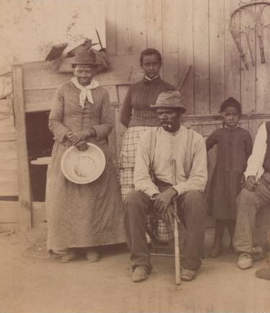

Slide 24
Mark 10:49-50 Jesus stopped and said, “Call him.” So they called to the blind man, “Cheer up! On your feet! He’s calling you.” ⁵⁰ Throwing his cloak aside, he jumped to his feet and came to Jesus.

Slide 25
Mark 10:51 What do you want me to do for you?

Slide 26
Mark 10:51 What do you want me to do for you? The blind man said, “Rabbi, I want to see.”

Slide 27
Mark 10:52 “Go,” said Jesus, “your faith has healed you.” Immediately he received his sight and followed Jesus along the road.

Slide 28
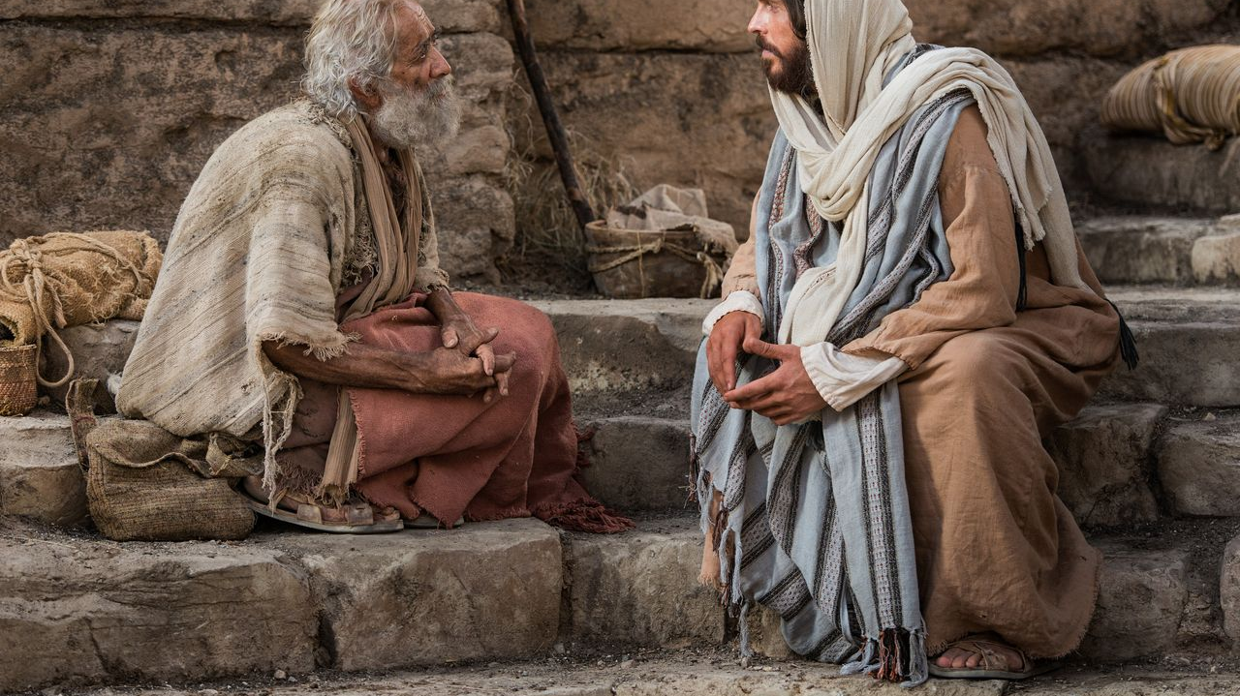
Immediately he received his sight and followed Jesus along the road.

