Slide 1





Tell someone about something special to you as a child that you remember, regrettably, either losing or having to part with.

Slide 2


Safety of officers
Recruitment of more officers
Emotional stamina & strength (for Missing Persons and Missing and Exploited Children work; death notifications, violent crime scenes, etc.)
Marriages & families

Slide 3
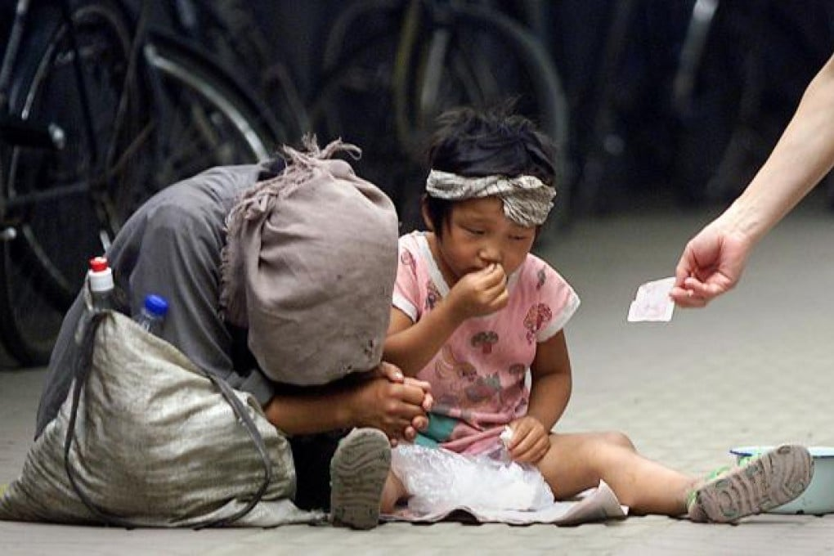
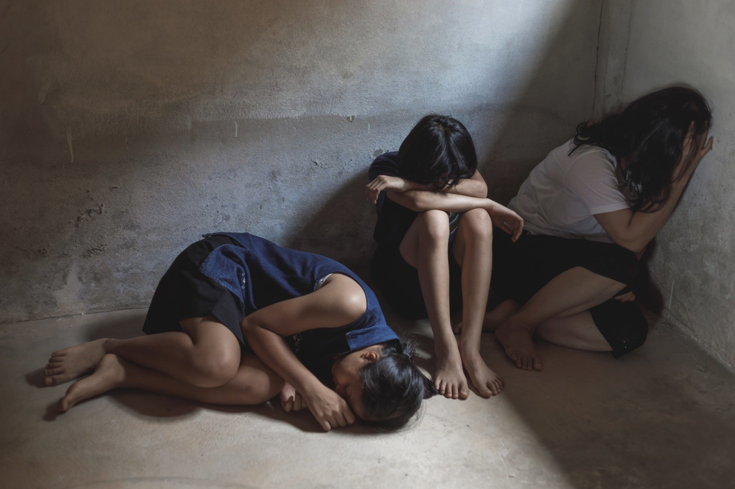

Slide 4
Mark 10
¹³ People were bringing little children to Jesus for him to place his hands on them, but the disciples rebuked them. ¹⁴ When Jesus saw this, he was indignant. He said to them, “Let the little children come to me, and do not hinder them, for the kingdom of God belongs to such as these. ¹⁵ Truly I tell you, anyone who will not receive the kingdom of God like a little child will never enter it.” ¹⁶ And he took the children in his arms, placed his hands on them and blessed them.

Slide 5
Mark 10
¹⁷ As Jesus started on his way, a man ran up to him and fell on his knees before him. “Good teacher,” he asked, “what must I do to inherit eternal life?”
¹⁸ “Why do you call me good?” Jesus answered. “No one is good—except God alone. ¹⁹ You know the commandments: ‘You shall not murder, you shall not commit adultery, you shall not steal, you shall not give false testimony, you shall not defraud, honor your father and mother.’”
²⁰ “Teacher,” he declared, “all these I have kept since I was a boy.”

Slide 6
Mark 10
²¹ Jesus looked at him and loved him. “One thing you lack,” he said. “Go, sell everything you have and give to the poor, and you will have treasure in heaven. Then come, follow me.”
²² At this the man’s face fell. He went away sad, because he had great wealth.
²³ Jesus looked around and said to his disciples, “How hard it is for the rich to enter the kingdom of God!”

Slide 7
Mark 10
²⁴ The disciples were amazed at his words. But Jesus said again, “Children, how hard it is to enter the kingdom of God! ²⁵ It is easier for a camel to go through the eye of a needle than for someone who is rich to enter the kingdom of God.”
²⁶ The disciples were even more amazed, and said to each other, “Who then can be saved?”
²⁷ Jesus looked at them and said, “With man this is impossible, but not with God; all things are possible with God.”

Slide 8
Mark 10
²⁸ Then Peter spoke up, “We have left everything to follow you!”
²⁹ “Truly I tell you,” Jesus replied, “no one who has left home or brothers or sisters or mother or father or children or fields for me and the gospel ³⁰ will fail to receive a hundred times as much in this present age: homes, brothers, sisters, mothers, children and fields—along with persecutions—and in the age to come eternal life. ³¹ But many who are first will be last, and the last first.”

Slide 9
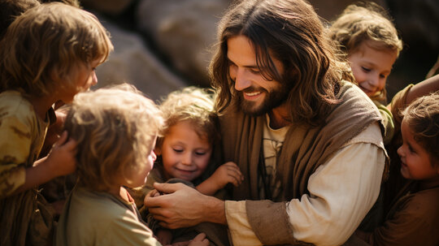

Slide 10
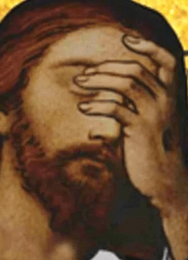
Jesus was “indignant” (vs. 14)
Greek: aganakteo = “much” + “grieved”.
Deep displeasure, vexation, indignation

Slide 12
Mark 10
¹⁴ When Jesus saw this, he was indignant. He said to them, “Let the little children come to me, and do not hinder them, for the kingdom of God belongs to such as these.

Slide 13
In what way must we ‘receive the kingdom of God like a little child’?

Slide 14
In what way must we ‘receive the kingdom of God like a little child’?
The humility of children?

Slide 15
In what way must we ‘receive the kingdom of God like a little child’?
The humility of children?
The faith of children?

Slide 16
In what way must we ‘receive the kingdom of God like a little child’?
The humility of children?
The faith of children?
The helplessness of children?

Slide 17
The difference between the two major Old Testament COVENANTS
Abrahamic Covenant: sign of circumcision
Mosaic Covenant: sign of the Sabbath

Slide 18
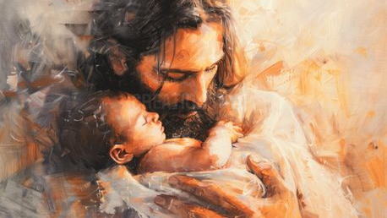

Slide 19
What we learn about this man from Matthew 19, Mark 10 & Luke 18?
He was a ruler of some sort, Lk. 18:18
He was young, Mt. 18:22
He was a man of action, Mk. 10:17 “Good teacher, what must I do to inherit eternal life?”

Slide 20
Mark 10
¹⁹ You know the commandments: ‘You shall not murder, you shall not commit adultery, you shall not steal, you shall not give false testimony, you shall not defraud, honor your father and mother.’”
²⁰ “Teacher,” he declared, “all these I have kept since I was a boy.”

Slide 21
Galatians 3:24
“Therefore the law was our tutor to bring us to Christ, that we might be justified by faith.”

Slide 22
Matthew 19:16
Just then a man came up to Jesus and asked, “Teacher, what good thing must I do to get eternal life?”

Slide 23
Mark 10
²¹ Jesus looked at him and loved him. “One thing you lack,” he said. “Go, sell everything you have and give to the poor, and you will have treasure in heaven. Then come, follow me.”

Slide 24
Mark 10
²⁸ Then Peter spoke up, “We have left everything to follow you!”
²⁹ “Truly I tell you,” Jesus replied, “no one who has left home or brothers or sisters or mother or father or children or fields for me and the gospel ³⁰ will fail to receive a hundred times as much in this present age: homes, brothers, sisters, mothers, children and fields—along with persecutions—and in the age to come eternal life. ³¹ But many who are first will be last, and the last first.”

Slide 25
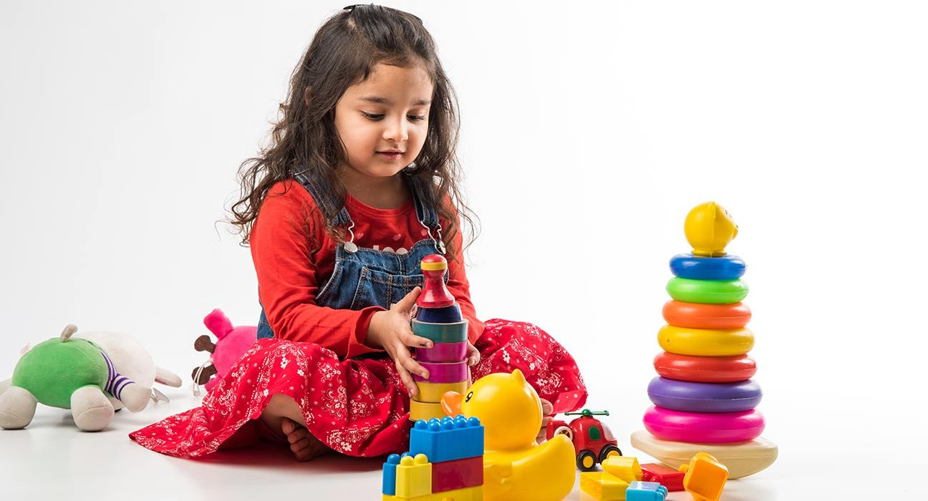

Slide 26


