Slide 1


Hanga Pitchfest 2023 Pitch Deck
Making it easy for young people in Rwanda to get started online and gain valuable experience through comprehensive web hosting, enriching courses, and a thriving freelance marketplace designed to foster a knowledge-based economy.
https://yagibaze.rw

Slide 2
Problem Statement
Critical mass of a highly skilled workforce to support opportunities available in ICT4D is required
The digital literacy penetration rate in Rwanda is a concerning issue, as it stood at only 30% of total population in January 2023
Sufficient and inclusive R&D infrastructure and resources should be established in specific niche areas
Problem Overview
Existing capacity building programs are not tailored for absolute young beginners in Rwanda. The cost and system complexities are still for intermediates
Ignorance of most people in villages when it comes to acceptance of ICT as a way of their everyday life
Major Causes
Unequal access to many opportunities and endless hurdles in national digital transformation journey
Shortage of skilled IT enthusiasts and high rate of illegal activities plus mental disorders among youth
Thousands of unemployed youth with millions of buried ideas which results in lack of prosperity
Direct Impact

Slide 3


Solution Statement
Advancing inclusive technology capabilities and making them beginner-friendly to meet critical needs of Rwandan market
web hosting
Cultivating skilled workforce in no-code website creation, AI prompt engineering, and ecommerce development
Freelance marketplace to foster a culture of creativity and meaningful work for everyone

Slide 4
Market Size
Total Rwandan Population 2023: 14,094,683 people
We are targeting students in high school and colleges, young entrepreneurs, small business owners, and digital creators located in Rwanda

Slide 5
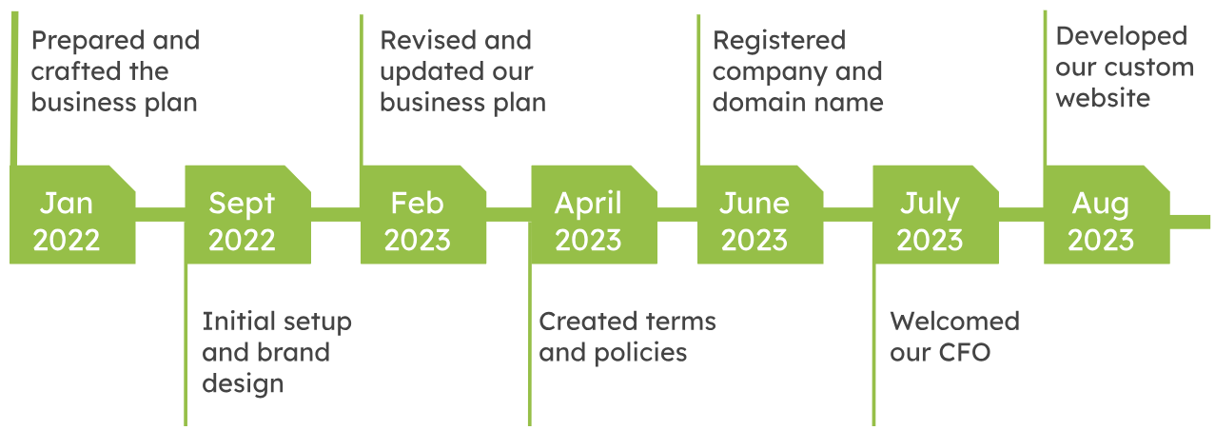
Product Traction

Slide 6
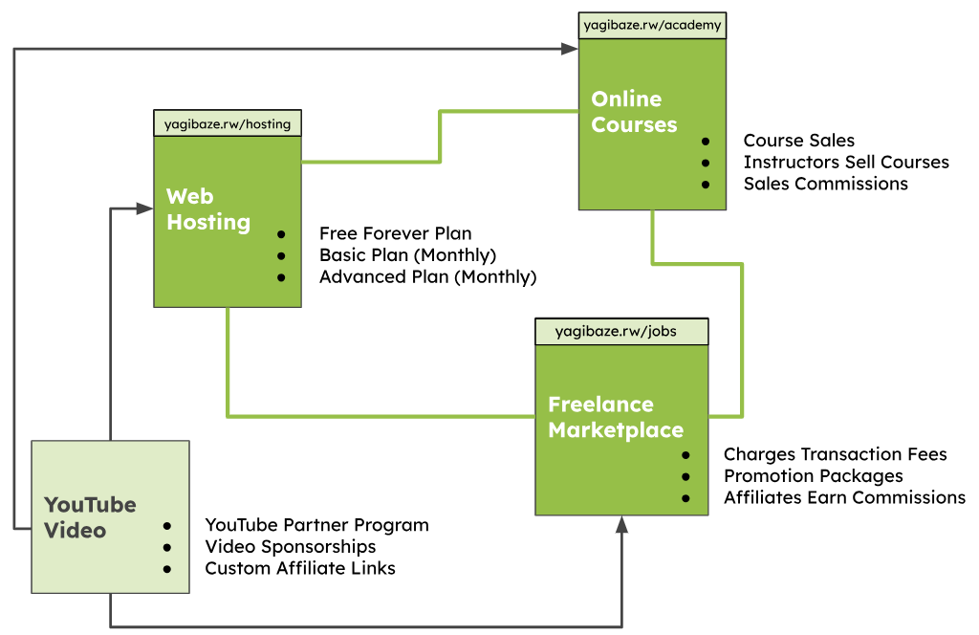
Business Model

Slide 7
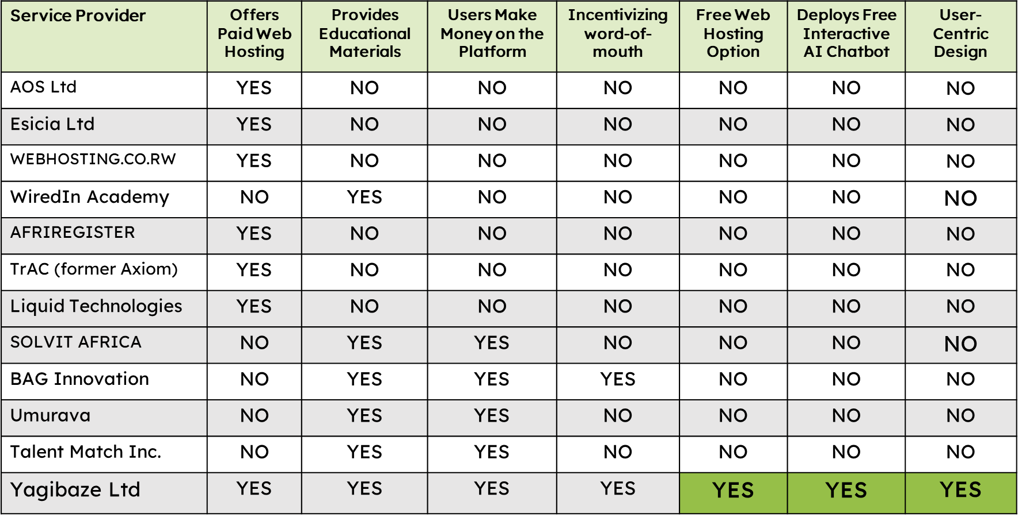
Our Competitors
Yagibaze Vs. Competition: Unique Value Proposition

Slide 8
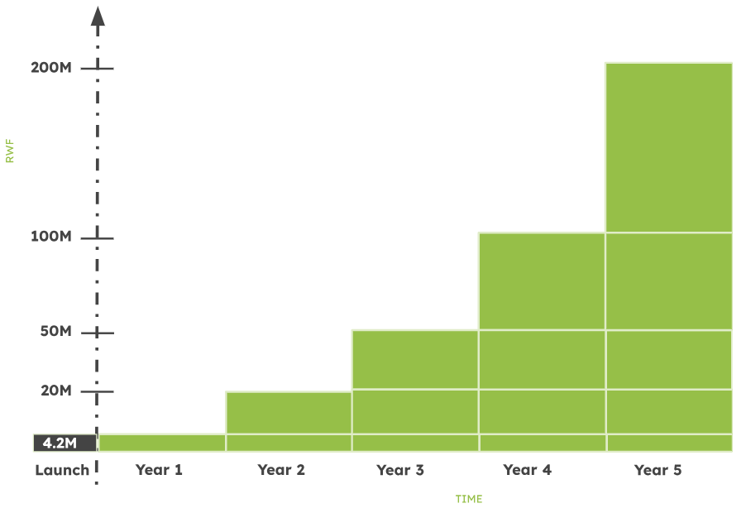
Funding Status
Revenue will grow
Product Enhancement
Marketing and Outreach
Hiring and Training
Partnerships and Collabo
Operational Expenses
as the time goes by

Slide 9
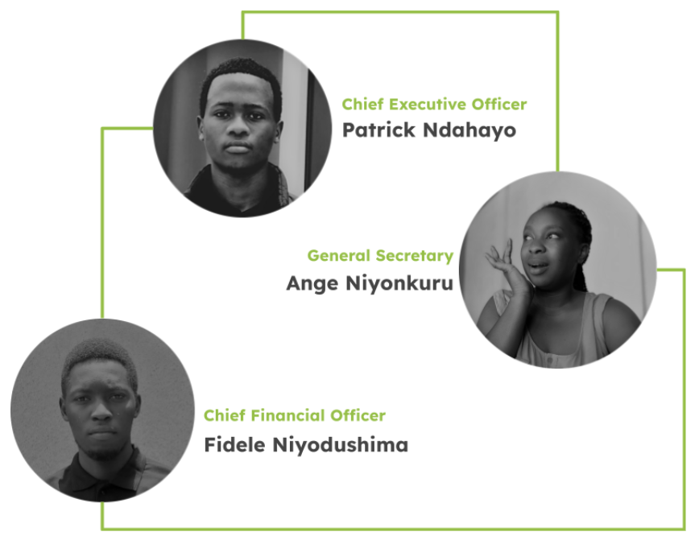
Team Members
A web developer who specializes in WordPress development, NLP Models, Google Workspace, and affiliate marketing
A motivated woman with analytical mindset, coupled with effective communication
An entrepreneur and financial manager with a background in mathematics and expertise in investment analysis and strategic planning

