Slide 1
Skin Cancer:
So What’s the Big Deal?
American Academy of Dermatology
Notes:
Thank you all for having me here today. I’m Dr. (NAME) from (INSTITUTION/PRACTICE). As a dermatologist, I specialize in the diagnosis and treatment of skin, hair and nail conditions. I’m here today to talk to you about skin cancer. What is it? Who gets it? How can you prevent it? I will answer all of those questions.

Slide 2

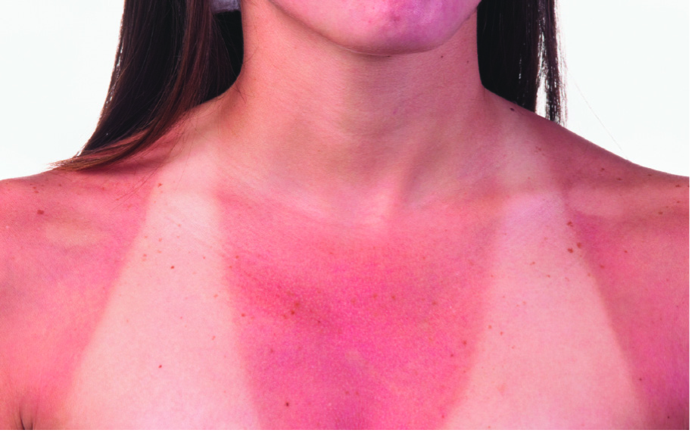


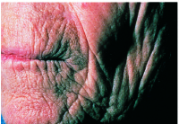
Teens & Tanning
Notes:
First, let me begin by asking all of you a question: How many of you think you look better with a tan? (Pause for raise of hands). As surprising as it may seem, a suntan is actually a sign of damage to your skin. What you need to know is that there is no safe way to tan.

Slide 3

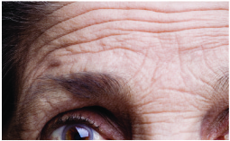
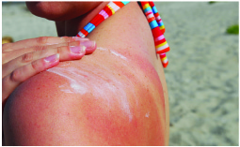
UVA and UVB = Skin Cancer
UVA = Aging
UVB = Burning
Notes:
When your skin is exposed to sunlight, it works overtime to produce extra melanin – the pigment that gives skin its color – to protect it from the damaging ultraviolet rays. So, basically, a tan is the skin’s response to injury. Sunlight consists of two types of harmful rays – ultraviolet A rays and ultraviolet B rays. UVA rays, which can pass through window glass, cause the skin to age, resulting in wrinkles and age spots. UVB rays are the sun’s burning rays and are the primary cause of sunburn. An easy way to remember this is UVA rays are the aging rays and UVB rays are the burning rays. Exposure to both forms of UV rays can lead to the development of skin cancer.

Slide 4
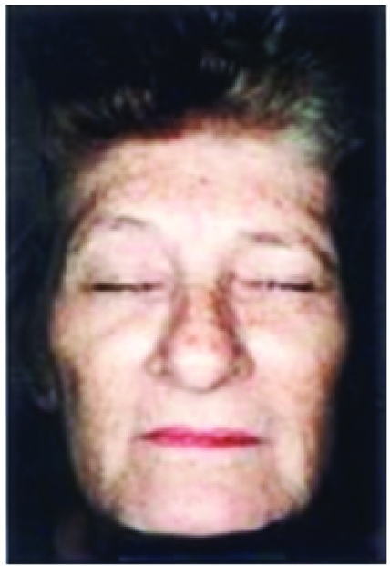
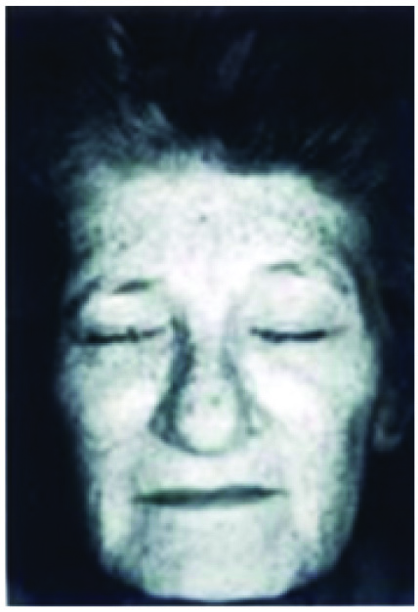
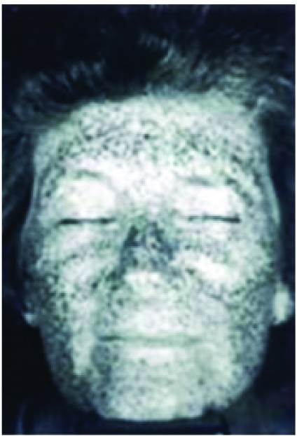
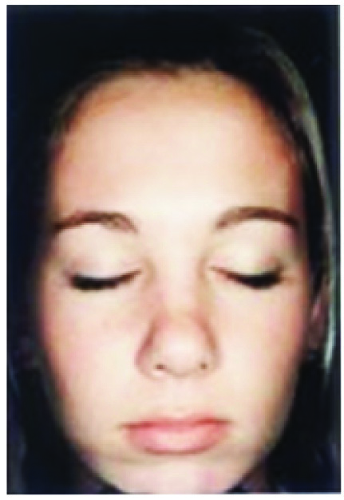
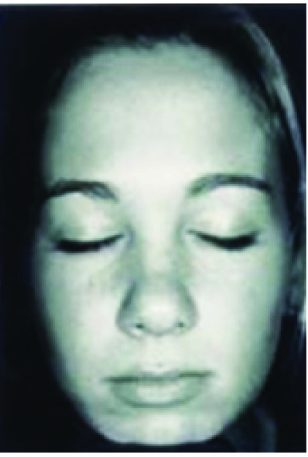
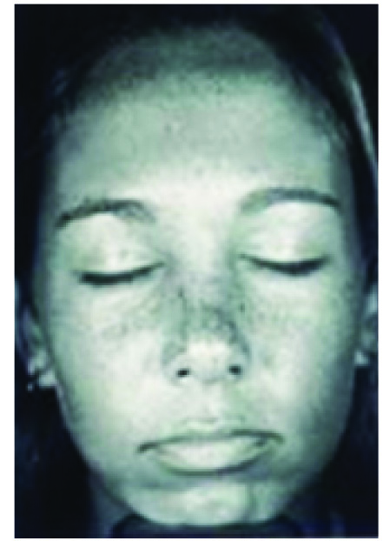

UV Camera:
The Damage Beneath Your Skin
Notes:
These photos were taken with a UV camera. The photos on the right show UV light damage beneath the skin that is not yet visible to the naked eye. The dark spots in these photos indicate the amount of damage a person has on their face. Research has shown that UV light from the sun and indoor tanning beds causes wrinkles, age spots and can lead to the development of skin cancer.
How many of you are NOT surprised by the amount of UV light damage on the top right photo, which clearly shows a lifetime of excessive UV exposure? However, how many of you ARE surprised by the amount of UV light damage already seen in the young girl’s photo at the bottom? She is only 17!

Slide 5
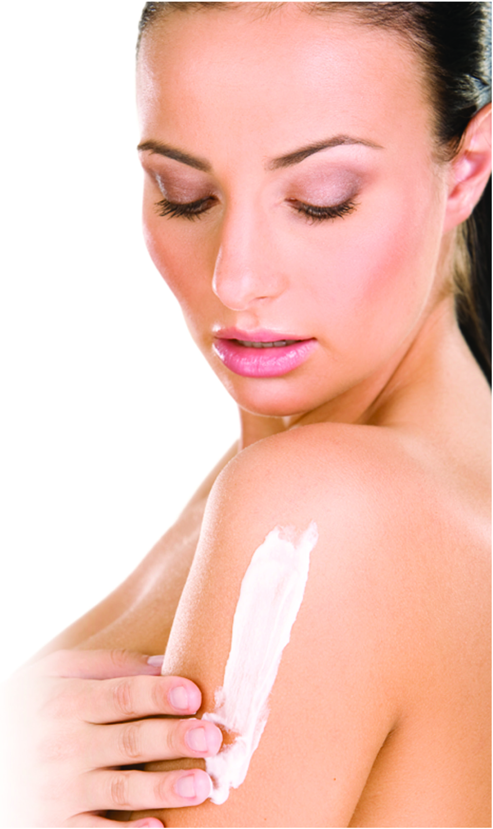
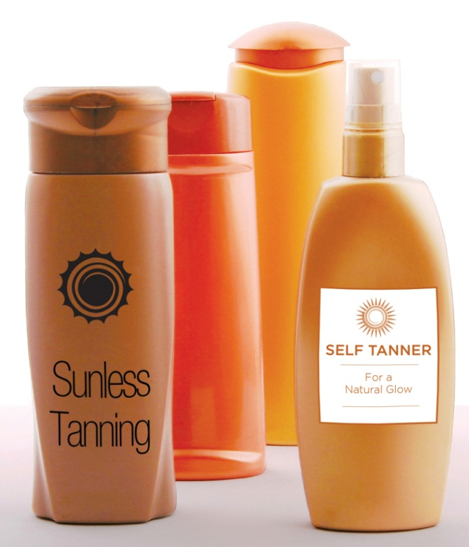
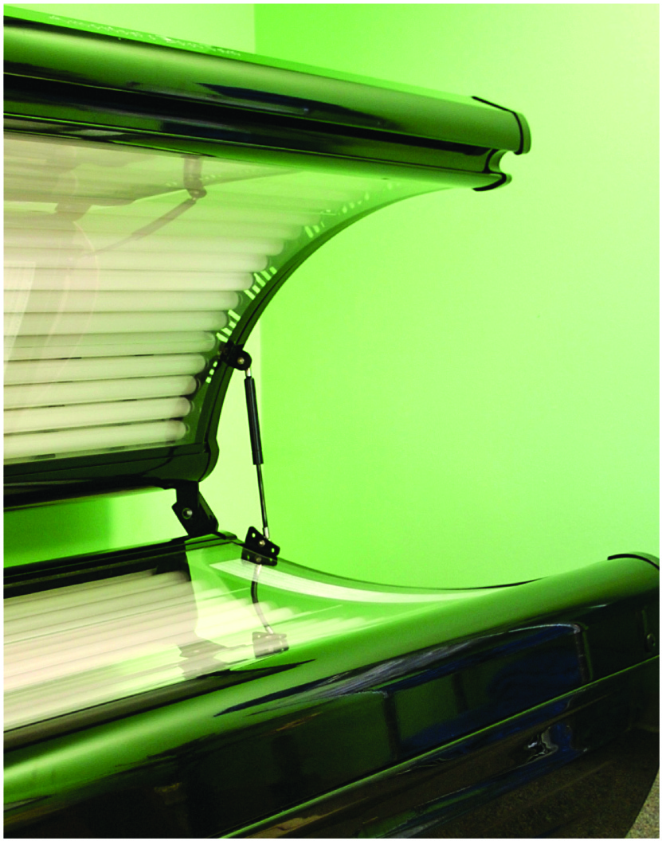
Dangers of indoor tanning
Notes:
How many of you think tanning beds are safer than the sun? (Pause hands raised.) For those of you who raised your hand, let me explain why this isn’t true. Like the sun, tanning beds emit dangerous UVA and UVB rays that can cause skin cancer, eye damage and wrinkles. Exposing yourself to the UV rays of indoor tanning beds increases your risk of developing melanoma, the deadliest kind of skin cancer, by 75 percent and the risk increases with each use. The only safe tan is the kind you get from a bottle. Use a sunless self-tanning product if you want to look like you’ve been in the sun, but remember to use sunscreen with it.

Slide 6


Which one will it be?
One in five Americans will develop skin cancer in their lifetime.
Notes:
Did you know that one in five Americans will develop skin cancer in their lifetime?

Slide 7

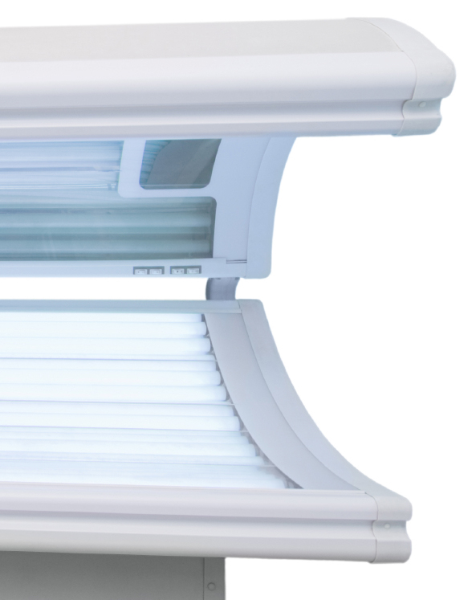




What causes skin cancer?
Notes:
So, what causes skin cancer? One way is overexposure to the sun – too much time outside without protecting your skin from the sun. Another way is tanning bed use – tanning bed lamps emit a similar amount of UV radiation as the sun and in some cases the radiation may be stronger. And a third cause is family history. Do you know the health background of your family? If not, you should ask so you know if you are at an increased risk.

Slide 8



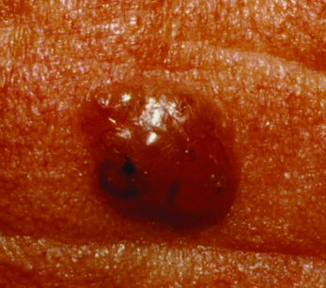
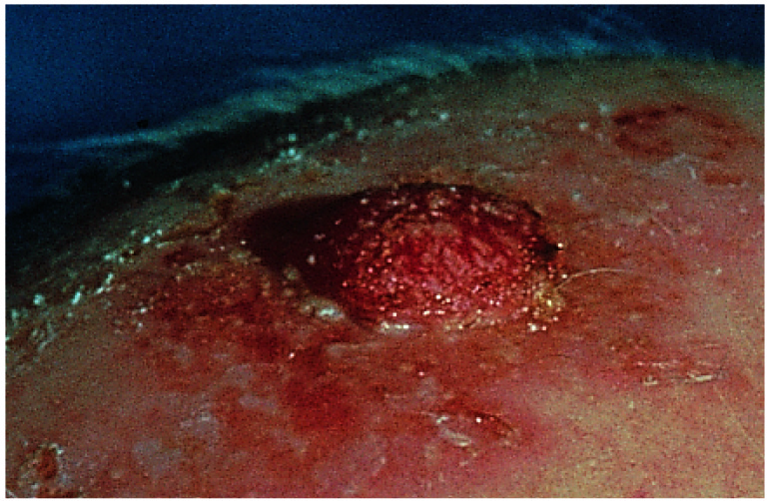
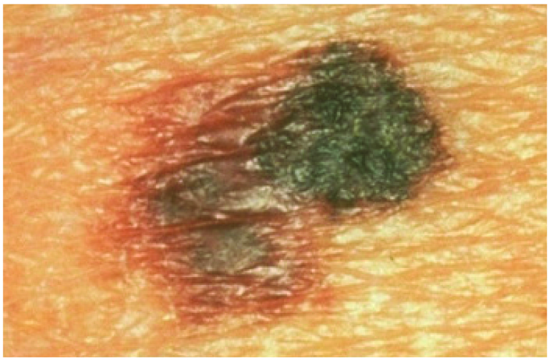



What is skin cancer?
Notes:
You might be wondering: what exactly is skin cancer? Well, there are three types of skin cancer: basal cell carcinoma, squamous cell carcinoma, and melanoma.

Slide 9
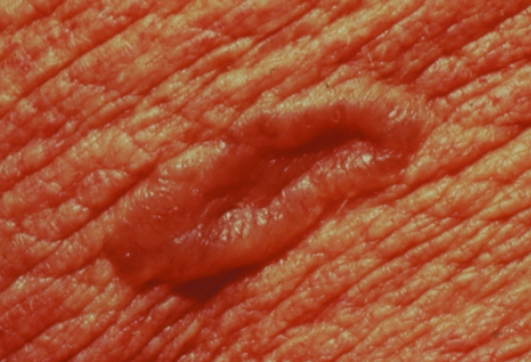
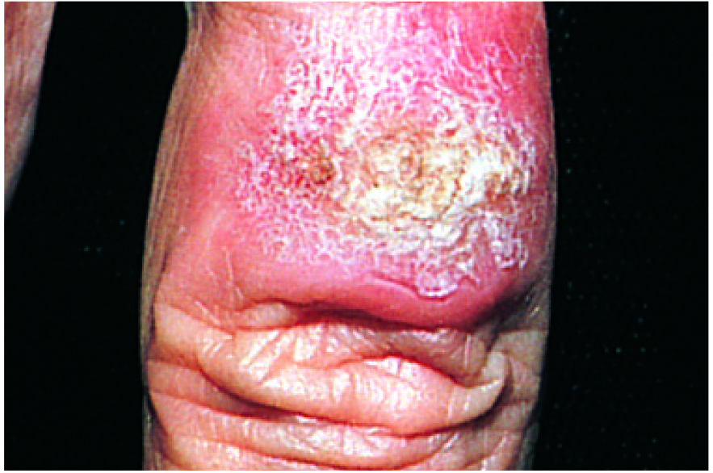


Basal cell carcinoma and squamous cell carcinoma
The most common forms of skin cancer
Arise within top layer of skin, usually on sun-exposed areas of body, including the face, forearms and neck
Usually look like a rough, red scaly area or bumps that bleed
Notes:
Basal cell carcinoma and squamous cell carcinoma are the most common forms of skin cancer. They usually are found on the top layer of the skin on sun-exposed areas of the body, including the face, forearms and neck. As you can see in these photos, they usually look like rough, red scaly patches or bumps that bleed. Both types are easily treated if detected early.

Slide 10
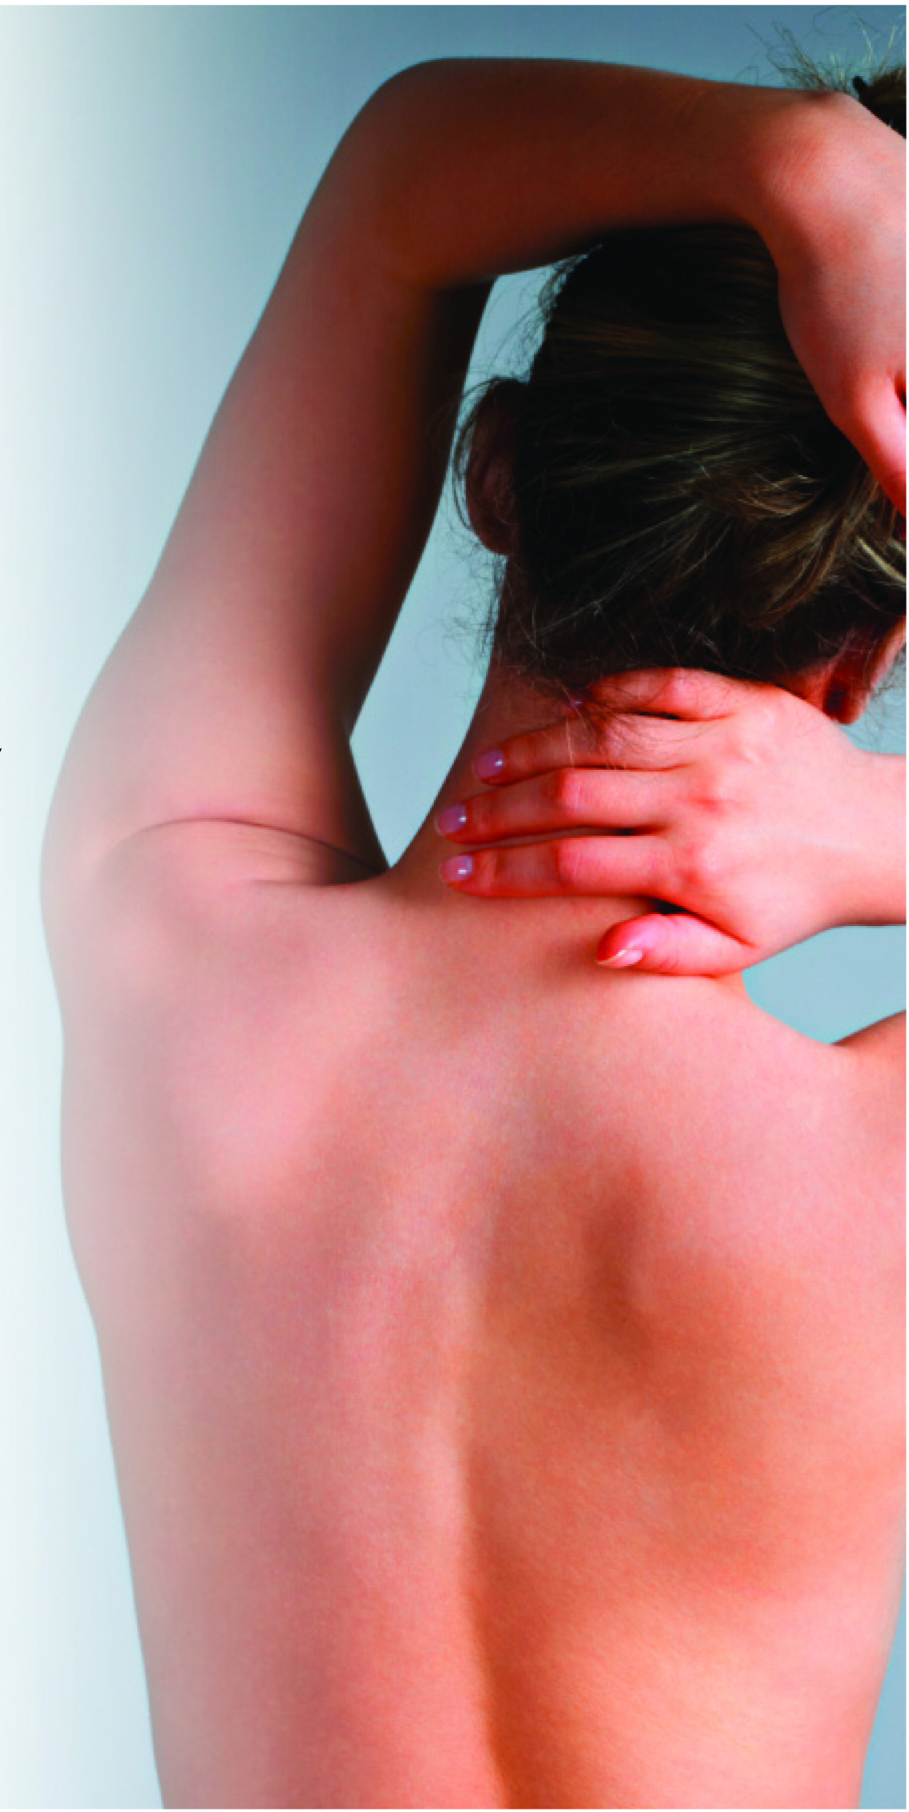
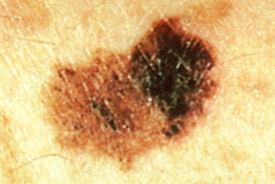
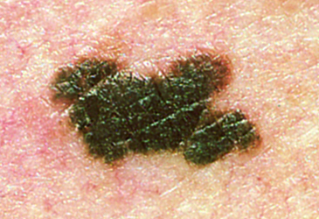
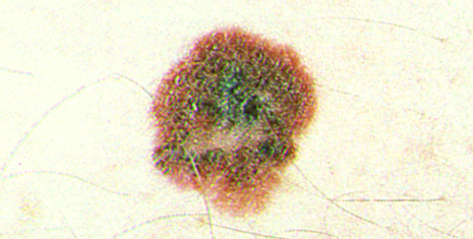
Melanoma
Deadliest form of skin cancer
Can occur anywhere on the body, but is most common on the upper back, torso, lower legs, head and neck
New, rapidly growing moles or moles that itch, bleed, change color or size = early warning signs of melanoma
Notes:
Melanoma is the deadliest form of skin cancer. It can occur anywhere on the body but is most common on the upper back, torso, lower legs, head and neck. New, rapidly growing moles or moles that itch, bleed, or change color or size are often early warning signs of melanoma.

Slide 11

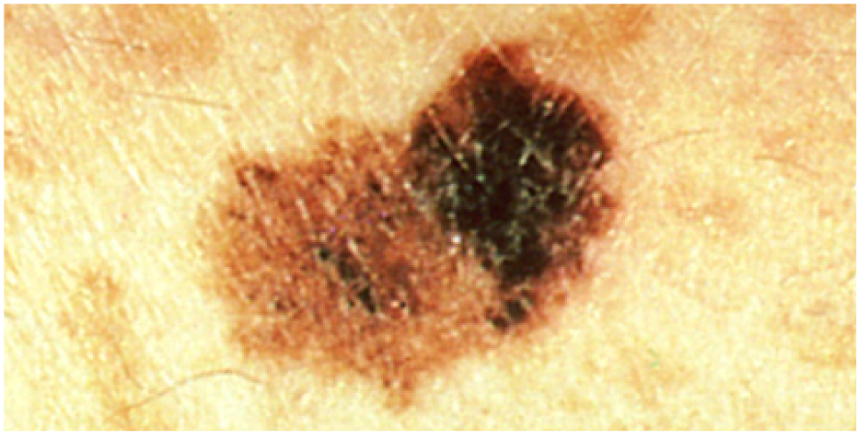
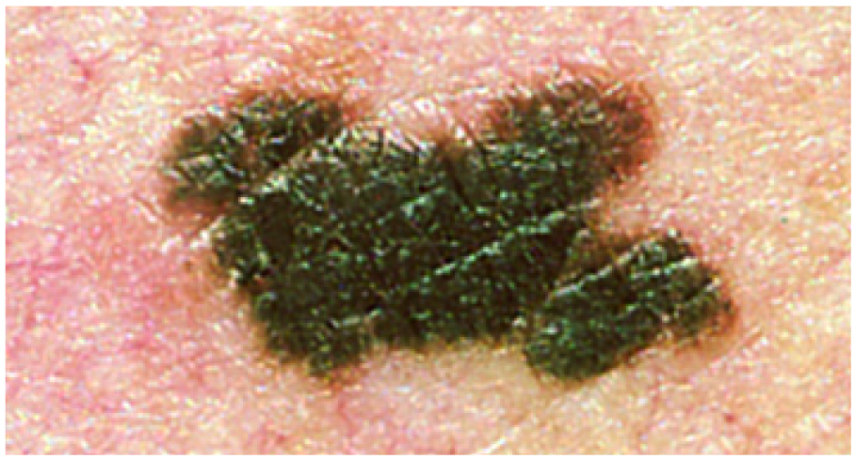
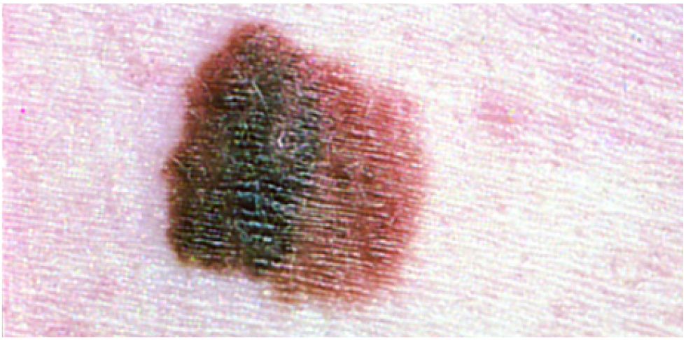
Is melanoma really that serious?
One American dies from melanoma every hour.
Second most common cancer in adolescents and young adults 15-29 years old.
Most common form of cancer for young adults 25-29 years old.
Notes:
So, is melanoma really that serious? Yes, it is. One American dies from melanoma every hour, and it’s not just adults who are at risk. Melanoma is the second most common cancer in teens and young adults 15-29 years old, and it’s the most common cancer in young adults 25-29.

Slide 12


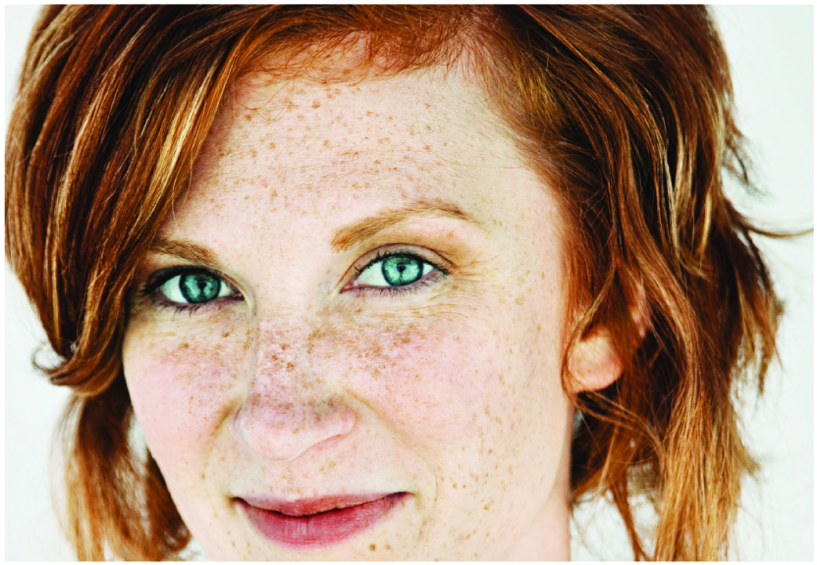

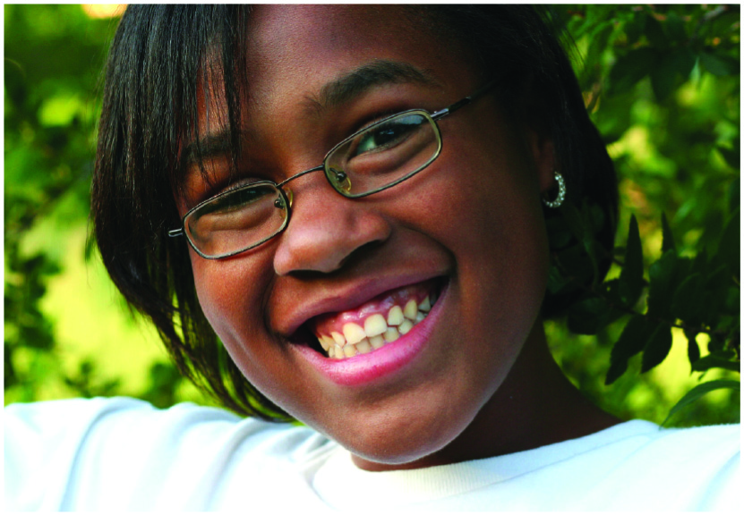
Who gets melanoma?
Notes:
If adults aren’t the only ones who can get melanoma, then who else can? Anyone can develop melanoma. No one is immune from this cancer. But, Caucasians are more at risk than other races, especially those with fair skin, red or blonde hair, blue or green eyes, more than 50 moles or a blood relative who had melanoma (like your mom, dad, sister or brother).

Slide 13
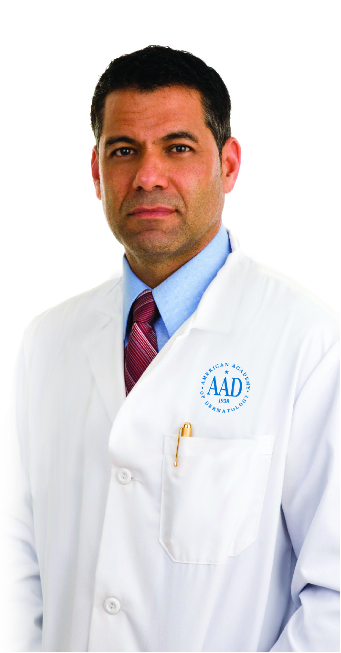
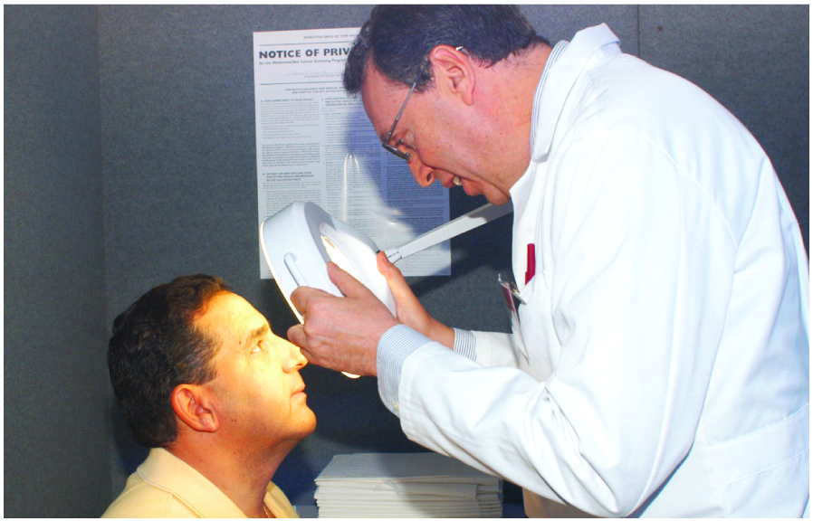
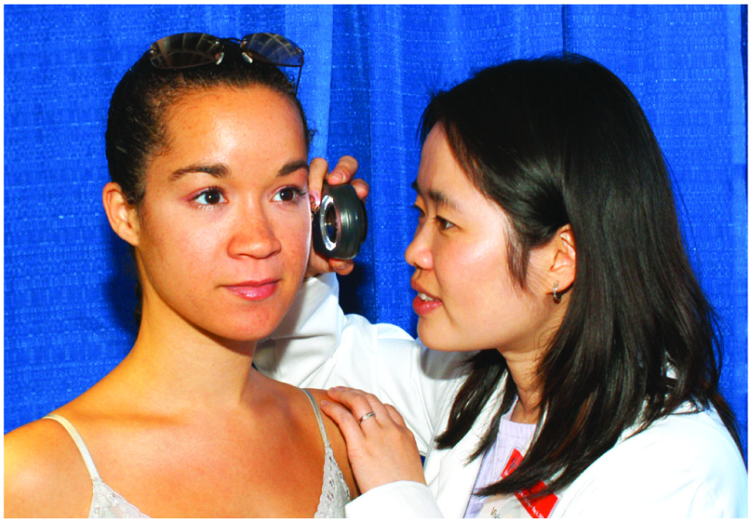
Can melanoma be cured?
If detected early, melanoma is highly curable.
Once melanoma spreads to the lymph nodes insides the body, the survival rates decrease significantly.
Notes:
What happens if you get melanoma? Can if be cured? When detected early, melanoma is highly curable. The average five-year survival rate for individuals whose melanoma is detected and treated before spreading to the lymph nodes is 98 percent. Once melanoma spreads to the lymph nodes and inside the body, the survival rate decreases significantly. Early detection is key in beating melanoma.

Slide 14

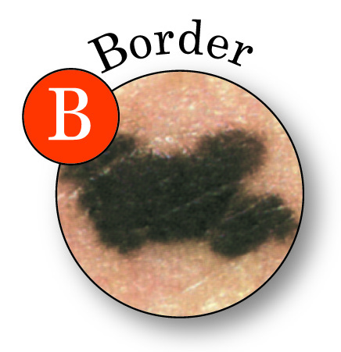
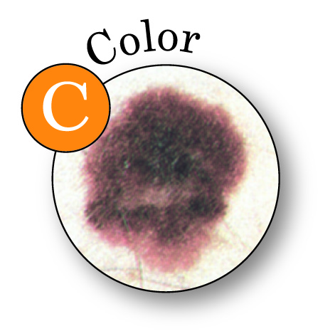
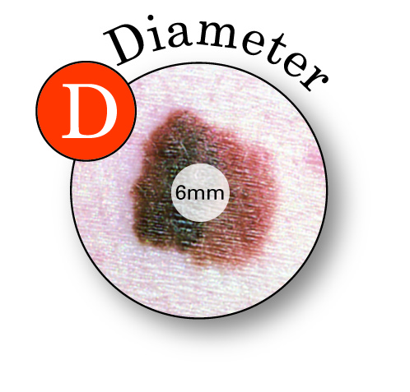
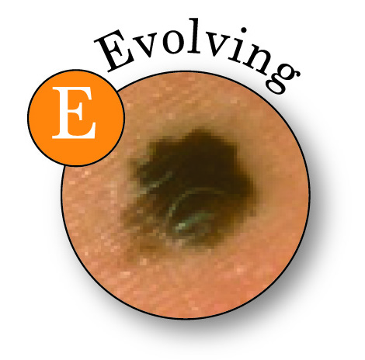
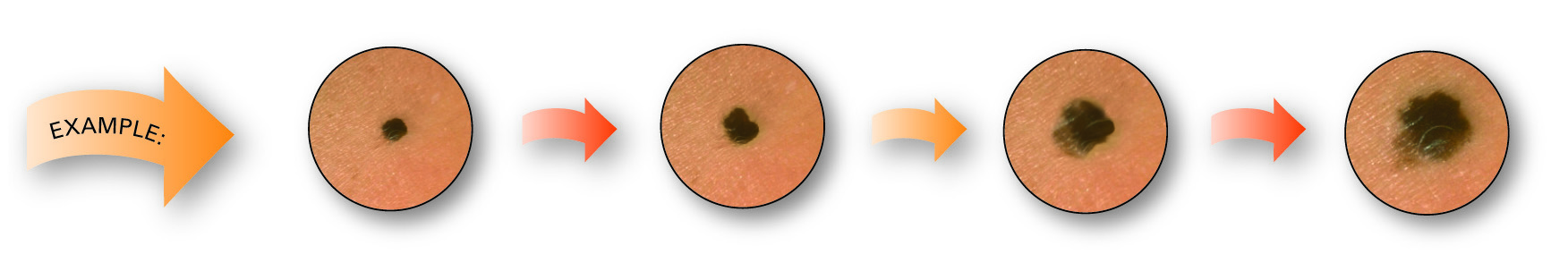
What does melanoma look like?
Notes:
I saw a couple of you looking at your skin, wondering if you should be concerned. What does melanoma look like? If you notice a mole on your skin, you should follow the simple ABCDE rule, which outlines the warning signs of melanoma: A stands for Asymmetry – one half is unlike the other half. B stands for Border – the mole has an irregular, scalloped or poorly defined border. C stands for Color – the color varies from one area to another; it can be shades of tan and brown, black and sometimes white, red or blue. D stands for Diameter – while they can be smaller, melanomas are usually greater than 6mm or the size of a pencil eraser. E stands for Evolving – the mole or lesion looks different from the rest or is changing in size, shape or color.
If you have an changing mole, a new mole or a mole that is different, you should make an appointment to see a dermatologist as soon as possible.

Slide 15



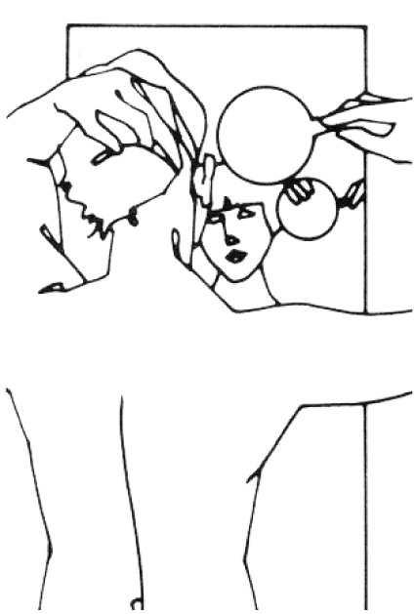






How to spot skin cancer
The American Academy of Dermatology encourages everyone to check your skin regularly
Notes:
Now that you know what to look for, I encourage everyone to check your skin on a regular basis, and keep track of your moles. Scan your entire body for suspicious moles, including your back, your scalp, the soles of your feet, between your toes and the palms of your hands.
(Note to AAD member: Bring in a hand held mirror to demonstrate skin self-exam.)

Slide 16
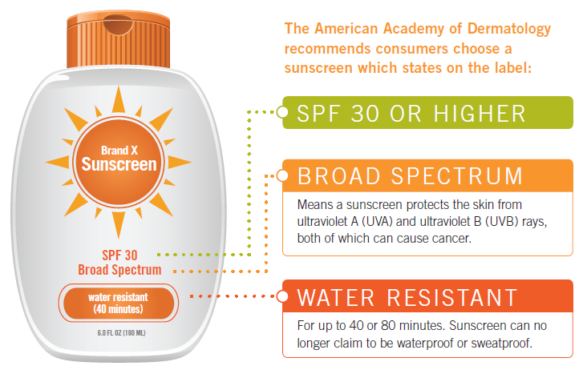
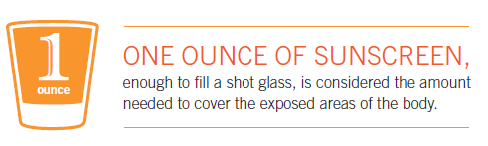
What can I do to protect myself?
Notes:
What can you do to decrease your risk of melanoma and other skin cancers? The best way to protect yourself is by avoiding excessive exposure to the sun and other forms of ultraviolet radiation, such as indoor tanning.
But there are a number of ways to protect yourself and still have fun in the sun:
Generously apply a broad-spectrum, water-resistant sunscreen with an SPF of at least 30 to all exposed skin. “Broad-spectrum” provides protections from both UVA and UVB rays. Re-apply approximately every two hours, even on cloudy days and after swimming or sweating.
Sunscreens should be applied to dry skin 15 minutes BEFORE going outdoors. When using sunscreen, be sure to apply it to all areas not covered by clothing and pay particular attention to the face, ears, hands and arms. Coat the skin liberally and rub it in thoroughly. Don’t forget that lips get sunburned too, so apply a lip balm that contains sunscreen. One ounce, enough to fill a shot glass, is considered the amount needed to cover the exposed areas of the body properly.

Slide 17


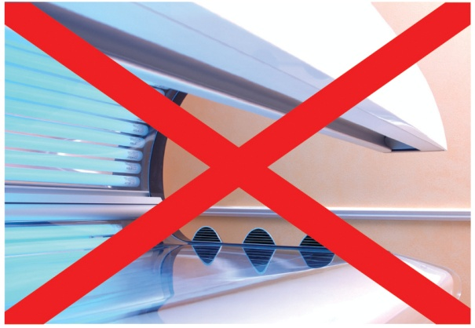

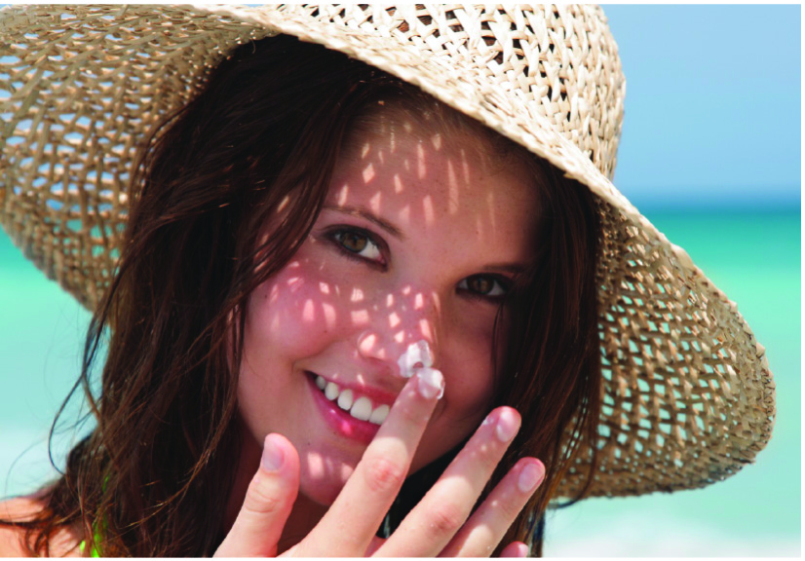
What else can I do
to protect myself?
Notes:
Wear protective clothing, such as a long-sleeved shirt, pants, a wide-brimmed hat and sunglasses where possible.
Seek shade when appropriate, remembering that the sun’s rays are strongest between 10 a.m. and 2 p.m. If your shadow is shorter than you are, seek shade.
Use extra caution near water, snow and sand as they reflect the damaging rays of the sun, which can increase your chance of sunburn.
Avoid tanning beds. Remember that UV light from tanning beds can cause skin cancer and wrinkling. If you want to look like you’ve been in the sun, consider using a sunless self-tanning product, but continue to use sunscreen with it.

Slide 18
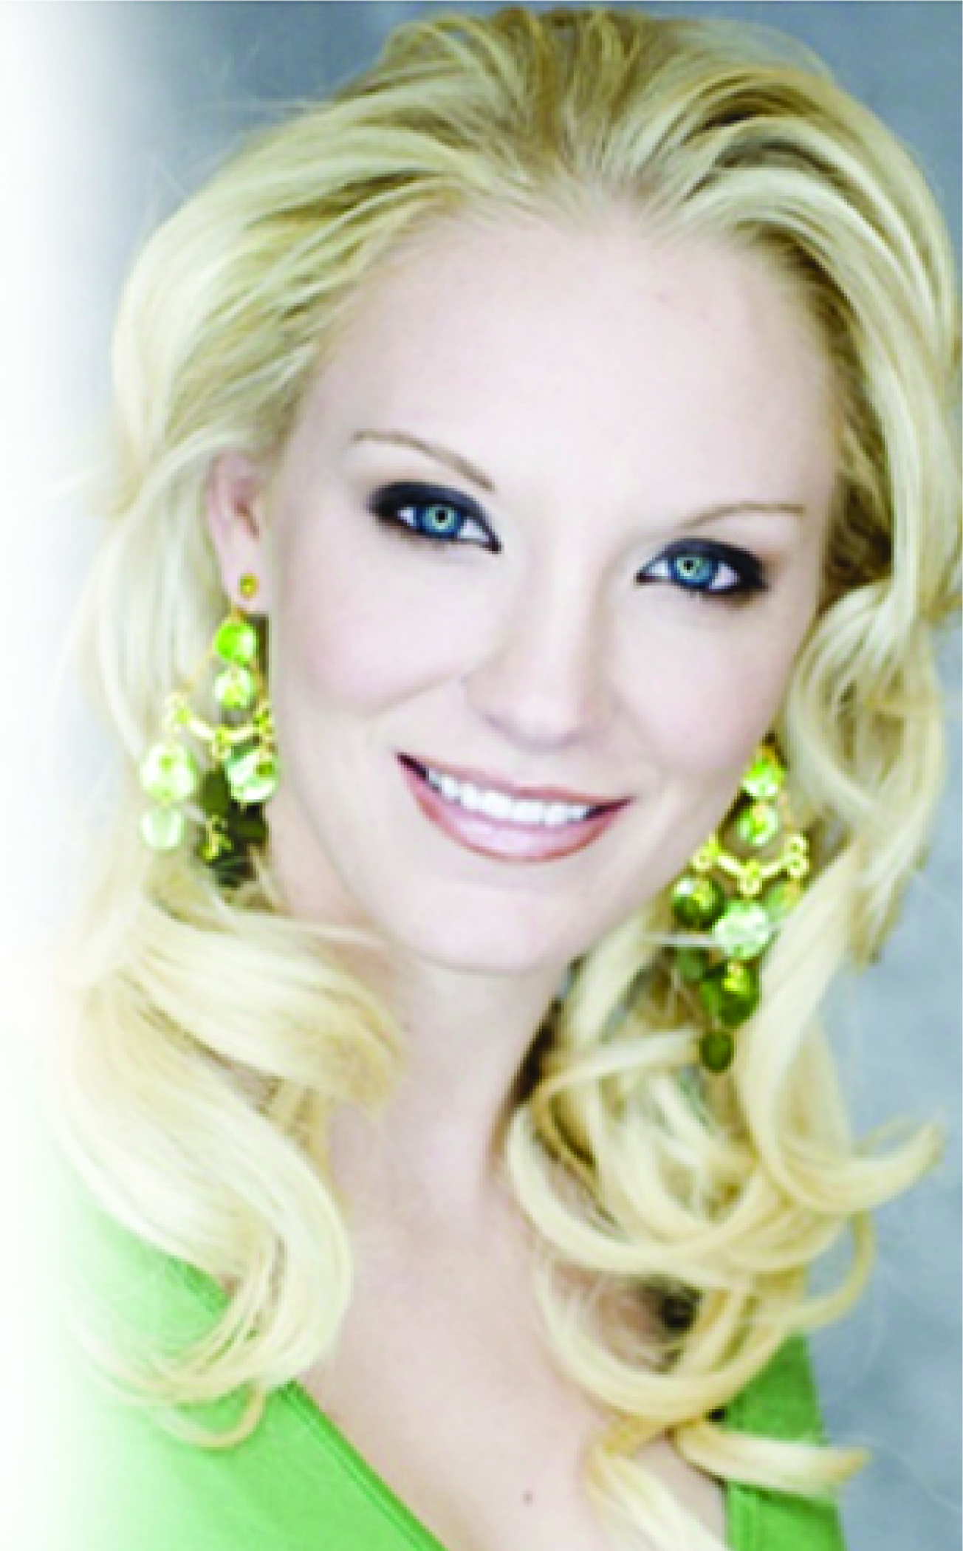
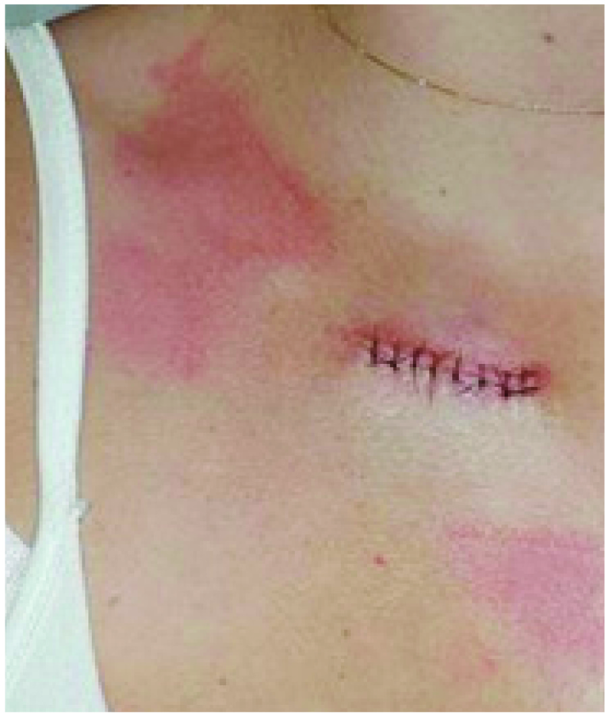
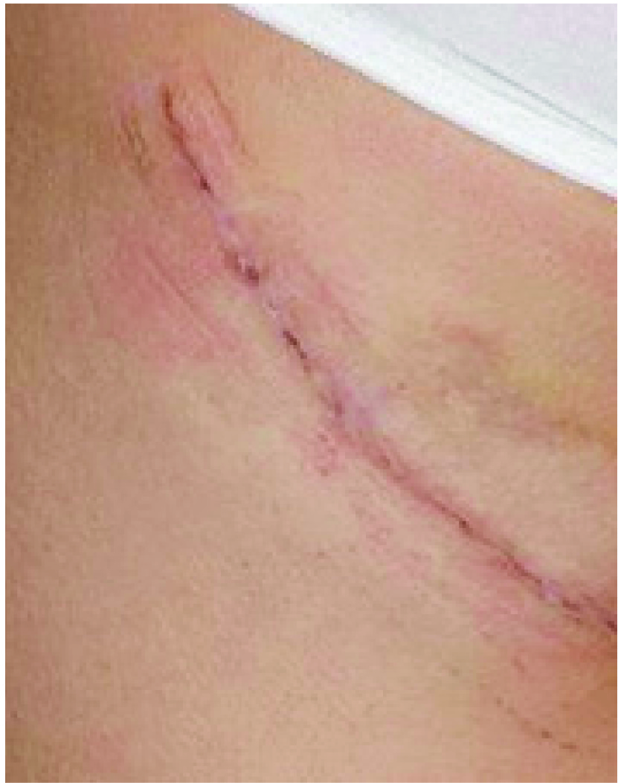
Diagnosed with melanoma at age 20!
Notes:
This is Brittany Cicala. At age 17, she started using tanning beds regularly – four times a week for three years. At age 20, she was diagnosed with stage II melanoma. Her surgery left her with a 7-inch scar, and the surgeon also removed seven lymph nodes from under her arm. She has had more than 20 suspicious lesions removed since the original surgery. Brittany went on to win the title of Miss Maryland and she says that battling cancer at such a young age has changed her view on life.

Slide 19



- Brittany Cicala
Notes:
Here is a quote from Brittany that I think wraps up perfectly what I hope I’ve conveyed to you today: “I don’t want anyone to go through what I have. I keep reminding people that skin cancer can happen to you. You’re not immune to this. This is such a preventable cancer. Wear a sunscreen with an SPF of at least 30 every day. Avoid tanning beds and get screened by a dermatologist regularly.”

Slide 20

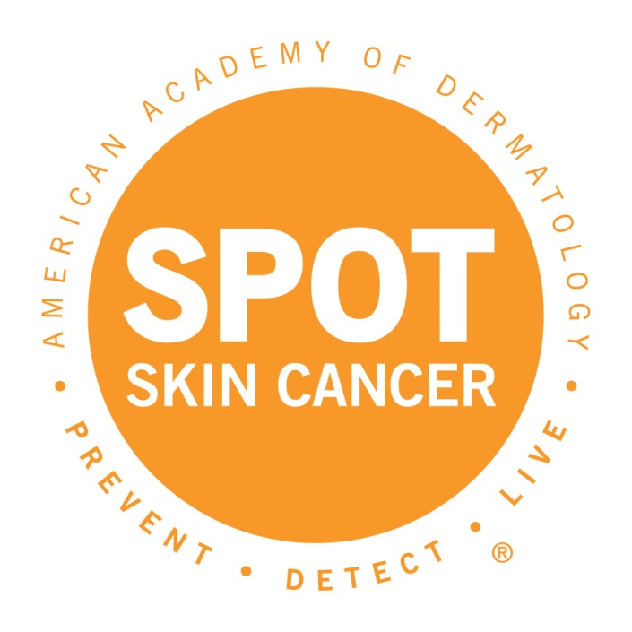
Questions?
www.SpotSkinCancer.org
Notes:
Thank you for taking the time to listen to my presentation. If anyone has any questions, I’d be happy to answer them.

