Slide 1
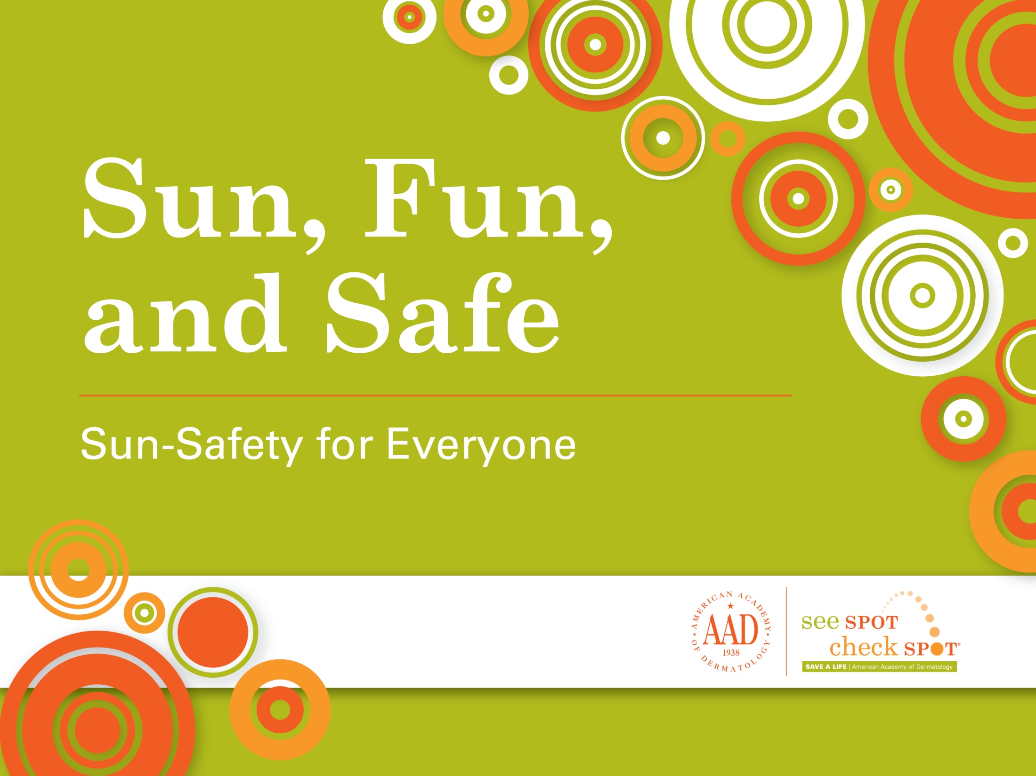
Sun, Fun, and Safe
Sun-Safety for Everyone
Notes:
Thank you for letting me visit with you today. I’m Doctor (NAME) from (INSTITUTE/PRACTICE NAME) and I’m a dermatologist. Does anyone here know what a dermatologist is? (Pause for answers.) A dermatologist is a doctor who cares for your skin, hair and nails. Today, I’m here to talk about how to protect yourself from the sun.

Slide 2

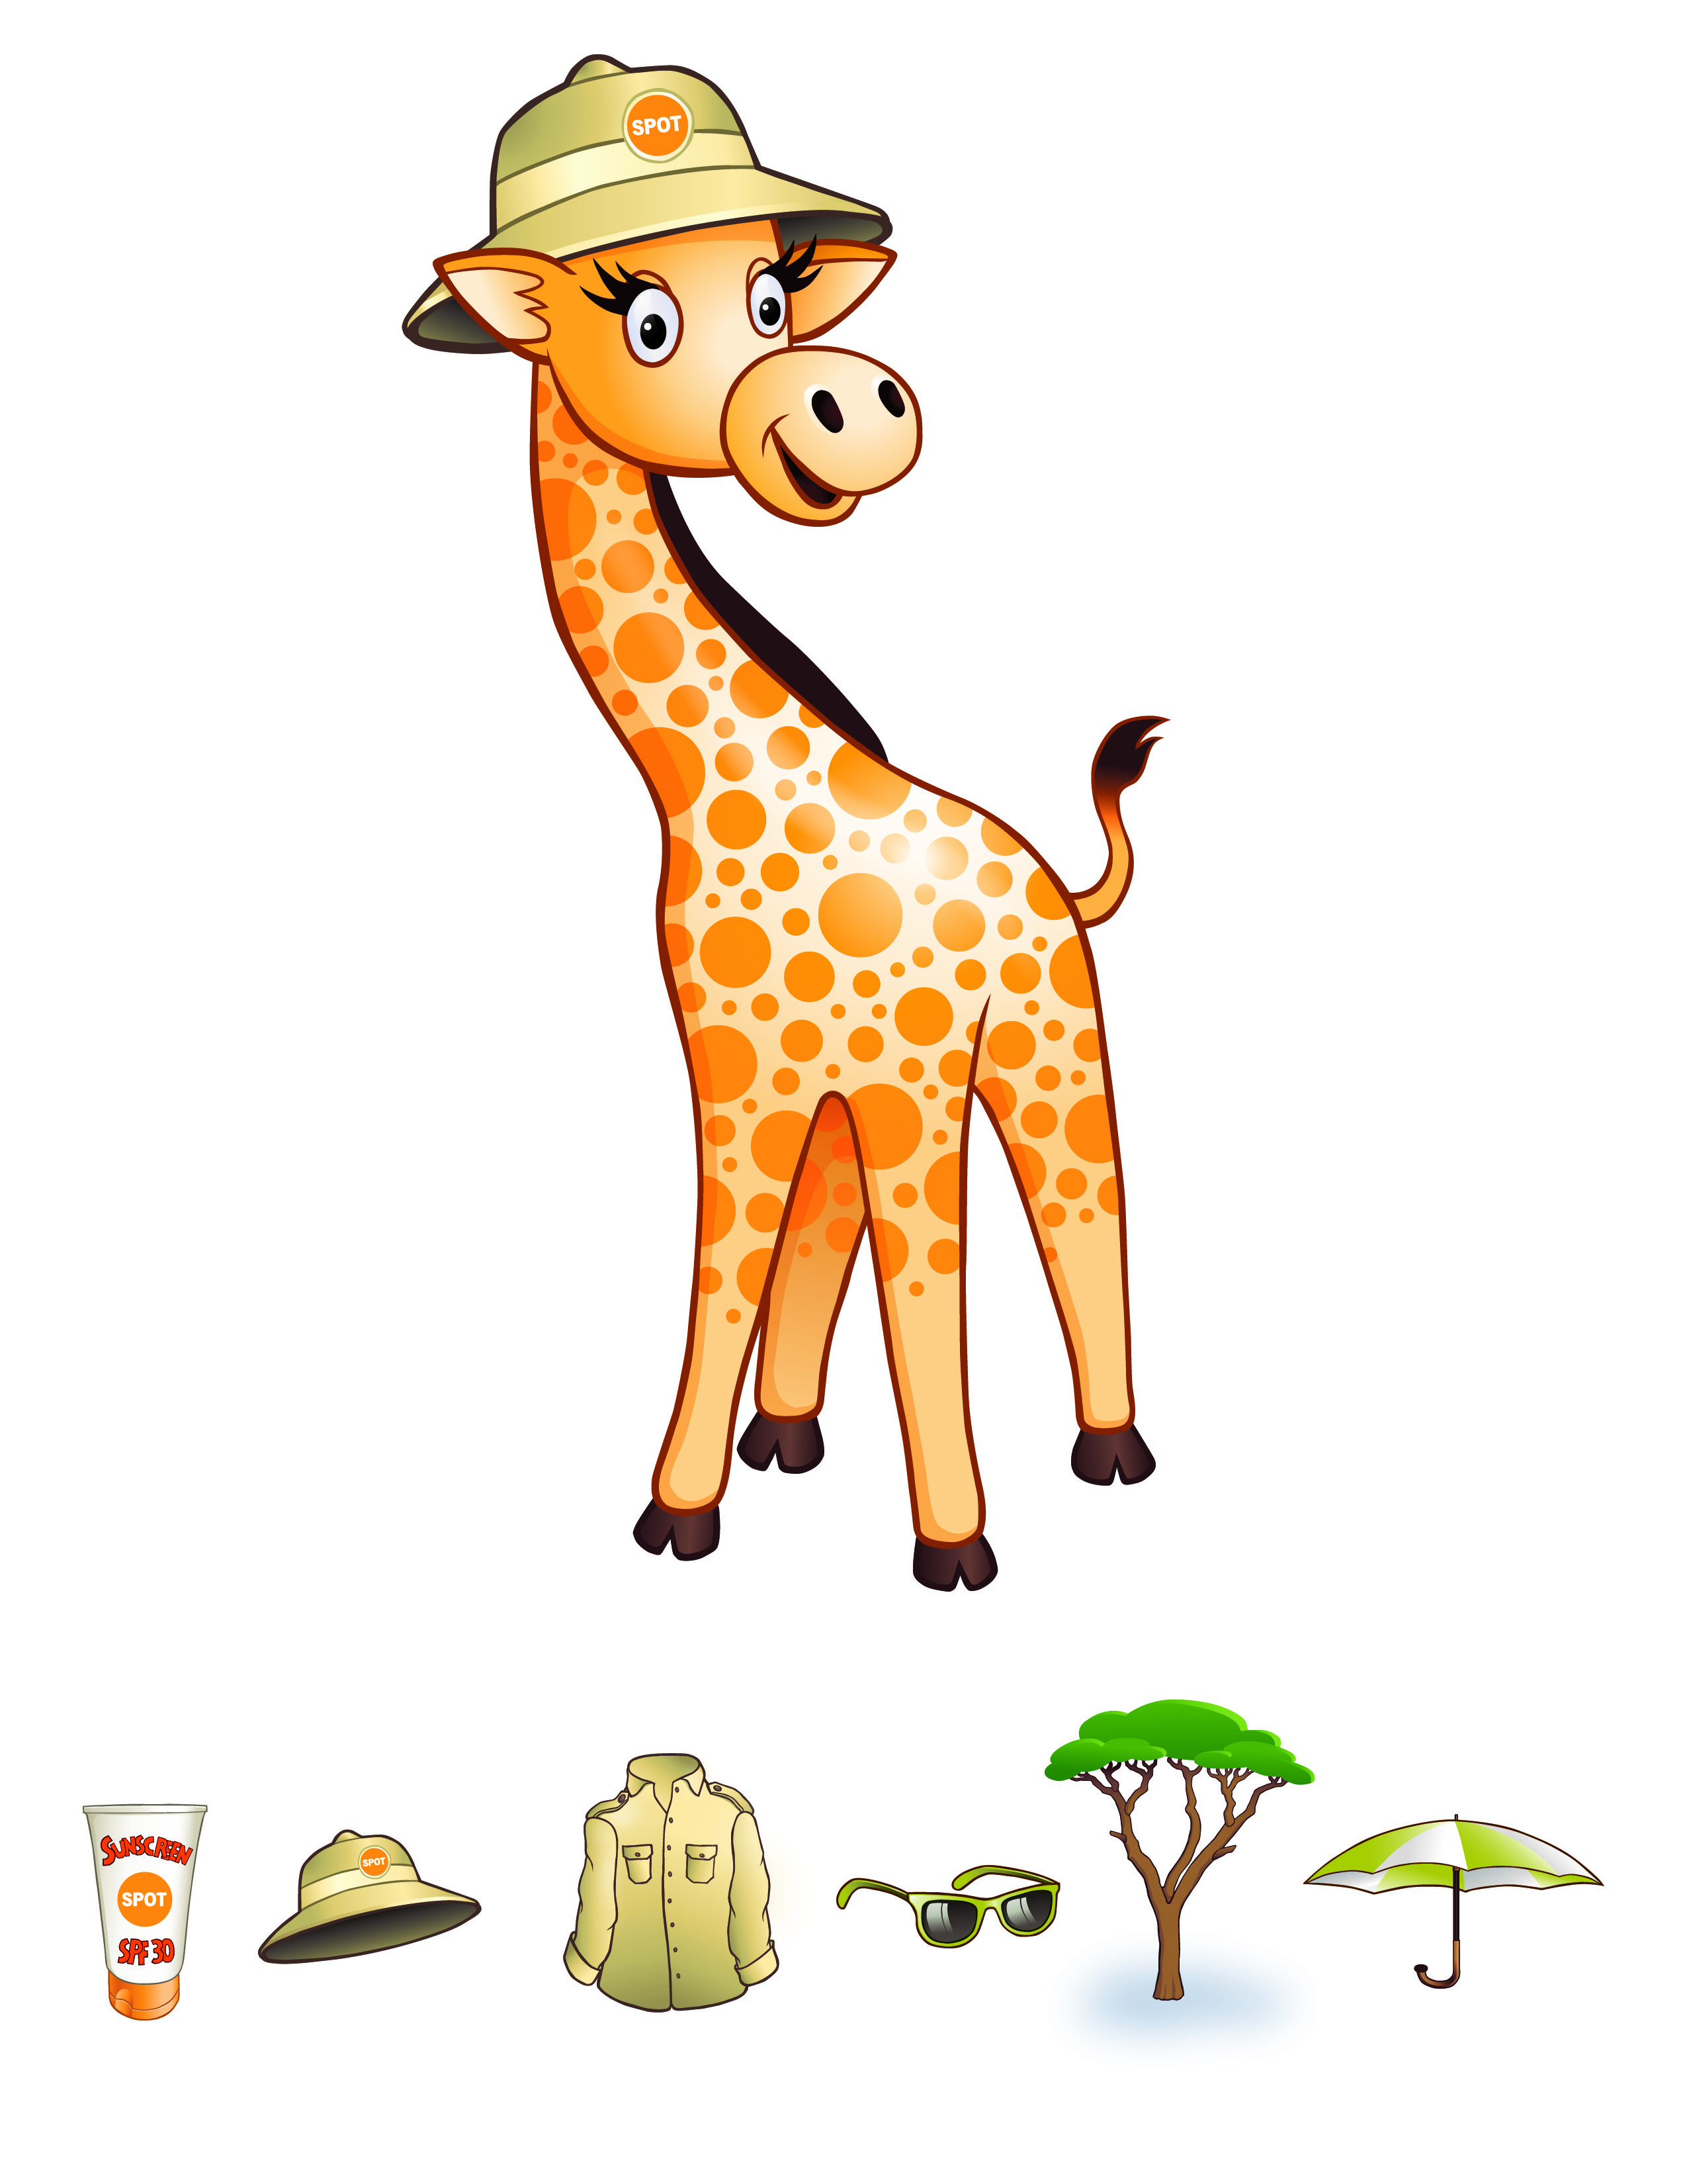
HELLO!
My name is Gigi the giraffe.
Notes:
This is my friend Gigi the Giraffe and she is here to help me tell you about the importance of sun protection.

Slide 3
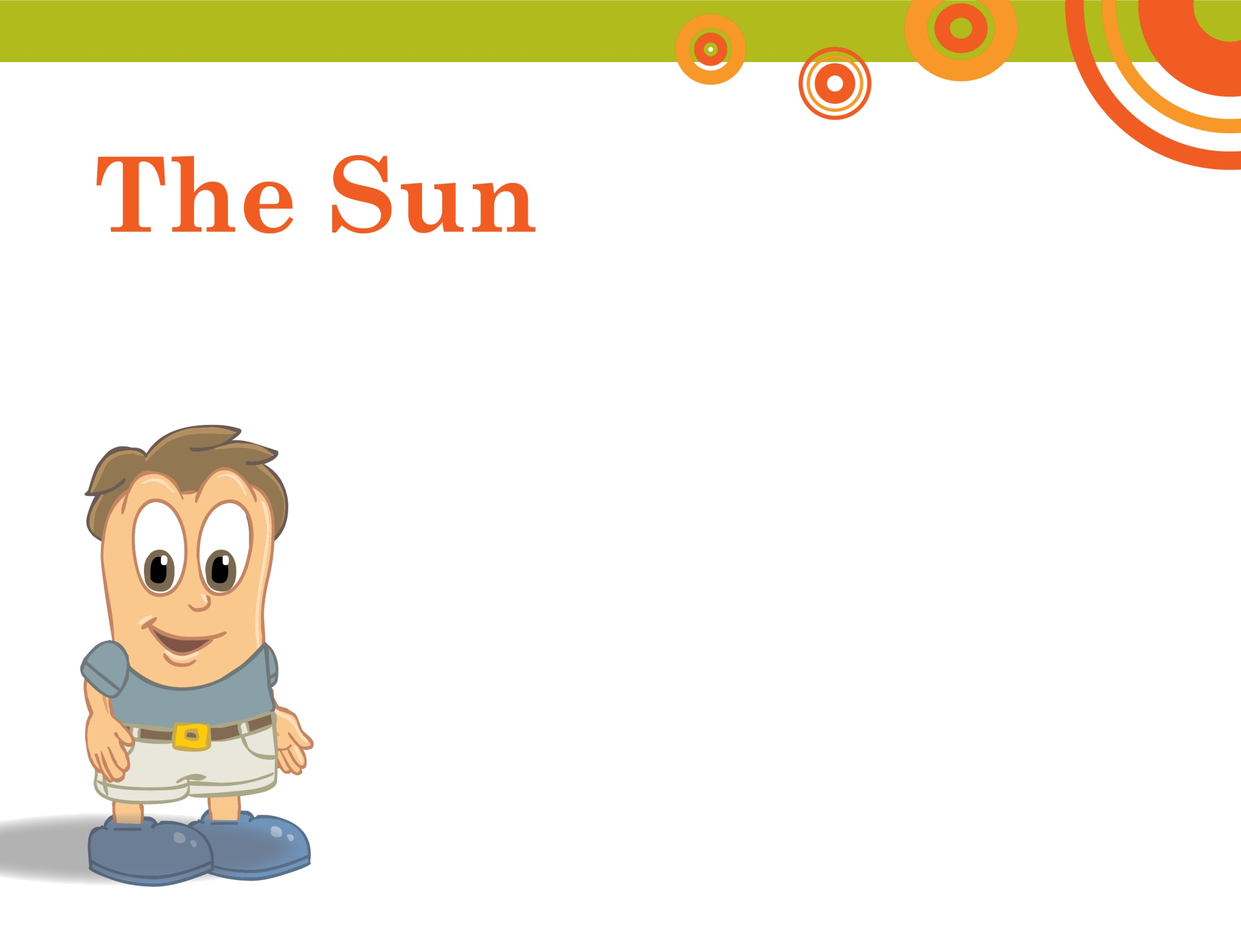

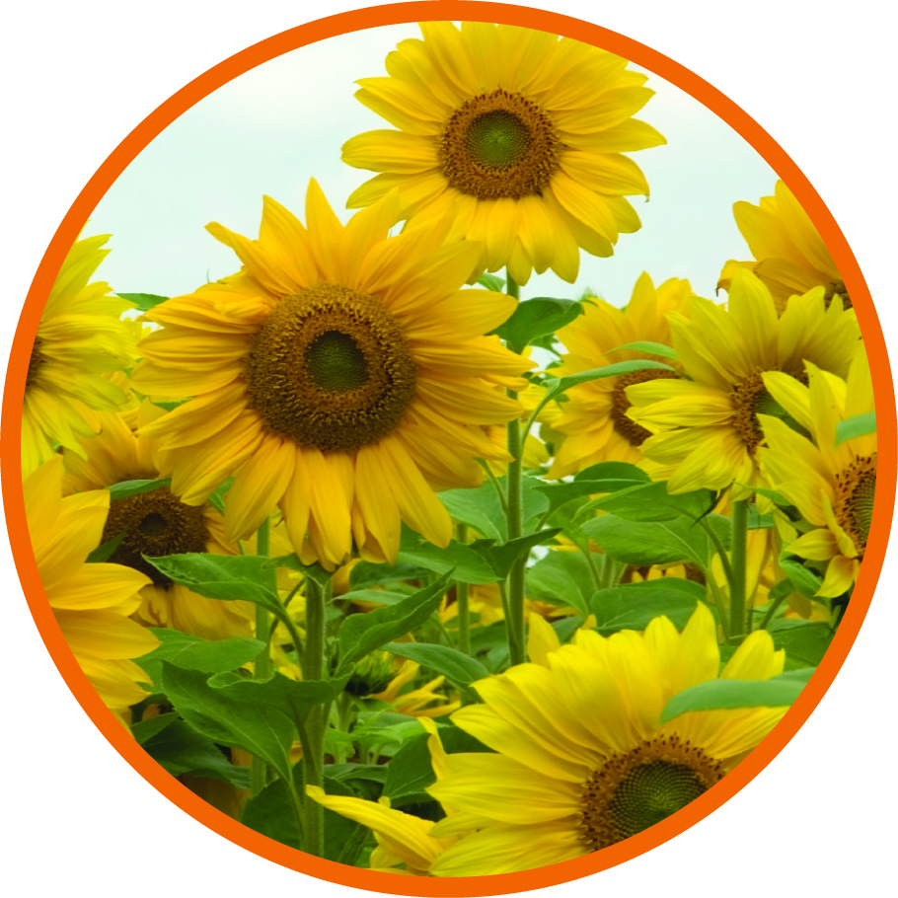
The Sun
Notes:
What do we know about the sun? (Pause for answers such as the sun is good for the flowers, trees, birds, etc.)

Slide 4
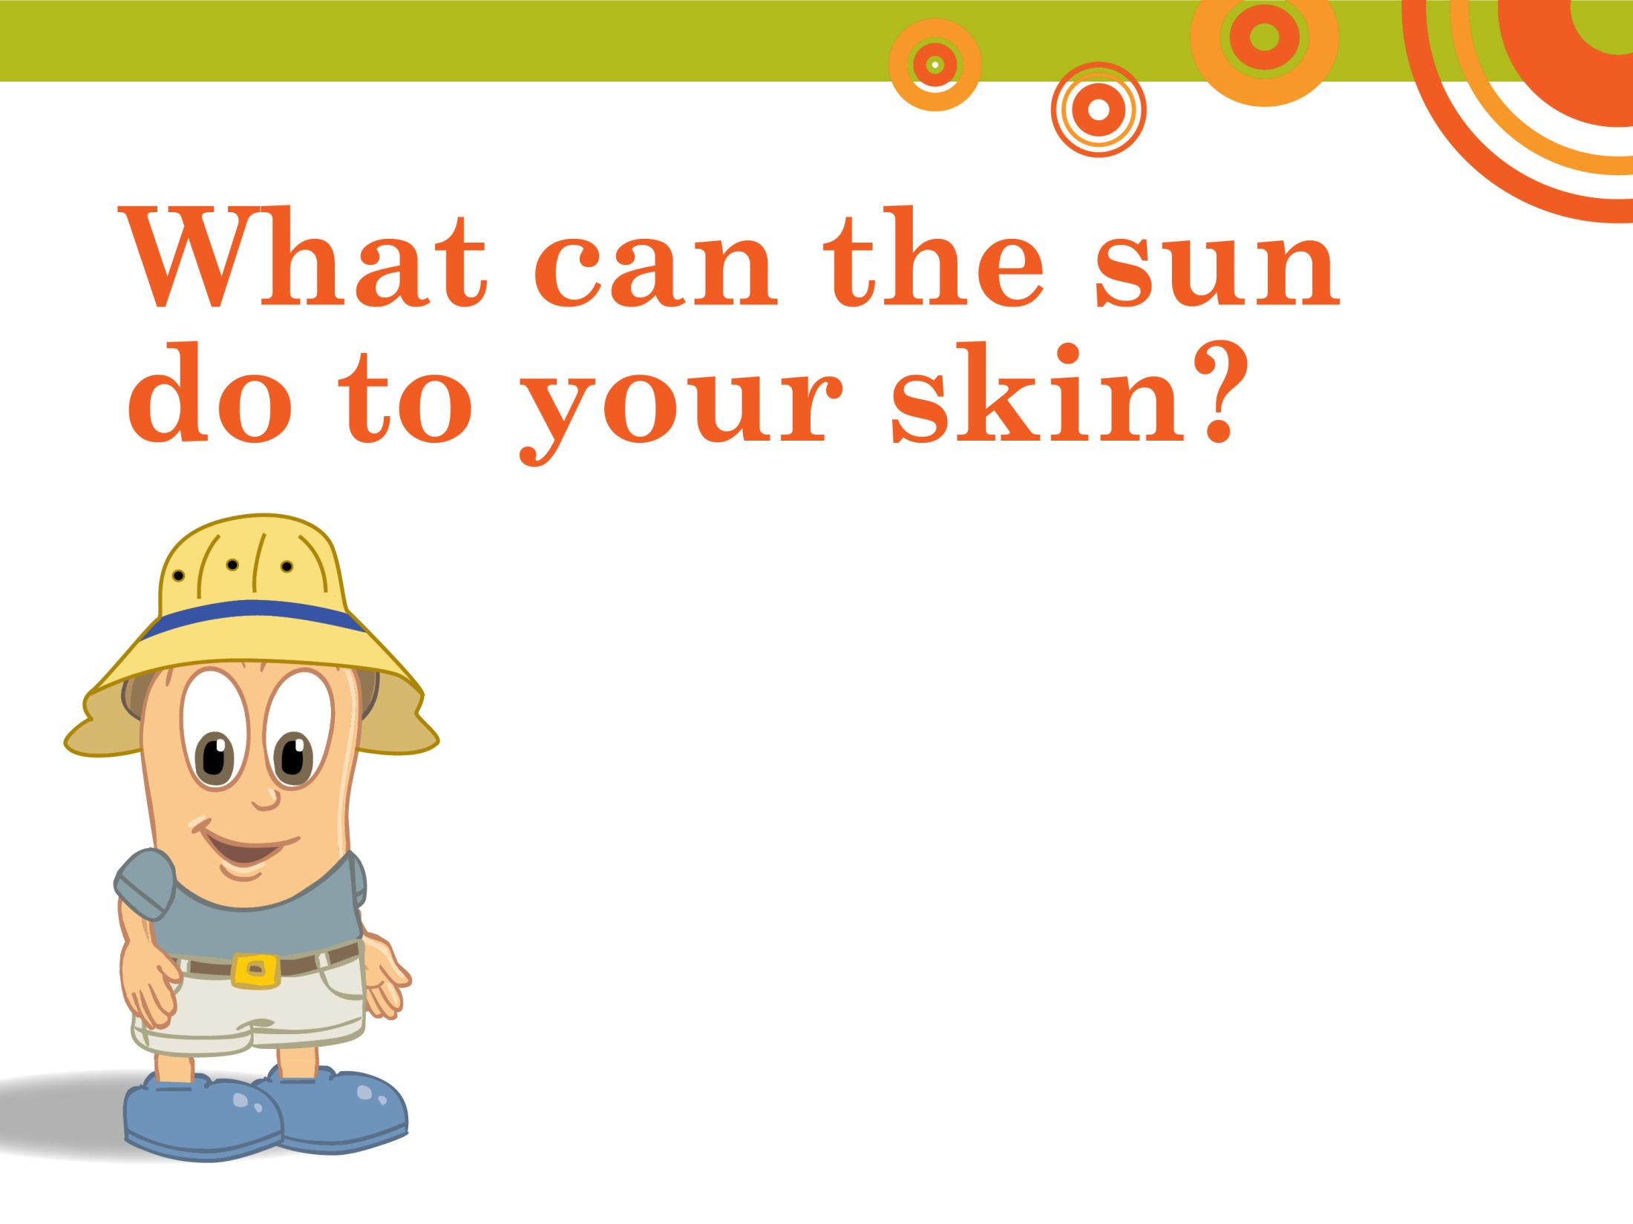
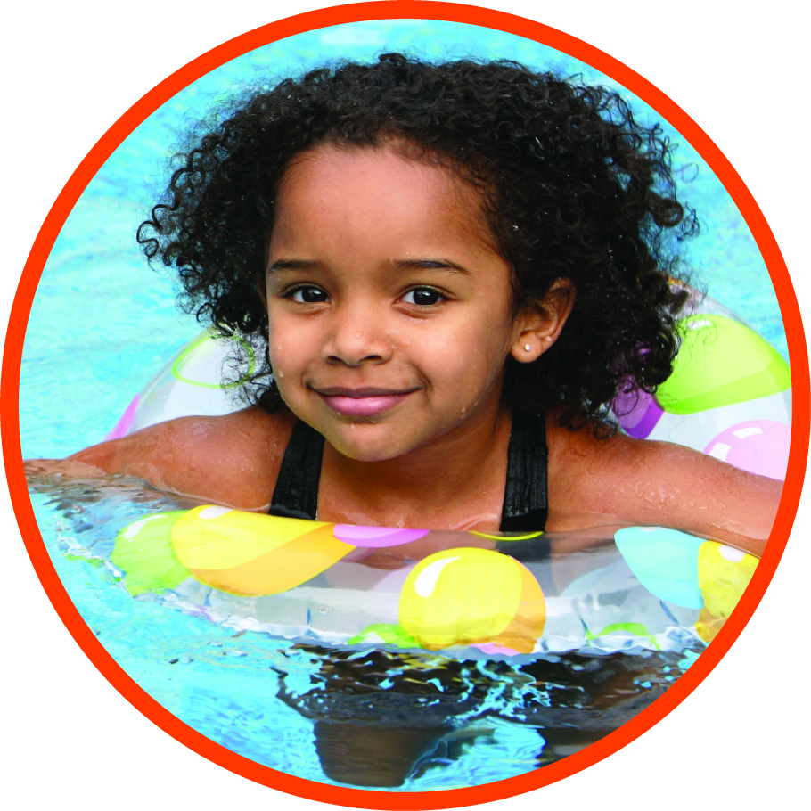
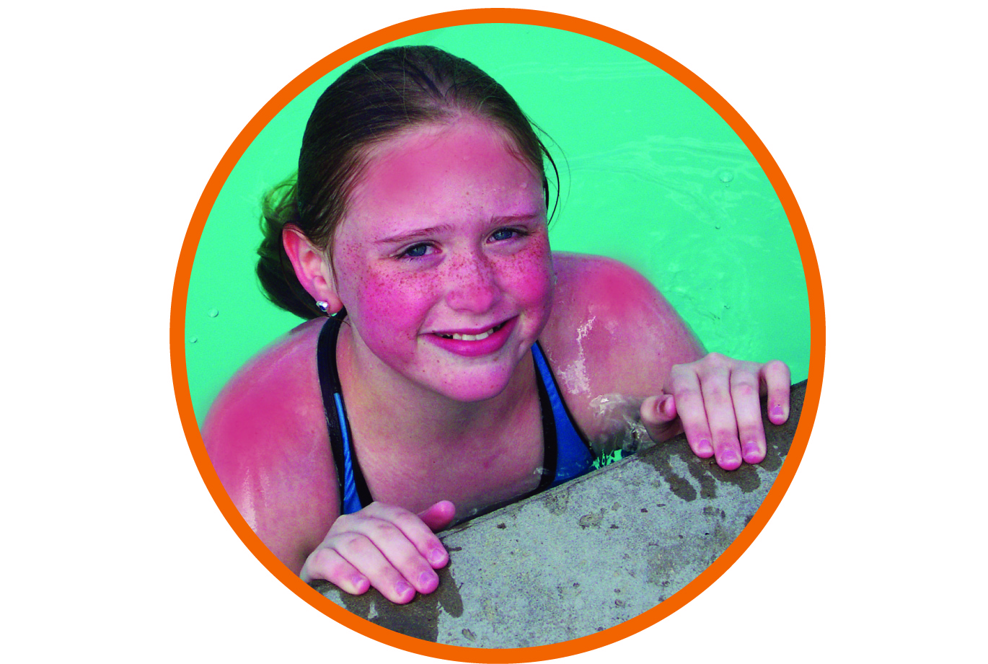
What can the sun do to your skin?
Notes:
How many of you have had a sunburn? (Pause for answers/hands raised). I bet that hurt, right? You probably tried really hard next time you were outside to not get a sunburn. Any time your skin is not protected by sunscreen or clothes and you get too much sun, it can burn.

Slide 5
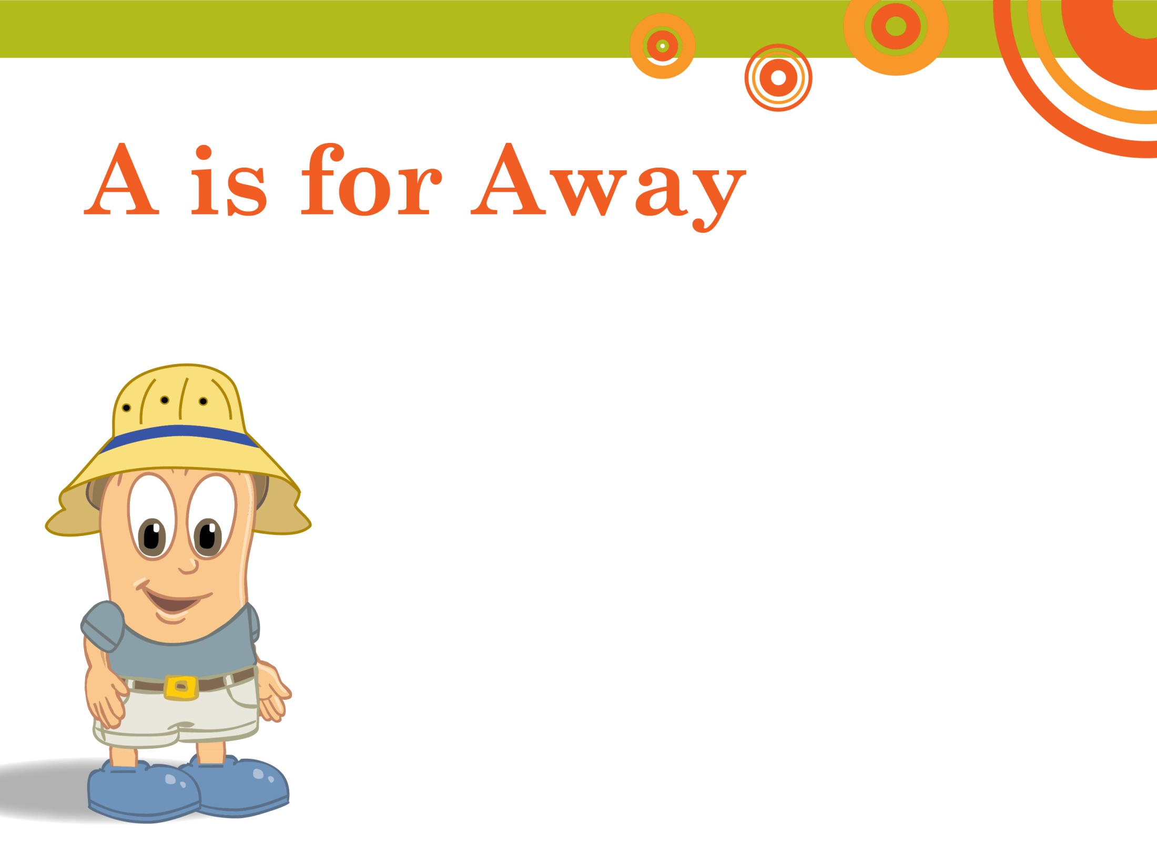
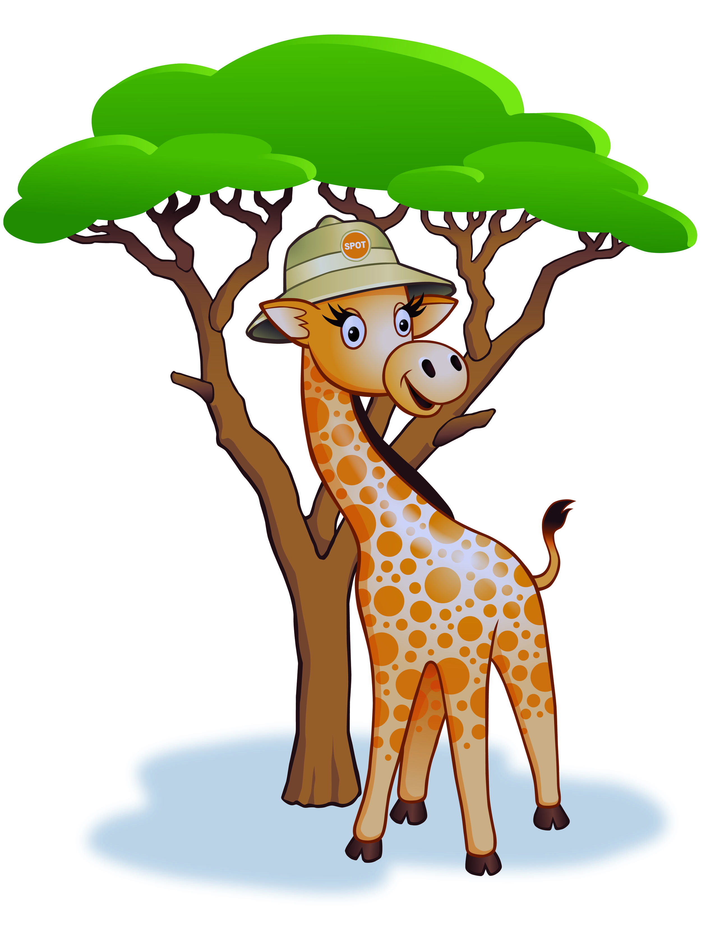

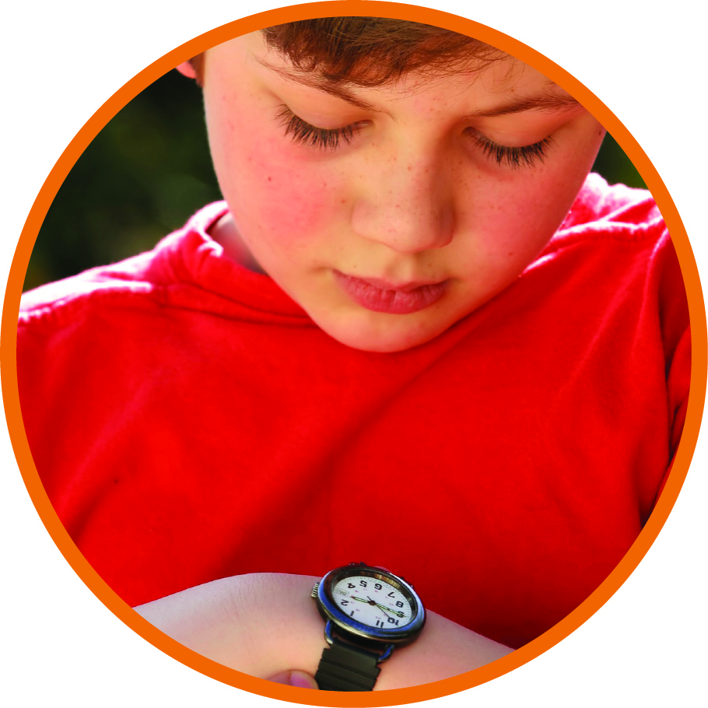
A is for Away
Notes:
So what’s the best way to protect yourself from the sun? Gigi says use your ABCs for safe fun in the sun.
A is for Away.
How many of you can tell time? (NOTE to AAD members: depending on the children’s ages, please adjust the script accordingly.)
For children able to tell time: Be sure to check a clock or your watch before you head outdoors. If it’s between 10 a.m. and 2 p.m., try to seek shade. These are the hours to stay away from the sun as too much sun can give you a sunburn.
For children not yet able to tell time: Ask your Mom and Dad to tell you when to seek shade, especially between 10 a.m. and 2 p.m. These are the hours to stay away from the sun as too much sun can give you a sunburn.
Have you ever looked at your shadow and noticed that it was long or short depending on the time of day? An important way to remember when to find shade is: if your shadow is shorter than you are, it’s time to get out of the sun.

Slide 6
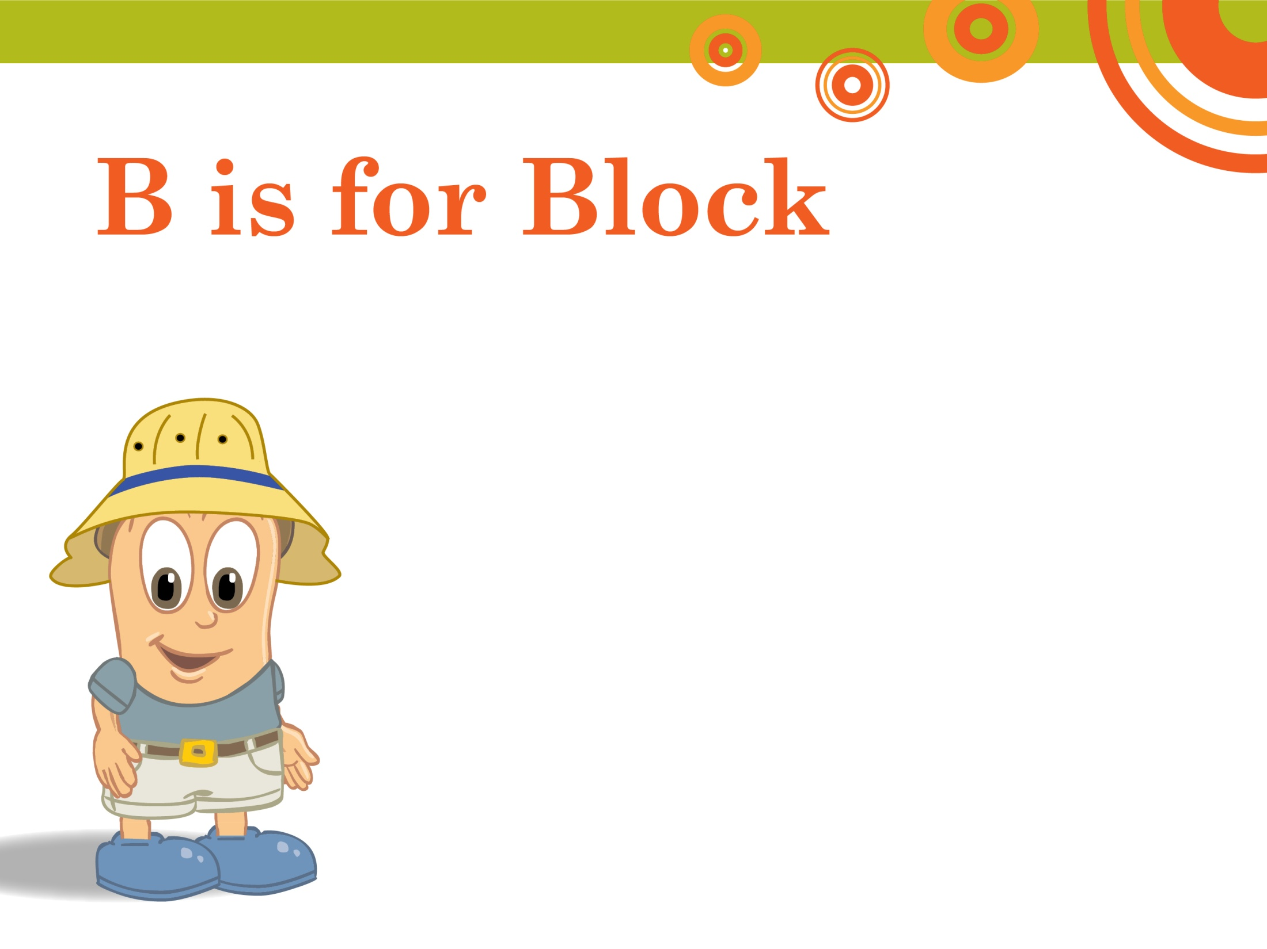
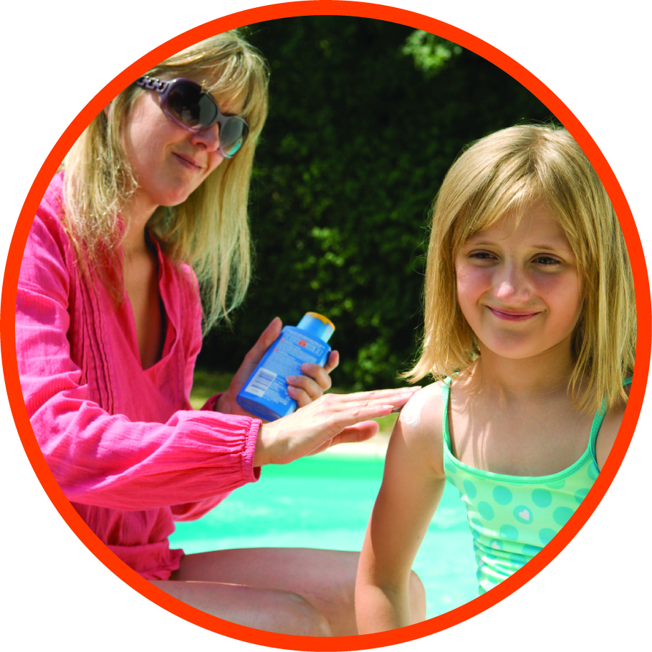
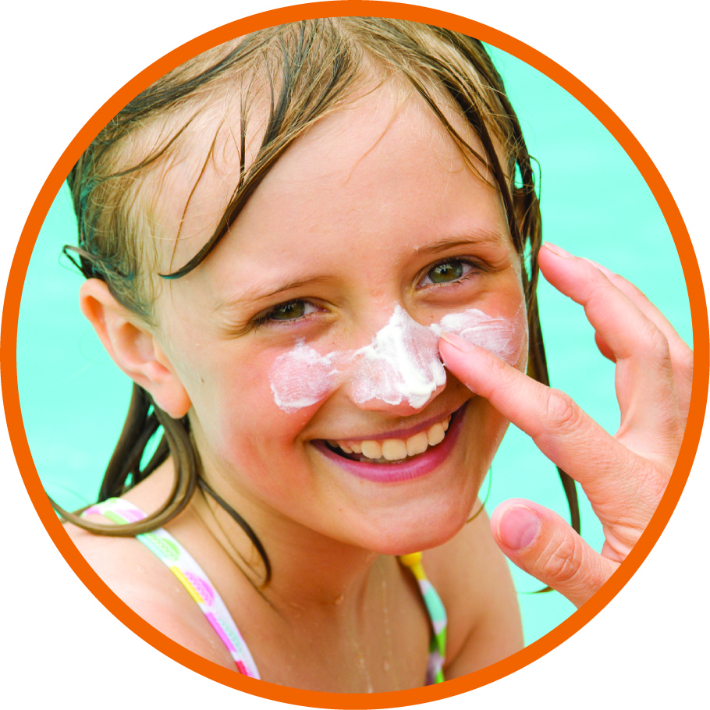
B is for Block
Notes:
B is for Block.
To block the sun, but not the fun, slather on sunscreen. Make sure you cover every inch of your skin not covered by clothing with sunscreen. Ask your parents or a friend to put sunscreen on those hard to reach areas and don’t forget your lips. Put on sunscreen 15 minutes before going outside. It only takes a few minutes. Sunscreen wears off, so put more on after swimming or sweating. Sunscreens rub off as well as wash off, so if you’ve dried off with a towel, be sure to reapply your sunscreen.

Slide 7
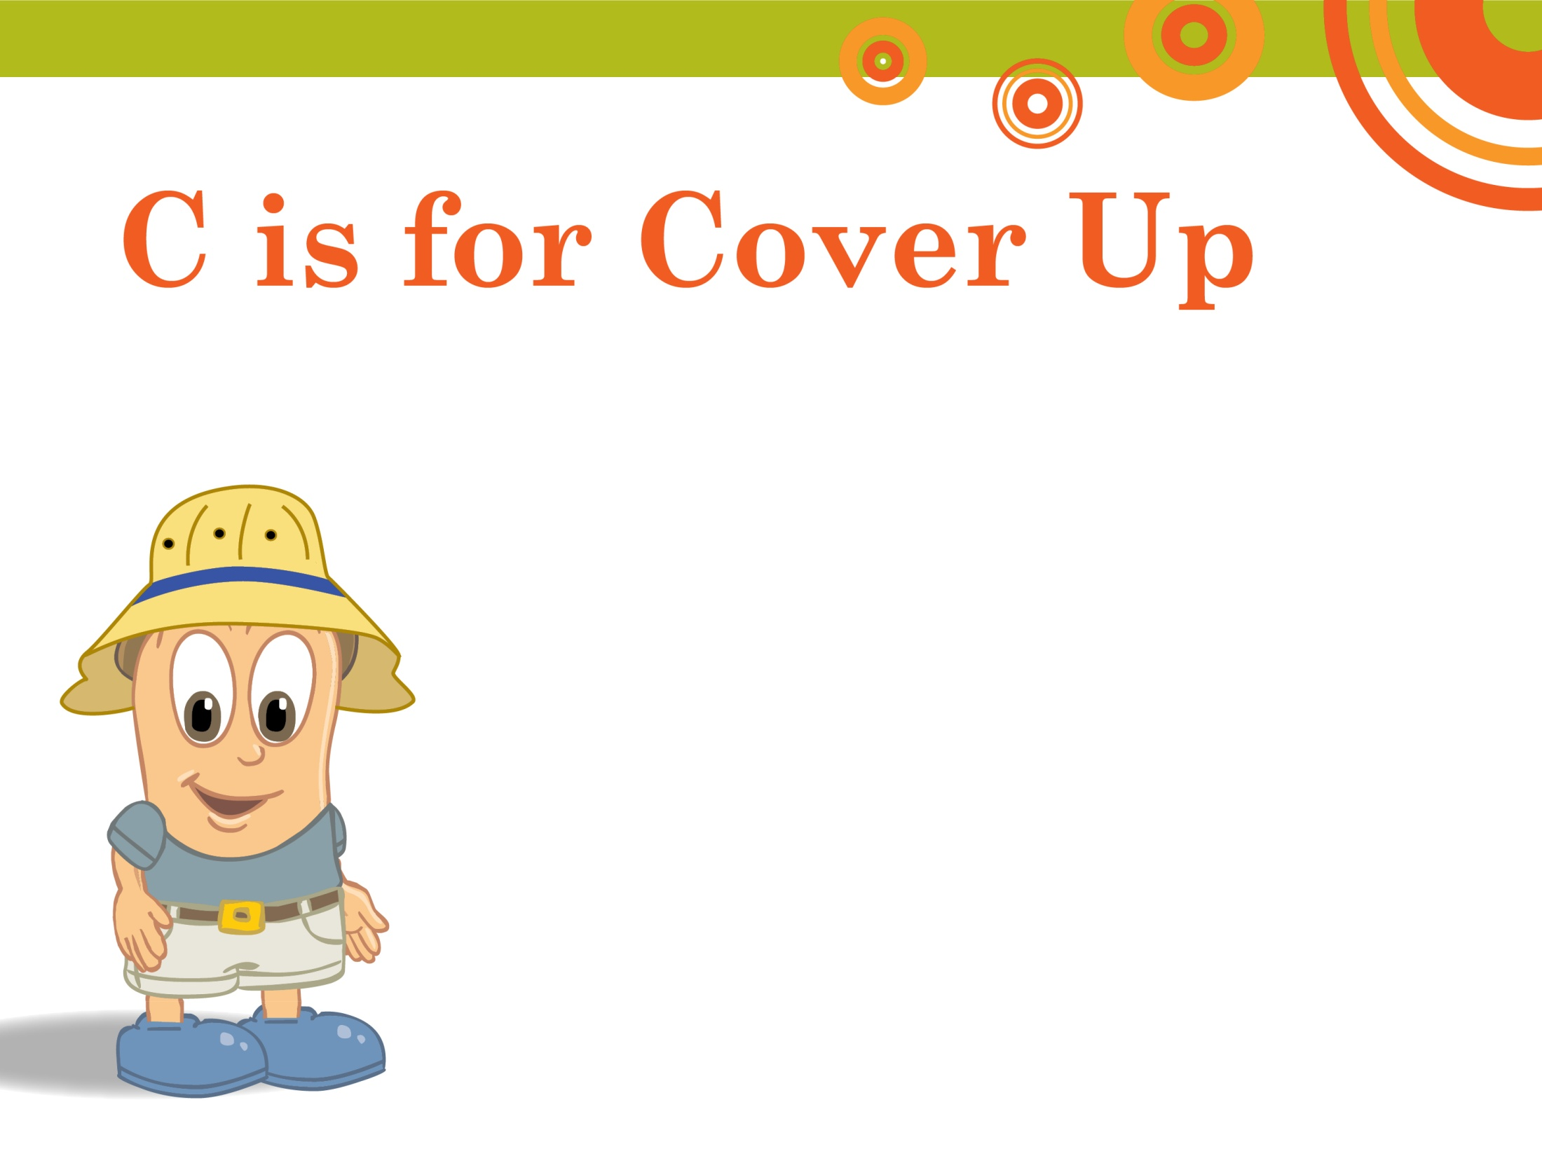
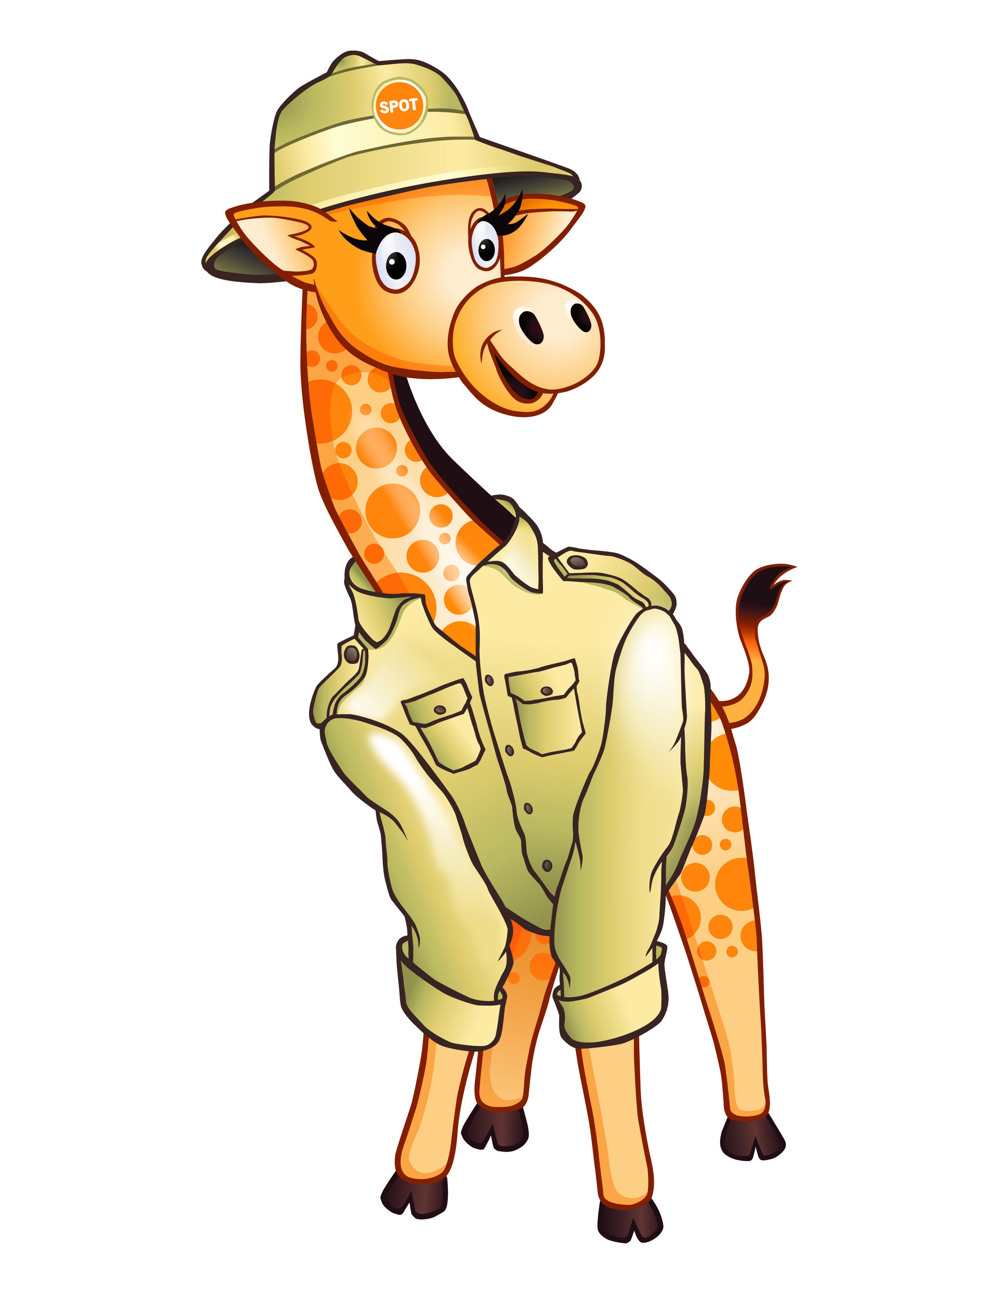
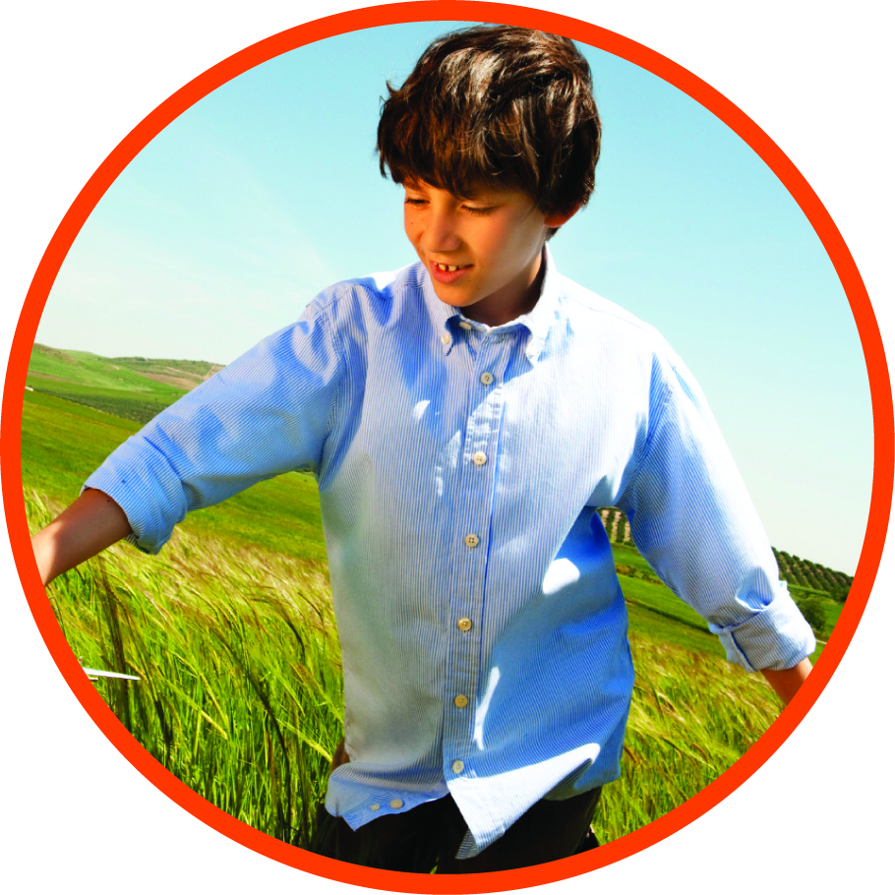
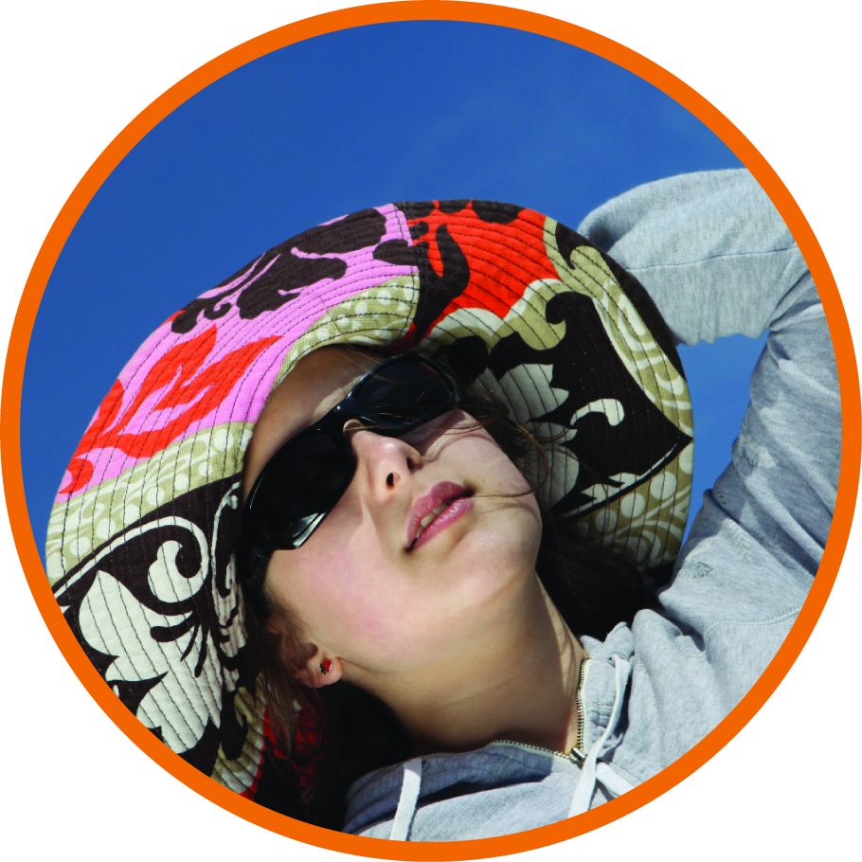
C is for Cover Up
Notes:
C is for Cover up.
Long-sleeved shirts and pants can help keep the sun off your skin. Hats, especially those with a really large brim all the way around, more than a baseball cap, are great because they keep the sun off your face, ears and neck. Sunglasses protect your eyes and the skin near your eyes.
(NOTE to AAD members: Please bring examples of these items to show.)

Slide 8
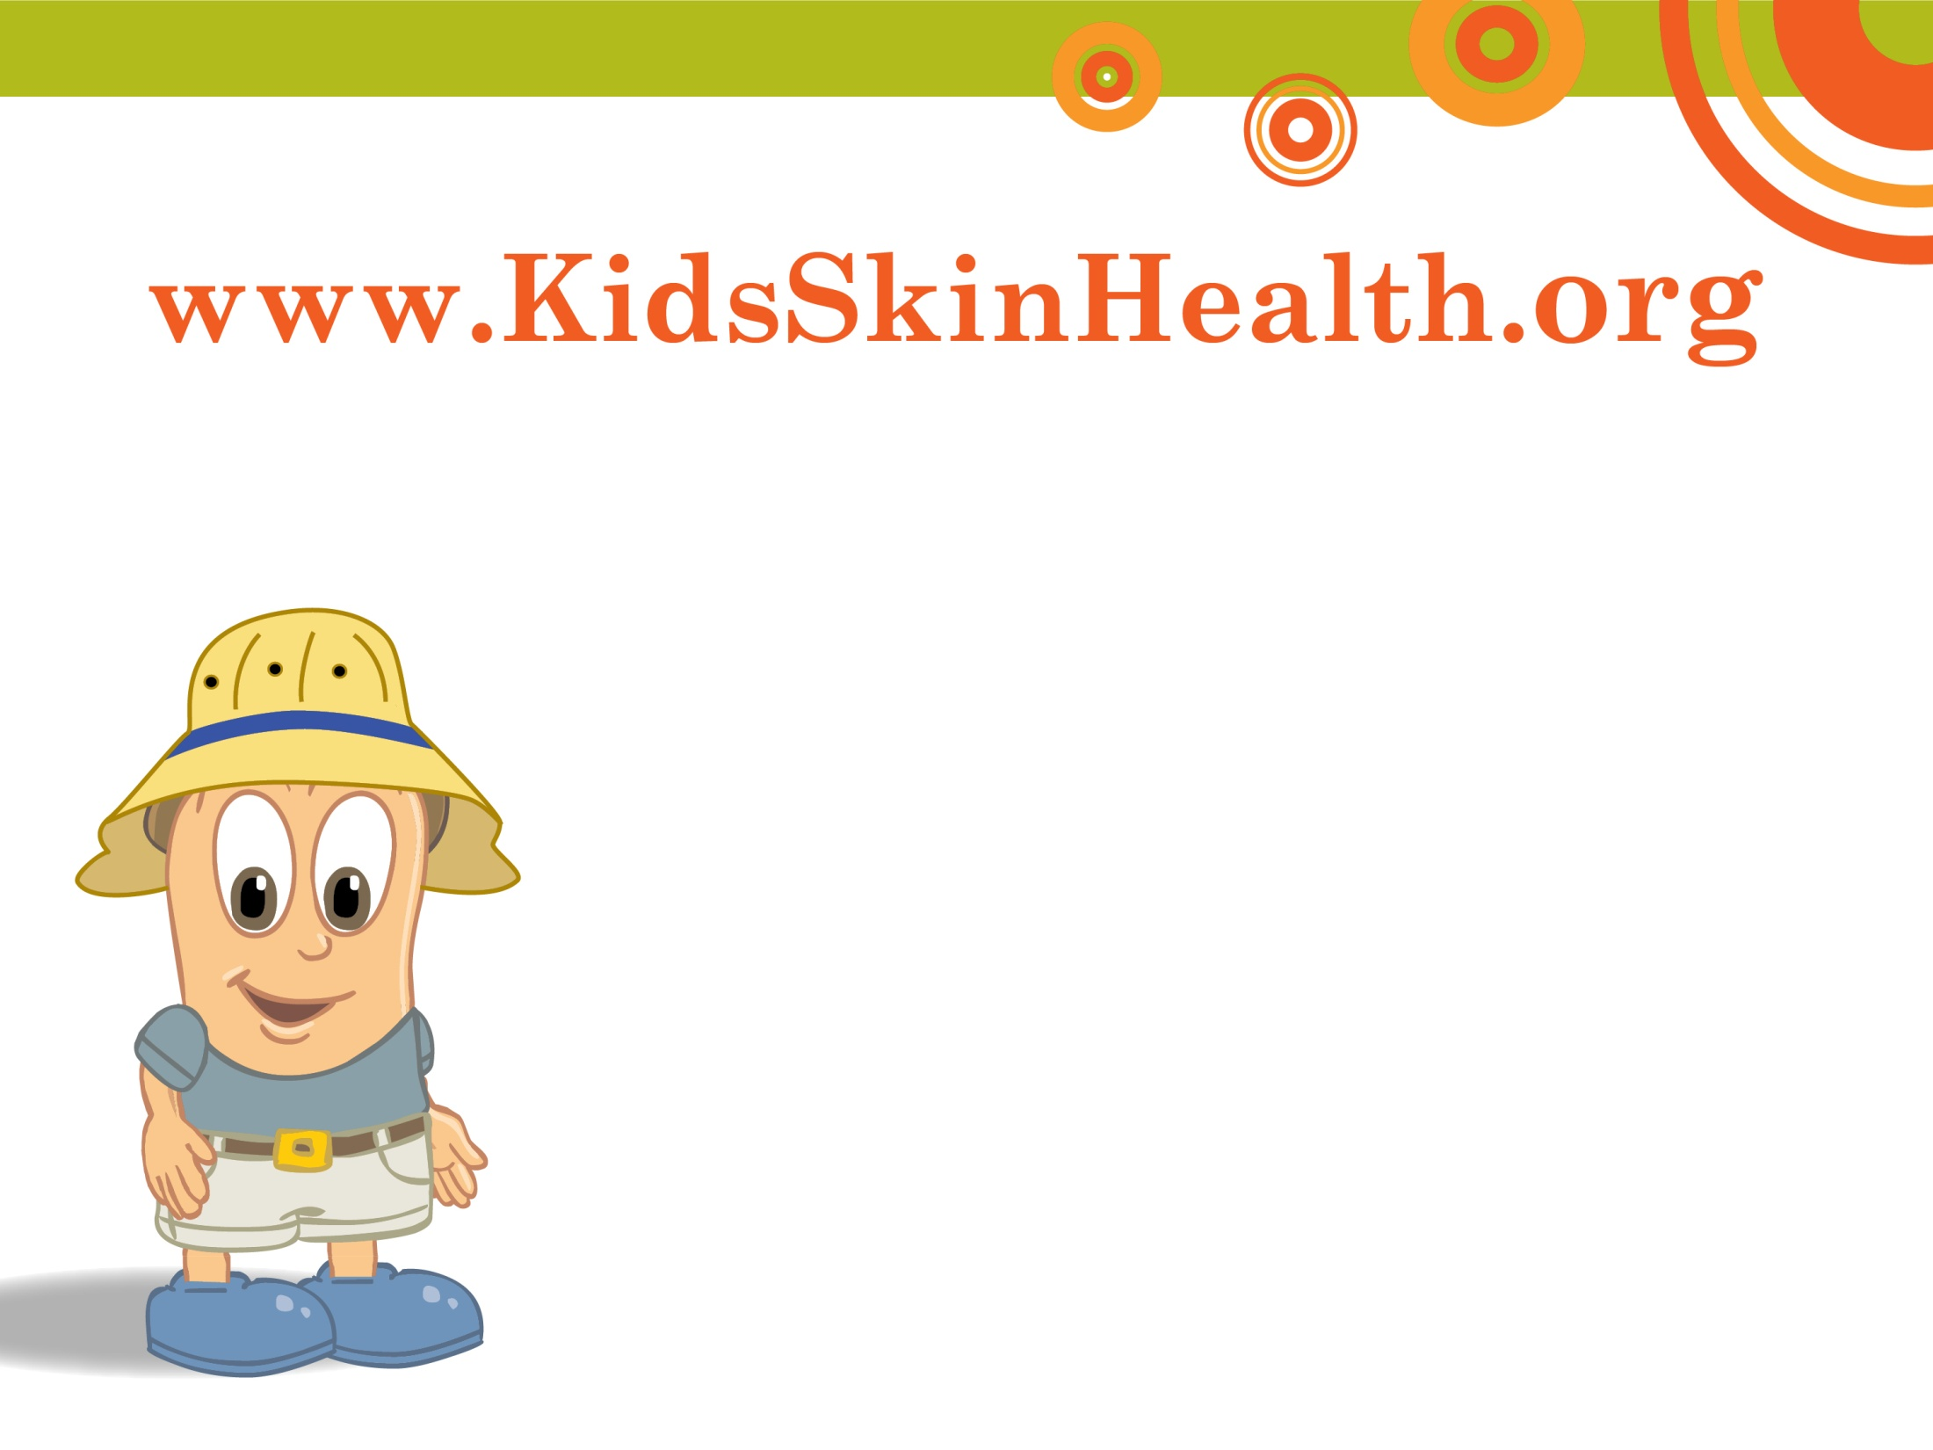
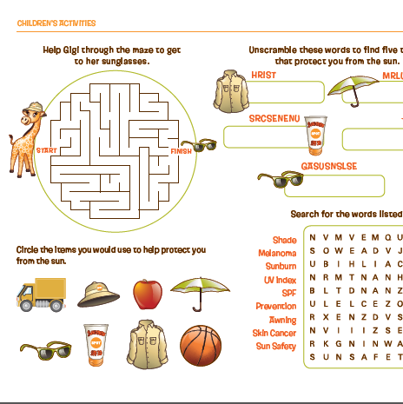
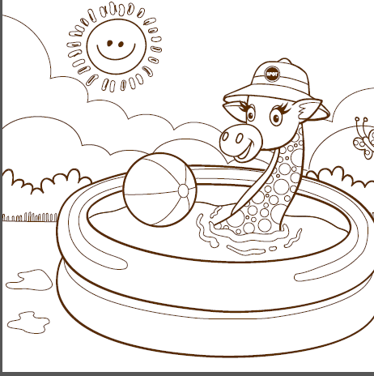
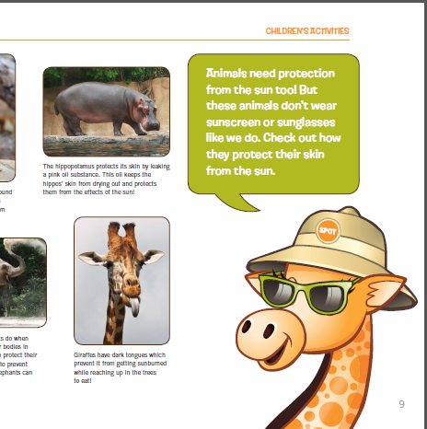
www.SpotSkinCancer.org
Notes:
To visit Gigi the Giraffe and learn more about protecting your skin from the sun, ask your parents if you can visit www.SpotSkinCancer.org website. You can download fun activity sheets and learn more fun stuff.

Slide 9
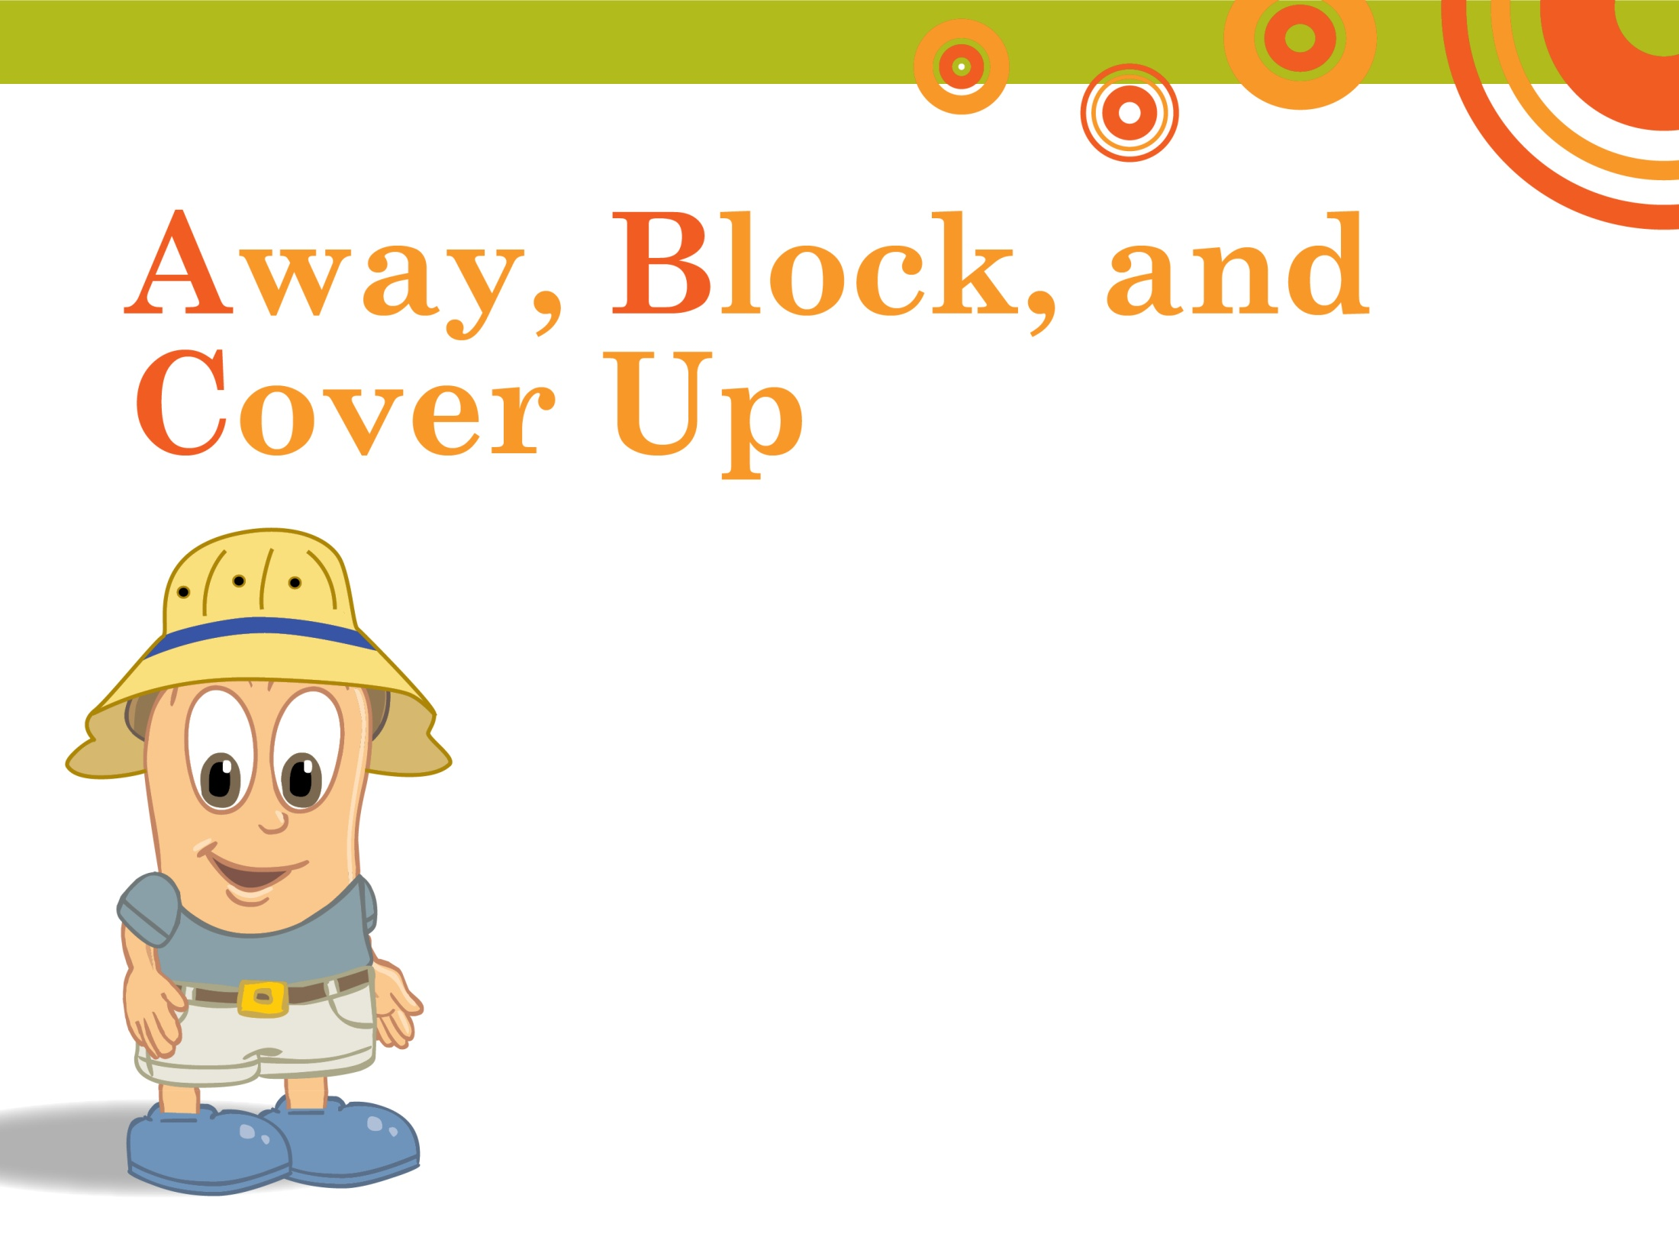
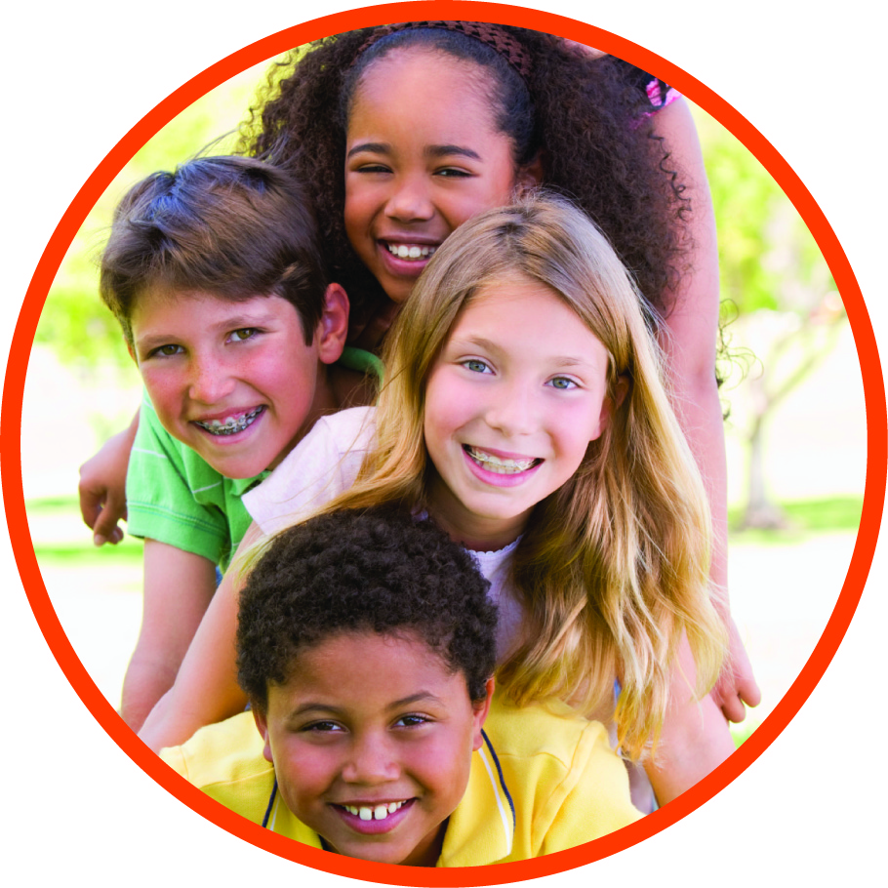
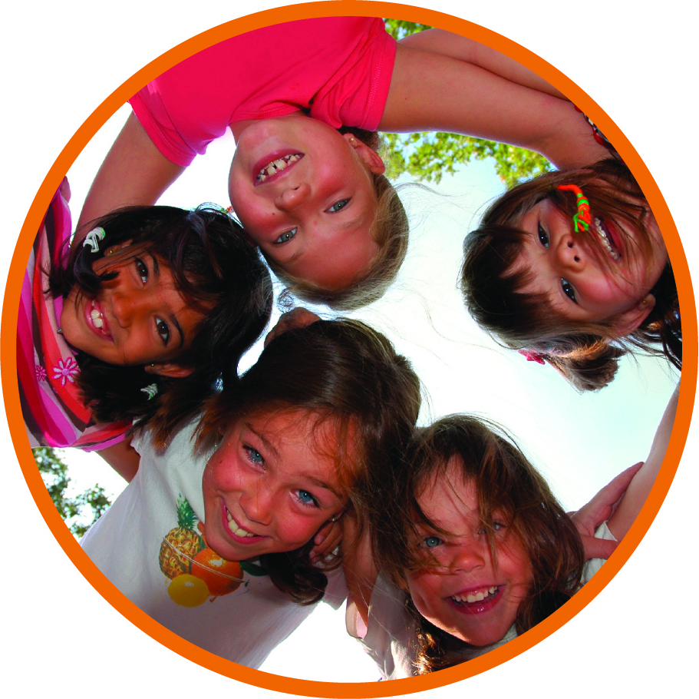
Away, Block, and
Cover Up
Notes:
I hope you enjoyed learning about the importance of being safe in the sun from Gigi. Remember the ABCs for safe fun in the sun. Now to help you remember to stay safe in the sun, the American Academy of Dermatology has provided you with some coloring pages featuring Gigi the giraffe to take home and share with your family. Then you can all stay safe in the sun together.
Thank you for your attention. Are there any questions I can answer?
(Note to AAD member: Print out copies of the coloring sheets in advance to hand-out . You can print from the following slides, or you can find them online in the Academy’s Children’s Toolkit: http://www.aad.org/spot-skin-cancer/understanding-skin-cancer/how-do-i-help-others-understand-skin-cancer/toolkits#.UYGKjV8o6M8)

Slide 10
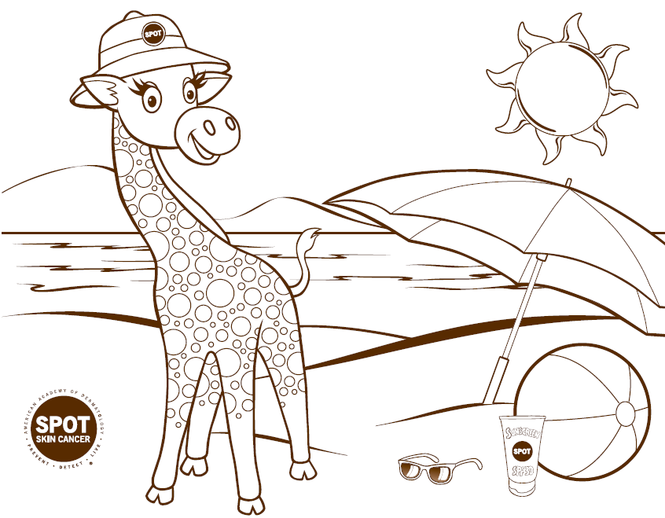

Slide 11
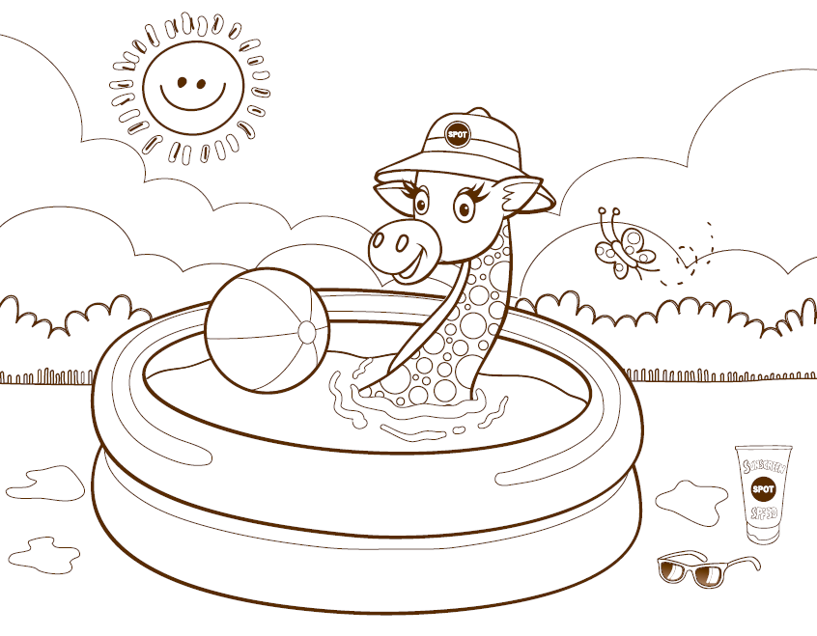

Slide 12
