Slide 1
Skin Cancer:
You can prevent it!
American Academy of Dermatology
Notes:
Thank you for letting me visit with you today. I’m Doctor (NAME) from (Institution/Practice Name). As a dermatologist, I specialize in the diagnosis and treatment of skin, hair and nail conditions.
Today, I’m here to talk to you about skin cancer detection and prevention.

Slide 2

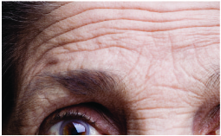
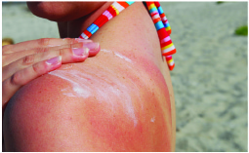
How does the sun affect your skin?
UVA = Aging
UVB = Burning
Notes:
There are two different kinds of ultraviolet, or UV, radiation that come from the sun. You probably have heard of UVA and UVB rays – both are dangerous, cause premature wrinkles and can increase your chance of developing skin cancer. These rays are always present, even when it’s cloudy. UVA rays, which pass through window glass, penetrate deeper into the dermis, the thickest layer of the skin. UVA rays can cause suppression of the immune system, which interferes with the immune system’s ability to protect you against the development and spread of skin cancer. UVA exposure also is known to lead to signs of premature aging of the skin such as wrinkling and age spots. UVB rays are the sun’s burning rays, which are blocked by window glass, and are the primary cause of sunburn. A good way to remember it is that UVA rays are the aging rays and UVB rays are the burning rays. Excessive exposure to both forms of UV rays can lead to the development of skin cancer. So what exactly are UV rays doing to your skin? Some of the damage caused by UV rays are: permanent destruction of the skin’s supporting structure – the collagen and elastic fibers; freckling; wrinkling; dilated blood vessels; suspicious skin lesions; redness; drug reactions and of course, skin cancer.

Slide 3

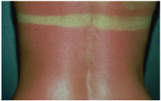
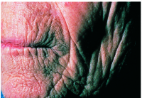
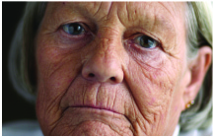
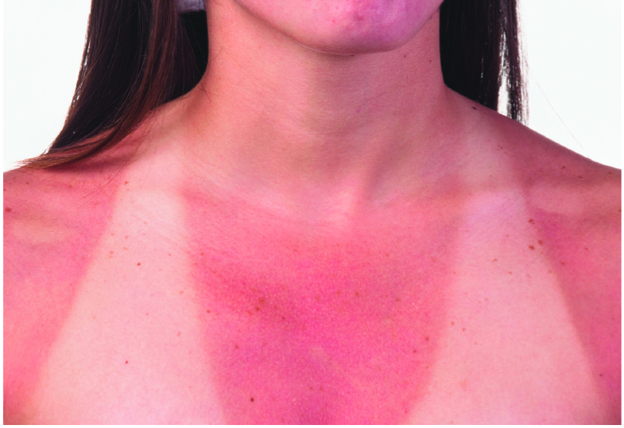
Is there a safe way to tan?
Notes:
So, is there a safe way to tan? What you need to know is that there is no safe way to tan. A tan is the skin’s response to injury caused by UV exposure. To protect your skin from UV damage, your body makes melanin every day. Melanin is the pigment that gives color to your skin and eyes.
When your skin gets damaged by the sun’s rays, it makes more melanin to try and protect your skin from further damage. That causes the skin to change color – darken or burn. Overexposure to ultraviolet light, both natural and artificial, results in changes to the skin’s texture, causing wrinkling and age spots. Thus, tanning to improve your appearance is ultimately self-defeating.
Every time you tan, you damage your skin and this damage accumulates over time. This accumulated damage, in addition to accelerating the aging process, also increases your risk for skin cancer.

Slide 4
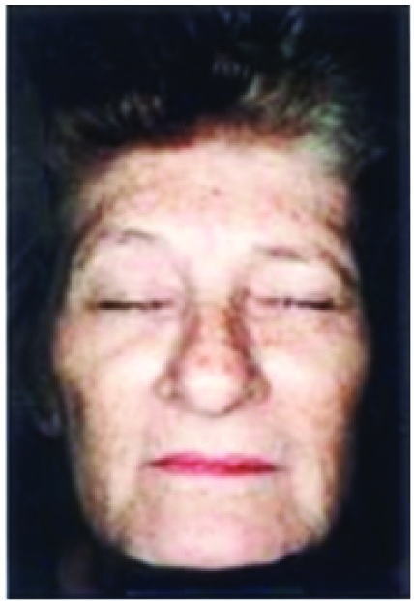
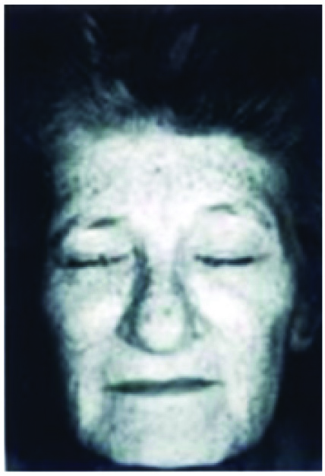
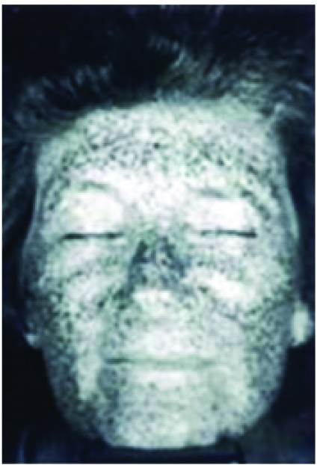
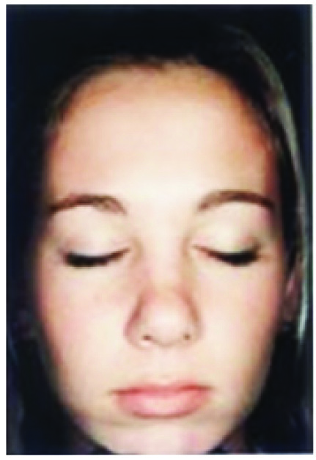
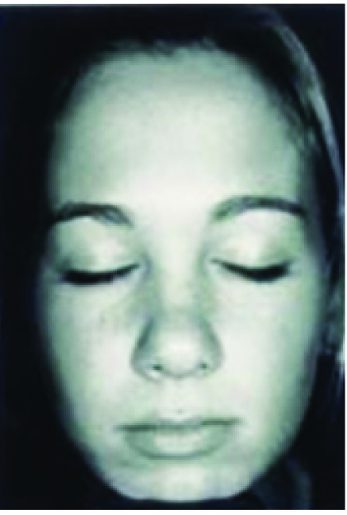
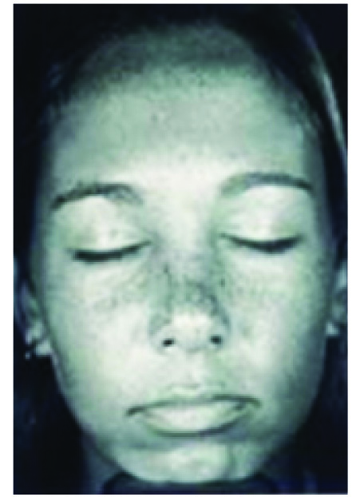

UV Camera:
The Damage Beneath Your Skin
Notes:
These photos were taken with a UV camera. The photos on the right show UV light damage beneath the skin that is not yet visible to the naked eye. The dark spots in these photos indicate the amount of damage a person has on their face. Research has shown that UV light from the sun and indoor tanning beds causes wrinkles, age spots and can lead to the development of skin cancer.
How many of you are NOT surprised by the amount of damage see in the young girl’s photo at the bottom? She is only 17!

Slide 5


Which one will it be?
One in five Americans will develop skin cancer in their lifetime.
Notes:
Current estimates are that 1 in 5 Americans will develop skin cancer in their lifetime.

Slide 6

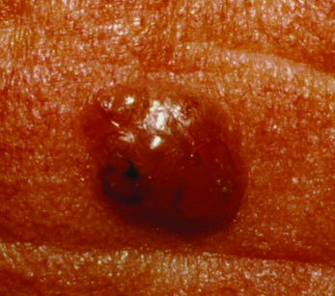
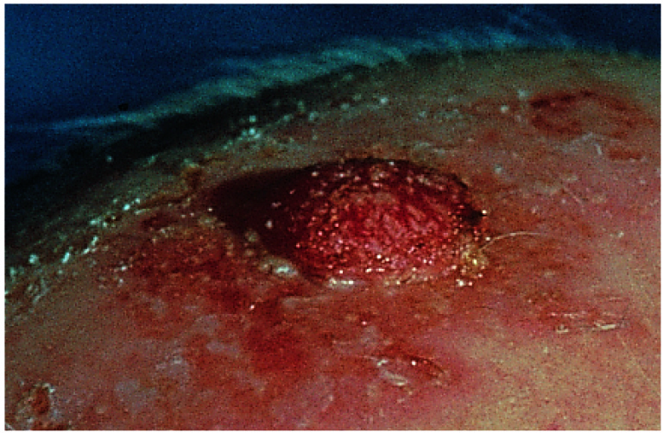
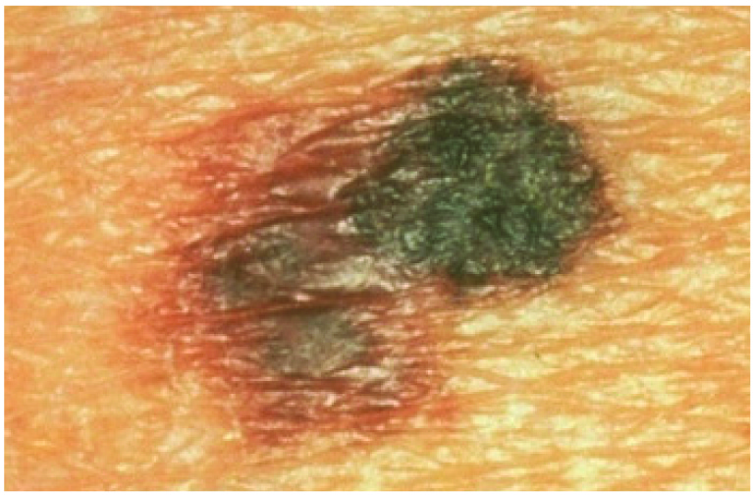



Types of skin cancer
More than 3.5 million skin cancers in more than 2 million people are diagnosed in the United States every year.
Basal cell carcinoma
Squamous cell carcinoma
Melanoma
Notes:
More than 3.5 million skin cancers in more than 2 million people are diagnosed in the United States every year. There are three different types of skin cancer. The most common types are basal cell and squamous cell carcinoma. The most deadly form of skin cancer is melanoma.
Early detection and treatment are very important with all three types.
Let’s take a look at each type of skin cancer now.

Slide 7
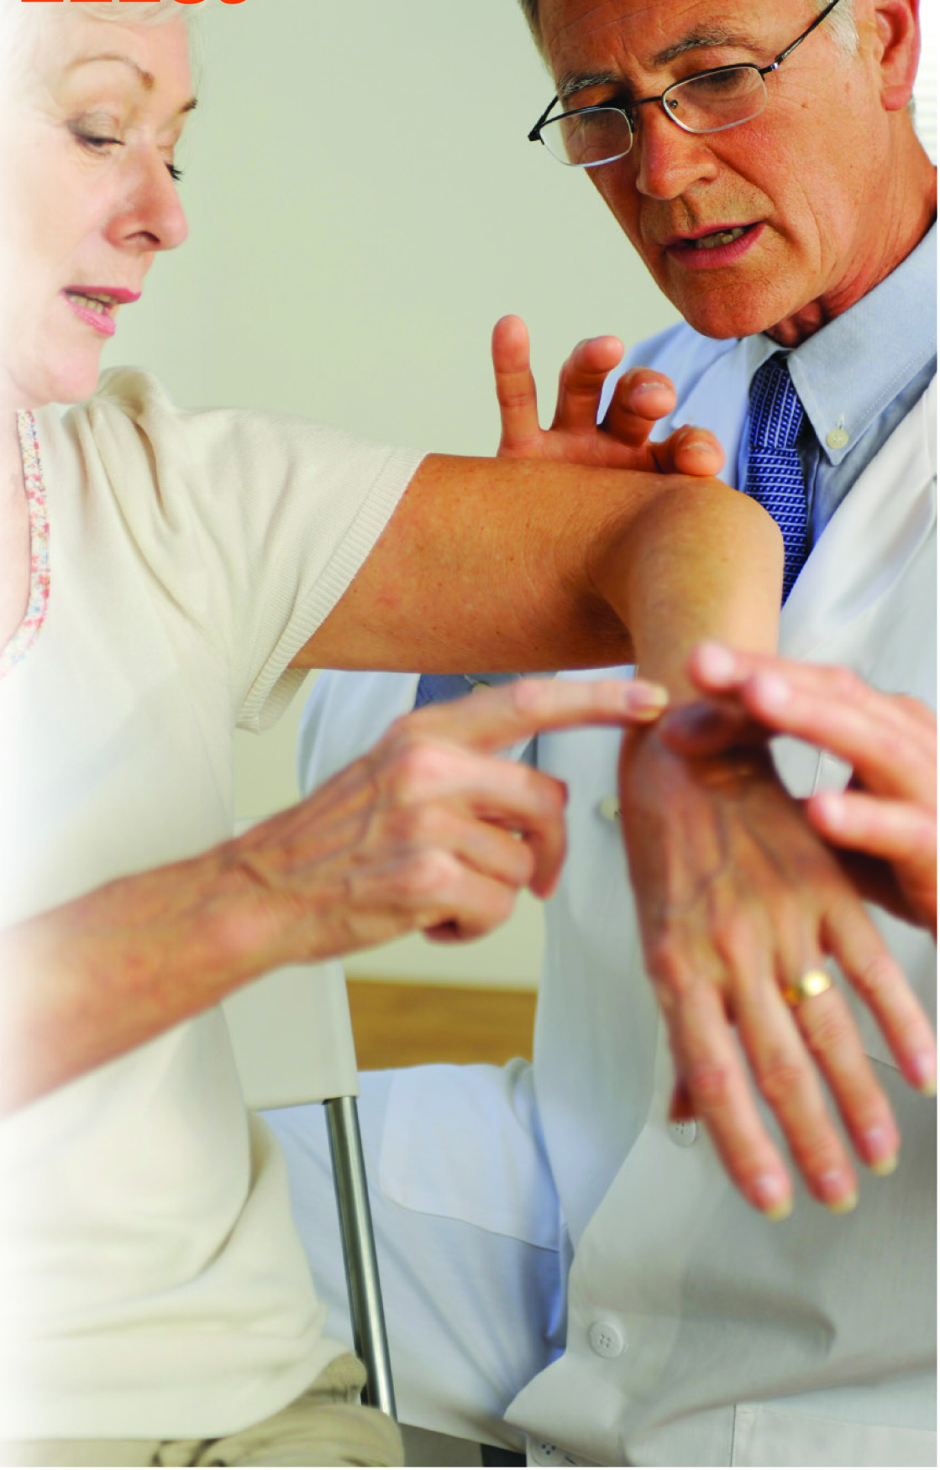
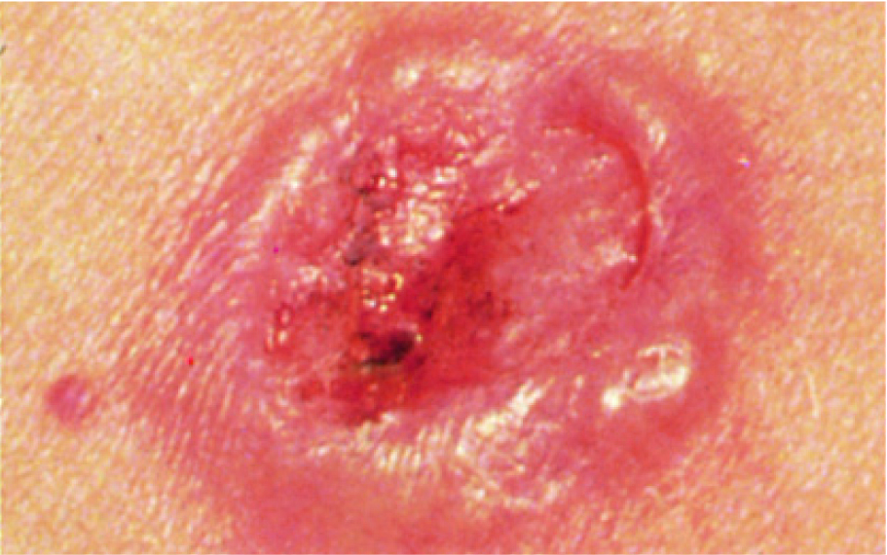
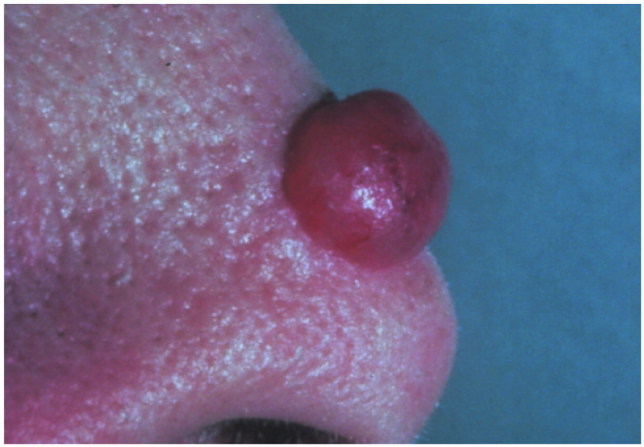
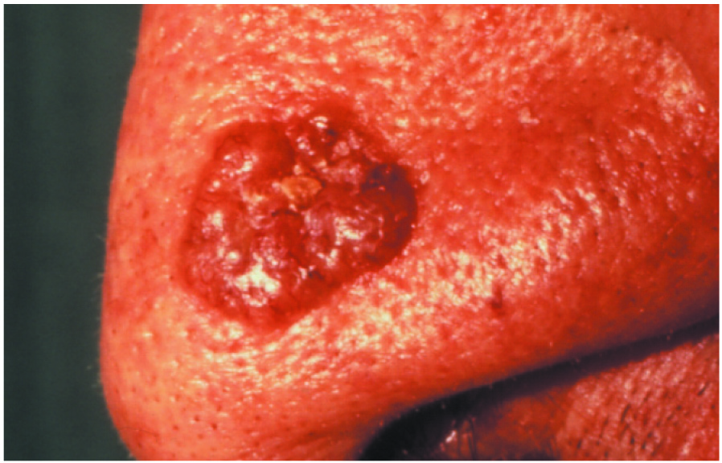
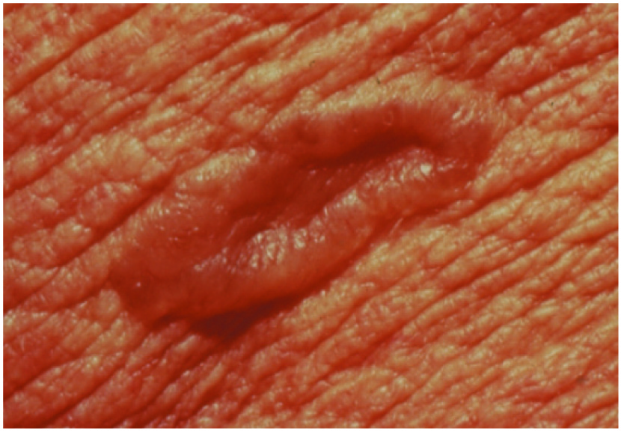
Basal cell carcinoma
Most common form of cancer
Notes:
Basal cell carcinoma is the most common form of cancer worldwide.
Basal cell carcinoma most often appears on sun-exposed areas such as the face, scalp, ears, chest, back, and legs.
These tumors can have several different forms. The most common appearance of basal cell carcinoma is that of a small dome-shaped bump that has a pearly white color. Another common sign is a sore that bleeds and heals, only to recur again.
If you have already had one basal cell carcinoma, studies have shown that you are at a 40 percent risk of getting a second basal cell carcinoma within five years.
Individuals who have had multiple basal cell carcinomas or other skin cancers, such as squamous cell, also are at an increased risk for melanoma.*

Slide 8
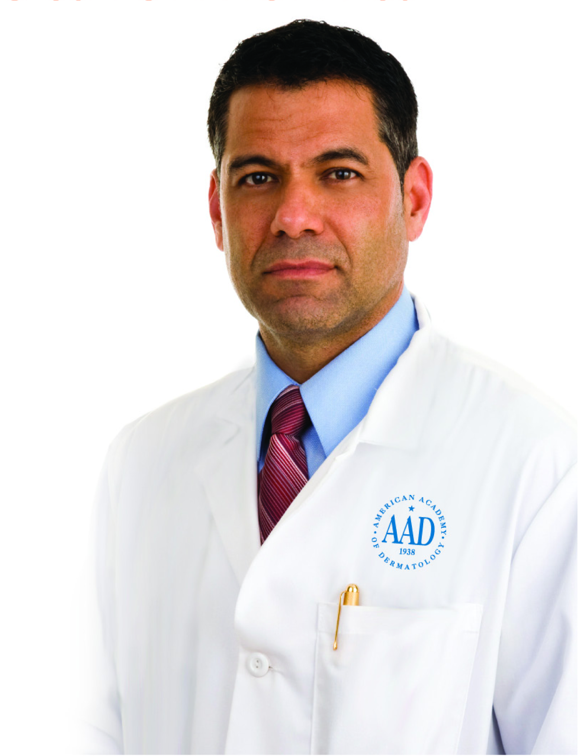
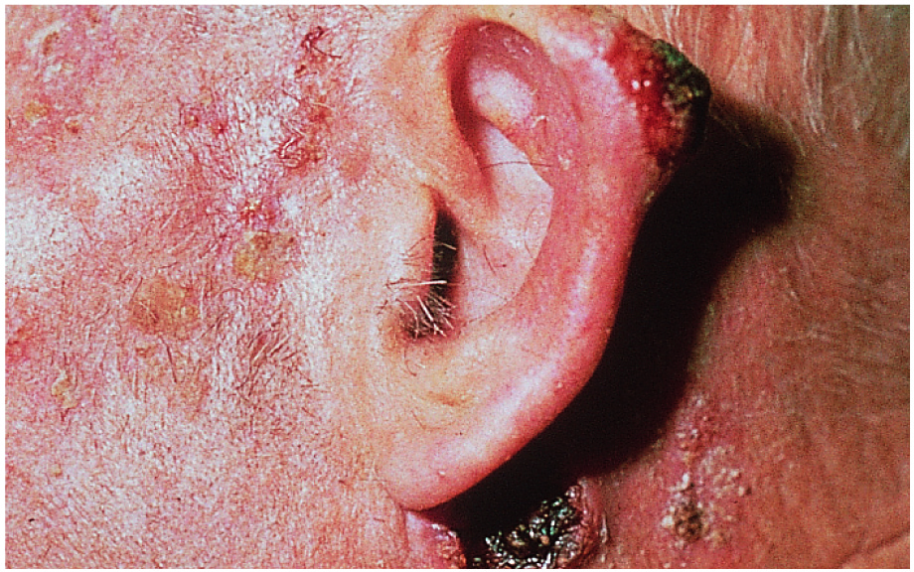
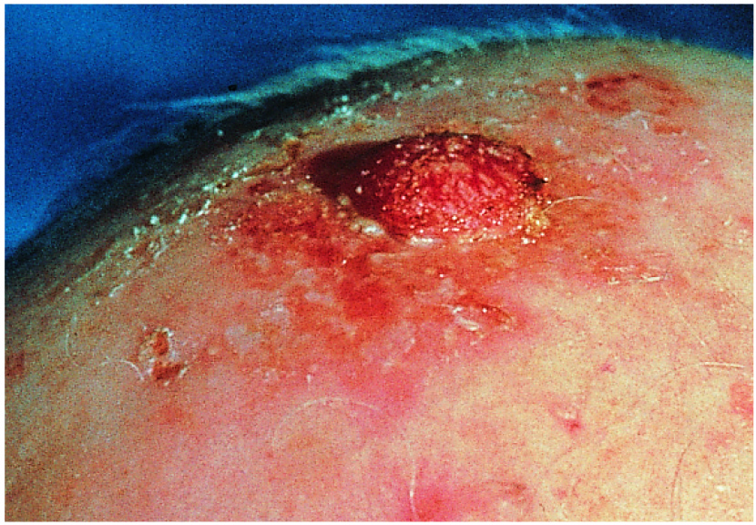
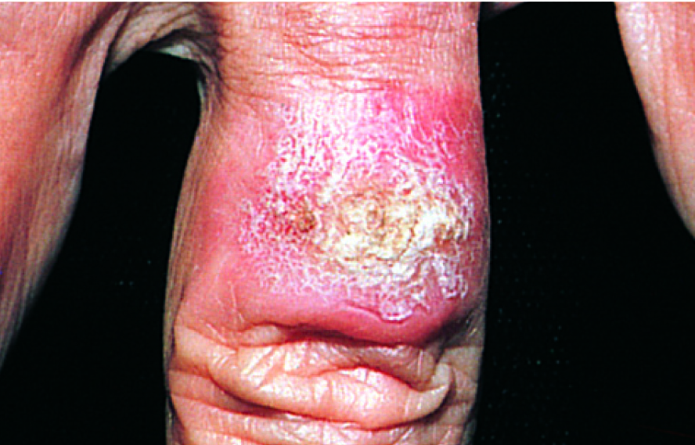
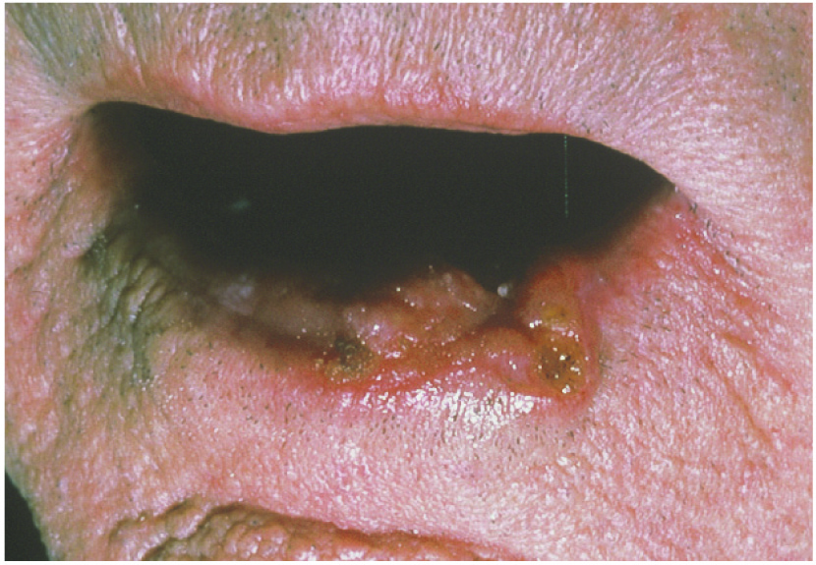
Squamous cell carcinoma
Second most common skin cancer
Notes:
Squamous cell carcinoma is the second most common skin cancer. More than 700,000 new squamous cell carcinomas are diagnosed every year in the United States.
Squamous cell carcinomas usually appear as crusted or scaly patches on the skin with a red, inflamed base, a growing tumor, or a non-healing ulcer. They are generally found on sun-exposed areas like the face, neck, arms, scalp, backs of the hands, and ears. The cancer also can occur on the lips, inside the mouth, on the genitalia, or anywhere on the body.
If left untreated, squamous cell carcinoma can destroy much of the tissue surrounding the tumor and may result in the loss of a nose or ear, for example. Aggressive types of squamous cell carcinomas, especially those on the lips and ears, can spread to the lymph nodes. However, both basal cell and squamous cell carcinomas are easily treated if detected early.*

Slide 9
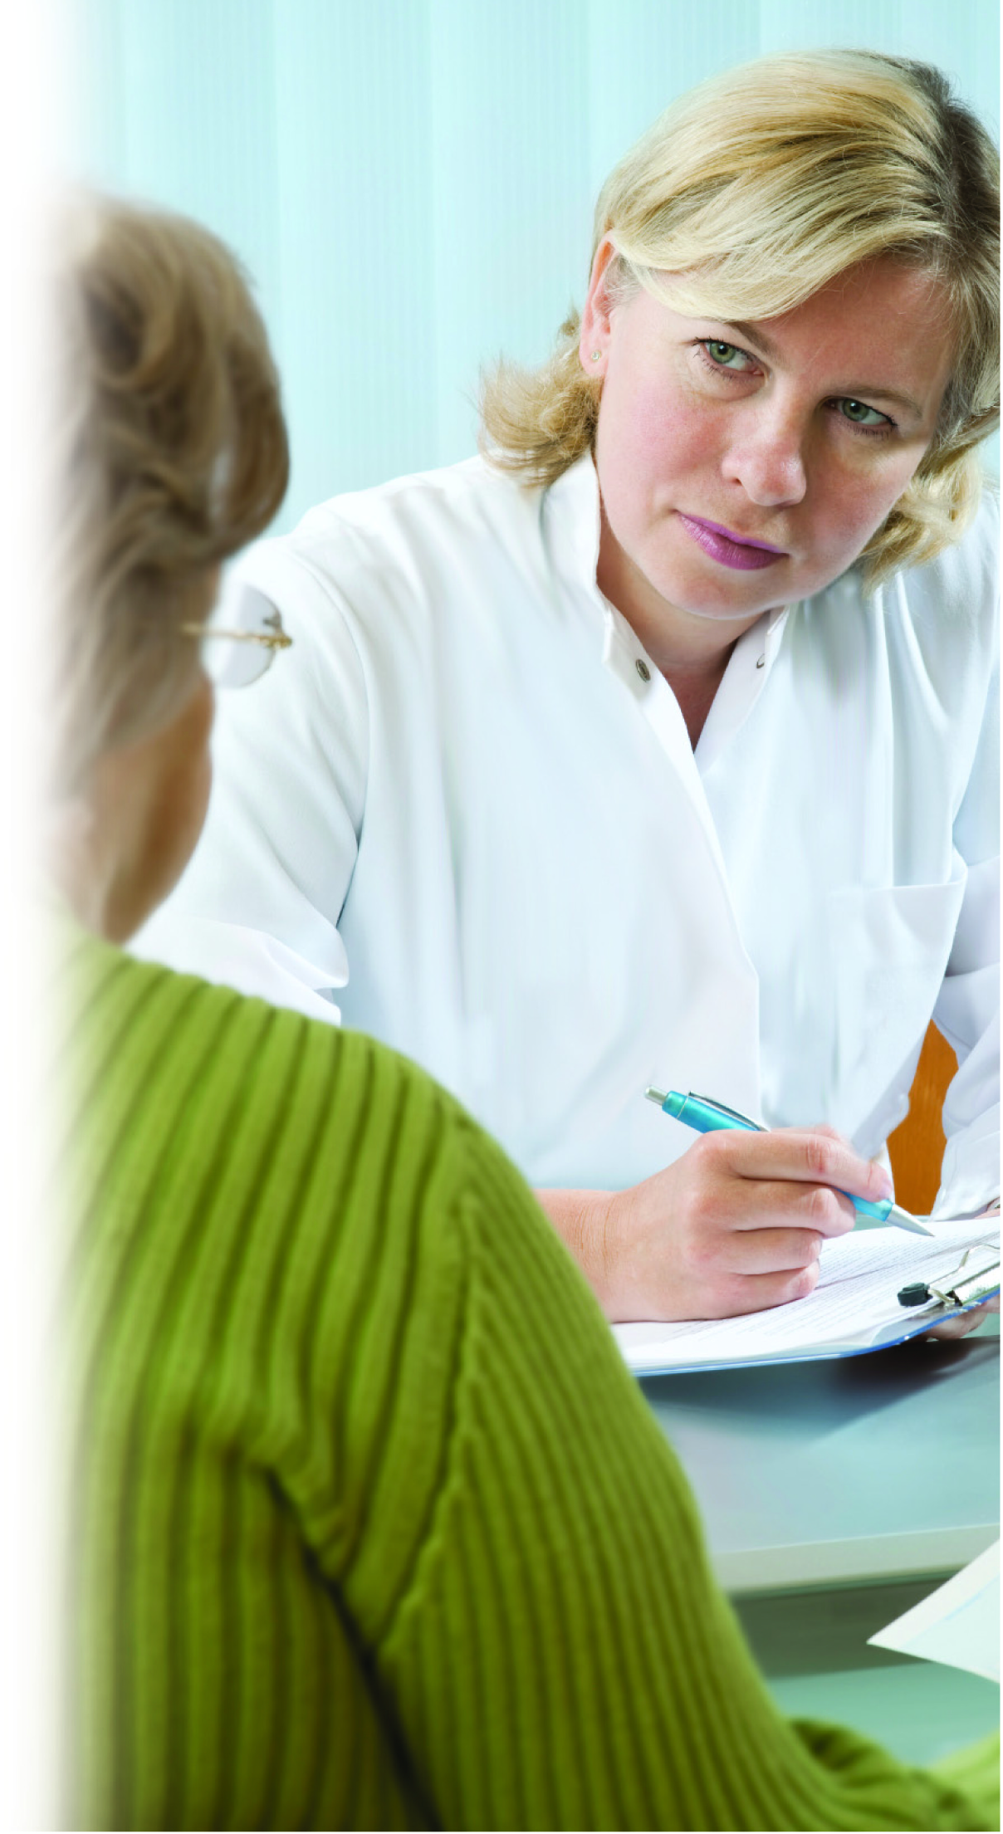
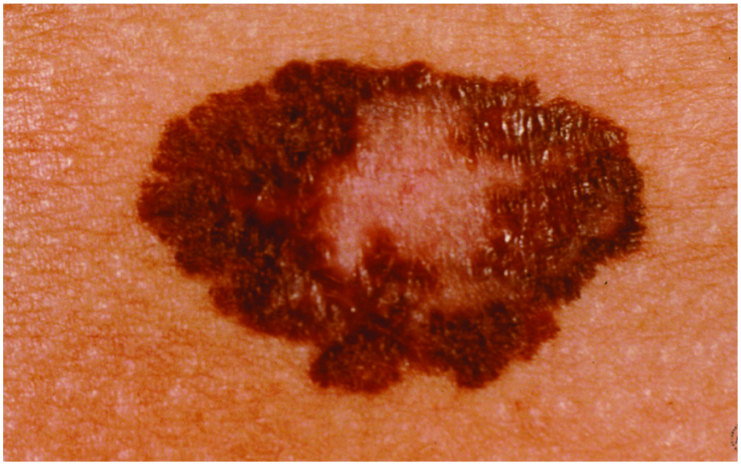
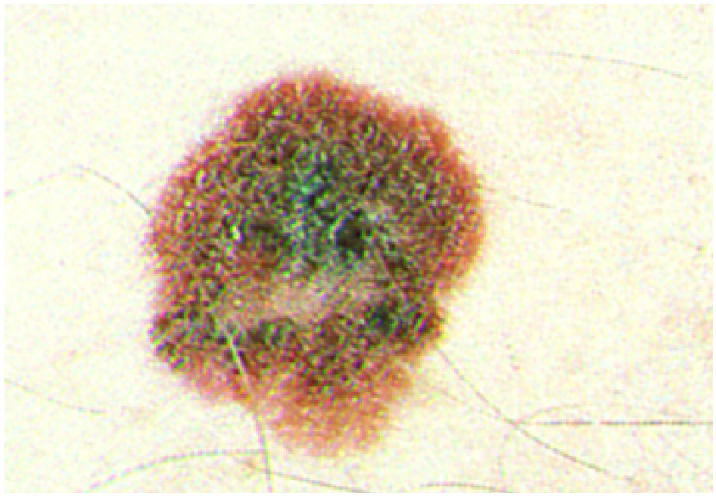
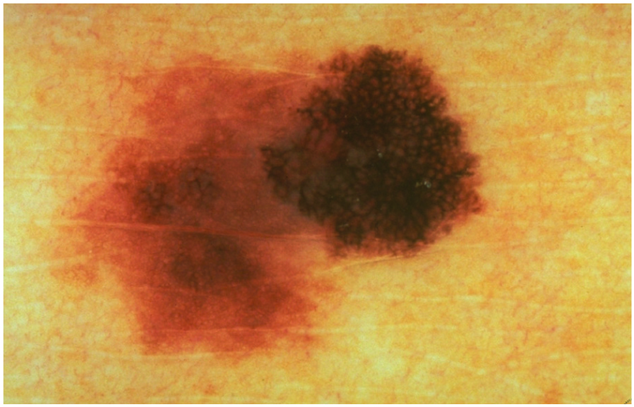
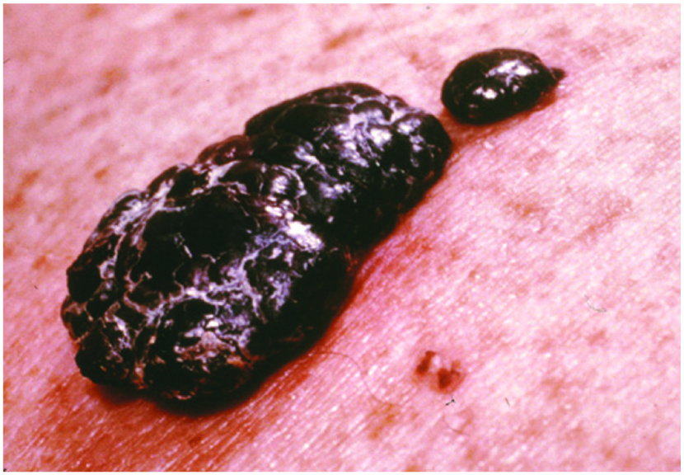
Melanoma
Deadliest form of skin cancer
Notes:
Melanoma, the most serious form of skin cancer, is characterized by the uncontrolled growth of pigment-producing cells. Melanomas might appear on the skin suddenly without warning, but they also can develop on an existing mole. They most frequently appear on the upper back, torso, lower legs, head and neck.
It is estimated that there will be more than 137,000 new cases of melanoma each year.*

Slide 10

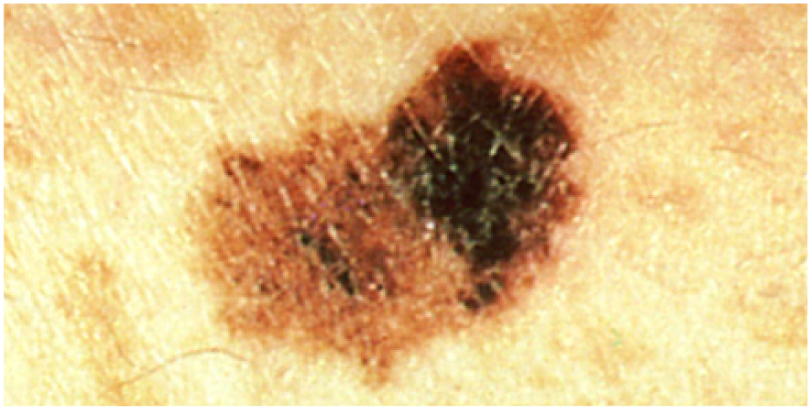
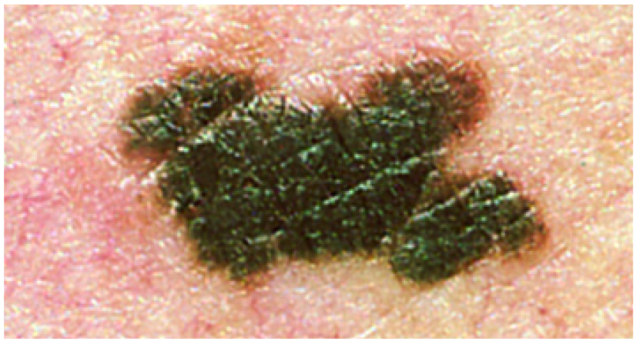
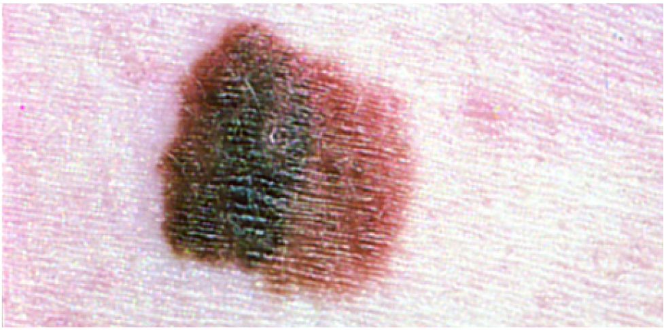
Melanoma
One American dies from melanoma every hour.
Most common form of cancer for young adults 25-29 years old.
Second most common cancer in adolescents and young adults 15-29 years old.
Notes:
More than 75 percent of all skin cancer deaths are from melanoma. One American dies of melanoma every hour.
This may surprise you, but melanoma is not just being diagnosed in older individuals any longer. In fact, it is the most common form of cancer for young adults 25-29 years old and the second most common form of cancer for adolescents and young adults 15-29 years old.
If detected and treated before it reaches the lymph nodes, melanoma has a 98 percent five-year survival rate.*

Slide 11

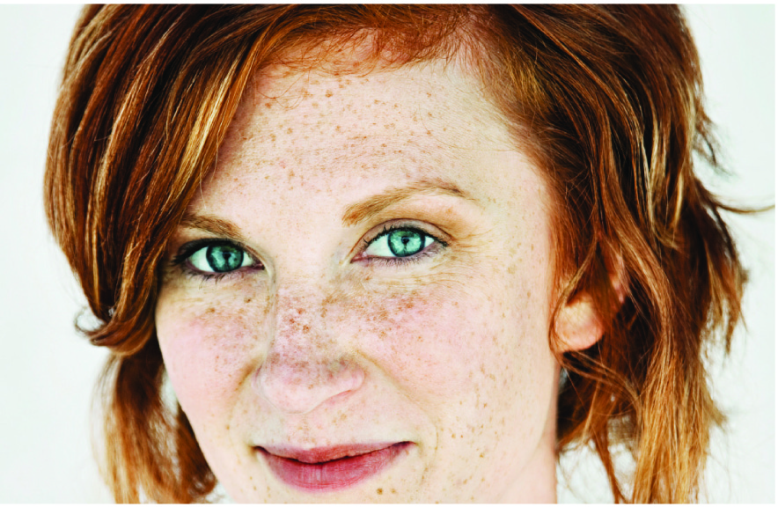



Who gets melanoma?
Notes:
Who gets melanoma?
Melanoma can strike anyone. Caucasians are more likely to be diagnosed with melanoma than other races. However, even among Caucasians, certain individuals are at higher risk than others. For example:
You have a substantially increased risk of developing melanoma if you have greater than 50 moles, large moles or atypical (unusual) moles.
Your risk is increased if a blood relative (e.g., your parents, children, siblings, cousins, aunts, uncles) has had melanoma.
If you are a Caucasian with fair skin, your risk is higher than a Caucasian with olive skin.
Redheads and blondes have a higher risk of developing melanoma. Blue or green eyes also increase your risk of developing melanoma.
Your chances increase significantly if you’ve already had a melanoma, but also increase if you have had either basal cell carcinoma or squamous cell carcinoma. Your risk for melanoma also may be increased if you have had other cancers, such as breast or thyroid cancer.

Slide 12


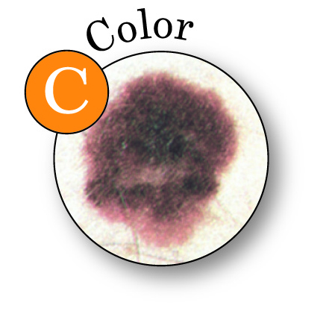
What does melanoma look like?
Asymmetry – One half is unlike the other half.
Border – An irregular, scalloped or poorly defined border.
Color – Is varied from one area to another; has shades of tan, brown or black, or is sometimes white, red or blue.
Notes:
Recognition of changes in the skin is the best way to detect early melanoma. Use the ABCDEs of melanoma detection and if you have a changing mole, a new mole, or a mole that is different, make an appointment to see a dermatologist as soon as possible.
Here is what the ABCDEs stand for:
A stands for ASYMMETRY – One half is unlike the other half.
B stands for BORDER – An irregular, scalloped or poorly defined border.
C stands for COLOR – Is varied from one area to another; has shades of tan, brown or black, or is sometimes white, red, or blue.

Slide 13
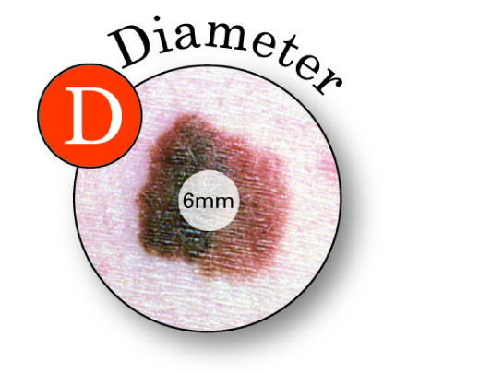
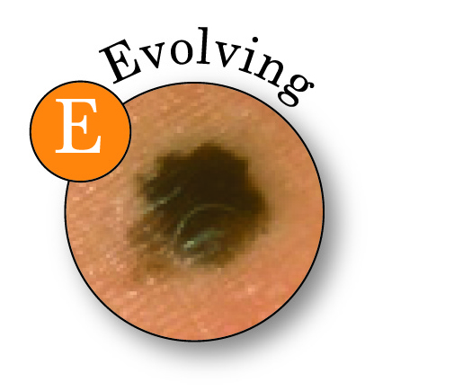
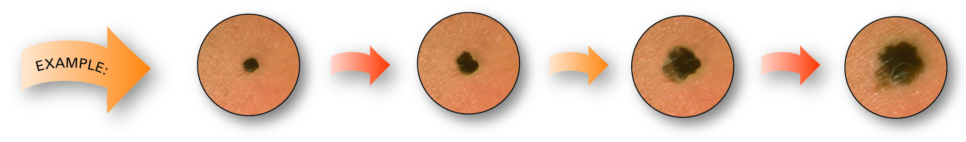
ABCDEs of melanoma
Diameter – Melanomas are usually greater than 6mm (the size of a pencil eraser) when diagnosed, but they can be smaller.
Evolving – A mole or skin lesion that looks different from the rest or is changing in size, shape or color.
Notes:
D stands for DIAMETER – While melanomas are usually greater than 6mm, the size of a pencil eraser, when diagnosed, they can be smaller.
E stands for EVOLVING – A mole or skin lesion that looks different from the rest or is changing in size, shape, or color.
The American Academy of Dermatology urges everyone to examine their skin regularly. This means looking over your entire body including your back, your scalp, the soles of your feet, between your toes and the palms of your hands. If you notice a mole that is different from others, or that changes, itches or bleeds, even if it is small, you should make an appointment to see a dermatologist as soon as possible.

Slide 14



Screen the one you love
Notes:
The best way to detect skin cancer early, when it is most treatable, is to perform a skin self-exam on a regular basis.
Now, new research shows that involving a partner in a skin self-examination makes it more likely that self screening will be performed and can improve the early detection of skin cancer which could lead to a better outcome.

Slide 15



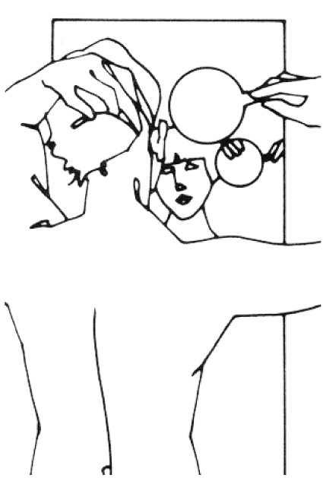






How to spot skin cancer
The American Academy of Dermatology encourages everyone to check your skin regularly
Notes:
So how do you conduct a skin self-examination? A skin self-examination is quick and easy and as I mentioned, a partner examination increases the chances that a suspicious spot will be found early. For anywhere that you can’t see easily, such as your back or your scalp, use a hand mirror or ask a partner to take a look.
Examine your body front and back in the mirror, then look at the right and left sides with your arms raised.
Bend your elbows and look carefully at forearms, back of upper underarms, and palms.
Look at the backs of your legs and feet, the spaces between your toes, and on the soles of your feet.
Examine the back of your neck and scalp with a hand mirror or have your partner examine those areas. Part your hair for a closer look.
Finally, check your back and buttocks with a hand mirror or ask your partner to check these areas.

Slide 16
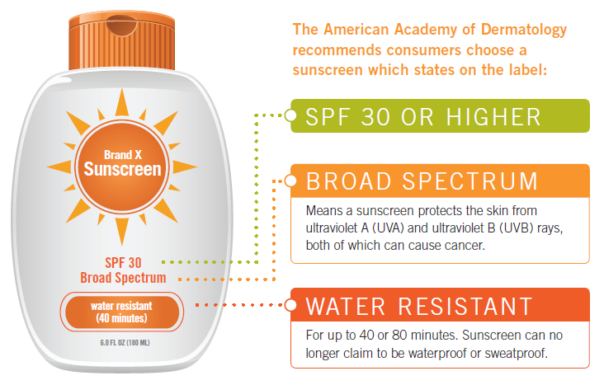
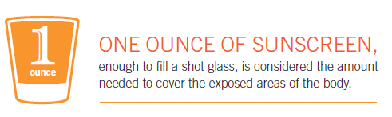
Prevent skin cancer…
Notes:
Sun exposure is the most preventable risk factor for all skin cancers, including melanoma. You can have fun in the sun and decrease your risk of skin cancer. Here’s how to Be Sun Smart®:
Generously apply water-resistant sunscreen with a Sun Protection Factor (SPF) of at least 30 that provides broad-spectrum protection from both UVA and UVB rays to all exposed skin.
Sunscreen should be applied every day to exposed skin if you will be outside. Sunscreens should be applied to dry skin 15 minutes BEFORE going outdoors. When using sunscreen, be sure to apply it to all exposed areas and pay particular attention to the face, ears, hands and arms. Coat the skin liberally and rub it in thoroughly – most people apply only 25-50 percent of the recommended amount of sunscreen. One ounce, enough to fill a shot glass, is considered the amount needed to cover the exposed areas of the body properly. Don’t forget that lips get sunburned too, so apply a lip balm that contains sunscreen with an SPF of 30 or higher.
Sunscreens should be re-applied approximately every two hours or after swimming or perspiring heavily. Choose a “water resistant” sunscreen and reapply as directed. Sunscreens rub off as well as wash off, so if you’ve towel-dried, reapply sunscreen for continued protection.

Slide 17
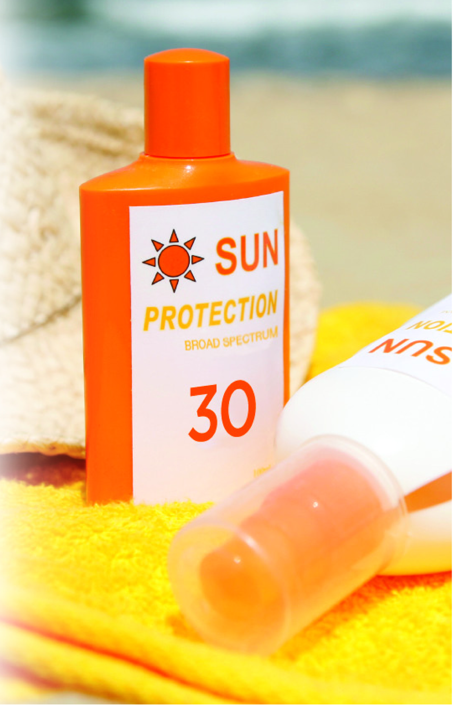


Prevent skin cancer…
Notes:
Wear protective clothing, such as a long-sleeved shirt, pants, a wide-brimmed hat and sunglasses, where possible. A wide-brimmed hat is a good way to create shade on your face and neck. Wearing sunglasses can help avoid skin cancers that occur in the eye, which account for 10 percent of all melanomas.
See shade when appropriate, remembering that the sun’s rays are strongest between 10 a.m. and 2 p.m. If your shadow is shorter than you are, seek shade.
Protect children from sun exposure by playing in the shade, using protective clothing, and applying sunscreen.

Slide 18
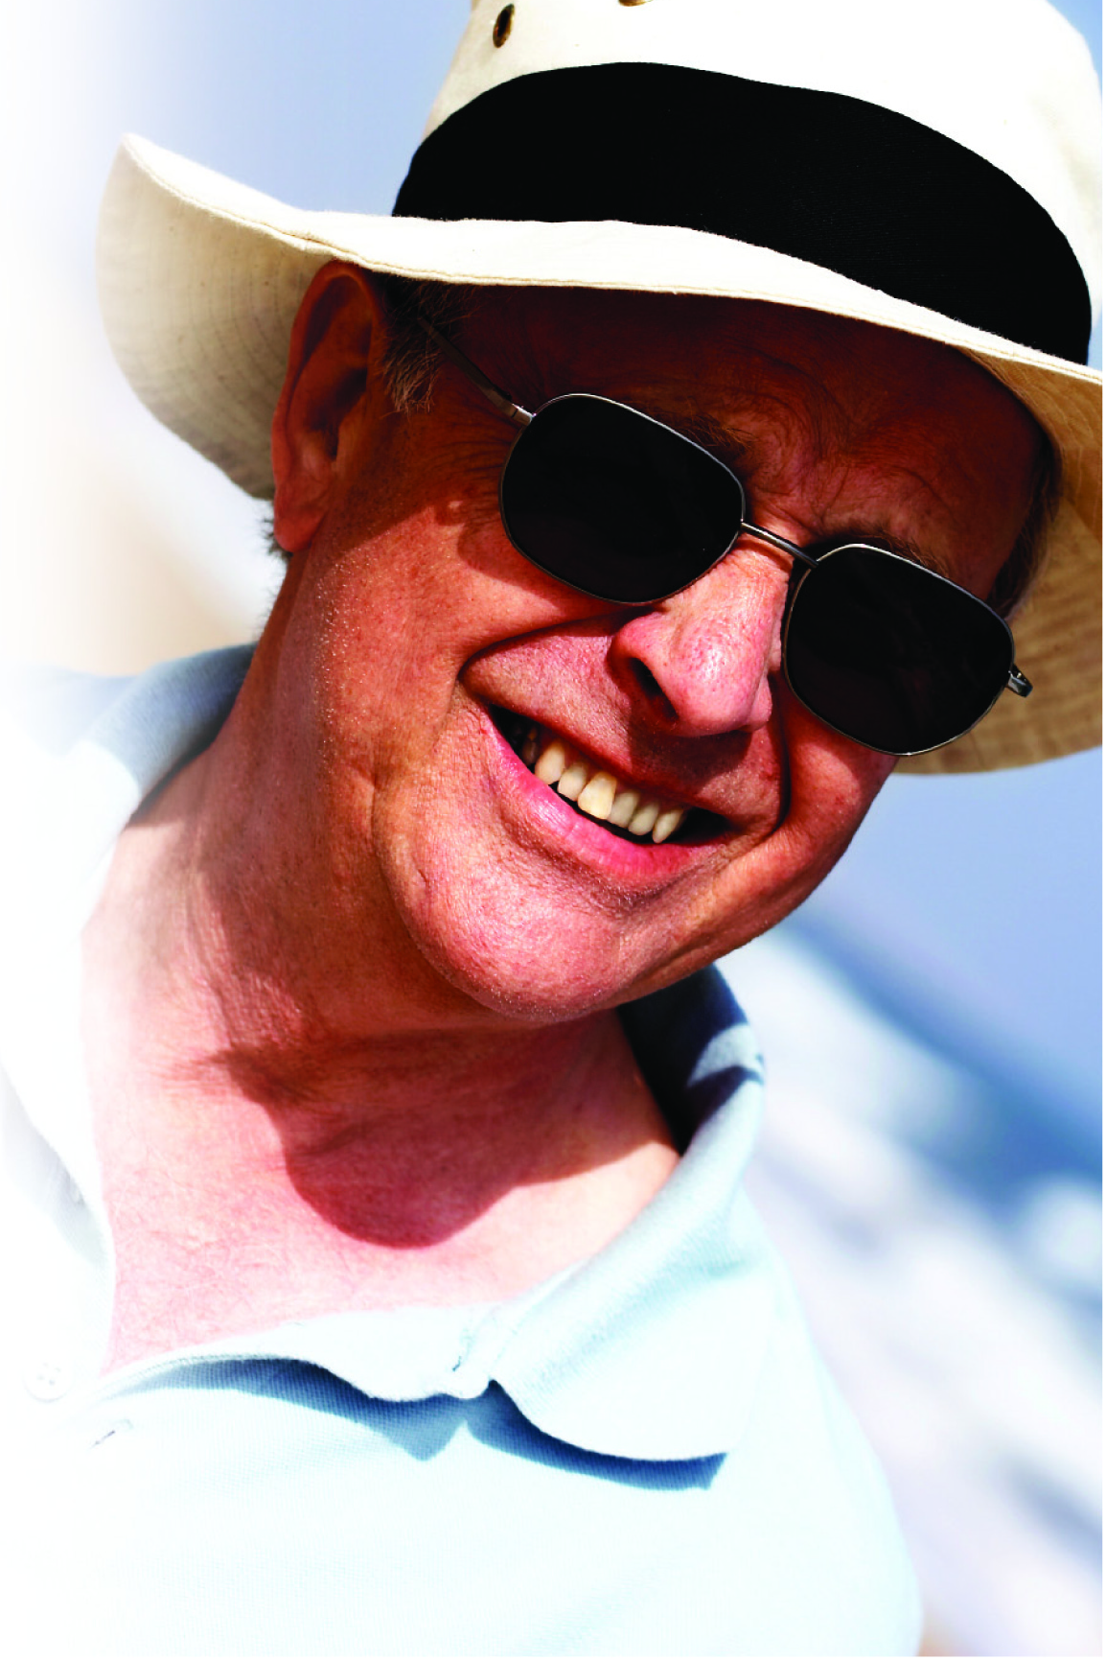

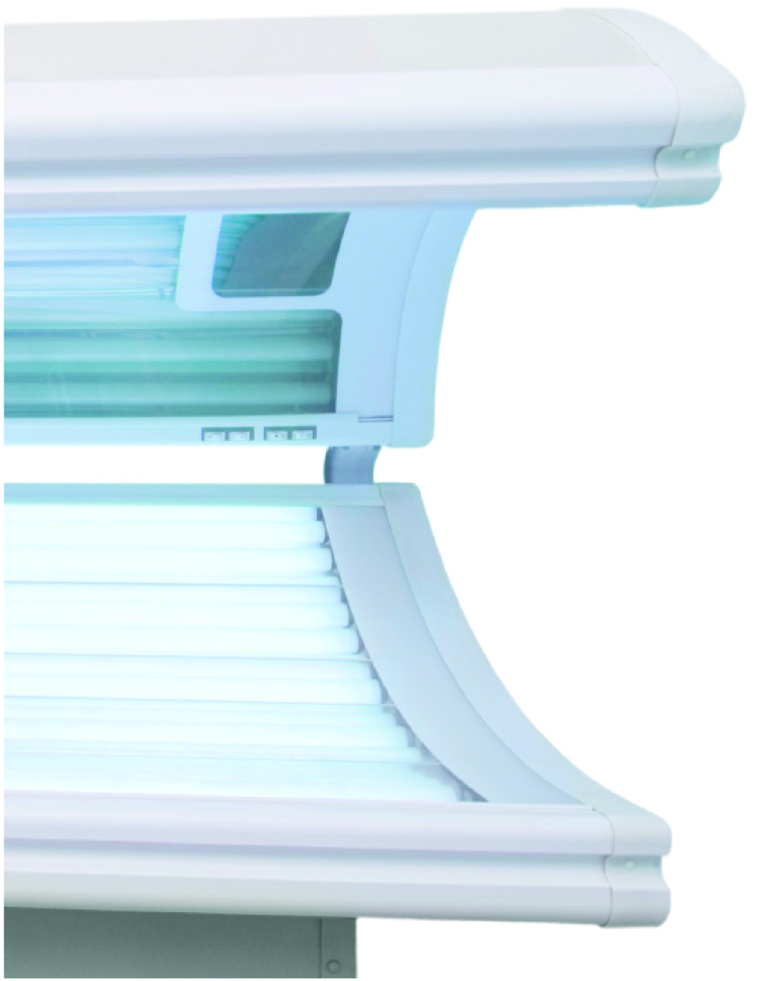
Prevent skin cancer…
Notes:
Use extra caution near water, snow and sand as they reflect the damaging rays of the sun, which can increase your chance of sunburn.
Get vitamin D safely through a healthy diet that may include vitamin supplements. Don’t seek the sun.
Avoid tanning beds. Ultraviolet light from the sun and tanning beds can cause skin cancer and wrinkling.
Despite what you may have heard, indoor tanning is not a safer way to tan. In spite of claims that tanning beds offer “safe” or “controlled” tanning, indoor tanning equipment, which includes all artificial light sources such as beds, lamps, bulbs, booths, etc., emits UVA and UVB radiation. The amount of the radiation produced during indoor tanning is similar to the sun and in some cases may be stronger.
Many tanning salons are unregulated, allowing customers, especially those with fair skin, access to tanning beds without supervision or eye protection.
If you want to look like you’ve been in the sun, consider using a sunless self-tanning product, but continue to use sunscreen with it.
Check your birthday suit on your birthday. If you notice anything changing, growing, or bleeding on your skin, make an appointment to see a dermatologist. As I said before, skin cancer is very treatable when caught early.

Slide 19
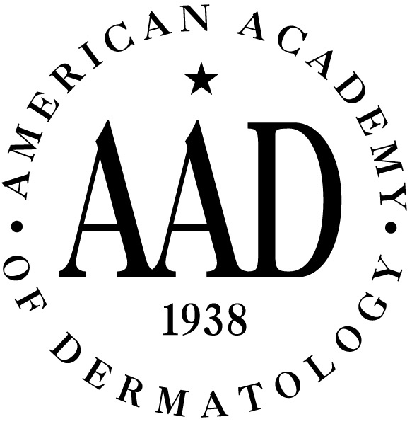
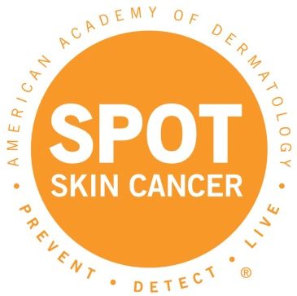
American Academy of Dermatology
For more information:
(888) 462-DERM (3376)
www.SpotSkinCancer.org
www.aad.org
Notes:
The American Academy of Dermatology has a variety of resources available to help answer your questions about skin cancer or other skin, hair and nail conditions. You can contact the Academy’s automated information center to request pamphlets on specific topics, or you can visit the Academy’s Web site or its specialized condition Web pages for more information.

Slide 20

Thank you
Notes:
Thank you for your attention today. I’m happy to answer any questions.

