Slide 1
TK Let’s GO Webinar Series
“Wrapping Your Head Around the TK/K Combo Classroom ”
May 22nd, 2012
3-4:15 p.m.
Presenters: Barbara Blakely, Recently Retired LAUSD TK Teacher and Lisa Peterson, TK/K Combo Teacher at Clovis Unified

Slide 2
Agenda
Welcome
Policy Update- Scott Moore, Senior Policy Advisor, Preschool California
Transitional Kindergarten Presentation: “Wrapping Your Head Around the TK/K Combo Classroom” – Barbara Blakely, Recently Retired TK Teacher and Lisa Peterson, TK/K Combo Teacher at Clovis Unified
Q&A- Please email all questions to Araceli Sandoval-Gonzalez: asandoval@preschoolcalifornia.org
Close- Ernesto Saldaña, State Field Director, Preschool California

Slide 3
Scott Moore - Policy Update
We would like to clarify that under any current scenario, whether it is under the law as laid out by SB 1381, or under the governor’s proposal in the May Revision, school districts that provide TK will receive full ADA funding.
http://action.preschoolcalifornia.org/site/MessageViewer?em_id=5821.0

Slide 4
The TK/K Combo Mindset
All children are working towards the same goals in the progression of learning.
Familiarize yourself with the following documents which provide the continuum for growth and development.
    Preschool Learning Foundations
    Common Core Standards

Slide 5

The TK/K Combo Mindset
NAEYC’s “Developmentally Appropriate Practice” document is another must read and/or review before beginning the TK/K Combo.

Slide 6
The TK/K Combo Mindset
The TK/K project based learning program will “look different” than a scripted one.

Slide 7
The TK/K Combo Mindset
Connecting with families: If you have the opportunity, arrange a time to meet children and families in an informal setting before the beginning of school.

Slide 8
Environment/Setting-Up Your Classroom:
Working From the Concrete to the Abstract
Gathering place – large carpeted area to provide group instruction, movement activities, and oral language development.

Slide 9
Environment/Setting-Up Your Classroom:
Working From the Concrete to the Abstract
Centers to provide project based learning, theme exploration, practice, and mastery:
    Library/Reading Center
    Writing/Art Center
    Listening Center
    Dramatic Play Center
    Computer Center
    Math/Science Center
    Manipulatives Center
  Your classroom size and layout will influence your design and use of space.
  Some centers might rotate throughout project themed learning activities, while others remain constant.

Slide 10
Environment/Setting-Up Your Classroom:
Working From the Concrete to the Abstract
Outdoor space will provide for large motor skills development, music and movement, art, and other activities designed to reinforce classroom curriculum.
Outdoor activities often offer opportunities for children, with the support of their teacher, to develop social/emotional skills
(eg. taking turns, developing relationships, problem solving, making choices).

Slide 11
Environment/Setting-Up Your Classroom:
Working From the Concrete to the Abstract
Materials – Basic materials include: books, art and paper supplies, easels, blocks and building props, puzzles, dramatic play equipment and props, music materials, science materials, and math manipulatives.
    Materials can be rotated according to your planned, themed activity.
    Specific materials may be required for your project activity.
    It may take some time to collect all materials you might like/need. Be patient. Ask for help from your school, parents, and community. A “Wish List” posted and/or sent home to families is helpful.

Slide 12
Planning a Curriculum
Project themed lessons integrated across all curricular domains (e.g. literacy, math, ELD, science, social studies, and physical education) will support children’s diversified needs in the cognitive, social/emotional, and physical arenas.

Slide 13
Planning a Curriculum
Flexible student grouping allows teachers the opportunity to support children in small groups or individually when the need arises and/or to meet specific objectives.
These groups are not static and may be reconfigured often, dictated by observation and/or assessment of children’s progress.
Checklists for observational quick and easy assessment assists in:
  planning and student grouping
  parent dialogue
  documentation for reports

Slide 14
Teacher/Family Communication
It is imperative to establish a good relationship with each child's parents to ensure continual support and involvement in their child’s growth and development
  Communication regularly with families. It is important to show parents that you understand their child’s individual needs and appreciate their input.
  Involve parents in their children’s learning.
  Recruit parents to help in the classroom and/or at home.
  Share your “Wish List” with parents

Slide 15
Differences in TK vs. K
Lisa Peterson
Jefferson Elementary School
Clovis , CA

Slide 16
Making up the Combo Class
Keep in mind when making up your combination class that you want as many, (if not all of the TK students registered at your site) of the TK students to be placed in the same classroom.
Place students who are age appropriate for kindergarten, but who are less mature, in the TK/K combination class.
Suggestions
meet with preschool teachers of incoming students
request end of year assessments for students that have attended preschool.
meet with student, give assessment, noting problem solving abilities, maturity, and previous exposure to academics

Slide 17
Parent Communication
Different from Kindergarten, the parents will need to be kept up to date on the vision and plan for TK.
Kindergarten is pretty well known, however, TK is still new to the community. Some parents may assume their child is going on to 1st grade the next year.
For questions, please email: asandoval@preschoolcalifornia.org
17

Slide 18
Kindergarten California Common Core Standards for TK
TK follows the Kindergarten California Common Core Standards for kindergarten.
The student drives the instruction so the teacher moves more slowly through the curriculum guiding social development, fine and gross motor skill development, as well as academic development.
Kindergarten follows the same standards but covers the entire KCCS in one year-therefore moving quickly. Not leaving as much time for all of the crucial developmental areas.
For questions, please email: asandoval@preschoolcalifornia.org
18

Slide 19

Curriculum Ideas "The WHAT"
Reading Recovery Strategies
These strategies allow me to differentiate instruction for all developmental and academic levels across the continuum. (Whole class lessons start out much slower than I would in regular Kindergarten.)
  Shared Reading
  Guided Reading
  Shared Writing
  Guided Writing
  Word Wall Work
  Word Work
  Centers/Stations
  Homogeneous Grouping
For questions, please email: asandoval@preschoolcalifornia.org
19

Slide 20
Grouping-ELA
Kindergarten has opportunities at their
Table for puzzles, unifix cubes, learning games, etc. They visit the choices during math tubs in the p.m.
Partial implementation of K CCCS
K
Playdough
Painting
Stamping
Sensory Tub
TK
Carpet
Area/Large Group
TK
K
K
Fully implemented
KCCC standards
Dramatic
Play
Area
Construction Pieces/computers/Library

Slide 21
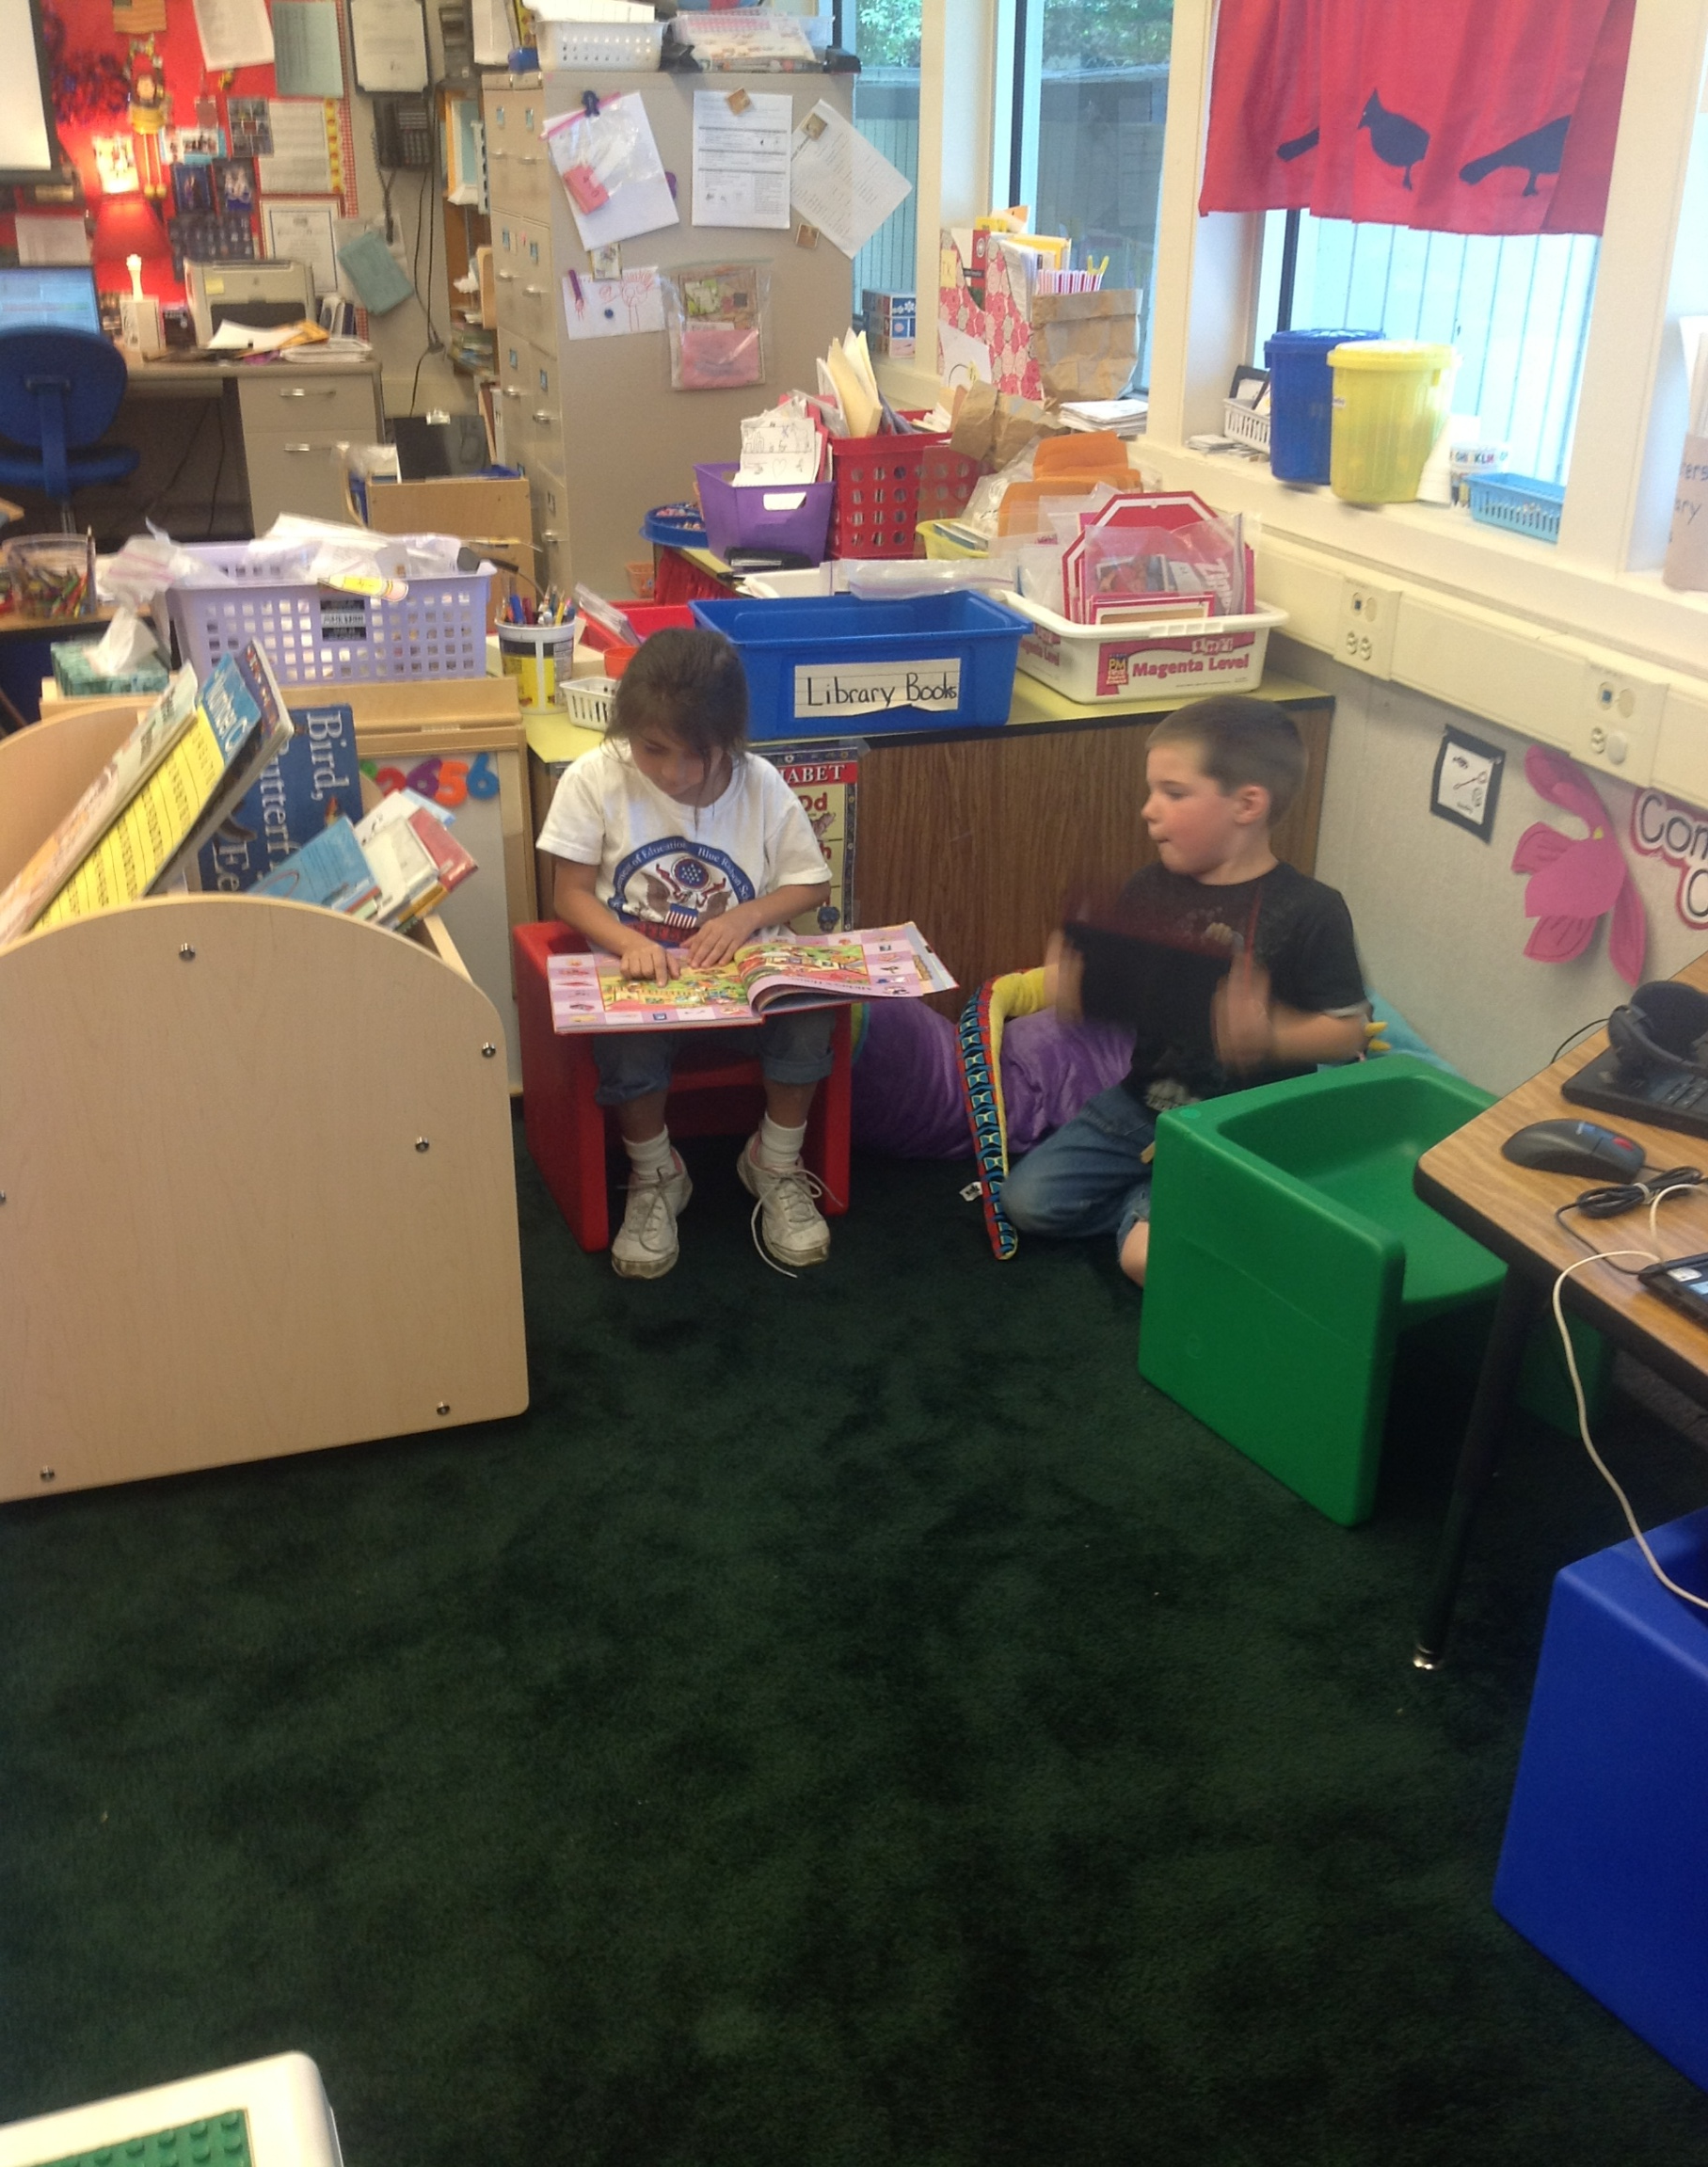
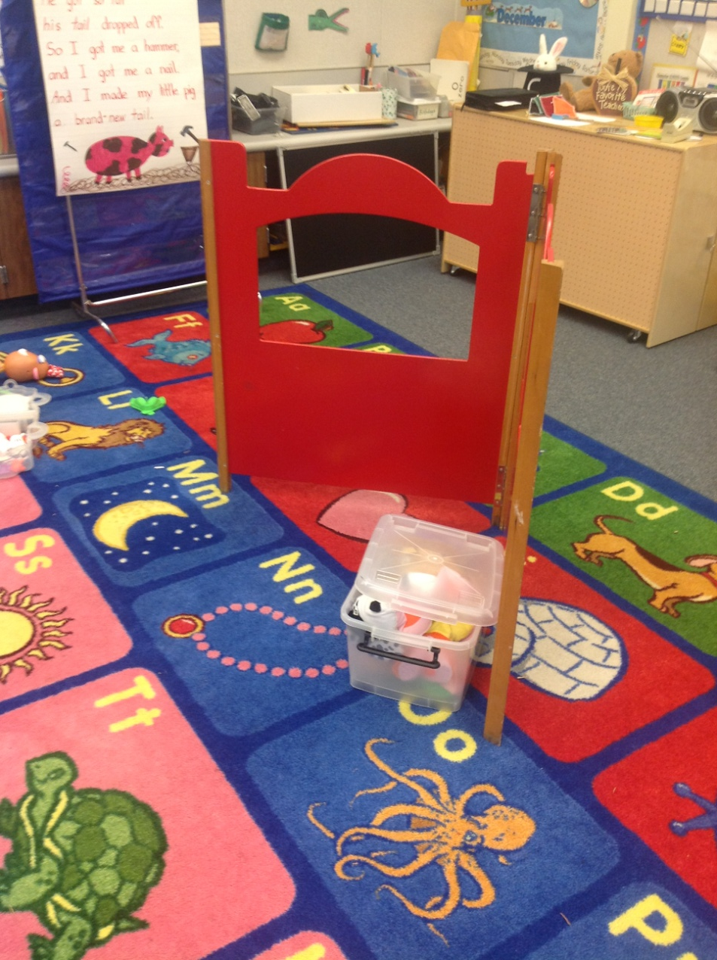
Library/Puppet Theater

Slide 22

Math
TK
  Math Their Way http://www.center.edu/index.shtmlstrategies Teacher made activities
  Focusing on a solid foundation of numerals 0-10
  More free exploration
Kindergarten
  State Adopted Math Series
  Teacher made activities/opportunities
  Focusing on a solid foundation of numerals 0-20

Slide 23
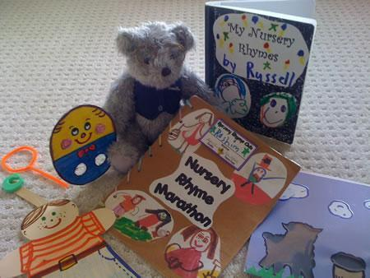
Carpet Time
TK
  Shorter pieces of time (10 min.)
  Lots of music opportunities
    welcome songs, calendar, days, months, colors, abc, phonics, DANCE-Farmer in the Dell, Hokey Pokey, Grandma at the Fair, Pizza Hut, Math Macarena, etc.
  Felt board stories
  Nursery rhymes w/ props
  Puppets
  Dramatic play social behaviors
  Short stories
  Finger plays
  More interruptions
Kindergarten
  15-20 min.
  Fewer songs-welcome- calendar-days-months
  Colors, numbers
  Fewer Nursery Rhymes
  Longer stories
  Shared writing starts earlier
  Not as much fine motor development
  Handwriting starts earlier
  Paper pencil work starts earlier

Slide 24
My Schedule
Beginning of year
  Welcome-looking at books-coloring projects
  Carpet time-read aloud-flag salute-Big Book
  Exploration time-puzzles-unifix cubes-playdough-blocks
  Carpet for Buzz Book (morning message)
  Music/movement
  Following directions activity
  Recess/snack
  Carpet time-read aloud-song
  Small groups-centers
  Lunch
  Quiet time-exploring sand table-water colors-home center-computers-puppets-puzzles
  P.E.
  Getting ready to go home
Currently
  Morning job-something small –names
  Calendar-Opening-Letters/Sounds-Sightword
  ABC stations-5 stations-5 groups-1 station a day change daily-
  HW-sounds-abc's-CAP-Fine Motor
    Or HWT
    Or Journals /picture/writing
  Recess
  Shared Writing/Reading/Read Aloud/Word Wall/Song
  ELA stations/centers/guided reading groups
  Lunch
  Read Aloud
  Math Meeting/Songs/Movement
  Math/Science/Social StudiesTubs
  Math Groups-Teacher Table
  P.E./Sharing/Rythm/Music/Instruments

Slide 25
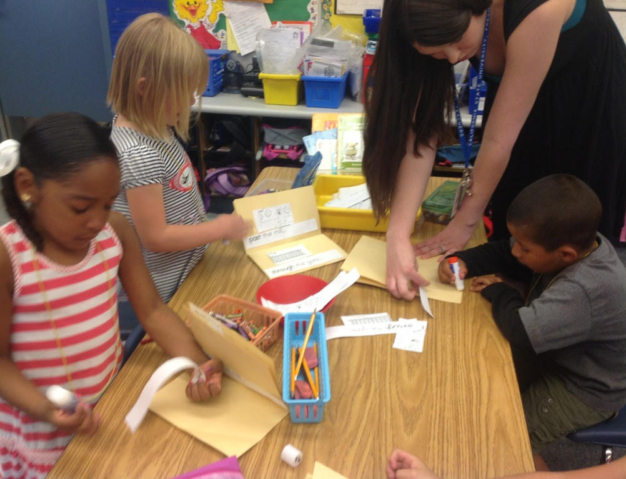
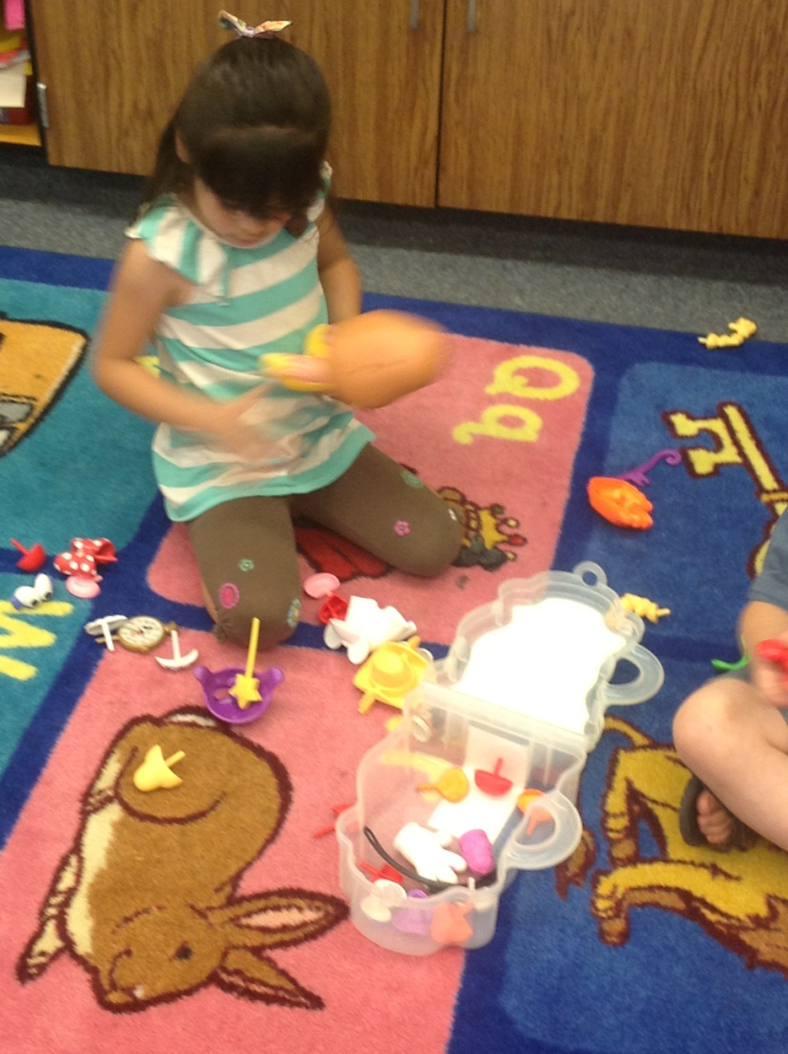
In the Classroom
TK Group at station
Kinder - finished with work

Slide 26
Gathering Academic Data
TK
  Modified District Assessments
  DIBELS
  DRA2 - Level 2
  DRDP – (SR)
  Math Their Way
K
  Full implementation of District Assessment using California Common Core Standards
  DRA2 – Up to level 6

Slide 27
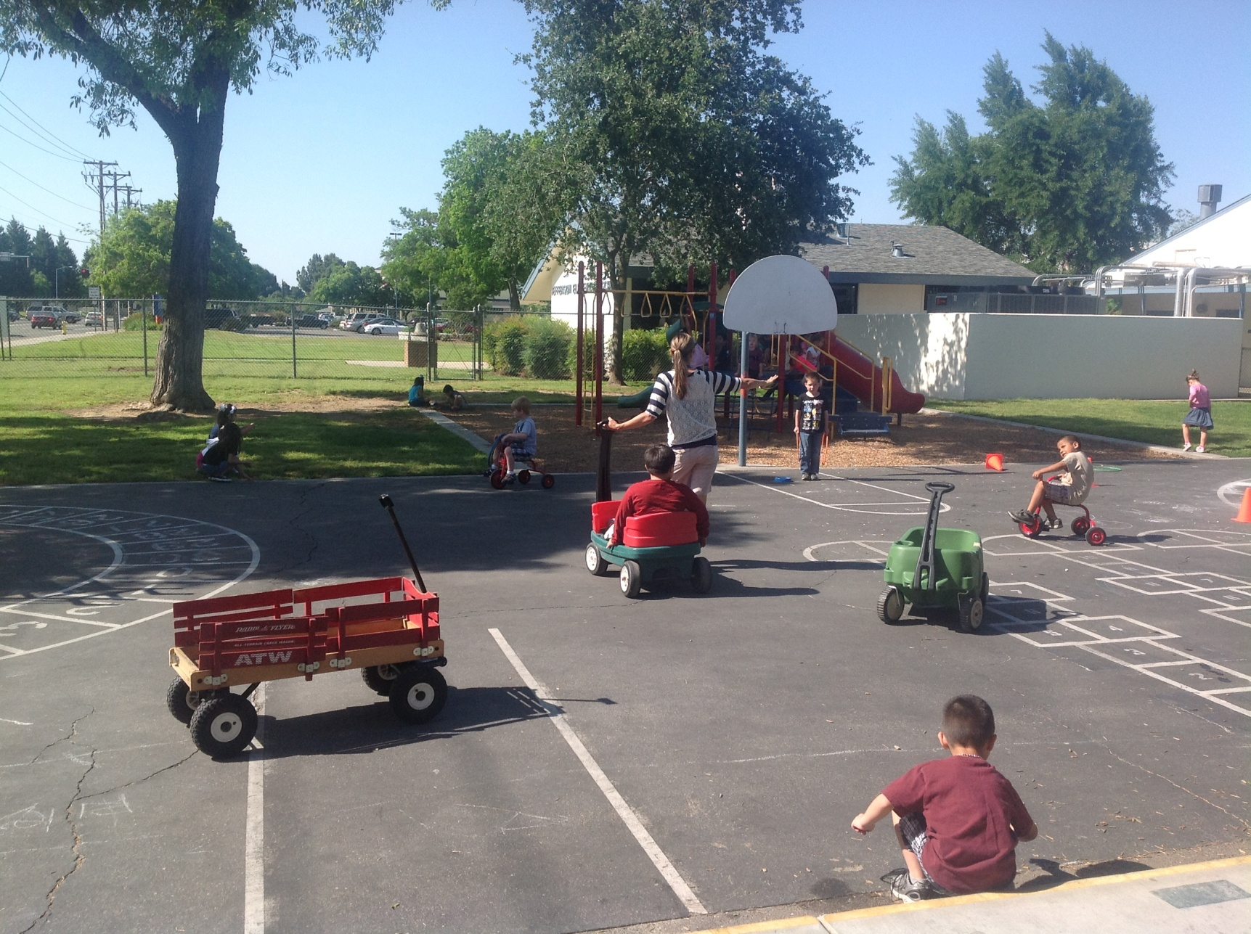
Play Ground
Wagons, balancing toys, trikes, jump ropes, crawl through tunnels, sand table, soccer nets, basketball, chalk, hoops, bean bags, cones, stop and go signs

Slide 28
The make up of my class now...
27 Students
18 Fall Birthdays 9/2-11/30
9 Spring/Summer Birthdays 12/2-8/31
14 Going to Kindergarten
4 TK going to 1st
7 K going to 1st
2 K repeating K-(developmentally not ready)
For questions, please email: asandoval@preschoolcalifornia.org
28

Slide 29
Internet Resources
Math Their Way: http://www.center.edu/index.shtml
Kindergarten/TK Resource: http://www.thekcrew.net/
TK resource: http://www.starfall.com
DIBELS assessment: https://dibels.uoregon.edu/
Music/rhymes/songs/movement: http://www.drjean.org/
http://www.kellyskindergarten.com/
http://ww2.fcoe.or
http://www.preschoolcalifornia.org/our-issues/transitional-kindergarten/g/?n=1009
For questions, please email: asandoval@preschoolcalifornia.org
29

