Slide 1
TK Let’s GO Webinar Series
Formative Assessment:
Critical to TK Success
June 19th , 2012
3-4 p.m.
Presenters: Christie Baird, Shirley Esau, and Margo Herter

Slide 2
Agenda
Welcome
Policy Update- Scott Moore, Senior Policy Advisor, Preschool California
Transitional Kindergarten Presentation: “Formative Assessment:
Critical to TK Success”, Christie Baird, Coordinator of Instructional Services, Orange County Office of Education, Shirley Esau, Principal, Kingsburg Elementary Charter School District, and Margo Herter, TK Teacher, Glendora Unified School District.
Q&A- Please email all questions to Araceli Sandoval-Gonzalez: asandoval@preschoolcalifornia.org
Close- Ernesto Saldaña, State Field Director, Preschool California
Next Call and Webinar: July 17th, 2012 @ 3pm

Slide 3
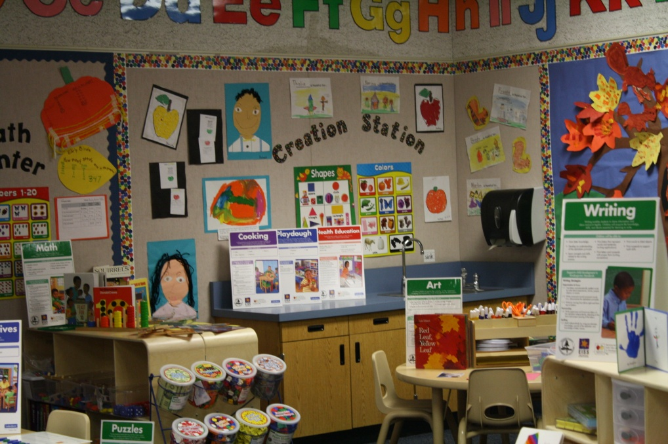
Preparing Our Youngest Students to Succeed in Kindergarten and Beyond
Christie Baird, Ed.D.
Orange County Department of Education

Slide 4
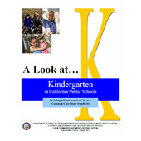
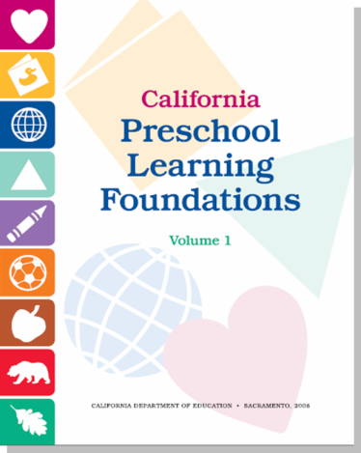
What Are our Goals for TK Students?
GOAL: ensure academic readiness and success in traditional kindergarten.
TK provides an opportunity for young children to gain a year of readiness experiences specifically tailored to their own needs.
The TK program addresses the young child’s language, literacy, and pre-math skills and emphasizes social and emotional development.

Slide 5
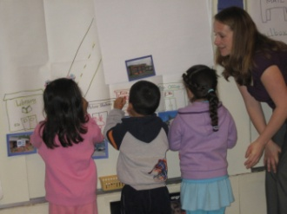
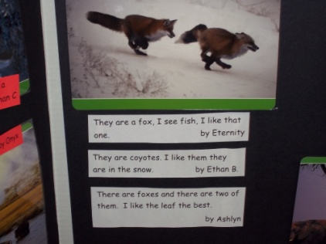
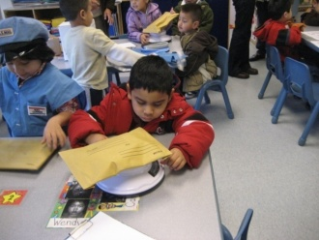
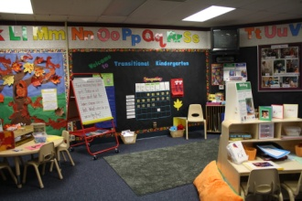
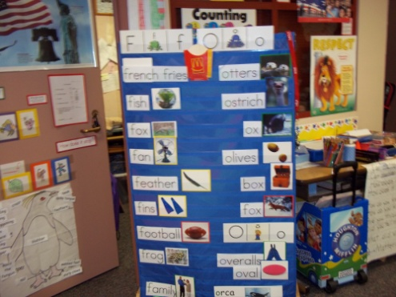
Supporting Children to Achieve Goals
Active learning experiences
Learning centers
Varied instructional strategies
Integrated curriculum
Balance between teacher-directed and child-directed activities
Assessment that drives instruction
(Transitional Kindergarten Planning Guide, CCSESA, 2011)

Slide 6
Assessment
The goal of assessment is to determine what students know and can do in order to build on their strengths to accelerate learning.

Slide 7
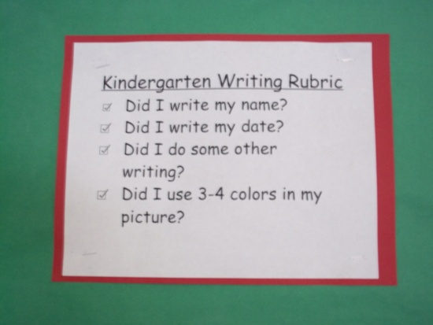
Assessment
Well-defined plan
Tools that are appropriate for age group
May include social-emotional
Use a variety of assessment tools and strategies
Emphasis on exposure to kindergarten standards rather than mastery

Slide 8
Summative vs. Formative Assessment
Summative – seeks to monitor educational outcomes often for the purpose of accountability
Formative - Formative assessments are on-going assessments, reviews and observations in a classroom

Slide 9
Effective Formative Assessment
Discover what students know and the range of skills and strategies they are using
Identify the next steps in a student’s learning
Plan for early intervention where problems are persistent
Decide on the resources or techniques that match the needs of an individual
Keep track of the progress of an individual or a group over a period of time
Monitor your own teaching practices

Slide 10
Ongoing Assessment Process
Information ➔
Planning ➔
Practice ➔
Assessment
effective practice = ongoing process

Slide 11


Sensitive to Differences
Individual differences
Special needs
“At Risk”
Gifted
Cultural
Bias

Slide 12
Objectivity
Bias and fairness
Objectivity
  Avoid categories and labels
  Be objective in collecting information
  Be objective in recording information
  Be objective in evaluating classroom procedures and instructional practices

Slide 13
What to Assess?
Major child growth and developmental domains
Expected outcomes of the program for individual children
Unique patterns of development, knowledge, attitudes, and interests
Problems or concerns about a particular child or group

Slide 14
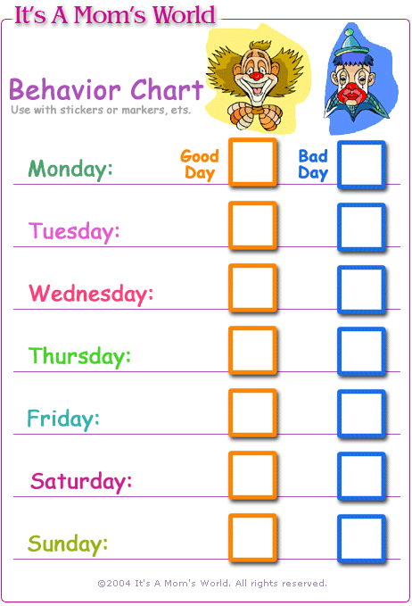

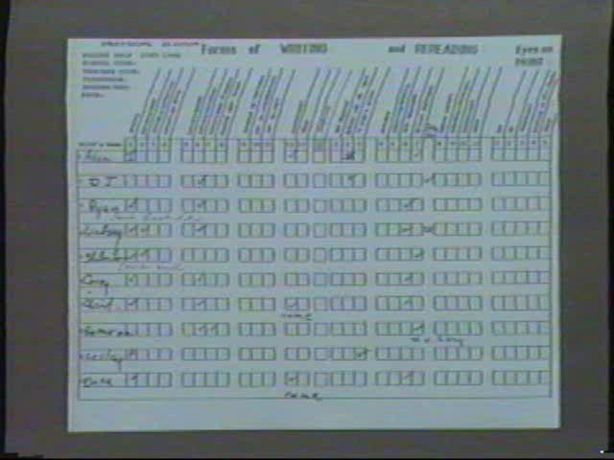
Examples of Assessment Data
Individual
Classroom
TK School site assessments
TK District
Standards and Benchmarks
Report cards
Portfolios

Slide 15
Informal Observation
Teachers must become skillful assessors who systematically identify individual strengths by understanding how those learners are developing.
The goal of assessment in TK is to find out what children know and what they can do.

Slide 16
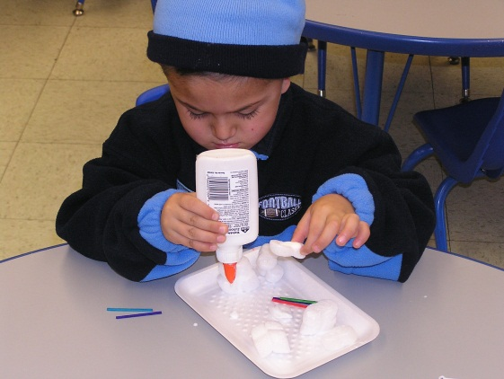
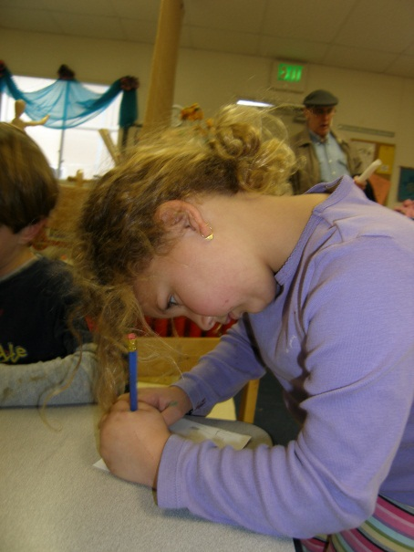
Formative Assessment Matters
“If you can both listen to children and accept their answers not as things to just be judged right or wrong but as pieces of information which may reveal what the child is thinking, you will have taken a giant step toward becoming a master teacher, rather than merely a disseminator of information." -Easley & Zwoyer, 1975

Slide 17


Transitional Kindergarten Assessment
Administrator Hat
Mrs. Shirley Esau, Principal
Kingsburg Elementary Charter School District
Kingsburg, CA
Washington School
Classroom Teacher Hat
Mrs. Margo Herter, TK Teacher
Glendora Unified School District
Glendora, CA
William B. Cullen Elementary

Slide 18
      What types of formative assessments do you use for TK?
Both Glendora and Kingsburg
  Pre-K assessment
    Designed by Kingsburg Elementary and Fresno County Office of Education
    Designed by Cullen Elementary Kindergarten Teachers
  California English Language Development Test (CELDT)
  Emerging Literacy Survey – Houghton-Mifflin Reading
  Anecdotal Records/Teacher Observations
  Teacher created assessments/tasks/assignments

Slide 19
What types of formative assessments do you use for TK?
Glendora
  Boehm 3- Test of Basic Concepts
  Listening & Speaking Rubric
  Writing Rubric
Kingsburg
  Dynamic Indicators of Basic Early Literacy Skills - Next (DIBELS) – University of Oregon for data collection
  Developmental Reading Assessment 2(DRA2)

Slide 20
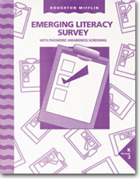


Samples

Slide 21
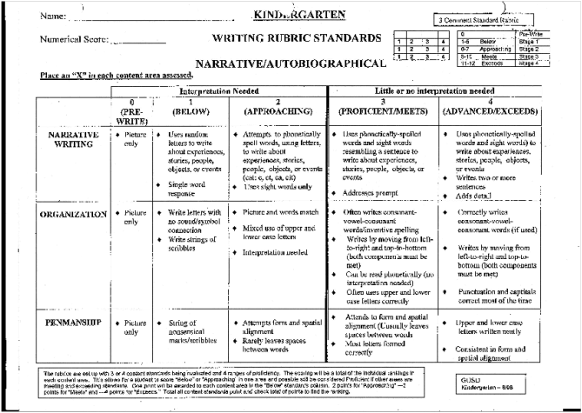
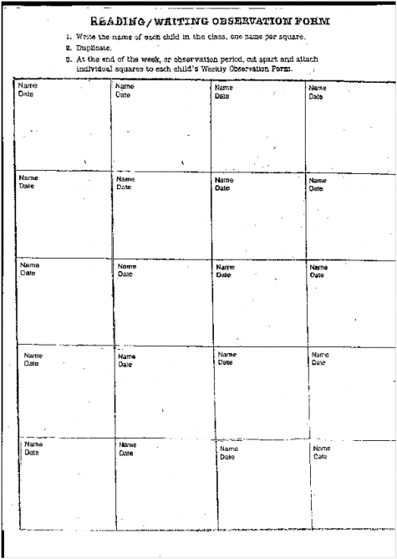
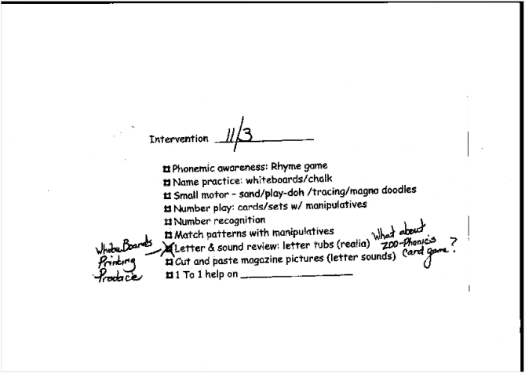
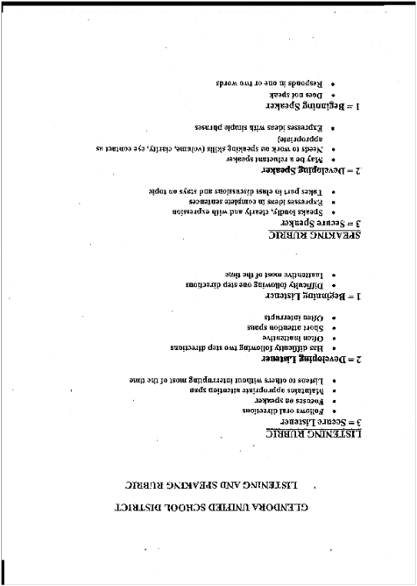
More
Samples

Slide 22
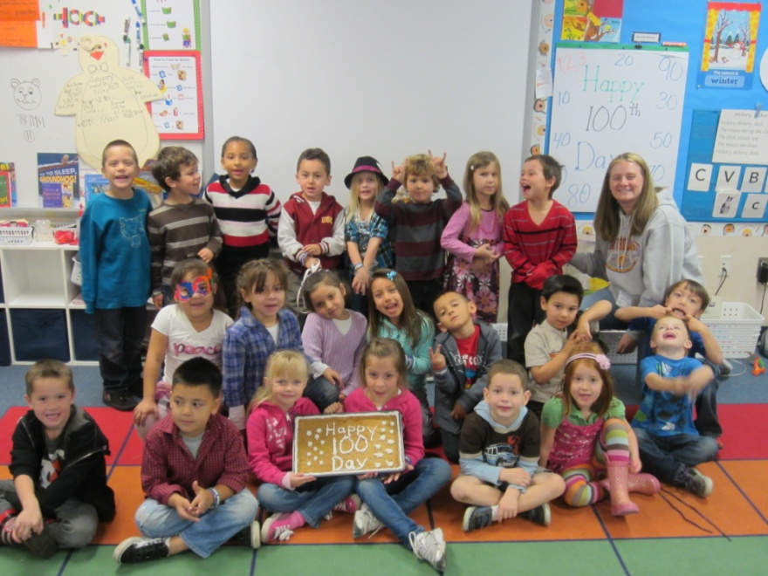
Piloted Assessments
Children’s Academic Progress Assessment
DRPD-SR created by CDE and West Ed will be available in August 2012.
GOLD by Teaching Strategies
Houghton/Mifflin Pre-K Splash
Teacher created assessments/benchmarks

Slide 23
      What are the challenges with these formative assessment?
Training on each instrument’s use and protocols
Training on how to use the data to drive instruction. Variable could be who gave the assessment
Making sure that testing does not take too much time away from learning
Creating a balanced formative assessments plan

Slide 24
      How do you use formal and informal assessments for ELD, ELA, Math and Social Emotional?
ELD – What level is a student at and using that information to form intervention and instruction
ELA and Math – Variety of assessments for different purposes.
  Teacher can instruct to meet student’s needs
  Teachers can design intervention for specific skills or standards
Social Emotional – this may be a missing piece in Kindergarten and helps a teacher know where their students are socially and emotionally, allowing them to design the appropriate activities and groups based on data

Slide 25
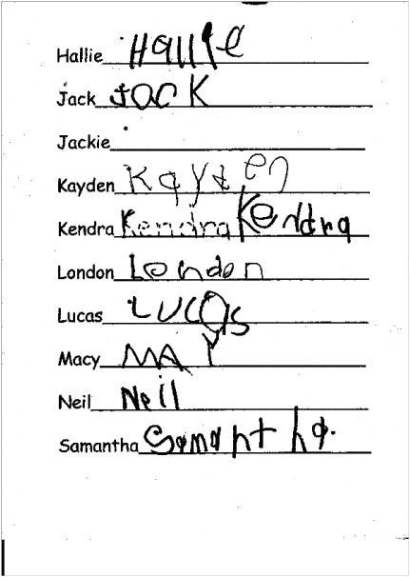
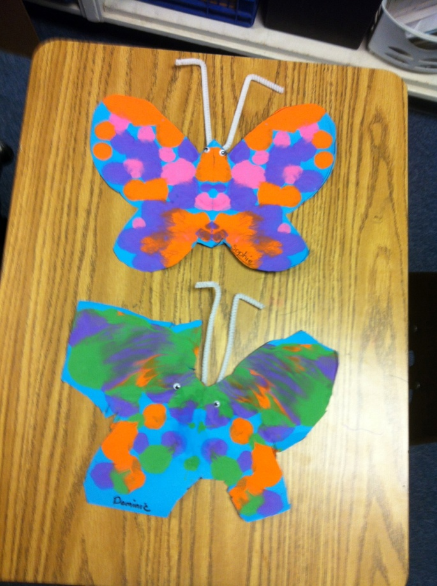
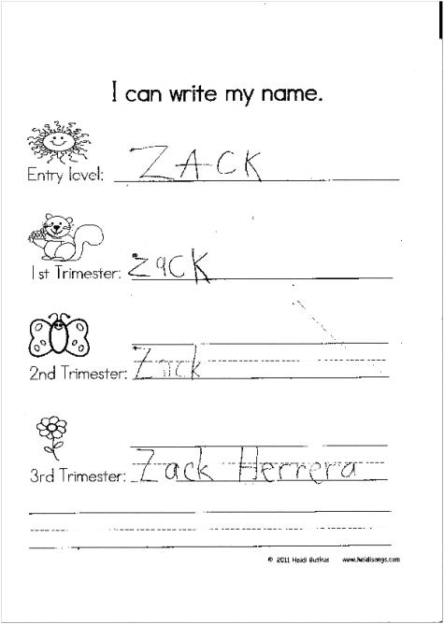
Types of Formative Assessments
Use methods of assessment that can be incorporated into your day
1 2 3

Slide 26
Practices/Standards
Be cognizant of developmental stages
Use resources that are available

Slide 27
      How do these formative assessments help you better meet the needs of your ELL students?
No matter what you use…
Needs to be developmentally appropriate
Needs to help develop required skills
Needs to help develop vocabulary
Needs to be mindful towards cultural diversity
Needs to value the importance of student’s home language
Needs to support oral language development
Needs to help teacher plan, develop and implement curriculum
Needs to help drive instruction and assist with the assessment process (when/where/how)

Slide 28
Next TK Monthly Call
Our next call will be on July 17th @ 3pm
  Participant Call-in information:
  1-866-710-0179 passcode 56647

