Slide 1

Transitional Kindergarten
Presentation for the Transitional Kindergarten Professional Learning Community
April 17, 2012
Early Learning Services Department
Santa Clara County Office of Education

Slide 2
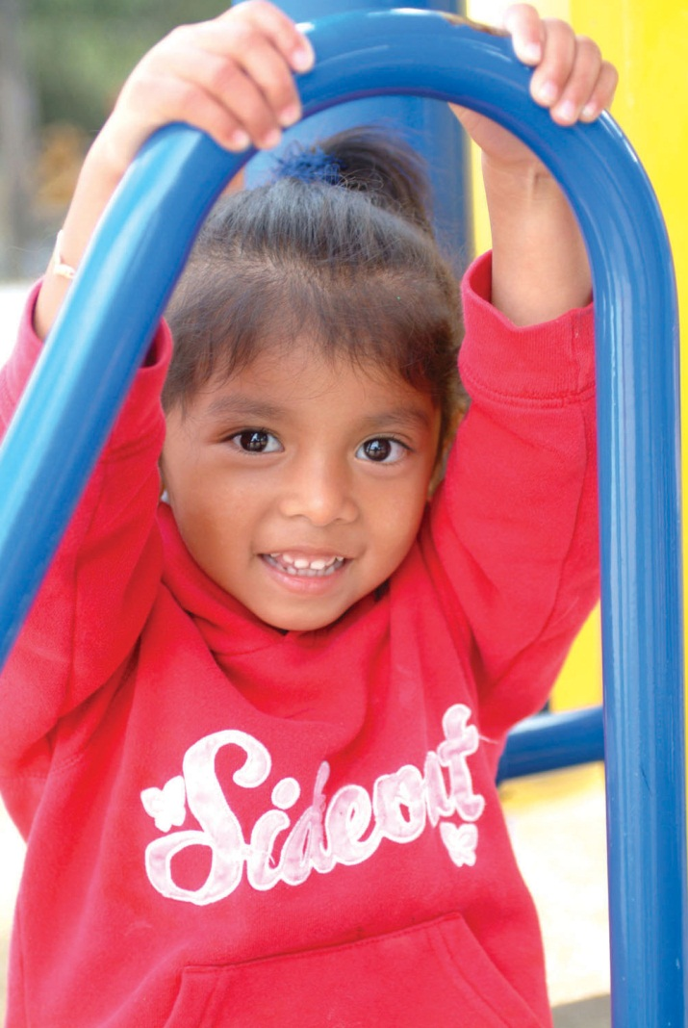
Agenda
Preschool Environmental Supports for Transitional Kindergarten (TK)
Transitional Kindergarten Environment

Slide 3

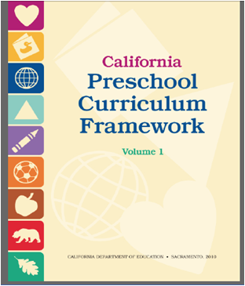
California’s Early Learning System
Preschool Environmental Supports for TK
Preschool Learning Foundations
Preschool Curriculum Frameworks

Slide 4
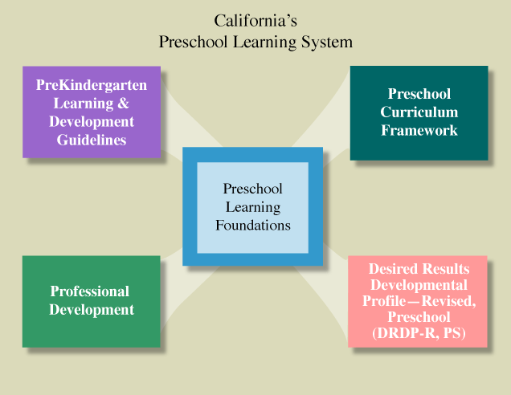
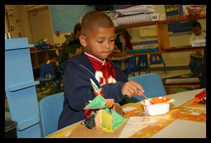
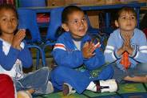
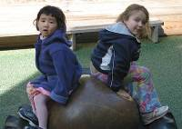
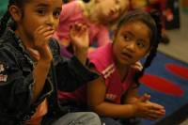
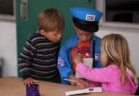
Preschool Environmental Supports for TK

Slide 5
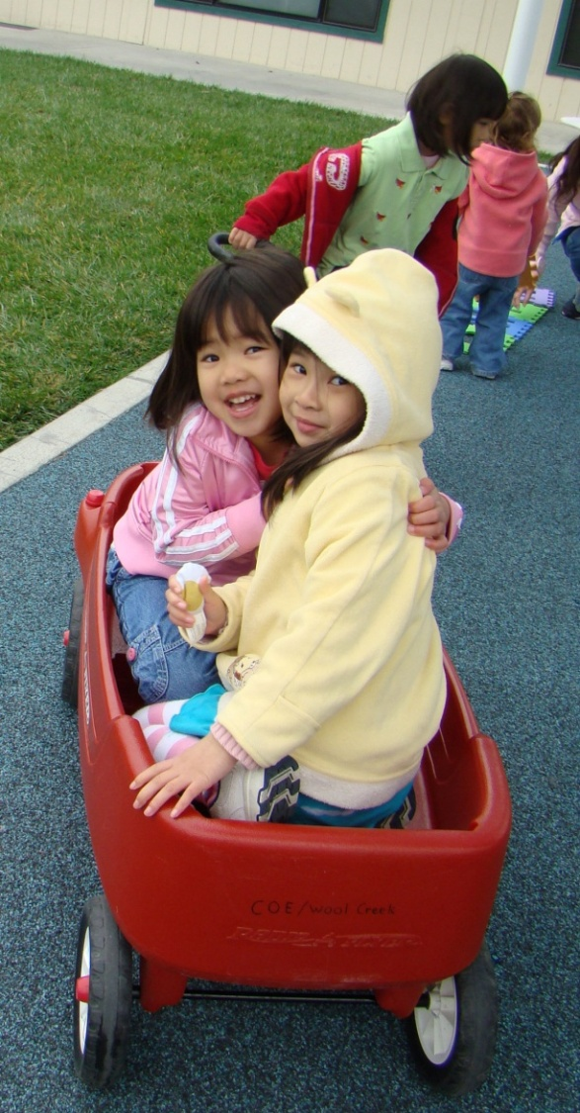
Preschool Environmental Supports for TK
  Preschool Practices that Support a High Quality TK Environment
Setting the stage for learning
(Invites inquiry, exploration,
problem-solving, small group and center activities)
Promoting independence
Scaffolding self-regulation
Providing supports in the
home language

Slide 6
Preschool Environmental Supports for TK
  Preschool Practices that Support a High Quality TK Environment
  Challenging & developmentally appropriate materials that reflect children’s emerging interests as observed in the context of play
  Ample supply of materials
  Organized learning centers (science, circle, math, blocks etc.)
  Appropriately sized small group activities
  Balance between teacher directed and child directed activities (varied small group experiences from minimum to maximum teacher supervision))
  Aesthetically appealing (avoid overstimulation)
  Public and private spaces
  Preschool Curriculum Framework, Vol. 1, p 43-44, CDE Press

Slide 7
Preschool Environmental Supports for TK
  Preschool Practices that Support a High Quality TK Environment - Continued
  Furnishings and materials accessible to children
  Display of children’s work
  Space for children’s belongings
  Reflective of diversity
  Space for arrivals and departures
  Supportive of children’s active engagement (physical and verbal support)
  Outdoor areas are supportive of social emotional development
  Preschool Curriculum Framework, Vol. 1, p 43-44, CDE Press , 2010

Slide 8
Preschool Environmental Supports for TK
Social-Emotional Development Supports a High Quality TK Environment
Self | Social Interaction | Relationships
Self-Awareness | Interaction with Familiar Adults | Attachment to Parents
Self-Regulation | Interaction with Peers | Close Relationships with Teachers and Caregivers
Social and Emotional Understanding | Group Participation | Friendships
Empathy and Caring | Cooperation and Responsibility
Initiative in Learning
Source: California Preschool Learning Foundations, CDE Press, 2008.

Slide 9
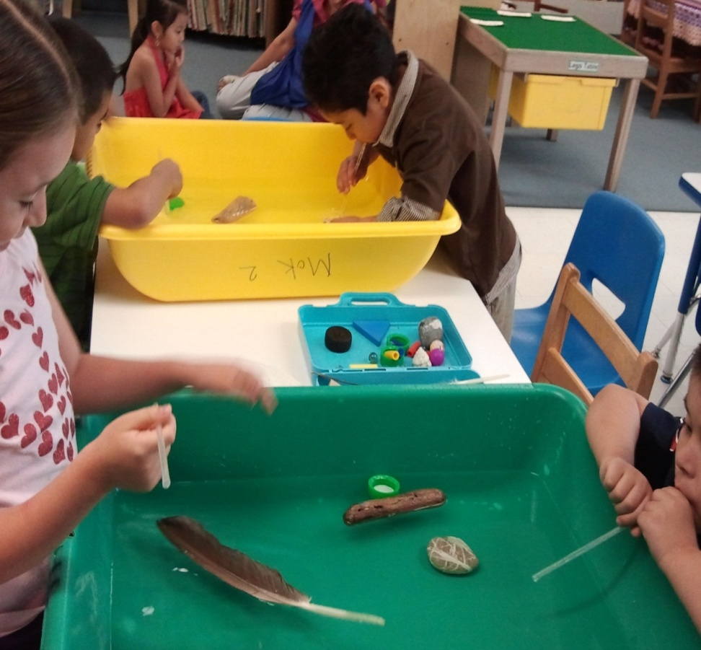
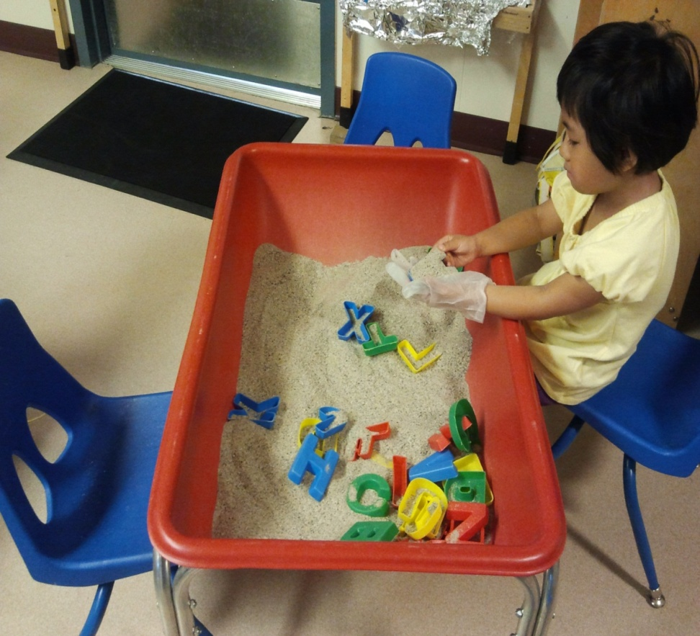
Preschool Environmental Supports for TK
Example of Active Engagement

Slide 10
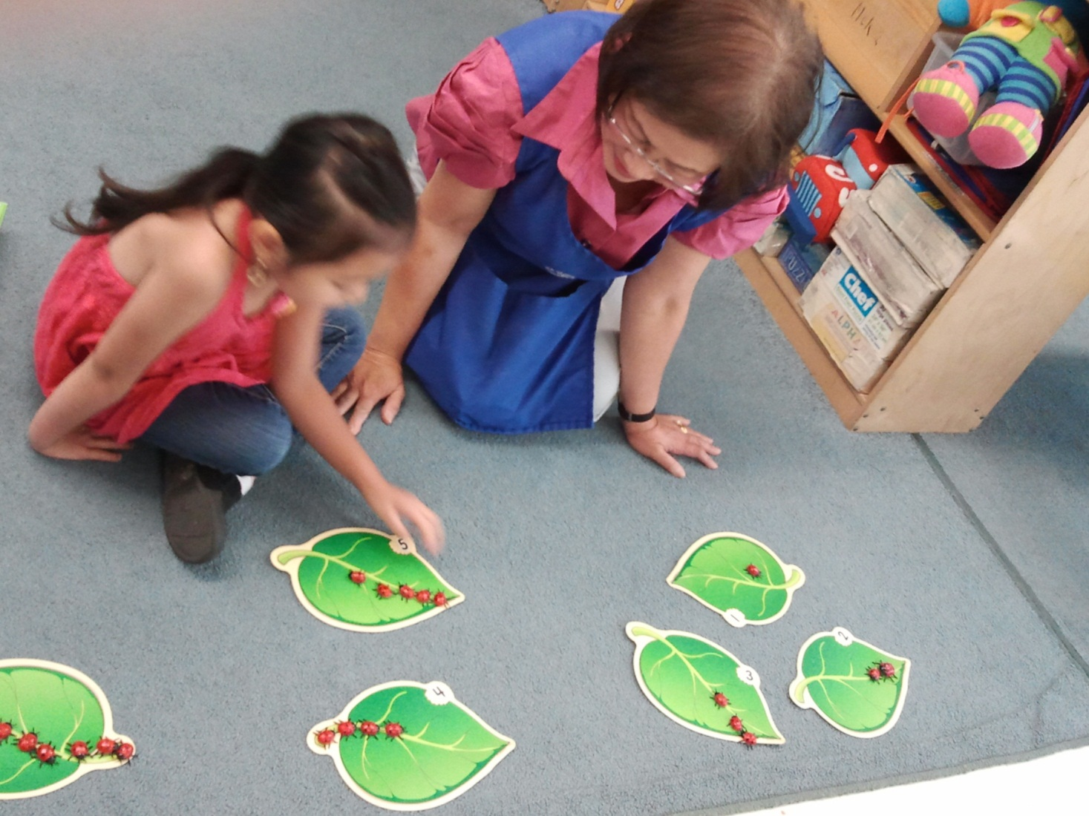
Preschool Environmental Supports for TK
Example of Individual Support

Slide 11
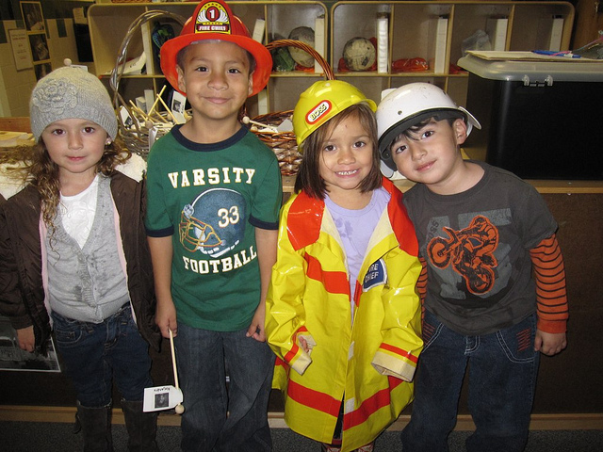
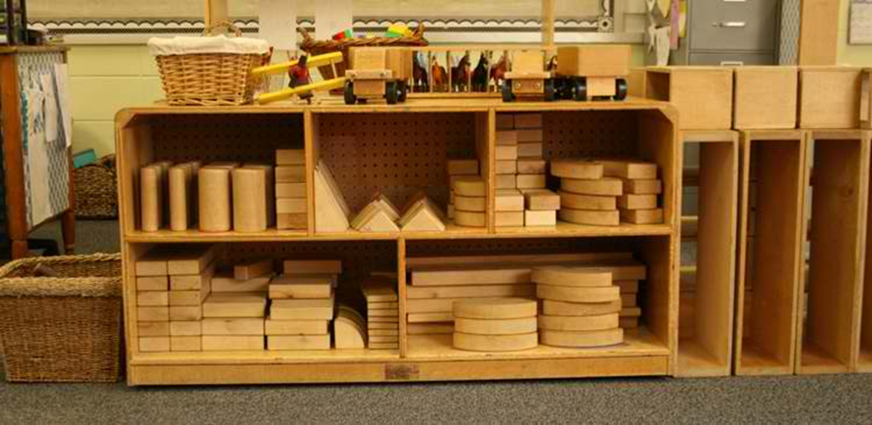
Preschool Environmental Supports for TK
Example of Dramatic Play and Block Area

Slide 12
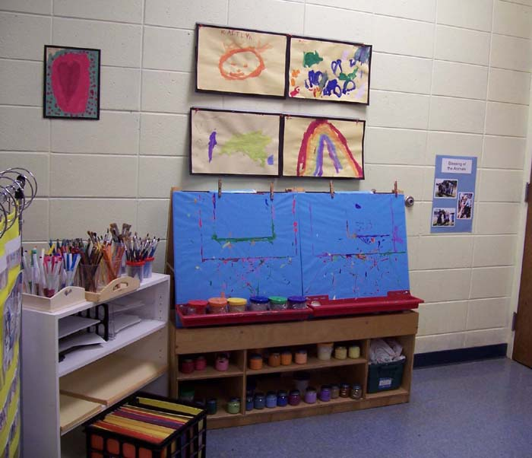
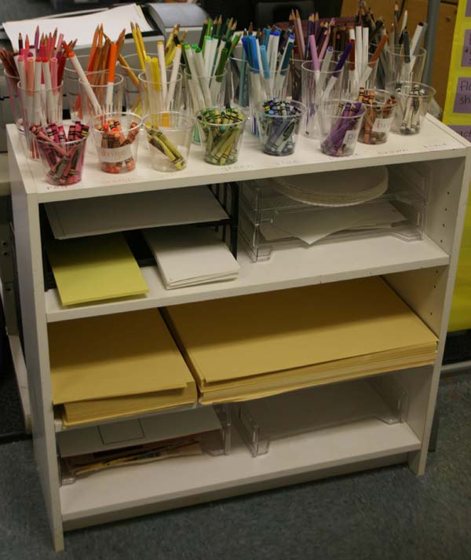
Preschool Environmental Supports for TK
Example of Art and Writing Area

Slide 13
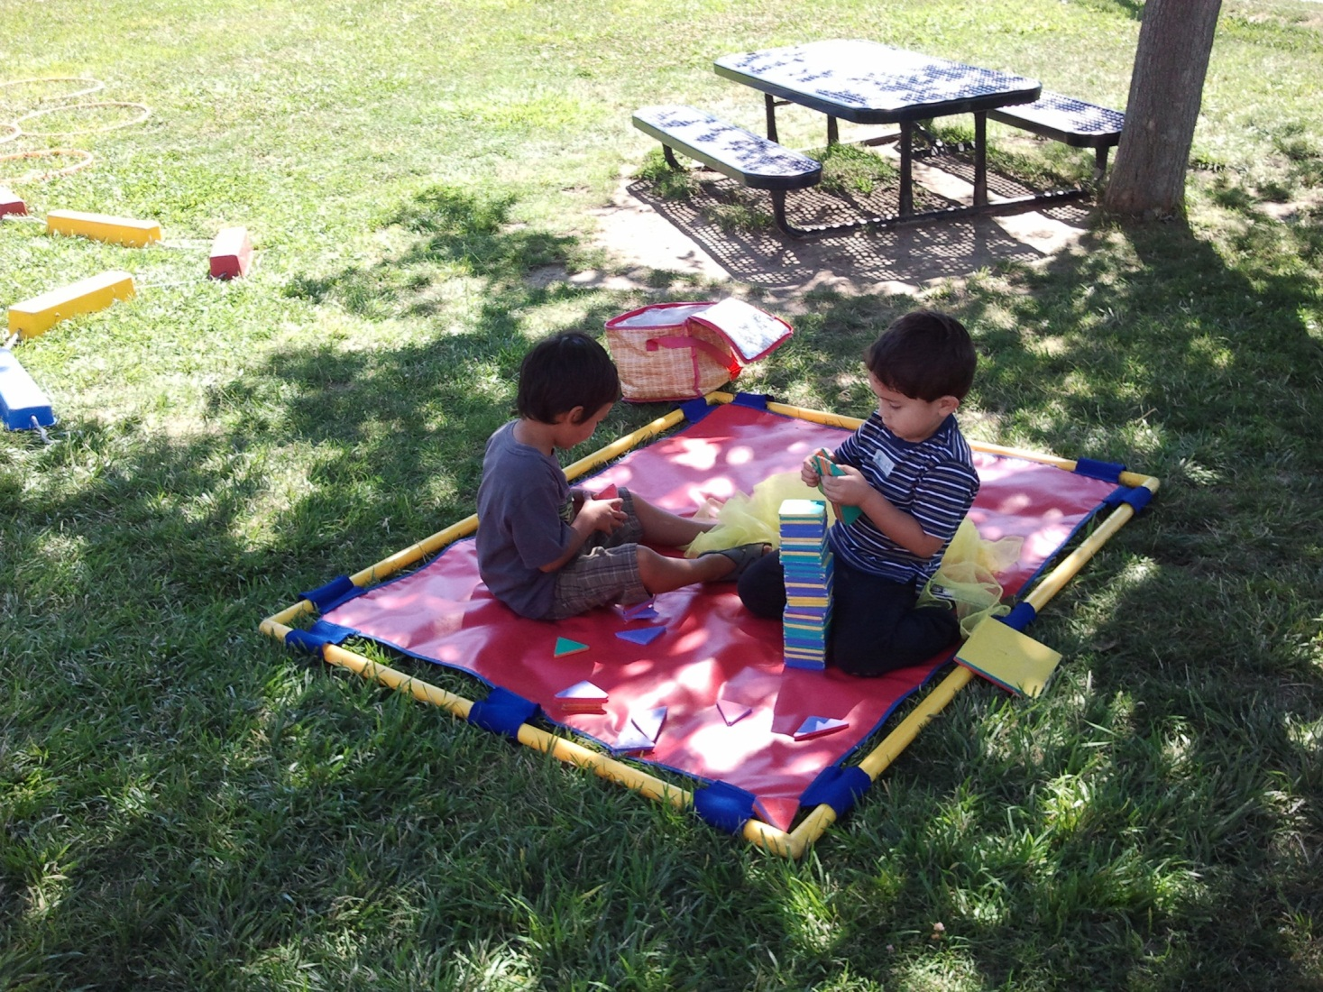
Preschool Environmental Supports for TK
Example of Supportive Outdoor Activities

Slide 14
Transitional Kindergarten Environment
  Transitional Kindergarten Best Practices that Support a High Quality TK Environment
Setting the stage for learning
(Invites inquiry, exploration,
problem-solving, small group and center activities)
Promoting independence
Scaffolding self-regulation
Providing supports in the
home language

Slide 15
Transitional Kindergarten Environment
Setting the stage for learning:
Use challenging and developmentally appropriate materials that scaffold children’s development
Provide ample supplies and materials that are easily accessible to children
Have an aesthetically appealing peaceful environment that encourages inquiry and exploration

Slide 16
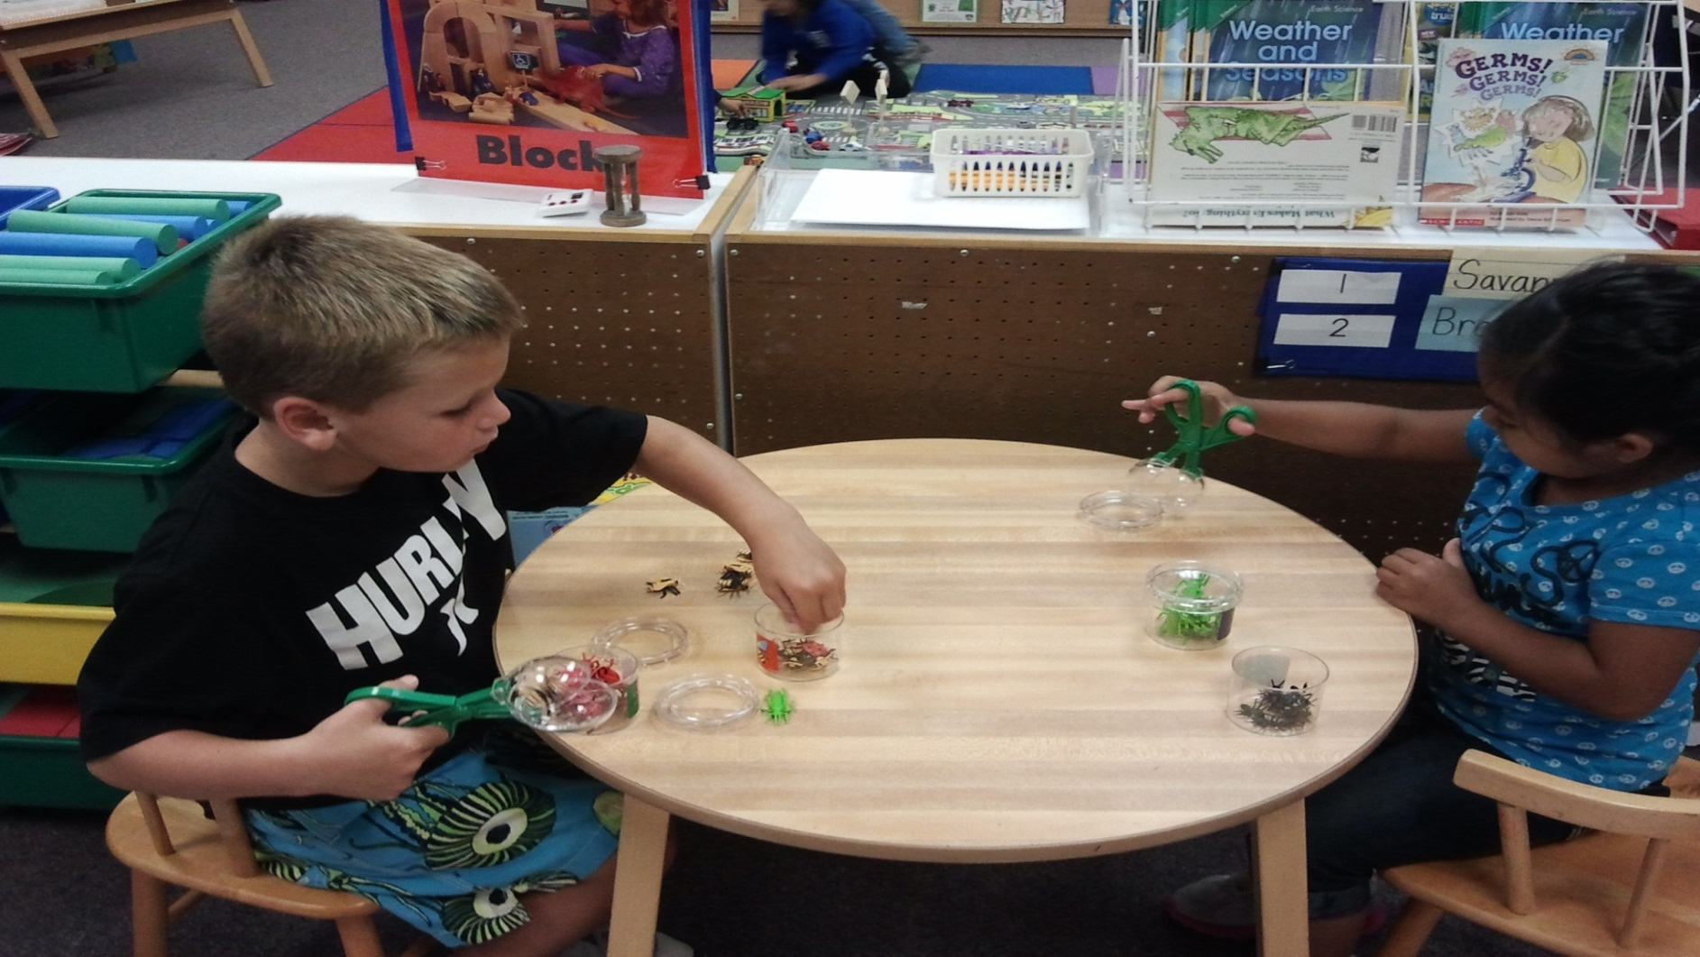
Transitional Kindergarten Environment
Setting the Stage - Science Center

Slide 17
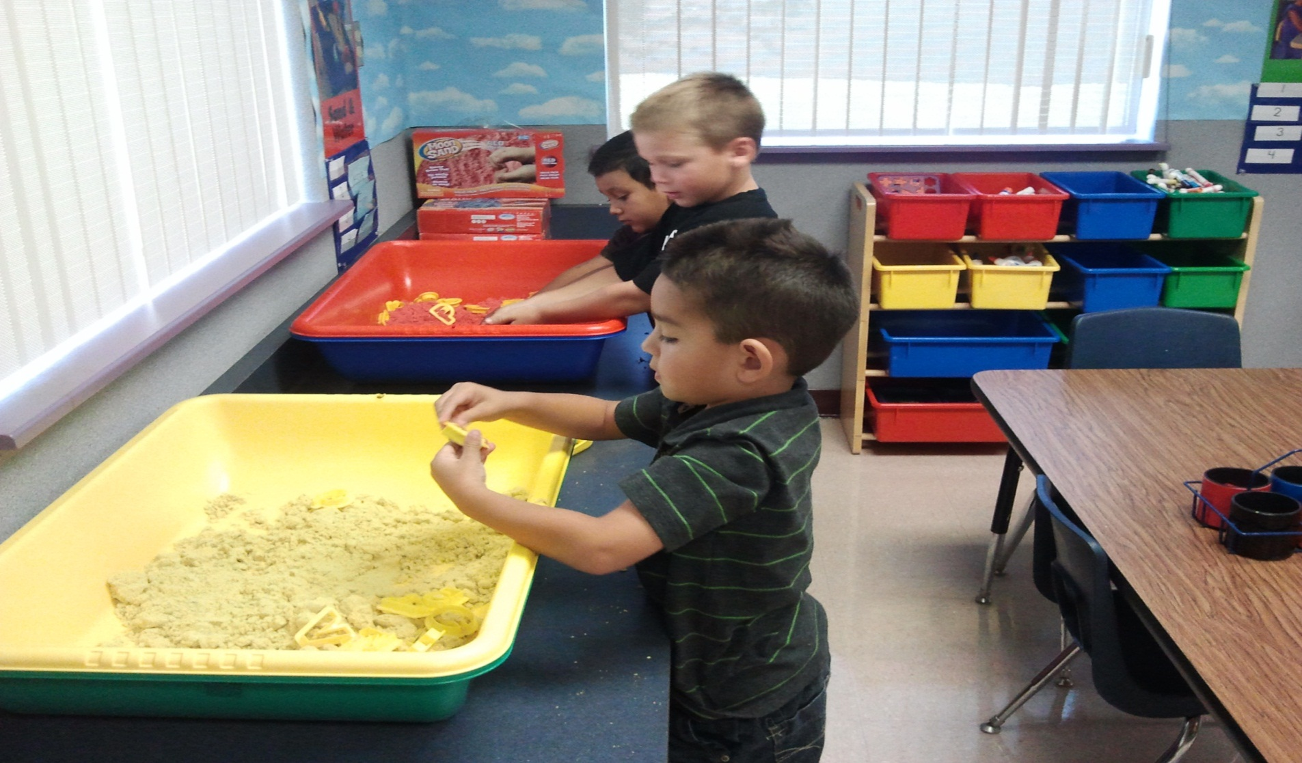
Transitional Kindergarten Environment
Setting the Stage – Sand and Water Center

Slide 18
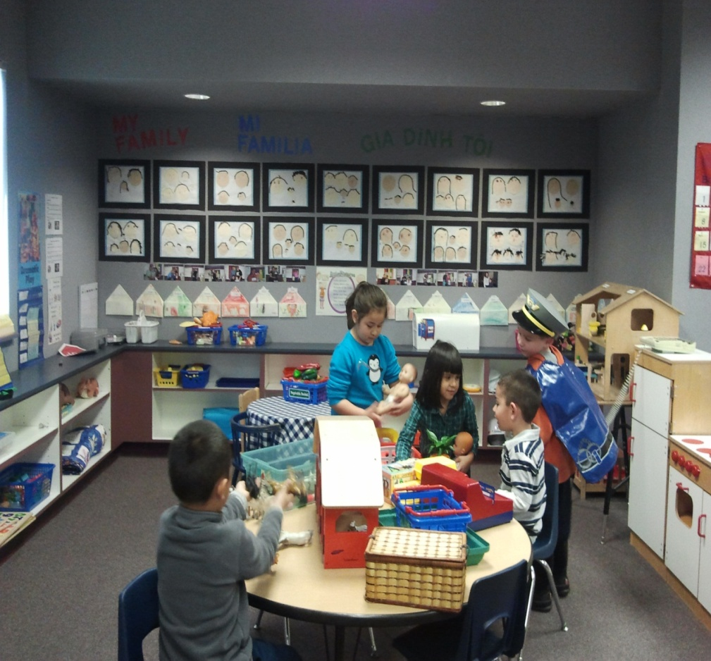
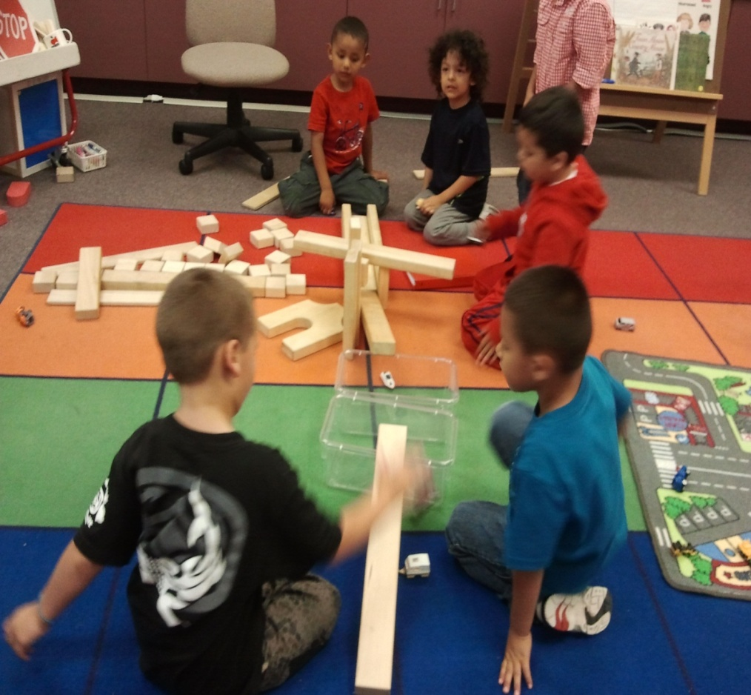
Transitional Kindergarten Environment
Setting the Stage – Dramatic Play and Block Area

Slide 19
Transitional Kindergarten Environment
Setting the stage for learning (continued):
Provide opportunities for small and large group activities
Physical environment is nurturing and engaging
Support children’s active engagement
Blending the preschool and kindergarten environment

Slide 20
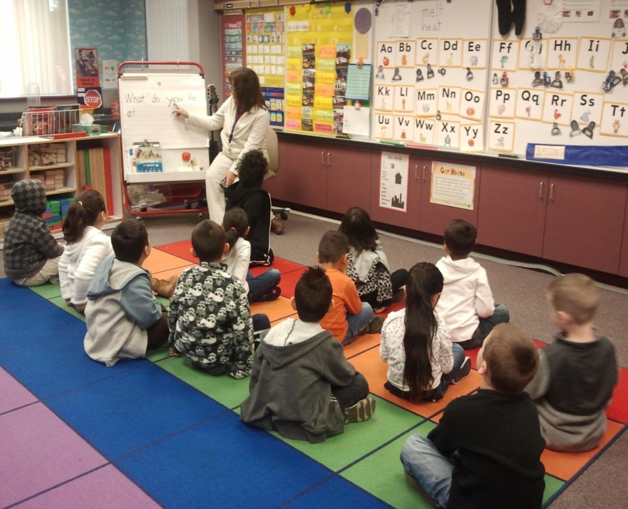
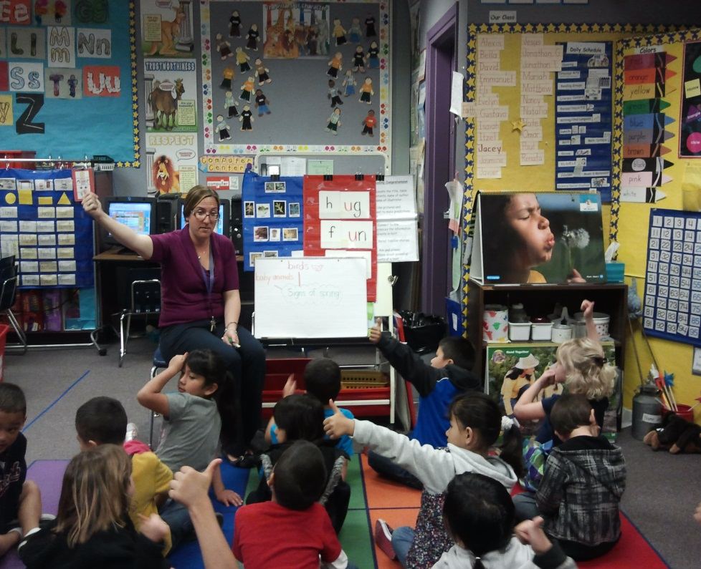
Transitional Kindergarten Environment
Setting the Stage – Morning Message
TK Classroom
Kindergarten Classroom

Slide 21
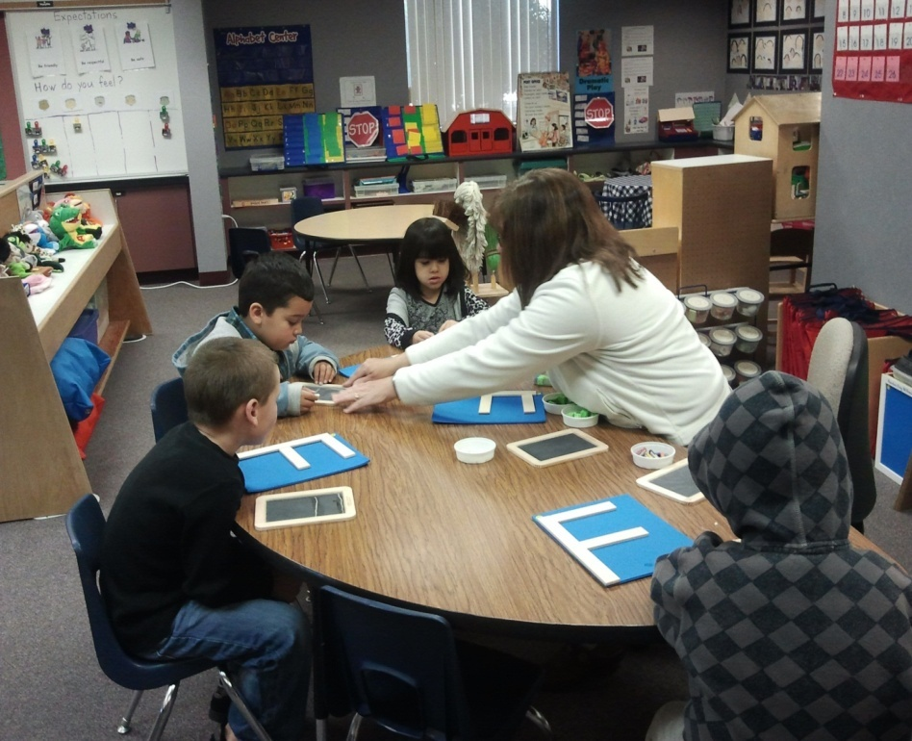
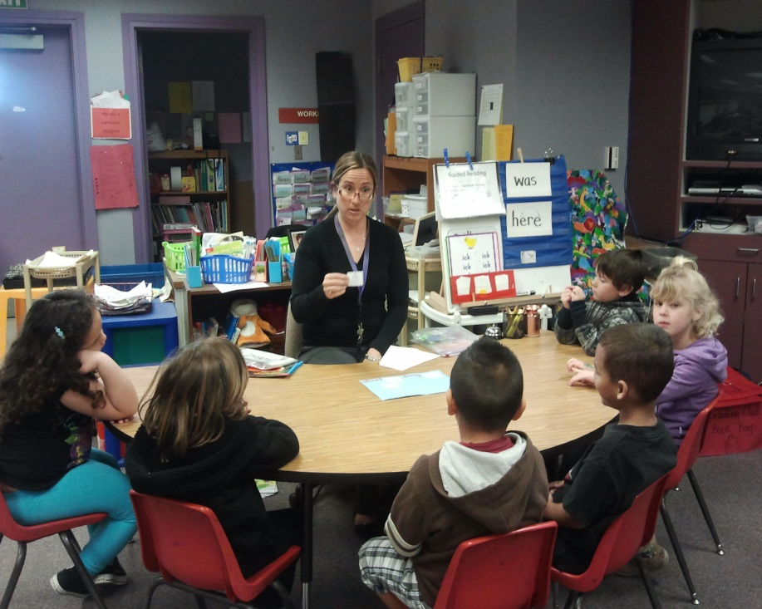
Transitional Kindergarten Environment
Setting the Stage - Literacy Center
TK Classroom
Kindergarten Classroom

Slide 22
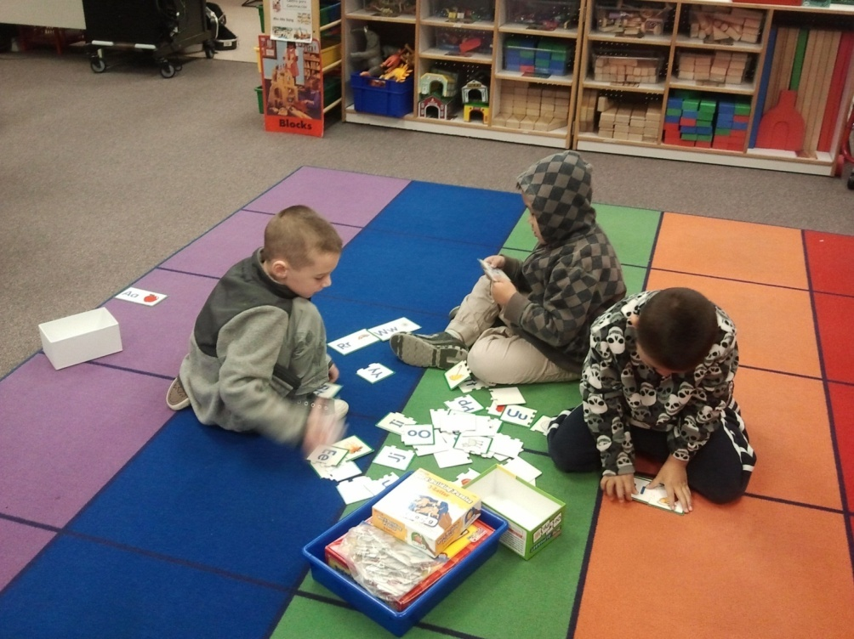
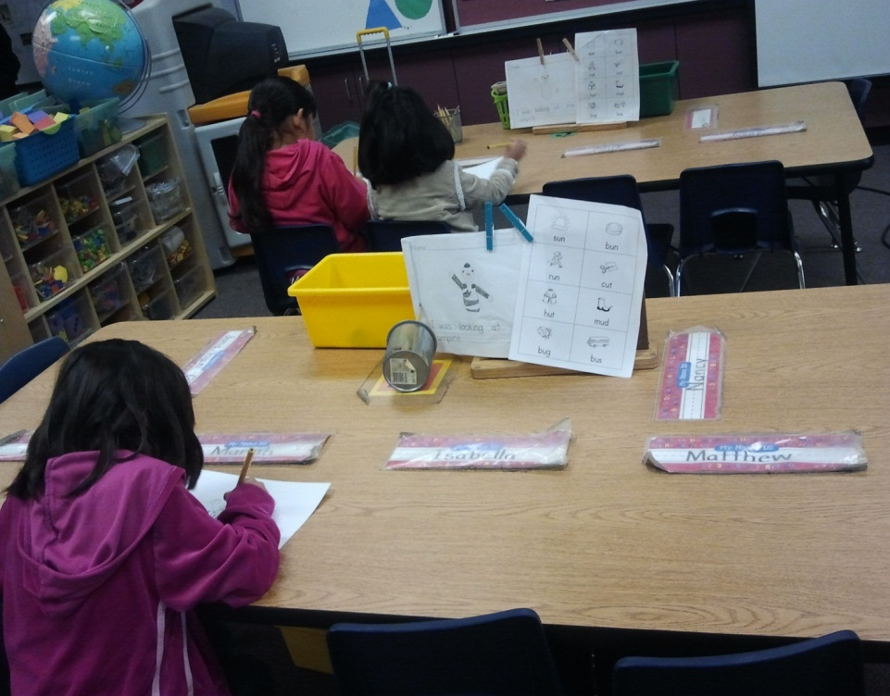
Transitional Kindergarten Environment
Setting the Stage – Literacy Center
TK Classroom
Kindergarten Classroom

Slide 23
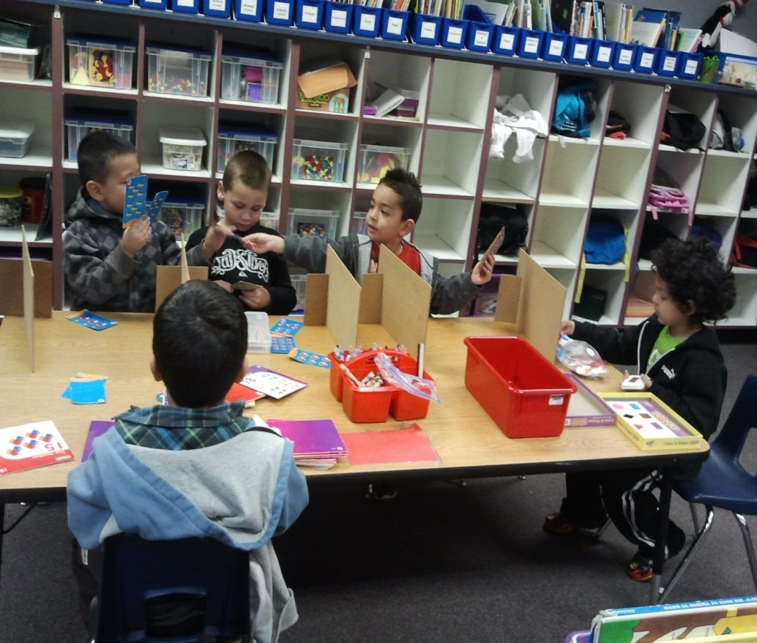
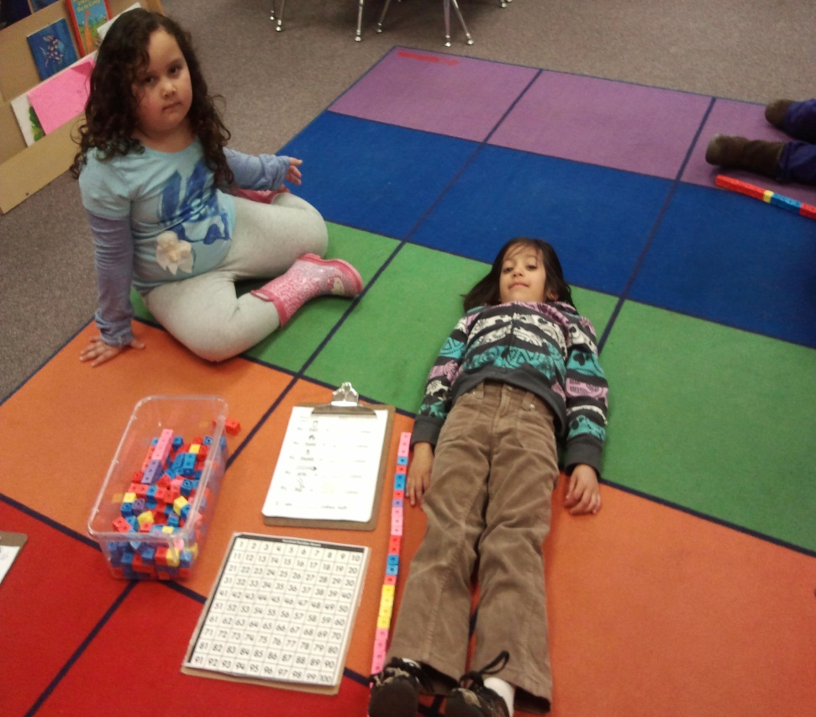
Transitional Kindergarten Environment
Setting the Stage - Math Center
TK Classroom
Kindergarten Classroom

Slide 24
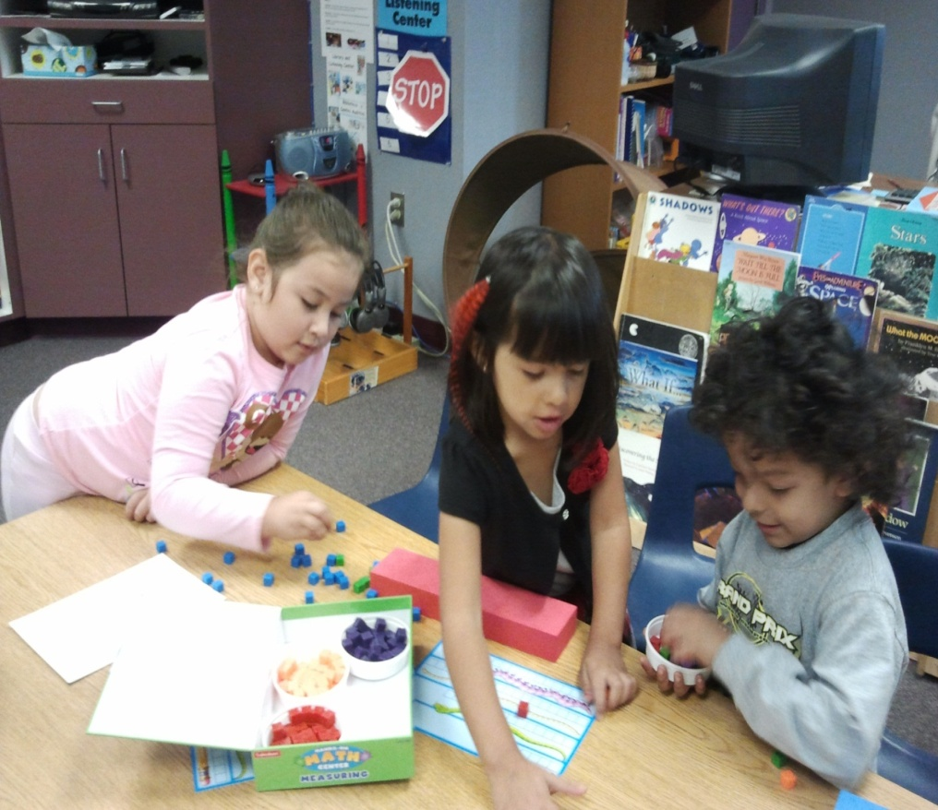
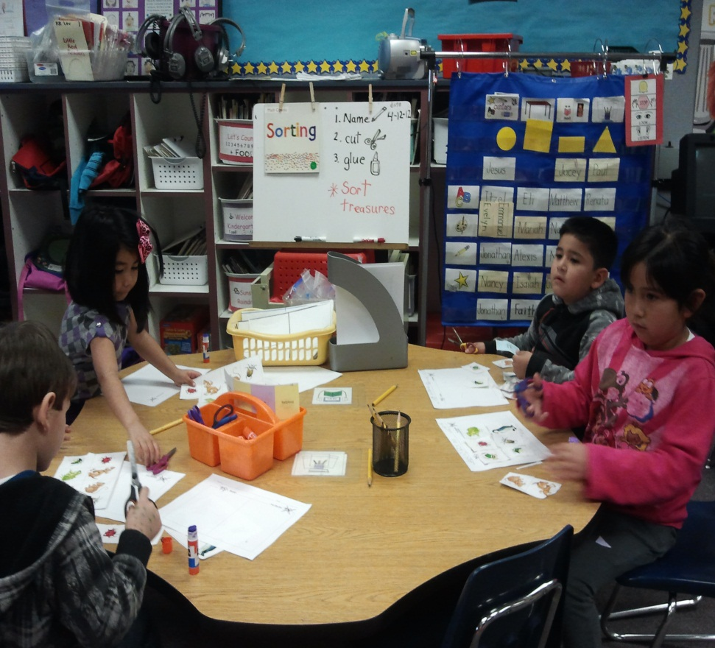
Transitional Kindergarten Environment
Setting the Stage - Math Center
TK Classroom
Kindergarten Classroom

Slide 25
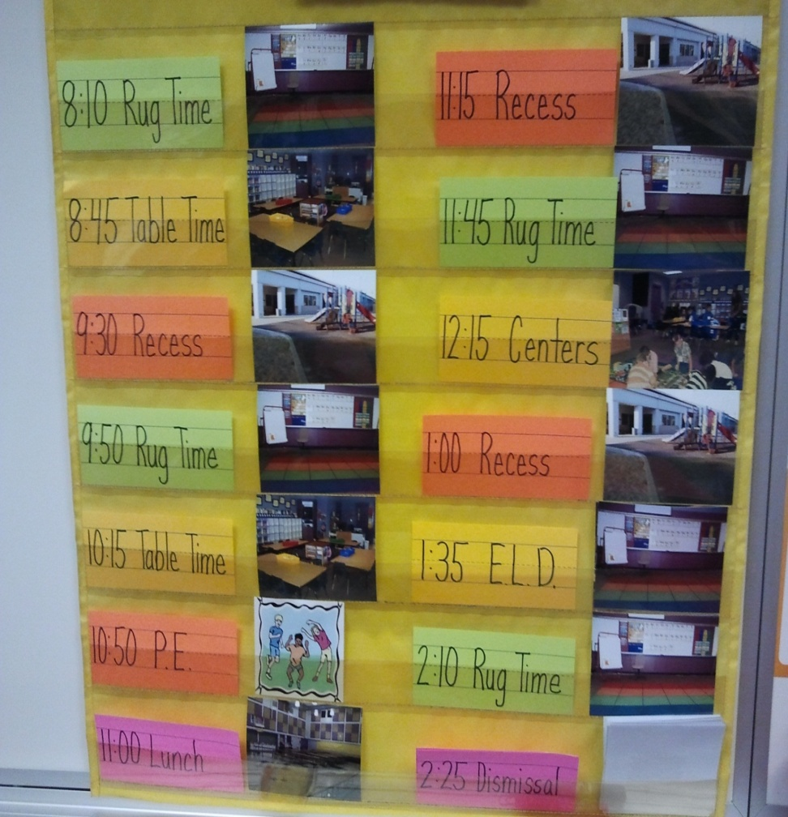
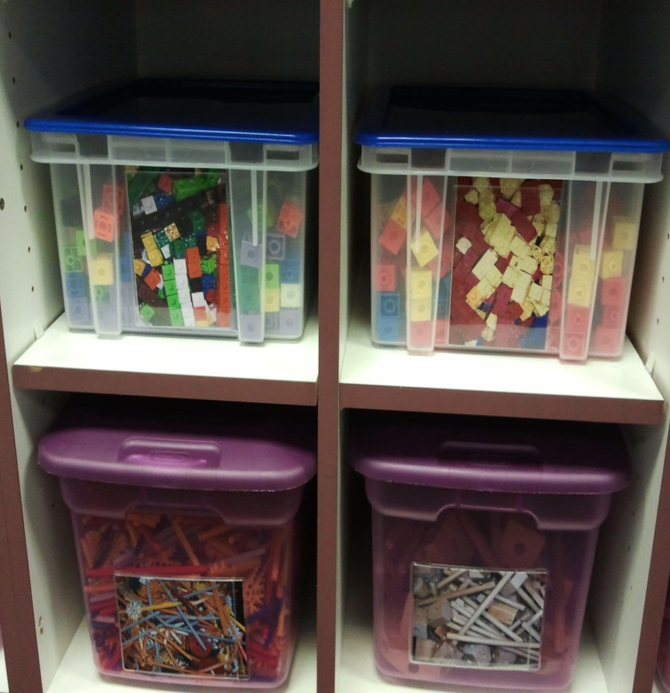
Transitional Kindergarten Environment
Promoting Independence - Visual Schedule and Clear Containers

Slide 26
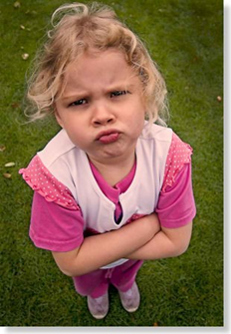
Transitional Kindergarten Environment
Scaffolding Self Regulation
Achieving sense of self
Behaving in a prosocial manner
Taking responsibility for self and others

Slide 27
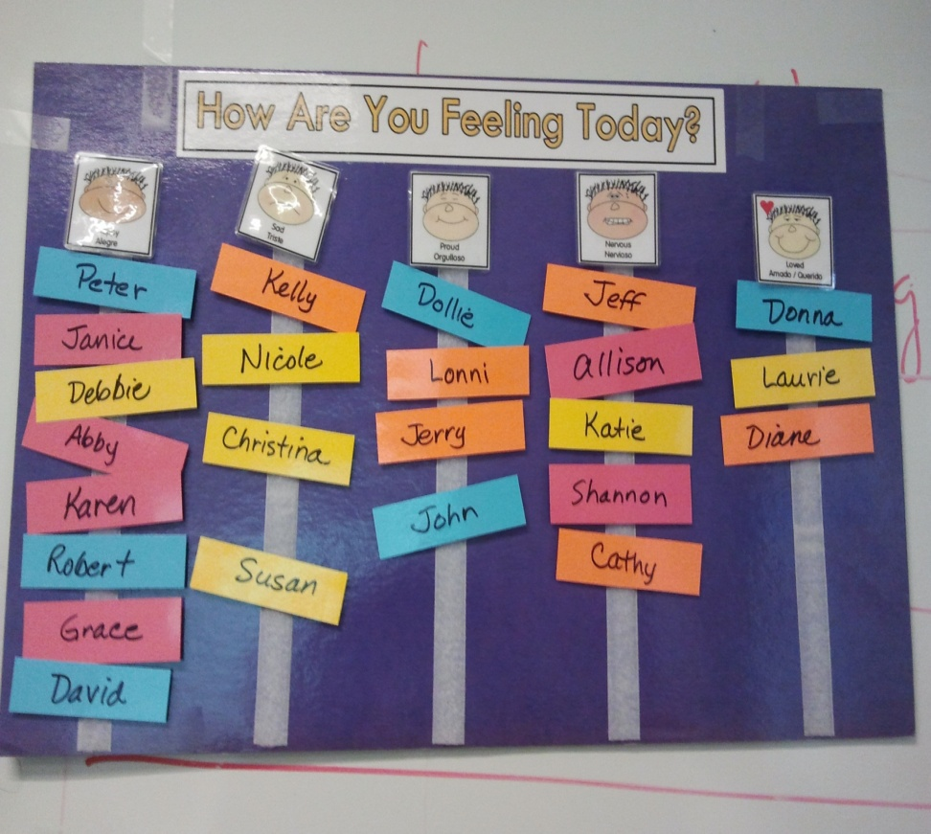
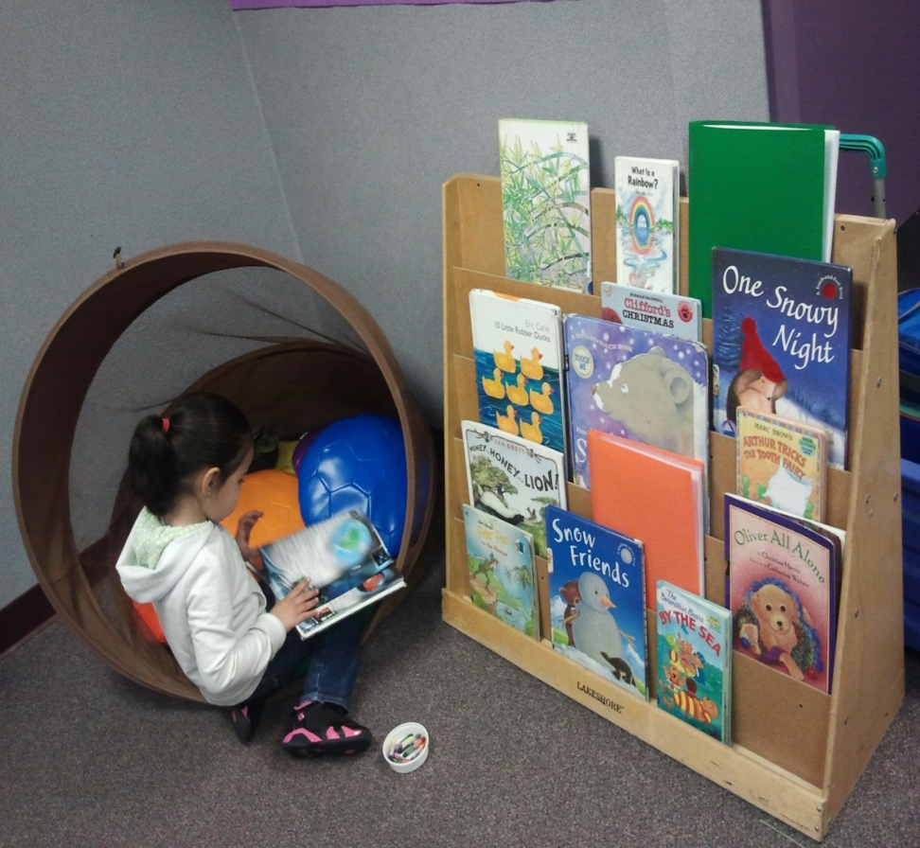
Transitional Kindergarten Environment
Scaffolding Self-Regulation – Feeling Chart and Private Space

Slide 28
Transitional Kindergarten Environment
Providing Supports in the Home Language
Reflective of diversity
Print rich labeling is visible and representative of home languages
Books, materials, displays and artifacts comprise all cultures, families and communities of students

Slide 29
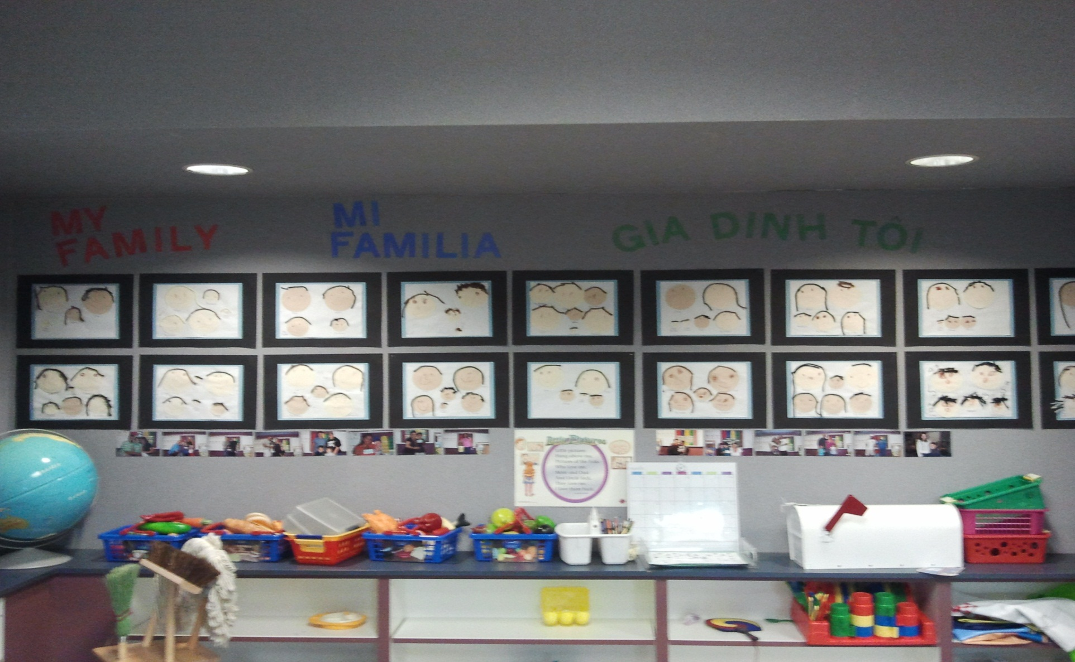
Transitional Kindergarten Environment
Providing Supports in the Home - Language Thematic Unit Sign

Slide 30
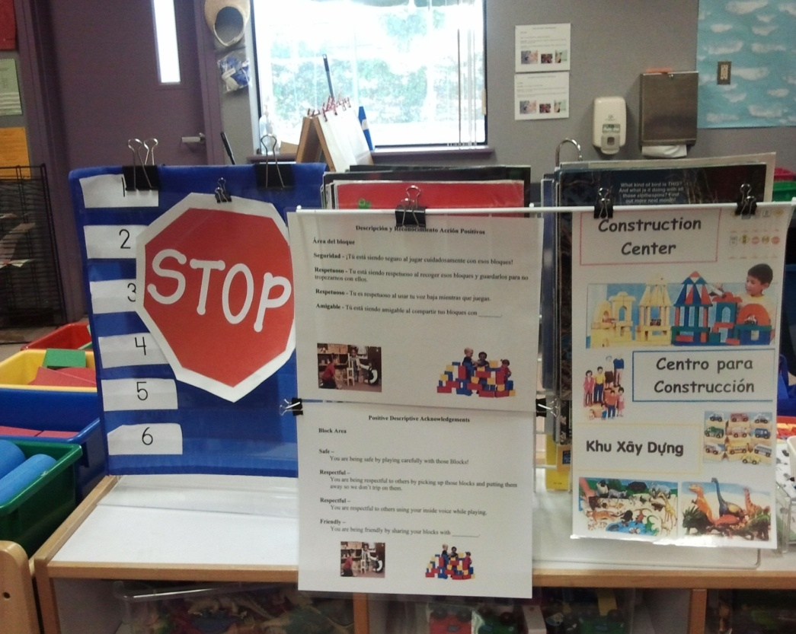
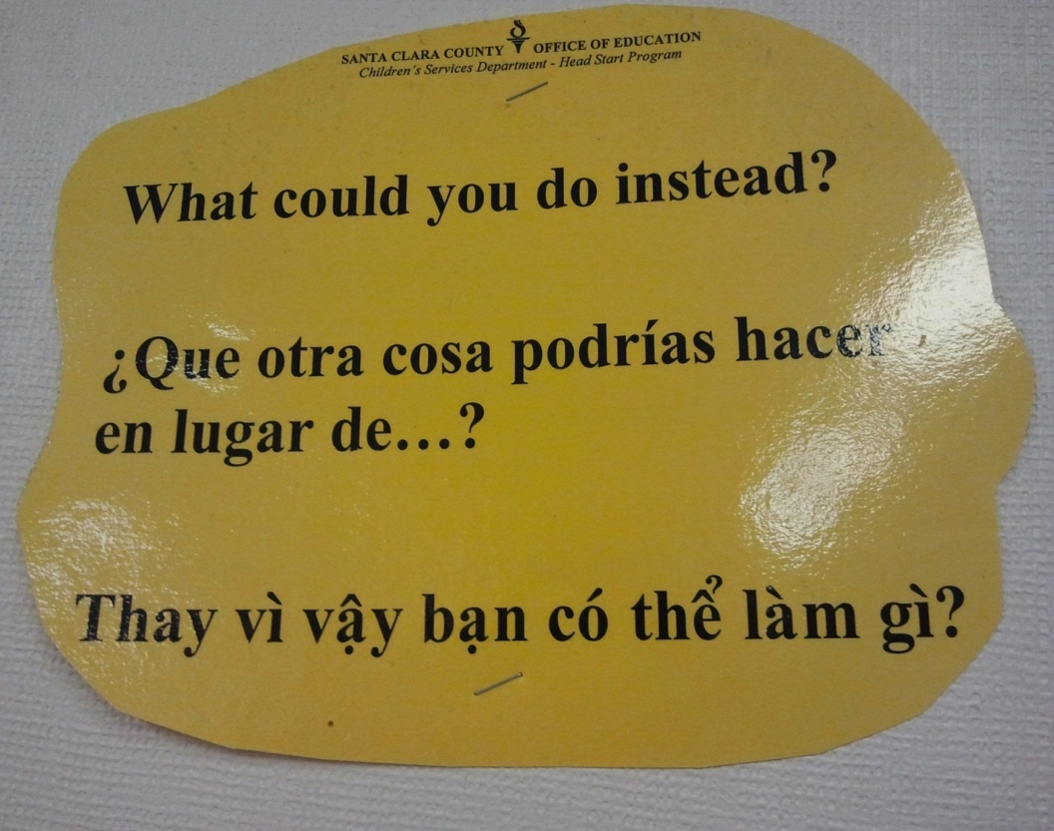
Transitional Kindergarten Environment
Providing Supports in Home Language - Center Information
and Higher Order Thinking Questions

Slide 31
P-TK-K Environment
Preschool | Transitional Kindergarten | Traditional Kindergarten
Developmentally appropriate | Developmentally appropriate | Standards based
Scaffolds self regulation | Scaffolds self regulation and encourages independence | Provides discipline strategies
Provides supports in home language | Provides supports in home language and English | Encourages parent involvement
Play based learning | Provides engaging interactive activities | Provides experiences to help students master academic standards
Centers based on children’s interests and individual learning needs | Centers based on children’s interests and learning needs, while incorporating content standards | Centers based on content standards, while following selected curriculum

Slide 32
Contact Information
Linda Cochran
CPIN Program Specialist
Phone: (408) 453-4334
E-mail: linda_cochran@sccoe.org
Elia Garcia
Transitional Kindergarten Program Specialist
Phone: (408) 453-3608
E-mail: elia_garcia@sccoe.org

