Slide 1
Noun Clause Trivia
Created by: Elinor Westfold and Loren Lee Chiesi
Photos by: Elinor Westfold and Loren Lee Chiesi

Slide 2
Objective
Form noun clauses from wh- questions

Slide 3
Step 1: Look at the question
Example: What is the capital of Australia?
Step 2: Respond with two sentences
Each group should write 2 responses for each question.
  1: We know/ don’t know + noun clause
  2: Your answer, as a FULL SENTENCE
Example:
  1: We know what the capital of Australia is.
  2: The capital of Australia is Canberra.

Slide 4
Step 3: Get points
When you are sure about your answers and everyone in your group agrees, all students in the group should raise their hands.
Your teacher will call on only ONE person to answer the question.
This person should read both sentences.
Scoring: 2 points possible for each question
  1 for the correct sentence with a noun clause.
  1 for the correct answer to the trivia question in a full sentence.
The team with the most points wins!

Slide 5
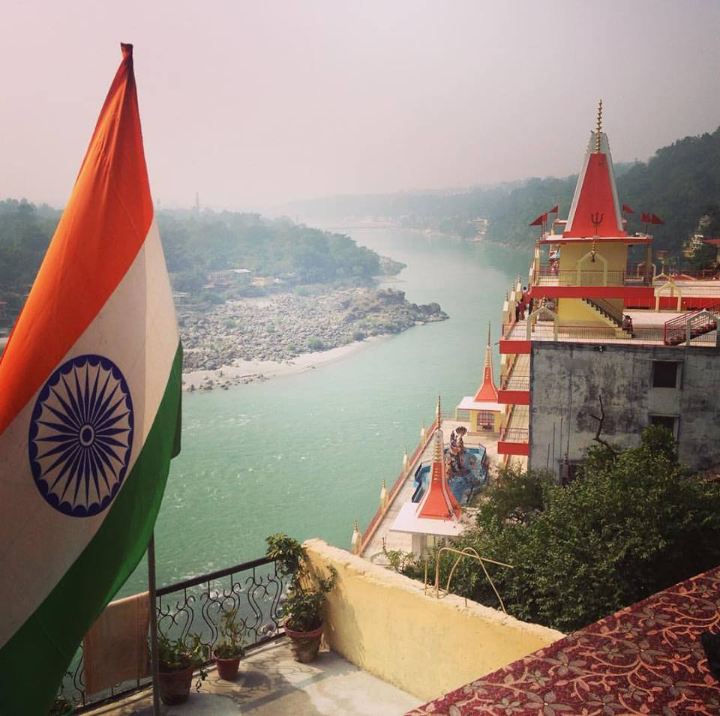
What is the longest river in India?

Slide 6
What is the second most common language in the U.S.?
(most common = spoken at home by the most people)

Slide 7
Which country is the biggest in the world? (In terms of area, not population)

Slide 8
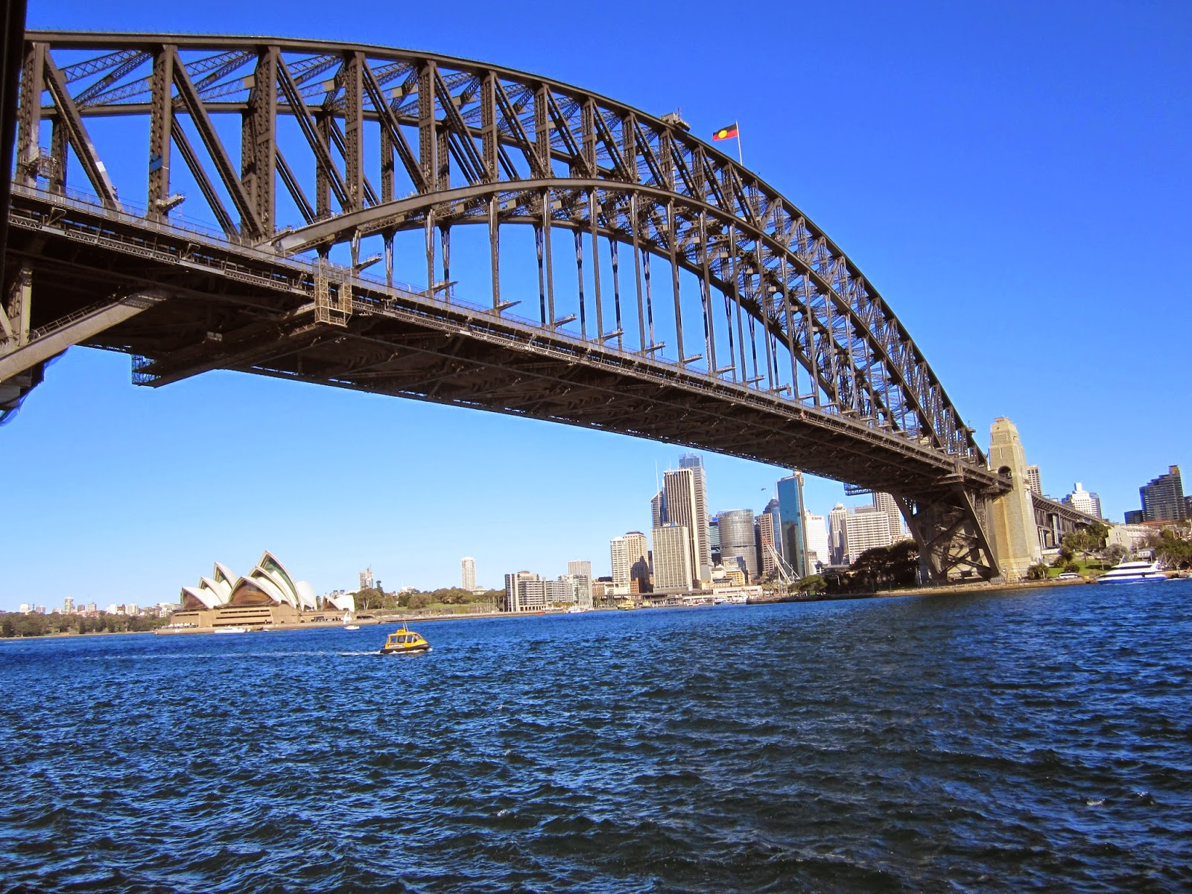
Where is this?

Slide 9

Who designed this pyramid?

Slide 10
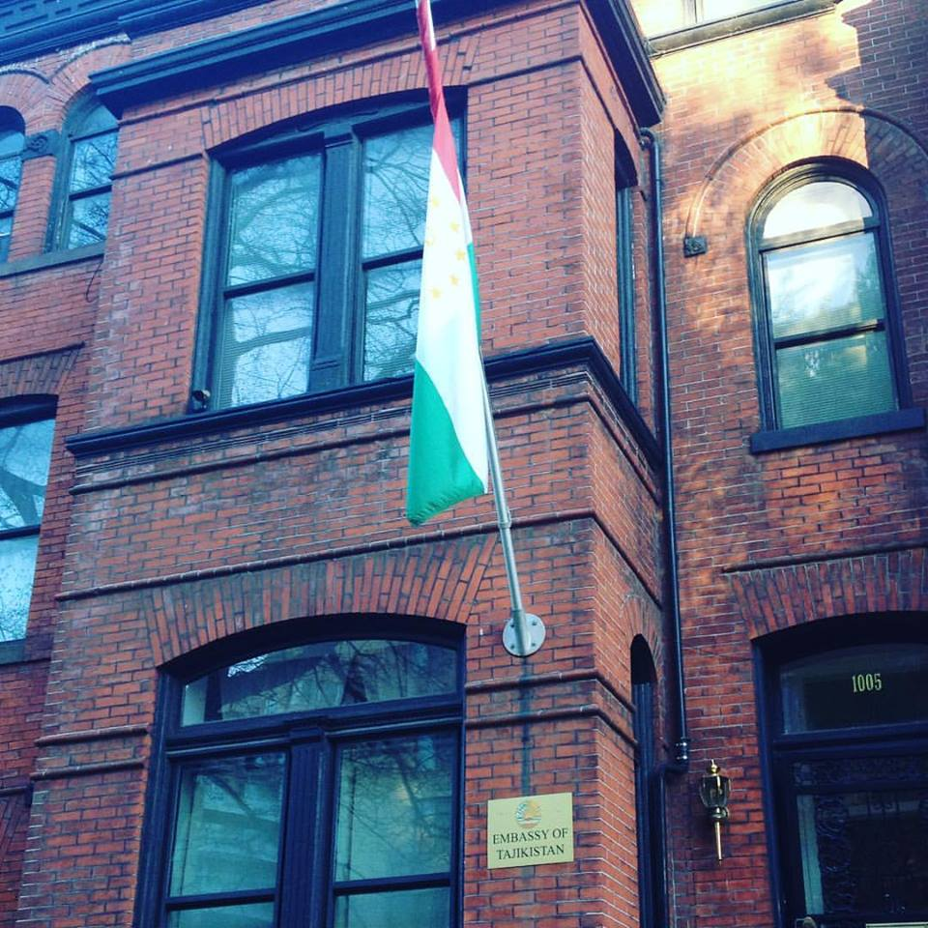
What is capital of Tajikistan?

Slide 11
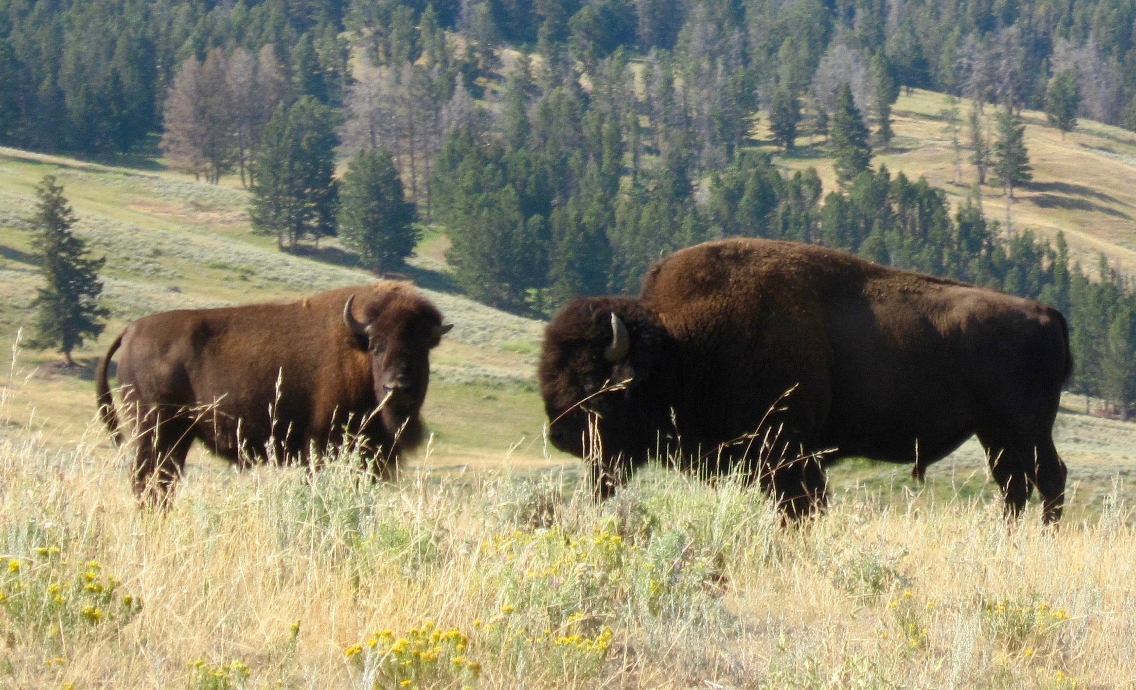
What are these animals?

