Slide 1
Adjective Clause Matching
Created by: Elinor Westfold and Loren Lee Chiesi

Slide 2
Objective
Create and recognize adjective clauses.

Slide 3
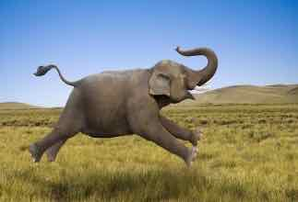
Part 1: Write Sentences
You will see groups of three pictures.
Choose a picture.
Quickly write your own sentence about the picture on your card in dark pen and BIG LETTERS. Use an adjective clause in your sentence.
Give your card to your teacher when you finish.
We will use your sentences to play a game.
Ex: This is an elephant that can fly.

Slide 4

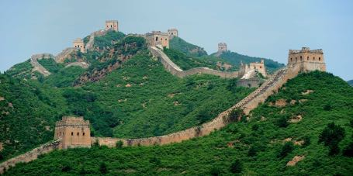
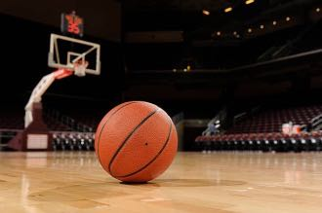
Choose one picture. Write a sentence with an adjective clause about it.

Slide 5
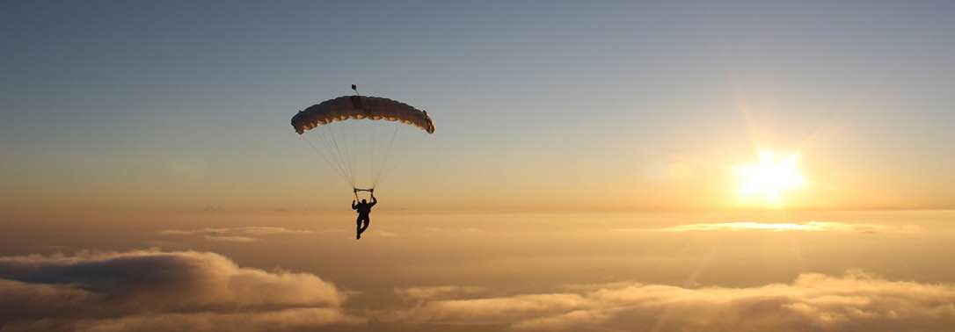
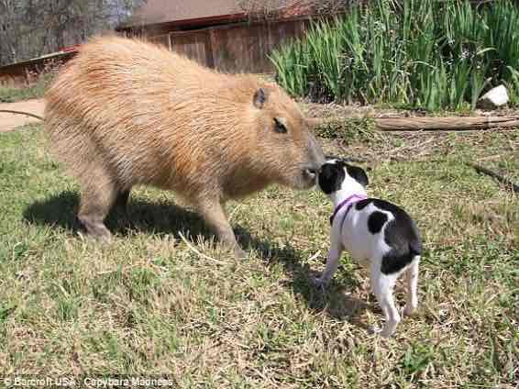

Choose one picture. Write a sentence with an adjective clause about it.

Slide 6

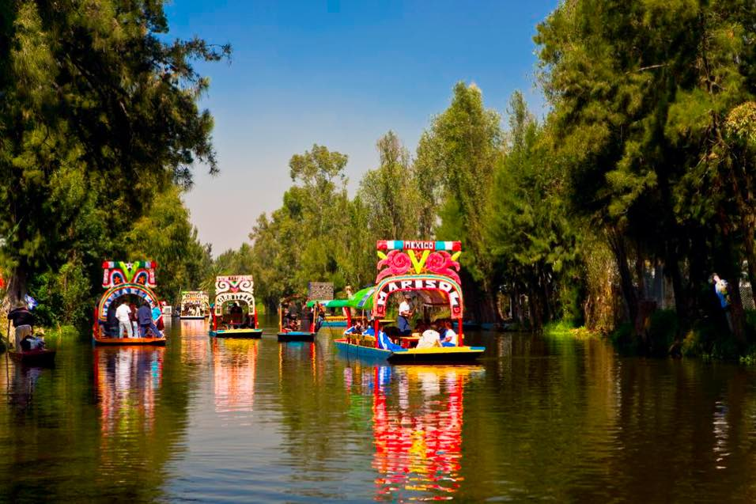
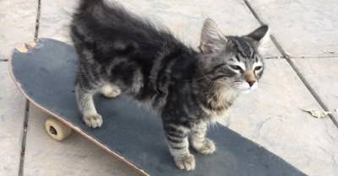
Choose one picture. Write a sentence with an adjective clause about it.

Slide 7
Part 2: Match your sentences to a picture
Send 1 team member to the table.
Put your hands behind your back.
I will show you a picture.
Grab the card that matches the picture.
  More than one card may match!
Read your card aloud so that we can check it. If you are correct, keep the card.
Send up a new teammate and repeat.
The team with the most cards wins!

Slide 8

Let’s play!
The Great Wall, China

Slide 10

Golden Gate Bridge, San Francisco, CA, USA

Slide 13
Xochimilco, Mexico

Slide 14
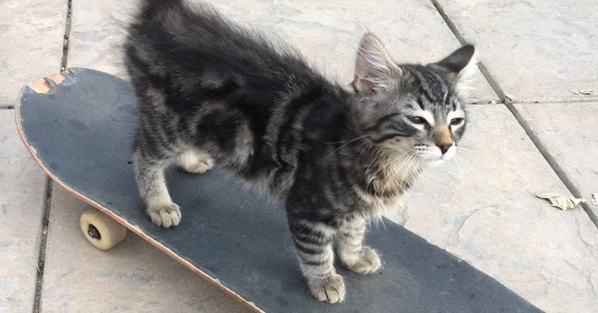

Slide 15


Slide 16


