Slide 1

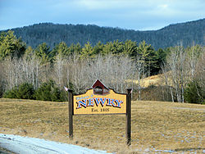
Where We Stand…Where We’re Headed
The Outlook for Travel and Tourism
Maine Governor’s Conference
January 26, 2012
Newry, Maine
Notes:
Primary points to cover:
We’re setting new records in visitation and spending, but consumer behavior and unexpected events have tempered our outlook for the next few years.
Good signs are in place, but we don’t know if they will be sustained in the coming months.
We will know about how the next six months look once the Conference Board releases it’s January consumer confidence figures – if they’re up for a third consecutive month that will be a very good sign.
And, we will know what the next six months should be like once we see how the Traveler Sentiment Index changes based on the January/February MMGY Global/U.S. Travel Association travelhorizonsTM survey.

Slide 2


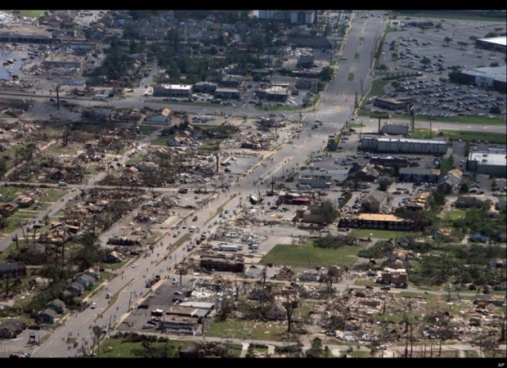


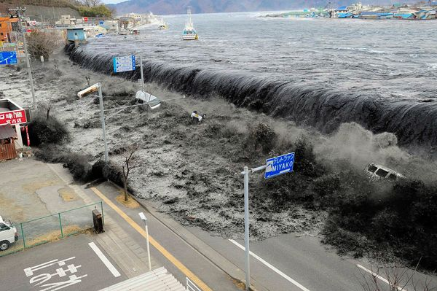
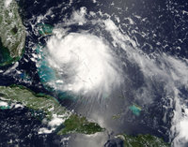

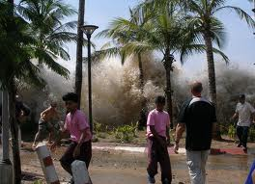


Notes:
I’m amazed at the resilience of Americans and the travel and tourism industry considering everything that ocurred in the past 10 years.

Slide 3
Total Domestic Visitors…
Passed 2007 record high in 2011
Millions of Person-Trips
(f) Forecast as of October 2011
Source: U.S. Department of Commerce; U.S. Travel Association and Tourism Economics
Notes:
New record high in domestic visitors in year-end 2011 (final estimates are not yet available)

Slide 4
Total International Inbound Travel…
Set new record high in 2011
Millions of Arrivals
(f) Forecast as of October 2011
Source: U.S. Department of Commerce; U.S. Travel Association and Tourism Economics
Notes:
Another new record is set.

Slide 5
Total Overseas Visitors…
Another record set in 2011
Millions of Arrivals
(f) Forecast as of October 2011
Source: U.S. Department of Commerce; U.S. Travel Association and Tourism Economics
Notes:
And another. We should be shouting from the rooftops!!!

Slide 6
Travel Spending…
Will exceed $800 billion for the first time
Dollars in Billions
(f) Forecast as of October 2011
Source: U.S. Department of Commerce; U.S. Travel Association and Tourism Economics
Notes:
And spending is up by “only” $111 billion dollars between 2009 and 2011.

Slide 7

% change in RevPAR through December 2011…
First time in 4 years all states have positive growth
ME
5.8%
VT
7.6%
NH
10.1%
10.0% or more
7.5% to 9.9%
5.0% to 7.4%
0.0% to 4.9%
Decrease
Source: Smith Travel Research, December 2011
Notes:
No year-over-year decreases in Revenue Per Available Room. The first time in four years!

Slide 8
Hotel Performance through December 2011…
2011 versus 2010
Source: Smith Travel Research, December, 2011
Notes:
Can leave in or take out. Maine is not necessarily underperforming compared to the U.S. and New England states. It’s more a factor that Maine did not realize the same substantial declines in occupancy room rates, RevPAR and demand. Smaller declines during the recession means smaller increases post-recession compared to states and regions that really felt the pinch.

Slide 9


With all this good news…
Why aren’t we jumping for joy?

Slide 10

Turning the economic corner…
Really? When?
Housing market still weak
Slow recovery in labor markets
Real median HH incomes down 7%
  from 2000
Shrinking middle-class
Inflationary pressures still high in travel
Ongoing debt crisis and political stalemates
Higher taxes?
Americans’ spending plans still on hold

Slide 11

Consumer Confidence rises for 2nd month
Good sign, but what will January show?
90 considered “healthy”
64.5
39.8
25.3
1985 = 100
Source: The Conference Board
Notes:
Consumer confidence has been anything but strong until November and December. Still 25 points below what is considered “healthy” the January figures should tell us if we may have, indeed, finally turned a corner. The January figures are likely to be released either on the 26th or the 27th.

Slide 12
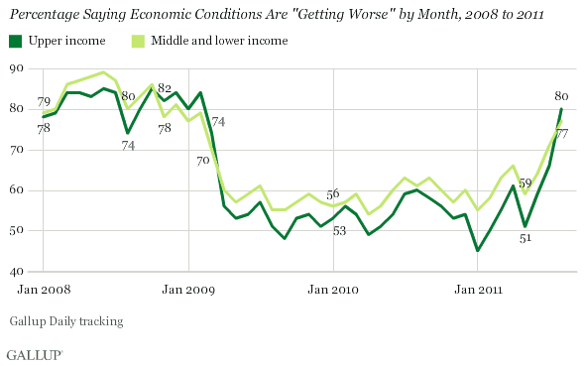
Upper-income Americans are more
concerned about the economy
Notes:
Concerns about the economy have reached into households with high incomes. Hope to see improvement in this. This slide is a candidate for elimination from the presentation.

Slide 13
Overall Traveler Sentiment IndexTM…
Immediate recovery, but nothing to write home about
Interest
Time
Money Available
Affordability
Service Quality
Safety
March 2007 = 100
Burp of Enthusiasm
Source: U.S. Travel Association/Ypartnership, travelhorizonsTM October 2011
Notes:
Travel Sentiment Index measures perceptions of travel among U.S. adults. Trend line reveals how overall perceptions of travel in the U.S. declined during the Great Recession, but quickly recovered to pre-recession levels. However, improvement is not able to be sustained.
Anxious to see if the TSI improves based on the January travelhorizons survey. Since Consumer Confidence has improved over the past two months, I would expect TSI to also show improvement.

Slide 14
Affordability of Travel IndexTM…
Deals & discounts made travel more affordable
March 2007 = 100
Deals and Discounts
Source: U.S. Travel Association/Ypartnership, travelhorizonsTM October 2011
Notes:
Affordability of travel plummeted during the recession but came back strong due to the deep discounts and savings offered pretty much throughout the industry. When the economy began to improve, the discounts either disappeared and were reduced. With gas prices on the rise, along with airfares, perceptions of affordability of travel dropped. However, as a good sign, the affordability index improved in July and October. Hope that the upward trend continues in February.

Slide 15
Led by still-high gas prices and rising air fares
Percentage change through December 2011
YTD TPI = +6.5%
YTD CPI = +3.2%
Does not include
various fees
Notes:
Cost of travel as measured by the Travel Price Index is increasing at a much faster pace than the consumer price index. Does not bode well for affordability and the ability of Americans to travel.

Slide 16
Money Available for Travel…
Heading in the wrong direction
March 2007 = 100
Source: U.S. Travel Association/Ypartnership, travelhorizonsTM October 2011
Notes:
One of the key Traveler Sentiment Indicators, “money available for travel” is still problematic. Nice “burp” in February, which we hoped would carry over into July and October, but it didn’t happen. Family budgets are still stressed and leisure travel is competing against other discretionary purchases – new appliances, electronics, jewelry, etc.

Slide 17
Leisure travel intentions soft…
October 2011 lowest among past five surveys
Plan to take a leisure trip between November and April
Source: U.S. Travel Association/Ypartnership, travelhorizonsTM October 2011
Notes:
Pretty much no story here. If asked, leisure travel intentions during the next six months consistently run nearly 20 percentage points below the percentage of U.S. adults who actually took at least one leisure trip.

Slide 18
Summer 2011
Future Overnight Leisure Travel Intentions
Future travel intentions are consistent with levels seen for the last two summers.
Mean Number of Trips
Summer 2009 – 1.1
Summer 2010 – 1.1
Summer 2011 – 1.1
Q46. In the next month, how many trips do you plan to take anywhere for business, to visit friends or relatives, or for leisure?
Is this more, the same, or fewer than the number of leisure trips you took during this same time period last year?
a, b, c notes significant difference at the 95% confidence level.
18
Notes:
18

Slide 19
Summer 2011
Future Day Leisure Travel Intentions
Planned leisure trips in the next month remained stable with Summer 2010.
Mean Number of Trips
Summer 2009 – 1.9
Summer 2010 – 1.9
Summer 2011 – 2.0
Q23_1. In the next month, how many trips do you plan to take anywhere for business, to visit friends or relatives, or for leisure?
Is this more, the same, or fewer than the number of leisure trips you took during this same time period last year?
a, b, c notes significant difference at the 95% confidence level.
19
Notes:
19

Slide 20
Business travel intentions…
Also soft but at least consistent
Source: U.S. Travel Association/Ypartnership, travelhorizonsTM October 2011
Notes:
Flat. Flat. Flat.

Slide 21
Incidence of Business Travel Down 15 Points Over Past 5 Years, but Stabilizing
Source: U.S. Travel Association/Ypartnership, travelhorizonsTM October 2011
Notes:
Business travel has never recovered from highs in the late 1990s and probably never will. Due primarily to the recession and company travel restrictions, the percentage of adults traveling for business purposes has fallen dramatically. Let’s wait and see what February brings.

Slide 22
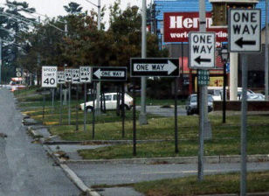
Looking ahead… Still a confusing economic and consumer environment!
Notes:
Even with all of the new records, the economy and changing consumer purchasing habits still put question marks about what 2012 and 2013 will be like.

Slide 23

Vacations are Needed Now More than Ever!
Notes:
Absolutely!

Slide 24

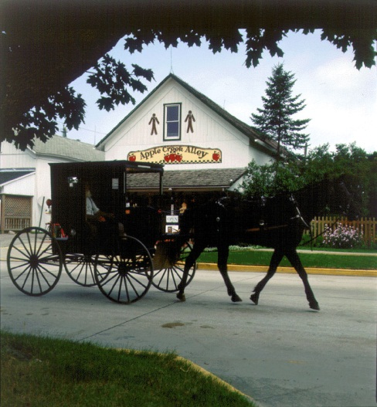




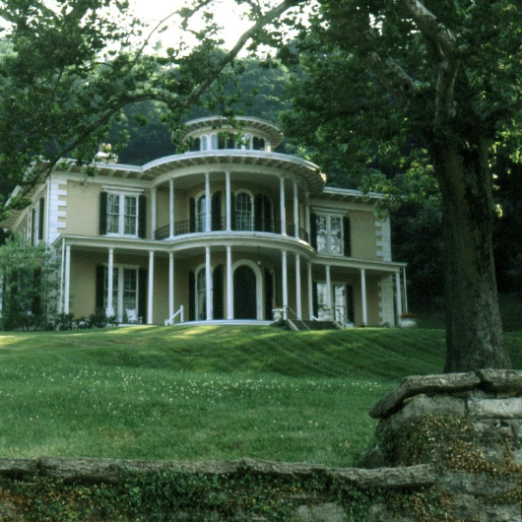
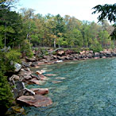
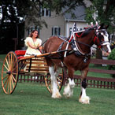
Leisure Travel Trends

Slide 25
Opportunities exist to entice 45 million “not sures” to take a leisure trip
Q: Over the next 6 months, do you plan to take any leisure trips of at least 50 miles one way from home or that will include an overnight stay?
Source: U.S. Travel Association/Ypartnership, travelhorizonsTM, October 2011
Notes:
This is an important finding to stress. If you’re not in the marketplace, your destination can lose out of the ability to entice the 45 million U.S. adults who are still undecided about whether or not to take a leisure trip in the next six months. Those who are actively marketing, are more likely to reap the benefits derived from these visitors and the dollars they leave behind.

Slide 26
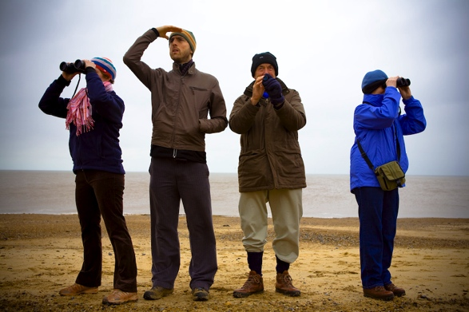
Census 2010: A Marketer’s View
Notes:
Marketers these days are looking in every direction for a sign!

Slide 27
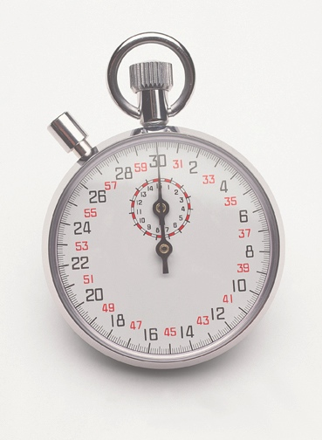
Last-Minute travel is still in…
Must be constantly in the market place
Took at least one last-minute trip in past year and keeps rising
30%
Source: Ypartnership/Harrison Group, 2011
Notes:
Another reason to be in the travel and tourism marketplace. Compared to ten years ago or more when people planned their leisure trips an average of six months out, last minute travel is in. Nearly a third of U.S. adults said they took a “last minute” leisure trip in the past year. “Last minute” is defined as deciding to travel and leaving on the trip all within 6 days or less!

Slide 28
Summer 2011
Planning Time Frame
Travelers continue to operate on a relatively short time frame, with more than half making the final decision to travel within three weeks of taking their trip to Maine.
Decision Making Time Frame
Summer 2009 (Base= 1,314)
Summer 2010 (Base=1,325)
Summer 2011 (Base=1,298)
Regional Q12. When you were planning this overnight trip in Maine, when did you first start thinking about it?
Regional Q13. When did you finally decide to take this specific trip in Maine?
a, c, e and b, d, f indicate significant differences at the 95% confidence interval.
28

Slide 29

Household Composition:
Notes:
If your destination’s marketing plan is still focused on a nice married couple with two lovely children who are living comfortably, CHANGE YOUR PLAN! Or at least think about it. Families depicted in the slide are slowly disappearing and being replace by single parent households and people living alone. For the first time in history, the number of families in the U.S. declined between 2010 and 2011. Families aren’t gone, but they have changed.

Slide 30


Why You Know You Need a Raise…
Household incomes have plummeted
Age | 2000 | 2010
Under 25 | $35,275 | $28,300
25 – 34 | $56,233 | $50,059
35 – 44 | $68,069 | $61,664
45 – 54 | $72,981 | $62,485
55 – 64 | $56,789 | $56,575
65+ | $29,226 | $31,408
Total | $53,164 | $31,408
Adjusted for inflation
-19.7%
-11.0%
-9.4%
-14.4%
-0.4%
+7.5%
-7.0%
Source: Census Bureau, Current Population Survey
Notes:
This is a really interesting and depressing finding from the Marketing Outlook Forum. Adjusted for inflation, household incomes are down substantially from 2000. Part of the new demographic make up of U.S. households. Why did average incomes rise for adults 65 years of age and older…they opted not to retire and spouses actually returned to the workforce to help make ends meet. Sad.

Slide 31

Single-Person Households as a Percentage of All Households: 1940 to 2010
Source: U.S, Census Bureau, Decennial Censuses, 1940-2010.
31
Notes:
One of the many demographic changes taking place today that impacts destination marketing.

Slide 32
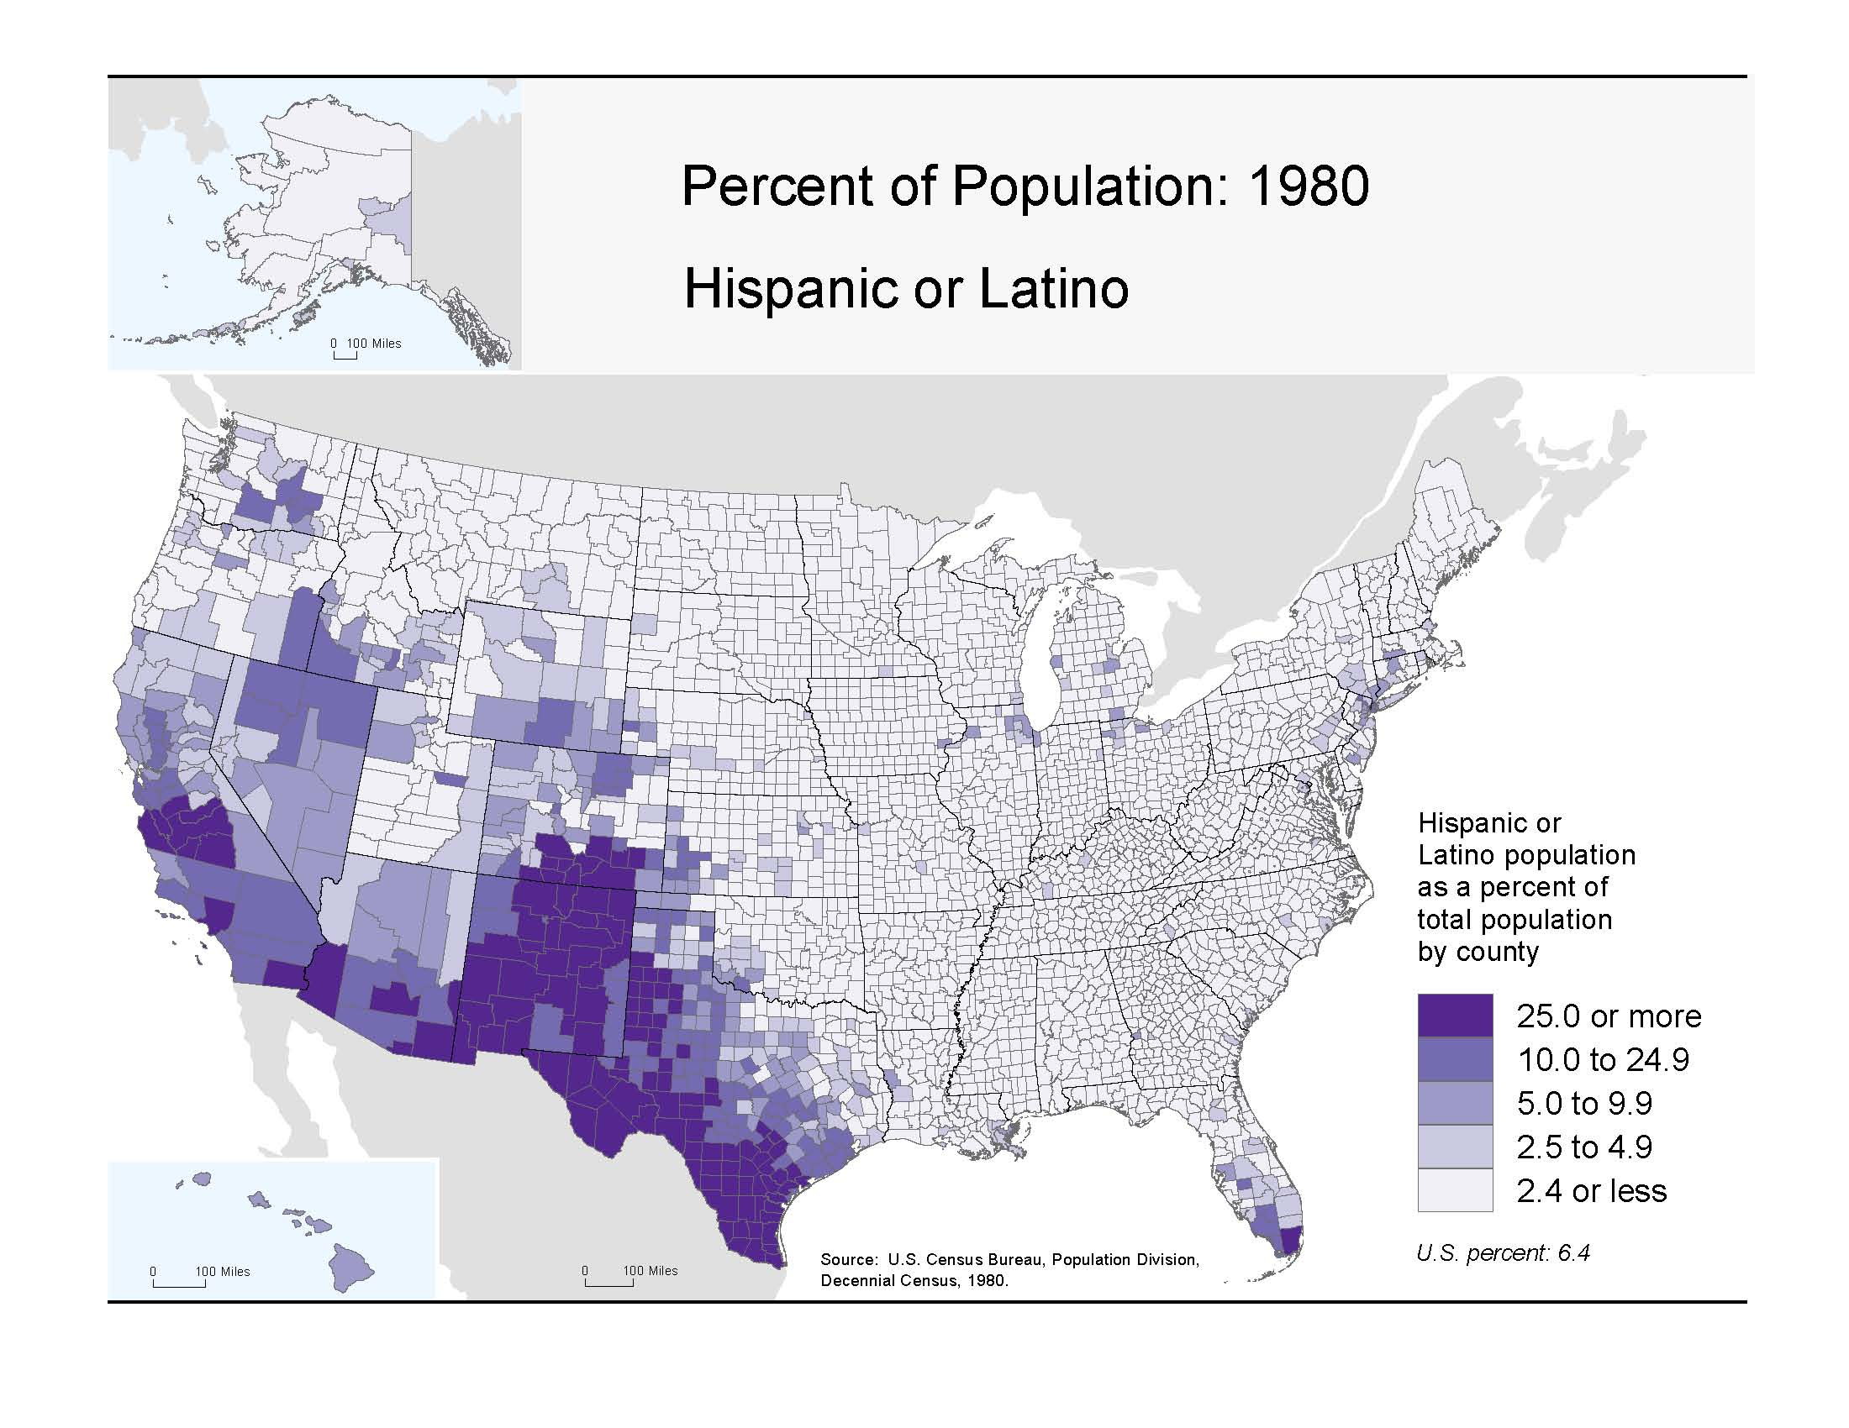


32
Notes:
Love this map. Shows the concentration of the Hispanic population as of 1980. Pretty much concentrated in the southwest U.S.

Slide 33
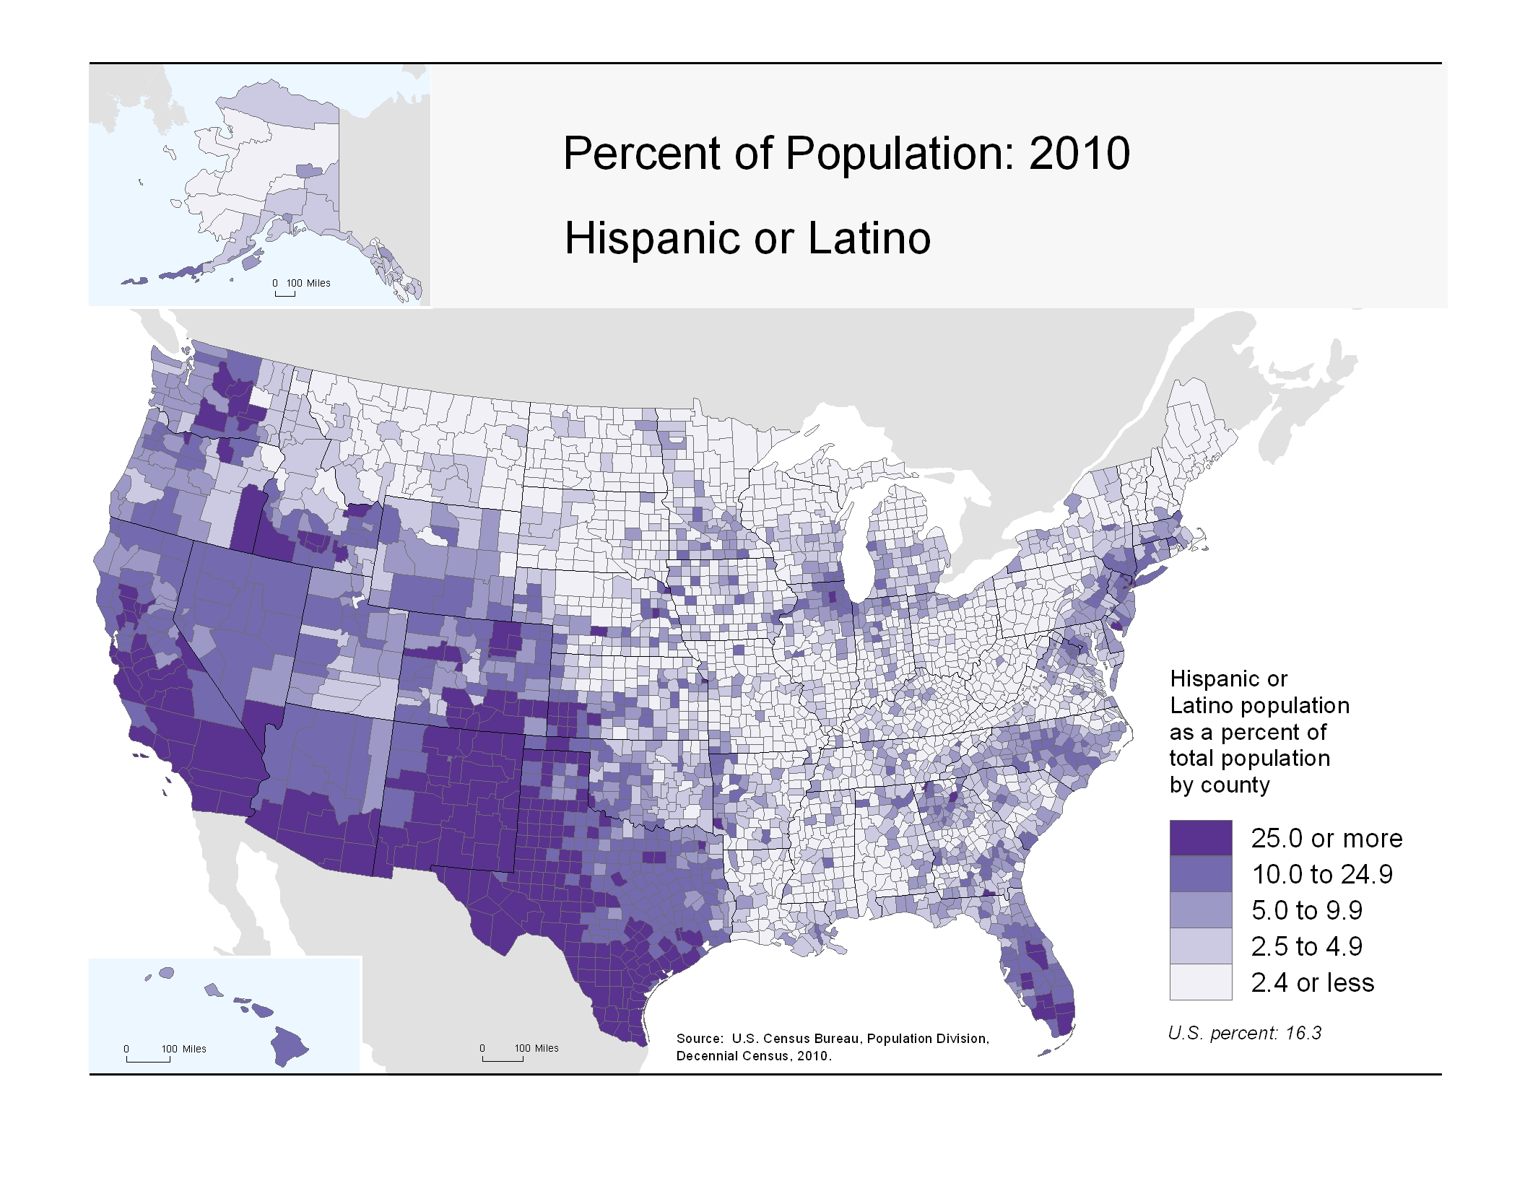
33
Notes:
Here is the distribution 20 years later. The Hispanic population cannot be ignored when marketing a destination.

Slide 34

Personal Wellbeing is the Focus
Important in Life | %
Healthier and happier | 61
Simplify life | 38
Financial security | 36
Improve appearance | 31
© The Futures Company 2011 ׀
Notes:
With all of the angst surrounding the recession and life in general, people are seeking happiness, financial security and to simply life. Since Maine is strong in these characteristics, may be valuable to consider marketing campaigns – if not already in place – that focus on well-being.

Slide 35
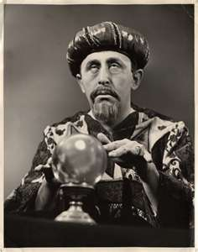
On to the SWAGs, uh, Forecasts!
Notes:
And here are the forecasts. If they ask what a SWAG is and depending on the audience, you can tell them that a SWAG is a “scientific wild-ass guess!”

Slide 36

Moderate gains in domestic leisure travel…
After a wild ride during the past decade
Forecasts
Notes:
You can run through these slides quickly. Most forecasts from U.S. Travel see moderate growth at the end of 2011 and declining increases in 2012 and 2013. Good to see increases, but don’t look for either large gains like 2002 following the events of 9/11 or large declines experienced during the recession. All bets are off on the forecasts should some unforeseen event – another oil spill, double-dig recession, invasion by locusts – should occur.

Slide 37
Domestic Leisure Visitors…
Will continue to set new records
Millions of Person-trips
* Forecast as of October 2011
Source: U.S. Travel Association and Tourism Economics
Notes:
Good news as long as nothing happens to trigger a downturn.

Slide 38
Slow but steady growth in business travel…
At this point up is really good!
Forecasts
Notes:
Business travel s-l-o-w-l-y improving.

Slide 39
Domestic business travel improves…
But still well below 1998 record high
(f) Forecast as of May 11, 2011
Source: U.S. Travel Association and Tourism Economics

Slide 40
Total domestic visitors…
Modest, but declining growth
(f) Forecast as of October 2011
Source: U.S. Travel Association and Tourism Economics
Notes:
Again showing higher growth rates in 2010 as we came out of the recession and more moderate gains in the next three years.

Slide 41
Good News…
Travel spending on the rebound
Billions of Dollars
F = Forecast
Source: U.S. Travel Association and Tourism Economics
Notes:
Travel spending is up, but mostly driven by international visitors.

Slide 42
Total United States 2011 Projection
Key Performance Indicator Outlook Scenario (% change vs. Prior Year)
Hotel Industry Performance Scenarios
 | 2011
 | Low RevPAR Growth | Forecast | High RevPAR Growth
Supply | 0.9 | 0.7 | 0.4
Demand | 4.0 | 4.7 | 5.3
Occupancy | 3.2 | 3.9 | 4.6
ADR | 3.2 | 3.7 | 4.5
RevPAR | 6.5 | 7.8 | 9.1
Notes:
Here are the latest lodging forecasts from Smith Travel Research for 2011…

Slide 43
Total United States 2012 Projection
Key Performance Indicator Outlook Scenario (% change vs. Prior Year)
Hotel Industry Performance Scenarios
 | 2012
 | Low RevPAR Growth | Forecast | High RevPAR Growth
Supply | 0.8 | 0.5 | 0.3
Demand | 2.0 | 2.5 | 2.9
Occupancy | 1.3 | 2.0 | 2.7
ADR | 4.3 | 4.9 | 5.7
RevPAR | 5.6 | 7.0 | 8.4
Notes:
And 2012. Biggest story is that average daily room rates continue to rise.

Slide 44

International and Overseas arrivals…
Slowing growth expected
(f) Forecasts as of October 2011
Source: U.S. Travel Association; Tourism Economics
Notes:
Both international (including Mexico and Canada) and overseas arrivals will continue to increase, but at smaller rates. Most of the growth coming from China, Brazil and India. Japan and the UK are still struggling.

Slide 45
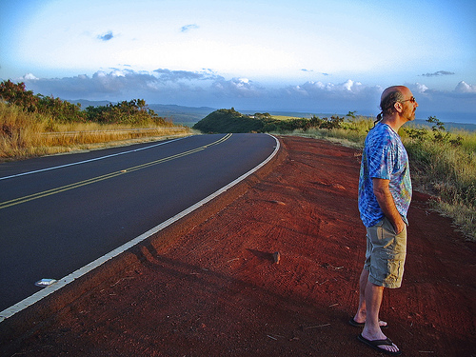
Keep looking ahead.
Notes:
It’s important to keep looking forward to see where the economy and consumers are headed. Research has never been more important!

Slide 46



Despite Problems, Happiness Reigns
%
%
Agree: In the past 10 years
I’ve become
miserable
I’ve become
happier
Notes:
Ending on a high note, although we have been through a lot, the majority of Americans agree that they are happier now than they were 10 years ago. Let’s keep this happiness going through travel!

Slide 47

Kevin Knight
Associate Director – Analytics
DPA
kevin.knight@digitalresearch.com
Notes:
Me

